Slide 1
Welcome to Rowan University

Slide 2
Today’s Agenda
Overview of helpful RU websites
Orientation & Transfer Student Checklist
Rowan Support Offices/Programs
Review Self-Service Banner, Section Tally and Rowan Success Network
General Education Requirements
Registration process
Question / Answers

Slide 3
I’ve been accepted Next steps…
Submit the Enrollment Confirmation Form you received in the mail along with the $200 deposit.
To be considered for a different major, please contact the Admissions Office prior to confirming enrollment
Your Enrollment Confirmation Form and deposit must be received and entered by the Office of Undergraduate Admissions before you can proceed with the remaining steps:
Register for Orientation
Meet with an Academic Advisor
Apply for housing

Slide 4
Orientation & Student Leadership Programs
Maria Arbizo
Assistant Director, Orientation
oslp@rowan.edu

Slide 5
Orientation Communication
Confirm admissions enrollment – it usually takes about one week for OSLP to receive your information
Activate your Rowan Network Account at https://id.rowan.edu
You need your Network Username and password to log in to the orientation reservation system!
Click “I don’t know my username”
Email to personal email address
Mailer to primary address

Slide 6
Orientation Dates
Fall Transfers
Wednesday, June 13th
Monday, June 18th & Tuesday, June 19th
Ideal for students who are living on campus or transferring from another four-year institution
Friday, July 6th
Friday, July 27th
*Orientation Reservation System will indicate major availability for each session

Slide 7
https://sites.rowan.edu/oslp/orientation

Slide 8
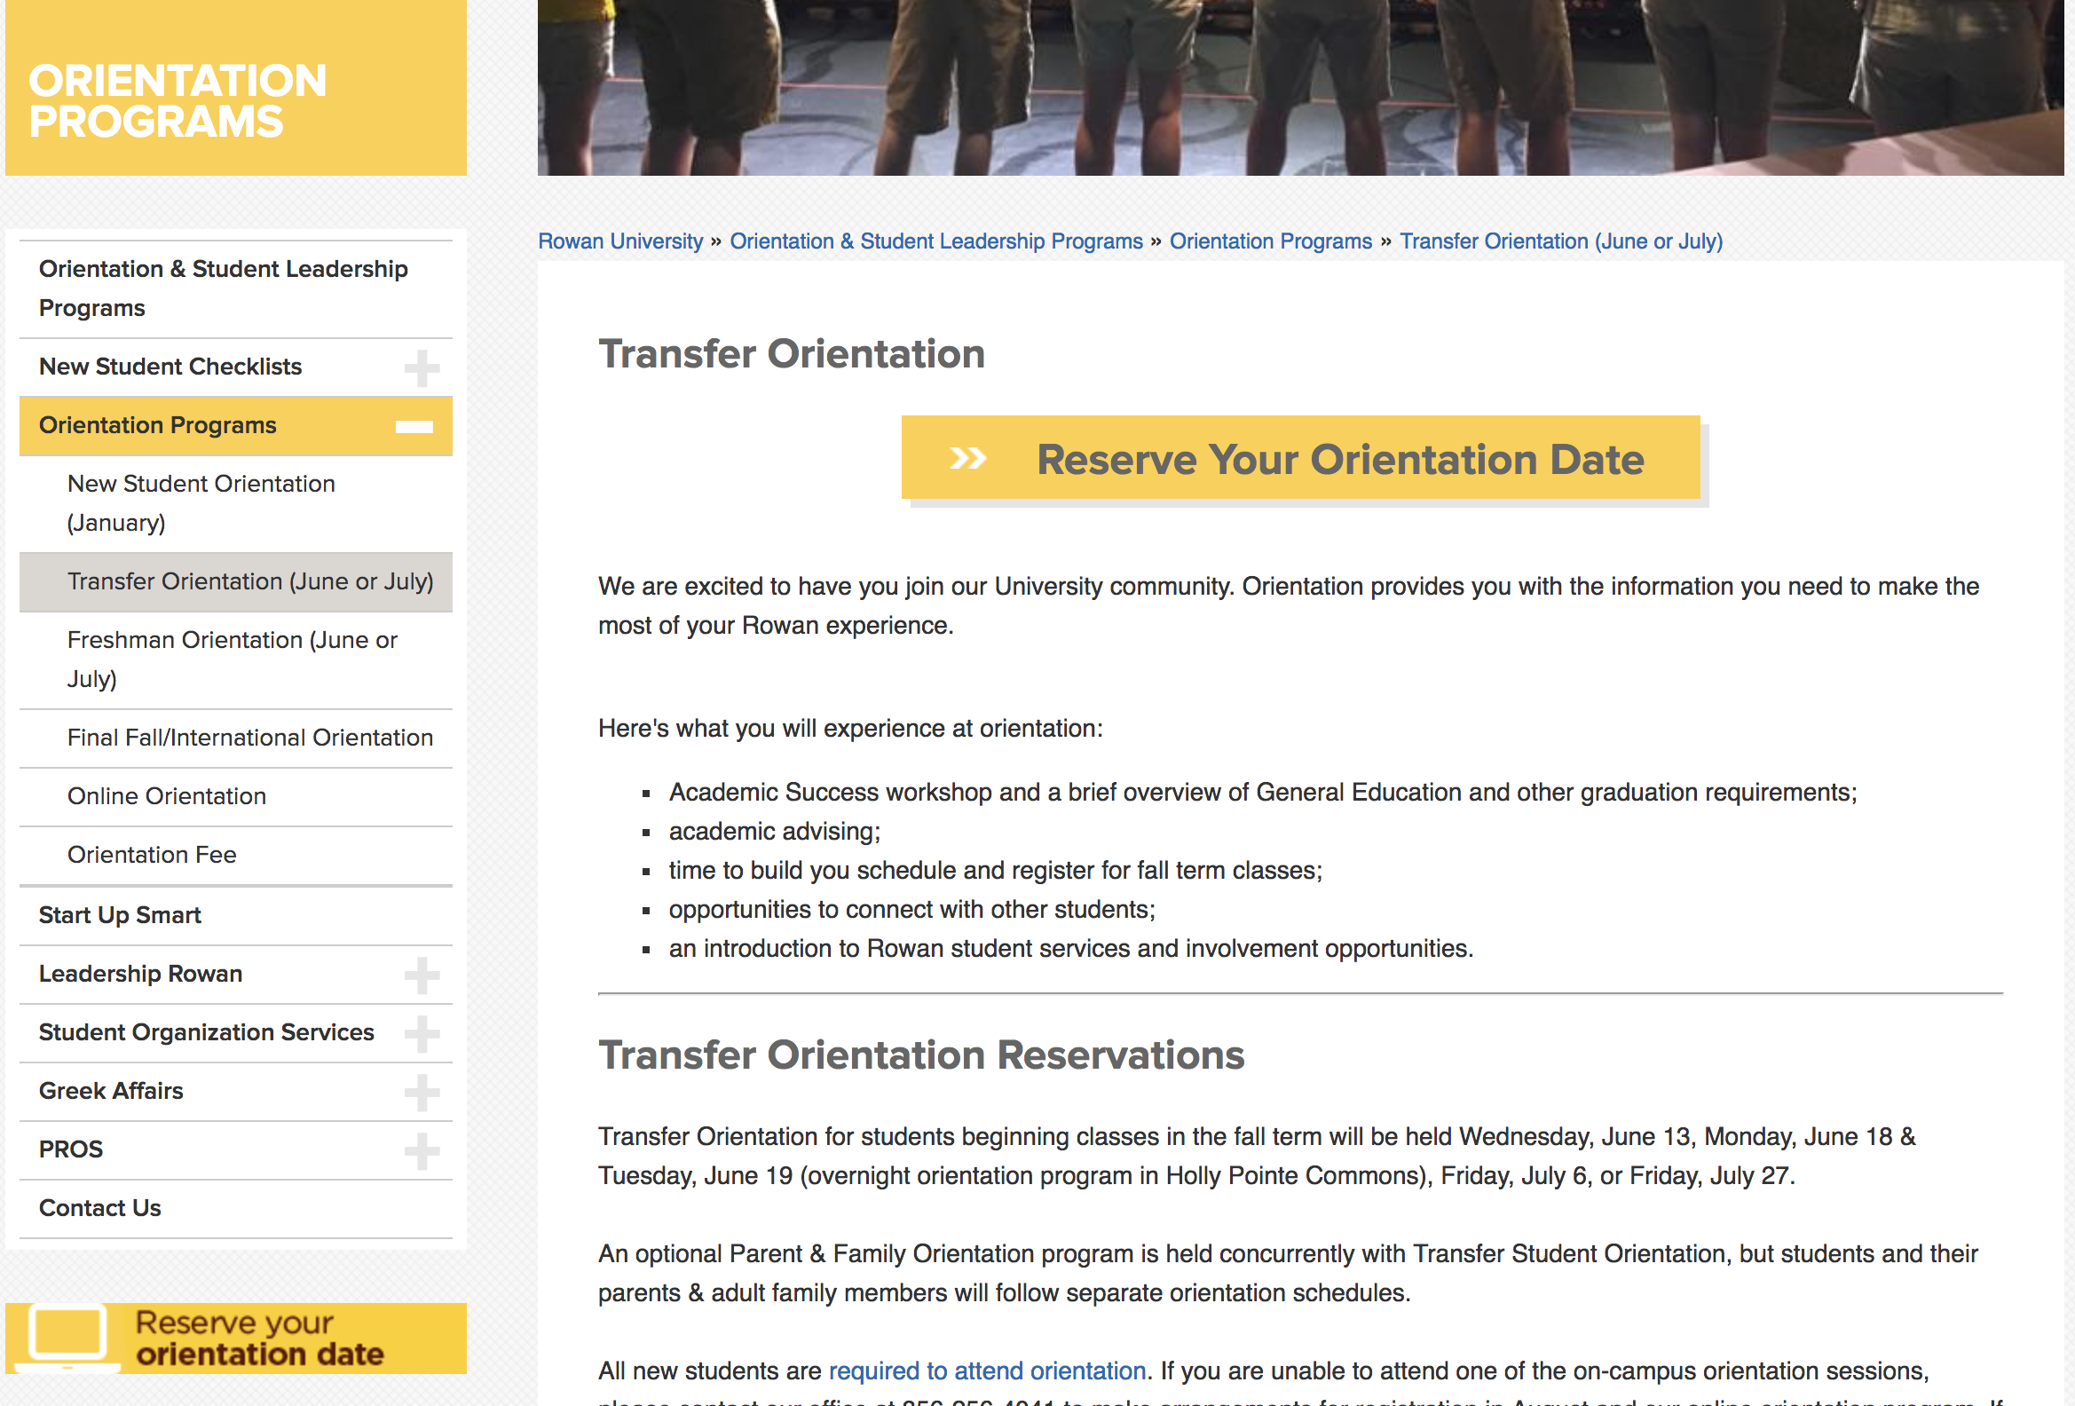

Slide 9
You will log in with your Rowan Network username and password to reserve your spot:

Slide 10
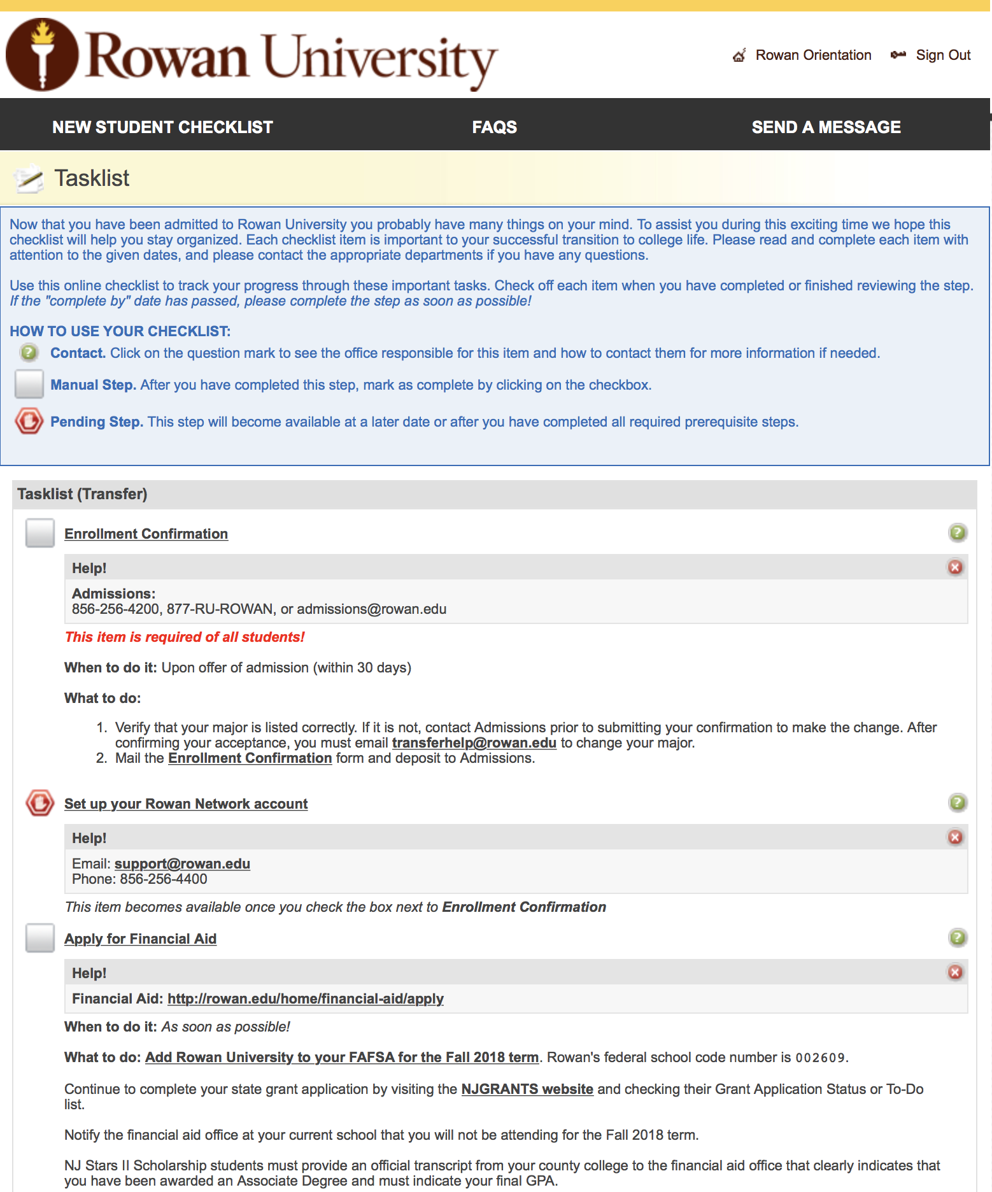

Slide 11
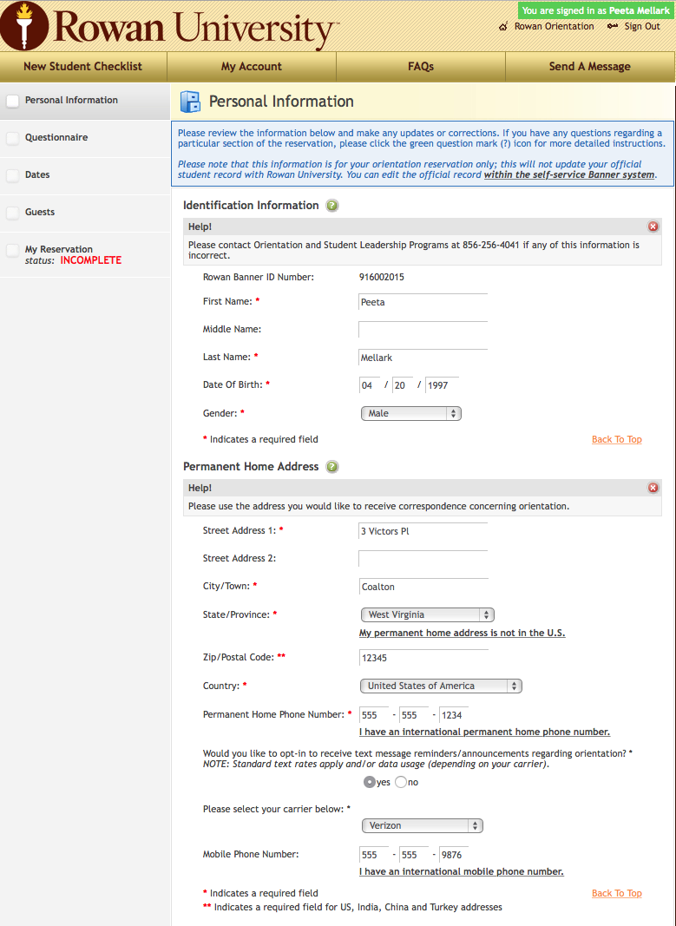
Fill out all four sections

Slide 12
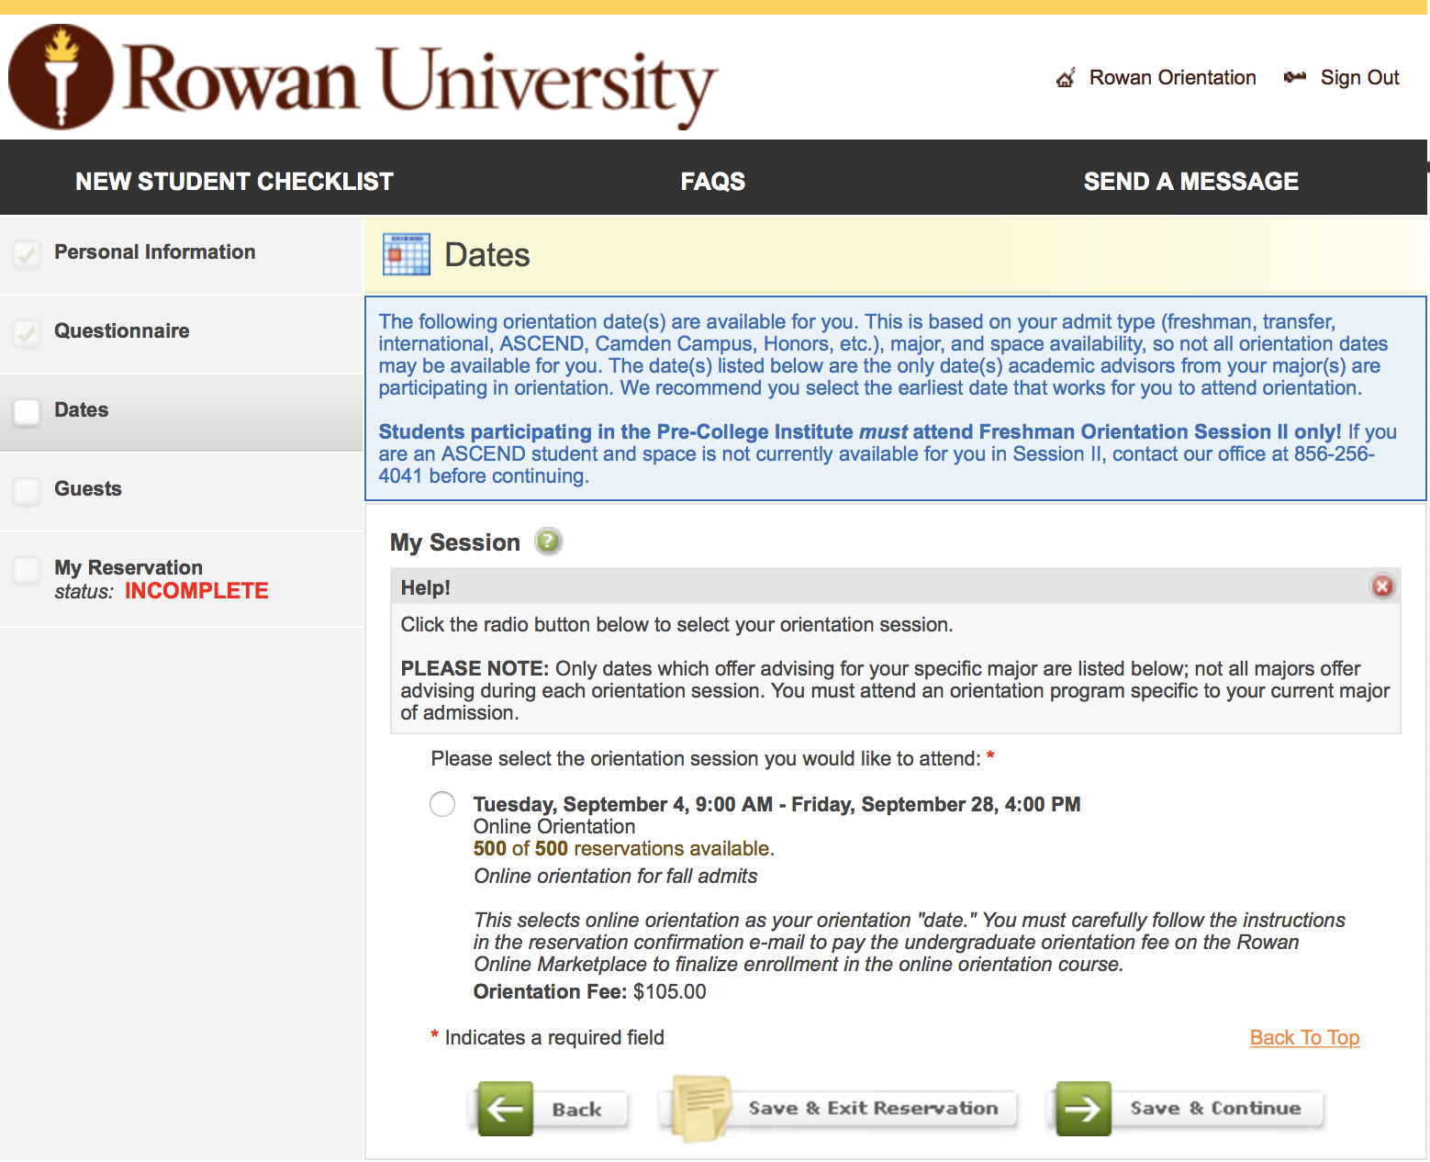

Slide 14
New Student Checklist
https://sites.rowan.edu/oslp/checklist/checklist40t.html

Slide 15
Need Help?
Email us: oslp@rowan.edu
Call us: 856-256-4041
Visit us: Savitz Hall, Suite 203
Chat us: On our website

Slide 16
Tau Sigma
Transfer Alliance
National Transfer Honors Society

Slide 17
Meet Our E-board
Lauren Burch, President
Neha Ahmed, Induction Chair
Jamie Walder, Senator
Rebecca Bradshaw, Treasurer
Amanda Wellik, Induction Chair
Alyssa Rogers, Secretary
Maria Arbizo, Assistant Director OSLP, Advisor
Danielle Davis, Graduate Coordinator, Advisor

Slide 18
Tau Sigma Mission
Tau Sigma is a national transfer student honor society designed to recognize and promote the academic excellence and involvement of transfer students.

Slide 19
Tau Sigma Invitation Requirements
Must be a full time student at Rowan
Receive a 3.5 or higher GPA during your first semester at Rowan
Earned 24 or more credits from another institution

Slide 20
Tau Sigma Benefits
Leadership opportunities – executive board
Scholarship opportunities
Professional development – national conference
Involvement

Slide 21
What do I need to know about Rowan?
Notes:
RU is a different experience –
Different culture
Campus is larger
Additional offerings
Advising varies according to the department

Slide 22
E-Mail Communications Policy
Your Rowan student e-mail account is the official form of communication.
All communications are sent to you Rowan e-mail account.
Read Rowan student email daily.
It is the student’s responsibility to check this e-mail account regularly.

Slide 23
Basic Skills Placement Testing
All incoming students are required to take certain placement tests, unless they meet one of the exemptions.
Incoming transfer students with 30 or more credits successfully transferred are exempt from Reading Comprehension and Elementary Algebra placement tests.

Slide 24
Possible Tests
Reading Comprehension
Elementary Algebra
College Level Math
Chemistry

Slide 25
number of credits transferred
specific courses transferred
declared major
required courses
standardized test scores
Visit the Basic Skills Placement Testing page for specific information or Email: testingservices@rowan.edu

Slide 26
Take Advantage of Resources!
Academic Success Center
Testing
Tutoring
Basic Skills
Disability Resources
Veteran’s Affairs
Academic Advising
Educational Opportunity Fund
Keyona Walker, Transfer Advisor
Financial Aid
Office of Career Advancement
Career Advising
Career Events
Campbell Library
Writing Center/Tutoring
Wellness Center
Health Services, Counseling & Psychological Services and Healthy Campus Initiatives
Technical Support
Rowan iCloud

Slide 27
Get to know your campus!
Notes:
Explanation – Rowan is a larger campus than what students may be used to. Remember, it took time to become comfortable with the county college environment. Time to adjust to a new and larger campus is important.
Ways to ease this process:
Take a tour - call Admissions office
Spend some time just walking around campus with a friend
Have a friend that attended or currently attends RU? Give them a call and ask them to give you a personalized tour.
Remind them of the importance of attending New Student Orientation (will show them site later in presentation)

Slide 29
University Advising Services Savitz Hall, 3rd Floor
www.rowan.edu/advising
advise@rowan.edu

Slide 30
Academic Advising at Rowan
Who we are:
University Advising Services - Team of 40+ professional academic advisors (and growing!)
University Advising Center
Embedded advisors in departments
Who we see:
Depends on the college/major
Advising caseloads may be divided by:
Alphabet (Ex: A-L, M-Z)
Number of credits (Ex: <60 credits, >60 credits)
One advisor for entire major
Combination (Ex: <45 cr., A-L, M-Z)

Slide 31
Why seek advising?
Meet with your advisor at least once a semester to:
Discuss current semester courses
Review major requirements
Plan courses for following semester
Discuss career goals
Avoid missing pre-requisites, important deadlines (withdraw, graduation application, financial aid/loans...) and remain in academic sequence
Ensure that you are making successful progress towards graduation
15 to finish!
Tuition Flat Rate-5th course no cost/Expedite graduation date
15 credits/semester = 30 credits/year
Delay in expected date of graduation = Time & Money

Slide 32
Academic Advising prior to Orientation
https://sites.rowan.edu/oslp/orientation/advising.html
Please contact the departments listed using e-mail or calling the number listed. If the department of your major is not listed, please contact the University Advising Center at 856-256-4459 for more information and/or to RSVP for one of their Advising Information Workshops.

Slide 33
General Education Requirements

Slide 34
General Education & Rowan Experience Requirements
General Education:
Communications (CC1 & CC2)
Math & Science
History/Humanities/Language (HHL)
Social & Behavioral Science (SBS)
Rowan Experience:
Rowan Seminar (RS)
Public Speaking
Artistic & Creative Experience (ACE)
Lab Science (LAB)
Broad-based Literature (LIT)
Multicultural/Global (M/G)
Writing Intensive (WI)

Slide 35
Transfer Credit Evaluation
After you are accepted the Registrar’s Office will perform a transfer credit evaluation.
If you have credits from a NJ community/county college, you may be able to preview anticipated articulations/course equivalencies through Njtransfer.org.
If you are currently enrolled in classes for the current semester at another institution, remember to send a final transcript directly to the Office of the University Registrar at Rowan University once courses are completed and grades are posted
Once your transfer credit evaluation is completed, you can view it on Student Self Service Banner. You can find it listed on your Student Academic Transcript or Student Transfer Credit Report

Slide 36
Note: “NEEDS DEPARTMENT REVIEW”
While the academic department is performing their review, it may say “Needs Department Review” next to pending courses on your Rowan transcripts.
If you find this on your transcript, please know that the review is in process and updates will be posted to your records ASAP.

Slide 37
GRAD / Degree Works Disclaimer
DegreeWorks/GRAD is the online database used as an advising tool for students to help guide and track their progress through their particular graduation requirements.
While helpful, it is not an official degree audit and should not be treated as such. Remember to always confirm any schedule or program changes with your academic advisor.

Slide 38
Rowan Success Network (StarFish)
Schedule advising appointments
Schedule tutoring
Review appointment calendar
Review advising notes
Look for Starfish email for feedback from your instructors
Setup profile & preferences
www.rowan.edu/rsn

Slide 39
www.rowan.edu/rsn

Slide 40
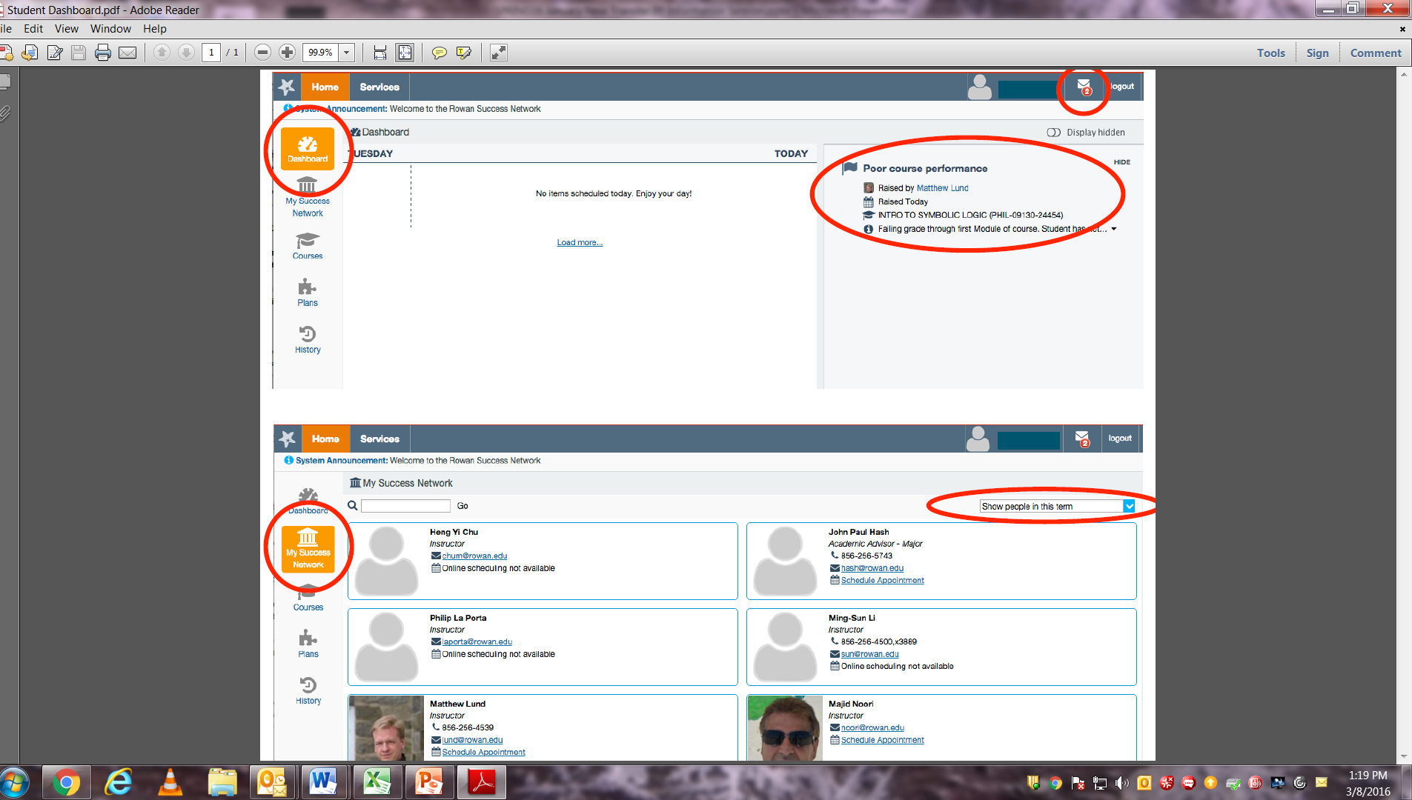
Your RSN Dashboard

Slide 41
How Do I Search for Courses?
Section Tally
http://banner.rowan.edu/reports/reports.pl?task=Section_Tally
Planning to take an online course?
Prerequisite=Rowan Online Immersion Training (ONL)

Slide 44
Self-Service Banner
Self-Service Banner
Notes:
Self-service – requires they have a Banner ID# and paid deposit.

Slide 45
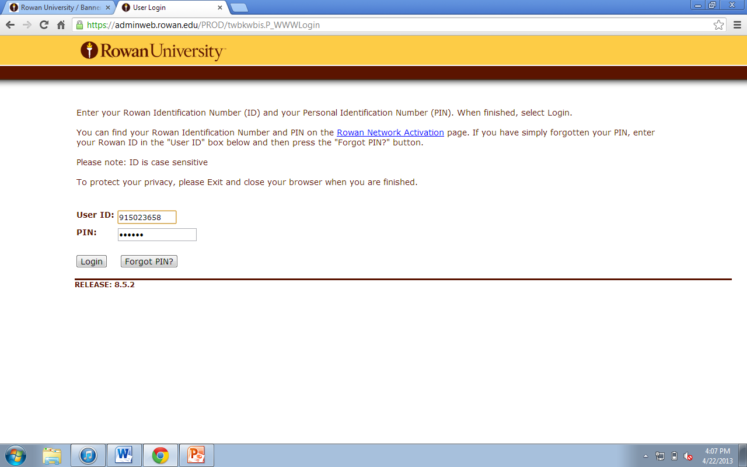
Notes:
ID and Pin

Slide 46
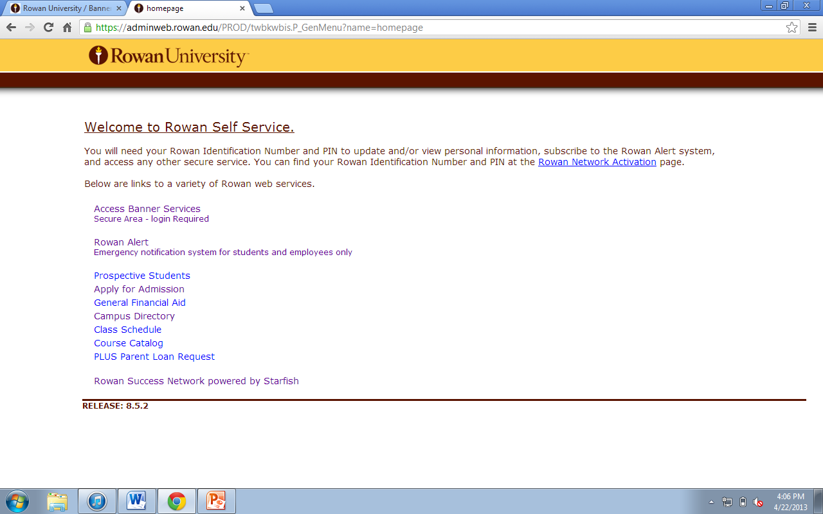
Notes:
Entry Page

Slide 52
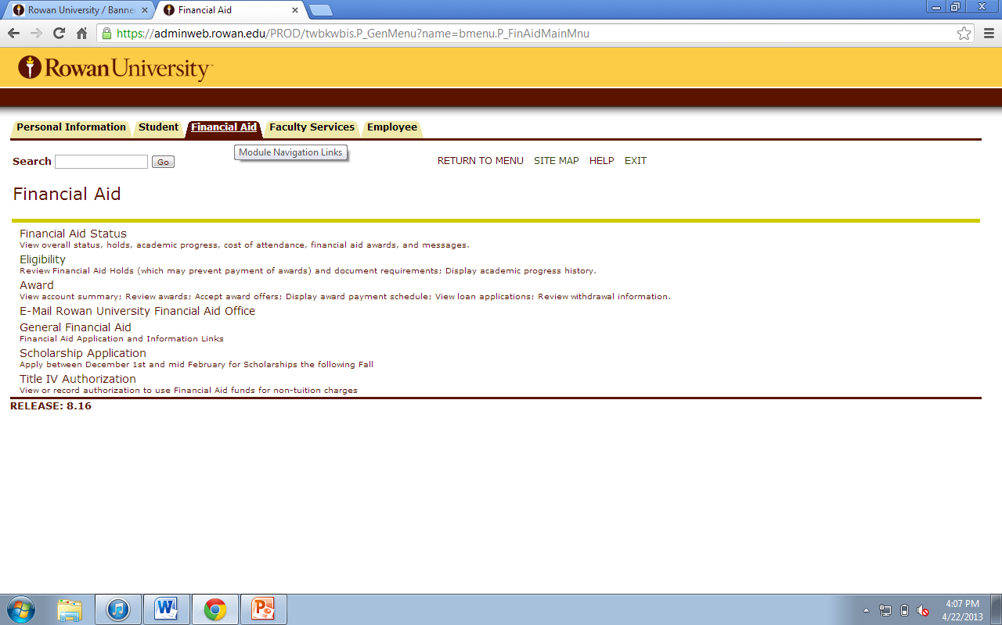
Notes:
Fin Aid

Slide 53
How Registration at RU works:
First Week of Registration
Seniors (90+ credits) and Students with Priority Registration Status
Second Week of Registration
Juniors (58+ credits)
Third Week of Registration
Sophomores (24+ credits)
Fourth Week of Registration
Freshmen (Any)

Slide 54
Navigating the Rowan University Website
www.rowan.edu
Notes:
Using the “search” feature should be a main point for this slide
How to find department websites

Slide 56
Get to know your academic department!
Website
Faculty contacts and bios
Research projects led by Faculty
Guest Lecturers
Student Conferences
Student Organizations
Social Media accounts (FB, Twitter, IG, etc.)

Slide 57
Transfer Student Housing Options
Application Process & Eligibility
All transfer students will receive housing and meal plan information from the Admissions Office upon acceptance to the University. Early applications are encouraged.
Applying
Incoming transfer students are able to apply for University housing two (2) business days after the University has received the student's admissions confirmation and deposit. Students are encouraged to apply as soon as possible. A non-refundable $200 deposit, payable by credit card, will collected during the application process. The deposit will be applied to your first semester bill. Check the Apply for Housing link to learn more.
housingquestions@rowan.edu

Slide 58
Roommate Requests
Students may indicate a requested roommate in My Housing.
Roommate requests are honored whenever possible, but not guaranteed.
Ability to match transfer students with continuing Rowan students depends on availability of space in their apartment.

Slide 59
Rowan Transfer Living Community!
Here at Rowan University, it is our mission to help our Transfer students have as positive an experience as possible.
To help facilitate this mission, we offer Transfer Living Communities, which are an opportunity for transfer students to live in our residence halls with other transfer students. This allows our students to get to know others who are new to Rowan and who may be having similar experiences.
“No matter where you started, you’ll always have a home at Rowan.”

Slide 60
Rowan 101: College Success Transfer Seminar
Special Section designed specifically for incoming transfer students to provide support during transition to RU.
2 credit free-elective course that provides support during students' transition to college level work;
Engagement with the Rowan community;
Planning for major and career.
Topics of discussions: academic integrity, academic skills, goal setting, financial literacy, and more.

Slide 61
Transfer Mentor Program
Designed to ease the transition of new transfer students into Rowan University by connecting incoming transfers with current transfer leaders on campus.
Mentee expectations:
Have a positive attitude
Eager to learn, ask for help
Reply to emails

Slide 62
Find Organizations and utilize discussion, new posts and group messaging
Find Events happening on campus
Track your Involvement (activities and membership)

Slide 64
Do you have questions about RU? Need some answers? Email: transferhelp@rowan.edu

Slide 65
Questions?

