Slide 1
JAGGAER Implementation Project Overview

Slide 2
Introducing Rowan ProConnect Rowan’s new Procure-to-Pay System
Rowan is implementing a new, easy to use eProcurement tool to modernize and improve the procure-to-pay process and user experience.
This is a significant technological and cultural change that will affect employees who purchase (and approve) goods and services.
Rowan ProConnect will replace Banner Purchasing and Accounts Payable modules.

Slide 3
Who is Impacted?
All Academic Departments
All Administrative Units
Employees who purchase and
approve goods or services
Employees who request
new suppliers

Slide 4
Rowan ProConnect Timeline
CY24 |  |  |  | CY25
Sep | Oct | Nov | Dec | Jan | Feb | Mar
Rowan ProConnect Introduction
Town Hall Sessions
ePro/AP Pilot Lunch and Learn Sessions
Solution Validation
Training
Go-Live
Post-Production Support

Slide 5
Rowan ProConnect Goals
INCREASE
ELIMINATE
Increase efficiency through process automation
Increase ease of use and consistency across the campus
Increase visibility for suppliers
Increase payment efficiency to better serve our suppliers
Eliminate errors with workflow automation and data validation
Eliminate duplication
Eliminate shadow systems
Eliminate the use of emails as a workflow process

Slide 6
Rowan ProConnect Benefits
Improved Visibility into Purchases
Connecting Disconnected Processes
Specific for
Rowan
Eliminating Outdated Systems
Real-time integration with financial systems enhances expenditure monitoring and budget tracking. Allows active view of budgeting for requested purchases, approval workflow and order status.
A suite of solutions that streamline and integrate different aspects of the procurement lifecycle including Contract Management, Supplier Management, Procurement, and Accounts Payable.
The system is designed for ease of use, ensuring that everyone can navigate and make the most of its features, including simpler searching for orders and invoices. Departments can access a marketplace of Rowan tailored catalogs and preferred vendors.
A centralized platform for the entire procure to pay process will eliminate the need for systems like Google Forms used for Contract and Supplier Management and allow you to track your purchase throughout the entire process in one system.
Notes:
Visibility - Allows you to see where in the process you are for workflow and approval
Connecting Disconnected - Everything in one system, no need for Google Forms for Contracting and Supplier Management. Also one place to shop with hosted and punchout catalogs for vendors including Amazon.
Specific for Rowan - tailored to Rowan’s processes and will be adjusted as needs for Rowan change
Eliminating Outdated systems - The homemade portals creating for Contracting, Supplier Management, and Procurement will be eliminated with the whole processes occurring in Rowan ProConnect. Reporting will also take place in the system and eliminate many of the reports created in Cognos

Slide 7
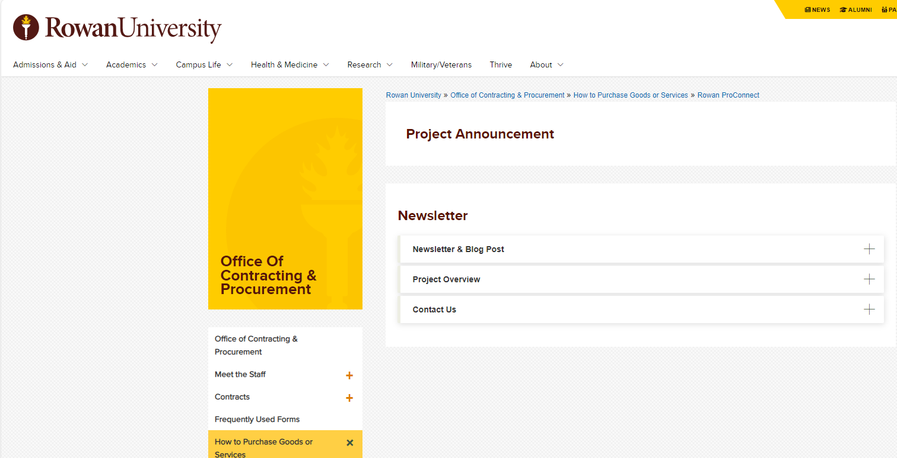
Additional Information
Where to find more information on Rowan ProConnect
Stay Informed
Additional project information and updates are available on our Rowan ProConnect Web Page
Questions?
Please direct questions to proconnectsupport@rowan.edu
Your involvement and feedback are vital as we transition to a more streamlined and efficient procure-to- pay process.
We encourage you to ask questions!
https://sites.rowan.edu/procurement/purchasing%20/rowanproconnect.html

