Slide 1
Contract Request Guide

Slide 2
Contract Request Overview
How to Create Contract Requests and Search for Requests/Contracts
As a Contract Requester, you will create a Contract Request for any need you believe requires a contract.
The Contract Request consists of completing some preliminary questions and information and attaching supporting documents and/or a supplier contract. Once submitted, the Contract Request will be routed for approvals, as applicable, and forwarded to the Contract Manager. The Contract Manager will review the request, approve or reject the request, create the contract record, submit the contract to the appropriate parties for review and approval, and send the contract for e-signature.
This reference guide is intended to illustrate the process of creating a contract request and provide commentary.
Best Practices
Use a contract request template that has been preconfigured to easily fill out required information to request a contract
Attach all supporting documentation for review by the Contract Manager
Questions will vary by the contract request template selected and the form will guide you through what information needs to be provided
Note: Based on the selections you make in certain fields, other fields may or may not be visible. If you do not see a field on your request form that is in the below guide that is because the visibility on that field was not triggered, meaning you can continue completing your request.

Slide 3
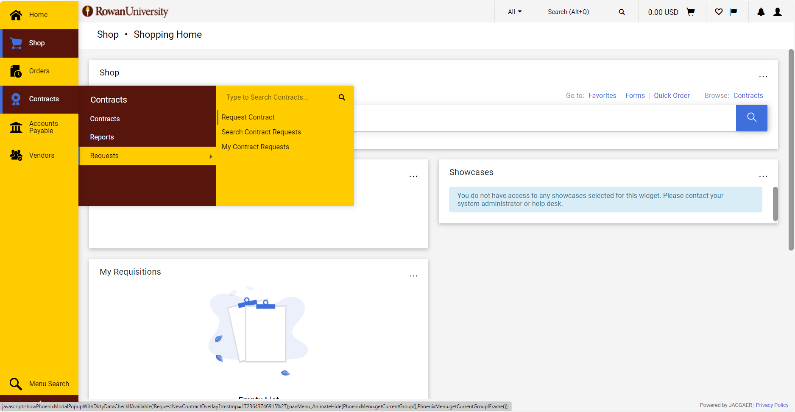
Step by Step
1. Open the Contract Request Form - Navigate to: Contracts > Requests > Request Contract

Slide 4
Step by Step
2. Create Contract Request - Give the Contract Request a descriptive name and select the Contract Request Template.

Slide 5
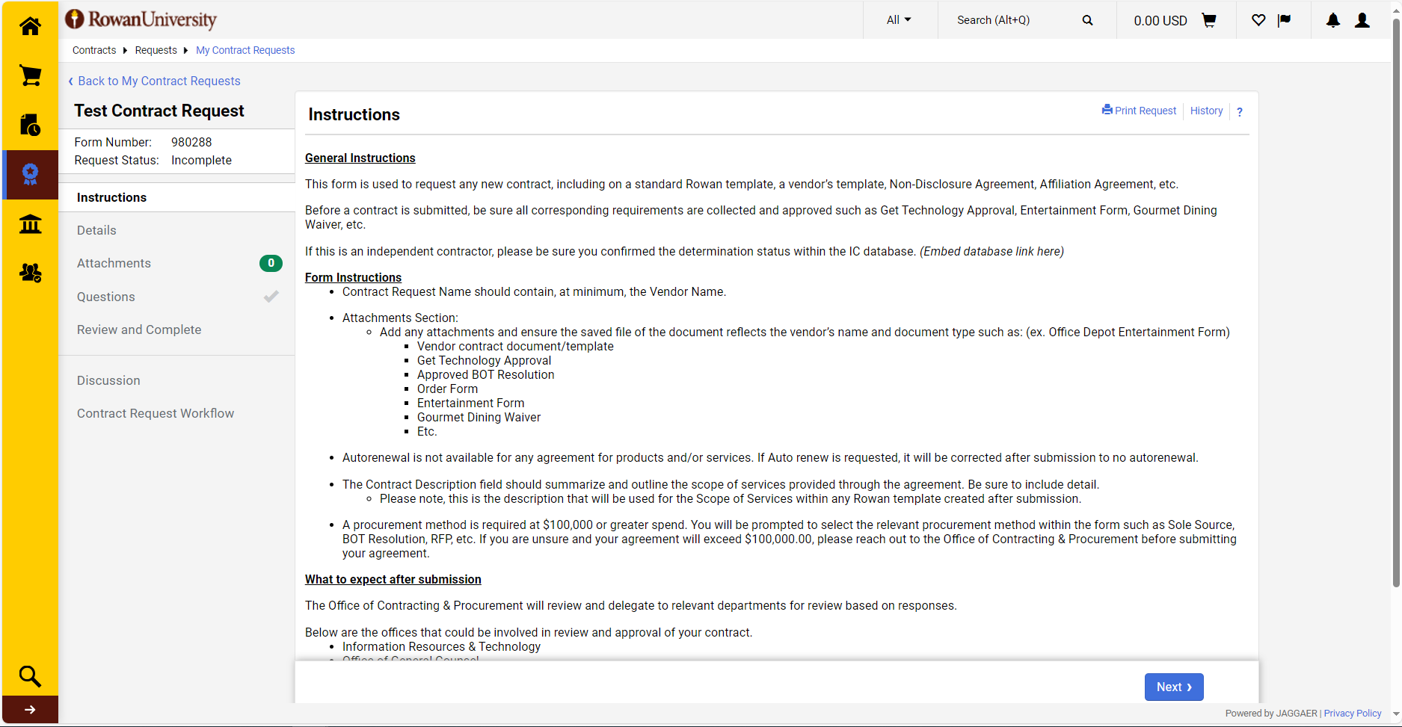
Step by Step
3. Contract Request Instructions - The Instructions page contains some information about the Contract Request. Click on any of the tabs on the left side of the screen to go directly to a specific page of the Contract Request, or click Next to proceed to each page in order. Green check marks indicate that the required fields for that page have been completed.

Slide 6
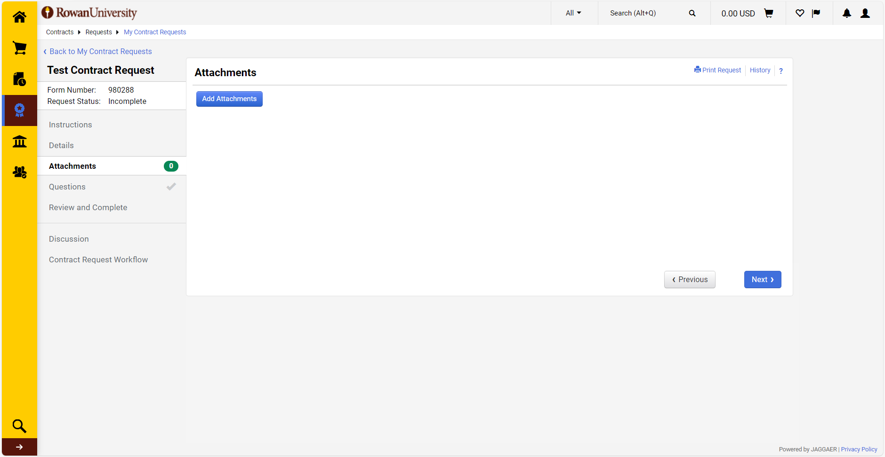
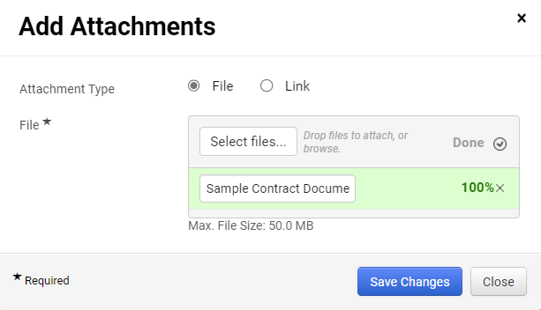
Step by Step
4. Attach Contract Document - In the Attachments tab, attach the contract document and any supporting documentation. Attach the MS Word contract document along with any supporting documentation (SOW, exhibits, price lists, etc.). Select save changes once all documents have been attached.

Slide 7
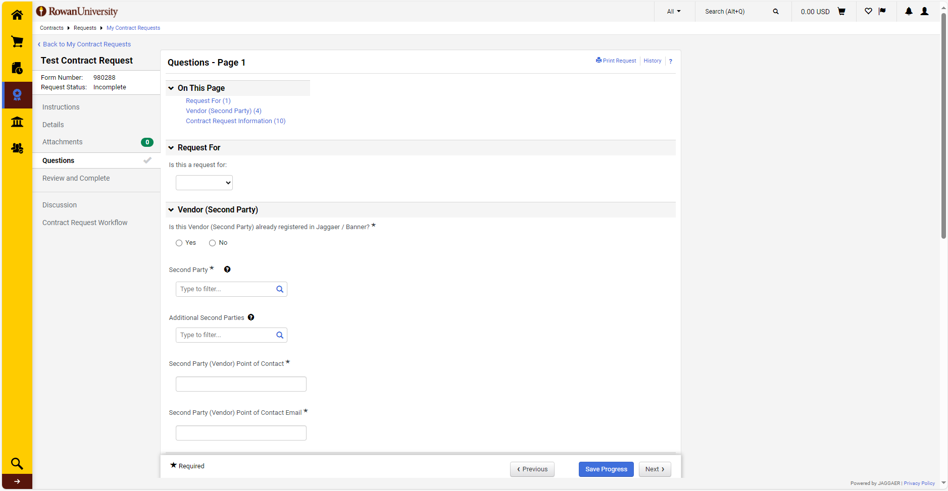
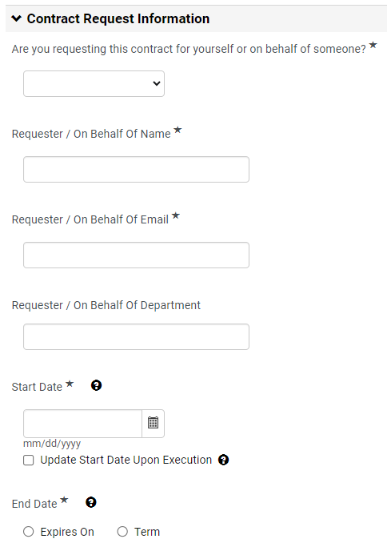
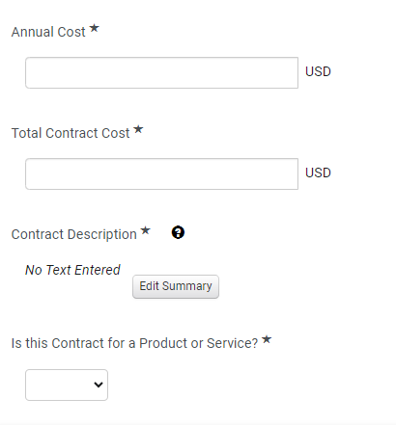
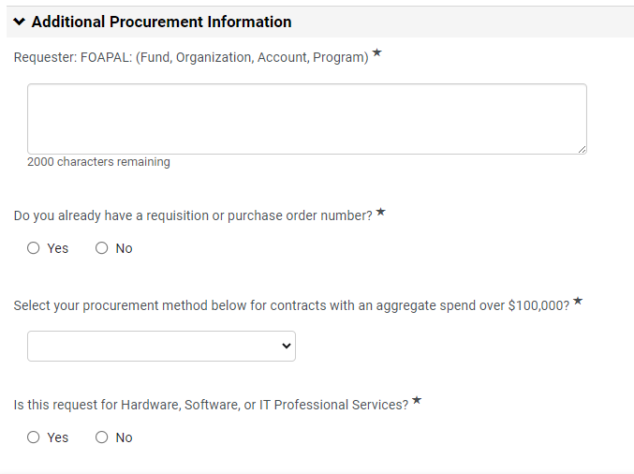
Step by Step
4. Complete Questions – On the Questions tab, provide all available information for the Contract Request. (*) Denotes a Required Field. The form is dynamic and additional questions may appear based on your answers.

Slide 8
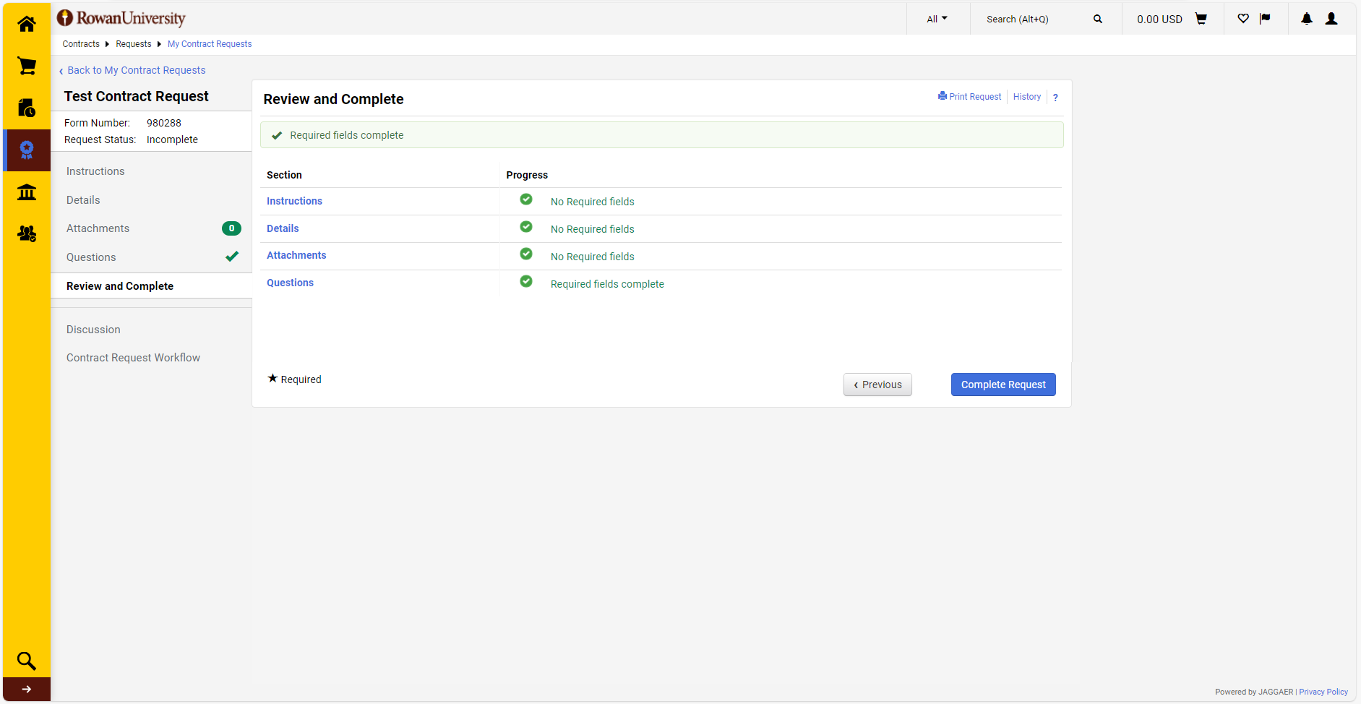
Step by Step
5. Review and Complete Request - Once all required information has been entered, navigate to the Review and Complete tab. If any required information is missing, it will be marked as incomplete on this tab, and you will not be able to proceed. Select the section not yet completed. Complete the unanswered questions and Save Progress before returning to the Review and Complete tab. Select Complete Request and then select Yes.

