Slide 1
ProConnect Training
Presented by Accounts Payable and the Office of Contracting & Procurement
August 2025

Slide 2
Agenda
What’s New Since Go Live
Choosing the most suitable form to submit requisitions
ProTips
Frequently Asked Questions
Invoicing
Receiving
Approvals
Contact Information
Questions

Slide 3
What’s New Since Go Live
Amazon Punchout
  FAQ: I clicked on the Amazon punch-out but it's just spinning! What do I do? Click the browser settings and make sure "Pop-Ups" are allowed.
  Access the presentation here.
  Amazon Business Purchase Guide
Furniture Process Improvements
Tariffs
Vendor Email Distribution Updates

Slide 4
Furniture Process
Improvements
Previous Process |  | New Process
Email Request |  | Entry into ProConnect
End-user sends an email to the Facilities Team with: |  | End-user logs requests directly into ProConnect with:
 | · Furniture description including assembly and installation needs |  | · Furniture description including assembly and installation needs
 | · Quantity & estimated cost |  | · Estimated cost
 | · Supporting documents (e.g., vendor quote) |  | · Supporting documents (e.g., vendor quote)
 |  |  | · Commodity Code (e.g., CD440-000)
Facilities Review |  | Automated Routing
Facilities Team checks: |  | ProConnect uses the commodity code to route the request to the correct approval queue automatically.
 | · Standards compliance
 | · Space/design alignment
 | · May request clarifications
 | · Sends approval email to user
Banner Entry & Email Forwarding |  | Approval Workflow in ProConnect
End-user enters request into Banner and forwards the Facilities approval email to requisitions@rowan.edu |  | Facilities Approvers are notified and review in ProConnect:
 |  |  | · Standards & space check
 |  |  | · May request clarifications
Key Improvements in the New Process
Eliminates manual email forwarding and Banner entry.
Reduces errors through automated routing using commodity codes.
Centralizes communication and approvals in ProConnect.
Ensures transparency and consistent policy enforcement.

Slide 5
Capturing Tariff Costs
Due to recent changes in global trade policies, tariffs on a variety of imported goods have led to noticeable increases in procurement costs across several categories. To better manage and monitor these changes, the University has established a new commodity code specifically designated for capturing tariff-related costs.
Key Updates:
Cost Increases: Expect price fluctuations on goods including lab equipment, IT hardware, office supplies, and certain construction materials. These are due to additional import duties levied on specific international sources.
New Commodity Code: To improve transparency and reporting, please use the following commodity code when submitting purchase requisitions affected by tariffs:
Commodity Code: CD482-002 Tariffs
Action Required:
Use CD482-002 Tariffs when applicable to help us track and analyze the financial impact of these tariff-related expenses.
Plan ahead for potential delays or increased pricing, particularly on international or specialized orders.
Consult procurement if you need help identifying alternative suppliers or managing budgets.

Slide 6
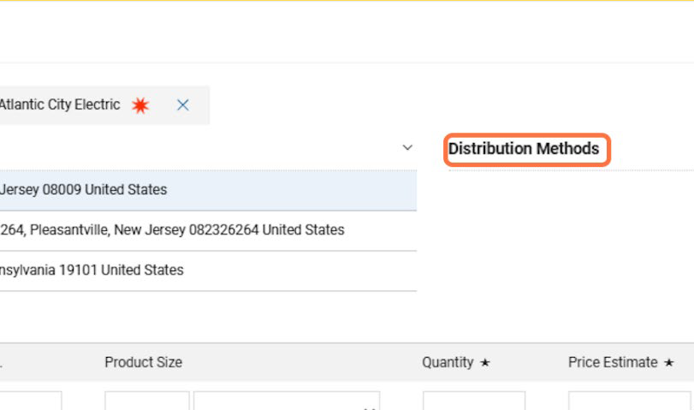
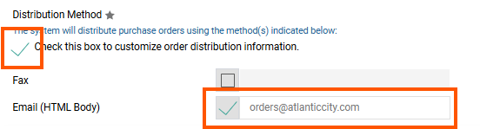
Editing Vendor Email Distribution
You can now change the email address to which Purchase Orders be sent.
Find the Distribution Methods link on your requisition or order form.
Add or change the email address you wish the PO be sent to. You can opt to use your own email address if the vendor does not need the PO.
Continue to process your order as usual.
See PO Distribution Guide for full list of instructions.

Slide 7
Forms for Requisitions
Available Form Types
Punchout Catalogs
  Amazon
  Fisher
  Grainger
  HD Supply
  Henry Schein
  VWR
Non-Catalog
Standing Order
  Sole Source (non-grant)
  Independent Contractor
  Grant Purchase Approval & SubAward Forms
Which is the most suitable form for my request?

Slide 8
ProConnect Form Selection Guide
Standing Order Form | Non-Catalog Form | Punchout Catalog
Purchasing services or goods billed across multiple invoices Hourly rates, milestones, or split deliveries Recurring payments or multiple delivery addresses Contract, statement of work (SOW), or long-term billing Invoicing based on time, progress, or multiple shipments | Goods not available in the catalog (e.g., quote-based products) Known SKU, price, and item details not in a catalog Physical items: computers, lab supplies, furniture, etc. Vendor does not have a catalog or punchout Submitting a quote-based purchase for goods | Goods listed in an online catalog (e.g., ODP, Amazon, Grainger) Vendor has a punchout or hosted catalog in ProConnect Catalog must be used if available Standardized products with pre-approved pricing Automated pricing, shipping, and invoicing
Note:
Standing Order Forms also include:
Grant Purchase Approval & SubAward Forms
Independent Contractor
Sole Source (non-grant)
ProTip: Using Non-Catalog Forms with Multi-Line Requisitions
If you decide to use a Non-Catalog Form and you're unsure whether items will ship separately, here’s what to do:
Add one shipping line for each product line in the requisition.
This ensures that each product can be received and invoiced independently if shipments are split.
Helps prevent errors or delays in receiving and payment processing.

Slide 9
ProTips
ePro Pro-Tips
Attach all documentation prior to submitting.
Use correct form for type of purchase.
  We cannot change a form for you. If you submit on an incorrect form, you will have to resubmit and it will route through the approval process again.
Alert requesters of pending carts or FUND/ORG approver of pending approval.
Respond to comments seeking information at earliest convenience.
Check the History Tab for important systematic information. Common errors messages:
  Line 1 Distribution 1, Banner status: invalidAccountingString - a FOAPAL value is either not valid or can’t be used in the combination
  Line 1 Distribution 1, Banner status: notAvailable - insufficient funds for the FOAPAL string
Review where your request is in the Workflow
You can only use FOAPALs that you have direct access, i.e., Banner Security Access.
Use only one bank code per requisition.
Prepared For / Prepared By
  The Prepared For and Prepared By fields should be the same end-users. The request will be returned to Draft, unless both individuals have Banner Finance Access to that specific fund/org combination.
Change Orders - you must make the changes to cost and/or quantity and explain in the required comment what the change was for.

Slide 10
FAQ
Where can I find more training and information? Visit the ProConnect page on the Office of Contracting & Procurement website.
How can I request individual or group training? Book a Training Session here
I received an email that my requisition was returned, but doesn't tell me why. Check the "History" and/or "Comments" tab in your requisition.
I forgot to add an attachment before submitting. How do I add it? Attach the documents to a new comment in your requisition.
Can I edit a requisition? You can only edit a requisition before it is fully approved. Otherwise, it must be withdrawn and resubmitted.
Why isn’t my invoice being paid? Unless it’s a punchout, you still need to forward your invoices to invoices@rowan.edu .
How do I request changes to my approval queue?
  To add or remove an approver from an existing Fund/Org approval queue, please email reqapprovalqueue@rowan.edu with the following details:
    Approval Queue ID to be updated
    Type of change (Add or Remove)
    Full Username to be added or removed

Slide 11
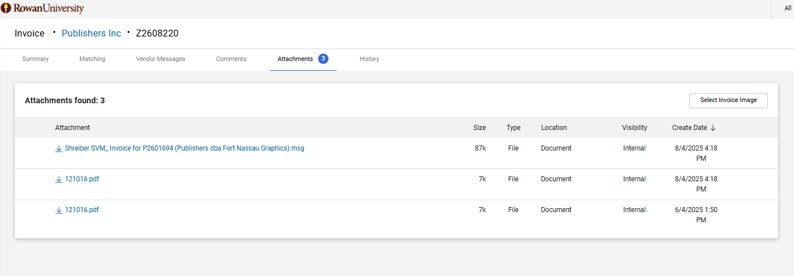
Invoicing
Invoices must still be sent to Accounts Payable at invoices@rowan.edu with a valid PO#
  Valid PO# is a P26#, anything else is not valid
  If attaching to the requisition/PO, AP is not notified of this.
  This is for ALL invoices, except punchout orders.
Can view copy of the invoice directly from ProConnect - under attachments tab

Slide 12
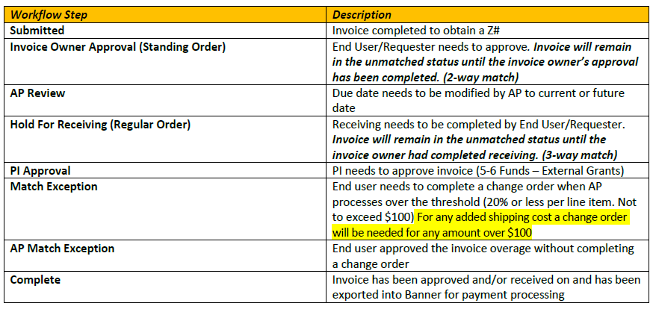
Tracking an Invoice - What Step is it in?

Slide 13
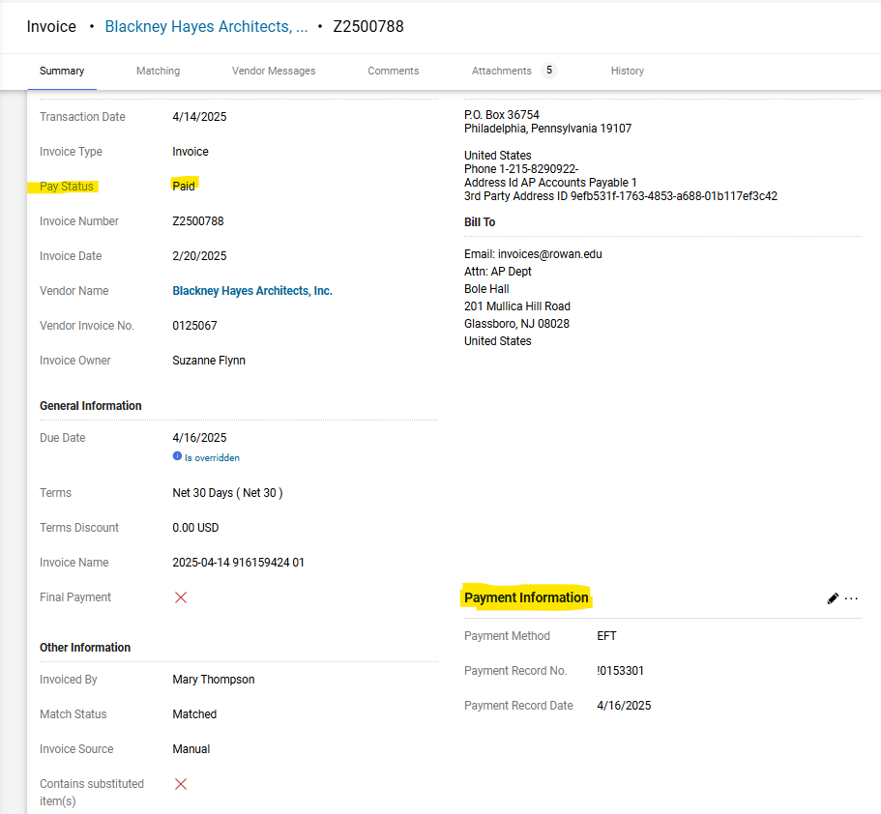
Payment Status
Invoice must be in complete status to export into Banner for payment processing
Payment information can be viewed in Banner or in ProConnect
  If viewing in ProConnect, the pay status will show paid and payment details will be displayed under Payment Information section.
  Payment Record # = check or direct deposit #

Slide 14
Approvals for Invoices
All invoices processed against standing orders require an approval from the invoice owner prior to the invoice being processed for payment.
Any invoices being funded with a 5 or 6 fund also require a PI approval in addition to the invoice owner approval.
Can only be approved by the invoice owner (individual who submitted the requisition)
Return for any corrections needed.
Reject invoice if it should not be paid and make a comment.
*NEW* Report available in ProConnect to find all invoices awaiting approval - step-by-step instructions found in our ProConnect End User Invoice Guide

Slide 15
Receiving
All invoices processed against non-catalog orders require receiving prior to the invoice being processed for payment.
All punch out orders require receiving.
Ensure you do not over receive as this will cause a match exception in the invoices
Receiving should only be done in ProConnect, not Banner
Can be completed before or after an invoice has been processed and can be completed by anyone
If you need something corrected on an invoice, do not do receiving yet and make a comment to AP asking for the correction.
*NEW* Report available in ProConnect to find all invoices awaiting receiving - step-by-step instructions found in our ProConnect End User Invoice Guide
Visit Step-by-Step Directions on Receiving an Invoice

Slide 16
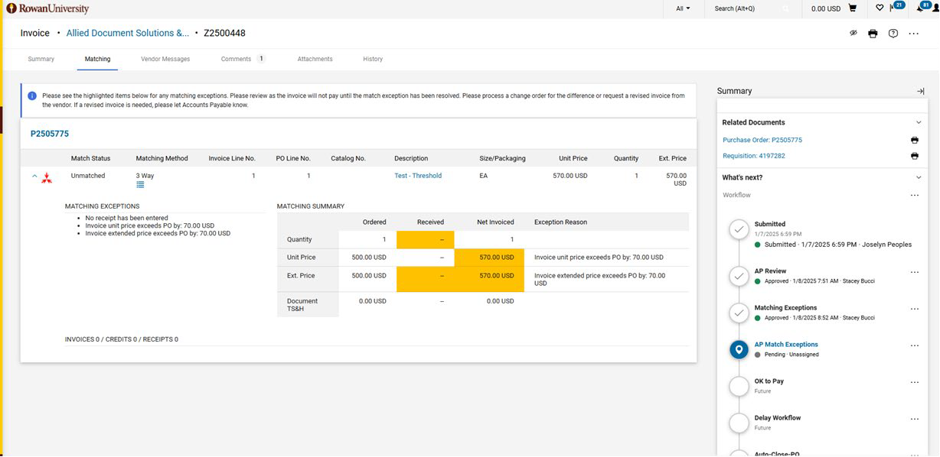
Invoices in Match Exception
Do not approve without reviewing the invoice to see if a change order is needed.
  You will typically see a comment from AP on the invoice requesting the change order.
  You can review the matching tab of the invoice to see what is unmatched.

Slide 17
Common Match Exception Reasons
Duplicate receiving
  Ensure you only receive the # of items that were on the requisition. You will need to delete any duplicates (reopen the receipt and select delete under the drop down menu).
Change order to increase amount
  Needed if the line item amount is exceeded by more than 20% - be sure to increase the exact line item requested rather than add a new line item
  Needed if shipping was not listed on the PO and is more than $100 - be sure to add a new line item for shipping
Incorrect type of PO was utilized
  Example shown on next slide for how to correctly utilize a non-catalog PO when purchasing multiple items in order for the invoice to process without any issues
    Alternative is to utilize a standing order - be sure to select the standing order form.

Slide 18
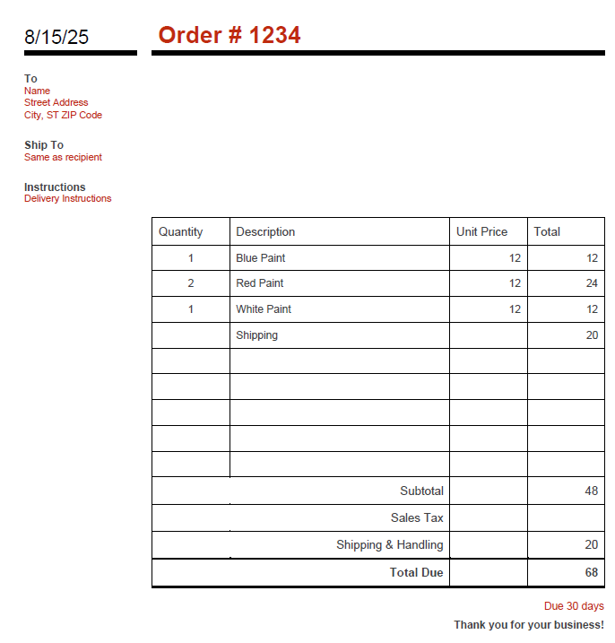
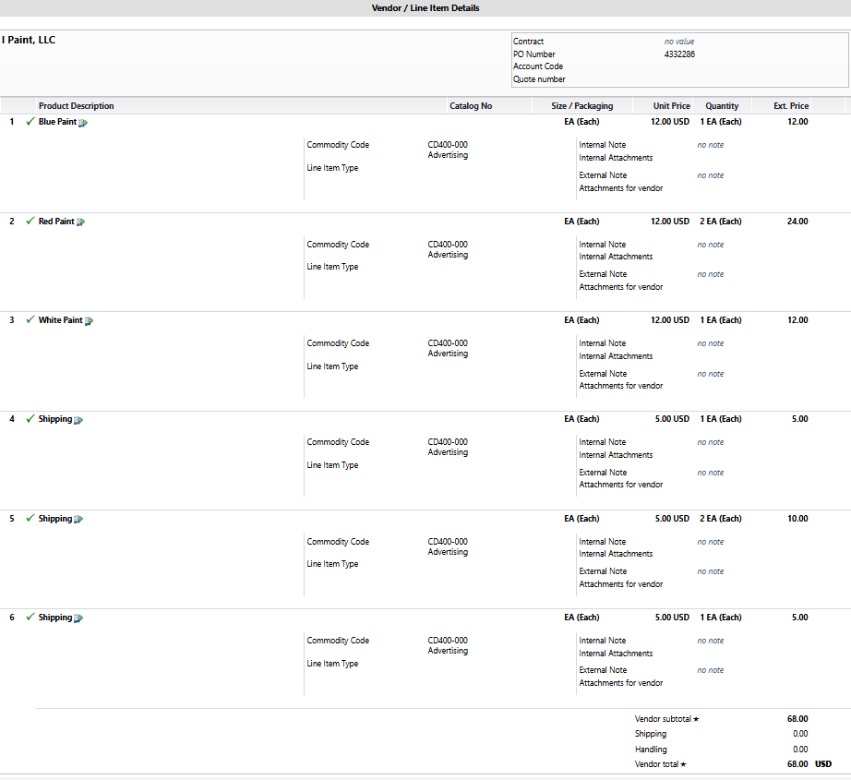
Invoice and PO Example that will not result in a Match Exception

Slide 19
Contact Information
AP Director - Joselyn Peoples ext. 4335 or email peoplesj@rowan.edu
OCP Director - Alexis Jones ext. 5171 or email jonesal@rowan.edu
Full AP Team Contact List
Full OCP Contact List
proconnectsupport@rowan.edu

Slide 20
Questions?

