Slide 1
Vendor Request Job Aid
Rowan ProConnect

Slide 2
Vendor Request Overview
How to Request Vendors in Rowan ProConnect
As a Shopper, you will request a vendor when setting up a business relationship with a person or company for the first time.
The Vendor Request consists of completing some preliminary questions and information and attaching supporting documents. Once submitted, the Vendor Request will be routed for approvals, as applicable, and will be forwarded to the Vendor Management team. The Vendor Management team will review the request, approve or reject the request, create the vendor record, send an invitation to the vendor to register in the Rowan ProConnect system, and submit the vendor to the appropriate parties for review and approval.
This reference guide is intended to illustrate the process of creating a vendor request and provide commentary.

Slide 3
Best Practices
Before creating a vendor request form ensure the vendor is not already established in the Rowan ProConnect system. and currently and active vendor for Rowan.
Adhere to the instructions provided in the request. This includes required information, specific documents to attach, reasons a request may be denied, and follow up steps.
Upload all necessary documents such as certifications, financial statements, and references. Ensure these documents are up-to-date and clearly labeled.
Before submitting, review all entered information for accuracy. This includes checking for typos, ensuring all mandatory fields are completed, and verifying document uploads.
Ensure that the information provided in the request matches what is in your vendor profile and any other submitted documents.
Submit your request well before any deadline to avoid any last-minute issues. This also gives you time to address any potential feedback or additional requirements.
Note: Based on the selections you make in certain fields, other fields may or may not be visible. If you do not see a field on your request form that is in the below guide that is because the visibility on that field was not triggered, meaning you can continue completing your request.

Slide 4
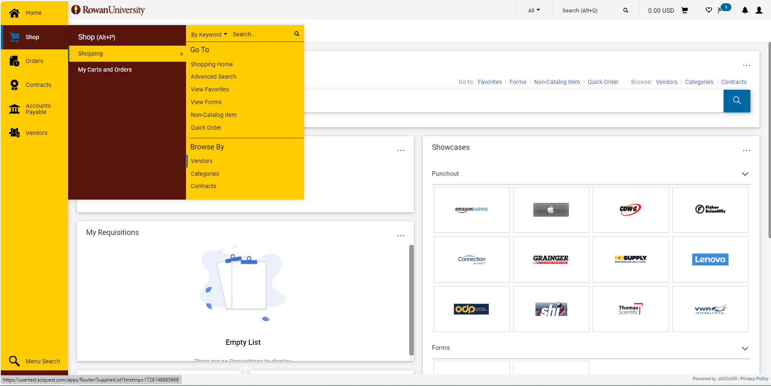
Step by Step
1. Search for Vendor - Navigate to: Shop > Shopping > Browse By: Vendors.

Slide 5
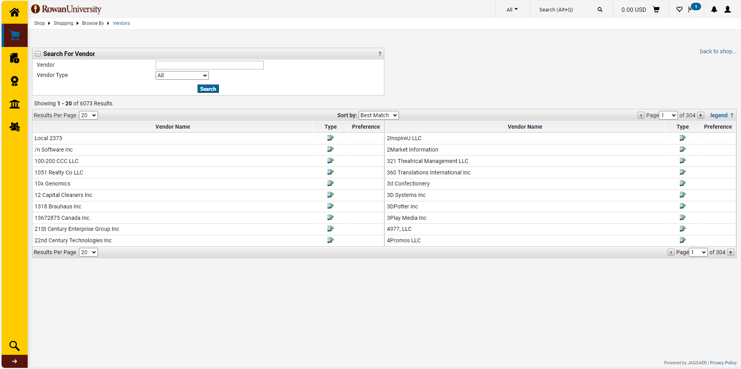
Step by Step
2. Complete Vendor Search - Type in the vendor name (any name that could be used for the vendor) and complete a vendor search to ensure the vendor is not already in the system.
Vendor Already in Rowan ProConnect:
If you do a search and find the vendor you should complete your shopping request with that vendor. If you see a vendor that may be the vendor you are looking to do business with, but are not sure please reach out to your vendor management team.

Slide 6
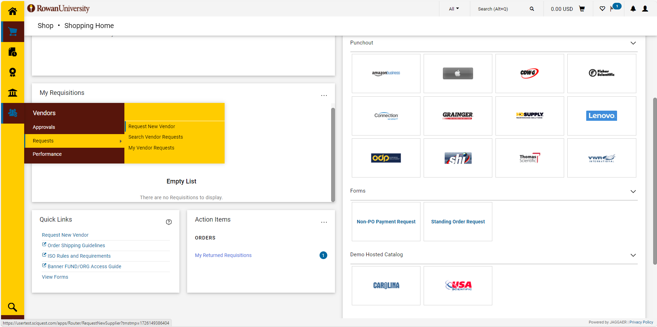
Step by Step
3. Vendor Request Form - There are a few locations to access the vendor request form. Navigate to: Vendors > Requests > Request New Vendors or from the Shopping Home Navigate to: Quick Links > Request New Vendor.

Slide 7
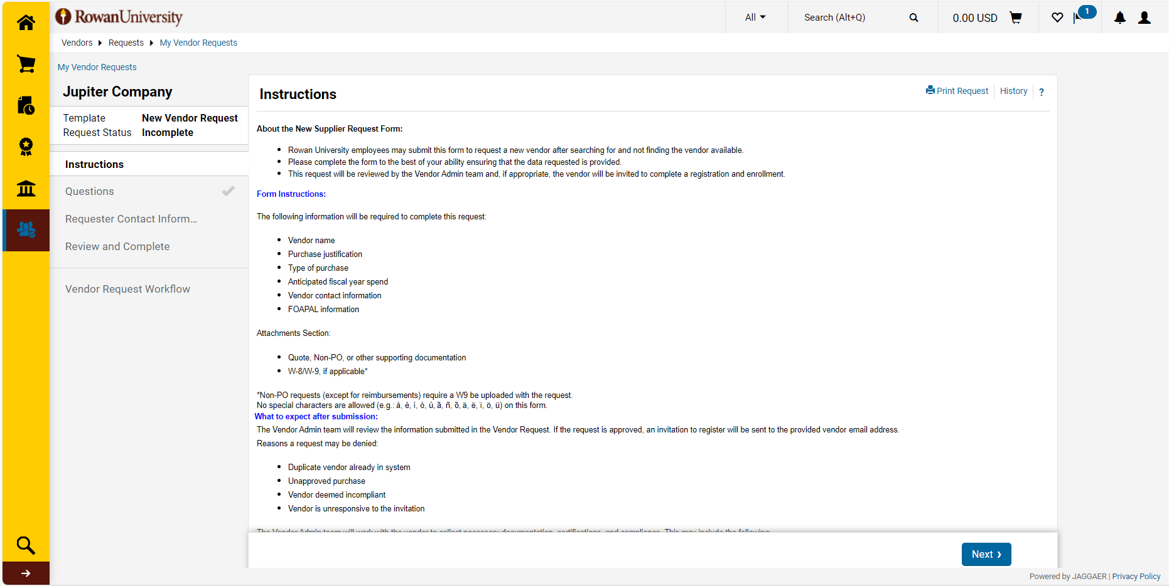
Step by Step
4. Read the Instructions- The Instructions page contains information on the Vendor Request. Click on any of the tabs on the left side of the screen to go directly to a specific page of the Vendor Request, or click Next to proceed to each page in order. Green check marks indicate that the required fields for that page have been completed. Select Next.

Slide 8
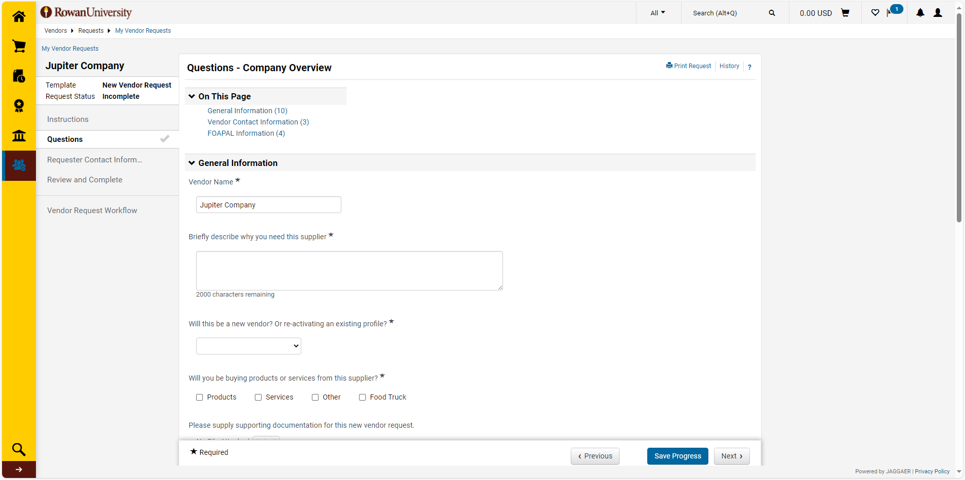
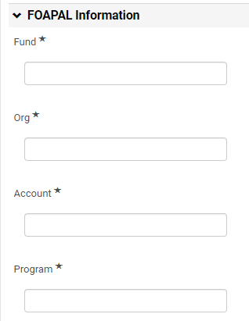
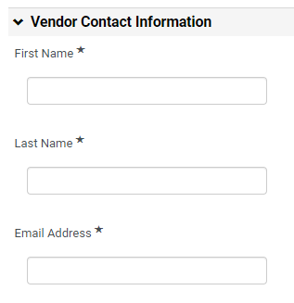
Step by Step
5. Complete the Questions - On the Questions tab, provide all information for the Vendor Request. (*) Denotes a Required Field. The form is dynamic and additional questions may appear based on your answers. Select Save Progress or Next.

Slide 9
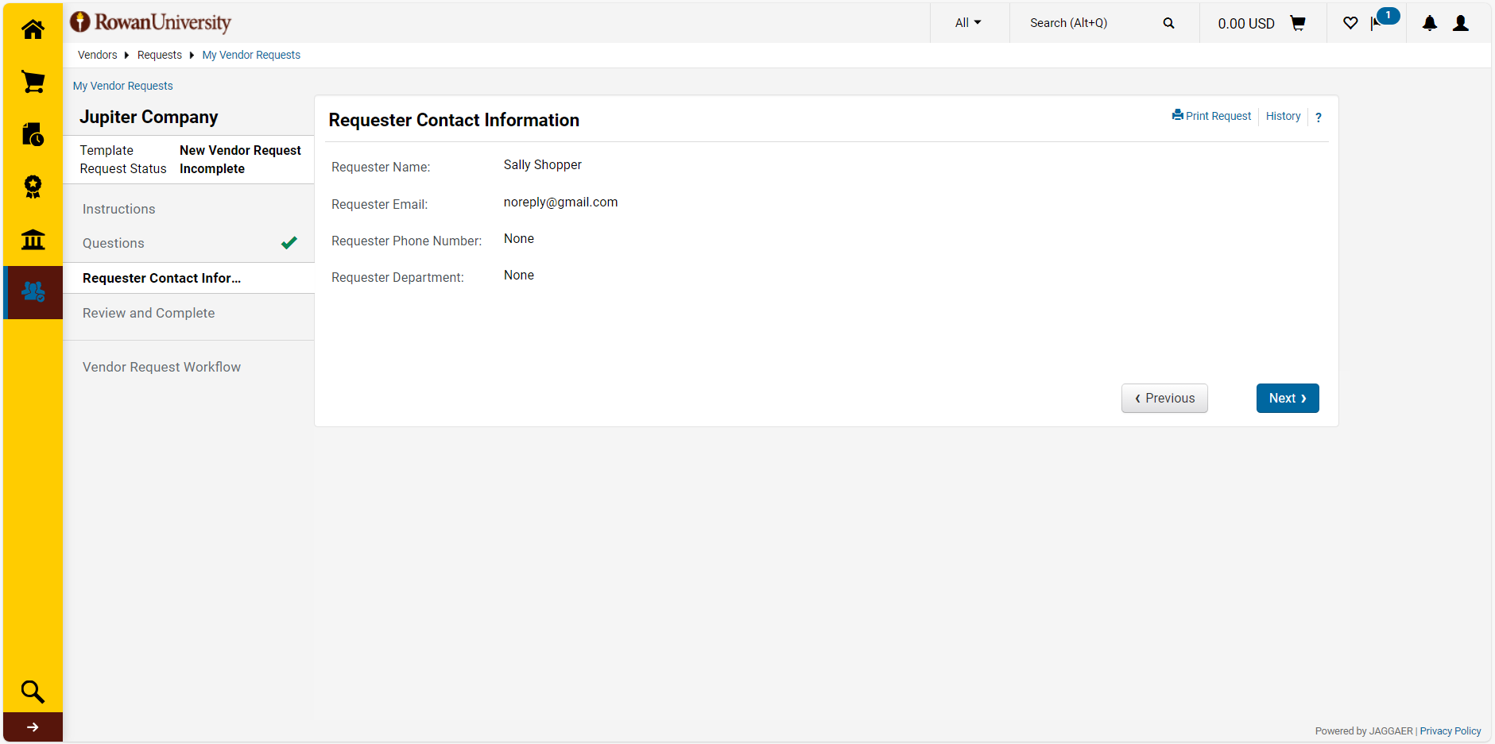
Step by Step
6. Requester Contact Information - Ensure all requester information is correct on this page. Select Next.

Slide 10
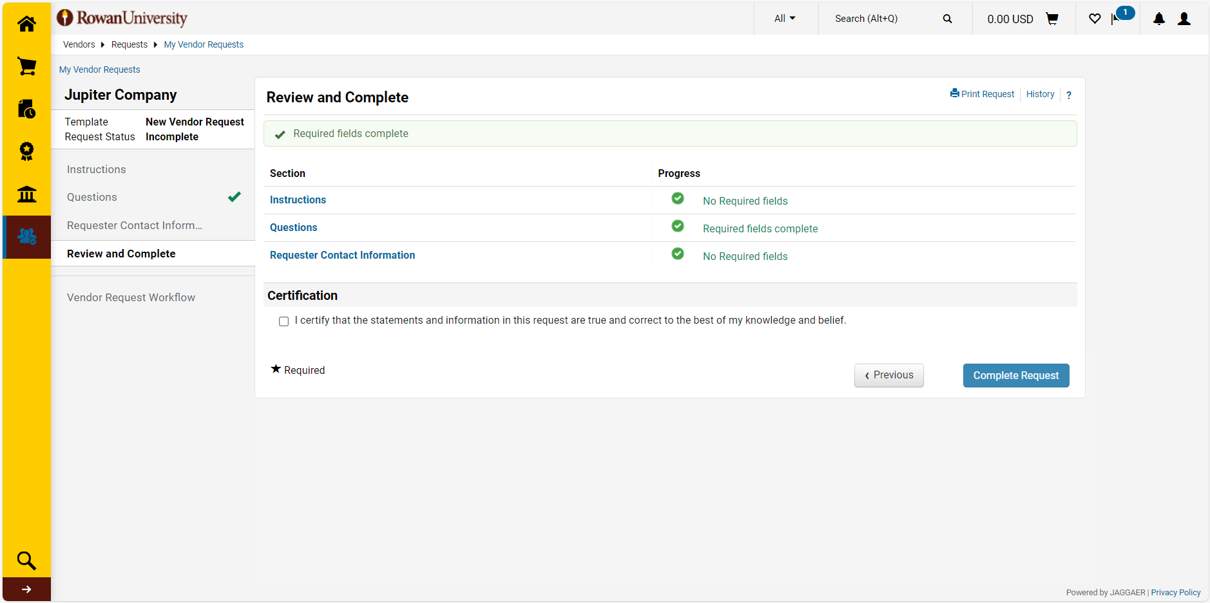
Step by Step
7. Review and Complete Request - Once all required information has been entered, navigate to the Review and Complete tab. If any required information is missing, it will be marked as incomplete on this tab, and you will not be able to proceed. Select the section not yet completed. Complete the unanswered questions and Save Progress before returning to the Review and Complete tab. Complete the Certification selection, select Complete Request, and then select Yes.

Slide 11
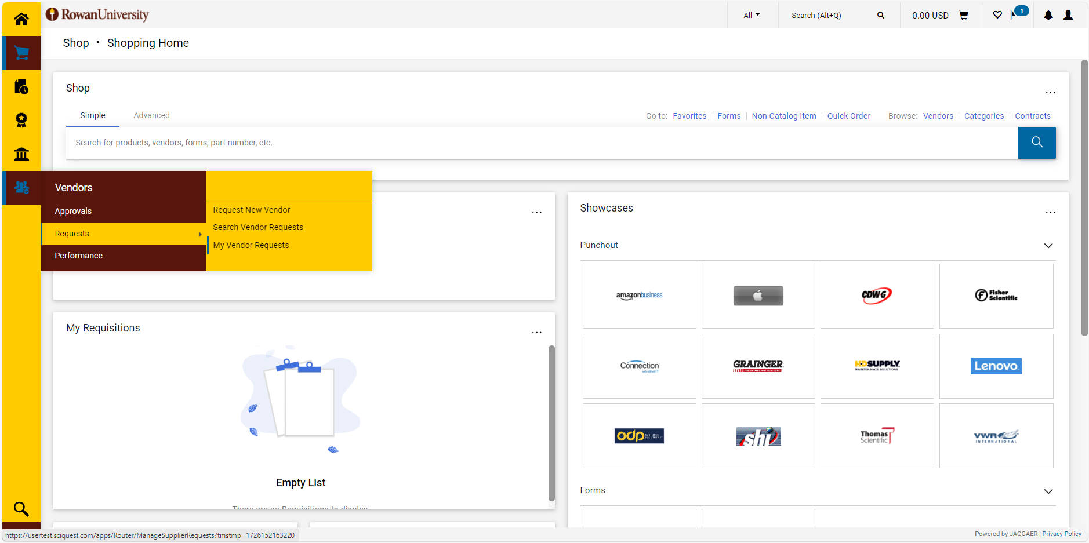
Step by Step
8. Check Status of your Request - After submitting a Vendor Request, check the status of your Request. Navigate to: Vendors > Requests > My Vendor Requests. This will return the list of all Vendor Requests you created.
Vendor Request Statuses:
Incomplete – this is a draft request, meaning you are working on it
Under Review – this is a request you have submitted but it has not been approved/processed
Approved – this is a request that has been fully approved but has not been converted into a contract yet
Completed – this is a request that has been approved and converted into a contract
Returned – The request has been sent back to the requester for further action (missing/incorrect information, additional documentation requirements)
Rejected – The request has been reviewed and denied

Slide 12
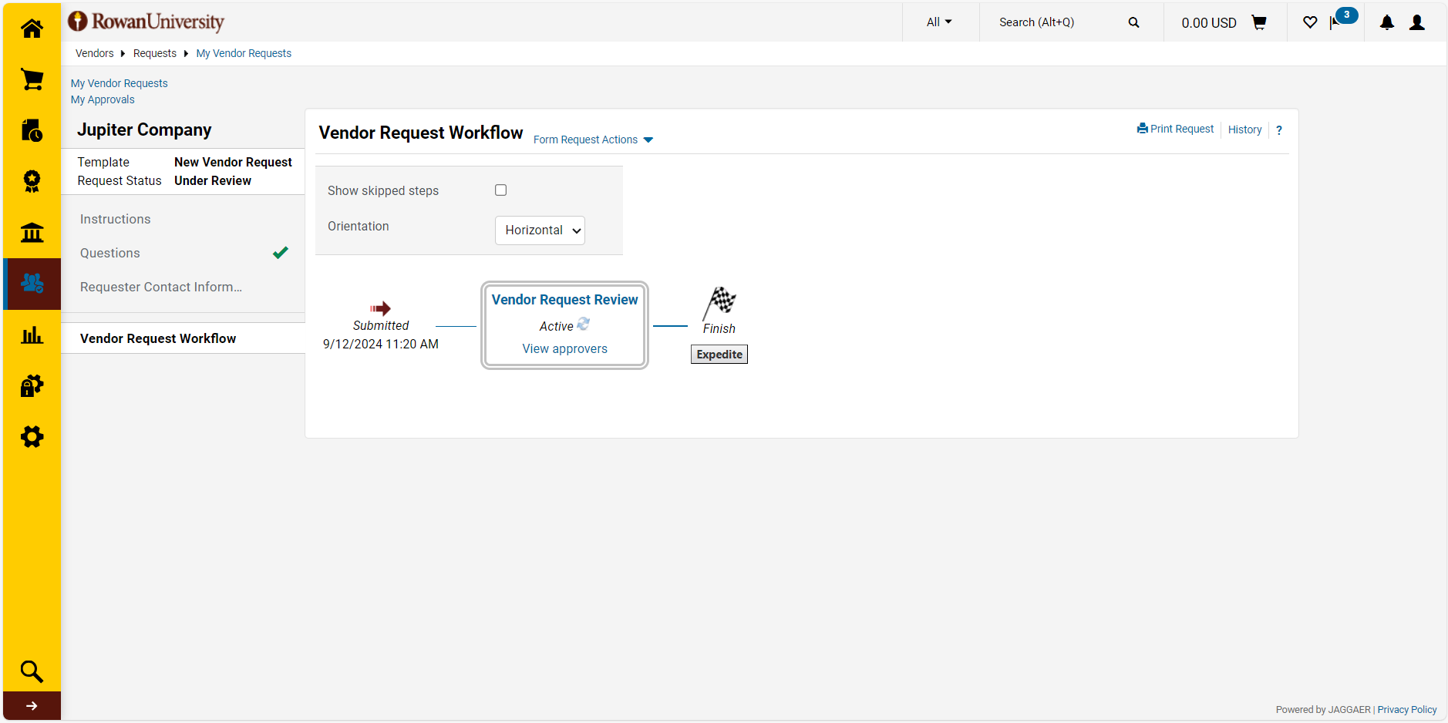
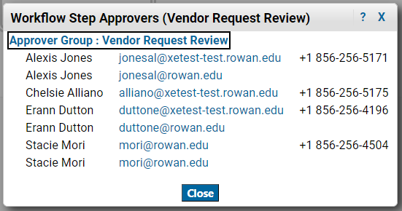
Step by Step
9. Check Vendor Request Workflow - If the request has not been completed yet and you wish to see who is the next approver you can click on the Vendor Request Workflow link in the left-hand menu to see where your request is in workflow.
Approver 1 Approver Email Phone Number
Approver 2 Approver Email Phone Number
Approver 3 Approver Email Phone Number
Approver 4 Approver Email Phone Number
Approver 5 Approver Email Phone Number
Approver 6 Approver Email Phone Number
Approver 7 Approver Email Phone Number
Notes:
Update to Current Vendor Management Team –Approver 1, 2 3 etc

