Slide 1

Independent Contractor
Presented by
The Office of Contracting & Procurement

Slide 2
Overview
Independent Contractor
  Definition
  How to identify
Process Updates
Engaging vendors through IC Process
Payment

Slide 3
What is an
Independent Contractor?

Slide 4
Definitions
Employee - a worker who is hired through Human Resources or the Office of the Provost, and paid under a W-2
Independent Contractor - an individual or single member LLC engaged in an established business, trade or profession who provides services to Rowan University and the fees are reported on the IRS Form 1099-NEC

Slide 5
Why do we need to identify
To determine if a vendor is:
  An employee subject to tax withholdings
    (receives IRS Form W2)
  or
  An IC responsible for paying their own taxes
    (receives IRS Form 1099-MISC)

Slide 6
Why do we do this?
To comply with federal and state guidelines for consistent and fair classification of workers
To avoid taxes, penalties, and interest assessed for noncompliance

Slide 7
How to Identify Vendors Requiring Determination
Considered Independent Contractors
Corporations
Partnerships
Require Careful Evaluation of Employee vs Independent Contractor
Single Member Limited Liability Companies
Individuals

Slide 8
Who Manages the Process?
Collaborative Effort
  Human Resources
  Contracting & Procurement
  Accounts Payable
  Payroll
  Determination of independent contractor status can only be made by Human Resources

Slide 9
Making Determination of IC Status
The more control the University has over a vendor, the more likely the vendor will be an employee rather than an IC
Factors for determining IC status fall into three categories
  Behavioral Control
  Financial Control
  Relationship of Parties

Slide 10
Behavioral Control
Will the individual have control of how the services are provided or will the University have majority control?

Slide 11
Financial Control
Will the individual have the ability of directing finances in connection with the services performed?

Slide 12
Relationship of Parties
Do they offer services to other clients?
There is a limited timeline with no continued relationship
Are benefits provided?

Slide 13
Making Determination of IC Status
In general, all three of the following requirements must be met to be considered an independent contractor:
  Minimal Direction: the worker is free from the employer’s control or direction in the performance of his/her work.
  Established Business or Trade: the worker is normally engaged in an independently established business or trade, which derives income from a number of clients including the University.
  Expertise: the work requires professional knowledge or professional expertise that is not generally available at the University

Slide 14
Independent Contractor Process Updates
Independent Contractor status determination is good for life of vendor, as long as:
  No changes in vendor W9
  Same scope of services being utilized
IC status is now determined during vendor onboarding
  Vendor intake form, IC determination form must be submitted through the Vendor Portal
IC Agreement template is updated to capture any changes in independent contractor status

Slide 15
Engaging Vendor
You are requesting services from a vendor, now what?

Slide 16
Overview of Steps
Identify Banner ID
Submit through Vendor Portal if new or deactivated vendor
Determine business type (individual, corporation, etc.)
Certification for Determination of Independent Contractor Status necessary if individual/single member LLC
Agreement
IC Agreement Template signed by vendor and submitted through contract portal
Requisition
Purchase Order
Receiving
Invoice
Payment

Slide 17
Resources
Banner Finance
Independent Contract Spreadsheet
Vendor Portal
Contract Portal
Independent Contractor Workflow

Slide 18
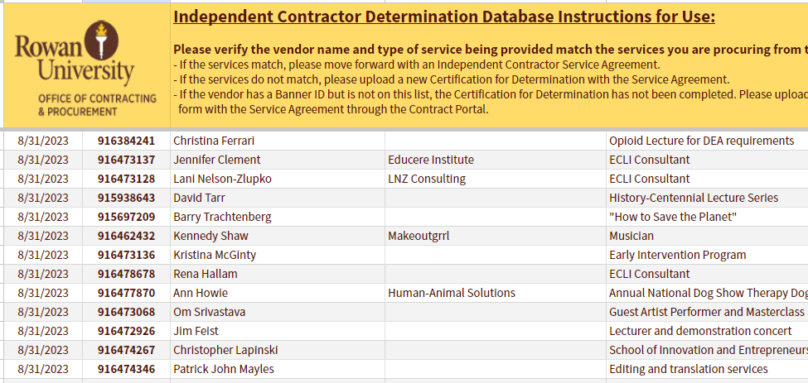
Independent Contractor Determination Database
Use to check pre-existing determinations on file

Slide 19
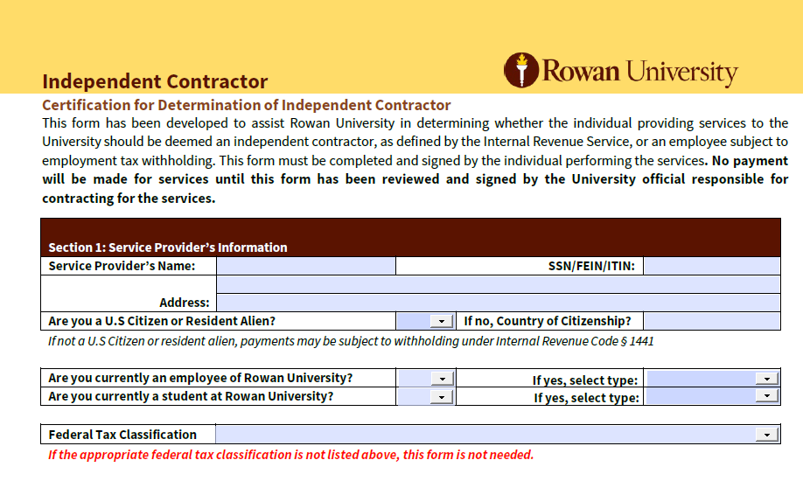
IC Certification for Determination Form
Updated form should be completed digitally
No longer requires departmental signature

Slide 20
Vendor Portal & Contract Portal
Vendor Portal | Contract Request Portal
Use to: Establish new vendor Set up an individual for payment/reimbursement Request the reactivation of a terminated Banner ID** Set up a student to receive prize money, stipend, etc. | Use to: Submit an agreement for by Rowan legal Obtain authorized signature on agreement

Slide 21
Existing Vendor
Identify Banner ID
Check Independent Contractor spreadsheet for determination status
Ensure scope of services matches determination approval
Complete IC agreement
Submit contract through contract portal
Submit requisition

Slide 22
Existing Vendor – No Determination on file OR Services do not match determination
Complete independent contractor agreement details
Send vendor the IC determination form and IC agreement
Submit agreement and IC determination form through the contract portal
If determined to still be an independent contractor
  Contract must be completed
If determined to be an employee
  Next steps sent via email

Slide 23
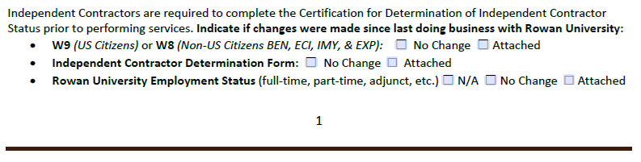
IC Service Agreement Template
Updates to Agreement Template
  Vendor must complete this portion at the bottom of page 1

Slide 24
New Vendor – No Banner ID
Submit New Vendor Intake packet and Independent Contractor Determination Form through Vendor Portal
Banner ID will be received once the vendor is built and determination is made
If determined to be IC
  Complete IC agreement
  Submit agreement through contract portal
  Submit requisition
If determined to be an employee
  Next steps will be sent via email

Slide 25
Independent Contractor Resources
Information for Independent Contractors can be found here: https://sites.rowan.edu/hr/independent_contractor/index.html
Includes:
  IC Policy
  IC Powerpoint
  Certification for Determination (IC Checklist)
  All required forms for both IC and employee.
  IC Workflow
Questions regarding IC determination: independentcontractor@rowan.edu
Questions regarding new vendors: vendors@rowan.edu

Slide 26
Payment Processing
Invoice and PO# needs to be sent electronically to invoices@rowan.edu for processing
  Vendor can utilize the Independent Contractor Payment Request Form if they do not have an invoice to provide
  Start & end date of the service need to be provided if not listed on the invoice
  NOTE: The vendor needs to provide actual receipts for any reimbursable portion (ex. travel or cost of supplies).
    If this is the case, we recommend setting up the requisition with two lines: 1 for the service/consultant fee and 1 for the reimbursables.
    If receipts are not provided, the vendor will be sent a 1099 on the entire amount of the payment.
Invoices are paid on a Net 30 basis unless otherwise stated on the contract
  Vendors receive payment on or within 30 days of the invoice date which is the date services were completed

Slide 27
Electronic Receiving
If receiving is required in order for the payment to be processed (regular purchase order utilized):
  Automated daily emails are sent if receiving is incomplete
  AP sends out reminder emails to process receiving
  See Quick Reference Guide on Receiving

Slide 28
Payment Verification
Utilize Banner Screen FOIDOCH to review the status of a particular document (can search by a requisition #, purchase order #, invoice #, or a check #)
  If the invoice states “Receipt Required” = either electronic receiving was not done on a PO or there may be an issue with the receiving document (Y number)
  If the invoice states “Approved” = invoice is approved, but payment has not been disbursed
  If the invoice states “Paid” = payment has been disbursed
    There will be a corresponding check disbursement document (CHK #)
Utilize Banner Screen FAIVNDH to review all of the payments processed to a vendor
  Utilize Banner Screen FOIDOCH to review the status of a particular document (can search by a requisition #, purchase order #, invoice #, or a check #)
For detailed step-by-step instructions on utilizing these screens, visit Invoice Payments

Slide 29
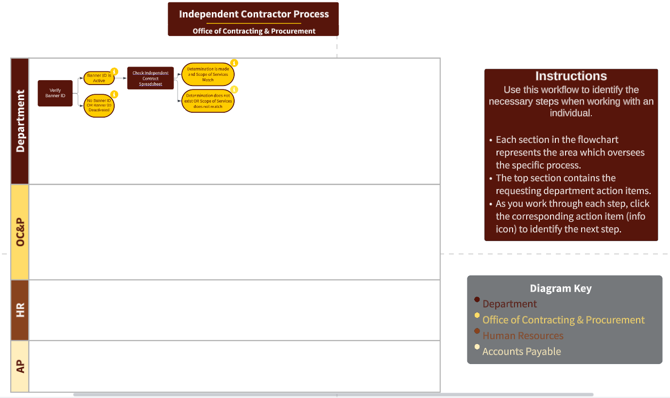
Independent Contractor Workflow
Interactive workflow to identify process for each IC

