Slide 1
Purchasing Card (P-Card)
Program Training
Policies and Procedures

Slide 2
Purpose of the P-Card Program
  The P-Card program has been established to provide an alternative method for authorized business purchases that benefit the University’s mission of education, research and public service.

Slide 3
Goals
Understand the purpose of the P-Card program.
Understand Rowan University policies governing the P-Card program.
Discuss how these rules apply in the context of purchases and transactions.

Slide 4

Definitions
Program Administrator
  Administers and oversees P-Card program. Reviews all transactions for procurement compliance.
Accountholder
  Responsible for all purchases and administrative tasks regarding the P-Card account.
Proxy Reconciler
  Mirrored access to Accountholder. Can complete tasks on behalf of Accountholder.
Approver
  Reviews all purchases for designated Accountholder(s).
  Approves/disapproves transactions based on departmental budget and goals.

Slide 5

Policies
P-Cards are the property of Rowan University and are to be used for University business only.
Only full-time employees are eligible for P-Card accounts.
All P-Card purchases must be shipped directly to the University and shall remain the property of the University.
Any purchase made outside of this policy becomes the sole liability of the Accountholder.
P-Card Accountholders are responsible for providing justification for each P-Card transaction.

Slide 6
Policies, continued
Rowan University receives various discounts from numerous vendors for products and services. The use of P-Cards, in many cases, voids discounts and tax-exempt status. Accountholders are responsible for ensuring sales tax charge is removed at the point-of-purchase. Should the vendor be unable to remove or refund the tax, the effort must be formally documented within the system.
Neglect or abuse of the P-Cards will result in cancellation of the card.
Fraudulent use of the card will result in disciplinary action up to, and including, termination of employment.
Please review the University Purchasing Card policy on the Office of Contracting and Procurement website.

Slide 7

Additional Considerations
If the card is issued with the intended use of supporting a department, college, or division, the P-Card’s safety and usage remain the sole responsibility of the employee whom the account is linked to (Accountholder).
All P-Card Accounts require an Approver. The Approver’s position must be a higher reporting-level than the Accountholder.
Several models of blocking schemes and spending limits are available and are determined by Accountholder job title and position.
Purchase transactions may not be split into multiple transactions to avoid the single transaction limit ($15k). Such activity is illegal and constitutes improper use of the card. The Accountholder will be subject to P-Card suspension and/or termination.

Slide 8
Additional Considerations, continued
Departments are permitted to use the P-Card to cover meal expenses incurred when hosting Candidates at local restaurants. The Provost office will cover expenses for (3) candidates (per faculty line) for full time faculty only. The limit of reimbursement is $200.00 per candidate per search for meals (this includes candidate meals during travel). If total (including tip) exceeds this amount, the difference will not be reimbursed. For further details, refer to the Candidate Reimbursement Policy and associated Procedures.
All Candidate reimbursements aside from Marriott and Gourmet Dining will be processed via Electronic Non-PO Forms.
All departmental budgets must be taken into consideration while using the P-Card.
New Jersey State and University procurement and budget procedures must be followed.

Slide 9

Allowable Purchases
The P-Card should only be used as a supplement for items that are not available through a Banner purchase order, in extreme emergencies, or with vendors who do not accept any other form of payment. Types of acceptable purchases are:
  Entertainment and dining, with approved Entertainment Form and Gourmet Dining waiver, if applicable.
  Emergency situations, with prior approval from the Office of Contracting and Procurement (OC&P).
  Vendors who are compliant, but do not accept POs, check or ACH payments, or issue invoices.
  Membership, registrations, and job posting fees.
  Travel accommodations, with limitations
  Public Notices
  Job Postings

Slide 10

Prohibited Purchases
Alcohol
New Jersey and Florida Sales Tax
Personal purchases
Cash advances
Approved Banner vendors
  Use the PO process whenever possible.
Travel-related meals
Fuel for personal vehicles
Textbooks
Gifts or food for University employees
Shipping to personal addresses
Unapproved IRT-related items, including hardware, software, and accessories
Hazardous, radioactive, or controlled materials and substances
On-campus purchase (Gourmet Dining, Rowan Foundations or Clubs)
Personal cell phones, cable, and Wi-Fi (some circumstances are allowed, determined only by OC&P)
Donations and sponsorships

Slide 11
Day Travel
Approved
  Local transportation (trains, subway, etc.)
  Parking
  Cabs/Uber
  Registration fees
Prohibited
  Meals
  Incidentals
  Fuel for personal vehicles
  Tolls
Day travel requires travel justification be included in the comments section of transaction

Slide 12
Overnight Travel
Encumbrance approval email must be attached to transaction.
Approved
  Hotels
  Transportation
  Parking
  Registration Fees
  Cabs/Uber
  Car rentals
    Fuel for rentals only
Prohibited
  Meals
  Incidentals
  Fuel for personal vehicles
  Tolls
  *Non-Reimbursable Travel Expense List (Available in AP’s Travel Policy)

Slide 13
Non-Reimbursable Travel Expense List
Airline or VIP club membership dues or one-day admission fees
Airline/car rental upgrades
Airline Seating: Main Cabin Extra, Preferred Seating, Delta Comfort (i.e. Extra Leg Room)
Air phone usage
Alcoholic refreshments
Baby-sitting or childcare costs
Barbers and hairdressers
Car repairs/routine maintenance or locksmith charges
Car washes / oil change
Clothing or toiletry items
Credit card delinquency fees/finance charges/annual fees
Day Travel Meals
Early Bird Check In
Excess baggage costs related to personal property
Expenses related to vacation or personal days taken before, during, or after a business trip
Frequent flyer mile (airline tickets purchased, partially purchased or accommodations and upgrades obtained using frequent flyer miles)
Helicopter services for local travel/entertainment
Hotel Suite
House sitting
Laundry or cleaning expenses
Loss or theft of cash advance money or airline tickets
Loss or theft of personal funds or property
Lost baggage
Luggage and briefcases
Magazines, newspapers, personal reading materials
Medical expenses while traveling
Movies
Optional travel protection or baggage insurance
"No show" for hotel or car service
Parking Lot Services (i.e. White Glove Service)
Parking or traffic violations
Personal accident or property insurance
Personal entertainment
Pet care / Boarding
Prescription (Refills)
Recreational expenses
Saunas, massages, spa visits, gym
Shoe shines
Souvenirs or personal gifts
Trip cancellation insurance
Uber / Lyft Premium Service

Slide 14

Accountholder Responsibilities
Must complete trainings before card is issued.
Accountholder is responsible for recapturing NJ and FL sales tax.
Report lost or stolen P-Cards to the customer service number listed on the card and the P-Card Administrator.
Notify P-Card Administrator of any changes to departmental position and responsibilities as they relate to the P-Card.
Accountholder must set up a PIN upon activating the card. PIN entry may be required at checkout and cannot be bypassed.
Accountholder must any report fraudulent charges to both Bank of America and the Program Administrator.
Accountholder will follow the Banner vendor setup process once State thresholds are met.

Slide 15

Transaction Process Overview
  Make purchase using P-Card.
  Finalize transaction in Works ® (allocate, receipts, sign-off).
  After Accountholder sign-off, transactions are reviewed and signed-off by the Approver.
  After Approver sign-off, transactions are reviewed for compliance by the Program Administrator.
    Corrective action must be taken for any transaction that is flagged (disapproved) by either the Approver or the Program Administrator. Failure to do so may result in card suspension.
    Only remove flags once the issue has been resolved.

Slide 16

Accountholder Responsibilities, Works®
Process for finalizing a transaction
  Allocate to the correct FOAPAL.
  Upload itemized receipts.
  Upload additional approvals or include in comments (IRT, Entertainment, Concur Approval, Gourmet Dining Waiver, etc.)
  Add any additional comments.
  Complete Accountholder sign-off.

Slide 17

Accountholder Responsibilities, Works®, continued
Transaction Allocation
  The Accountholder must ensure all transactions are fully allocated with the correct Fund, Organization, Account, Program, and Justification.
  Once complete, the transactions must be signed-off on.
  This must be completed by 4 p.m. on the ninth (9th) day of each month In the event the 9th falls on a Saturday, Sunday, or holiday, transactions must be completed by 4 p.m. on the last business day before the 9th.
  Accounts with transactions that are not fully allocated by this date will be immediately suspended.

Slide 18

Accountholder Responsibilities, Works®, continued
Receipts
Accountholder must collect and reconcile charge receipts for all P-Card charges.
Receipts must be detailed and itemized.
Receipts must be uploaded to Works®.
Transactions that do not have a corresponding itemized receipt become the liability of the Accountholder and may require reimbursement at the discretion of the Office of Contracting and Procurement.
Accountholder departments are required to retain original credit card receipts for three calendar years. Receipts may be stored off-site after three years, but must remain accessible for seven years.

Slide 19

Accountholder Responsibilities, Works®, continued
Approvals
  All P-Card transactions are subject to the same approvals as a purchase order including IRT and Entertainment.
  All approvals (IRT approval, Entertainment Form*, Gourmet Dining Waiver, Concur Approvals, etc.) must be either uploaded as a receipt.

Slide 20

Proxy Reconciler
A Proxy Reconciler may be appointed at the request of the Accountholder.
The Proxy Reconciler will have mirrored access to the Accountholder with the ability to allocate, upload receipts, and sign-off on transactions.
Ultimate responsibility for these tasks remains with the Accountholder.

Slide 21

Approver
The Approver must review all transactions for his or her designated Accountholder(s) each month.
The Approver must approve or flag each transaction based on the budget and goals of the department.
Unapproved transactions should be flagged and sent back to the Accountholder with direction on specific corrective action to be taken.
Once the transaction has been resolved, it should be re-reviewed and approve or re-flagged by the Approver.
Failure to review and approve transactions on a regular basis may result in the suspension of the Accountholder’s card.

Slide 22
Reconciliation
  Transactions will post to Banner mid-month following the purchase post date.
  Example:
    Purchase made on March 31st
    Transaction posts on April 1st
    Foapal will be charged mid-May
  Credit limits are renewed on the first of the month.
  Funds will be with held from your available credit until they have been finalized in Works.

Slide 23
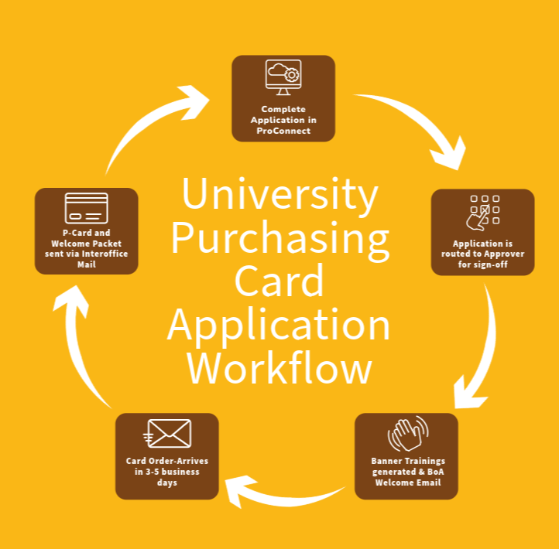
Requesting a P-Card
  Purchasing Card Request/Change Form is available in ProConnect, under Purchasing Card Forms.
  Card will be ordered upon completion of Banner trainings.

Slide 24
Account Changes
Any changes to the account must be reported to the Program Administrator via the Purchasing Card Request/Change Form. Forms must include all signatures.
Changes include:
  Proxy Reconciler change
  Approver change
  Accountholder department change
  Spending limit increase request
  Account cancellations

Slide 25
Pro Tips
Treat your card as if it is your personal account
Activate your card and set up your PIN immediately
Monitor your available credit
BoA Global Card Access app
Transaction comments- the more, the better! (Why are you using the card)
Supporting documentation must be clear and uploaded to each transaction (approvals, receipts, forms, waivers, etc.)

Slide 26
Purchasing Card Forms defined
Purchasing Card Application – Request, replace, or update a P-Card account.
P-Card Authorization Form – Borrow OC&P’s P-Card if your department doesn’t have one.
Purchasing Card Credit Limit Increase Request– Request a temporary credit limit increase.
Purchasing Card Missing Receipt Affidavit – Report a lost or misplaced receipt(not applicable for travel).
Purchasing Card Override Request – Request a one-time override for ITAP related purchases and transactions that decline due to a blocked MCC Code.
Purchasing Card Used Equipment Request – Request approval to buy used goods with a P-Card.

Slide 27
Program Administrators
Nicole Johnson johnsonn@rowan.edu x.65174
Kristine Rivera riverak@rowan.edu x. 64172
Stacie Mori mori@rowan.edu x. 64504
Thank you!
Program Primary Contact
pcard@rowan.edu

