Slide 1
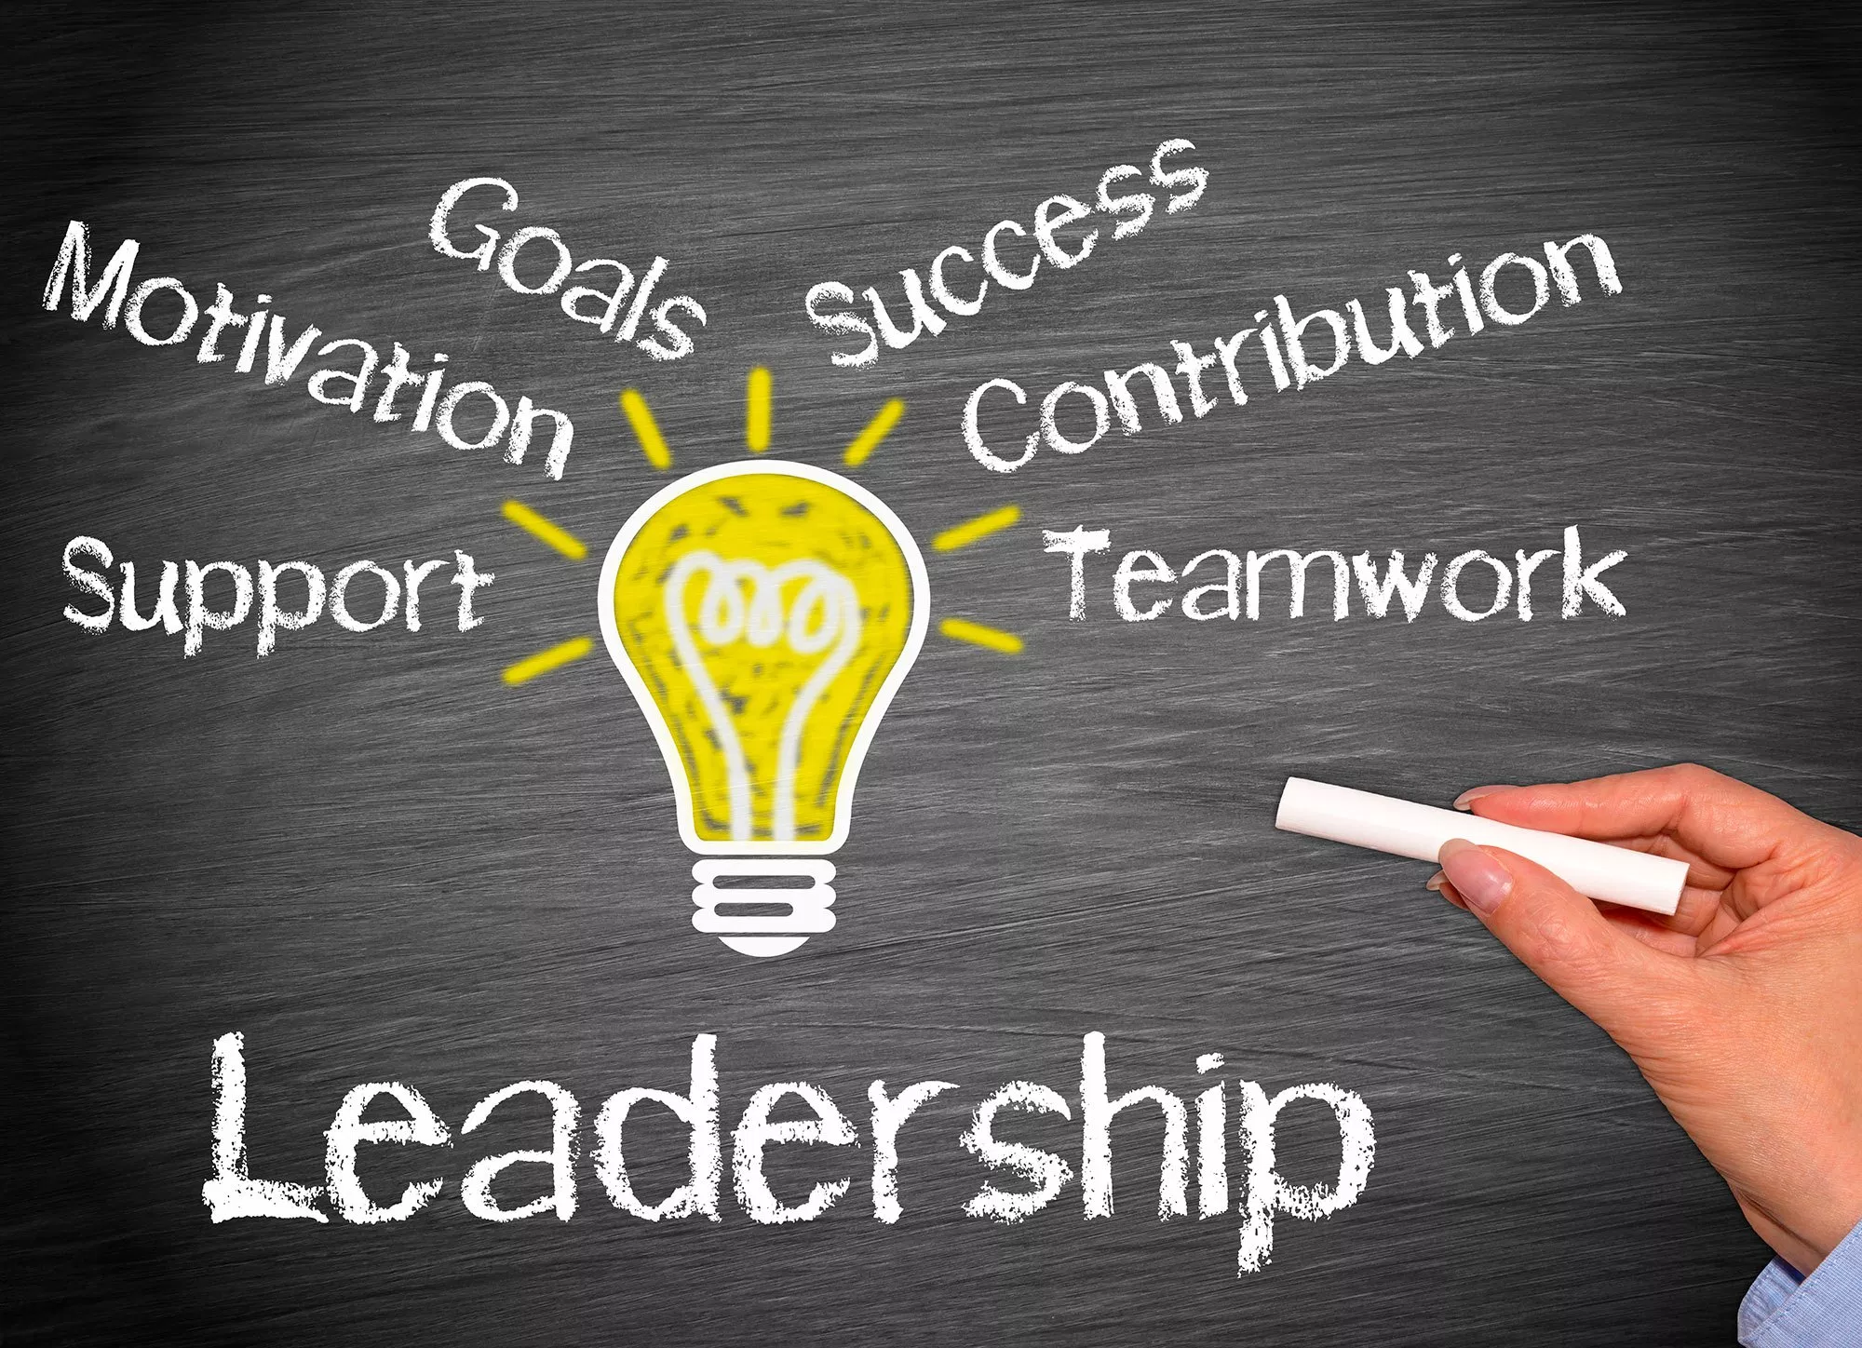
Teambuilding and Positivity in the Workplace
The Office of Human Resources

Slide 2
Agenda
Building Collaboration and Teamwork
Positivity in the Workplace

Slide 3
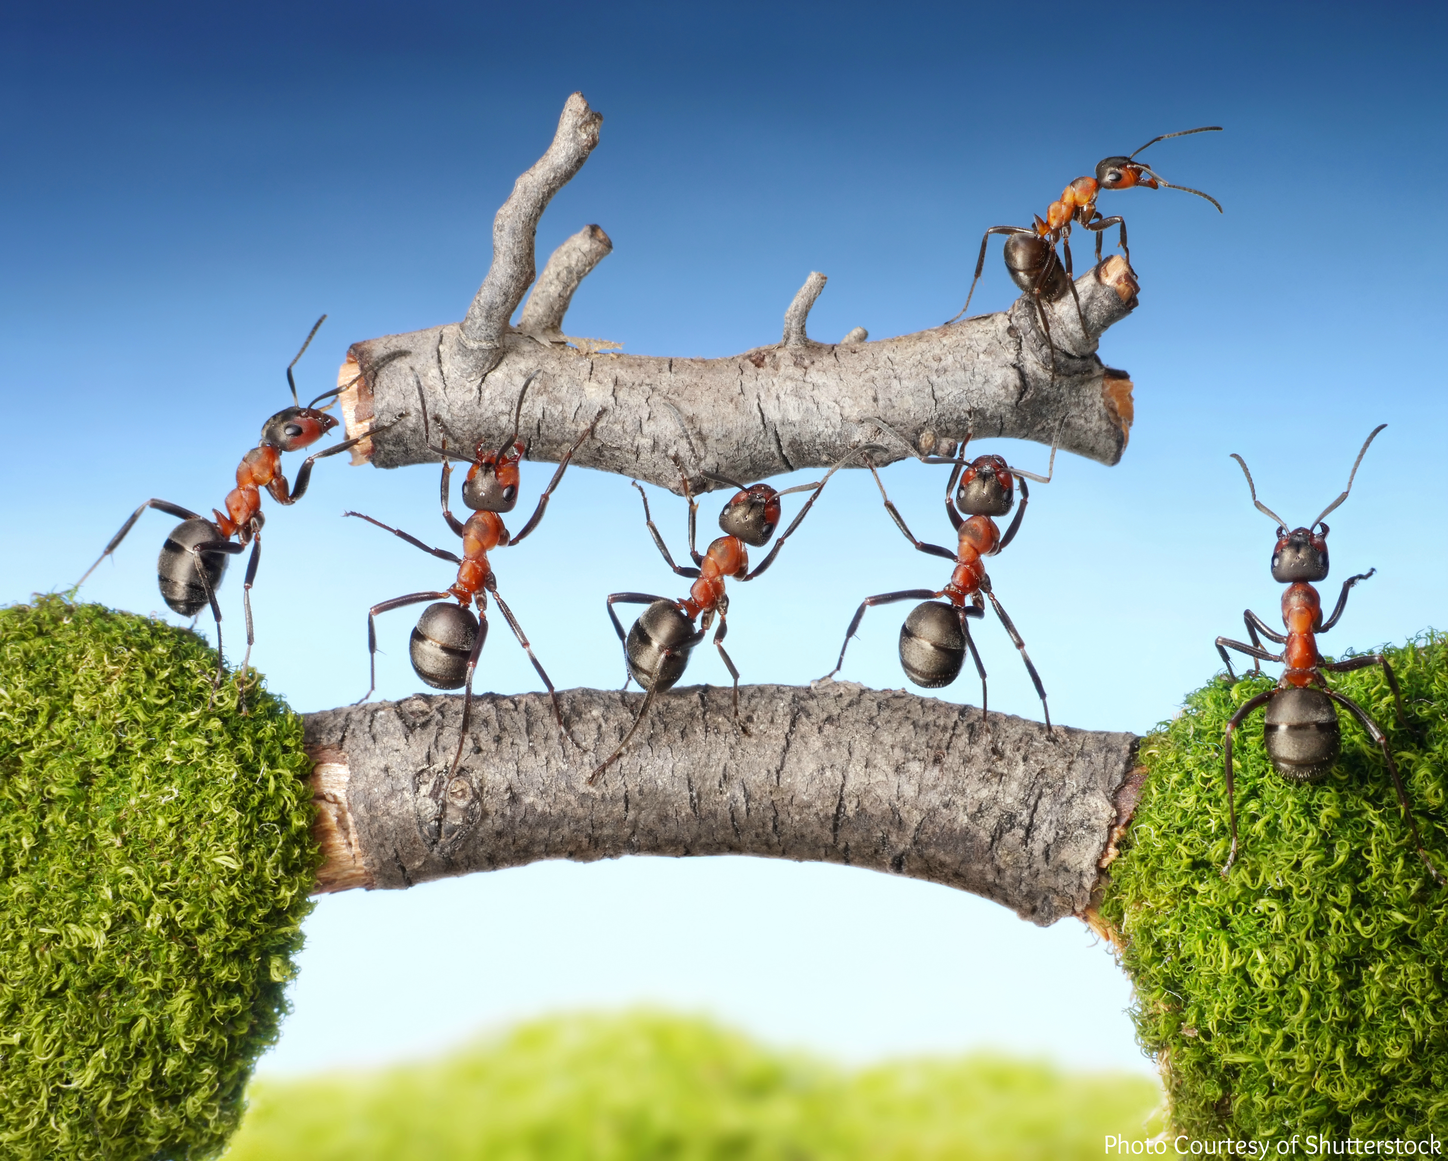
Building Collaboration and Teamwork

Slide 4
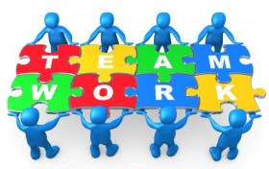
Tuckman’s Stages of Group Development
Bruce Tuckman completed significant research into the theory of group dynamics.
He received his Ph.D. in Psychology from Princeton University.
Tuckman believed that these stages are all necessary and inevitable in order for a team to grow, face up to challenges, tackle problems, find solutions, plan work, and deliver results.

Slide 5
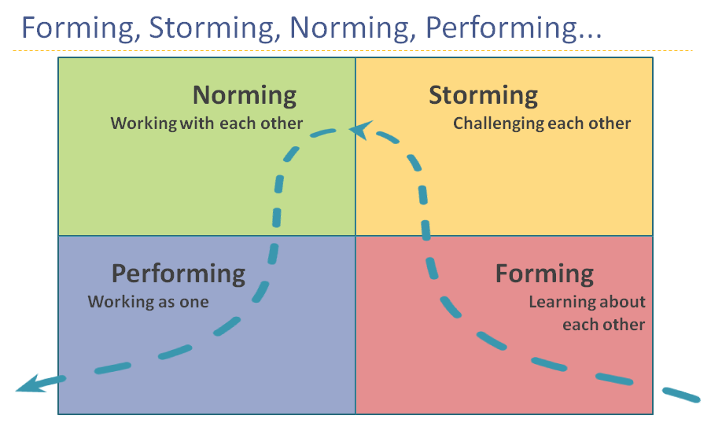

Slide 6
Stage One – Forming
Description: Stage in which team members are introduced and overly polite and pleasant.
Common Characteristics: Questioning, socializing, displaying eagerness, focusing on group identity and purpose, and sticking to safe topics.
Members are often guarded in their interactions because they’re not sure what to expect from other team members (similar to Orientation day at school or a new job).
Good time to learn about individuals’ skills and background, as well as goals, job responsibilities, etc.
During this stage, productivity is typically lower than expected.
Notes:
Jeremy

Slide 7
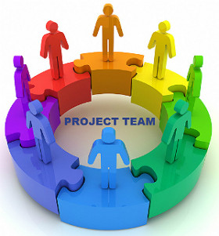
Forming – Enhance Team Development by:
Sharing responsibility
Encouraging open dialogue
Providing structure
Developing a climate of trust and respect
Notes:
Jeremy

Slide 8
Stage Two – Storming
Description: May be characterized by competition and strained relationships among team members. There are various degrees of conflict dealing with issues of power, leadership, and decision-making.
Common Characteristics: Resistance, lack of participation, conflict, competition, and high emotions
Often starts where there is a conflict between team members' natural working styles
If the way the team will work has not been clearly defined, people may feel frustrated or overwhelmed.
The most critical stage for the team
The Goal: Prevent discontents and increase the team’s strength!
Notes:
Jeremy

Slide 9
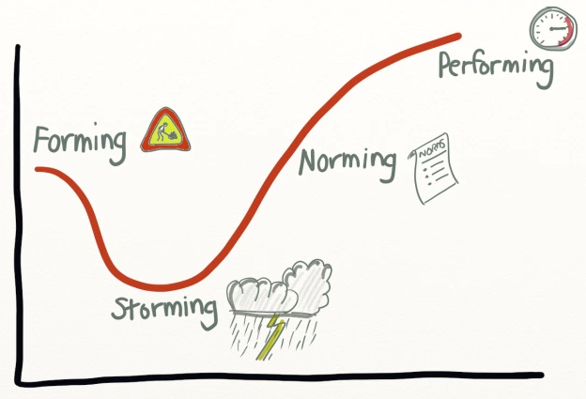
Storming – Enhance Team Development by:
Joint problem solving
Discussing different points of view – helps avoid Group Think!
Remembering that most teams experience conflict; disagreements are normal and expected.
Not skipping this stage to avoid conflict! Avoidance usually makes things worse.
Having Decision-making procedures
Encouraging two-way communication
Supporting collaborative team efforts
Notes:
Jeremy

Slide 10
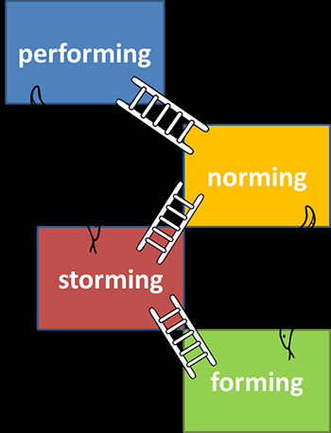
Stage Three – Norming
Description: Characterized by cohesiveness among members. In this phase, members realize their commonalities and learn to appreciate their differences.
Common Characteristics: Reconciliation, relief, lowered anxiety, members are engaged and supportive, cohesion developing
Functional relationships are developed resulting in the evolution of trust among members.
Important to promote exchange of opinions amongst team members.
Notes:
Jeremy

Slide 11
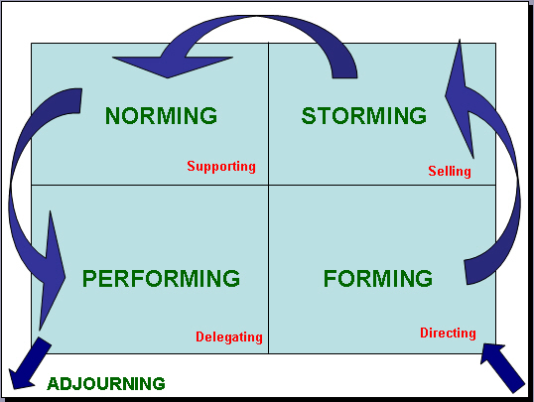
Norming - Enhance Team Development by:
Communicating frequently and openly about concerns.
Encouraging members to manage the team process.
Giving positive and constructive feedback to each other.
Supporting consensus decision-making efforts.
Managers should delegate appropriately to increase team efficiency – be aware of each member’s strengths when delegating.
Notes:
Jeremy

Slide 12
Stage Four – Performing
Description: The team now possesses the capability to define tasks, work through relationships, and manage team conflicts by themselves.
Common Characteristics: Demonstration of interdependence, ability as a team to effectively produce, and balance of task and process orientation
Communication is open and supportive. Members interact without fear of rejection.
Leadership is inclusive and shared. Different viewpoints and information are shared openly.
Conflict is now viewed as a catalyst that generates creativity in the problem-solving process.
Notes:
Jeremy

Slide 13
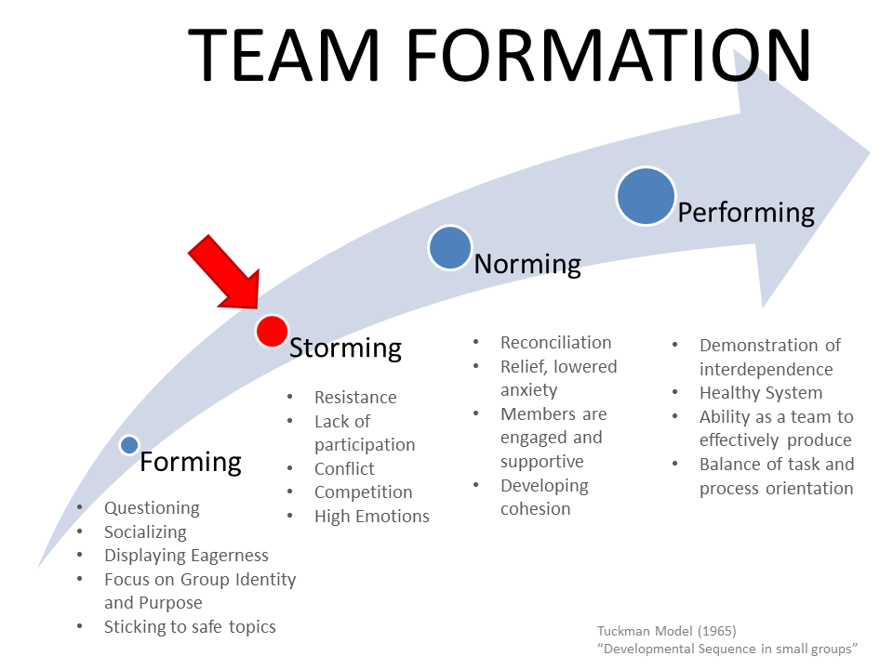
Performing – Enhance Team Development by:
Offering feedback when requested
Supporting new ideas and ways for achieving outcomes
Encouraging ongoing self-assessment
Developing team members to their fullest potential
Looking for ways to increase the team’s capacity
Notes:
Jeremy

Slide 14
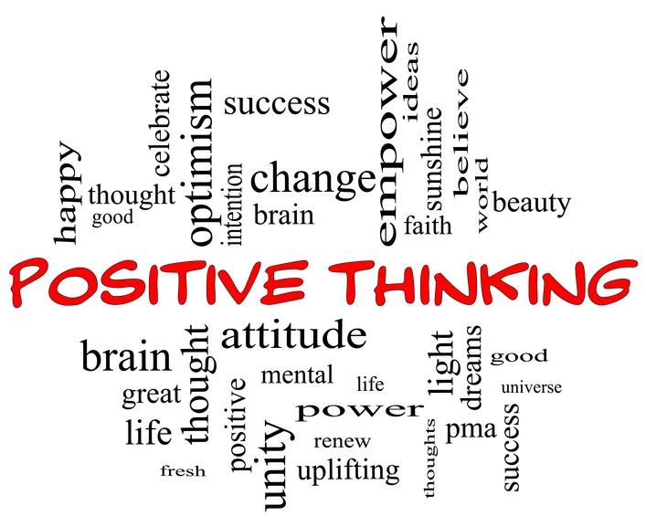
Positivity In the Workplace
Notes:
Jeremy

Slide 15
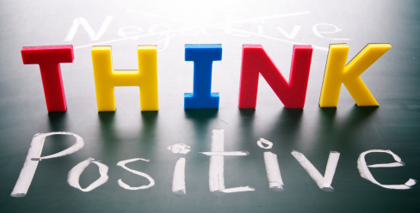
Positive Teams Are More Productive
What does a positive team look like?
Care for, are interested in, and maintain responsibility for colleagues as friends
Provide support for one another, including offering kindness and compassion when others are struggling
Avoid blame and forgive mistakes
Inspire one another at work
Emphasize the meaningfulness of the work
Treat one another with respect, gratitude, trust, and integrity
Notes:
Jeremy

Slide 16
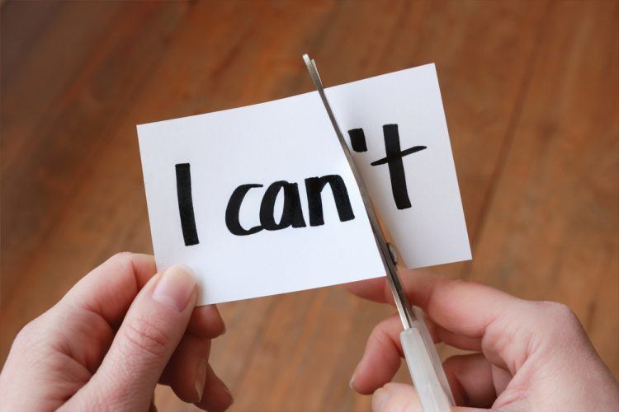
Positive Teams Are More Productive
How does a positive team benefit the individual & the organization?
Increases positive emotions
Buffers against negative events
Attracts, retains, and bolsters employees
Increases organizational effectiveness
Increases your coping abilities and builds resilience
Spreading positivity will strengthen your mindset, as well as those around you
Notes:
Jeremy

Slide 17
Tips for Promoting Positivity in the Workplace
Show gratitude –
Seeing the positive qualities in others helps bring out the positive qualities in yourself
Gratitude can transform your way of thinking
Helps develop respect, trust, and mutual appreciation among peers
Examples: Complimenting colleagues, spreading random acts of kindness, and the Gratitude Jar.
Use positive messaging –
Positive messaging means using words that are laced with optimism – more impactful
Communicating in this way will change the way your listeners receive your feedback
It should be personal, encouraging, passionate, and empowering.
Practice thankfulness –
We all crave recognition or praise for our efforts. A simple “thank you” goes a long way. Being specific is even better!
Make it a habit to thank someone for their work daily, but keep it genuine. Learn to realize when you are thankful for something. Did a colleague’s idea from a meeting truly inspire you? Did someone go out of their way to make your day even just a little bit easier? Send them a quick email or stop by their desk and let them know.
Notes:
Jeremy
Gratitude: Staff Meetings – At the end of each staff meeting we pass the gratitude jar

Slide 18
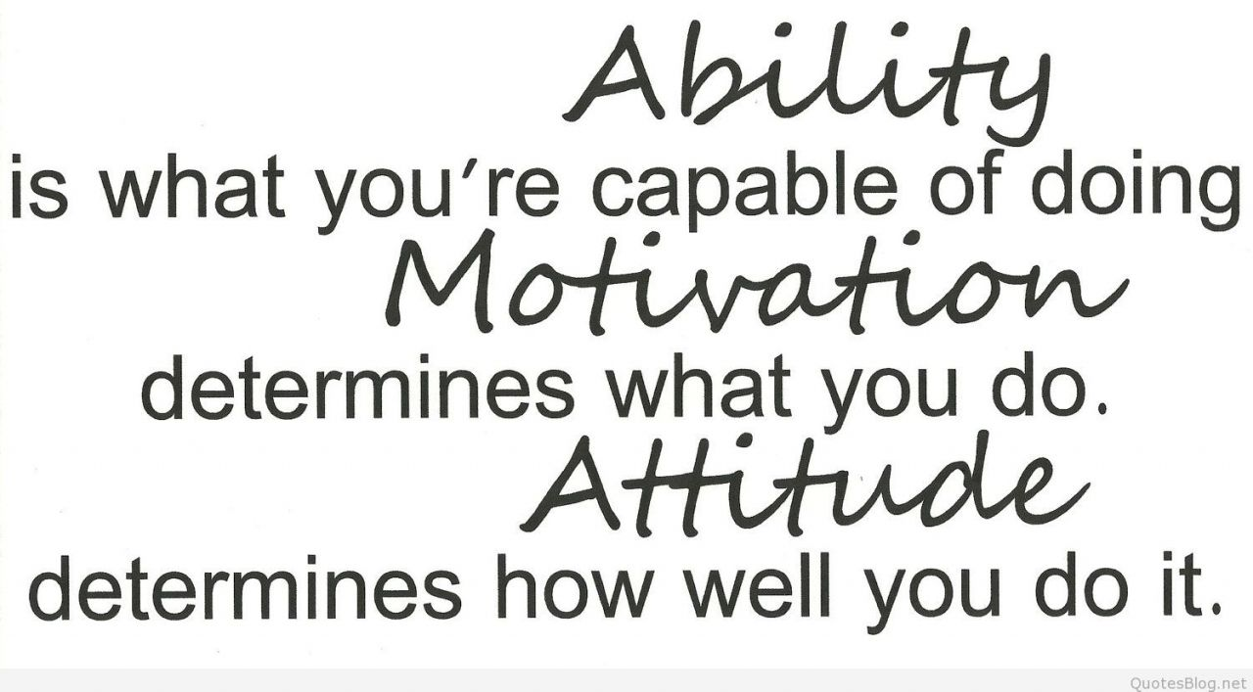
Promoting Positivity - More Tips:
Appreciate the little wins – It’s easy to celebrate a major milestone, but remembering to celebrate the steps along the way can be difficult. Every goal requires smaller steps of action, and most of the time those actions get overlooked. Remember to appreciate the little wins and give recognition to the employees who might be “behind the scenes” of a big accomplishment.
Smile – Even when you don’t feel like it; it can help boost positive thoughts and feelings. A genuine smile is contagious.
Develop healthy work relationships – Essential for a positive work environment. Find ways to create kinship among your colleagues. Social gatherings and regular check-ins at work are great ways to develop these relationships.
Notes:
Jeremy

Slide 19
Promoting Positivity - Another Tip:
Recognition – Recognizing accomplishments can have a major impact.
Examples:
Put a note of thanks on an employee’s computer or desk
Greet co-workers every morning
Recognize someone at every staff meeting
When you hear a positive remark about someone, repeat it to that person as soon as possible (Face-to-face is best, e-mail or voice mail are good in a pinch)
Practice positive nonverbal behaviors that demonstrate appreciation, such as smiles, or a handshake
Start a suggestion program
Publicly recognize the positive impact on operations of the solutions employees devise for problems.
NOTE: The Managers Toolkit on the HR page of the Rowan website has a Recognition Toolkit that has a lengthy list of simple ways to motivate and recognize co-workers.
Notes:
Jeremy

Slide 20
Group Discussion
What are the group dynamics strengths of your teams?
What are the areas to work on?

Slide 21
Action Plan
What will you do to implement a concept from today’s session?
When will you do this?

