Slide 1

Strategies for Managing Communication & Conflict

Slide 2
Agenda
Statistics
The Communications Model
4 Word Build Activity
The Interaction Process
Conflict Management
Handling Common Conflicts Activity
Thomas-Kilmann Conflict Mode Instrument
Tips for Tackling Workplace Conflict
Action Plan

Slide 3
Alarming Statistics
Managers said they spend, on average, 18% of their time — more than seven hours a week or nine weeks per year — intervening in employee disputes.
$359 Billion in paid hours or the equivalent of 385 million working days are lost each year to workplace conflict
85% of employees deal with conflict on some level; 29% almost constantly
34% of conflict occurs among front-line employees
49% of conflict is a result of personality clashes and “warring egos”
34% of conflict is caused by stress in the workplace or heavy workloads
25% of employees have seen conflict result in sickness or absence
9% have seen workplace conflict cause a project to fail
Notes:
Bullet 1 – Accountemps survey, 2017
Bullet 2 – Workplace Conflict and How Businesses Can Harness It to Thrive
All other bullets – Robyn Short

Slide 4
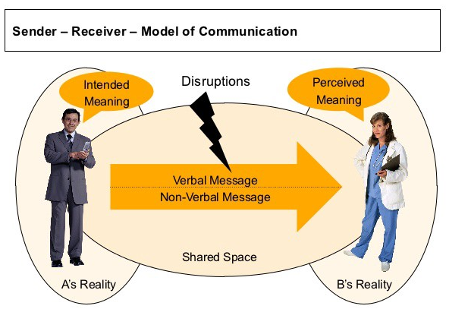
Communications Model
Notes:
Give me an example of a time when you’ve had a conversation that you thought you and the other person had the same understanding, and ultimately you found out that it was not true.
Explain model- sender/receiver, all the noise in between- frameworks, backgrounds, socialization all become noise. They may or may not interfere with how we interpret communication
A’s Reality vs. B’s Reality
Intention vs. Perception
Verbal and non verbal

Slide 5

Sender/Receiver Interactions
Interpretation based on experience:
  Work/Industry background
  Acronyms
  Understanding of the topic

Slide 6
4 Word Build Activity
Observations about final words selected
How did you come to the decisions in your group(s) with regard to which ones to keep or drop?
Were you passive in one group and more active in another?
Did anyone try to dominate the conversation?
Any new insights into the original word (post activity)
How did you feel completing the exercise?
What did you learn from the exercise?

Slide 7
Assertive vs. Aggressive Communication
Assertive: those who put forth their needs and views confidently and directly. They stand up for themselves, but always consider the views of others.
  Behavior: Act with poise, include everyone, collaborate as a team
  In the Office: “Can you have this ready by Wednesday?”
Aggressive: forceful individuals with intentions of dominating others
  Behavior: Making commands or having too high an expectation of others
  In the Office: My way or the highway – “You will have this done by Wednesday!”
What is the difference?
Notes:
The core difference between assertiveness and aggressiveness is people awareness. Know your timing; judge the true reaction of those around you; and carefully consider the results of your prior patterns. If what you’re doing hasn’t been met with success before, pause before you take out your hammer/gavel once again to make your point. In the workplace, it’s better to dole out information and your case as you gauge reaction - than it is to risk a crash and burn.
As with so many things, how you package your information can easily overshadow your content. It’s unfortunate in many cases because you may have worked on a project for months, but if you approach senior management with your staff like a stampede expecting to take no prisoners, you’ll likely be the one shot down.
https://www.psychologytoday.com/blog/tame-your-terrible-office-tyrant/201305/how-be-assertive-not-aggressive

Slide 8
Assertive vs. Passive Aggressive Communication
Assertive: having/showing confidence and directness
  Behavior: Communicate honestly, directly, and with no hidden agenda
  In the Office: “Will you please file these documents?”
Passive Aggressive: showing indirect resistance to the demands of others and an avoidance of direct confrontation, hostility
  Behavior: Snide comments, stubbornness, deliberately not completing tasks
  In the Office: “After you finishing chatting or doing whatever it is you do all day, would you mind filing these documents? That is, if you are not too busy.”
What is the difference?

Slide 9
Nip Passive Aggression in the Bud
Learn to recognize passive aggressive behavior & don’t be lenient
  Examples: Sugarcoated hostility, sarcasm, the silent treatment
Set limits and follow through
  Make it clear that you will not tolerate the behavior
Speak specifically – not generally
  Confront the individual for specific actions and be clear about the issue at hand
Practice assertive communication
  Confident, nonreactive, and respectful
Notes:
http://www.huffingtonpost.com/2014/06/26/stop-being-passive-aggressive-behavior-signs-_n_5515877.html

Slide 10
Use the Interaction Process
Here’s an example:
Open – the purpose of this meeting is to determine our goals for the year
Clarify – in this step we are clarifying what goals we are working on for the year
Develop – consider each person’s input into the goals they present
Agree – agree on the goals that we are working on for the year
Close – So, in summary, we have decided to work on x, y and z goals
Notes:
Check for understanding!! Check for non-verbals!!!!!
Don’t make assumptions!

Slide 11

Keys to the Interaction Process
  Co-workers need to feel appreciated, listened to, understood and involved
  Maintain or enhance self esteem
  Ask for help and encourage involvement
  Share thoughts, feelings, and rationale (employees, esp. direct reports, like to understand the “why”)
  Provide support without removing responsibility (guide, don’t take someone off the hook)

Slide 12

Maintain/Enhance Self-esteem
Focus on Facts
  Instead of “you never follow through”, be specific
Respect and support others
  Even when performance isn’t their best, still provide support
Clarify Motives
  Ensure that they understand where you are coming from
Notes:
People need to feel respected and have a sense of self-worth.
High self-esteem produces confidence that frees people to be innovative and collaborative.

Slide 13
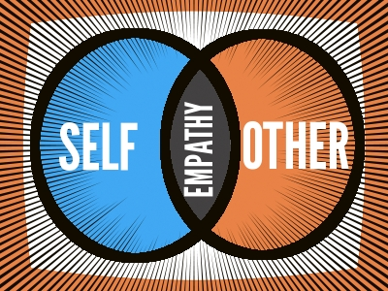
Maintain/Enhance Self-esteem
Acknowledge accomplishments and express confidence in their abilities.
Example:
  “Having you record open issues during our meeting kept us on schedule and enabled us to cover all agenda items. Thanks for your help.”

Slide 14

Ask for Help and Encourage Involvement
Utilize the expertise of co-workers by asking for their input with tasks/projects.
  Example:
    “With your experience working on similar equipment, what technical problems do you think we should address in the procedures manual?”

Slide 15
Keep your team in the loop
When possible, offer the “why”
Use good judgment – ask yourself if the information can be shared and if it will benefit the people involved.
  Example:
    “That’s right, Mary was promoted recently. And I realize you anticipated a promotion too, especially since you joined the organization at the same time. Let’s talk about some of the areas in which you can focus your development efforts in order to be considered for promotion in the future.”

Slide 16

Provide Support without Removing Responsibility
Help others “think” and “do”
  You’ve been working with this customer for 3 months and are most qualified to handle this problem. I know you’re concerned about staying in touch with the rest of the team while you work with him. What can I do to help there?

Slide 17
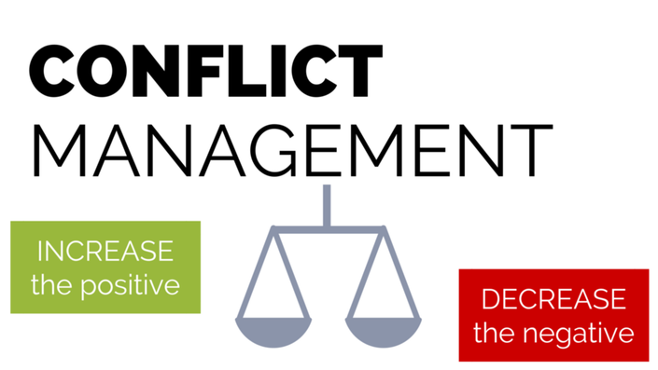
Conflict Management

Slide 18

Conflict Management
Definition of Conflict:
A fight, battle, or prolonged struggle; a controversy or quarrel
The truth about Conflict:
Conflict is inevitable; however the results of conflict are not predetermined.
Conflict might escalate and lead to nonproductive results, or conflict can be beneficially resolved and lead to high quality products.
Notes:
Although very few people go looking for conflict, more often than not, conflict results because of miscommunication between people with regard to their needs, ideas, beliefs goals and values
If we can learn to manage conflict then we are less apt to practice destructive behaviors, that will negatively impact our team.

Slide 19
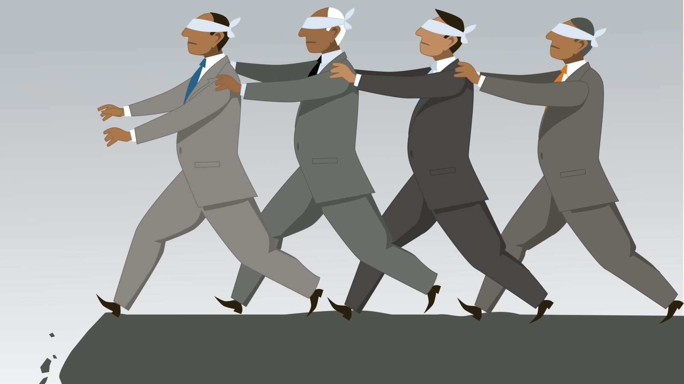
Why is Conflict Needed?
4 Vertical Lines Example
Helps raise and address problems
Helps people learn how to recognize and benefit from differences
Helps avoid “Group Think”
What are some negative effects of “Group Think”?
Notes:
Why might conflict be a good thing?? Then bring up bullets
Thinking gray is the antithesis of group think-
8 people were brought together in a room and shown a series of cards on which were printed four vertical lines. Each subject was asked in turn to identify which one of the 3 lines on the right side of the card was the same length as the line on the left side of the card. The experiment was arranged so that seven of the eight subjects were in fact ringers who would identify the same one of the right-hand lines as being equal in length to the left hand line, when in fact it was not. The one true subject was then faced with either going along with the judgement of the group and declaring as true something he knew to be false, or taking a position which was at odds with the consensus of his peers. Roughly ¾ of the subjects went against their better judgment and joined in with the false consensus at least once.

Slide 20
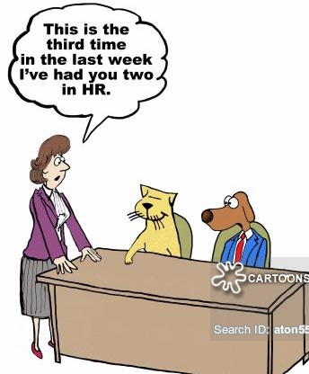
When does Conflict become a problem?
When it:
  Hampers productivity
  Lowers morale
  Causes more and continued conflicts
  Causes inappropriate behaviors
Notes:
Ask them to answer, then bring up each bullet

Slide 21

Managing Conflict – Supervisors
Most critical activity for effective conflict management:
  More informal one-to-one conversations with direct reports
  Acting as mediators
  Providing more clarity over expected forms of behavior
Notes:
Importance of trust!!

Slide 22

Conflict Exercise
Handling Common Conflicts Activity
Common Conflicts That Come up When Working Together on a Project or Task
  Personality differences
  Language barriers
  Age Differences
  Different energy levels
  Different opinions
  Practical challenges
What are some ways to deal with these common conflicts?

Slide 23
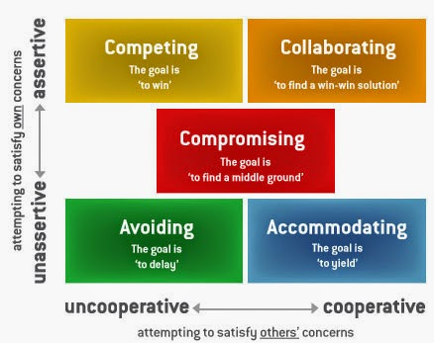
Thomas-Kilmann Conflict Mode Instrument
Notes:
Importance of trust!!

Slide 24
Styles
Avoiding – avoid whenever possible and withdraw when confronted
  Advantages: Could work or be best choice when an issue is trivial or when there is no chance of winning; allows involved parties to cool down; may allow others to resolve conflict more effectively (on their own)
  Disadvantages: Hoping issues will resolve themselves is not a good long term strategy in many cases. Can make a manager appear weak or not in control. Can cause long term damage with employee relationships;

Slide 25
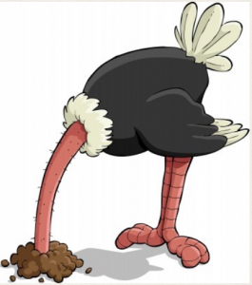
Overuse of Avoiding
Could result in:
  Lack of input from you
  Decisions made by default
  Festering issues
Notes:
Share your experiences with overuse of the avoiding mode and describe how these experiences made them feel

Slide 26

Styles
Accommodating – Accommodators give ground as a way of maintaining harmony
  Advantages: Time saver, helps avoid any unnecessary argument/tension; may be useful when harmony and stability are more important than the subject at hand
  Disadvantages: Concern for others overrides concern for self and empowers others to control the situation
Notes:
Accommodating- whereas avoiders stay away from conflicts, accommodators give ground as a way of maintaining harmony. Sacrificing one’s principles and putting harmony above dealing with important issues. If you are clearly wrong, giving up your original position can be a sign of strength, not weakness

Slide 27
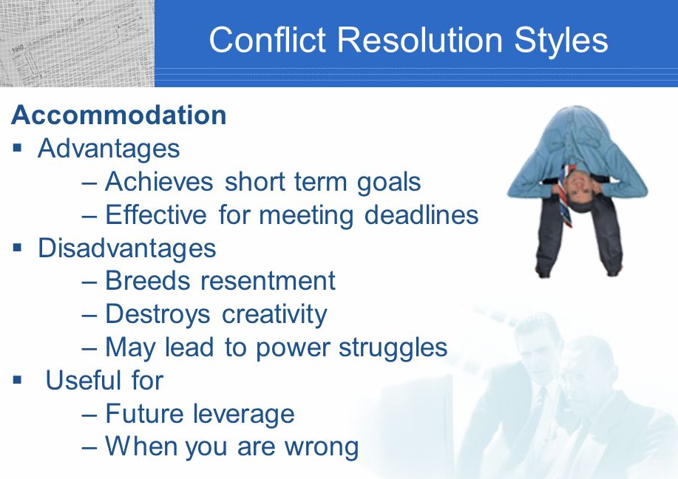
Overuse of Accommodating
May work against your own goals and objectives
Can be harmful to the relationship if one person always gives in and the other always gets their way
Notes:
Share recent situations when the accommodating mode was useful or not useful

Slide 28
Styles
  Competing: the only way for one party to reach its goals is to overcome the other; this is the “win-lose approach”; you act in an assertive way to achieve your goals, without seeking to cooperate w/ the other party;
  Advantages: when quick, decisive action is vital; when important issues where unpopular actions need implementing
  Disadvantages: generates ill will that is costly and unpleasant; workers whose needs are ignored are likely to resent their employer and act in ways that cost the organization.

Slide 29

Overuse of Competing
Could result in:
  Lack of feedback
  Reduced learning
  Low empowerment
  Surrounded by “yes” people
Notes:
Share your experiences with overuse of the competing mode and describe how these experiences made them feel

Slide 30

Styles
Compromising: each party sacrifices something he/she is seeking to gain agreement; this is the “lose-lose” scenario where neither party really achieves what they want;
  Advantages: it is cooperative, recognizing that both parties must agree to resolve a conflict
  Disadvantage: it is self-centered since the parties act in their self interest to get the best possible deal

Slide 31
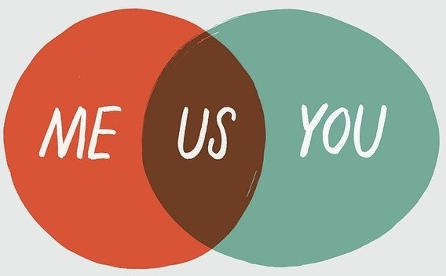
Critical Compromising Skills
Negotiating
Finding a “middle ground”/making concessions
Assessing value
When has compromising been effective for you? Not effective?
The trap is to fall into compromising as an easy way out, when collaborating would produce a better solution.
Notes:
This requires a moderate level of assertiveness and cooperation. It may be appropriate for scenarios where you need a temporary solution, or where both sides have equally important goals.

Slide 32

Styles
Collaborating: Working together to resolve conflicts; this is where you break free of the “win-lose” paradigm and seek the “win-win”
  Advantages: benefits are clear; not only can the issue at hand be resolved, but the relationship between parties is improved.
  Disadvantages: takes time and a mutually satisfactory outcome isn’t always possible.

Slide 33

Collaborating Skills
Ability to listen, understand and empathize
Identifying underlying concerns
When has collaborating been effective for you? Not effective?
Notes:
Share experiences in which collaborating is useful; now think about when collaborating was not effective and brainstorm some of the problems that can occur when collaborating is misused.

Slide 34

When conflict takes you by surprise…
Stop, Breathe and Think
Take it somewhere else
Despite best efforts, it may not work, elevate to your supervisor

Slide 35
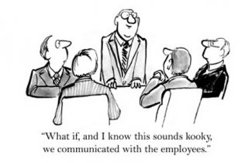
Tips for Tackling Workplace Conflict

Slide 36
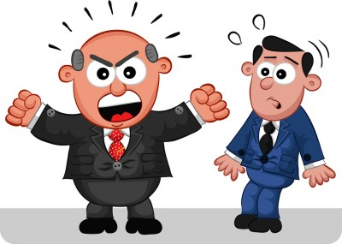
Tip 1: Tackle the issue after both parties have calmed down
Address issues before they escalate, but be sure to wait until things have cooled down
Difficult to have a productive discussion if you or your co-worker are angry or upset

Slide 37

Tip 2: Practice “active listening”
Example: You were passed over for a promotion that you felt you deserved
When you approach your manager, don’t just fire off your concerns
Hear he/she out – pay attention, ask questions, try to understand their perspective, and acknowledge the emotions you are feeling
Focus on what to work on; don’t dwell on it!
Seek to understand; be open-minded

Slide 38
Tip 3: Ask the other person to suggest a solution
Example: Holiday scheduling – equitable distribution
The manager could ask the team for what they think works best – what’s fair
Consider various approaches and be open to ideas other than your own
Agree on a solution that all parties will be satisfied with and then discuss a plan for next steps

Slide 39
Tip 4: Consider your role in the conflict
Example: You are the first to gossip about something you found out about a co-worker recently
Take responsibility for your actions
Try to forgive and forget when you are on the receiving end of this type of situation
Be able to let go and move on after addressing the problem
You and your co-workers don't necessarily have to be great friends, but you do need to be able to work together in a professional manner.

Slide 40
Tip 5: Contact HR if necessary
Example: Workplace harassment – based on age, gender, race, etc.
When direct attempts aren't effective, you may have to pursue formal channels
Talk to your manager and/or HR and follow the formal process for filing a complaint.
Document the problem in writing, being specific about what behaviors occurred, when they happened, what impact they had, and what needs to be done to resolve the conflict.

Slide 41

Review
Statistics
The Communications Model
The Interaction Process
Conflict Management
Thomas-Kilmann Conflict Mode Instrument
Tips for Tackling Workplace Conflict

Slide 42

Action Plan
What will you do to implement a concept from today’s session?
When will you do this?
What results do you expect and how will they be measured?
What assistance will you need to implement your plan?

