Slide 1
Effective Performance Reviews: A major factor in employee success and engagement
Jeremy Trowsdale
Human Resources
5/2020

Slide 2
DISCUSSION TOPICS
Common Supervisor and Employee Perspectives
Keys to Success
General Recommendations
System Overview (including Section explanations)
System Enhancements and Tips
New Hire Guidance
Process and Timelines
Questions and Support

Slide 3
Common Negative Supervisor Perspectives on Perf. Reviews
Delivering bad news is difficult/Employees may get defensive
My direct reports don’t take constructive criticism and professional development suggestions well
I don’t see the value gained through the process

Slide 4
Common Positive Supervisor Perspectives on Perf. Reviews
Builds rapport with my direct reports (being able to discuss their career, their progress, where they can improve)
Develops my skills as a Supervisor (writing, coaching, having challenging conversations, etc.)
Will facilitate my department staying on target with goals
Develops the skills of my direct reports (writing, goal setting, evaluating performance, etc.)
Can be used as a tool to manage and document performance improvement and performance issues;
Documentation is critical when an employee’s performance is subpar

Slide 5
Common Negative Employee Perspectives on Perf. Reviews
It’s a meaningless exercise that Managers just want to get through
There’s always one negative focus area and then little about anything else
It’s rarely a two-way discussion
The basis for measurement is vague
My manager has a minimal understanding of what I do every day

Slide 6
Common Positive Employee Perspectives on Perf. Reviews
Receiving feedback is a growth opportunity that will improve my overall performance
It’s scheduled time to discuss my career plan, professional development options, and other concerns
The process will sharpen my skills (evaluating my performance, writing, performance discussions, etc.)
The process ensures that I am on target with goals and daily responsibilities

Slide 7
Reviewer Keys to Success
Demonstrate respect and confidentiality
Encourage conversation at the review meeting
Track performance year-round, positive and negative events (Suggestion: use the Notes button – can be used for both the employee and supervisor)
Consider more one-on-one meetings with direct reports to discuss goal progress, performance, etc. – helpful with preventing annual review surprises.
Ratings and narrative regarding subpar performance must be accurate; if not, the behavior is unlikely to change!
Ensure you avoid recency bias! The review should truly be an annual review;
Example: Great performance for 11 months of review period, 1 mistake in the last few weeks before review is written by supervisor = subpar review and vice-versa – not fair, but often happens!

Slide 8
Avoid the Halo/Horns Effect
Definition: a type of cognitive bias where a person’s impression of another can substantially influence one’s thoughts and feelings about that person.
Perf. Rev. Example: Modern studies have shown that managers who rate an employee high in one or two key areas of performance tend to give favorable scores in all aspects of performance. The same goes for those managers that rate employees poorly in one certain area; they tend to see a worse rating overall.
Best way to avoid: Strong documentation; take notes on all aspects of performances throughout the year. Having a healthy list of positive and not-so-positive aspects of performance gives the manager a more well-rounded view of the employee.
Without notes, managers can tend to base their evaluations around one event or a recent memory of events.
What have you found to be the most important keys to ensuring successful performance reviews?

Slide 9
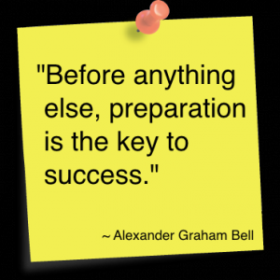
Planning/Preparation
Review the following beforehand:
Last year’s Managerial Performance Review (available in the system)
Current review period accomplishments
Any Written counseling documentations (if applicable)

Slide 10
Writing the Review
Briefly describe performance results (provide supporting examples if necessary).
Explain how you did/did not meet your goals (Self-Eval. perspective); Supervisor should state more than just “Agreed”
Document and discuss accomplishments, strengths and areas needing improvement (Self-Eval. and Supervisor)
If self-evaluation doesn’t list a key professional development opportunity that would be beneficial, identify for the employee.
Plan and schedule follow-up with goals (if applicable) – demonstrates to the employee the intent to support and ensure goals are met.
No Surprises! The review should be a recap of the feedback the employee has been given throughout the year.

Slide 11
Writing the Review
Make reviews constructive, specific and focused on performance, not personality
Vague | Specific
You frequently miss tasks and project deadlines. | The ABC report that was due on October 15th was received on November 8th. The XYZ project was due on December 31st and was turned in on January 22nd.
You seem to make a lot of errors. | During August, you made five errors on the monthly report, three errors on the customer service letter, and routed four calls incorrectly.
You are never at your desk. | I went by your office four different times yesterday and you weren’t there.

Slide 12
Writing the Review
Another example:
Instead of:
“You have good communication skills.”
Consider:
“Your verbal and written communication is clear, accurate and thorough. The monthly reports you submitted were complete, easy to understand and required little to no modification. You can further enhance your presentation skills by taking a training course on Effective Presentations.”

Slide 13
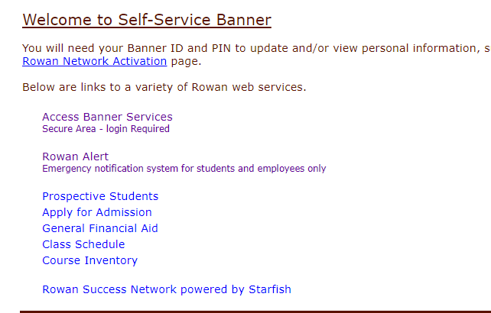
Completing the Managerial Performance Review
System Access:
Self-Service Banner (SSB) – Click on Employee tab, click on Employee Dashboard, enter network credentials, click Manager Employee Menu in bottom right corner, and you will see the Managerial Review Form link.

Slide 14
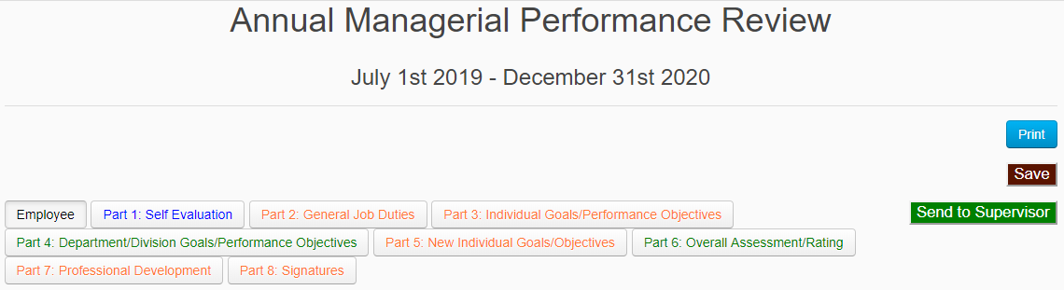
Completing the Managerial Performance Review
Color coding to assist with completion
Black: Reference Only
Blue: Managerial Employee only
Green: Supervisor of Managerial Employee Only
Red: Both

Slide 15
Completing the Managerial Performance Review
Part 1: Self Evaluation
(Blue indicates to be completed by Mgr. employee only)

Slide 16
The Importance of the Self-Evaluation
Your Manager may not have all the facts
They may not be maintaining a list of your accomplishments throughout the year
Even worse, they may only be remembering the one project you were unsuccessful with this year
Ultimately, the person with the most knowledge of what you do at work is you
You and your manager might not be on the same page
Your self-evaluation may cause your manager to see your performance in a different light
By recommending goals for the upcoming year, you have the opportunity to drive your area in the way you see best
Allows you the opportunity to recommend the professional development plan that makes sense for your role

Slide 17
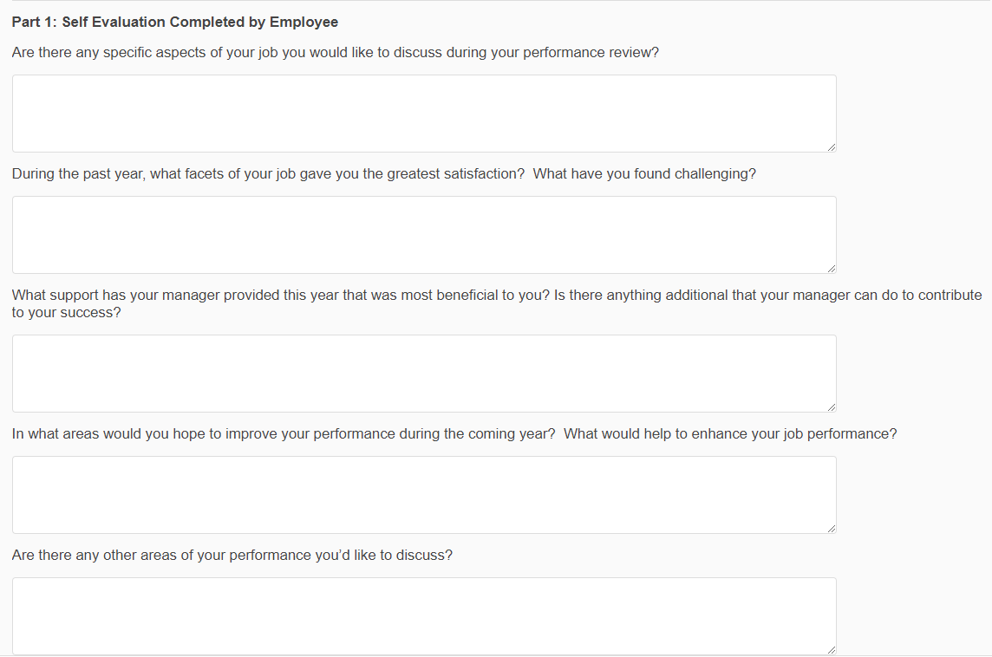
The Self-Evaluation

Slide 18
Completing the Managerial Performance Review
Part 2: General Job Duties
Red indicates the Supervisor of the Mgr. employee will complete ratings and comments and the Managerial employee will edit any Duties/Responsibilities if necessary
Note: If the Managerial employee didn’t receive a review last year, they will have to fill in the Duties/Responsibilities

Slide 19
Performance Review Sections
General Job Duties (Part 2) – 4 to 5 major areas for which the employee has responsibility
Mgr. employee does not provide narrative; Rating and comments completed by Supervisor of Mgr. employee
Comprised of what the employee does, oversees, or both (brief description)
Note: If employee received Mgr. Rev. last year, the verbiage from last year will already be there (it is moved over from prior year review);
Supervisor can edit the responsibilities if needed; new hires and transfers will need their duties/responsibilities data entered

Slide 20
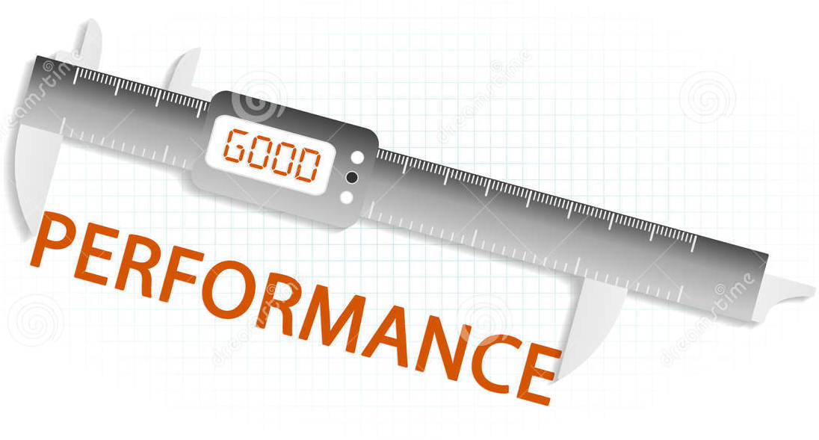
General Job Duty – Example
Administration & Training for performance management
Expectation (Description of the job duty)
- Oversee the ePAR process and monitor compliance of ePAR forms
- Advise supervisors regarding performance issues and the applicable documentation
- Ensure training programs are held on a regular basis
- Develop and maintain regular performance management workshops for managerial employees
- Track compliance of managerial forms

Slide 21
The Ratings System
Significant Achievement: Employee performance is consistently excellent and exceeds expectations. Demonstrates very high level of performance in all areas of responsibility. Viewed as a role model in position. Demonstrates high levels of effort, effectiveness, and judgment.
Full Achievement: Performance consistently meets the appropriate level of expectations. Consistent, ongoing accomplishment of goals and ongoing work responsibilities; successful in terms of expected work output, quantity/quality and contribution to unit success.
Partial Achievement: Performance did not consistently meet expectations or at times was below expectations. Inconsistent job performance related to goal achievement, quality, quantity of work and/or the individual is not yet technically proficient or does not show sustained and continuing progress toward achieving proficiency, ongoing work results, or goals.
Unacceptable Achievement: Performance did not meet most objectives and/or did not demonstrate results at the expected level. Termination for cause is likely unless performance materially improves promptly.
The Ratings System descriptions seen above are on the Employee tab in every performance review.

Slide 22
Completing the Managerial Performance Review
Part 3: Individual Goals/Performance Objectives
Red indicates both the Mgr. employee and their supervisor will be completing part of the section

Slide 23
Ind. Goals/Performance Objectives
Employees who received a Managerial Review last year: The goals that were set in last year’s performance review carry over to the new review. Provide input on your performance as it relates to these goals. If a goal was changed during the year, edit accordingly.
Employees who did not receive a Managerial Review last year: The employee will either fill in the goals given by their supervisor since their hire date, transfer date, etc. or leave the section blank if they are a recent New Hire or have not received goals.
Supervisors: Either select N/A in the Ratings dropdown menu or rate the goals accordingly. Add Comments to substantiate the rating.

Slide 24
Completing the Managerial Performance Review
Part 4: Department/Division Goals/Performance Objectives
Green indicates the supervisor of the Mgr. employee will be completing the section

Slide 25
Department/Division Goals/Performance Objectives
Supervisor completes before Mgr. employee writes their individual goals – ensures individual goals are aligned with Department/Division goals
Click “Department/Division Goals” on Home screen and add each goal one by one; on Part 4 of each employee’s review, select each department/division goal on the dropdown box and the description will flood in automatically.
Beginning October 1, Mgr. employee can begin Self-Evaluation, Supervisor can begin Department/Division Goals; once Department/Division goals done, Mgr. employee can complete their individual goals and finalize their self-eval.

Slide 26
Completing the Managerial Performance Review
Part 5: New Individual Goals/Objectives
(Red indicates the Mgr. employee and possibly their supervisor will be completing part of the section)

Slide 27
Goal Setting Guidelines
Goal setting in partnership is an effective strategy. The Review system is designed accordingly.
Potential Issues with Manager completing solely:
The employee feels left out of the process
Limited buy-in from the employee
Resentment towards the manager may develop
Potential Issues with Employee completing solely:
Misalignment with overall organizational/departmental goals
Goals may be focused on existing strengths of employee rather than challenging the employee to grow in other areas that are outside his/her comfort zone

Slide 28
Goal Setting Guidelines
Goal setting in partnership should ensure the goals:
Align with University/Department objectives
Offer a fair amount of challenge
Create buy-in from both parties
Are more project than task list oriented
Things to consider when writing goals:
- What steps the employee will take … by when?
- What steps the supervisor will take … by when?
- Criteria for assessing success
- Process to track and review plan

Slide 29
Completing the Managerial Performance Review
Part 6: Overall Assessment/Rating
Green indicates the supervisor of the Mgr. employee will be completing the section

Slide 30
Overall Assessment/Rating
Supervisor provides an overall performance summary (narrative) and an overall rating for the employee – it should be brief
The Managerial employee doesn’t complete any part of this section.

Slide 31
Completing the Managerial Performance Review
Part 7: Professional Development
(Red indicates the Mgr. employee and possibly their supervisor will be completing part of the section)

Slide 32
Professional Development
Completed by employee as a draft, supervisor to edit.
What type of professional development would add value to the employee’s role at Rowan?
Examples: certifications, new job tasks, new projects, training classes, other education, etc.

Slide 33
Completing the Managerial Performance Review
Part 8: Signatures
Red indicates both the Mgr. employee and their supervisor will be completing the section

Slide 34
Signatures
Signatures Order: Supervisor, Employee, (system will allow employee to sign first also), and finally, the Division Head (if applicable).
Note: The Employee signature only acknowledges receipt of the review, not necessarily agreement. The employee should use the Comments section to document concerns.

Slide 35
Miscellaneous
Spellcheck: Words underlined in red are misspelled; there isn’t a spellcheck button to click to check the whole document
Click “Return to Employee for Editing if Needed” to have the employee make changes.
Click “Ready for Review” to finalize and move on to your in person meeting
New Hire Goal Sheet for New Hire Managerial employees – available on the HR website
Outside of system, easy option to provide goals to a New Hire that starts mid-cycle
Form mirrors New Individual Goals section in system (Part 5)

Slide 36
What’s new this year?
Removed DOB data entry from signature process (unnecessary and sometimes causes issues)
Changed “Complete” status to “Awaiting Division Head Signature” to prevent confusion
Removed the Part 1 Self-Evaluation question that asks about being up to date on ePARs and reviews, feedback, etc.
Changed the rating term “Significant” to “Outstanding”
Made the fields in Part 3 not mandatory so it’s no longer necessary for New Hires to type in N/A for all the fields (it will prevent the confusion it sometimes causes if the New Hire forgets to type N/A)

Slide 37
System Tips
Upon completion of all of their sections, the Employee should click “Send to Supervisor” to notify the supervisor they can begin their sections.
If you are done your part of the review and click “Send to Supervisor” or “Review with Employee” and it says you need to fix your errors, check to ensure you have filled out every comment field and selected a rating or N/A. Boxes that are incomplete will have a red outline if they are the reason for the error.
You will receive automated E-mails when a Status changes or the Employee “Sends to Supervisor” because they are done their portion of the performance review. The Subject Line will summarize the E-mail purpose (see below).

Slide 38
System Tips
The Save button saves your work; it does not allow for saving to a computer drive.
You can save reviews to a drive if you need to, but only in pdf format. The process:
Click the Print button, click Change, select Save as PDF, click Save, and select the drive and folder.
Ensure all electronic signatures have been completed. The review won’t go into Final Status until that is done.
To add the electronic signature, click “Electronically Sign”.
Ensure all of your direct reports’ reviews are in a Final status before closing the door on this year’s reviews.

Slide 39
New Hire Guidance
For this unique review period (7/1/2019 to 12/31/2020), use your judgement regarding the inclusion or exclusion of ratings
Probably a solid guideline would be New Hires hired 7/1/2020 or later would not receive ratings
Electronic signatures should be completed for all reviews.
Benefits of completion for New Hires:
Provides an opportunity for the new Managerial Employee and their Supervisor to agree upon and document goals (if not previously done)
The New Employee receives a progress update.
Facilitates next year’s review
Carry-over of information put in this year to next year’s review

Slide 40
Managerial Performance Review Flowchart
Available on the Rowan website; click Employees (top of the page), scroll to the bottom and click Office of Human Resources, click Training (on the left), and click the link “Managers Toolkit”.

Slide 41
Process and Timelines – 2019-20
Review based on performance between July 1, 2019 and December 31, 2020
June 1 – June 30 – Meet with your Manager to discuss any necessary adjustments to the goals set last year; make any necessary edits to Part 3 and save the updated version – just this year
December 1 – December 31 – Department/Division goals are completed; Managerial employees complete self-evaluations and submit their portion of the evaluation process by December 31st.
January 1 – February 12 – Supervisors finish evaluations, review evaluations with division heads and hold meetings with direct reports (can begin earlier if the self-evaluations have been submitted)
Summary of Review Sections
Part 1 – Self Evaluation – Managerial Employee
Part 2 – General Job Duties – Supervisor, unless employee is a New Hire or edits are needed to the duties
Part 3 – Individual Goals/Performance Objectives – Both
Part 4 – Department/Division Goals/Performance Objectives – Supervisor
Part 5 – New Individual Goals/Objectives – Managerial employee, unless supervisor would like to edit
Part 6 – Overall Assessment/Rating – Supervisor
Part 7 – Professional Development – Managerial employee unless supervisor would like to edit
Part 8 – Signatures – Both

Slide 42
Questions/Support
Call or E-mail:
Jeremy Trowsdale – System/Technical questions and verbiage, ratings, or goal suggestions
Example: If an employee’s review is missing from the system or a reporting relationship needs to be corrected

