Slide 1

Effective Performance Reviews
A major factor in employee success and engagement

Slide 2

Discussion Topics
Part 1:
Performance Review Experiences
Effective Performance Reviews Guidance
Feedback and Phrasing Recommendations
Part 2:
NEOED Perform System Overview
Part 3:
New Hire Guidance
Process and Timelines
Support and Resources

Slide 3

Part 1: Performance Review Experiences, Guidance, and Feedback Recommendations

Slide 4

Performance Reviews: What Works – and What Doesn’t
Pair & Share
Think about a previous performance review you found helpful – what made it work?
Now think about one that didn’t – what got in the way?
Notes:
“Before we get into the system and the process, I want to start with our experiences. Most of us have given or received performance reviews, and they’re not all the same. A quick reflection will help ground our conversation today.”
“What’s interesting is that most of what makes reviews helpful or frustrating isn’t the form—it’s how the process is used. Today, we’ll focus on how NEOED Perform is designed to support the good practices you named and reduce some of the common pain points.”

Slide 5

What Makes a Performance Review Effective
Demonstrate respect and maintain confidentiality
Approach the review meeting as a two-way conversation
Track performance year-round – both strengths and growth areas
Provide regular feedback to avoid review-time surprises
Clear, specific narratives and accurate ratings drive improvement
Avoid Halo/Horns bias – rate each competency independently
Base ratings on observable behaviors and outcomes
Avoid recency bias – evaluate performance across the entire review period
Example: Great performance for 11 months, 1 recent mistake before review time = subpar review and vice-versa.
Prepare in advance for the review conversation

Slide 6
Effective Feedback: Specific Examples Matter
Ensure your comments are constructive, specific and focused on performance.
❌ Vague | ✅Specific
You frequently miss tasks and project deadlines. | The ABC report was due on October 15 and was submitted on November 8. Similarly, the XYZ project was submitted three weeks after the December 31 deadline. Let’s work together on strategies to improve planning and deadline management moving forward.
You seem to make a lot of errors. | In August, the monthly report contained five data entry errors, and the customer service letter included three formatting issues. Let’s review these examples together to identify patterns and reduce future errors.
You have good communication skills. | Your verbal and written communication is clear, accurate and thorough. The monthly reports you submitted were complete, easy to understand and required little to no revision. To further strengthen your skill set, you may want to consider a training course on Effective Presentations.

Slide 7
Say This Instead: Clear, Constructive Performance Review Language
When Avoiding Absolutes or Judgments
Instead of…
“You always / You never”
“Bad attitude”
“Difficult personality”
Say this instead…
“In several situations this year, I observed…”
“Here’s the specific behavior I want to discuss and its impact…”
“This behavior has made collaboration more challenging because…”
When Feedback Feels Vague or Subjective
Instead of…
“Lacks professionalism”
“Poor communicator”
“Not a good fit”
Say this instead…
“Professional expectations include X; in these instances, that wasn’t met…”
“In team meetings, key updates were often incomplete or unclear, which led to…”
“This role requires X; here’s where there’s a gap and what success would look like…”

Slide 8
Say This Instead: Clear, Constructive Performance Review Language
When Delivering Difficult or Developmental Feedback
Instead of…
“This shouldn’t be a surprise.”
“You need to fix this.”
“Leadership is concerned.”
Say this instead…
“This has come up before, and I want to be clear about where things stand now.”
“Let’s talk about what needs to change and how I can support that.”
“Here’s the feedback, and I want to walk through it with you.”
When Addressing Performance Compared to Expectations
Instead of…
“Everyone else is doing fine.”
“Meets expectations for now.”
“We’ll see what happens next year.”
Say this instead…
“Here’s how performance aligns with the expectations of the role.”
“You’re meeting expectations in X areas; growth is needed in Y.”
“These are the focus areas we’ll revisit in our next check‑in.”

Slide 9
Say This Instead: Clear, Constructive Performance Review Language
When Discussing Potential or Advancement
Instead of…
“Has potential but…”
“You’re not there yet.” – Too vague
“You’re lucky this isn’t worse.”
Say this instead…
“To be ready for the next level, these specific skills or experiences are needed…”
“Here’s what growth would look like over the next review cycle.”
“This rating reflects current performance against expectations.”
Effective performance language is specific, behavior‑based, and focused on impact and next steps.

Slide 10
Part 2: NEOED Perform System

Slide 11

NeoEd – Single Sign-on access
HR website > Organizational Development > Performance Management
NEOED Perform
Select Login with SSO on the NeoEd sign-in page.
Don’t enter your credentials in the Username and Password fields (you’ll receive an error message).

Slide 12
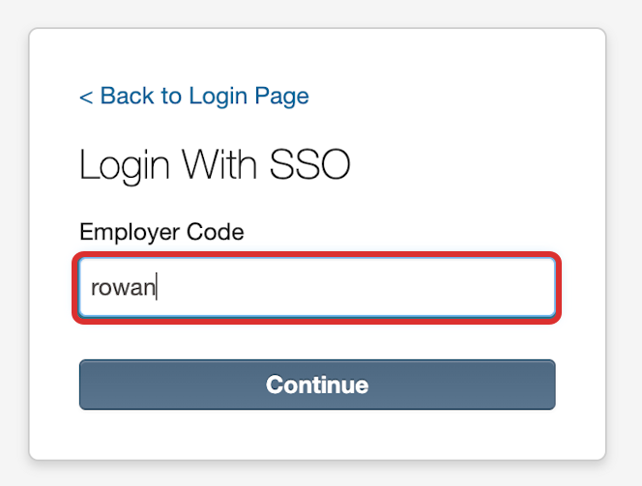
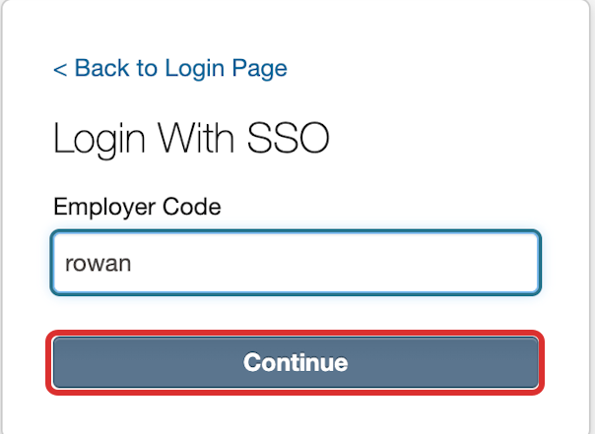
NeoEd – Single Sign-on access
Enter rowan, the field is not case-sensitive.
3. Select Continue.
Note: After this step, you will be brought to the NEOED Dashboard if you are already signed into other Rowan applications (Example: Banner).

Slide 13
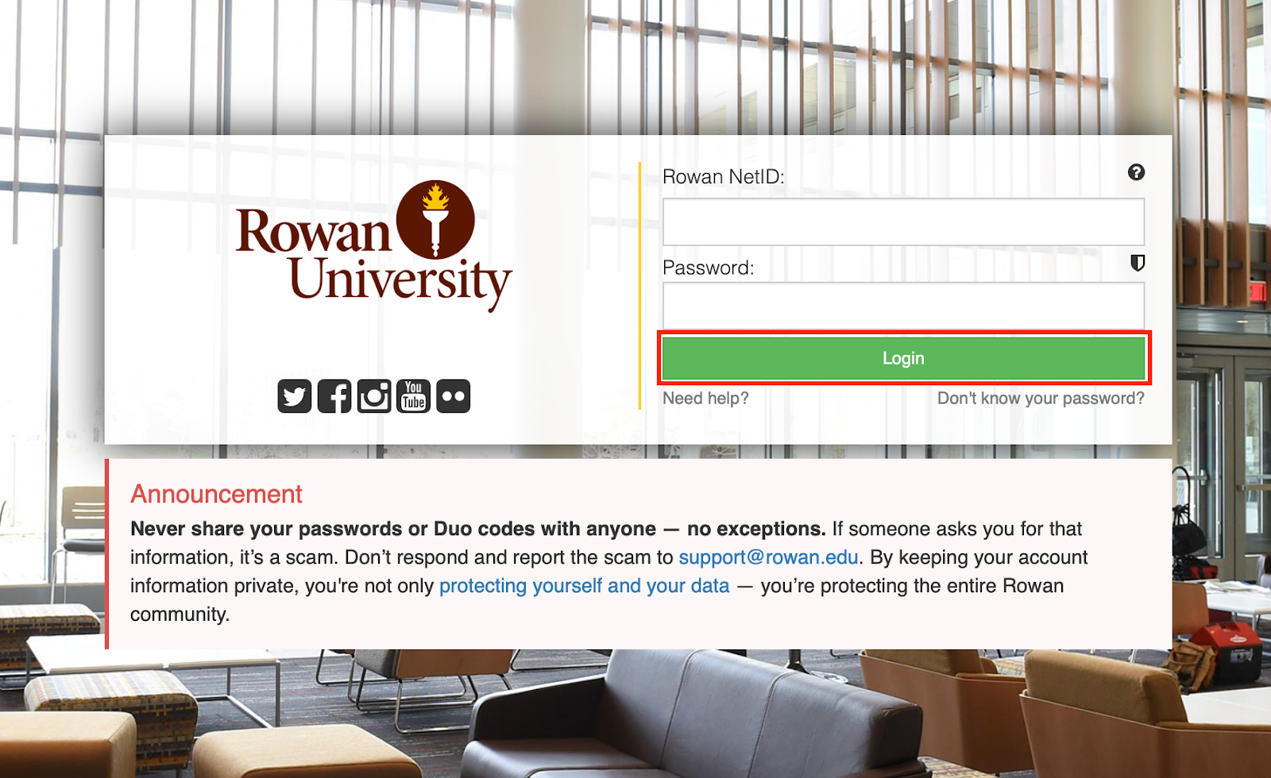
NeoEd – Single Sign-on access
When the Rowan log in screen appears, enter your Rowan NetID and Password, and select Login.
Enter Duo, if prompted.

Slide 14
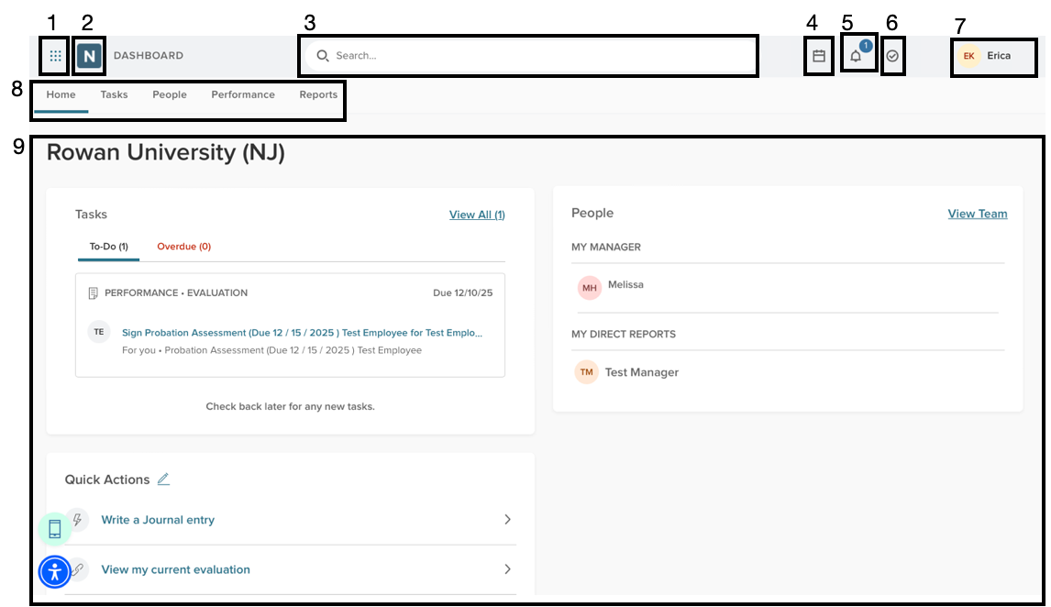
NeoEd – System Navigation
All users start on the Home screen, which reflects the employee point of view. The system consists of several menus and a dashboard. The dashboard contains links to other parts of the system that allow you to begin processes or sort and view information right from the dashboard.
2. NeoEd Logo - Takes you back to the home screen. 3. Search - Allows a user to search within the application. 4. Calendar - provides a view of the calendar of events.
5. Notifications - lists any notifications for actions you must take within NeoEd Perform, items to view, or indications that others have taken action or completed tasks.
6. Tasks - lists tasks that must be completed within NeoEd Perform. 7. User Menu - gives access to your user profile, password settings, and allows you to sign out.
8. Dashboard Tabs - Allows you to switch between dashboards and access your tasks, people, performance evaluations, and reports.
9. Dashboard - Gives an overview of the system, creating shortcuts to areas and actions.

Slide 15
Journal Entries
Ongoing notes linked to an employee record
Used to document achievements, concerns, and key events
Entries can include text, attachments, and prior documentation
May be shared with the employee or leadership (at creation or later)
To create a journal entry:
Go to Performance → Journal Entry (or from the Home tab)
Select the employee
Enter details, add attachments if needed, and click Submit Journal Entry
See the Managerial Reviews Knowledge Base article for more information

Slide 16
Completing the Managerial Performance Review

Slide 17
Managerial Review Workflow
Step 1: On June 1, the review form goes live in NEOED Perform and the Managerial Employee receives an e-mail alert that they can begin their self-evaluation.
Step 2: The Managerial employee completes and submits their self-evaluation by June 15.
Step 3: Their direct manager completes their part of the review form based on their team member’s self-evaluation and performance, makes any necessary changes to goals, and submits it by July 15.
* Step 4: If the Overall Rating is “Does Not Meet Expectations” or “Partially Meets Expectations”, the review is sent to HR for approval and a signature.
Step 5: The review is now viewable by the Managerial employee (to prepare for the review meeting with their manager).
Step 6: A task is system-generated for the Managerial employee’s direct manager to schedule a meeting to discuss the review with them.
Step 7: After the meeting has occurred, the direct manager marks the task as complete in Perform, adding the meeting date and any pertinent details of the meeting to the Comments section. They approve and sign the performance review.
Step 8: The form moves to the direct manager’s manager (2nd level) to review, approve, and sign.
Step 9: The form is sent to the Managerial employee to sign.
(Note: The entire review should be completed with all signatures by August 15.)
Step 10: The form is saved in NEOED Perform.

Slide 18
The Self-Evaluation
Why is it important to include a self-evaluation in the Managerial review form?

Slide 19
The Importance of the Self-Evaluation
Without your input, a single less-successful project might overshadow your broader achievements.
Opportunity to highlight your wins and progress throughout the year.
You are the most knowledgeable person about your daily work & impact.
Opportunity to propose a professional development plan aligned with your goals & role.
By suggesting goals for the upcoming year, you can help shape the direction of your work and team.

Slide 20
Entering the Goals for the Current Review Period
Enter the goals for the current review cycle (the preceding 11 months).
Note: They are still accessible in last year’s review form in Self-Service Banner.
This year: Select Add Goals > New Goal and copy goals from last year’s SSB review (or manually add any new goals assigned during this cycle).
Future years: Use Roll Over Goals From Previous Evaluation to carry forward, edit, or add goals.
After entering, click “Save” or “Save and Add Another”. When done, click “Submit Content” and “Yes, I’m Finished.” to move to the next section.
You’ll receive a NEOED email to inform you of the next step.
Notes:
The key distinction between "From Last Scheduled Evaluation" and "Roll Over Goals From Previous Evaluation" is that the former pulls goals specifically from the last evaluation generated by the same scheduled program, while "Roll Over Goals From Previous Evaluation" is designed to carry forward goals more broadly from the previous evaluation. In other words, the "Roll Over Goals From Previous Evaluation" option will pull the goals from the last evaluation that the employee had, so it will not matter if the goals are from a totally different review form.
The "From Last Scheduled Evaluation" option will only pull from the last evaluation for the employee using the same evaluation program.

Slide 21
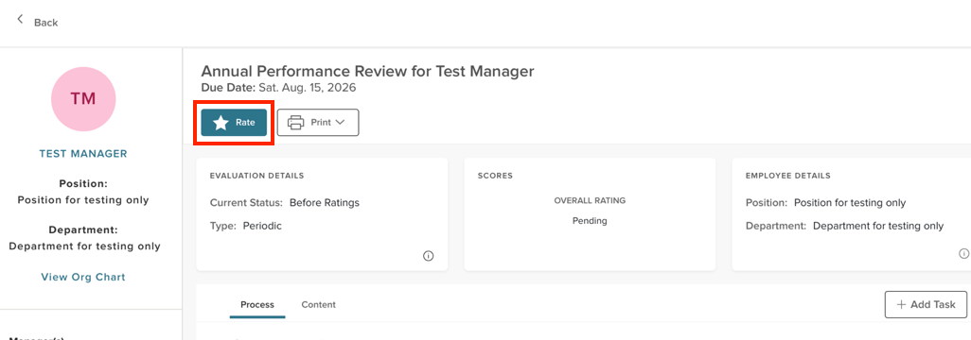
“Rating” the Goals for the Current Review Period
Select Rate to move to the Ratings section.
On the next screen, select Collapse Supplemental Resources to free up more screen real estate.
Continue by selecting Complete or Incomplete for the ratings for the goals.
If Incomplete is selected, you’ll be required to enter comments.

Slide 22
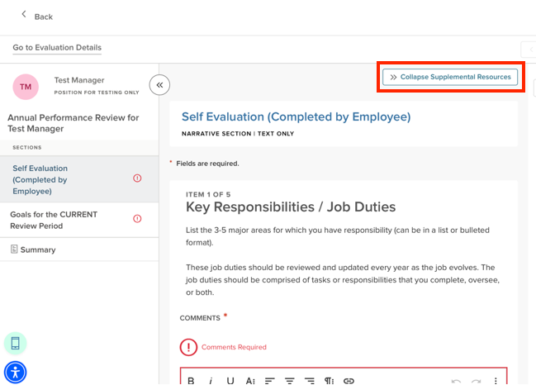
Key Responsibilities/Job Duties
General Job Duties – 3 to 5 major areas for which the Managerial employee has responsibility
Should be a concise, bulleted list
Should be reviewed and updated every year as the job evolves.
Comprised of what the employee does, oversees, or both
Mgr. employee does not provide self-narrative or self-ratings

Slide 23

General Job Duty – Examples
Administration & Training for University Performance Management processes.
Manage and coordinate the year-end close process and the preparation of Rowan’s annual financial statements.
Conduct and manage all data collection, analysis, and presentation of information to administration and faculty related to the educational program and licensure scores.
Establish and maintain audiovisual design standards for classrooms, conference rooms, and other collaborative learning spaces across all campuses.
Provide leadership by supervising and leading advisors in the College of Engineering.

Slide 24
Reflection Questions
Performance Highlights – Which of your leadership strengths, accomplishments, or contributions had the greatest impact on your area/the University?
Professional Challenges – What significant challenges did you encounter this year in fulfilling your responsibilities or advancing departmental priorities, and how did you address them?

Slide 25
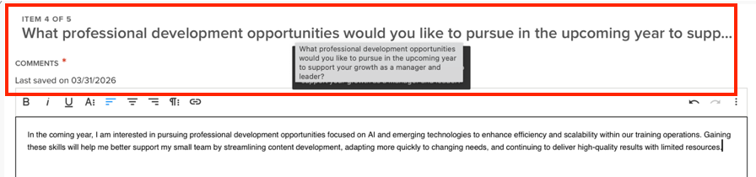
Looking Ahead………
What professional development opportunities would you like to pursue in the upcoming year to support your growth as a manager and leader?
Please list your goals for the NEXT review period (2-4 recommended).

Slide 26
Completing the Supervisor’s Section (after the self-evaluation has been submitted)

Slide 27
“Rating” the Goals for the Current Review Period
Select Complete or Incomplete for the goals that were assigned and/or completed for the current review cycle (the preceding 12 months).
Note: They are still accessible in last year’s review form in SSB.
If you select Incomplete, comments are required.
When all the current goals have been rated, select Next Section.

Slide 28
Review the self-evaluation
All the information is in “Read Only” status.
Review the Job Duties to ensure your team member’s view of their role is aligned with yours.
Review the Performance Highlights, Professional Challenges, and Professional Development Opportunities for discussion and assistance with your feedback.
Review the future goals to ensure they are aligned strategically w/ divisional plans.
This information will be key for the review meeting.

Slide 29
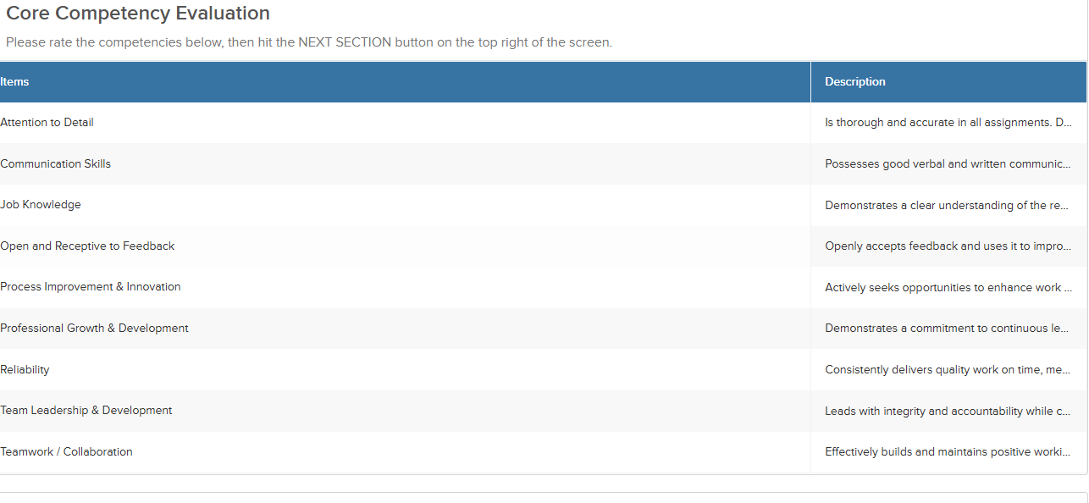
Competency Ratings
Note: Comments are required for each competency but can be concise.

Slide 30
The Ratings Scale
Outstanding Achievement: Performance consistently and significantly exceeds expectations across all areas of responsibility. Demonstrates exceptional results, sound judgment, and a high level of effectiveness. Serves as a role model within the position, positively influences others, and contributes meaningfully beyond core responsibilities to advance team and organizational goals.
Meets Expectations: Performance consistently meets expectations across primary responsibilities. Reliably achieves goals and delivers expected results in quality, quantity, and timeliness. Contributes effectively to team and department success and fulfills the full scope of the managerial role.
Partially Meets Expectations: Performance inconsistently meets expectations. While some responsibilities may be met, results fall short in key areas such as goal achievement, quality, or productivity. Focused development and increased consistency are needed to achieve full proficiency in the role.
Does Not Meet Expectations: Performance consistently falls significantly below expectations and fails to meet key objectives. Required competencies and responsibilities are not demonstrated at an acceptable level. Immediate and sustained improvement is required.

Slide 31

Setting Goals in Partnership
Set goals collaboratively to strengthen alignment and ownership
Effective goals:
Align with university and department objectives
Provide an appropriate level of challenge
Build shared commitment
Focus on projects or outcomes (not just task lists)
When writing goals, consider:
What will be accomplished—and by when?
Is the timeline realistic and achievable?
What support or actions will the supervisor provide?
How will success be measured?
How will progress be tracked and discussed?

Slide 32
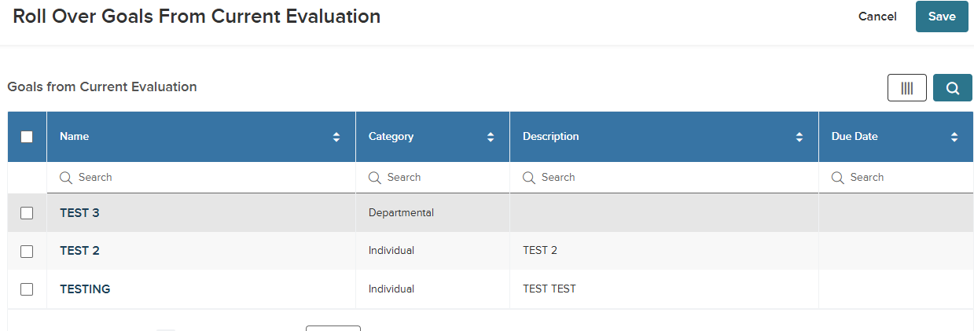
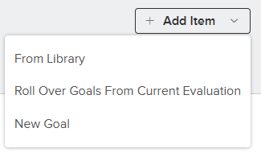
Goals for the NEXT review period
Click Add Item and select:
Roll over goals from Current Evaluation to carry forward goals from the Self Evaluation
New Goal to add a goal not included in the Self Evaluation
You may use both options and edit any rolled‑over goals as needed.
When done, click Next Section.

Slide 33
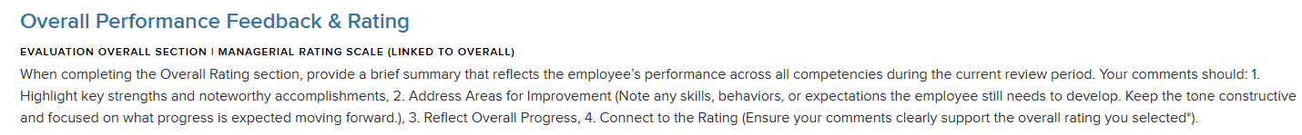
Overall Performance Feedback & Rating
The system automatically calculates the Overall Rating based on the Competency ratings entered
To change the Overall Rating, you must adjust the Competency ratings
Enter a brief overall performance summary
Keep it concise, especially if details are documented elsewhere
Use Summary to review the full evaluation
When ready, click Submit Evaluation, then Continue
The review becomes viewable to the employee before your meeting

Slide 34
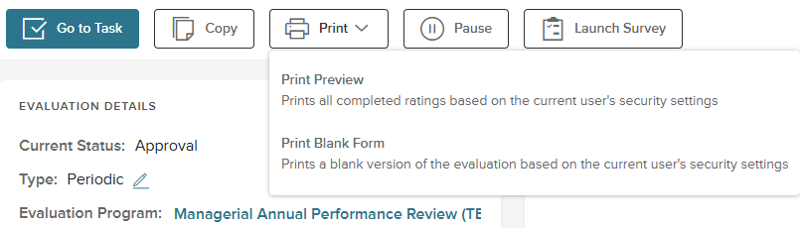
Print Preview
After submitting the evaluation, the home screen displays additional options
Select Print → Print Preview to view a polished version of the review
You will not use the Copy, Pause, or Launch Survey options

Slide 35
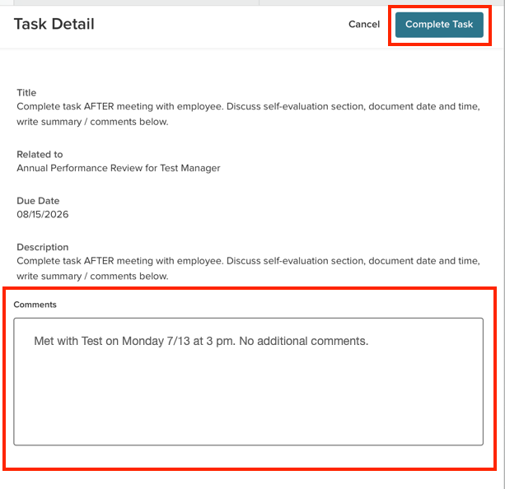
Review Meeting
Schedule a meeting to discuss the review and answer questions
After the meeting, record the date in the Comments section and select Complete Task

Slide 36
Signatures
Click “Approve & Sign”.
Optional: Enter comments
The system defaults to an auto-generated signature (recommended)
When ready, click Submit
Signatures Order:
Manager of the Managerial Employee
Second-level manager
Employee
The employee’s signature acknowledges receipt, not agreement.
Employees may document concerns in the Comments section

Slide 37
Part 3: New Hire Guidance, Process & Timelines, and Support & Resources

Slide 38

New Hire Guidance
New Hire Goal Sheet (fillable pdf) for new Managerial employees
Available on the HR site
Organizational Development > Manager’s Toolkit > Supervisor’s Checklist When Hiring a New Employee
An outside-the-system option to document goals when a new hire starts mid-cycle
Benefits for New Hires:
Aligns the manager and new employee on goals
Documents expectations if goals were not previously established
Supports a smoother next year’s performance review

Slide 39
Process and Timelines
Review period: July 1, 2025 – June 30, 2026
June 1 – Review form opens in NEOED Perform
Managerial employee receives a system alert to begin the self‑evaluation
Due by June 15 – Managerial employee submits self‑evaluation
Due by July 15 – Direct manager:
Completes the evaluation
Updates goals as needed
Submits the form
Reviews with an overall rating below Meets Expectations are routed to HR for review and approval
The completed review becomes available to the Managerial employee
The direct manager notifies the Managerial employee and schedules a meeting
Due by July 30 – Perform generates a task for the direct manager to schedule the review meeting

Slide 40
Process and Timelines (continued)
After the meeting – The direct manager:
Marks the task complete
Records the meeting date in Comments
Approves and signs the review
Due by August 10 – Review routes to the second‑level manager for approval and signature
Due by August 15 – Review routes to the managerial employee for signature
After all signatures are complete, the review is stored in NEOED for reference

Slide 41
Support & Resources
Questions or support:
Contact Jeremy Trowsdale, Andrea Lloyd, Jennifer Deal (SOM), or hrtraining@rowan.edu
Performance Management resources:
Available on the HR site under
Organizational Development > Performance Management
Link: Performance Management
Resources include:
Access to NEOED Perform
This PowerPoint
Review timelines
Knowledge Base article for Managerial Performance Reviews
Link to the Managerial Performance Reviews course in the Rowan Training Portal

