Slide 1

Effective Performance Reviews
A major factor in employee success and engagement

Slide 2

Discussion Topics
Part 1:
Common Review Perspectives
Keys to Success
Feedback and Phrasing Recommendations
Part 2:
NEOED Perform System Overview
Part 3:
New Hire Guidance
Process and Timelines
Questions and Support

Slide 3

Common Perspectives on Performance Reviews
What are some common positive perspectives on performance reviews?
What are some common negative perspectives on performance reviews?
Notes:
Common Positive:
Builds rapport with team members or my manager (discussing career aspirations, progress, where they can improve, etc.)
Develops my supervisory skills (writing, coaching, having challenging conversations, developing goals, etc.)
Helps my team stay on target with goals
Allows for managing and documenting performance issues
Common Negative:
Delivering bad news is difficult; employees may get defensive
My team doesn’t take constructive criticism and P.D. suggestions well
I don’t see the value gained through the process.
Creating SMART goals can be quite challenging.
It’s a meaningless exercise that managers just want to get through.
There’s usually one negative focus area and then little about anything else.
It’s rarely a two-way discussion.
The basis for measurement is vague.
My manager has a minimal understanding of my work.

Slide 4

Reviewer Keys to Success
Demonstrate respect and confidentiality
Encourage conversation at the review meeting
Track performance year-round (positive and negative)
More frequent feedback means fewer review-time surprises
Without specific narrative and accurate ratings, subpar performance is unlikely to change!
Avoid the Halo/Horns Effect (a rater bias in which excellence (halo) or poor performance (horns) in one area skews ratings across all competencies).
Avoid recency bias! The review must be an annual review.
Example: Great performance for 11 months, 1 recent mistake before review time = subpar review and vice-versa.

Slide 5
Giving Effective Feedback – Be Specific Clarity helps your team grow.
Ensure your comments are constructive, specific and focused on performance.
❌ Vague | ✅Specific
You frequently miss tasks and project deadlines. | The ABC report was due on October 15 and was submitted on November 8. Similarly, the XYZ project was submitted three weeks past the December 31 deadline. Let’s work together on strategies to improve deadline management.
You seem to make a lot of errors. | In August, there were five data entry errors in the monthly report and three formatting issues in the customer service letter. We can review these together to identify patterns and reduce future mistakes.
You have good communication skills. | Your verbal and written communication is clear, accurate and thorough. The monthly reports you submitted were complete, easy to understand and required little to no modification. You can further enhance your presentation skills by taking a training course on Effective Presentations.

Slide 6

Phrases to Avoid in Performance Reviews (Verbal)
🔴 Avoid Saying (delivery pitfalls)
“This shouldn’t be a surprise.”
“You always…” / “You never…”
“Everyone else is doing fine.”
“That’s just how leadership sees it.”
“Don’t take this personally.”
“We don’t have time to get into that.”
“I’m just being honest.”
Why they’re risky
Absolutes feel unfair
Signals the conversation is not actually collaborative
Better framing
“Let’s walk through the key themes and examples.”
“Here’s what I’ve observed, and I’d like your perspective.”

Slide 7

Phrases to Avoid in Performance Reviews (Written)
⚠️ Avoid Writing (documentation pitfalls)
“Bad attitude”
“Not a good fit”
“Unmotivated”
“Too emotional”
“Difficult personality”
“Poor communicator” (without specifics)
“Has potential but…” (with no development plan)
“Meets expectations for now”
Why they’re risky
Vague and subjective
Open to misinterpretation
Hard to defend if questioned later
Better framing
Describe observable behaviors
Anchor feedback to impact and expectations
Include examples and next steps
If it can’t be supported with examples, written clearly, and discussed respectfully – Don’t say it or write it.

Slide 8
Say This Instead: Clear, Constructive Performance Review Language
When Avoiding Absolutes or Judgments
Instead of…
“You always / You never”
“Bad attitude”
“Difficult personality”
Say this instead…
“In several situations this year, I observed…”
“Here’s the specific behavior I want to discuss and its impact…”
“This behavior has made collaboration more challenging because…”
When Feedback Feels Vague or Subjective
Instead of…
“Lacks professionalism”
“Poor communicator”
“Not a good fit”
Say this instead…
“Professional expectations include X; in these instances, that wasn’t met…”
“In team meetings, key updates were often incomplete or unclear, which led to…”
“This role requires X; here’s where there’s a gap and what success would look like…”

Slide 9
Say This Instead: Clear, Constructive Performance Review Language
When Delivering Difficult or Developmental Feedback
Instead of…
“This shouldn’t be a surprise.”
“You need to fix this.”
“Leadership is concerned.”
Say this instead…
“This has come up before, and I want to be clear about where things stand now.”
“Let’s talk about what needs to change and how I can support that.”
“Here’s the feedback, and I want to walk through it with you.”
When Addressing Performance Compared to Expectations
Instead of…
“Everyone else is doing fine.”
“Meets expectations for now.”
“We’ll see what happens next year.”
Say this instead…
“Here’s how performance aligns with the expectations of the role.”
“You’re meeting expectations in X areas; growth is needed in Y.”
“These are the focus areas we’ll revisit in our next check‑in.”

Slide 10
Say This Instead: Clear, Constructive Performance Review Language
When Discussing Potential or Advancement
Instead of…
“Has potential but…”
“You’re not there yet.”
“You’re lucky this isn’t worse.”
Say this instead…
“To be ready for the next level, these specific skills or experiences are needed…”
“Here’s what growth would look like over the next review cycle.”
“This rating reflects current performance against expectations.”
Effective performance language is specific, behavior‑based, and focused on impact and next steps.

Slide 11

What makes a performance review successful, in your experience?

Slide 12

NEOED Perform System

Slide 13

NeoEd – Single Sign-on access
HR website > Organizational Development > Performance Management
NEOED Perform
Select Login with SSO on the NeoEd sign-in page.
Don’t enter your credentials in the Username and Password fields (you’ll receive an error message).

Slide 14
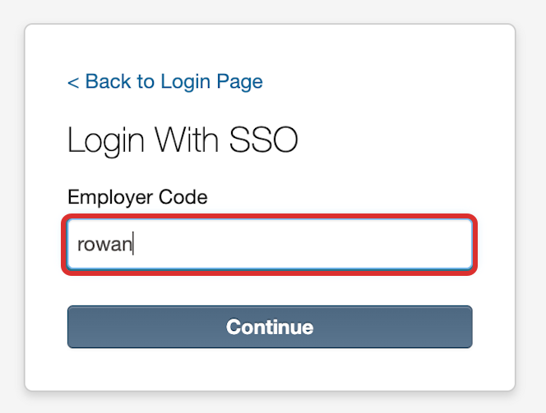
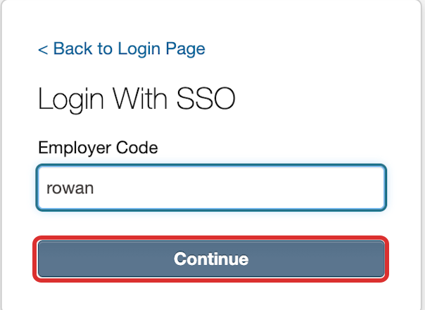
NeoEd – Single Sign-on access
Enter rowan, the field is not case-sensitive.
3. Select Continue.
Note: After this step, you will be brought to the NEOED Dashboard if you are already signed into other Rowan applications (Example: Banner).

Slide 15
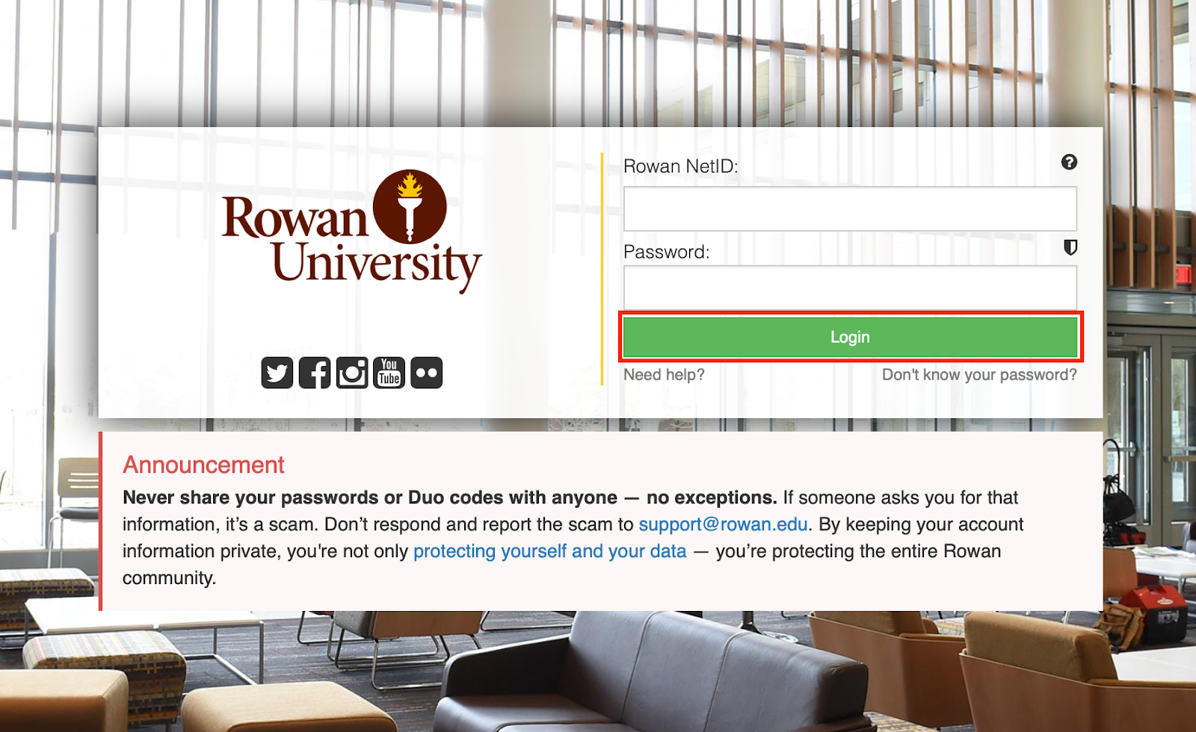
NeoEd – Single Sign-on access
When the Rowan log in screen appears, enter your Rowan NetID and Password, and select Login.
Enter Duo, if prompted.

Slide 16
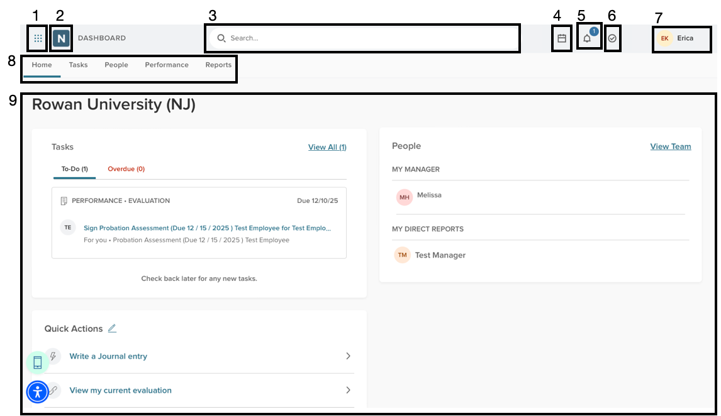
NeoEd – System Navigation
All users start on the Home screen, which reflects the employee point of view. The system consists of several menus and a dashboard. The dashboard contains links to other parts of the system that allow you to begin processes or sort and view information right from the dashboard.
2. NeoEd Logo - Takes you back to the home screen. 3. Search - Allows a user to search within the application. 4. Calendar - provides a view of the calendar of events.
5. Notifications - lists any notifications for actions you must take within NeoEd Perform, items to view, or indications that others have taken action or completed tasks.
6. Tasks - lists tasks that must be completed within NeoEd Perform. 7. User Menu - gives access to your user profile, password settings, and allows you to sign out.
8. Dashboard Tabs - Allows you to switch between dashboards and access your tasks, people, performance evaluations, and reports.
9. Dashboard - Gives an overview of the system, creating shortcuts to areas and actions.

Slide 17
Journal Entries
Journal Entries are notes that can be entered throughout the year and are linked to an employee record.
This feature allows employees to document events and supervisors to note employee achievements and concerns.
Entries created by supervisors can be shared with the employee or leadership and may include text, attachments, and references to prior documentation.
Note: You can share later on as well (after creation).
To create a journal entry, select the Performance tab > Journal Entry (they can also be created from the Home tab)
Type the name of the individual to attribute the journal entry to. Select the individual from the list.
Complete your journal entry, add attachments or references if needed, then select Submit Journal Entry.
See the Knowledge Base article for Managerial Reviews for more information on Journal Entries.

Slide 18
Completing the Managerial Performance Review

Slide 19
Managerial Review Workflow
Step 1: On June 1, the review form goes live in NEOED Perform and the Managerial Employee receives an e-mail alert to inform them that they can begin their self-evaluation.
Step 2: The Managerial employee completes and submits their self-evaluation by June 15.
Step 3: Their direct manager completes the review form based on their team member’s self-evaluation and performance, makes any necessary changes to goals, and submits it by July 15.
* Step 4: The review is sent to HR for approval and a signature if the Overall Rating is “Does Not Meet Expectations” or “Partially Meets Expectations”.
Step 5: The review is now viewable by the Managerial employee to go over prior to meeting with their manager.
Step 6: A task is system-generated for the Managerial employee’s direct manager to schedule a meeting to discuss the review with them.
Step 7: After the meeting has occurred, the Managerial employee’s direct manager marks the task as complete in Perform, adding the meeting date and any pertinent details of the meeting to the Comments section. They approve and sign the performance review.
Step 8: The form moves to the direct manager’s manager (2nd level) to review, approve, and sign.
Step 9: The form is sent to the Managerial employee to sign.
(Note: The entire review should be completed with all signatures by August 15.)
Step 10: The form is saved in NEOED Perform.

Slide 20
Completing the Self-Evaluation

Slide 21
The Power of Self-Evaluation
Your manager may not have full visibility into all your contributions.
Without your input, a single less-successful project might overshadow your broader achievements.
Opportunity to highlight your wins and progress throughout the year.
You are the most knowledgeable person about your daily work & impact.
Opportunity to propose a professional development plan aligned with your goals & role.
By suggesting goals for the upcoming year, you can help shape the direction of your work and team.
If you don’t advocate for your growth, who will?

Slide 22
Entering the Goals for the Current Review Period
Enter the goals that were assigned for the current review cycle (the preceding 12 months).
Note: They are still accessible in last year’s review form in Self-Service Banner.
This year: Select Add Goals > New Goal and copy goals from last year’s SSB review (or manually add any new goals assigned during this cycle).
Future years: Use Roll Over Goals From Previous Evaluation to carry forward, edit, or add goals.
After entering, click “Save” or “Save and Add Another”. When done, click “Submit Content” and “Yes, I’m Finished.” to move to the next section of the review.
You’ll receive an email to inform you of the next step.

Slide 23
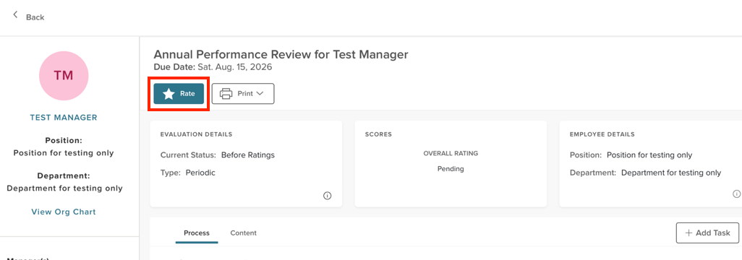
Rating the Goals for the Current Review Period
Select Rate to move to the Ratings section.
On the next screen, select Collapse Supplemental Resources to free up more screen real estate.
Continue by selecting Complete or Incomplete for the ratings for the goals.
If Incomplete is selected, you’ll be required to enter comments.

Slide 24
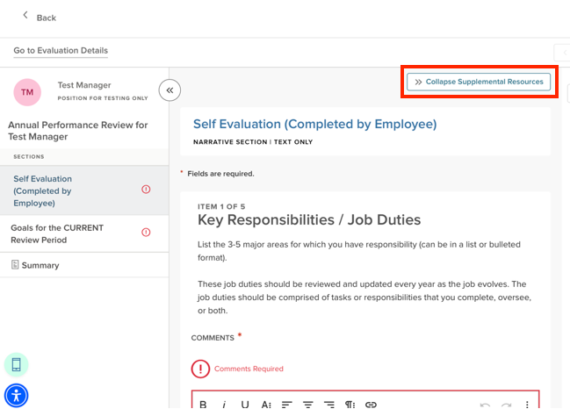
Key Responsibilities/Job Duties
General Job Duties – 3 to 5 major areas for which the employee has responsibility (it’s now one of the self-evaluation questions).
Should be a concise list or bulleted format.
Should be reviewed and updated every year as the job evolves.
Comprised of what the employee does, oversees, or both (brief)
Mgr. employee does not provide self-narrative regarding their performance.

Slide 25
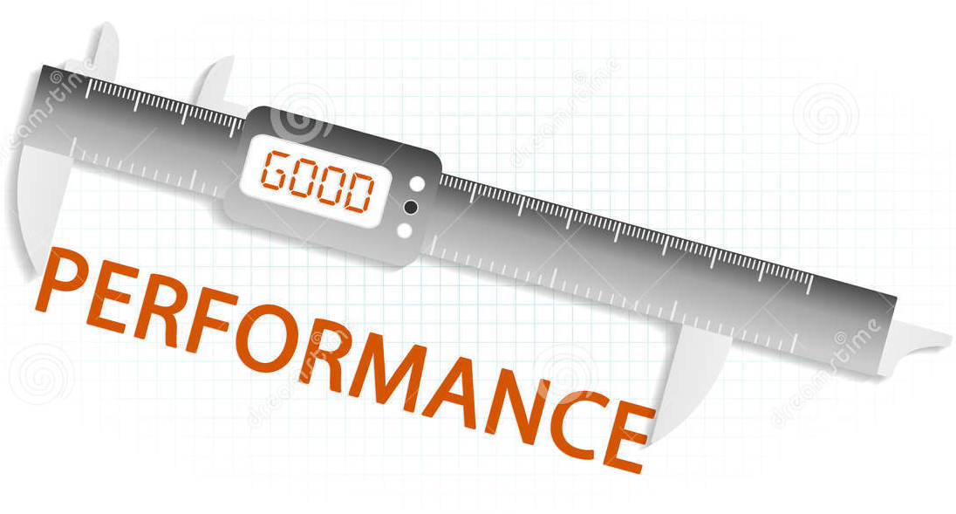
General Job Duty – Examples
Administration & Training of University Performance Management processes.
Manage and coordinate the year-end close process and the preparation of Rowan’s annual financial statements.
Conduct and manage all data collection, analysis, and presentation of information to administration and faculty related to the educational program and licensure scores.
Establish and maintain audiovisual design standards for classrooms, conference rooms, and other collaborative learning spaces across all campuses.

Slide 26
Reflection Questions
Performance Highlights – Which of your leadership strengths, accomplishments, or contributions had the greatest impact on your area/the University?
Professional Challenges – What significant challenges did you encounter this year in fulfilling your responsibilities or advancing departmental priorities, and how did you address them?

Slide 27
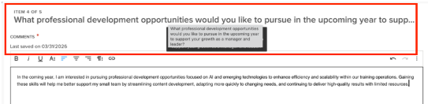
Looking Ahead………
What professional development opportunities would you like to pursue in the upcoming year to support your growth as a manager and leader?
Please list your goals for the NEXT review period (2-4 recommended).

Slide 28
Completing the Supervisor’s Section (after the self-evaluation has been submitted)

Slide 29
“Rating” the Goals for the Current Review Period
Select Complete or Incomplete for the goals that were assigned and/or completed for the current review cycle (the preceding 12 months).
Note: They are still accessible in last year’s review form in SSB.
If you select Incomplete, comments are required.
When all the current goals have been rated, select Next Section.

Slide 30
Review the self-evaluation
All the information is in “Read Only” status.
Review the Job Duties to ensure your team member’s view of their role is aligned with yours.
Review the Performance Highlights, Professional Challenges, and Professional Development Opportunities for discussion and assistance with your feedback.
Review the future goals to ensure they are SMART and aligned strategically w/ divisional plans.
This information will be key for the review meeting.

Slide 31
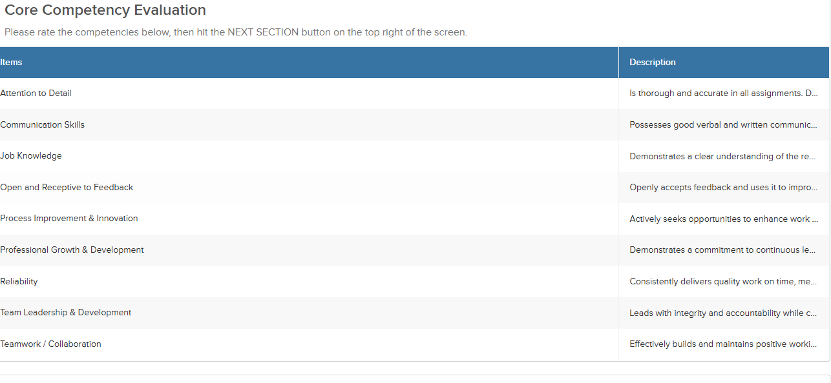
Competency Ratings
Note: Comments are required for each competency but can be concise.

Slide 32
The Ratings Scale
Outstanding Achievement: Performance consistently and significantly exceeds expectations across all areas of responsibility. Demonstrates exceptional results, sound judgment, and a high level of effectiveness. Serves as a role model within the position, positively influences others, and contributes meaningfully beyond core responsibilities to advance team and organizational goals.
Meets Expectations: Performance consistently meets expectations across primary responsibilities. Reliably achieves goals and delivers expected results in quality, quantity, and timeliness. Contributes effectively to team and department success and fulfills the full scope of the managerial role.
Partially Meets Expectations: Performance inconsistently meets expectations. While some responsibilities may be met, results fall short in key areas such as goal achievement, quality, or productivity. Focused development and increased consistency are needed to achieve full proficiency in the role.
Does Not Meet Expectations: Performance consistently falls significantly below expectations and fails to meet key objectives. Required competencies and responsibilities are not demonstrated at an acceptable level. Immediate and sustained improvement is required.

Slide 33

Goal Setting Guidelines
Goal setting in partnership is an effective strategy, and our review system is designed accordingly.
Goal setting in partnership should ensure the goals:
Align with University/Department objectives
Offer a fair amount of challenge
Create buy-in from both parties
Are more project than task list oriented
Things to consider when writing goals:
What steps the employee will take … by when?
What steps the supervisor will take … by when?
Criteria for assessing success
Process to track and review plan

Slide 34
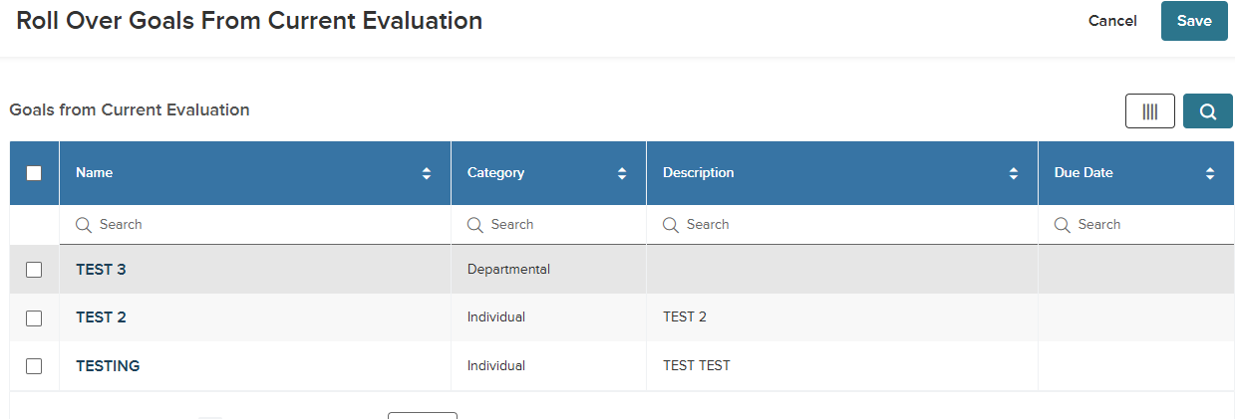
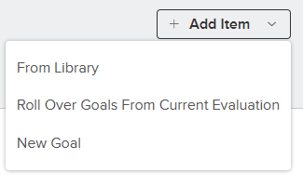
Goals for the NEXT review period
Click Add Item (upper right of screen) and select either “New Goal” if you are adding a goal that is different than the goals entered in the Self Evaluation or “Roll over goals from Current Evaluation” if you decide to move forward with the goals outlined in the Self Evaluation.
Additional Notes: You can also use both to add the goals you would like to include from the Self Evaluation and add some new goals. You can also edit the goals that you brought in from the Self Evaluation.
When done, click “Next Section”.
Notes:
The key distinction between "From Last Scheduled Evaluation" and "Roll Over Goals From Previous Evaluation" is that the former pulls goals specifically from the last evaluation generated by the same scheduled program, while "Roll Over Goals From Previous Evaluation" is designed to carry forward goals more broadly from the previous evaluation. In other words, the "Roll Over Goals From Previous Evaluation" option will pull the goals from the last evaluation that the employee had, so it will not matter if the goals are from a totally different review form.
The "From Last Scheduled Evaluation" option will only pull from the last evaluation for the employee using the same evaluation program.

Slide 35
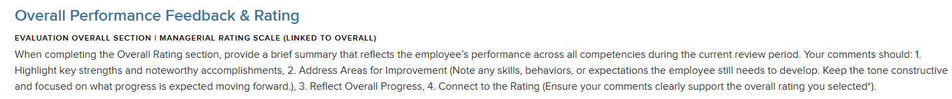
Overall Performance Feedback & Rating
The system calculates the Competency ratings entered and automatically fills in the Overall Rating for you.
Note: The only way to adjust the Overall Rating is to adjust the Competency ratings.
Provide an overall performance summary (narrative) – it should be brief, especially if you elaborated extensively in other sections of the review.
The Summary button allows you to view the whole review before submitting it.
Once done reviewing and there are no adjustments to be made, you can click “Submit Evaluation”. Another screen will pop up; click “Continue”.
The review is now viewable for your team member in advance of your meeting.

Slide 36
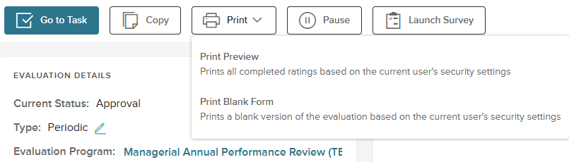
Print Preview
Once you submit the evaluation, the home screen appears with additional options.
By clicking Print, you can select Print Preview to see a polished version of the review.
You won’t be using the Copy, Pause, or Launch Survey options.

Slide 37
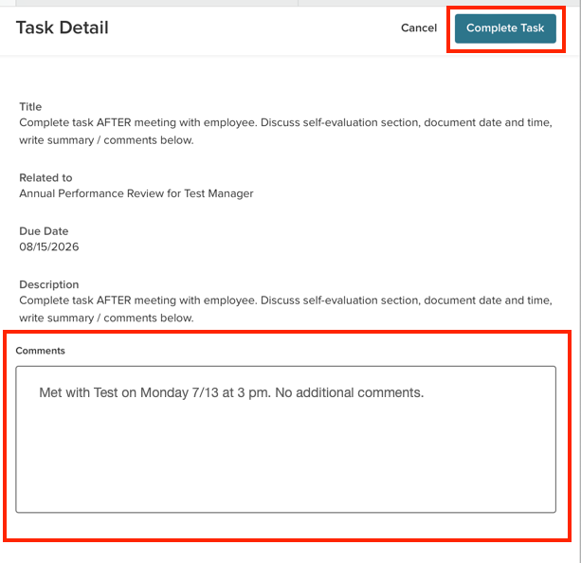
Review Meeting
Next, schedule the meeting with your team member to discuss the review and answer any questions.
Once the meeting has occurred, add notes to the Comments section indicating the date and time of the meeting, and select Complete Task.

Slide 38
Signatures
Next, click “Approve & Sign”.
You can now enter comments (optional). The system will default to an Auto Generated signature and that is recommended (you could draw it). When ready, click Submit.
Signatures Order:
Manager of the Managerial Employee
Manager of that Manager (2nd level)
Employee
The Employee signature acknowledges receipt of the review, not necessarily agreement. The employee should use the Comments section to document concerns.

Slide 39

New Hire Guidance
New Hire Goal Sheet (a writable pdf) for New Hire Managerial employees – available on the HR site (Organizational Development > Manager’s Toolkit > Supervisor’s Checklist When Hiring a New Employee)
Outside of system, easy option to provide goals to a New Hire that starts mid-cycle
Benefits of completion for New Hires:
Provides an opportunity for the new Managerial Employee and their manager to agree upon and document goals (if not previously done)
Facilitates next year’s review

Slide 40
Process and Timelines
Review based on performance between July 1, 2025 and June 30, 2026
June 1 – Review form goes live in NEOED Perform, and the Managerial employee receives a system alert to begin their self-evaluation.
Due by June 15 – Managerial employee will complete their self-evaluation and submit it.
Due by July 15 – Managerial employee’s direct manager completes their part of the evaluation form based on the self-evaluation and performance, makes any necessary changes to goals, and submits it.
* The form will be sent to HR if the overall rating is below Meets Expectations for review, approval, and signature. If necessary, HR will have a conversation with the direct manager.
The review form will now be available to the managerial employee in the system. Their direct supervisor will notify them where to access it and schedule a meeting to discuss it.
Due by July 30 – A task is system-generated by Perform for the Managerial employee’s direct manager to schedule a meeting to discuss the review.

Slide 41
Process and Timelines (continued)
AFTER the meeting has occurred, the direct manager marks the task as complete, adding the meeting date and time information to the Comments section. They will approve and sign the review.
Due by August 10 – The form will be forwarded to the manager’s manager (2nd level) for review, approval, and signature.
Due by August 15 – The form will be forwarded to the Managerial employee for signature.
Once they have signed the form, it will be stored in NEOED for reference.

Slide 42
Support & Resources
Call or E-mail:
Jeremy Trowsdale, Andrea Lloyd, Jennifer Deal (SOM), or hrtraining@rowan.edu
Access Performance Management resources on the HR site under Organizational Development > Performance Management
Link: Performance Management
Resources include:
Link to NEOED Perform
This PowerPoint
Timelines
Knowledge Base article specific to Managerial Performance Reviews

