Slide 1
Student Employment
Office of Human Resources

Slide 2
Agenda
Contacts
Types of Student Employment
Student Employment Rules
Student Work Study Form Overview
Federal Work Study Overview with Kira Aguilar
Q&A

Slide 3
Contacts
Student Work Study: Edyta Paluch
Paluch@rowan.edu | Ext. 53129
Federal Work Study: Kira Aguilar
Aguilar@rowan.edu | Ext. 64277
I-9 HQ & I-9s: Payton Hynson & Sonia Bodden
hynsonp9@rowan.edu | Ext. 65237
bodden@rowan.edu | Ext. 53366

Slide 4
Types of student employment

Slide 5
Federal Work Study (FWS)
Available to students who have been awarded work-study as a part of their Financial Aid package.
Student is awarded money and can look for employment on campus and use those funds to be paid.

Slide 6
Institutional Work Study (IWS)
Available to all students regardless of if they are eligible for financial aid.
Students may work both FWS and IWS but are encouraged to use their FWS funds first.
IWS funds are allocated to departments as a part of their annual budgets.
Students can apply for employment in the departments and be paid as long as the department has funds available.

Slide 7
Student Hourly
Departments can hire students in a part-time temporary status using a budget or grant surplus.

Slide 8
Student Employment Rules

Slide 9
General Rules
Students may not work more than 20 hours per week while classes are in session and may work up to 25 hours per week during Summer & Winter breaks.
  Note: Students with a full-time stipend contract working 20 hours a week (i.e. Fellows or Residence Directors) may not work any additional assignments.
Students must be in good academic standing.
Students may not work until the I-9 is completed in I-9 HQ and the Student Work Study form has been entered and processed.
Notes:
Students may work no more than 20 hours per week while classes are in session and are capped at 25 hours a week during Summer and Winter breaks. Summer hours begin at the end of the academic year and end August 31st. Departments must adhere to the 25-hour cap to ensure that students remain below the threshold for state benefits eligibility. This keeps Rowan University in compliance with federal and state rules and regulations as well as union rules regarding memberships.

Slide 10
Documentation
Do not send any copies of student documentation to Human Resources.
A paper copy of the State W-4 or Certificate of PA Residency must be filled out and sent to Payroll Services.
The Federal W-4 and Direct Deposit will be filled out by the student via Self-Service Banner once the Student Work Study form has been processed and the job is in the system.
  The student will receive an automated email instructing them to log into Banner to update these forms.

Slide 11
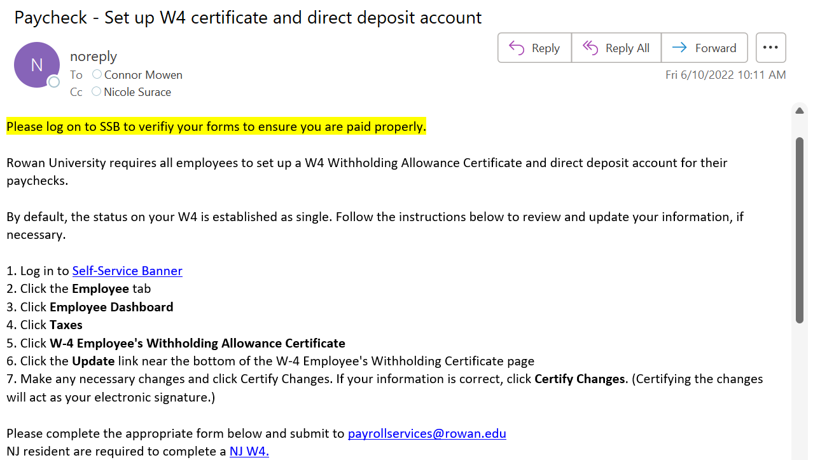
Sample Email

Slide 12
I-9s
An I-9 must be completed in I-9 HQ prior to a student beginning employment. All student employees must have a valid I-9 on file.
The I-9 must be completed prior to the Student Work Study form being submitted.
To request that an I-9 be initiated for your student, please complete the New Hire I-9 Request Form.
You must view original documents (not scans/copies/photos) when completing the I-9. It is against federal regulation to accept scans/photos or copies of documents.

Slide 13
Compensation
Jobs are classified into four levels and seven steps per level. The more complex the job, the higher the level.
Student workers typically earn step increases after they have worked one academic year and return to work to the same department the following year.
Step increases are processed via the Student Work Study form.
Departments that wish to pay students a different hourly wage than listed must submit a job description and pay rate justification in the comments of the Student Work Study form.

Slide 14
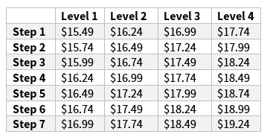
Pay Scale as of January 1, 2025

Slide 15
STUDENT WORK STUDY FORM

Slide 16
Student Work Study Form Uses
Assignment Entry: Enter an assignment for a student. To be used when a student begins working in your department, changes position numbers (i.e., switching from FWS to IWS), or to renew their assignment for the new fiscal year.
Rate Update: Process a step increase or other rate change for a student assignment.
Termination: End a student assignment.

Slide 17
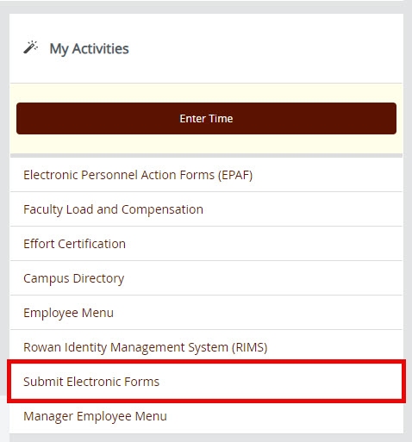
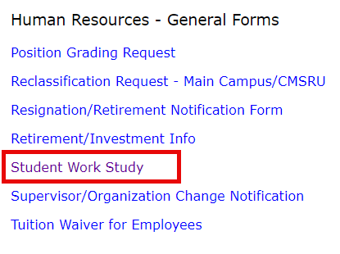
Completing the Student Work Study Form
The form can be accessed via Self-Service Banner under Submit Electronic Forms.

Slide 18
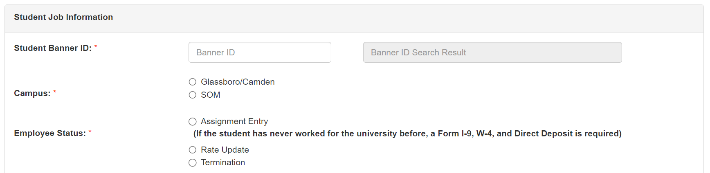
Completing the Student Work Study Form
To begin, enter the student’s Banner ID. Select the campus they’ll be working on and the reason you’re completing the form.

Slide 19
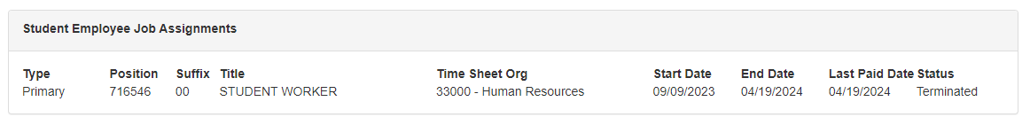
Completing the Student Work Study Form
At the bottom of the screen, you will be able to see a list of any assignments the student may have had (both active and inactive), including any full-time GA/Fellow positions that may render them ineligible for an additional position on campus.

Slide 20
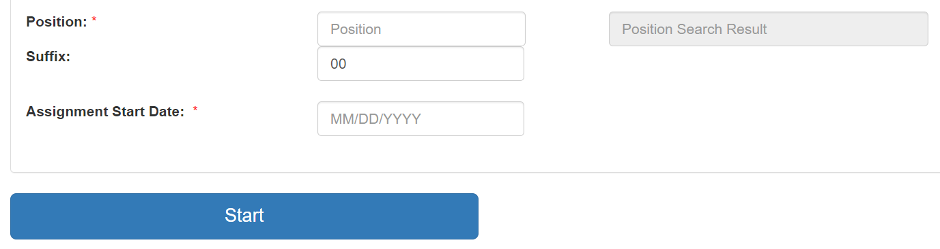
Completing the Student Work Study Form: Assignment Entry
Enter the position number/suffix and the assignment start date then press Start.
  Note: the assignment start date does NOT need to be the start of the pay period. If the student has never worked for the University before and an I-9 is needed, the assignment start date must match the hire date listed on the I-9.

Slide 21
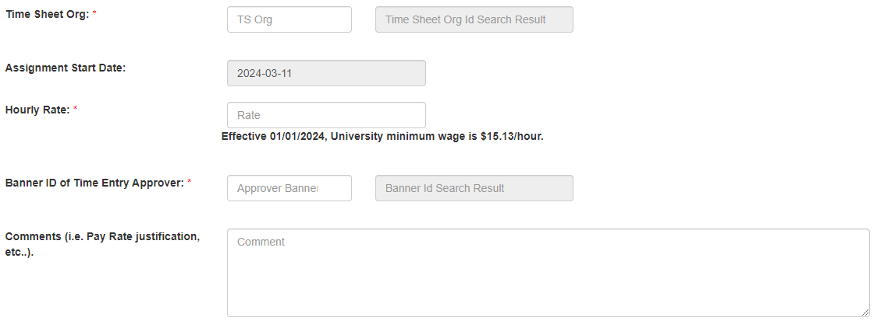
Completing the Student Work Study Form: Assignment Entry
Enter the Timesheet Org, the Hourly Rate, and the Banner ID of the student’s WTE approver.

Slide 22

Completing the Student Work Study Form: Assignment Entry
Enter any comments needed, such as a justification for the pay rate if does not align with the pay scale.
Submit the form.

Slide 23
Completing the Student Work Study Form: Assignment Entry
Once submitted, the form will be routed to a series of approvers:
  Student (Note: If the student does not approve the form within 14 days, the form will be voided).
  HR I-9 (confirms that there is a valid I-9 on file for the student and it was completed correctly)
  FWS/OSP (if applicable)
  HR Student Work Study Admin
Once the form is fully approved, an EPAF will be created and processed by Human Resources.

Slide 24
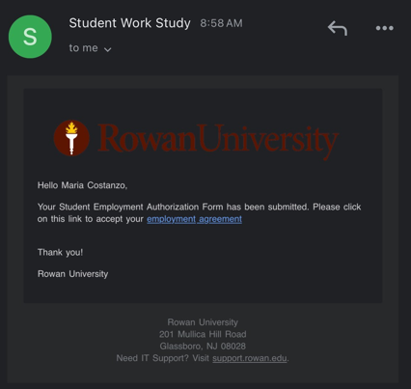
Student Email Example

Slide 25
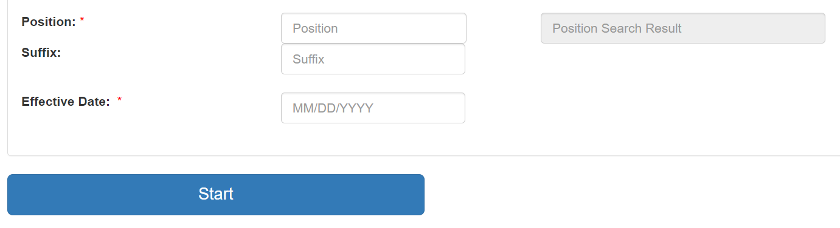
Completing the Student Work Study Form: Rate Update
Enter the position number/suffix and the effective date then press Start.
Note: Effective date must be the start of the pay period.

Slide 26
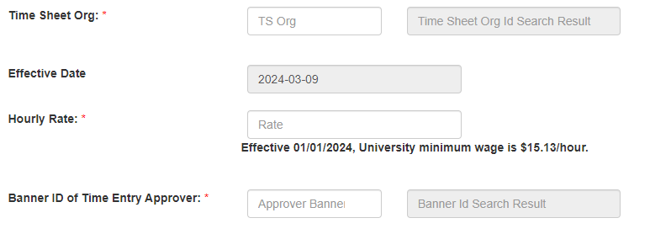
Completing the Student Work Study Form: Rate Update
Enter the Timesheet Org, the Hourly Rate, and the Banner ID of the student’s WTE approver.

Slide 27
Completing the Student Work Study Form: Rate Update
Enter any comments needed, such as a justification for the pay rate change.
Submit the form.

Slide 28
Completing the Student Work Study Form: Rate Update
Once submitted, the form will be routed to a series of approvers:
  Student (Note: If the student does not approve the form within 14 days, the form will be voided).
  HR I-9 (confirms that there is a valid I-9 on file for the student and it was completed correctly)
  FWS/OSP (if applicable)
  HR Student Work Study Admin
Once the form is fully approved, an EPAF will be created and processed by Human Resources.

Slide 29
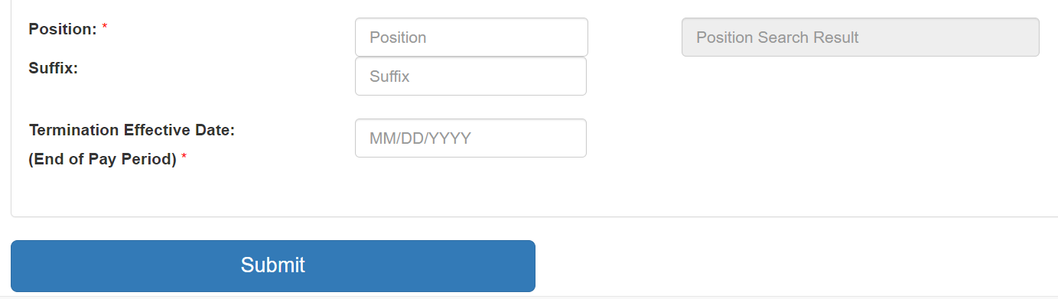
Completing the Student Work Study Form: Termination
Enter the position number/suffix and the termination date then press Start.
  Note: Termination date should be the end of the current (or a future) pay period.
The form will be routed to HR for approval and processing.

Slide 30
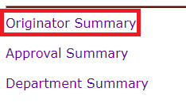
Checking the Status of a Form
To see where a form is at in the approval process, go to the Submit Electronic Forms menu, scroll to the bottom of the screen then select Originator Summary.

Slide 31
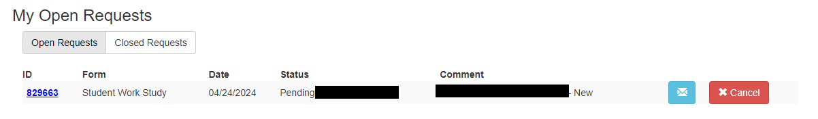
Checking the Status of a Form
You will then see a list of your pending forms and who it’s currently waiting for approval from.

Slide 32
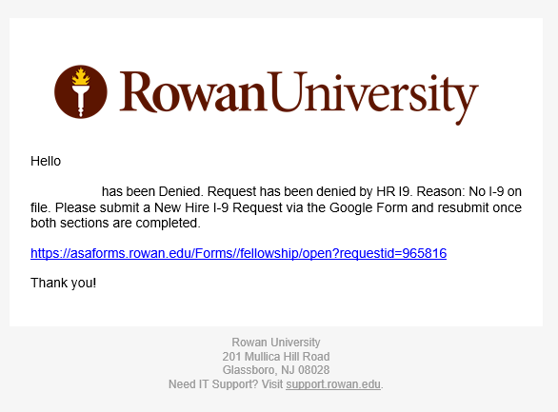
Form Denial
If your form is denied by any of the approvers, you will receive an email stating who denied the form and the reason they listed for the denial.

Slide 33
Federal Work Study Overview
Notes:
What do students think about the financial aid office?
Who has completed a FAFSA?
What do you know about financial aid?
What is the most confusing part of financial aid for you?
What do you think student’s need to know about for financial aid?

Slide 34
What is FWS?
FWS is a federally-funded program that allows eligible students to earn funds and gain real-life work experience through working on-campus or for an approved off-campus community service program.
Notes:
Federal Work-Study is a federally funded program that allows eligible students to earn a bi-weekly paycheck to assist with the cost of school while gaining real-life work experience. Many positions are located on campus, while others are in partnership with off-campus non-profit organizations and community service.

Slide 35
Federal Work Study
100% of wages are paid to eligible students by the Financial Aid Office
  Department is only required to pay for their NJ Paid Leave (NJPL) earnings
  One hour of sick time accrued for every 30 hours worked.
Student must complete a FAFSA and have financial need
Money is paid to students as a bi-weekly paycheck.
Students receive the money as they work and earn it.

Slide 36
Student Onboarding
• Must complete the I-9 form before starting work.
Must not start working before having an active timesheet in Self-Service Banner.
Student workers may work in only ONE FWS position at a time.
Student workers must be paid for ALL hours worked. Volunteering is not permitted.
Notes:
Before you can start working you need to make sure you have an active timesheet in Self-Service Banner. There is a hiring process that your supervisor will guide you through prior to your first day of work. If you are unsure, please check with your supervisor to confirm.
You are only permitted for have one FWS position at a time, but you are able to have a second job on campus, as long as it is being paid through non-FWS funds. There are limits to the number of hours you can work between your positions which we will discuss shortly.
Keep in mind- volunteering for FWS is not permitted, you must be paid for all hours worked.

Slide 37
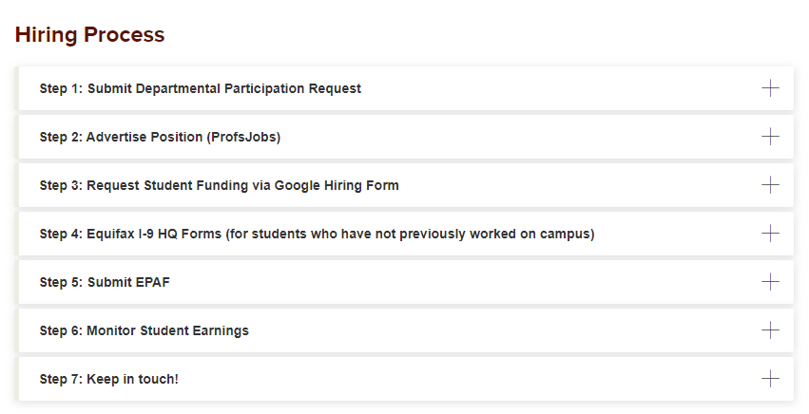
How to Participate in FWS
FWS Supervisor Information

Slide 38
Questions?

