Slide 1
I-9 Compliance & Equifax I-9 HQ
Office of Human Resources

Slide 2
I-9 Contacts
HR I-9 Team, hri9@rowan.edu
856-256-4134
Payton Reilly, reillypa@rowan.edu
Ext. 65237
Sonia Bodden, bodden@rowan.edu
Ext. 53366

Slide 3
General I-9 Compliance

Slide 4
Completing the I-9
Anyone who is being paid by the University as an employee must have a valid I-9 on file.
Section 1 of the I-9 must be completed by the employee on or before the first day of work.
Section 2 of the I-9 must be completed by an authorized representative within 3 business days of the employee’s first day of work.
  Note: If your new hire’s first day is on a Saturday/Sunday, the I-9 will be due on Wednesday.

Slide 5
Documentation
You must view original documents (not scans/copies) when completing the I-9. It is against federal regulation to accept scans or copies of documents.
You may not request that a new hire bring specific documentation (i.e. Driver’s License and Social Security Card) to complete Section 2. You must provide the new hire with the list of acceptable documents and allow them to choose which documents they’d like to present (as long as they satisfy the I-9 requirements for their citizenship status).
You must scan the front and back of each individual document and upload the scan to I-9 HQ. Do not include any tax documents or superfluous documentation.
Notes:
-When you sign Section 2, you are attesting under the penalty of perjury that you viewed the original documents and they appear genuine and relate to the employee named.
-Do not scan multiple documents on one page and upload to I-9 HQ. For example, if you’re uploading a scan of a List B document (such as a driver’s license), only the List B document should be on the scan. The List C document should be on a separate scan.

Slide 6
Documentation (Cont’d)
Note on Social Security Cards:
  Social Security cards used as a List C document must be unrestricted.
  If the Social Security Card has any annotation on it, such as “Valid for Work Only With DHS Authorization”, it cannot be used as a List C document. The new hire will need to present a different document to satisfy I-9 requirements.

Slide 7
International Employees
When you hire an international employee, they must present either an EAD card OR their Foreign Passport, I-94, and the document that gives them work authorization.
  For international students on an F-1 visa, this form is the I-20 they receive from the International Center.
  For other employees or visa types, please contact HR to confirm what documentation is needed.

Slide 8
Equifax I-9 HQ Training

Slide 9
Equifax I-9 HQ Terminology
Onboarding Packet Sent: I-9 has been initiated for the new hire and is awaiting Section 1 Completion.
  Note: Department administrators only have access to complete Section 2 of the I-9 and will not see any Onboarding Packet Sent tasks.
Pending I-9: Section 1 has been completed and Section 2 is now pending.
Supplement B: The new term for what was previously known as Section 3 of the I-9. Supplement B is used for rehires and work authorization reverifications.

Slide 10
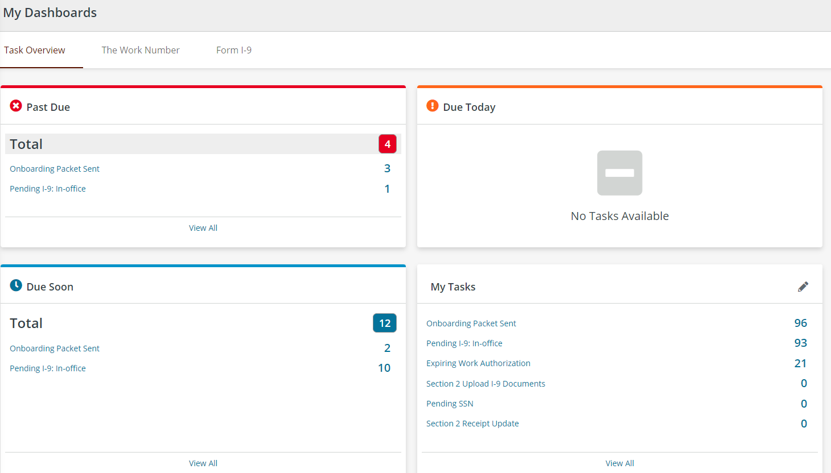
Dashboard Review
Your dashboard is what you’ll see as soon as you log into I-9 HQ. Let’s review each panel.

Slide 11
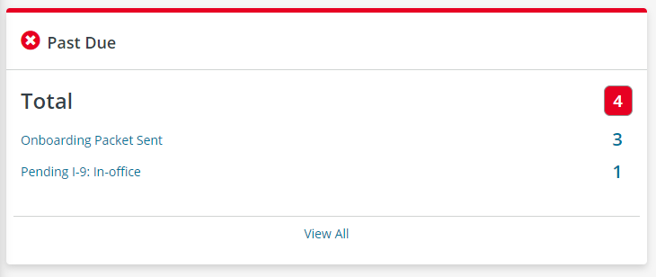
Dashboard Review
The Past Due panel shows all tasks for your location that are currently overdue. Select each task name to see each pending new hire under that task type and the due date.

Slide 12
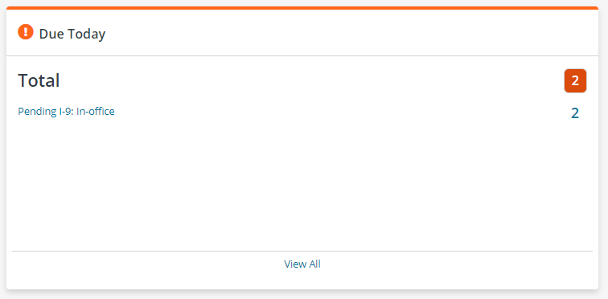
Dashboard Review
The Due Today panel shows all tasks need to be completed by the end of the day in order to remain in compliance. Select each task name to see each pending new hire under that task type.

Slide 13
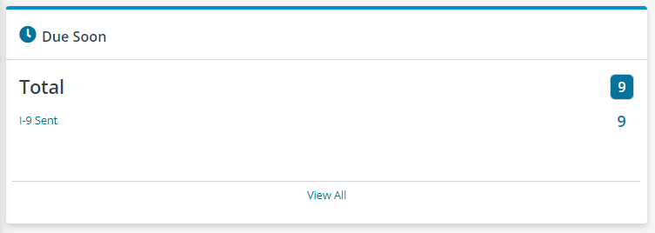
Dashboard Review
The Due Soon panel shows all tasks are due in the next few days. Select each task name to see each pending new hire under that task type.

Slide 14
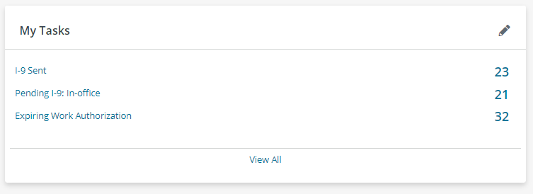
Dashboard Review
The My Tasks panel is a customizable panel that shows all pending tasks for your location, regardless of the due date. Select each task name to see each pending new hire under that task type.

Slide 15
Initiating an I-9
To initiate an I-9 for your new hire, complete the New Hire I-9 Request Google Form.
Human Resources will review the request to ensure that the new hire does not already have a pending or completed I-9.
If they do not, HR will initiate the I-9 for the student. I-9s are bulk-initiated at the end of each business day.
Once the new hire completes Section 1, their name will appear as a pending task on your Equifax dashboard.

Slide 16
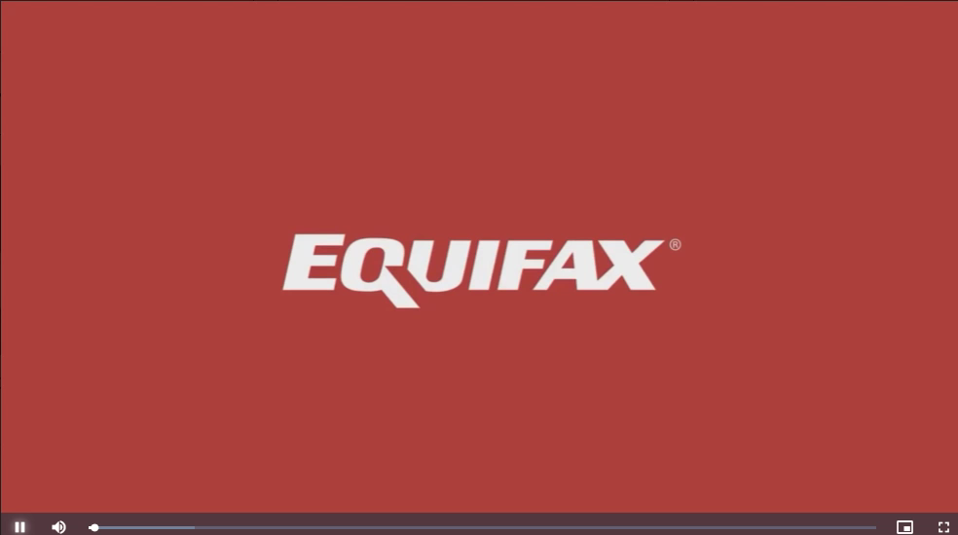
Section 1 - New Hire Experience
Hover over the above video and press Play.
Note: disregard any information about I-9 Anywhere. Rowan does not utilize this service.

Slide 17
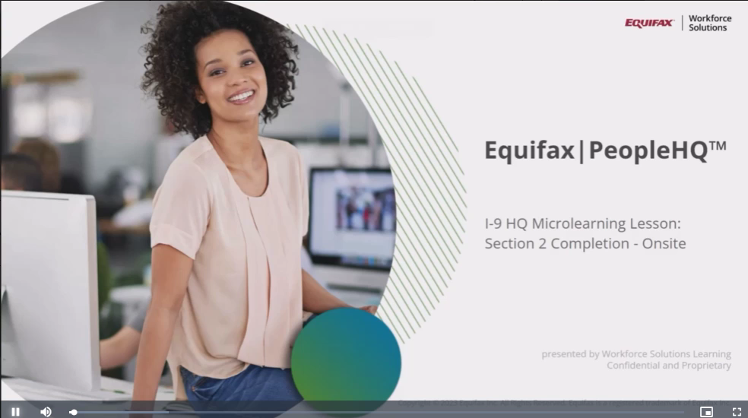
Completing Section 2
Hover over the above video and press Play.

Slide 18
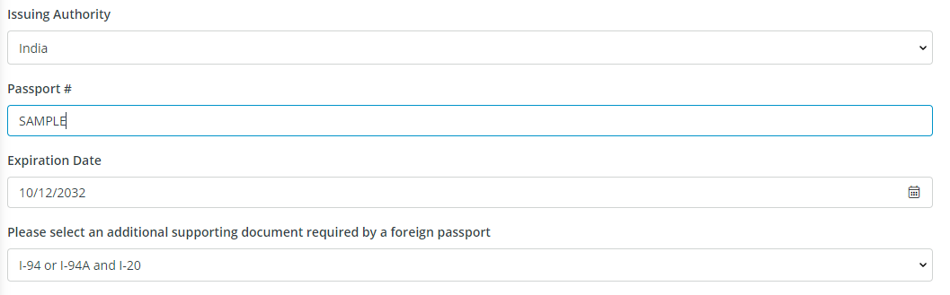
Completing Section 2 for International Employees
When completing Section 2 for an international student worker, select Foreign Passport, then I-94 or I-94A and I-20 as the document selection.
When entering the I-20 information, be sure to select the Employed on Campus box and enter Rowan University as the I-20 Issuing Authority.

Slide 19
Supplement B: Rehires and Reverifications
Supplement B is used to reverify work authorization for international employees and for rehiring employees that have not worked in more than a year but completed their I-9 less than three years ago.
HR will process any Supplement Bs that populate in your task lists.

Slide 20
Additional Information
If you need access to I-9 HQ, or for any questions relating to I-9s or I-9 HQ, please email the HR I-9 team at hri9@rowan.edu.
You can review additional I-9 resources on the HR website: https://sites.rowan.edu/hr/i9_resources.html

