Slide 1

Your Money Matters
Office of the Bursar
Office of Financial Aid

Slide 2


What is Financial Aid?
    Financial aid is need based funding intended to assist families bridge the gap between what a family can afford and the total cost of education.
Types of Aid:
Scholarships
Grants
Loans
Work Study
Sources:
Federal Government
State
Private/ other

Slide 3

Scholarships & Grants
“Gift Aid” that does not have to be repaid
Scholarships
  Merit based: Rowan Scholars Program; Rowan Trustee Scholarship
  Continuing Foundation Scholarship Program
Grants
  Based on financial need
  Sources: Federal & State

Slide 4

Federal Student Loan Summary
Program | Eligibility | Annual Amount | Interest Rates/Lender Repayment
Subsidized Direct Student Loan | The federal government pays interest while borrower is in school | $3,500 - $5,500 | Fixed rate of 5.04% Between 10 and 25 years to repay.
Unsubsidized Direct Student Loan | The borrower is responsible for all interest; must be at least half-time; financial need not required | $5,500 - $20,500 | Fixed rate of 5.04%
Direct Plus Loan | For parents of dependent undergraduate students. *Based on credit check. | Maximum amount is cost of attendance minus financial aid | Fixed rate of 7.59%

Slide 5
Work Study
Federal Work Study
Indicate desire to participate on FAFSA
Demonstrate “financial need"
Paid out of federal funds
Institutional Work Study
Any student may apply
Paid out of institutional funds

Slide 6
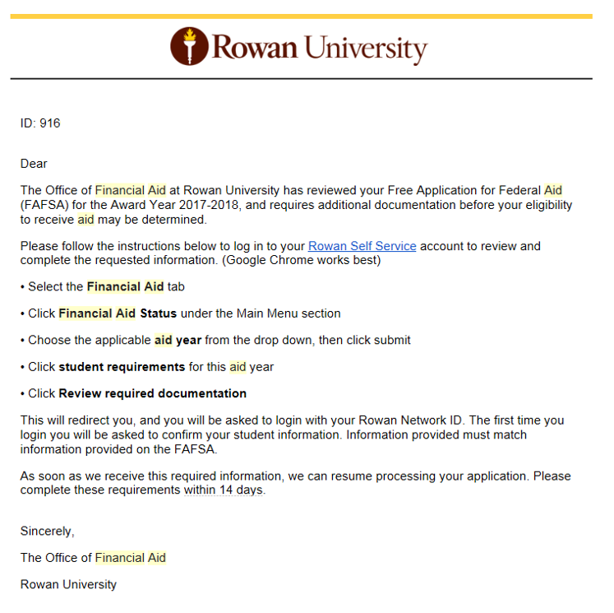
Student Self - Service

Slide 7
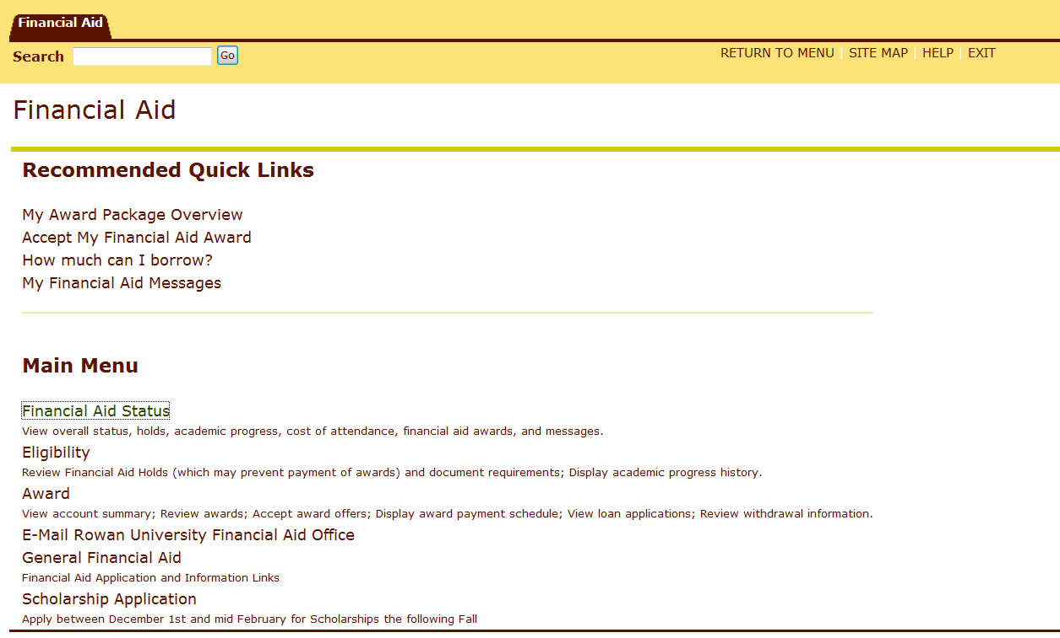
Self – Service How To

Slide 8
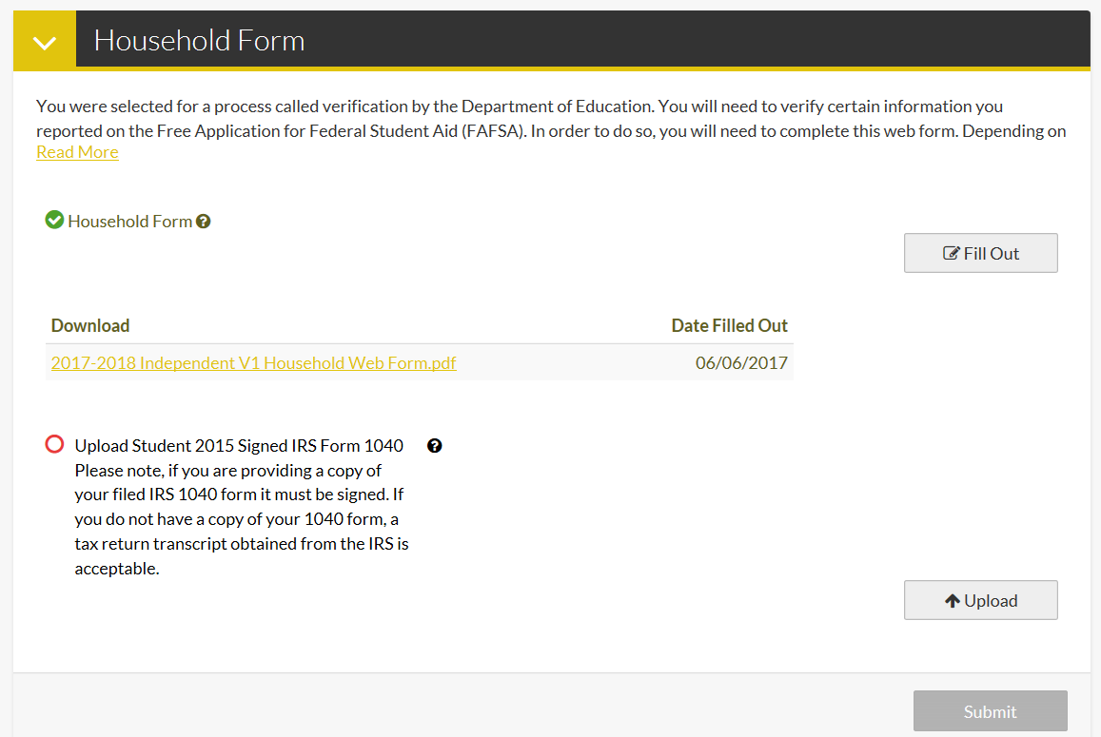
Self – Service How To

Slide 9
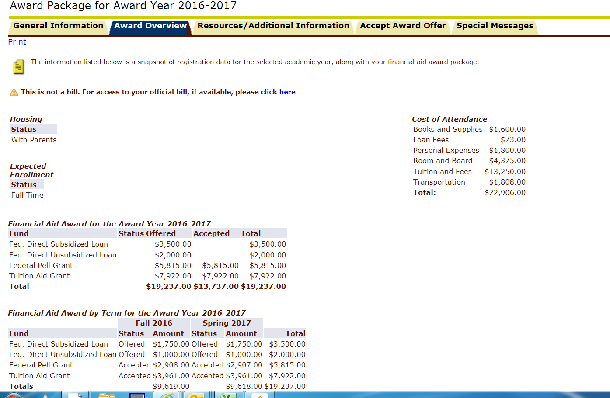
Self – Service How To

Slide 10
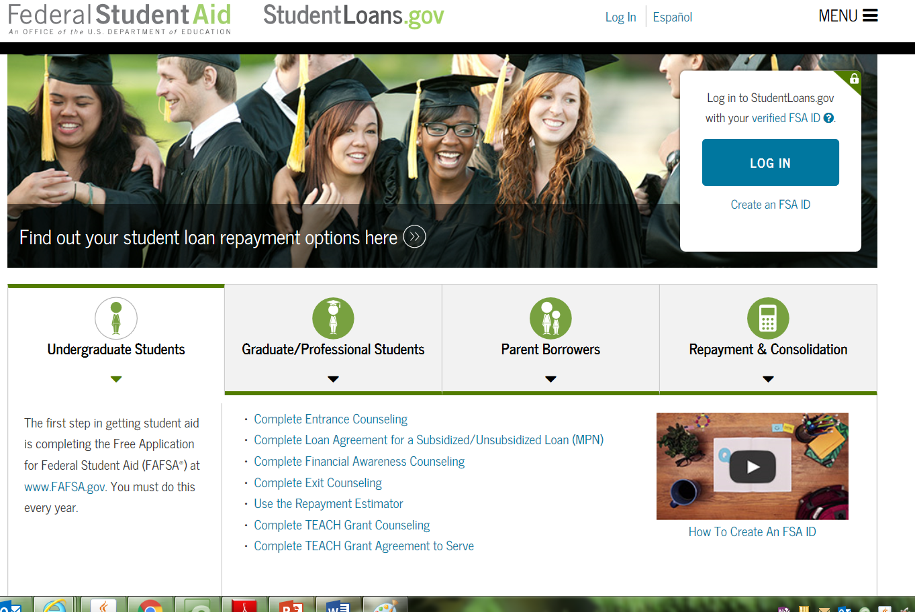

Slide 11
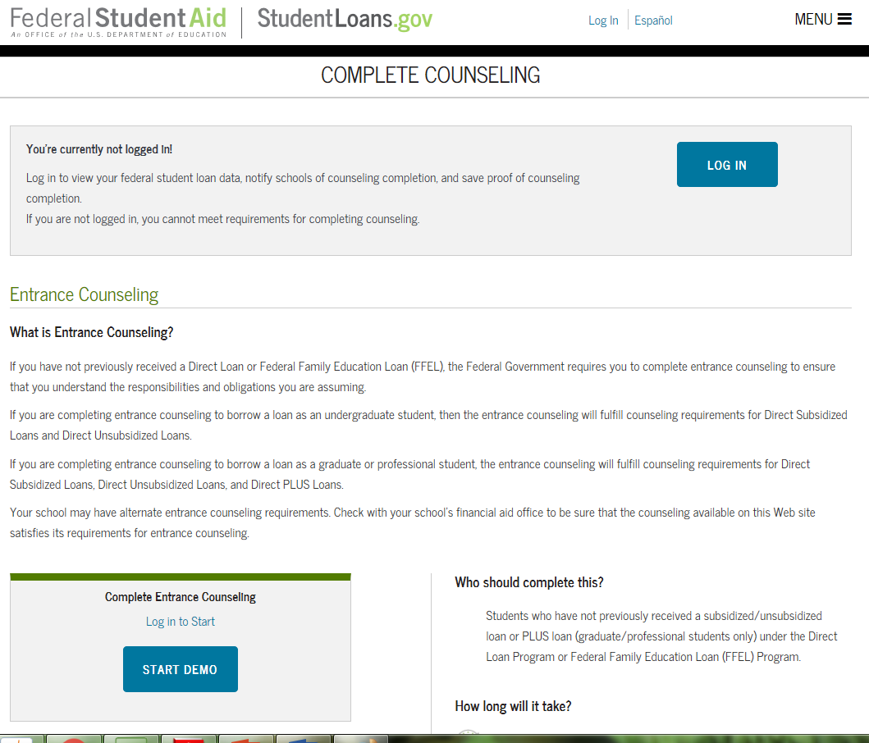

Slide 12
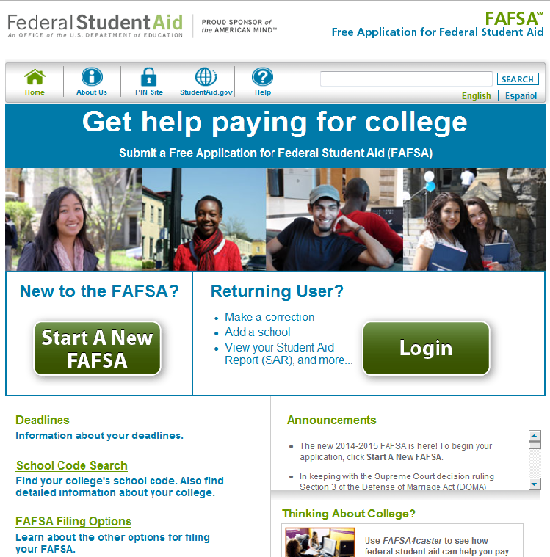
Apply for Financial Aid Online Every Year
FAFSA.ED.GOV

Slide 13
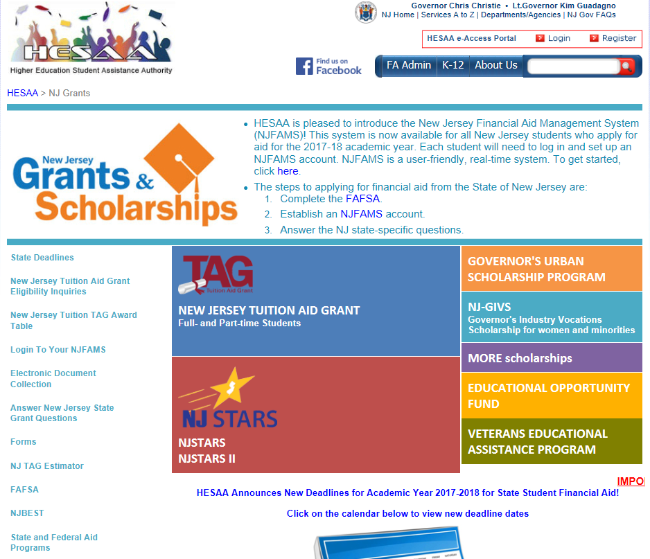
Apply for Financial Aid Online Every Year
NJGRANTS.ORG

Slide 14

Financial Aid Process
Complete your FAFSA & Submit Additional Information to HESAA
Review your SAR (Student Aid Report)
Complete Verification Process, if Selected
Review your Award Package
Accept Award Offered
Complete Loan Entrance Counseling & Sign your MPN
Apply for Parent PLUS Loan/ Private Loan Only if Needed

Slide 15
Satisfactory Academic Progress (SAP)
Federal guidelines stipulate that in order to receive financial aid, students must meet the minimum standards of Satisfactory Academic Progress (SAP).
Brief Summary of Rowan University’s Financial Aid SAP Policy:
Grades reviewed after each term.
Minimum Cumulative GPA requirement = 2.00
Minimum Completion Rate = 67%
Students who do not meet the GPA or Completion Rate requirement after one semester will receive a WARNING.
Students who do not meet the GPA or Completion Rate requirement after their WARNING semester will be notified their Financial Aid eligibility has been suspended.
NOTE: Students can appeal their suspension. For more information, go to https://www.rowan.edu/home/financial-aid/satisfactory-academic-progress.
Students are strongly encouraged to use academic and counseling services should issues arise throughout the semester.

Slide 16

Financial Aid Office
Location: Savitz Hall, 1st floor
Website: www.rowan.edu/financialaid
Hours: Summer Hours
Monday through Friday, 11:30 a.m. to 4:30 p.m.
  Fall – Spring Hours
  Monday through Friday, 8:00 a.m. to 4:30 p.m.
  *most Wednesdays until 6:00 p.m.
Phone: 856.256.4250
Email: financialaid@rowan.edu
Twitter: @RowanFinAid

