Slide 1
Fiscal Year-End Prep
FY 25 Year-End Training presented by the Division of Finance
Wednesday, April 30, 2025

Slide 2
Agenda
Budget
Procurement
Accounts Payable
Accounting Services
Grants
Questions

Slide 3
Finance Division
Accounting Services
Payroll
Accounts Payable (A/P)
Finance Division
Contracting & Procurement
Budget
Bursar

Slide 4
Budget

Slide 5
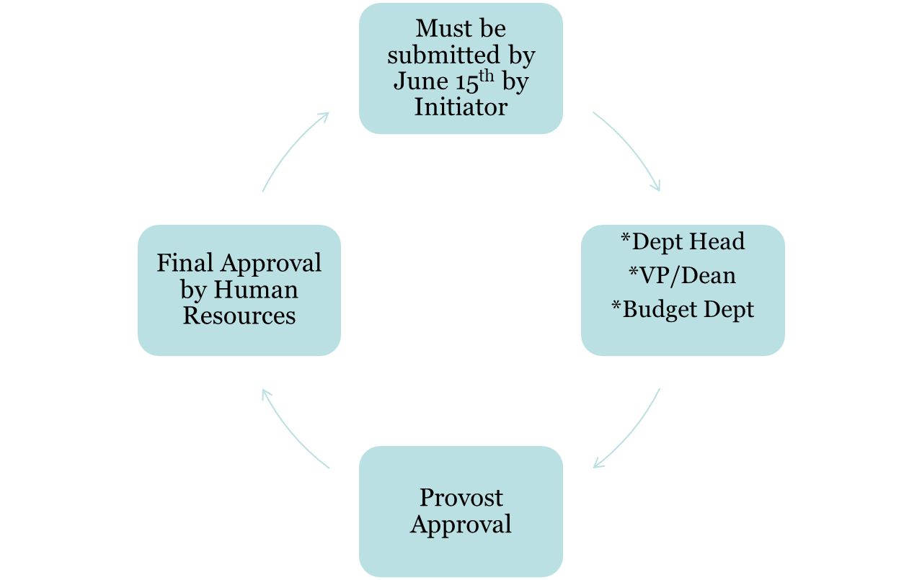
Life Cycle of a Salary Contract
Must be submitted by June 12th by Initiator
*Fiscal Year End Budget Availability (Payroll 14)

Slide 6
Finalize FY 25 Operating Budgets (Non-Rollover)
Clean up account
Start the new fiscal year fresh
For closing purchase orders - refer to slide 19
For closing travel – refer to slide 31
Purchase Orders roll, but NOT the funds in operating accounts!

Slide 7
Finalize FY 25 Operating Budgets (Non-Rollover)
Ensure adequate budget availability for central charges (non encumbered expenses)
Purchasing Card (BOA)
Amazon
Telephone
Duplicating
Copier
Catering
Stationery
Office Depot
Bookstore
Gasoline
Housekeeping Supplies

Slide 8
FY 26 Operating vs Carry Forward Budgets
Operating Budgets = Non Rollover
Funds include: 10110, 10200, 10112, 10400, 30010, 30015, 30040, 30050, 30200
Budgets available starting July 1st
Carry Forward Budgets = Rollover
Start Up Funds: 11099
CHRI: 16800, 16801
Student Clubs: 30044
Budgets will be available after FY 25 closes and the reconciliation process is complete

Slide 9
FY 26 Operating Budgets vs Carry Forward Budgets
Carry Forward Budgets = Rollover
Special Program Budgets
Will follow annual process
Budget Form Submission exceptions
Start Up Funds: 11099
CHRI: 16800, 16801
Student Clubs: 30044
Budgets will be available after FY 25 closes and the reconciliation process is complete

Slide 10
Contact Information
Budget@rowan.edu

Slide 11
Procurement

Slide 12
New Vendor, Vendor Reactivation Requests, Contracts
Vendors
Requests submitted after June 14th may not be processed before the requisition cut off date. It is imperative that all requests are submitted by the deadline to ensure vendor accounts are established in time to process your requisition. Vendor IDs will not be created in lieu of vendor compliance in order to process requisitions.
Vendors with an anticipated spend of $15,000 or more generally take more time to onboard. Please keep this in mind when submitting your requests.
Contracts
If your request has an associated contract and services will be provided in the closing fiscal year, please submit the contract accordingly and allow three weeks for processing.
You can request a New Vendor, Vendor Reactivation, and a Contract Request in ProConnect.

Slide 13
Requisitions
Training Materials for ProConnect & Banner Requisitions
Purchase Process Requirements
ProConnect:
Shopper Guide
Requestor Guide
Approver Guide
All new requisitions must be completed, including appropriate Departmental Queue Approvals, by the date provided in the Annual Memo. When placing your requisition please ensure all required documentation including any quotes, forms, etc., is provided so the purchase order conversion can be completed timely.
Incomplete requisitions, will be deleted on June 30th regardless of funding to ensure a smooth fiscal year closeout.

Slide 14
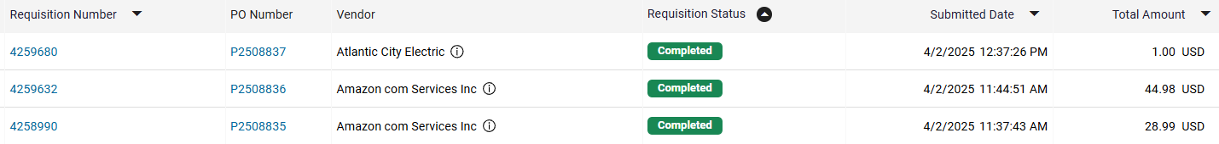
Requisitions: ProConnect
How can I tell where my requisition is in the process? Or has my requisition been converted?
ProConnect
Go to Orders>My Orders>My Requisitions
Use the Filter Tool to organize your view

Slide 15
Requisitions: Banner
How can I tell where my requisition is in the process? Or has my requisition been converted?
To view the Banner approval history for a document:
From the Banner 9 Welcome screen, search for page FOIAPPH and hit Enter
Enter the document number into the Document Code field
Click “Go” on right hand side
The Details section will display actions taken on the document to date
To view the pending approvals for a document:
From the Banner 9 Welcome screen, search for page FOAAINP and hit Enter
Enter the document number in the Document field
Click “Go” on right hand side
The Queue list will display queues and approvals still pending. Fully approved documents will not display on this page
NOTE: “NON_GRANTS REQ QUE” is the Purchasing queue.

Slide 16
Receiving in ProConnect & Banner
If your purchase order was created in ProConnect, your receiving should be done in ProConnect. If your purchase order was created in Banner, your receiving should be completed in Banner.
Receiving is necessary to issue payment to the vendor. Receiving should be completed when the goods or services have been received or completed - not before.
Goods and/or services must be physically and electronically received by the close of the fiscal period, June 30, to be charged to the closing year’s budget
Any open purchase orders at the end of the closing year will be charged against the new fiscal year’s budget if the item hasn’t been physically received.
How to create receipts?
ProConnect
Banner

Slide 17
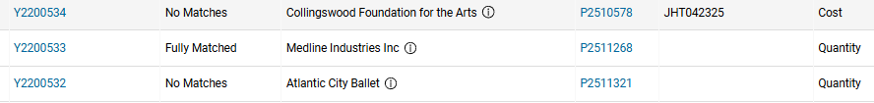
Receiving in ProConnect & Banner
How to ensure you have completed your receiving?
ProConnect
Go to Orders>My Orders>My Receipts
Use the Filter Tool to organize your view
Check the Matching tab to ensure the receiving was done correctly. The invoice must be in matched status in order for payment to be made. If the invoice is in unmatched status, review to see if a change order is needed.
Banner

Slide 18
Existing Purchase Orders: Change Orders
If your purchase order was created in ProConnect, you can complete your change order directly in ProConnect. If your purchase order was created in Banner, you must submit a change order request in the Change Order Portal.
Change order requests to existing purchase orders will be treated like new requisitions and follow the same cutoff schedule.
Note: If the invoice amount is more than 10% of PO amount or greater than $100 you will need to request a change order. In ProConnect, a line item cannot be exceeded by more than 20%. If shipping is not present on the PO, but included on the invoice, AP can add any amount up to $100. Otherwise, you will need a change order.
Change Order Instructions ProConnect
If you have any PO specific questions, please reach out to the buyer listed on your PO.

Slide 19
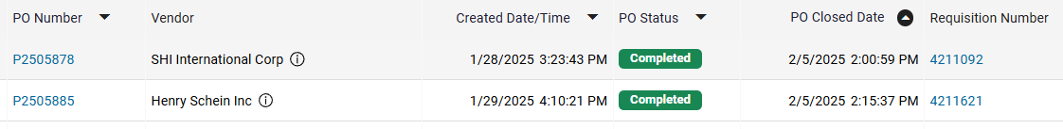
Existing Purchase Orders: Closeouts
If your purchase order was processed in ProConnect, you can request a close out directly within your purchase order in ProConnect. If the purchase order was processed in Banner, you must submit your closeout request in the Closeout Request Form.
Important Note: ALL PURCHASE ORDERS IN BANNER WILL BE CLOSED THIS FISCAL YEAR.
ProConnect
Go to Orders>My Orders>My Purchase Orders
Use the Filter Tool to organize your view
Fiscal Year 25 Closeout Instructions
Banner
Please check the PO status in FGIENCD in the Encumbrance Detail section to ensure your PO is in "O" (open) status. If your status is "C" closed you will not need to fill out this form. Your PO has already been closed.
Pro Tip: Your Encumbrance Detail may have multiple pages, you will need to check each page to know if your PO is fully closed.
ProConnect & Banner
All invoices must be paid prior to closing PO.
If your PO has multiple line items, they cannot be closed individually. Due to limitations in system functionality, the entire PO will need to be closed.

Slide 20
Amazon
Orders submitted after the cutoff date of June 19th will be rejected.
Forward all applicable approvals (Entertainment Form, IRT, furniture) to amazon@rowan.edu to avoid processing delays.
Orders for departments with their own approval queues (Athletics, SOM, Engineering, and Grants) should be placed as early as possible to allow time for all Approver reviews.
For funds which are exempt from cutoff dates, Amazon orders may be processed with a requisition after this date. Choose “Pay by Invoice” as the payment method at checkout. Once approved, enter a requisition in Banner using ID 916307054. You will need to forward the order confirmation email to amazon@rowan.edu as supporting documentation.

Slide 21
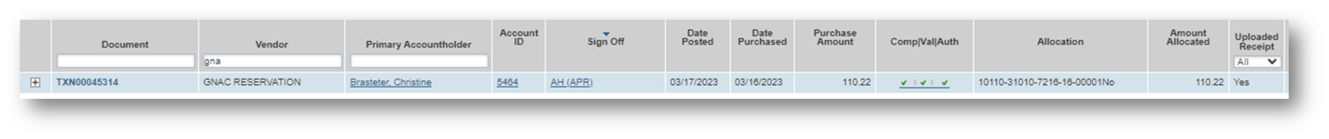
Purchasing Cards
The cutoff date for FY25 purchases is June 30th. Purchases for FY26 should not be made until July 1.
When applicable, Entertainment Forms, Gourmet Dining Waivers, IRT approvals, and furniture approvals must be submitted to the Accountholder’s designated P-Card representative along with any override requests.
Finalizing Transactions
Transactions typically post to the account two business days after the purchase was made. During the month of June, you should routinely check your accounts in the Works system for any open transactions.
Transactions are not considered finalized until receipts have been uploaded, allocations have been completed, and transactions have been signed off.
Yes in the Uploaded Receipt column indicating you have successfully uploaded a receipt.
Three green check marks in the Comp/Val/Auth column indicates you have successfully allocated the transactions.
AH in the Sign Off column indicates you have successfully signed off.
All June P-Card transactions must be allocated in the BoA Works system by 4 p.m. on July 10th.

Slide 22
Contact Information
Alexis Jones jonesal@rowan.edu
Amazon: Katie Cacchioli cacchioli@rowan.edu
Bank of America: Nicole Johnson johnsonn@rowan.edu, or Chelsie Alliano alliano@rowan.edu
Closeouts: Kristine Rivera riverak@rowan.edu
Change Orders: Christina Haley haley@rowan.edu
Contracts: Rebecca Hartman hartmanr@rowan.edu, or Chelsie Alliano alliano@rowan.edu
Requisitions: Christina Haley haley@rowan.edu
Office Depot: Christina Haley haley@rowan.edu
Vendors:Erann Dutton duttone@rowan.edu, or Chelsie Alliano alliano@rowan.edu
ProConnect: ProConnectsupport@rowan.edu, or Beth McMillan mcmillanb@rowan.edu

Slide 23
Accounts Payable

Slide 24
Invoices Processed in Banner
Monday, July 7th— last day to submit any invoices to be processed for FY 25
Ensure all invoices have been sent to Accounts Payable via invoices@rowan.edu
Ensure you send the vendors you are working with their approved PO#(s) as soon as you obtain them & request that they send their invoices with the PO# on it to invoices@rowan.edu
Can request that the vendor copy end-user on the email
To avoid processing delays:
Ensure you process electronic receiving in Banner as soon as you receive the product/service
If you know you will be invoiced a higher amount than you originally thought & requested on the requisition, submit a change order ASAP & ensure you process electronic receiving for the additional amount
NOTE: If the invoice amount is more than 10% of PO amount or greater than $100 you will need to request a change order
An invoice needs to be submitted - Proforma invoice or quote is NOT accepted
Start & end date of the service need to be provided if not listed on the invoice
For ex. Membership/subscription term
Ensure you are responding to AP requests in a timely manner
If receiving is required in order for the payment to be processed:
AP sends out reminder emails to process receiving – these emails will be sent out weekly & daily as we get closer to FYE
Automated daily emails are sent if receiving is incomplete

Slide 25
Invoices Processed in ProConnect
Monday, July 7th— last day to submit any invoices to be processed for FY 25
Ensure all invoices have been sent to Accounts Payable via invoices@rowan.edu
Ensure you send the vendors you are working with their approved PO#(s) as soon as you obtain them & request that they send their invoices with the PO# on it to invoices@rowan.edu
Can request that the vendor copy end-user on the email
To avoid processing delays:
Approve any standing order invoices (awaiting invoice owner approval)
Complete receiving for any regular order invoices if items have been received on or before June 30th
If items have not been received, make a comment on the invoice.
Verify that PI approval is also completed when applicable (necessary for all 5 or 6 funds)
Review any invoices in Match Exception – do not only approve without further action as these require change orders
Ensure change orders are in complete status prior to approving the invoice
Change order is needed if the line item has been exceeded by more than 20%
Change order is needed if shipping was not requested on the PO and is on the invoice for more than $100
An invoice needs to be submitted - Proforma invoice or quote is NOT accepted
Start & end date of the service need to be provided if not listed on the invoice
For ex. Membership/subscription term
Ensure you are responding to AP requests in a timely manner
For additional instructions on invoices in ProConnect, please visit Invoice Payments - ProConnect or see ProConnect End User Invoice Guide .

Slide 26
Important Note Pertaining to ALL Invoices
*Only services that have been rendered or items that have been physically received on or before June 30th will be recorded in FY 25*
Any invoices processed in Banner or ProConnect that remain in the system awaiting receiving as of June 30th EOB will be deleted and re-processed as FY 26 expenses after the FYE roll.
If in Banner, a new PO will need to be opened in ProConnect for the invoice to be re-processed against.

Slide 27
Non-PO Payment Requests
Monday, July 7th— last day to submit any Non-POs to be processed for FY 25
Email all requests directly to invoices@rowan.edu with “Non-PO” listed in the subject line – please do not send via inter-office mail.
Note: we will be hosting a separate training specifically on Electronic Non-POs during FYE on Wednesday, June 11th.
To avoid processing delays:
Review the Non-PO Category List to ensure you are not submitting a Non-PO that is not reimbursable
Double check that all required documentation is attached to your Non-PO Payment Request Form & that all approvals have been obtained
For example, ensure proof of payment is attached (examples shown on slides 28-29) & all approval signatures have been obtained
For additional information on required documentation, visit our Non-PO Payment Request Webpage

Slide 28
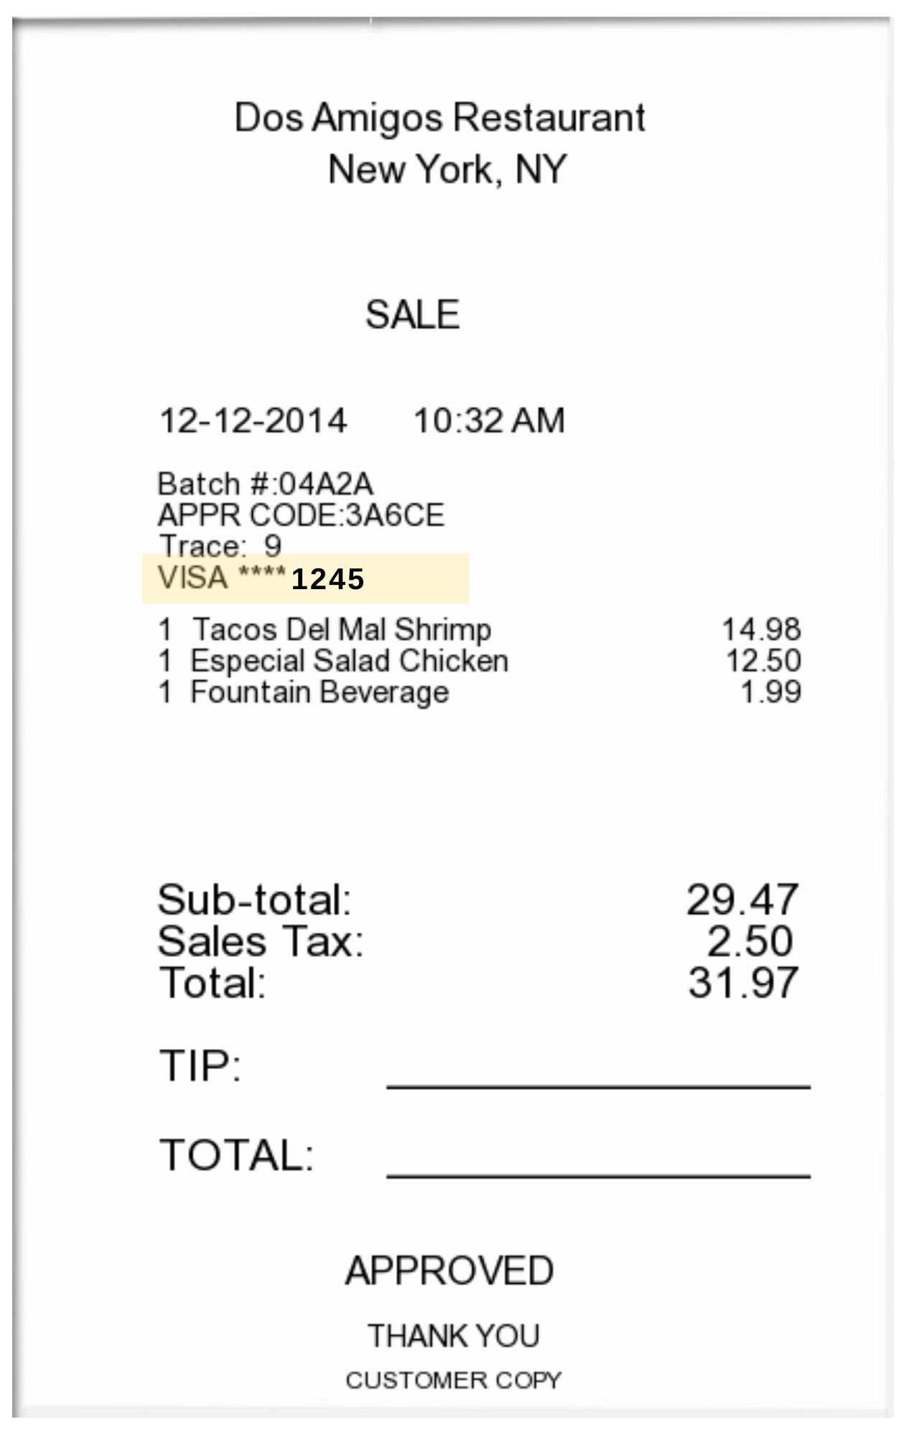

Proof of Payment Example
Itemized Receipt with CC Info Listed
Credit Card with matching 4 digits

Slide 29
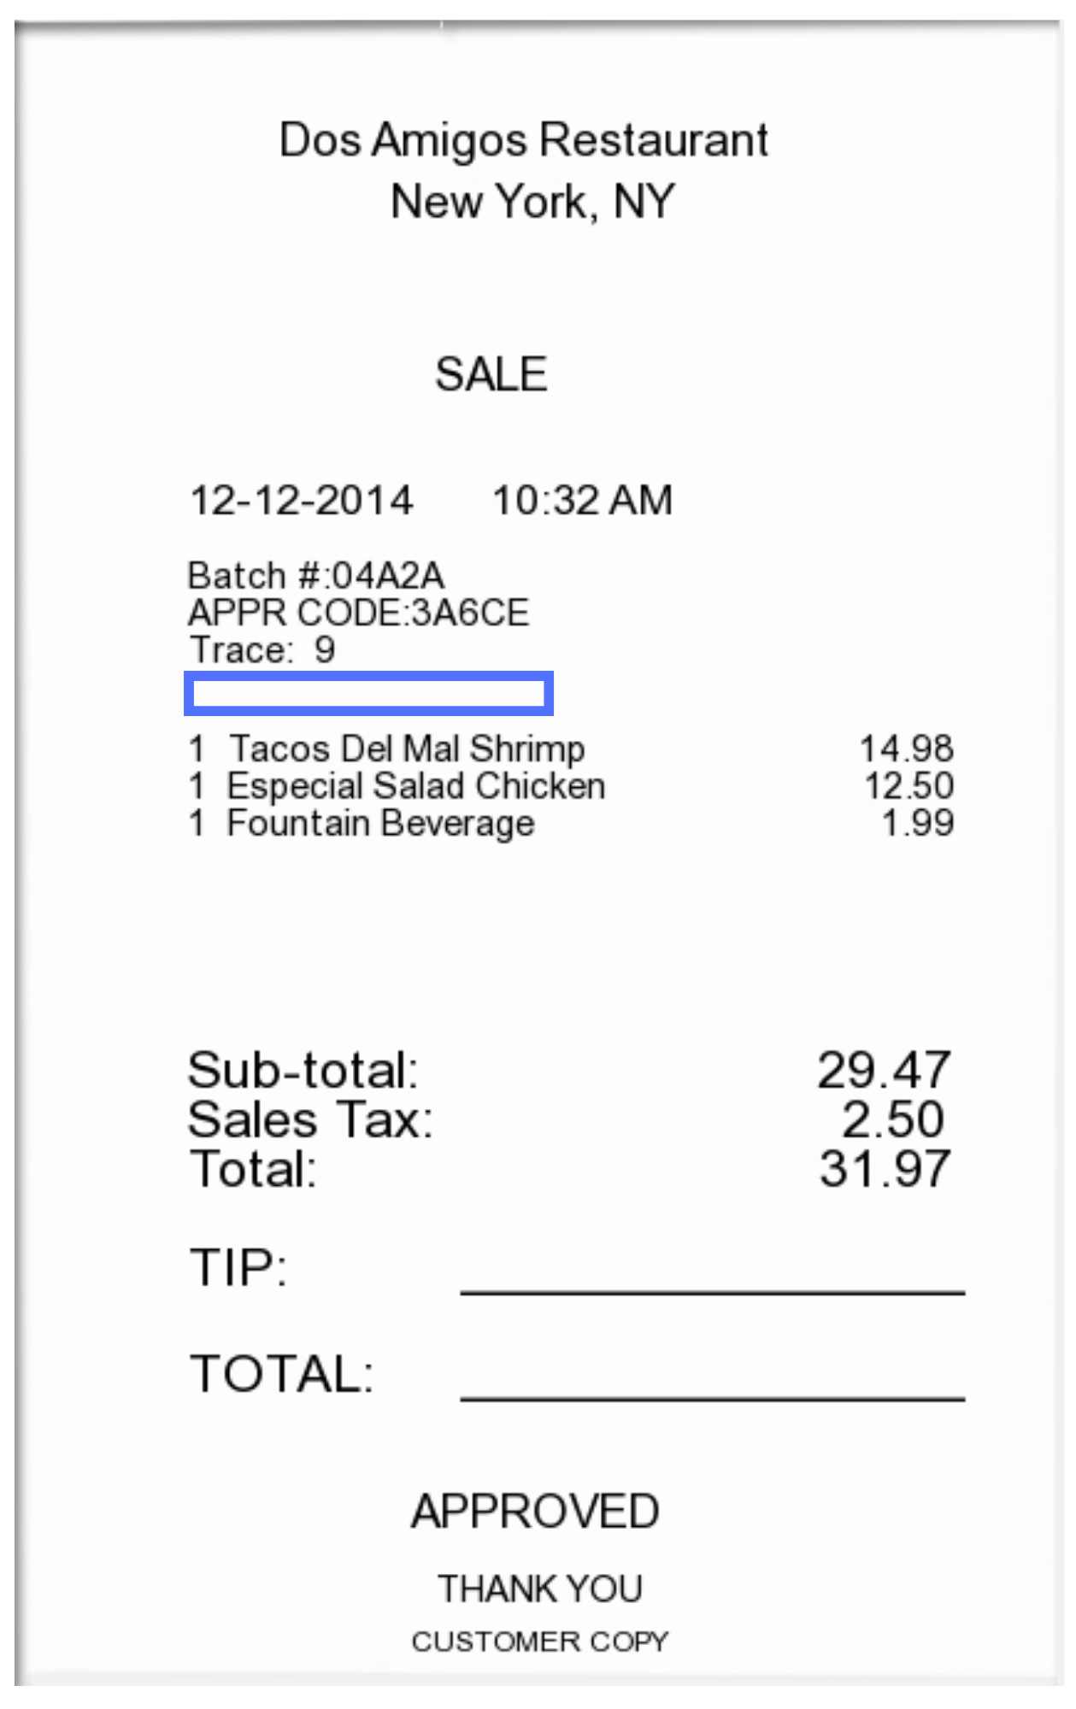
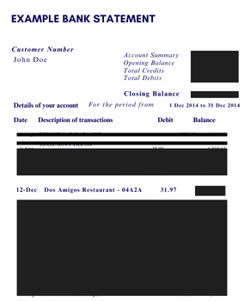
Proof of Payment Example
Itemized Receipt without CC Info Listed
Redacted bank statement showing the charge & the name of the individual being reimbursed

Slide 30
Memberships/Subscriptions
Memberships/Subscriptions spanning two fiscal years: FY 25-FY 26 or purely for FY 26
For ex. Spanning from June 1, 2025 – June 1, 2026 or July 1, 2025 – July 1, 2026
Must be processed and paid by June 30th
NOTE: It must be processed & paid by June 30th in order to be reflected in FY25 & utilize SDE Dates (start & end date)

Slide 31
Employee Travel - Overnight & Day
Monday, June 30th— last day to submit any Concur expense reports to be processed for FY 25
NOTE: Keep in mind that you need to allow sufficient processing time for travel requests to be fully approved with encumbrance #s.
If deadline is missed, Accounting Services will capture and analyze the expense for reporting in the proper fiscal year.
Review any open encumbrances — confirm expense reports have been submitted & fully approved
Once the report has been fully approved in Concur (sent for payment status), Close Out Your Request
If you closed out your request and notice the budget is still held up, there may be an error — email asktravel@rowan.edu
To avoid processing delays:
Cost Object Approvers (COA) in Concur — verify there is sufficient budget in the foapal lines before approving reports to avoid Non-Sufficient Fund (NSF) issues. If you need to move budget, have it moved prior to submitting the report.
Ensure all required documentation is attached – utilize Expense Report Tip Sheet and visit Employee Travel for more resources

Slide 32
Concur Travel Encumbrances - For Employees
FY 25 encumbrances do not roll over into FY 26 — this cannot be changed due to Banner systematically closing out the encumbrances for the fiscal year-end roll
Due to this, if your trip is still multiple months away & you will not be charging any of the expenses before June 30th, we recommend not submitting your Travel Request until after June 30th.
If submitting an FY 26 Travel Request in FY 25:
Before June 30th - include all predicted travel expenses on the request, but only include amounts for the expenses that will be charged in FY 25 and will be included in the encumbrance
After July 1st – submit another Travel Request as “extension of prior trip”
Include all travel expenses, but only include amounts for the expenses that will be charged in FY 26 and will be included in the encumbrance
NOTE: Only airfare and registration can be submitted as a prepayment for reimbursement.

Slide 33
Student Travel - Overnight & Day
Monday, June 30th— last day to submit any paper expense reports to be processed for FY 25
NOTE: Keep in mind that you need to allow sufficient processing time for travel requests to be fully approved with encumbrance #s.
Review any open encumbrances
Confirm expense reports have been submitted & fully approved – can verify payment status to the student via Banner screen FAIVNDH
Email asktravel@rowan.edu with the following info to close-out existing encumbrances:
Traveler Name
Encumbrance #
Destination
Reason for closing
To avoid processing delays:
Verify there is sufficient budget in the foapal lines before approving reports to avoid Non-Sufficient Fund (NSF) issues. If you need to move budget, have it moved prior to submitting the report.
Ensure all required documentation is attached to the travel form – utilize Expense Report Tip Sheet and visit Student Travel Webpage for more resources

Slide 34
Payment Verification
Utilize Banner Screen FOIDOCH to review the status of a particular document (can search by a requisition #, a purchase order #, an invoice #, or a check #)
If invoice states “Receipt Required” = either electronic receiving was not done on a PO or there may be an issue with the receiving document (Y number)
If invoice states “Approved” = direct pay or invoice is approved, but payment has not been disbursed
If invoice states “Paid” = payment has been disbursed
There will be a corresponding check disbursement document (CHK #)
Utilize Banner Screen FAIVNDH to review all of the payments processed to a vendor
Can search by Banner ID to see if a Non-PO has been processed
For detailed step-by-step instructions on utilizing these screens, visit Invoice Payments

Slide 35
Contact Information
AP Director - Joselyn Peoples ext. 4335 or email peoplesj@rowan.edu
AP Supervisor - Stacey Bucci ext. 4117 or email buccis@rowan.edu
Full AP Team Contact List
For Invoices or Non-PO Questions - email invoices@rowan.edu
Invoice Payments - Banner
Invoice Payments - ProConnect
Non-PO Payment Requests
For Travel Related Questions - email asktravel@rowan.edu
Travel
For Gift Card Related Questions, email giftcards@rowan.edu
Gift Cards

Slide 36
Accounting Services

Slide 37

Accounting Services (AS)…
Year End Topics
FinSecurity (Banner Finance Access)
Set up Approval Queues (Banner Queues)
Banner Finance Fiscal Year End Process Update (Roll)
Fixed Assets/Equipment Inventory & recording Disposals
Journal Entries (including Departmental Charge Authorizations (DCAs))
Compile Annual Financial Statements for all entities (RU, RUF, SJTP, SGA, & REA)
Work with external & internal auditors; ensuring audit compliance & reporting
Financial & Compliance Reporting (excluding external grant reporting)
Facilitating ad hoc, monthly, quarterly & annual reporting

Slide 38
FinSecurity
FinSecurity
AS in conjunction with Analytics, Systems & Applications (ASA) Security is responsible for providing access to the Banner Finance System.
Requests for Banner Finance Security should be made through Rowan Support Portal
Instructions on AS website at: Banner Finance Security
Please allow adequate time for approvals and processing.
Fiscal Year End Reminder
Submit changes or access request as soon as possible with proper approvals via the Rowan Support Portal.
FY25 fund access cutoff is June 1, 2025.
Access can not be established via email requests.
New FY26 funds must be established in Banner before access is given.

Slide 39
Departmental Queue Approvals
Departmental Queue Approvals (Non-PO & Requisition* Queues)
AS sets up and maintains approval queues in the Banner Finance System
Queue approver changes should be communicated as soon as possible, please allow sufficient time for changes to be incorporated.
Queue approvers will be confirmed annually.
*ProConnect queues will be updated separately and subsequently to Banner Requisition queues.
Fiscal Year End Reminder
Approvers to complete FY25 requisition review by cutoff date of June 19th.
Approvers will be asked to clear all queues prior to the Banner Finance FYE Process update (system roll procedures), scheduled for mid-July (tentatively July 25th). See slide 15 for more information.
Finance will be reminding approvers of pending items prior to system roll. Items in queues may be deleted if not addressed.

Slide 40
Banner Finance FYE Process Update (Roll)
AS facilitates the Banner Finance Process Update (system roll)
Roll general ledger balances (balance sheet accounts beginning balances)
Roll Open ProConnect POs so available in Banner in new FY
All Banner initiated POs will be systematically closed.
All encumbrances (E#) will be systematically closed out.
Roll Grant & Capital Budgets (Inception to Date budgets)
All users are required to remain out of the system.
Fiscal Year End Reminder
Prep for roll by reviewing open POs throughout the year
Investigate open balances with services provided or goods received
Ensure receiving is done correctly on PO
Ensure vendor has submitted invoice to invoices@rowan.edu
Request close out of PO when no longer needed or with zero balance
Banner initiated POs will be closed out as part of FY25 FYE process.
Encumbrances (E#) should be closed out in concur.

Slide 41
Fixed Assets/Equipment
AS capitalizes equipment that meets the policy threshold.
During FY25, the threshold increased to $10,000 for non-external grant funds. External grant funds (beginning with a 5xxxx or 6xxxx) continue to capitalize costs above $5,000.
This includes the shipping and handling, installation, and parts needed to make the equipment operational for each item.
AS is working to ensure FY25 are recorded in appropriate accounts, you may see reclassification transactions in your departmental budgets.
For FY25, requisitions must continue to use account code 7645, equipment over $5K*, and contain required document text (custodian information, intended usage, description, location, and estimated useful life).
AS is required to inventory items every two years in order to comply with federal, state and University guidelines. Departments are encouraged to maintain up-to-date equipment records in order to assist in the physical inventory process.
* Effective FY26, a new account code will be established for University equipment , and account 7645 will be renamed to equipment over $5k (Grants Only).

Slide 42
Fixed Assets/Equipment
Link to existing training tools on the AS website at or (threshold updates in the process):
Quick Reference Guide for Fixed Asset Purchases $5,000* and up and
Fixed Assets – Ordering Equipment over $5,000 instruction video*
Fiscal Year End Reminder
Ensure requisition has proper account code and document text to prevent delays and denials.
Please respond to inventory requests promptly to ensure all items are viewed in appropriate timeframe.
Items must be received on campus by June 30th in order to be applied against FY25. If an item is not received by June 30th it will be applied to FY26 budget.
*AS is in process of updating training tools to reflect changes to threshold.

Slide 43
Equipment Disposals
Fixed Asset Disposals
AS is responsible for the centralized accounting and reporting of University equipment assets meeting the capitalization threshold.
To ensure accurate financial reporting, disposal of equipment should be documented and communicated timely to AS.
Disposals include transfers to outside agencies (state, other institutions of higher education, not for profit organizations).
Fiscal Year End Reminder
Departments are responsible of ensuring all equipment disposals have the fully completed disposal form submitted to AS. Disposals will not be processed without the fully completed/approved disposal form.
Accurate financial statement presentation is dependent upon timely communication.

Slide 44
Journal Entry Examples
Journal Entry Requirements
DCAs are journal entries – Department Reimbursements**
Cash Receipts
Daily Transmittals – account for revenue
General Accounting Entries – e.g., depreciation, disposals, accruals & prepaid entries**, various monthly feeds, etc.
FOAPAL Reclassifications & Correcting Entries - e.g., correcting a program code
Must have supporting documentation
If Reclassification, correcting or general journal entry, must balance (Banner Doc Type JDCA, JE15 & JE16)
Must be submitted timely

Slide 45
DCAs (Departmental Charge Authorizations)
Currently two methods to submit DCAs, Electronic Workflow or legacy paper form .
Electronic DCA workflow has certain fund & account code exclusions, this activity should be submitted on legacy paper form. Also, legacy paper form should continue to be used for Barnes & Noble and Central Receiving/Stores.
Link to electronic DCA workflow process and help. (dca.rowan.edu) & link to Training material.
DCA email box for questions or legacy paper form submission is dca@rowan.edu.
Reminder, please only submit DCA forms once and only as fully executed documents.

Slide 46
DCAs (continued)
Reminders:
Account codes should match on each side of the transaction,
Exception of Bursar fund activity (2912) for Fellow Tuition/Fees/Stipends & Rowan Bucks
Only non-salary expense accounts (7xxx), can be used within the DCA workflow.
Legacy paper DCA should be used for external grant funds & component unit activity.
No DCA should use 7400, reserve allocation.
Ensure budget availability & adequate documentation to support journal.
Electronic DCA workflow has validate button to check budget at point in time. FGIBAVL should be verified before submitting paper form.
Copy of Banner expense should be included in supporting documentation, reference to Banner I# and/or PO# requested.
Approval routing can not be changed by AS on electronic DCA workflow.

Slide 47
DCAs (continued)
Fiscal Year End Reminder
Ensure routing department contact is correct.
Connect with other department to ensure proper contact (not department approver).
AS can not change routing of the electronic DCA workflow.
If routing is incorrect, DCA will need to be completely redone/resubmitted, which delays processing.
Ensure adequate documentation is attached to support the DCA.
Inadequate support will delay processing.
All journal entries need proper documentation to support transaction.
Operating Budgets cannot transfer to Special Programming accounts, including Rowan Global accounts.
Cutoff for all FY25 DCAs (paper and electronic) must be received in Accounting Services by end of day July 11th. These DCAS must contain appropriate sign off and documentation before sending to AS.
External Grants (funds beginning with 5 or 6) have a DCA cutoff extension of July 25th at noon.

Slide 48
Foundation at Year End – 3 Steps
Check these account codes for credit activity
7415 – Transfer from Foundation (applies to operating & carryforward funds)
5302 – Foundation Revenue (applies to carryforward funds)
9001 – Discuss with OSP (applies to specific external grant funds)
Verify the activity
Review the budget and YTD Activity transaction details
Contact Information:
AdvSvcs@rowan.edu for donor-related info/questions
dearj@rowan.edu for accounting issues/questions
Act on the information
Be cognizant of any donor intent before accumulating expenses
Operating fund balances do not roll. Use as soon as possible before 6/30
Special program/carryforward fund balances will either roll or can be made available in next fiscal year after a budget set-up request

Slide 49
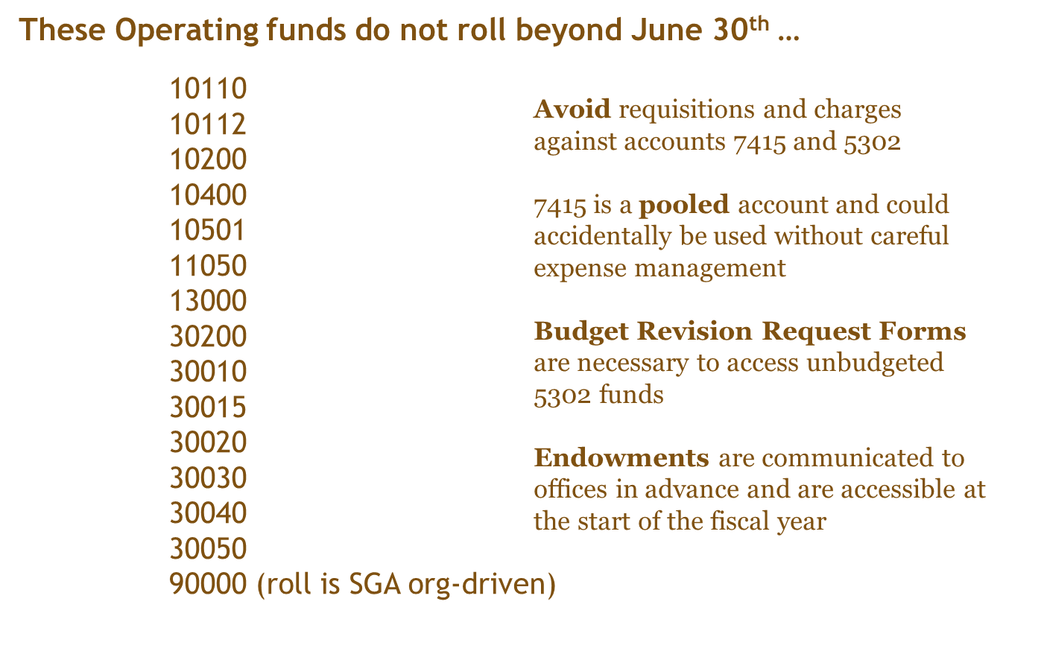
Reminders

Slide 50
Accruals & Prepaid Entries
GAAP requires recognition of revenue when earned and expenses as incurred, an accrual/prepaid entry is an adjustment made to an account to ensure revenue & expenses are recorded in the same period.
Accounts Payable assists when processing invoices in identifying appropriate timeframe for that expense.
To ensure accurate financial reporting, Accounting Services reviews data and prepares an adjusting journal entry to reflect as an accrual or a prepayment when appropriate.
Fiscal Year End Reminder
Complete Receiving timely, as goods are received and services performed. Do not complete receiving before goods are received or services performed.
Review POs to ensure all anticipated invoices are applied and close out POs when no longer needed.
Ensure vendor provides invoices to invoices@rowan.edu in a timely manner and follow up on outstanding invoices.
ProConnect POs will roll into FY26. After the system roll, invoices received for expenses incurred in FY25 will be accrued back to FY25 until mid-August.

Slide 51
Annual Audited Financial Statements….
Audit Process
Accounting Services is responsible for coordination of annual audit for all entities (RU, RUF, SJTP, SGA, & REA)
Involves various Administrative Offices on Campus
Financial Aid, Grants, Bursar, Payroll, Human Resources
Involves ALL Departments, including Academic Departments
Fixed Asset/Equipment physical inventory
Adequate supporting of all journal entries, including DCAs
Provide supporting documentation to auditors for selections
Journal entries are selected to “test” the balance shown in the financial statements.
Fiscal Year End Reminder
AS may reach out for assistance on certain audit requests, including asset inventory. Please respond timely to requests or direct to appropriate department contact.

Slide 52
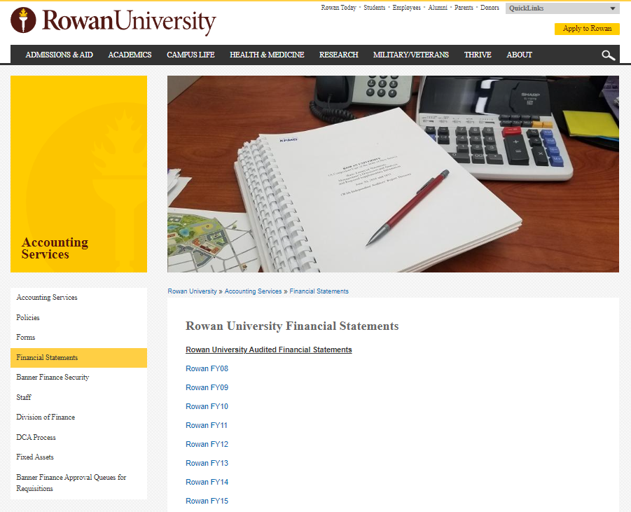
Financial Statements
Audited Financial Statements can be obtained from the Accounting Services website.

Slide 53

Examples of Financial Reporting
Annual Audited Financial Statements (main deliverable that drives Annual Memo deadlines- next slide)
Including A-133 Reporting
Annual Capital Grant Reporting to State
Annual statistical reporting
Annual IPEDS reporting
Quarterly: Financial Statement (USDA compliance requirement)
Monthly: SJTP, SOM prepares monthly reporting
Periodic: Actuals for Board Reporting multiple times per year for reporting entities
Bond Disclosure/Reporting
Event Disclosure under Rule 15c2-12
Annual Tax Compliance Certifications
Various Ad-hoc reporting

Slide 54
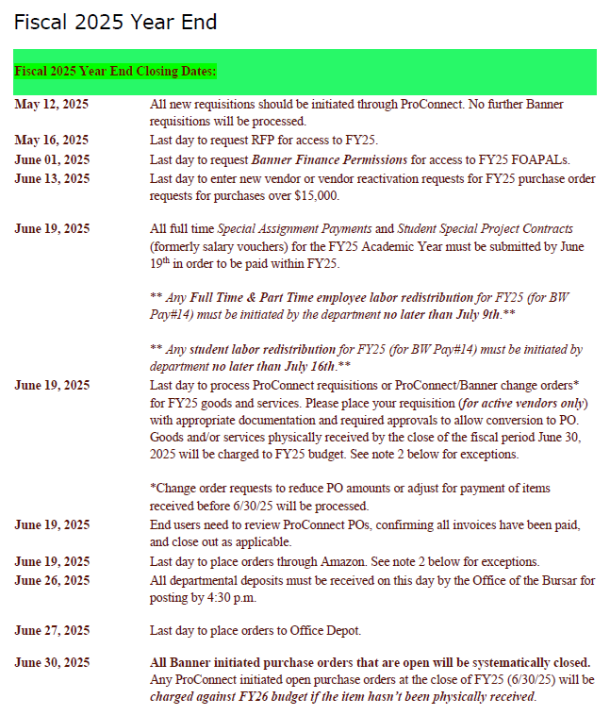
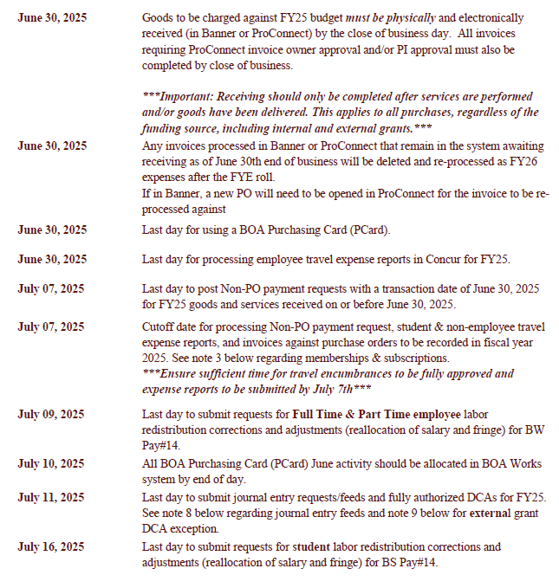
Reminder!

Slide 55
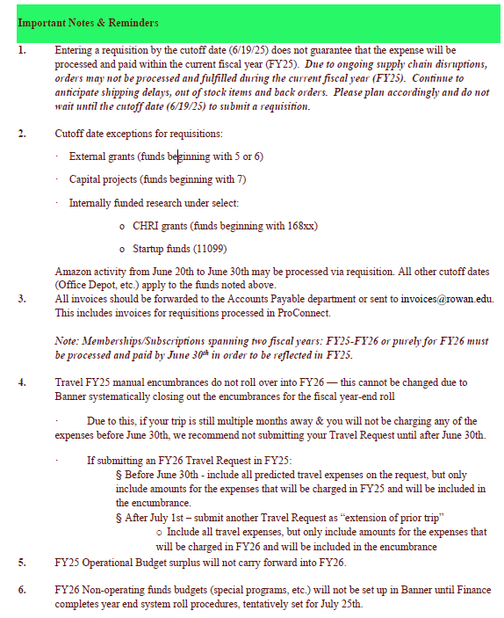
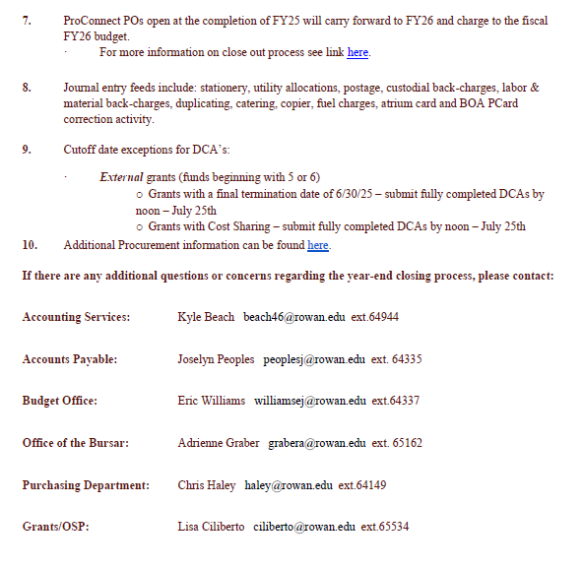
Reminder!

Slide 56
Contacts & Resource Information
Accounting Services Full Team Contact Information
For General Accounting Services questions - AccountingServices@rowan.edu
Link to Accounting Services Website
Link to Financial Statements
For FinSecurity information
Link to Instructions - Banner Finance Security
For Banner Requisition Approval Queues information - reqapprovalqueue@rowan.edu
Link to Instructions - Requisition Approval Queue
Link to video - User Approval Instruction Video
For Fixed Asset Equipment information
Link to policy - Fixed Assets
Link to policy - Disposal of Fixed Assets
Link to disposal form - Equipment Disposal Form
For DCA information & questions - DCA@rowan.edu
Link to DCA Process
Link to DCA instruction manual

Slide 57
Grants

Slide 58
Grant Related Reminders
Budgets
Grant Budgets are Carry Forward Budgets and do not operate on the same fiscal year as operating budgets.
New Cognos reports to help with grant management.
Can be run by PI, Grant, or Org.
Special Assignment vouchers for FY25 Academic Year must be completed by June 30th. At this time pre approval should have been received.
Summer Non Teaching voucher requests (July 1 through August 31) should be submitted for pre approval for payment in July and August.

Slide 59
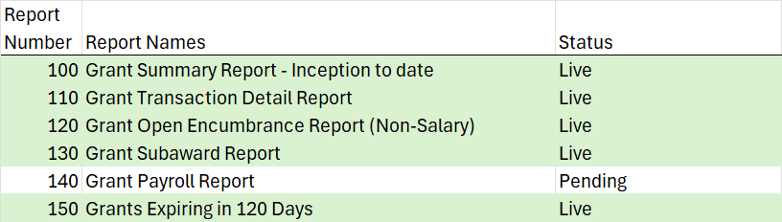
New Grants Management Cognos Reports
Empower Department staff to help support Faculty
Through Cognos, Grants Folder

Slide 60
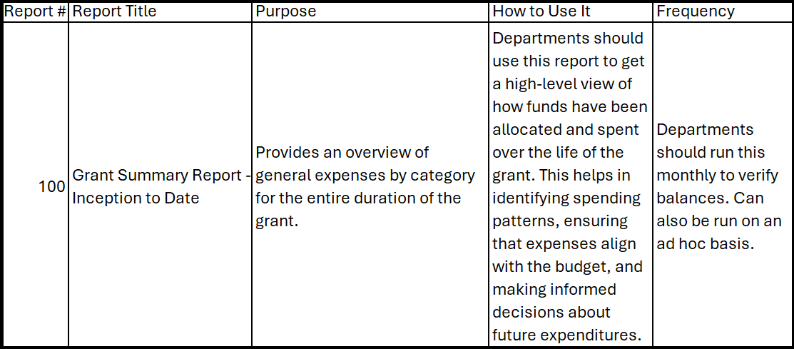
New Grants Management Cognos Reports

Slide 61
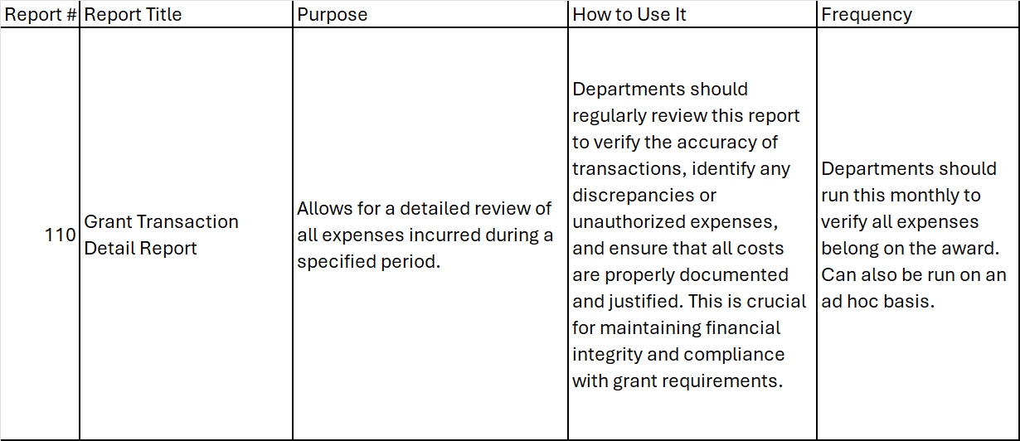
New Grants Management Cognos Reports

Slide 62
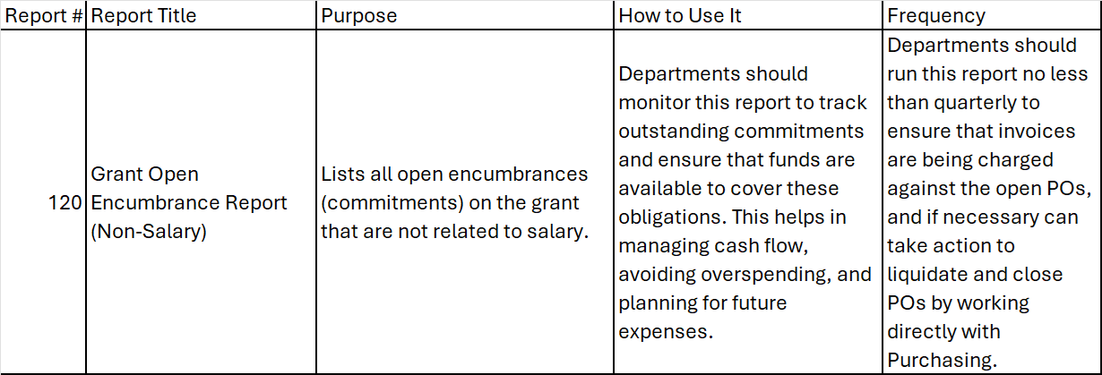
New Grants Management Cognos Reports

Slide 63
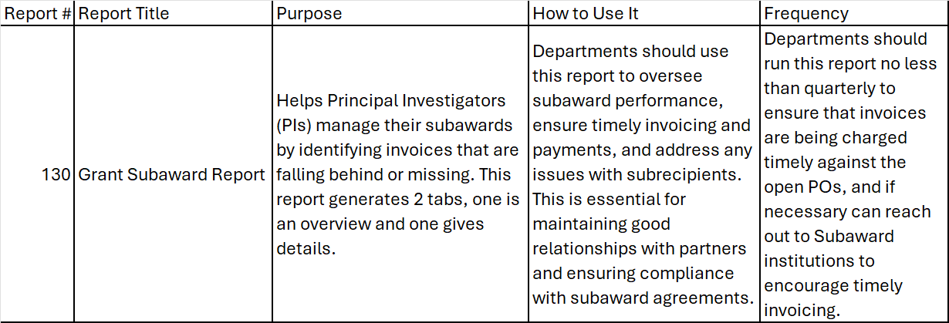
New Grants Management Cognos Reports

Slide 64
New Grants Management Cognos Reports

Slide 65
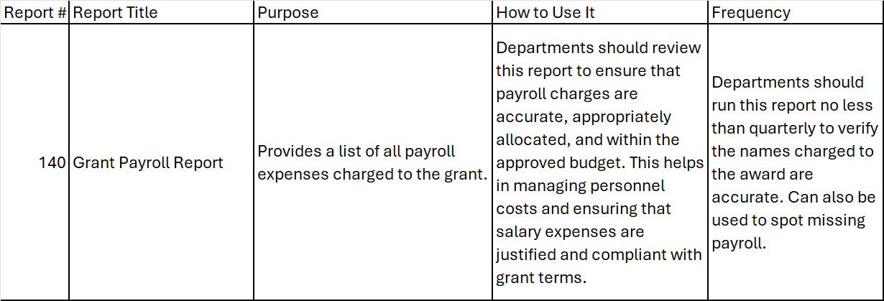
New Grants Management Cognos Reports

Slide 66
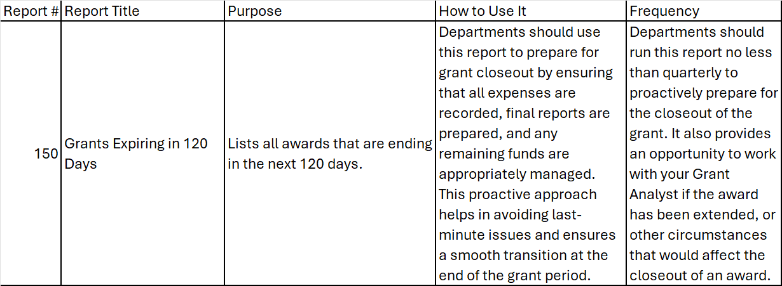
New Grants Management Cognos Reports

Slide 67
New Grants Management Cognos Reports
Questions about the reports?
To request access, email postaward@rowan.edu
Include details such as the PI(s) or Orgs you manage.
You will be added to a RIMS group managed by the Post Award Team.

Slide 68
Grant Related Reminders
Procurement
Receiving - This should not be delayed. If you have physically received the goods or services, please receive in Banner or ProConnect, as applicable.
Approvals - Please ensure you promptly approve any invoices awaiting PI approval or invoice owner approval in ProConnect or they will not pay.
Standing orders ( Subawards, VWR, etc.) - All POs in Banner will be closed. Please reopen in ProConnect.
Amazon - Please make sure you adhere to year end deadlines. Payment by personal credit card is not acceptable.

Slide 69
Grant Related Reminders, continued
Accounting Services
DCA’s - for grants it is still a manual process
DCA Form on Accounting Services' webpage
DCA’s will not be processed without proper supporting documentation.
Deadline for FY25 DCA’s is noon on July 18th for grants that end 6/30/2025 and Department Cost Sharing.
Cost Transfers - per federal regulations cannot exceed 90 days from occurrence. Transfer cannot cross fiscal years.
Asset Inventory - is required every 2 years per federal regulations. Please respond timely to requests or direct to appropriate department contact.
If Asset is no longer in use, please let us know!

Slide 70
Post Award Staff Assignments
Staffing Assignments current in flux due to open positions and new staff. If unsure, please send an email to postaward@rowan.edu
Likely to change in new fiscal year. Keep an eye out.
DUR website updated regularly

Slide 71
Questions?

