Slide 1

LASER SAFETY TRAINING
Mandatory for all users of Class 3B and Class 4 lasers

Slide 2
Laser Safety Training Overview
Section 1 – Laser Fundamentals
Section 2 – Laser Hazard Classification
Section 3 – Laser Hazards
Section 4 – Laser Control Measures
Notes:
The Rowan University Laser Safety Training has been developed to assist laser users in understanding the basic components of a laser and how they work, how lasers are classified, hazards during laser use, and control measures to reduce the risks from known hazards.

Slide 3
Laser Safety Training
LASER
  is an acronym of Light Amplification by Stimulated Emission of Radiation.
  is a device that produces radiant energy predominantly by stimulated emission.
The light emitted by a laser is non-ionizing, electromagnetic radiation.
Section 1 – Laser Fundamentals
Notes:
Laser is an acronym of Light Amplification by Stimulated Emission of Radiation. Lasers are devices that produce radiant energy predominantly by stimulated emission. The light emitted by a laser is non-ionizing, electromagnetic radiation.

Slide 4
Stimulated Emission
Albert Einstein theorized and proposed that a photon passing near an excited electron of the same energy would cause the approached electron to return to its ground state and in so releasing a photon of light.
Two identical photons would exist and travel as a coherent pair in the exact same direction.
This mechanism would be repeated over and over again as each of the triggered photons approached other excited electrons.
Notes:
Albert Einstein theorized and proposed that a photon passing near an excited electron of the same energy would cause the approached electron to return to its ground state and in so releasing a photon of light. Two identical photons would exist and travel as a coherent pair in the exact same direction. This mechanism would be repeated over and over again as each of the triggered photons approached other excited electrons.

Slide 5
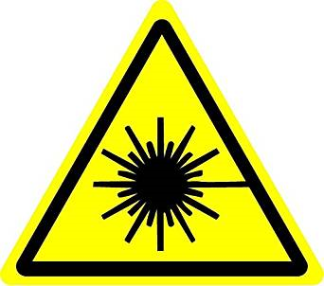
Laser Theory and Operation
A basic understanding of how a laser operates helps in understanding the hazards when using a laser device.
Notes:
A basic understanding of how a laser operates helps in understanding the hazards when using a laser device.

Slide 6
Laser Theory and Operation
The smallest particle of light energy in quantum mechanics is a photon.
A photon is produced whenever an electron in a higher-than-normal orbit falls back to its normal orbit.
During the fall from high energy to normal energy, the electron emits a photon, a packet of energy, with very specific characteristics such as frequency or color which match exactly to the distance the electron falls.
Notes:
An electron has a natural orbit that it occupies, but if you energize an atom, you can move its electrons to higher orbitals. A photon is produced whenever an electron in a higher-than-normal orbit falls back to its normal orbit. During the fall from high energy to normal energy, the electron emits a photon, a packet of energy, with very specific characteristics such as frequency or color which match exactly to the distance the electron falls.

Slide 7
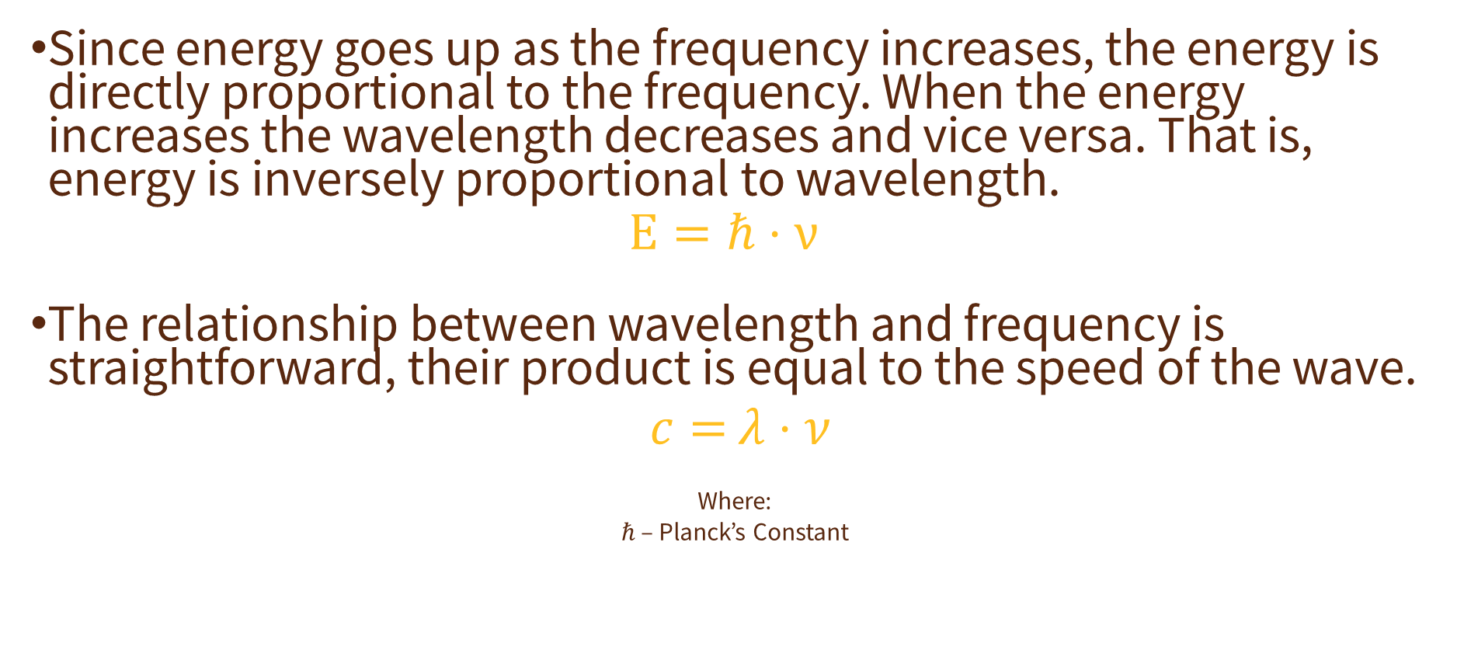
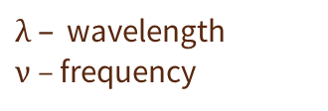
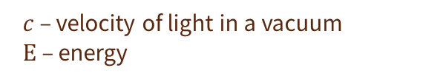
Laser Theory and Operation
Since energy goes up as the frequency increases, the energy is directly proportional to the frequency. When the energy increases the wavelength decreases and vice versa. That is, energy is inversely proportional to wavelength.
$$Ε=ℏ⋅ν$$
The relationship between wavelength and frequency is straightforward, their product is equal to the speed of the wave.
$c=$ $λ⋅ν$
Where:
$ℏ\text{ –}$Planck’s Constant
$λ –$wavelength
$ν$ – frequency
$c$ – velocity of light in a vacuum
$Ε$ – energy
Notes:
The relationship between wavelength and frequency is straightforward, their product is equal to the speed of the wave. Since energy goes up as the frequency increases, the energy is directly proportional to the frequency. When the energy increases the wavelength decreases and vice versa. That is, energy is inversely proportional to wavelength.

Slide 8
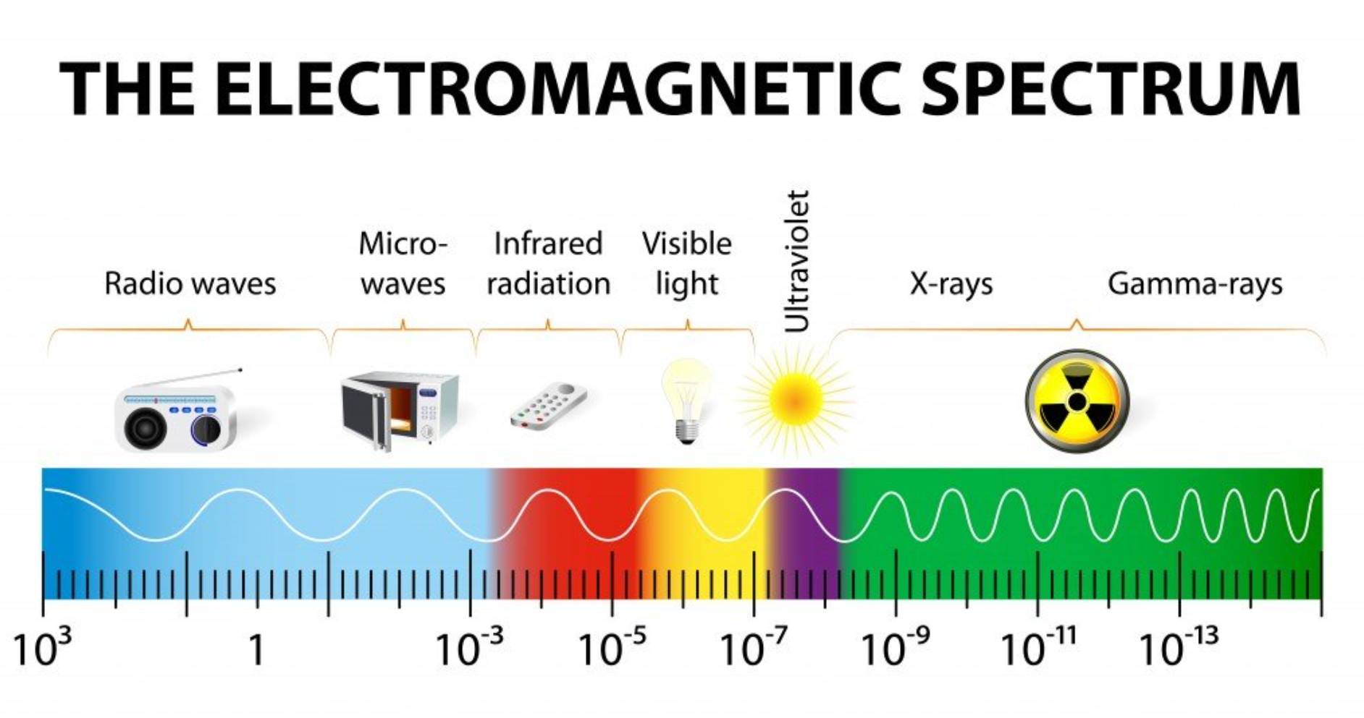
Laser Theory and Operation
Radio waves are the least energetic kind of photons, have longer wavelengths, and lower frequency.
Gamma rays are the most energetic kind of photons, have shorter wavelengths, and higher frequency.
Notes:
The electromagnetic spectrum can be expressed in terms of energy, wavelength or frequency. Radio waves are the least energetic kind of photons, have longer wavelengths, and lower frequency. Gamma rays are the most energetic kind of photons, have shorter wavelengths, and higher frequency. Each way of thinking about the electromagnetic spectrum is related to the others in a precise mathematical way.

Slide 9
Components of a Laser
The three main components of lasers are active media, an energy source, and the resonance cavity.
Notes:
The three main components of lasers are active material, an energy source, and a resonance cavity. Active Medium is the material in which the laser action takes place. The active medium may be solid crystals, liquid dyes, gases like carbon dioxide, or semiconductors. The Energy Source pumps the active centers from ground state to excited state to achieve population inversion. The pumping by the energy source can be optical, collision, or chemical depending on the active medium. The Resonance cavity consists of active medium enclosed between two mirrors one is highly reflective mirror and the other is partially transmissive mirror.
The laser output may be steady, as in continuous wave lasers, or pulsed. A Q-switch in the optical path is a method of providing laser pulses of an extremely short time duration. The Q-switch may use a rotating prism, a pockels cell or a shutter device to create the pulse. Q-switched lasers may produce a high-peak-power laser pulse of a few nanoseconds duration.

Slide 10
Energy Sources for Lasers
Optical Pumping
  Optical pumping uses photons provided by a source to transfer energy to the lasing material. The optical source must provide photons which correspond to the allowed transition levels of the lasing material.
    Examples: Xenon flash lamp, arc lamp, another laser
Collision Pumping
  Collision pumping relies on the transfer of energy to the lasing material by collision with the atoms or molecules of the lasing material. Energies which correspond to the allowed transitions must be provided.
    Examples: electrical discharge in a pure gas or gas mixture in a tube
Chemical pumping
  Chemical pumping systems use the binding energy released in chemical reactions to state.
    Examples: chemical oxygen iodine laser (COIL), all gas-phase iodine laser (AGIL), and the hydrogen fluoride (HF) and deuterium fluoride (DF) lasers
Notes:
The pumping system imparts energy to the atoms or molecules of the lasing medium enabling them to be raised to an excited “metastable state” creating a population inversion. Optical pumping uses photons provided by a source such as a Xenon gas flash lamp or another laser to transfer energy to the lasing material. The optical source must provide photons which correspond to the allowed transition levels of the lasing material. Collision pumping relies on the transfer of energy to the lasing material by collision with the atoms or molecules of the lasing material. Again, energies which correspond to the allowed transitions must be provided. This is often done by electrical discharge in a pure gas or gas mixture in a tube. Chemical pumping systems use the binding energy released in chemical reactions to state.

Slide 11
Types of Active Medium
Solid State
  A solid-state laser is a laser that uses solid as a laser medium.
    Examples: ruby laser, Neodymium-doped Yttrium Aluminum Garnet (Nd: YAG) laser, etc.
Gas Laser
  A gas laser is a laser in which an electric current is discharged through a gas inside the laser medium to produce laser light.
    Examples: Helium (He) – Neon (Ne) lasers, argon ion lasers, carbon dioxide lasers (CO2 lasers), carbon monoxide lasers (CO lasers), excimer lasers, nitrogen lasers, hydrogen lasers, etc.
Liquid Laser
  A liquid laser is a laser that uses the liquid as laser medium.
    Example: dye laser
Semiconductor Laser
  These lasers are very cheap, compact size and consume low power. Semiconductor lasers are also known as laser diodes.
    Example: quantum well lasers
Notes:
A solid-state laser is a laser that uses solid as a laser medium. In these lasers, glass or crystalline materials are used. A gas laser is a laser in which an electric current is discharged through a gas inside the laser medium to produce laser light. A liquid laser is a laser that uses the liquid as laser medium. In liquid lasers, light supplies energy to the laser medium. Semiconductor lasers play an important role in our everyday life. These lasers are very cheap, compact size and consume low power. Semiconductor lasers are also known as laser diodes. Semiconductor lasers are different from solid-state lasers. In solid-state lasers, light energy is used as the pump source whereas, in semiconductor lasers, electrical energy is used as the pump source.

Slide 12
Types of Resonators
Linear (or standing-wave) Resonators
  Made such that the light bounces back and forth between two end mirrors. For continuously circulating light, there are always counterpropagating waves, which interfere with each other to form a standing-wave pattern.
    A simple linear optical resonator with a curved folding mirror:
Ring Resonators
  Light can circulate in two different directions. A ring resonator has no end mirrors.
    A four-mirror bow-tie ring resonator:
Notes:
Linear resonators are made such that the light bounces back and forth between two end mirrors. For continuously circulating light, there are always counterpropagating waves, which interfere with each other to form a standing-wave pattern. In ring resonators, light can circulate in two different directions. A ring resonator has no end mirrors. In either case, a resonator may contain additional optical elements which are passed in each round trip. For example, a laser resonator contains a gain medium which can compensate the resonator losses in each round trip of the light.

Slide 13
Types of Laser Emission
Continuous Wave (CW) Lasers
  Operates in a stable, continuous output for a period ≥ 0.25 s.
Single Pulsed Lasers
  Delivers its energy in the form of a single pulse or a train of pulses with duration of a pulse ≤ 0.25 s.
Single Pulsed Q-switched Lasers
  Emits short (10 ns – 250 ns) high-power pulses by means of a Q-switch.
Notes:
Continuous Wave Lasers operate in a stable, continuous output for a period greater than or equal to 0.25 seconds rather than a pulsed mode. Single Pulsed Lasers deliver their energy in the form of a single pulse or a train of pulses with duration of a pulse less than or equal to 0.25 seconds. This mode of operation is sometimes referred to as long pulse or normal mode. Single Pulsed Q-switched Lasers are the result of an intracavity delay which allows the laser media to store a maximum of potential energy. Then, under optimum gain conditions, emission occurs in single pulses with high peak powers. Emits short high-power pulses by means of a Q-switch.

Slide 14
Types of Laser Emission
Repetitively Pulsed or Scanning Lasers
  Generally involve the operation of pulsed laser performance operating at a fixed (or variable) pulse rates which may range from a few pulses per second to as high as 20,000 pulses per second.
Mode Locked
  Operate as a result of the resonant modes of the optical cavity which can affect the characteristics of the output beam.
  When the phases of different frequency modes are synchronized, i.e., "locked together," the different modes will interfere with one another to generate a beat effect.
  Lasers operating in this mode-locked fashion, usually produce a train of regularly spaced pulses.
  A mode-locked laser can deliver extremely higher peak powers than the same laser operating in the Q-switched mode.
Notes:
Repetitively Pulsed, or scanning lasers, generally involve the operation of pulsed laser performance operating at fixed or variable pulse rates which may range from a few pulses per second to as high as 20,000 pulses per second. The direction of a Continuous Wave laser can be scanned rapidly using optical scanning systems to produce the equivalent of a repetitively pulsed output at a given location.
Mode Locked Lasers operate as a result of the resonant modes of the optical cavity which can affect the characteristics of the output beam. When the phases of different frequency modes are synchronized, i.e., "locked together," the different modes will interfere with one another to generate a beat effect. The result is a laser output which is observed as regularly spaced pulsations. Lasers operating in this mode-locked fashion, usually produce a train of regularly spaced pulses. A mode-locked laser can deliver extremely higher peak powers than the same laser operating in the Q-switched mode. These pulses will have enormous peak powers.

Slide 15
Laser Safety Training
The Food & Drug Administration (FDA) regulates all lasers.
The FDA recognizes four major hazard classes, including subclasses:
  1 & 1M
  2 & 2M
  3R & 3B
  4
Section 2 – Laser Hazard Classification
Notes:
Research studies have created the basis for how the Food & Drug Administration classify lasers. The FDA recognizes four major hazard classes of lasers, including subclasses. The higher the class, the more powerful the laser is and the greater the potential to pose serious injury if used improperly. Labeling is required and must include a warning symbol that states the class and the output power of the product to be compliant with International Electrotechnical Commission regulations.

Slide 16
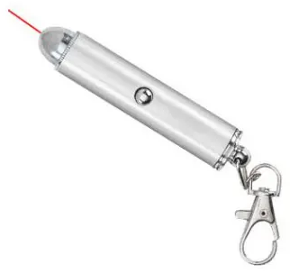
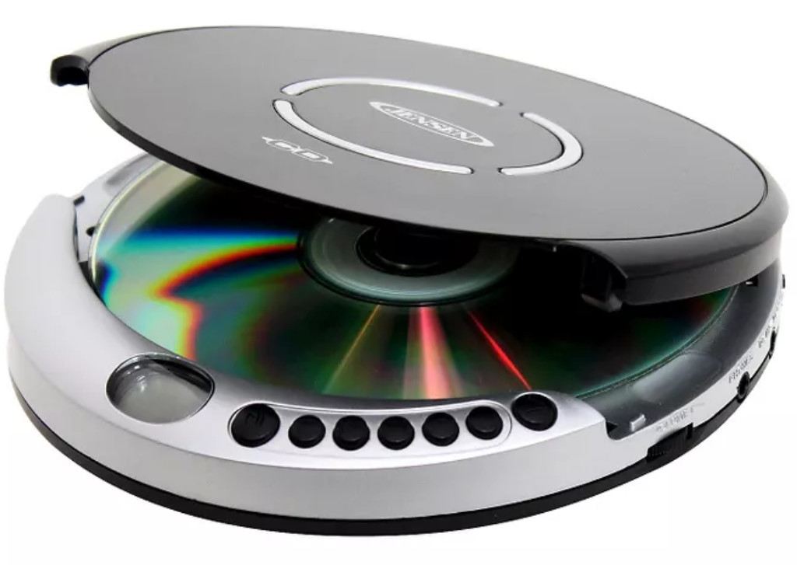

Laser Hazard Classification – Class 1 Lasers
Considered non-hazardous. Hazard increases if viewed with optical aids, including magnifiers, binoculars, or telescopes.
Examples of Class 1 & 1M Lasers
  Laser printers
  CD players
  DVD players
Notes:
A Class 1 laser is considered safe based upon current medical knowledge. This class includes all lasers or laser systems which cannot emit levels of optical radiation above the exposure limits for the eye under any exposure conditions inherent in the design of the laser product. There may be a more hazardous laser embedded in the enclosure of a Class 1 product, but no harmful radiation can escape the enclosure. Class 1 lasers are not required to be registered under the Rowan University Laser Safety Program.

Slide 17
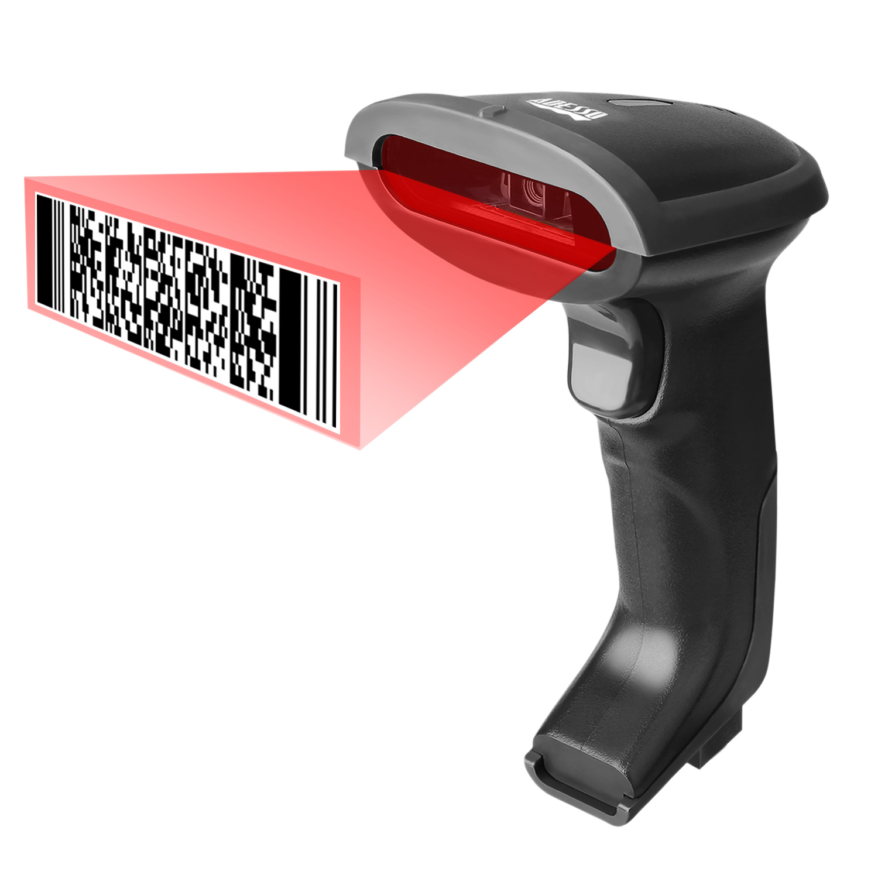
Laser Hazard Classification – Class 2 & 2M Lasers
Hazard increases when viewed directly for long periods of time. Hazard increases if viewed with optical aids.
Examples of Class 2 & 2M Lasers
  Barcode scanners
Notes:
Class 2 lasers are low power, visible light lasers that could possibly cause damage to a person's eyes. An example of Class 2 laser is a barcode scanner. If class 2 laser beams are directly viewed for long periods of time damage to the eyes could result. Class 2 lasers are not required to be registered under the Rowan University Laser Safety Program.

Slide 18
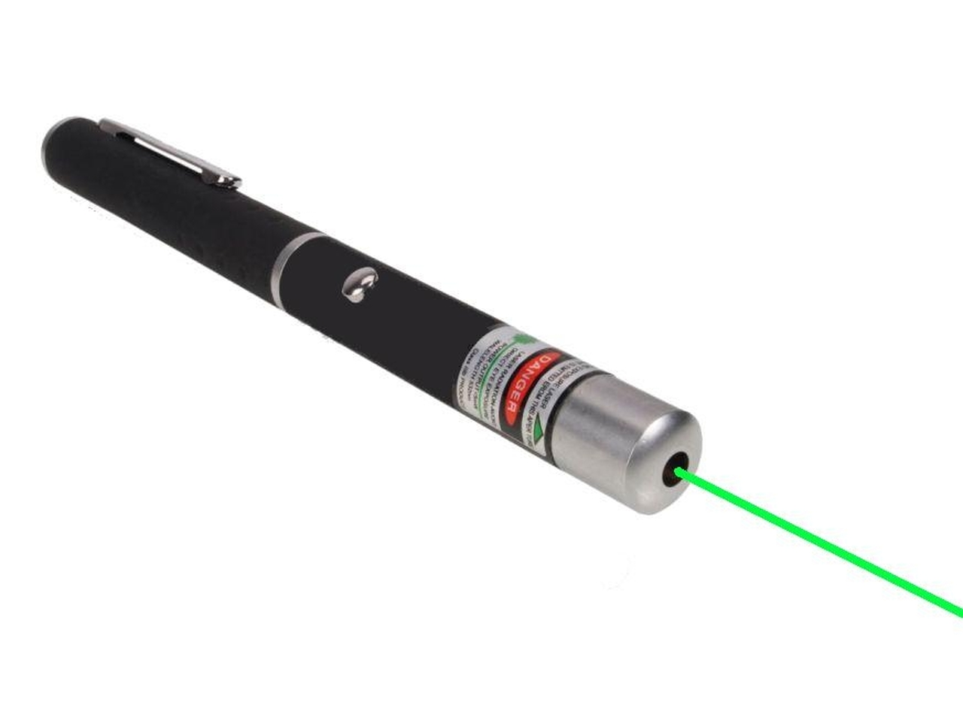
Laser Hazard Classification – Class 3R Lasers
Depending on power and beam area, can be momentarily hazardous when directly viewed or when staring directly at the beam with an unaided eye. Risk of injury increases when viewed with optical aids.
Examples of Class 3R Lasers
  Laser pointers
Notes:
Class 3R lasers are continuous wave, intermediate power devices. Direct viewing of the Class 3R laser beam could be hazardous to the eyes. Avoid viewing Class 3R laser beams directly. Avoid pointing a Class 3R laser beam at a person. Avoid viewing a Class 3R laser beam with telescopic devices; this amplifies the problem. Class 3R lasers are not required to be registered under the Rowan University Laser Safety Program unless the laser radiation exceeds the Maximum Permissible Exposure Limit.

Slide 19

Laser Hazard Classification – Class 3B Lasers
Immediate skin hazard from direct beam and immediate eye hazard when viewed directly.
Examples of Class 3B Lasers
  Laser light show projectors
  Industrial lasers
  Research lasers
Notes:
Class 3B lasers are intermediate power devices. Some examples of Class 3B lasers are entertainment light shows, industrial, and research lasers. Direct viewing of the Class 3B laser beam is hazardous to the eye and diffuse reflections of the beam can also be hazardous to the eye. Avoid viewing the Class 3B laser beam directly. Avoid viewing a Class 3B laser beam with telescopic devices. Whenever occupying a laser controlled area, wear eye protection suited for the wavelength and power of the laser. Class 3B lasers are required to be registered under the Rowan University Laser Safety Program.

Slide 20
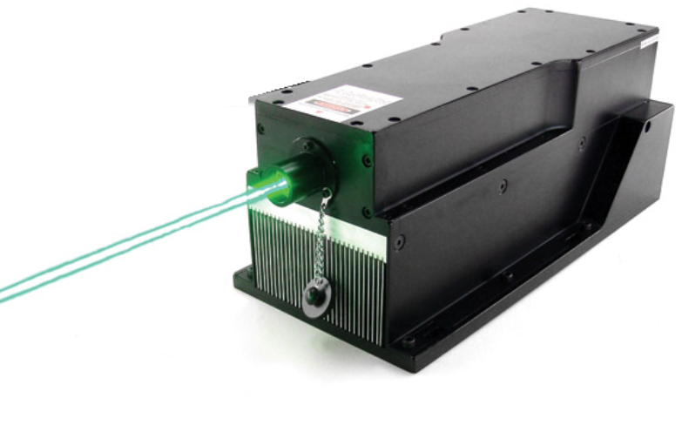
Laser Hazard Classification – Class 4 Lasers
Immediate skin hazard and eye hazard from exposure to either the direct or reflected beam; may also present a fire hazard.
Examples of Class 4 Lasers
  Laser light show projectors
  Industrial lasers
  Research lasers
  Medical device lasers for eye surgery or skin treatment
Notes:
Class 4 lasers are high power devices. Some examples of Class 4 laser use are surgery, research, drilling, cutting, welding, and micromachining. The direct beam, specular and diffuse reflections from Class 4 lasers are hazardous to the eyes and skin. Class 4 laser devices can also be a fire hazard depending on the reaction of the target when struck. Most laser eye injuries occur from reflected beams of class 4 laser light, so keep all reflective materials away from the beam. Remember it is the roughness of the surface relative to wavelength that determines the reflectivity of the surface. Whenever occupying a laser controlled area, wear eye and skin protection appropriate for the wavelength and power of the laser in use. Greater controls are required to ensure the safe operation of this class of laser devices. Class 4 lasers are required to be registered under the Rowan University Laser Safety Program.

Slide 21
Laser Hazard Classification –
Class to be Determined
Manufacturers are required by the U.S. Food and Drug Administration to label lasers with a hazard classification. In cases where the class is unknown, do the following:
  Contact the Laser Safety Officer
  Make all possible efforts to convert a high powered laser into a Class 1 Laser System
Notes:
Manufactures are required by the Food and Drug Administration to label each laser with a hazard classification. There are occasionally times where a laser class is unknown. An example is this would be if a researcher fabricated their own laser. In a case such as this, contact the Laser Safety Officer and make all possible efforts to create a Class 1 Laser System.

Slide 22
Laser Safety Training
The hazards of lasers may be separated into two general categories:
  beam related hazards to eyes and skin
  non-beam hazards such as electrical and chemical hazards
Section 3 – Laser Hazards
Notes:
The hazards of lasers may be separated into two general categories – beam related hazards to eyes and skin and non-beam hazards, such as electrical and chemical hazards.

Slide 23
Beam Related Laser Hazards
Exposure to the laser beam is not limited to direct beam exposure. Particularly for high powered lasers, exposure to beam reflections may be just as damaging as exposure to the primary beam.
  Intrabeam exposure means that the eye or skin is exposed directly to all or part of the laser beam.
  Specular reflections from mirror surfaces can be nearly as harmful as exposure to the direct beam, particularly if the surface is flat.
  Diffuse Reflections are reflections off of rough surfaces such as clothing, paper, and the asphalt roadway.
Notes:
Exposure to the laser beam is not limited to direct beam exposure. Particularly for high powered lasers, exposure to beam reflections may be just as damaging as exposure to the primary beam. Intrabeam exposure means that the eye or skin is exposed directly to all or part of the laser beam. The eye or skin is exposed to the full irradiance or radiant exposure possible. Specular reflections from mirror surfaces can be nearly as harmful as exposure to the direct beam, particularly if the surface is flat. Curved mirror-like surfaces will widen the beam such that while the exposed eye or skin does not absorb the full impact of the beam, there is a larger area for possible exposure. Diffuse Reflections are reflections off of rough surfaces such as clothing, paper, and the asphalt roadway. Whether the surface is microscopically rough or smooth has a tremendous impact upon the subsequent reflection of a beam of light but even a reflection from a rough surface can cause injury.

Slide 24
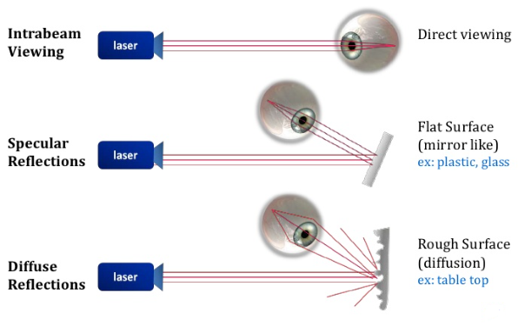
Beam Related Laser Hazards
Notes:
There are various ways that the beam can cause injury to the eye, skin, or environment around you. Here are a few examples of ways the beam can come into direct or indirect contact with people or items within range.

Slide 25
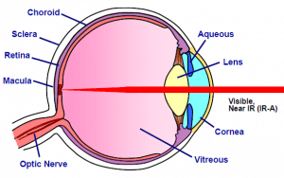
Beam Related Laser Hazards
Eye
  Retinal
    Photoretinitis
    Retinal Burns
    Photo Disruption of Retina
    Visual Effect
  Corneal
    Photo Keratitis
    Corneal Burns
    Superficial Injury
    Deep Burns
Retinal damage can cause permanent loss of vision.
Notes:
One of the major dangers of laser light is hazards from beams entering the eye. The eye is the organ most sensitive to light. Just as a magnifying glass can be used to focus the sun and burn wood, the lens in the human eye focuses the laser beam into a tiny spot than can burn the retina or damage other parts of the eye. A laser beam with low divergence entering the eye can be focused down to an area 10 to 20 microns in diameter. Most eye injuries occur during alignment.

Slide 26
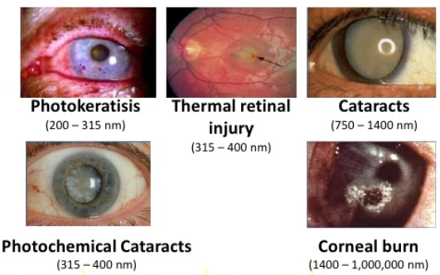
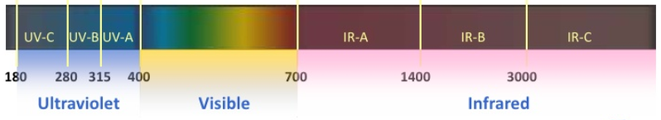
Beam Related Laser Hazards
Biological Effects on the Eye
Notes:
Examples of the biological effect that lasers can have on the eye at various wavelengths.

Slide 27
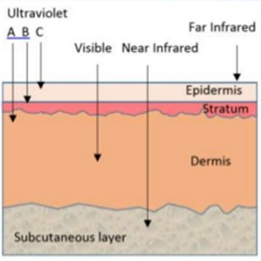
Beam Related Laser Hazards
Skin
  UV Sunburn
    erythema
    photochemical effect
  UV Delayed Effects
    accelerated aging
    cancer
  Thermal Skin Burns
    is caused by thermal effect on skin epithelium typically by IR laser radiation
Notes:
Lasers can harm the skin via photochemical or thermal burns. Depending on the wavelength, the beam may penetrate both the epidermis and the dermis. The epidermis is the outermost living layer of skin. Far and Mid-ultraviolet are absorbed by the epidermis. A sunburn may result from short-term exposure to the beam. UV exposure is also associated with an increased risk of developing skin cancer and premature aging of the skin.
Carbon dioxide and other infrared lasers are most commonly associated with thermal burns, since this wavelength range may penetrate deeply into skin tissue. The resulting burn may be first degree, second degree, or third degree. Some individuals are photosensitive or may be taking prescription drugs that induce photo-sensitivity. Particular attention must be given to the effect of these drugs, including some antibiotics and fungicides, on the individual taking the medication and working with or around lasers.

Slide 28
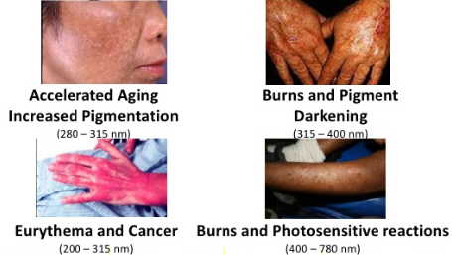

Beam Related Laser Hazards
Biological Effects on the Skin
Notes:
These are a few examples of the biological effect that lasers can have on the skin at various wavelengths.

Slide 29
Non-beam Related Laser Hazards
Chemical Hazards
  Material Emissions: Particulate and gaseous materials (vaporized target, reaction products)
Secondary Hazards
  Explosion: high gas pressure arc lamps
  Fire: combustible material in vicinity of beam
Electrical Hazards
  High Current: power supplies (large capacitors)
    More than a dozen electrocutions of individuals from laser-related accidents have been reported in America
Notes:
Non-beam hazards are a class of hazards that do not result from direct human exposure to a laser beam. These hazards are associated with components of a laser system, materials used to generate the laser beam, and materials generated when the laser beam interacts with a target. A few of the most common types of non-beam related hazards are chemical, secondary, and electrical hazards.

Slide 30
Laser Safety Training
Engineering controls are devices that are incorporated into the laser systems and are designed to limit accidental exposure to the laser beams.
Administrative controls are methods or instructions which specify operating procedures and rules that supplement engineering controls.
Non-beam related hazard controls are practices that can help reduce hazards related to chemicals, fires, and explosions.
Personal Protective Equipment (PPE) is used as the last line of defense to protect the eyes and skin from injury.
Section 4 – Laser Control Measures
Notes:
Control measures should be implemented whenever possible. Engineering controls, administrative controls, non-beam related hazard controls, and personal protective equipment are all very important to incorporate into your practice when operating a laser.

Slide 31
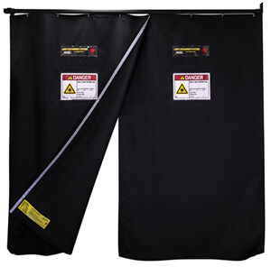
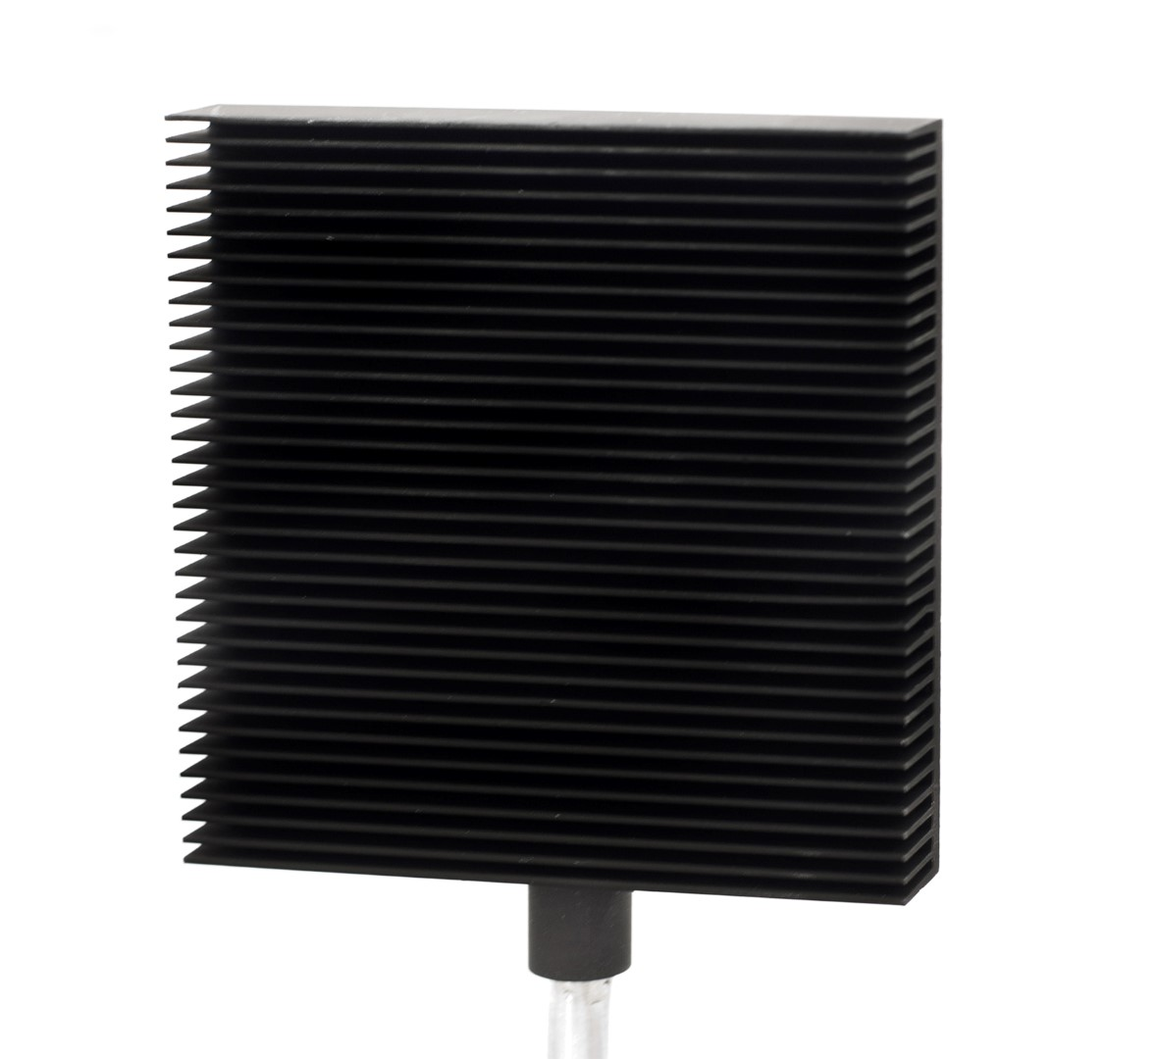
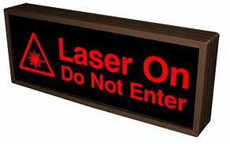
Controls for Beam Related Laser Hazards
Engineering Controls
  Protective housing
  Activation warning system
  Interlocks
  Aperture beam blocks
  Warning Lights
Notes:
Engineering Controls are devices that are incorporated into the laser systems and are deigned to limit accidental exposure to the laser beams. Implementing engineering controls is the best way to reduce hazards when working with lasers. Some engineering controls that can be implemented are: providing the laser with protective housing, installing interlocks, use an aperture beam block, and the use of warning lights.

Slide 32
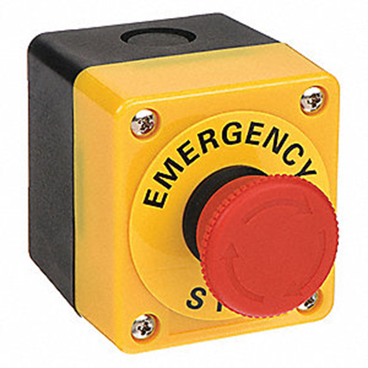
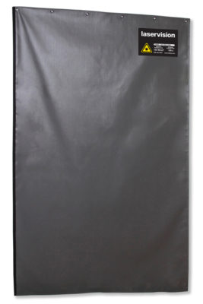
Controls for Beam Related Laser Hazards
Engineering Controls
  Window covers
  Emergency stop
  Nominal Hazard Zone (NHZ)
  Entryway Controls
Notes:
More examples of engineering controls are window covering, emergency stop, marking off the Nominal Hazard Zone, and creating entryway controls. For more detailed control measures, refer to the Rowan University Laser Safety Manual or consult with the Laser Safety Officer.

Slide 33
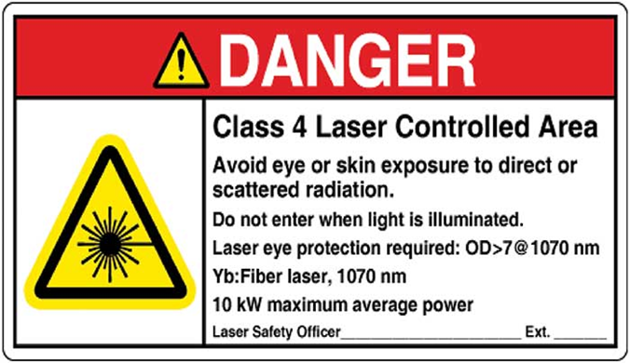
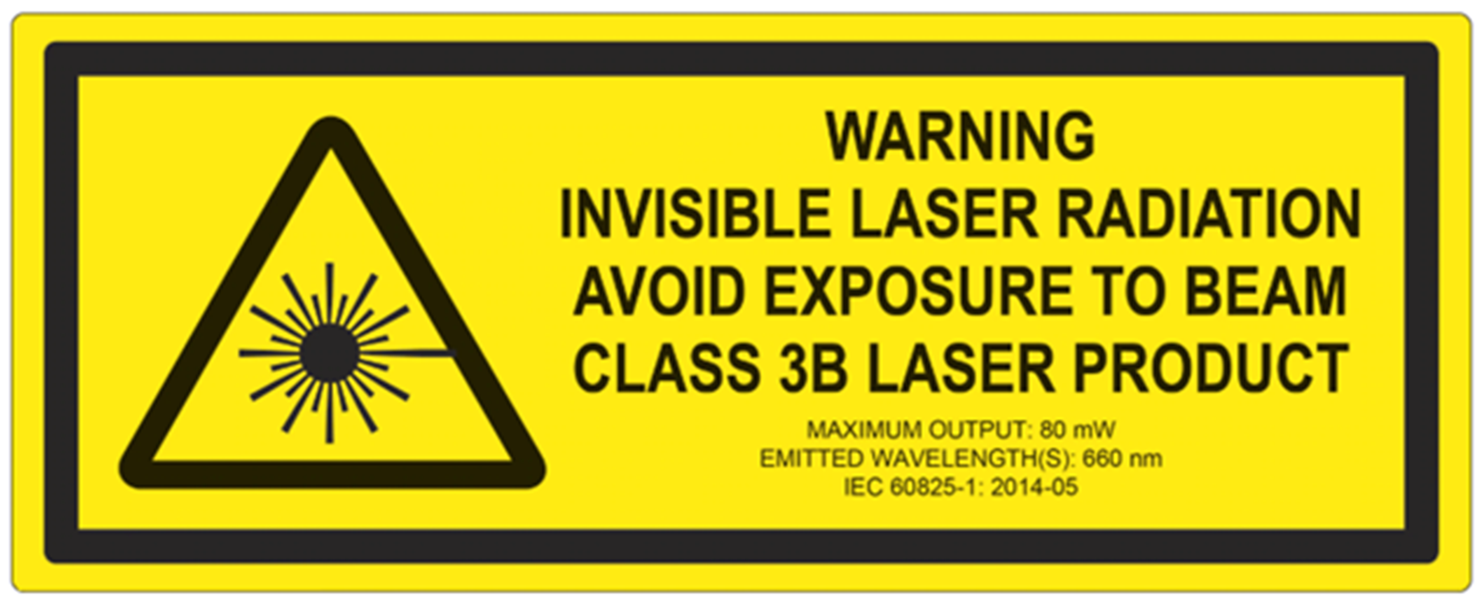
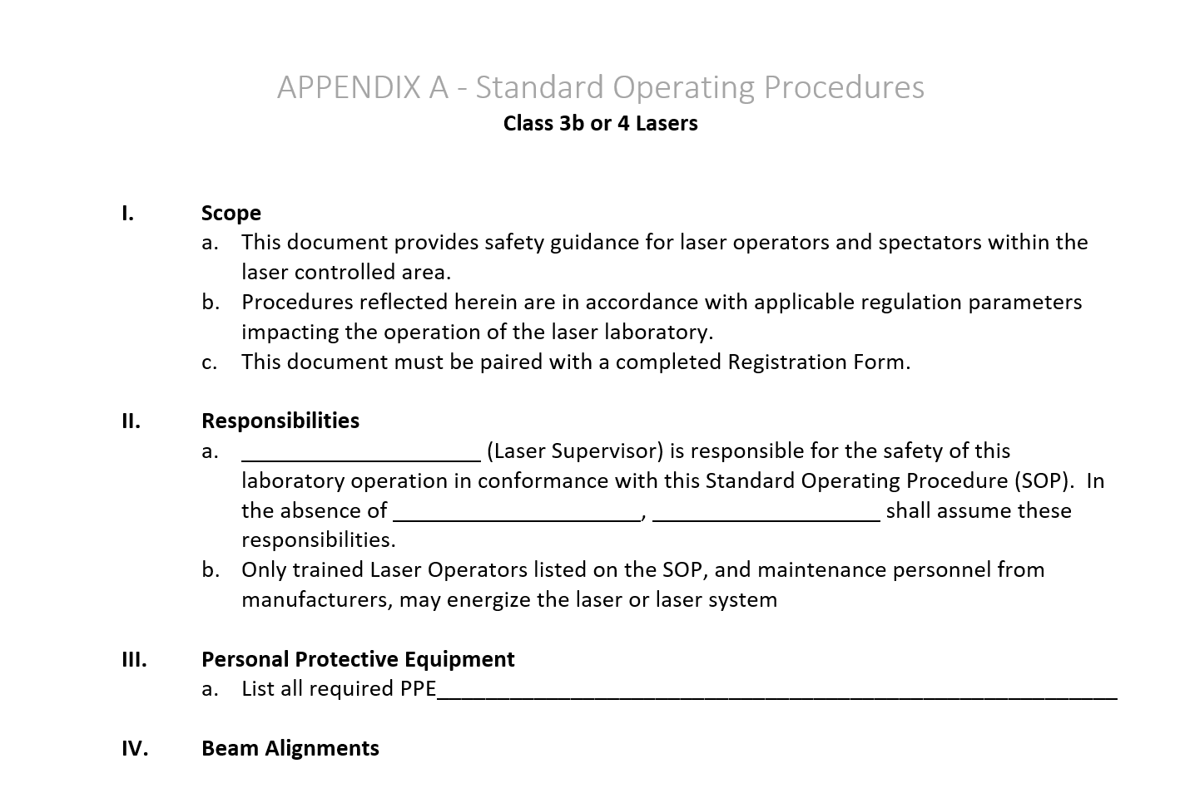
Controls for Beam Related Laser Hazards
Administrative Controls
  Complete training
  Restrict access
  Obtain permission
  Identify hazards with signs & labels
  Create Standard Operating Procedures (SOP)
Notes:
Administrative Controls are methods or instructions which specify operating procedures and rules that supplement engineering controls. Some administrative controls are completing training, restricting access to the room where the laser is stored and used, requiring all users to obtain permission prior to ever working with the laser, and identifying hazards with signs and labels.

Slide 34
Controls for Non-beam Related Laser Hazards
Controls for chemical hazards
  Mix chemicals in a fume hood
  Wear Personal Protective Equipment (PPE)
  Use secondary containment
  Review Safety Data Sheets (SDS)
  Store in ventilated gas cabinets
  Use halogen detection and alarm systems or halogen gas scrubbers in rare cases
  Prevent from inhaling
  Ventilate adequately
  Use local exhaust systems
Notes:
Way to reduce Chemical hazards:
Mix chemicals in a fume hood
Wear Personal Protective Equipment (PPE)
Use secondary containment
Review Safety Data Sheets (SDS)
Store in ventilated gas cabinets
Use halogen detection and alarm systems or halogen gas scrubbers in rare cases
Prevent from inhaling
Ventilate adequately
Use local exhaust systems

Slide 35
Controls for Non-beam Related Laser Hazards
Controls for explosion hazards
  Enclose high-pressure arc lamps, filament lamps, and capacitor banks in a housing that can withstand the maximum explosive pressure
  Enclose or equivalently protect the laser target and elements of the optical train which may shatter during laser operation
  Be aware of the possibility of explosive reactions from chemical laser reactants
Controls for fire hazards
  Separate flammables
  Construct with fire resistant materials
  Keep fire extinguishers nearby
  Shield against radiation (x-ray, plasma, radiofrequency, and microwaves)
Notes:
Ways to reduce explosion hazards:
Enclose high-pressure arc lamps, filament lamps, and capacitor banks in a housing that can withstand the maximum explosive pressure.
Enclose or equivalently protect the laser target and elements of the optical train which may shatter during laser operation
Be aware of the possibility of explosive reactions from chemical laser reactants
Ways to prevent Fire:
Separate flammables
Construct with fire resistant materials
Keep fire extinguishers nearby
Shield against radiation (x-ray, plasma, radiofrequency, and microwaves)

Slide 36
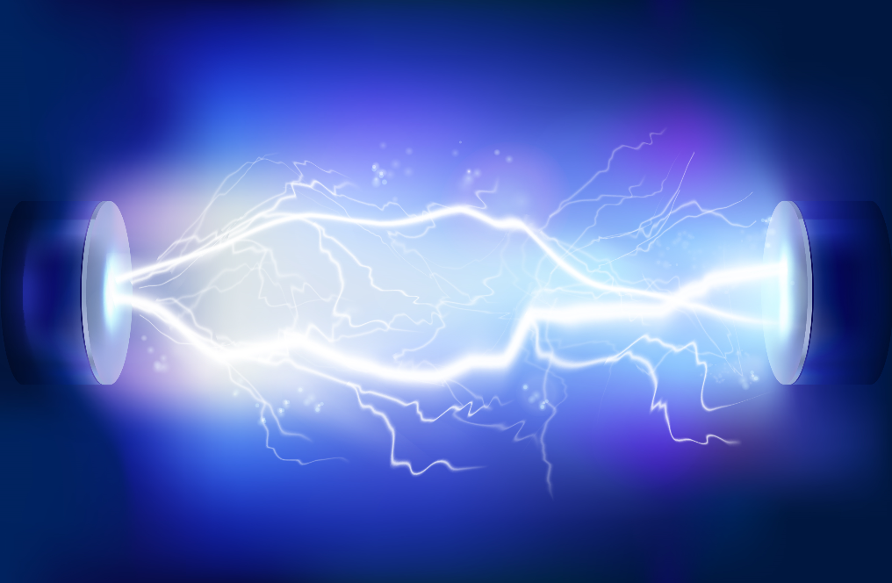
Controls for Non-beam Related Laser Hazards
The leading cause of death related to lasers is caused by Electrical Shock/Injury
Notes:
The leading cause of laser related deaths are caused by Electrical Hazards.

Slide 37
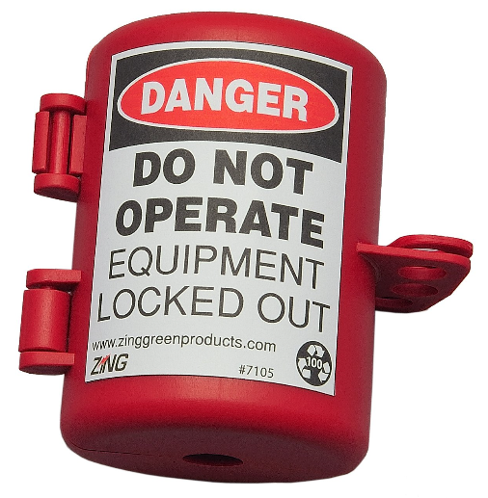
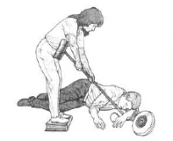
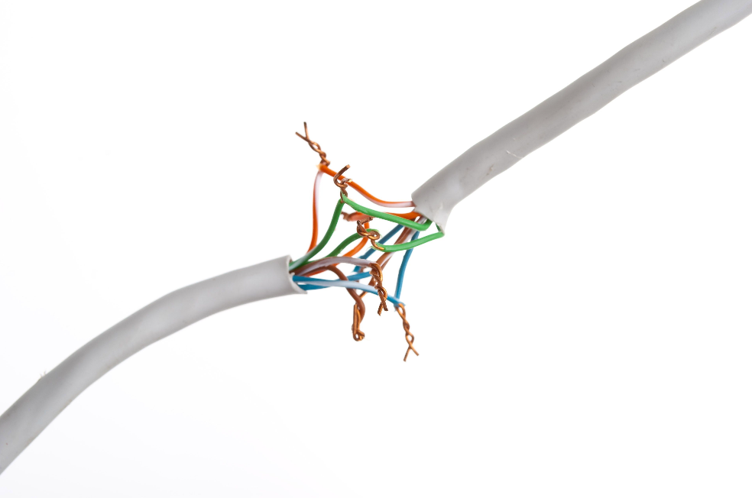

Controls for Non-beam Related Laser Hazards
Controls for electrical hazards
  Eliminate contact with high voltage
  Arrange for repairs
  Lockout/Tagout
  Inspect cords and plugs
  Ground all equipment
  Complete training
If someone is electrocuted:
  Kill the circuit
  Call 9-1-1
  Use nonconductor to remove victim
  Initiate CPR (if trained)
Notes:
Ways to prevent Electrical Hazards include: eliminating contact with high voltage, arrange for repairs, lockout/tagout, inspect cords and plugs, ground all equipment, complete training. If someone is electrocuted immediately kill the circuit. Call 9-1-1, use nonconductor to remove victim, then initiate CPR.

Slide 38
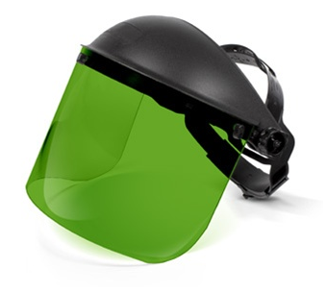
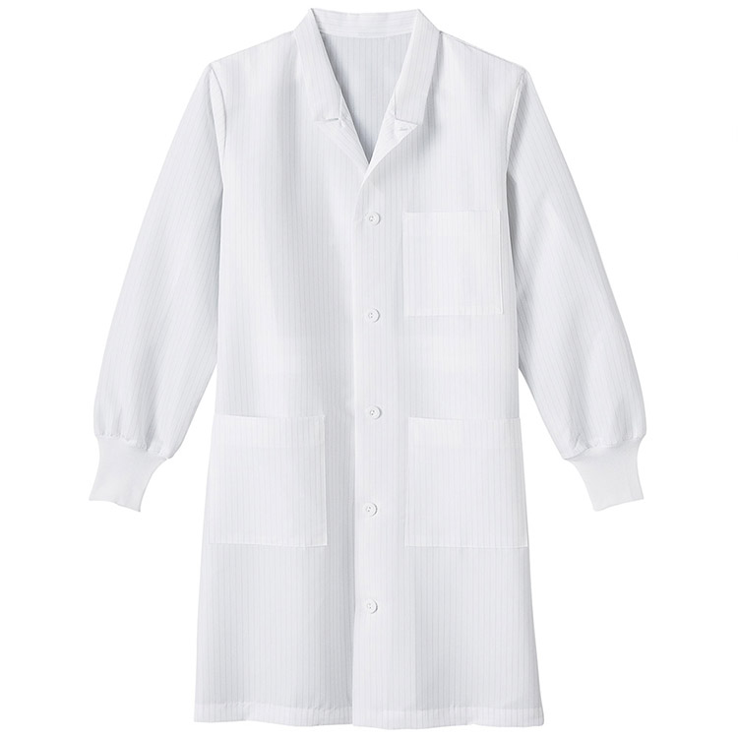
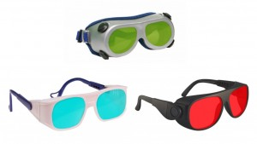

Personal Protective Equipment (PPE)
Lab coat
Eyewear
Face shield
Gloves
Notes:
Personal Protective Equipment is the last line of defense when attempting to prevent injury from lasers. A hazard assessment must be completed and documented in the Standard Operating Procedures for each laser and procedure. The Standard Operating Procedure requires necessary PPE to be listed and used whenever the laser is in operation.

Slide 39
PPE – Selecting Eyewear
When selecting eyewear:
  Know your laser’s wavelength.
  Determine the protection level needed based on your laser’s output parameters, or look for the recommended Optical Density (OD). This can be found in the laser manual.
  Select a filter whose specifications match the above information. Choose one that offers the highest visibility.
  Find a frame that’s right for you. For prescription options, choose a fit-over frame.
Notes:
When choosing eyewear or face shielding, it is important to be sure that you have proper protection. The eyewear selected should be in accordance with the wave length and recommended optical density of the laser you are working with.

Slide 40
Laser Safety Training
Section 1 – Laser Fundamentals
  Understanding the basic components of a laser and how they work
Section 2 – Laser Hazard Classification
  Understanding how lasers are classified
Section 3 – Laser Hazards
  Become aware of beam and non-beam hazards
Section 4 – Laser Control Measures
  Control measures for reducing beam and non-beam hazards
Summary
Notes:
The Rowan University Laser Safety Training has been developed to assist laser users in understanding how lasers work, how lasers are classified, hazards during laser use, and control measures to reduce the risk of hazards.

Slide 41
Laser Safety Training Summary
Some of the most common causes of laser related injuries
  Unanticipated eye exposure during alignment
  Misaligned optics
  Not wearing available eyewear
  Using improper laser protective eyewear
  Improperly handling high voltage
  Placing reflective objects into or near the beam path
  Bypassing interlocks
  Turn on laser accidentally
  Failure to follow the written standard operating procedures
Notes:
The single most common laser related injury is unanticipated eye exposure during alignment. Eyewear must be worn at all times when operating a laser. Additionally, the leading cause of death related to lasers is electric shock or injury. Use the least amount of power or energy whenever possible and use safe practices whenever near the electrical connection.

Slide 42
Laser Safety Training Summary
Good laser safety practices
  Use minimum power or energy
  Use appropriate laser protective eyewear
  Enclose the laser beam path to the greatest possible degree
  Remove unnecessary objects near the beam
  Keep beam path away from eye level
  Terminate laser beam with beam block
  Get hands-on training for each laser
  Follow standard operating procedures
Notes:
Creating good practices when working with lasers will reduce your risk for injury. Remember to always use minimal power when possible, wear appropriate eyewear whenever operating a laser, and follow standard operating procedures.

Slide 43

Laser Safety Training – More Information
For more information, see the Rowan University Laser Safety Manual or contact Environmental Health and Safety
Phone: (856) 256-5105 Email: ehs@rowan.edu
Notes:
For more information on laser safety, see the Rowan University Laser Safety Manual or contact Environmental Health and Safety.

