Slide 1
DCHAS Laboratory Risk Assessment Teaching Materials
Version 1.2
Developed by ACS DCHAS Risk Assessment Video Task Force
For more information, send comments and questions: membership@dchas.org
November, 2018

Slide 2
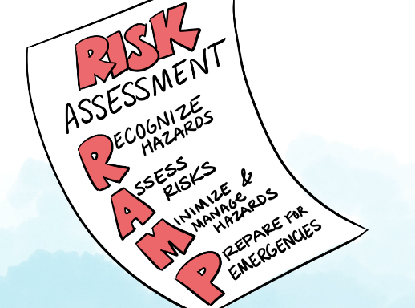
Purpose of this PowerPoint file
The Goal of this file is to support discussions that use the DCHAS risk assessment video as a teaching tool for laboratory workers who work with hazardous chemicals. It is not a complete lab safety training program unto itself. It is expected that users will adapt the content of this file to the needs of the audience that they are addressing.
Intended Audience: workers in and supervisors of research labs who have hands on responsibilities for using and overseeing evolving chemistries.
When: This powerpoint file and notes support initial training of lab workers; the video itself is designed for reminder training.
Where: The primary audience for these resources is academic laboratories which include workers with a variety of experience levels. Why: support improved risk assessment planning and then situational awareness as chemistry proceeds

Slide 3
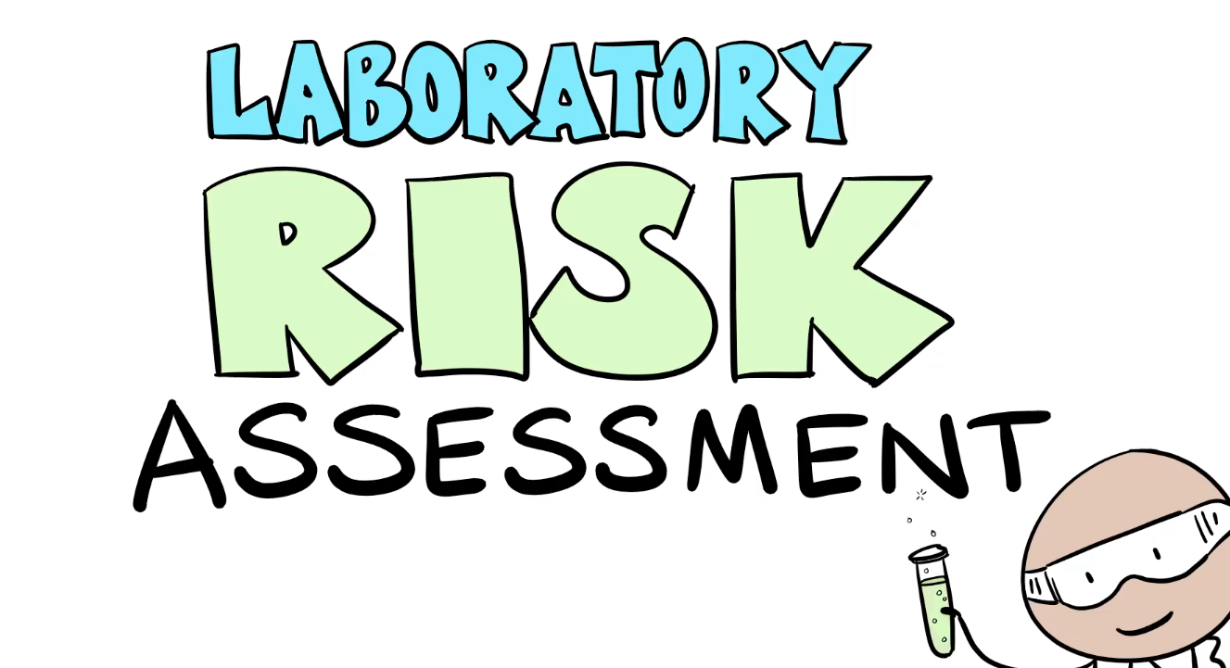
Intended Audience
The chemical safety information in this video is designed for people who work in laboratories as defined by OSHA – hazardous chemicals are used in quantities that can be handled by one person in short term processes.

Slide 4
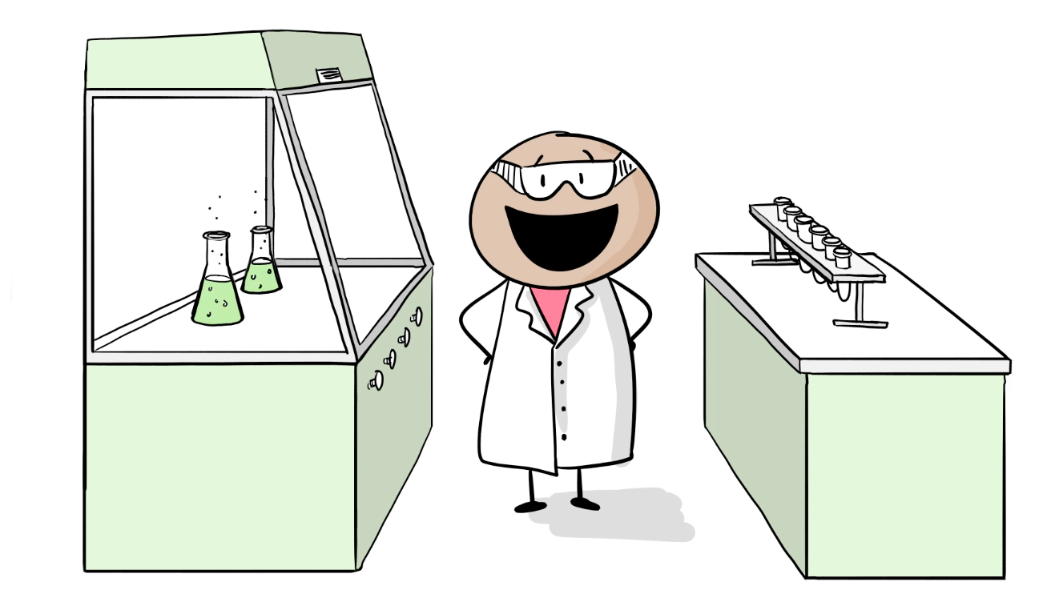
First Day in the Lab
Your first day in a research laboratory can be exciting, but also a little daunting. Whether you are doing research in chemistry, biology, geology, engineering, or life sciences, it is likely that you will need to work with unfamiliar hazardous chemicals. This video is about how to protect both yourself and your science from the risks those hazards present.

Slide 5
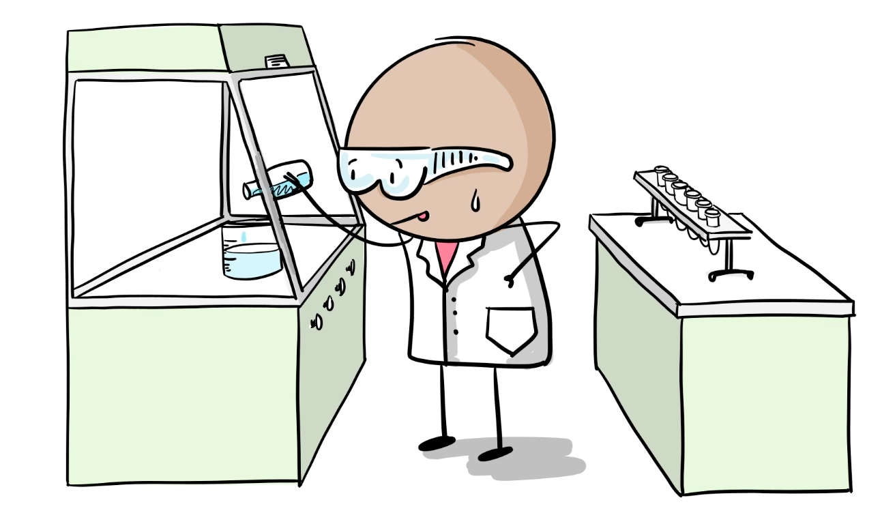
First Procedure
As you start your first lab chemical procedure, you will need to practice a variety of lab skills. Often, it can be a good idea to use water in lab equipment the first time you use it to just get a feel for how the equipment works before starting work with a flammable or toxic chemical.

Slide 6
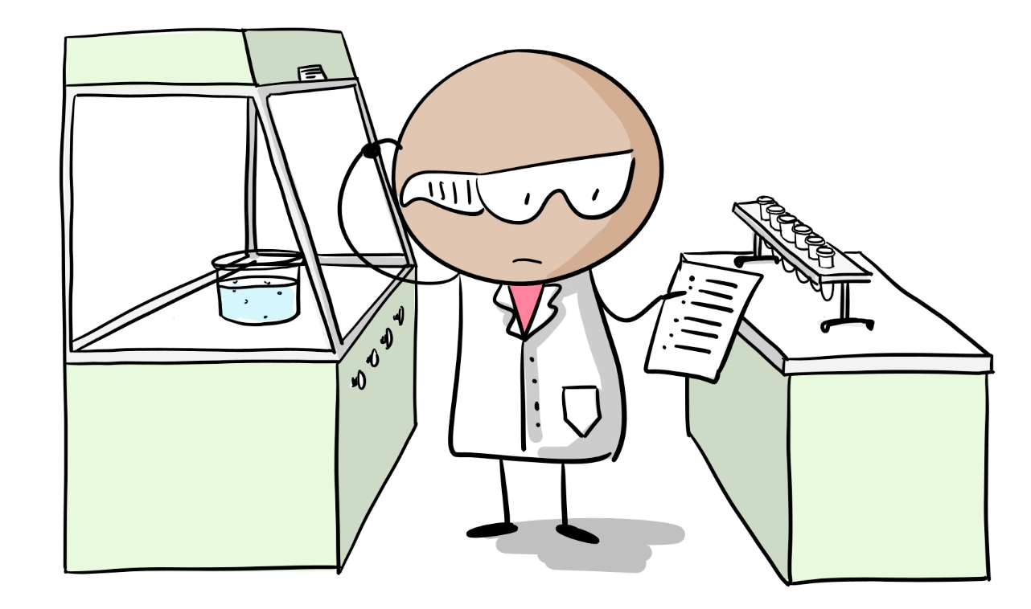
Is Following Directions Enough to Stay Safe?
In the research lab, it is likely that any Standard Operating Procedures will need to be modified as the work proceeds. This may be because the SOP was written for a different purpose or in a lab with equipment your lab may not have. For these reasons, it is important for you to think through what can go wrong and what you need to do to be ready for these situations.

Slide 7
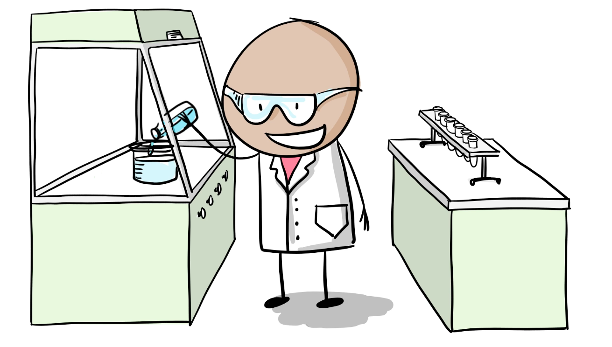
Increasing Comfort Level
Once you have gained some level of familiarity with the procedures involved in your lab research, it’s easy to relax and become less attentive as your work proceeds.

Slide 8
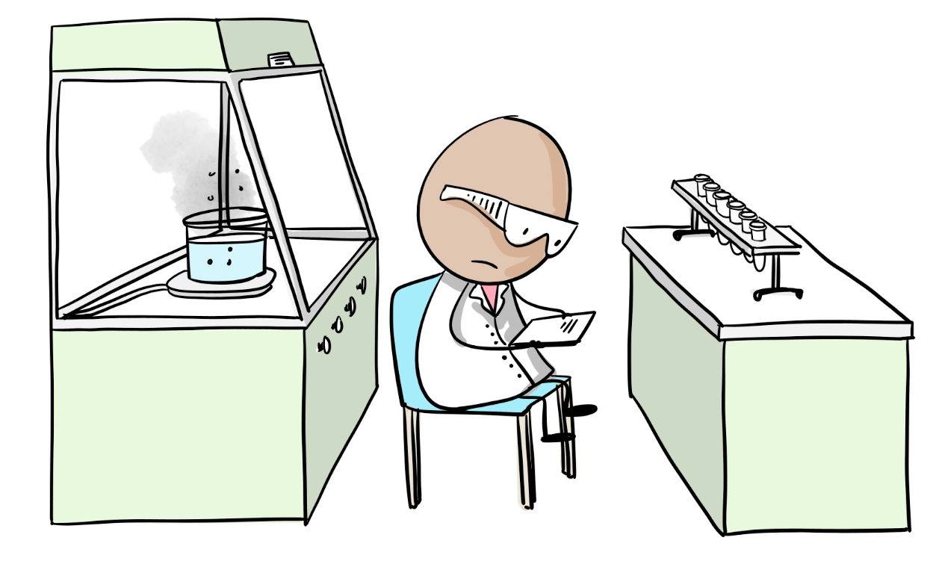
Distracted from Process
But when you get to the lab at the beginning of the day, “Cut myself on broken glassware” is not on the “To Do” list. It’s important to be aware that surprises can happen and that not all surprises are good surprises. Maintaining Situational Awareness as you work is key to Protecting Yourself, Your Neighbors and Your Science from unhappy surprises.

Slide 9
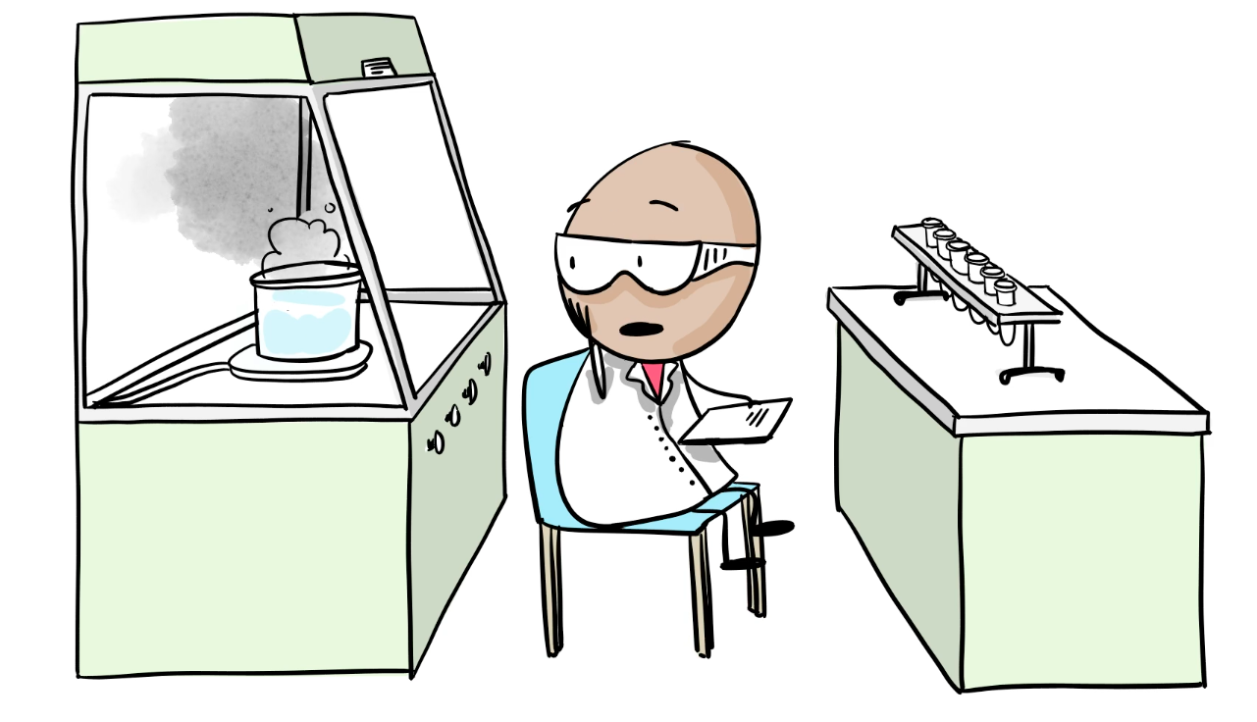
Startle Reflex
Unexpected events do happen. And how you react to a surprise will depend on how much you’ve thought about what you’ll do about the possibility before the surprise occurs.
So how do we get ready for the unexpected?

Slide 10
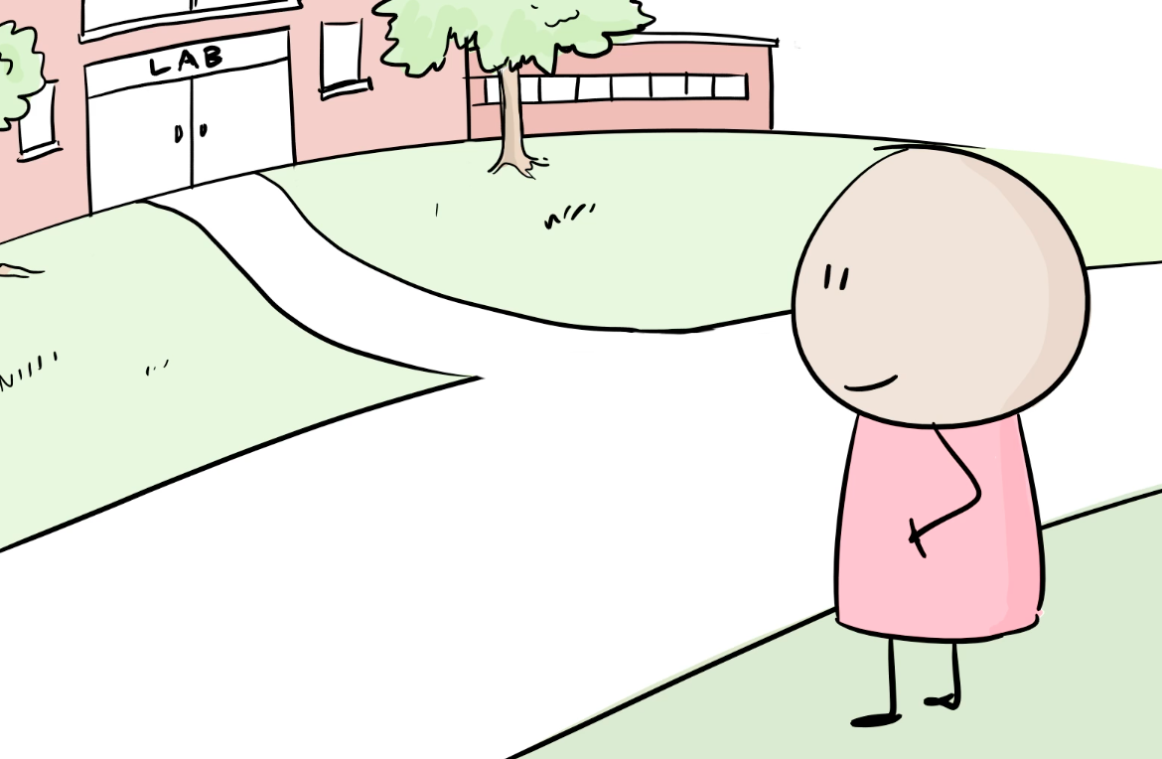
Crossing the Road to the Lab Safely is the First Task of the Day
Fortunately, we have experience with this question every day on the way to the lab. We know that the most dangerous part of the workday can be getting to work – in the United States, close to 100 people per day die in highway accidents.

Slide 11
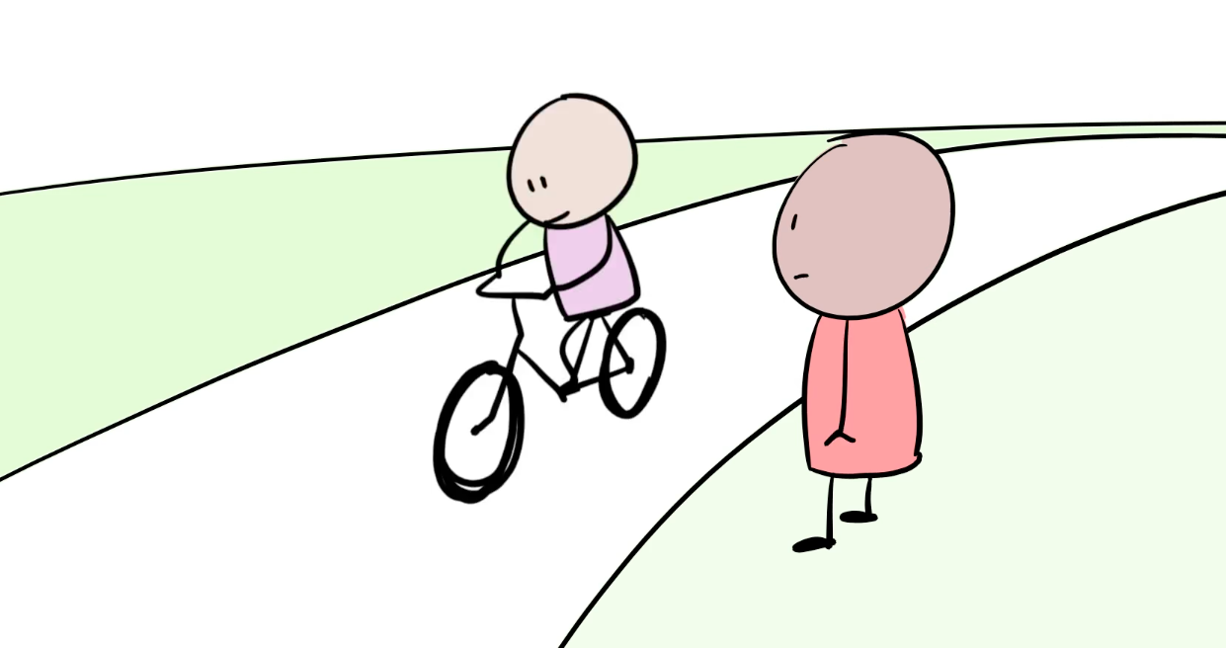
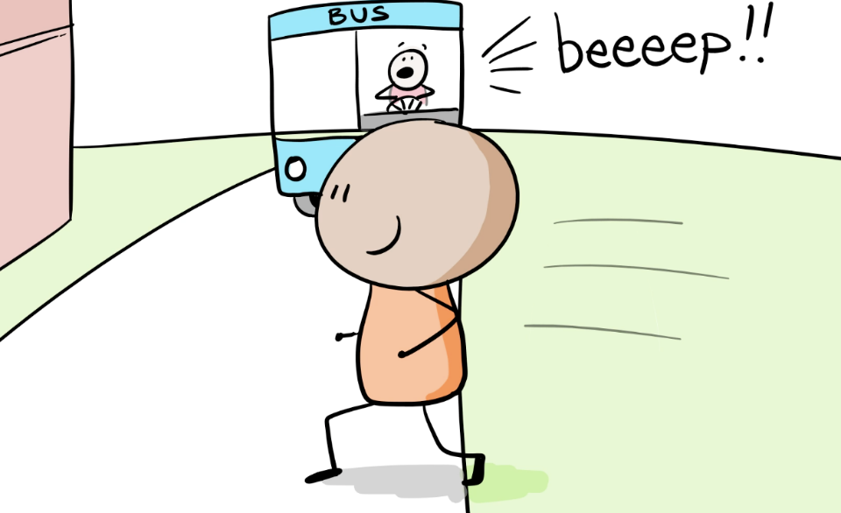
Different Levels of Hazards
One reason that roads are dangerous is that there are many different hazards with different levels of risk involved in travel along them. Sometimes we forget that these different levels of risk require different precautions.

Slide 12
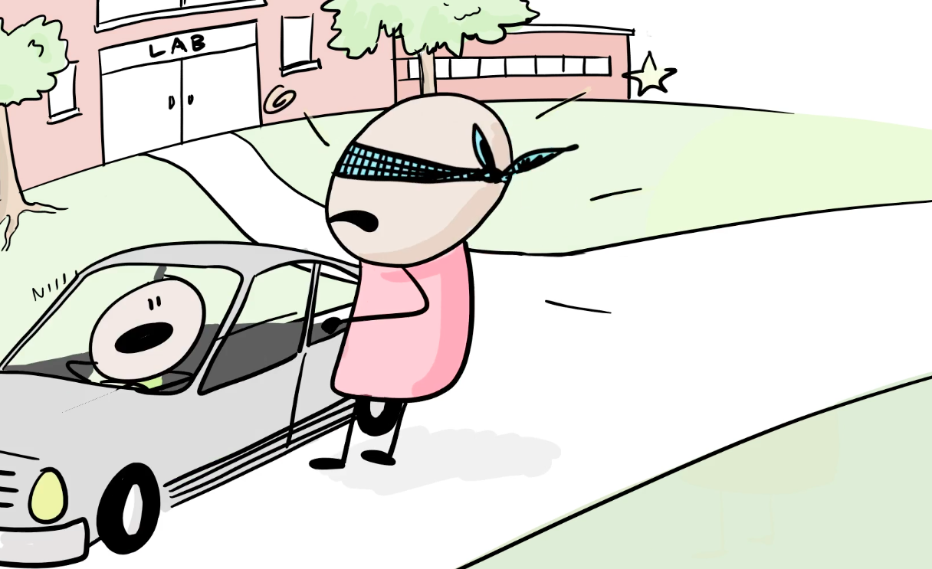
Complacency Leads to Risk Blindness
This “risk blindness” occurs not only in traffic, but also in the lab.
How can we deal with this challenge?

Slide 13
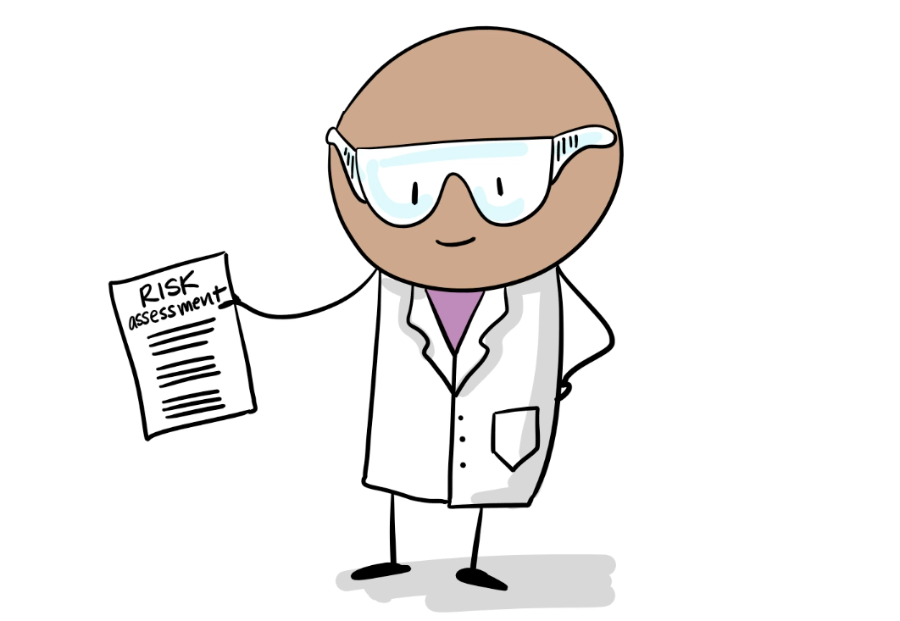
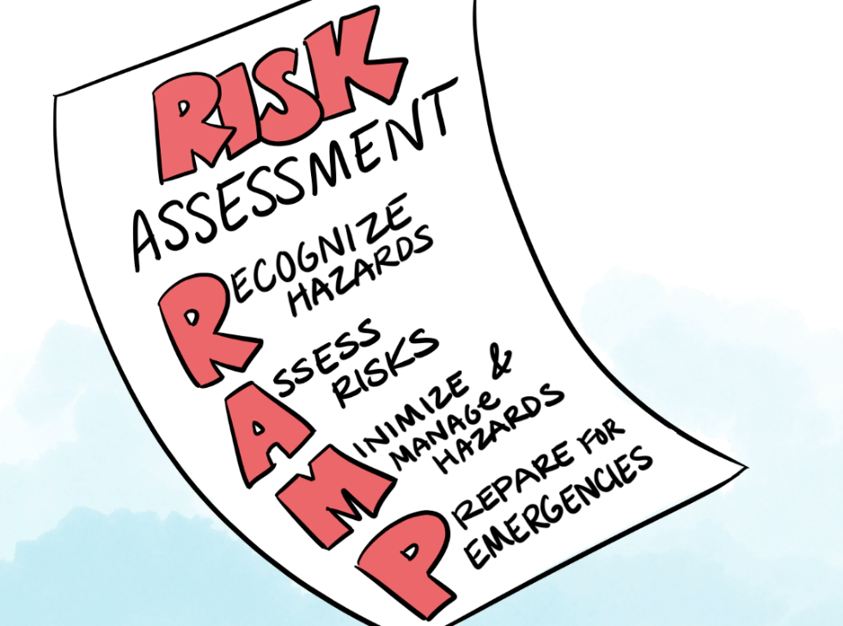
Risk Assessment Document
A key piece of managing “risk blindness” is a laboratory risk assessment. A risk assessment helps identify key parameters that indicate safety problems as your chemistry proceeds. The risk assessment can be organized around the RAMP paradigm.

Slide 14
The RAMP Process and Associated Information Tools
Recognize
- GHS information from the label and SDS
- Reactivity data from PubChem LCSS
Assess
- Write a detailed description of the work to be done
- Review GHS signal words of reactants and products
- Using hazard assessment methods from ACS web site
Manage
- Understand laboratory ventilation equipment and rates
- Use Personal Protective Equipment (gloves, eye protection, etc.) based on a risk assessment of likely scenarios and manufacturer’s compatibility guides
Prepare for Emergencies
- Identify the most likely scenarios
- Locate and understand how to use emergency equipment
- Review institutional emergency plans
Protect Your Neighbors and the Environment
- Manage lab wastes using institutional waste disposal services
- Consider Greener Chemistry opportunities
- Share your Lessons Learned from lab incidents

Slide 15
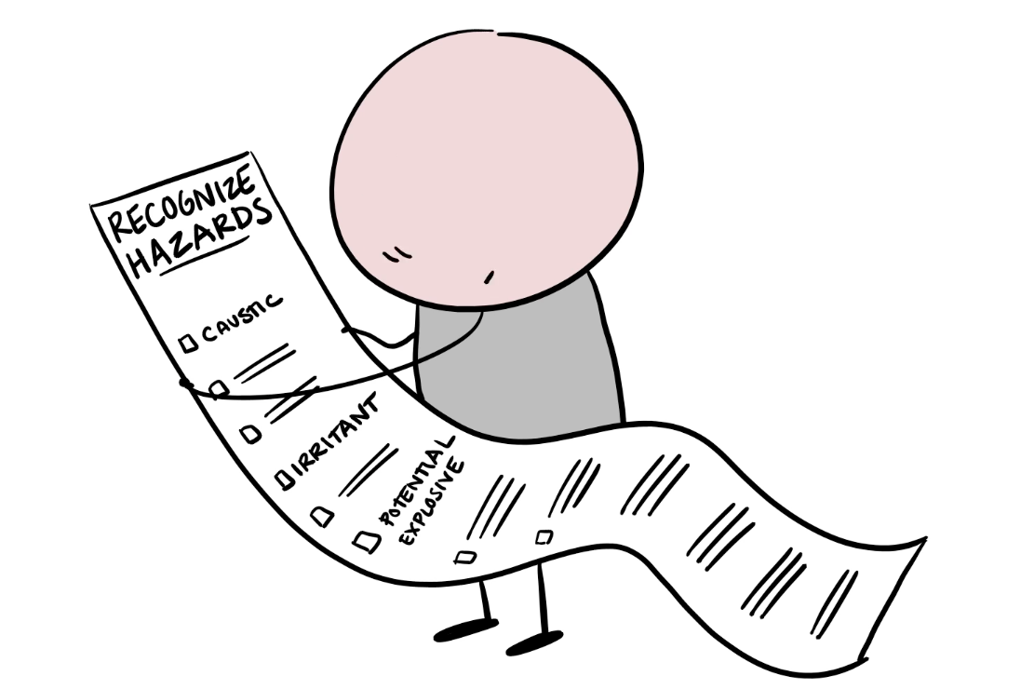
Recognize: Hazard Identification
Recognizing hazards requires a description of the process being assessed. The more detailed this description is, the better your risk assessment will be. Often, writing out the description will bring to mind hazards you aren’t consciously aware of after some experience in the lab.

Slide 16
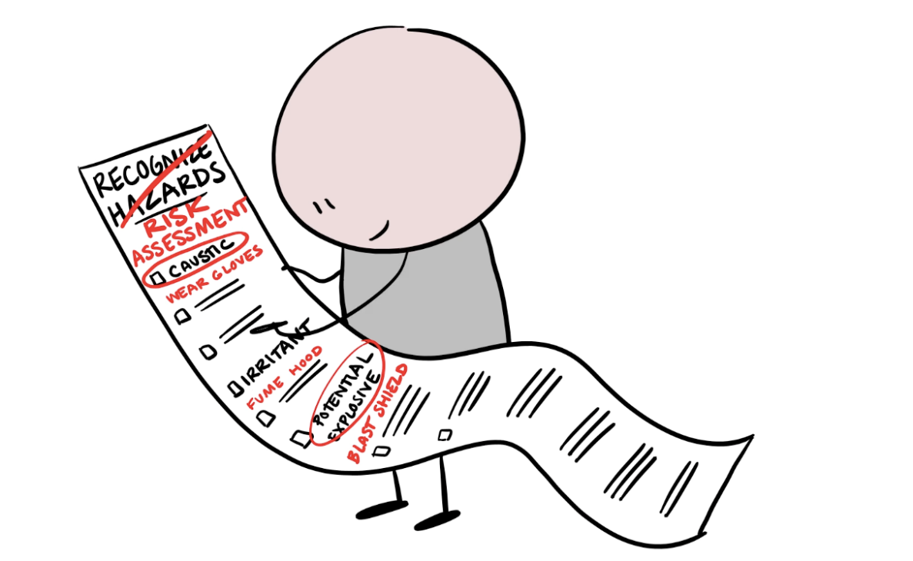
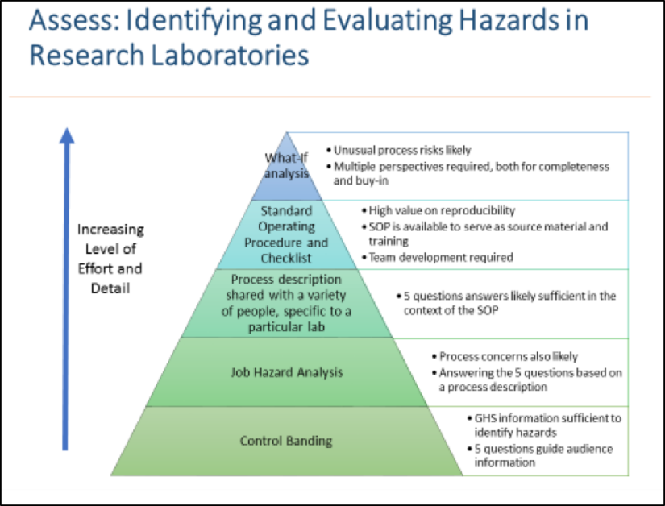
Assess: Ranking Risks
Once you have a list of the hazards associated with the process, you need to assess and prioritize those hazards based on the level of risks they present. This can get complicated because there are two elements of this risk: the likelihood of the risk occurring and the consequence of this event.
For example, one of the most frequent laboratory accidents is cuts from broken glassware; however, these may not require treatment beyond first aid. Comparing the importance of this hazard with the less common, but larger risk, of a laboratory fire due to a solvent leak from a rotovap will require careful thought.
Discuss these risks with other people in your lab group and your organization’s safety professionals to help everyone understand what the labs safety expectations are.

Slide 17
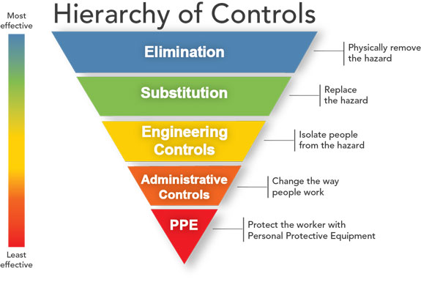
Manage: Identify Precautions
A safety management system will take advantage of interconnected methods to control these risks. The precedence for choosing among these techniques is outlined by the “Hierarchy of Controls”. Note that the combination of management controls best suited for a particular process is likely to vary from lab to lab.
For example, we can avoid using respirators as Personal Protective Equipment in the laboratory by using engineering controls, such as fume hoods and general lab ventilation, to control chemical vapors and thus worker exposure levels.
However, in some cases, such as in cleaning a chemical spill, we might need to use a respirator when we are unable to control exposure using engineering or administrative controls.

Slide 18
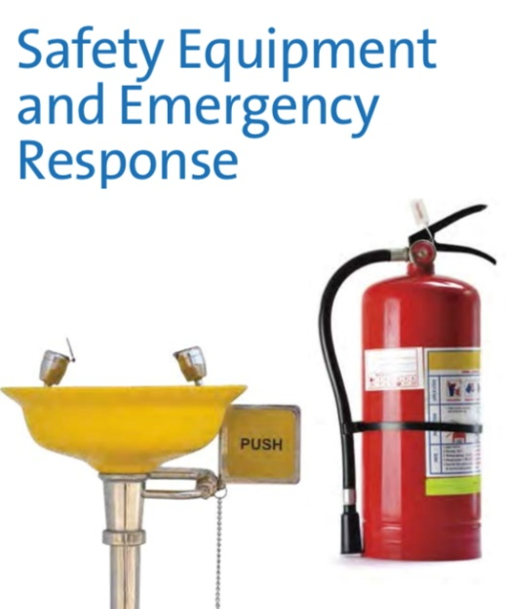
Prepare for Emergencies
Working with hazardous chemicals presents the risk of a variety of emergencies in the lab. Unexpected events such as fires, medical emergencies and leaks and spills of hazardous chemicals can arise quickly.
Consult your local emergency plan to be sure you understand their capabilities and expectations, but to protect yourself and others, you should seek help when you’re not sure what to do. When in doubt, call 911 for immediate help. Know where to find and how to use emergency equipment such as eyewashes, safety showers and fire extinguishers.
After an incident, the lab supervisor should lead a friendly review of the event to identify changes the event suggests should be made. If the emergency is an unusual one, share it with your colleagues when you publish your scientific results to help them share in your learning as well (see the Analytical Chemistry editorial at
for more information about this expectation).

Slide 19
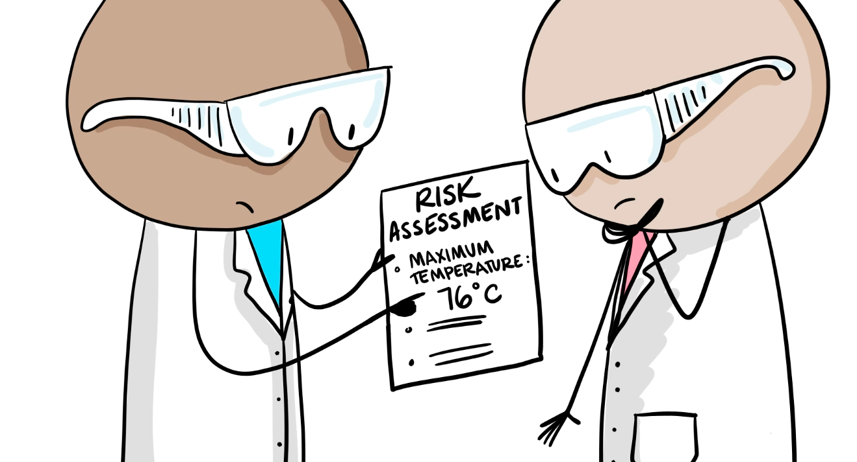
Process Parameters
In addition to the chemical hazards identified by the GHS designations, process hazards such as temperature, pressure and chemical reactivities need to be considered in the risk assessment. This assessment can also identify critical control points for scientific aspects of your work.

Slide 20
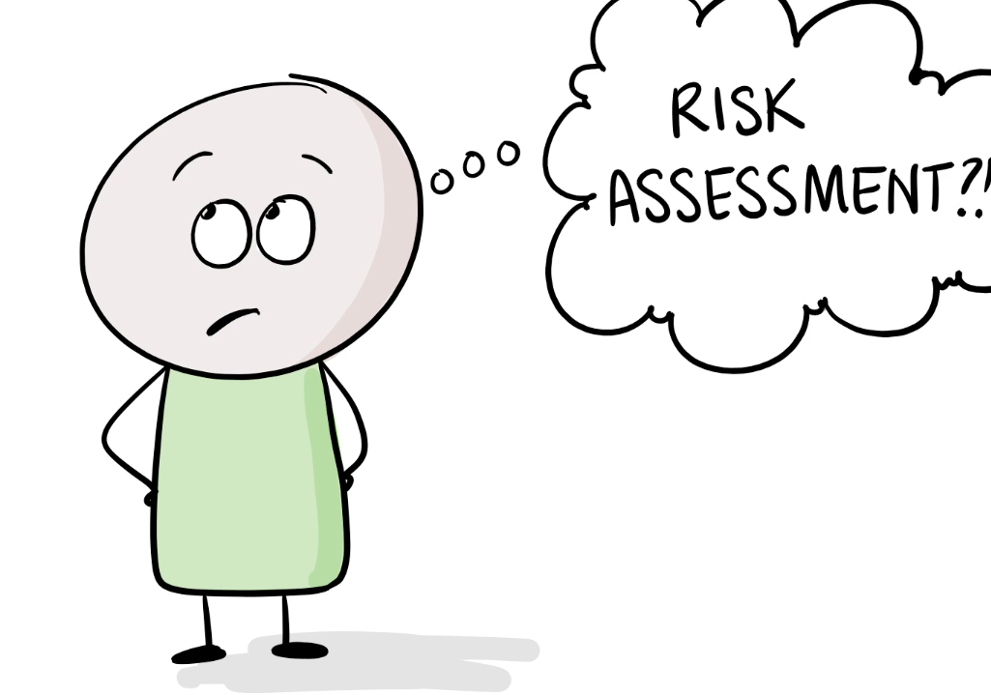
Why a Risk Assessment?
Not everyone appreciates the scientific and safety value of a careful risk assessment. For example, the ACS Strategic Plan notes that: “Despite increasing awareness of the importance of having an active safety culture in the workplace, some practitioners see safety as interfering with success.”
It is important to recognize the lack of a risk assessment imperils not only the scientist and their colleagues, but also the science they are working on. Following are some real life examples where a more complete risk assessment would have saved personal and scientific harm.

Slide 21
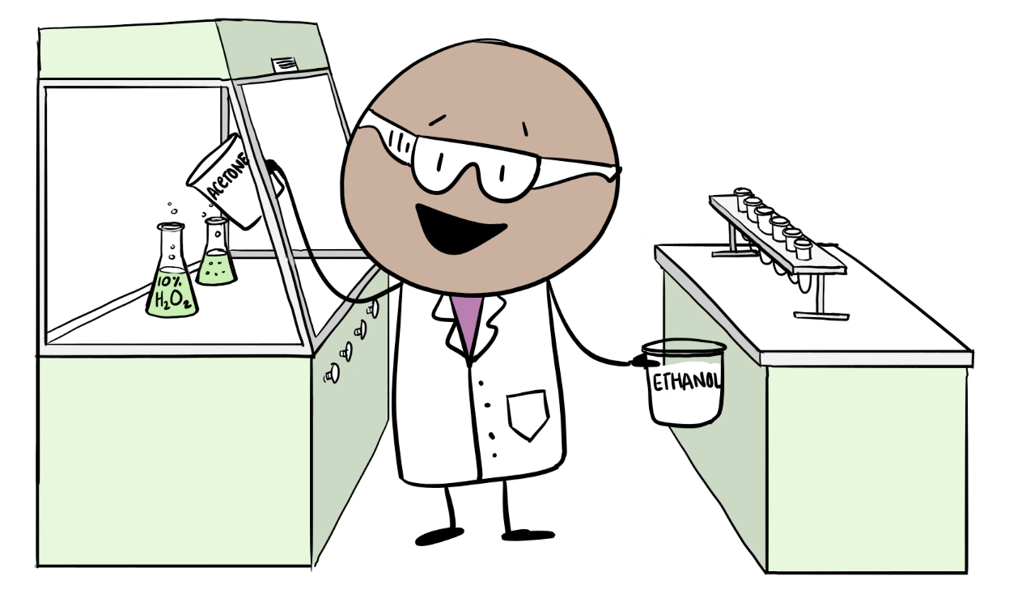
Fallacy 1: Solvents Aren’t Chemicals
Some chemists overlook the hazards of solvents as they plan their work. A substitution that may seem trivial at the scientific level can have serious safety and science implications. One such incident involved the use of PEG in a procedure. This led to an explosion which destroyed the experiment and the fume hood. The scientist suffered significant injuries, but was not permanently injured. The complete description of this incident can be found at http://cenblog.org/the-safety-zone/2014/07/more-details-on-the-university-of-minnesota-explosion-and-response/

Slide 22
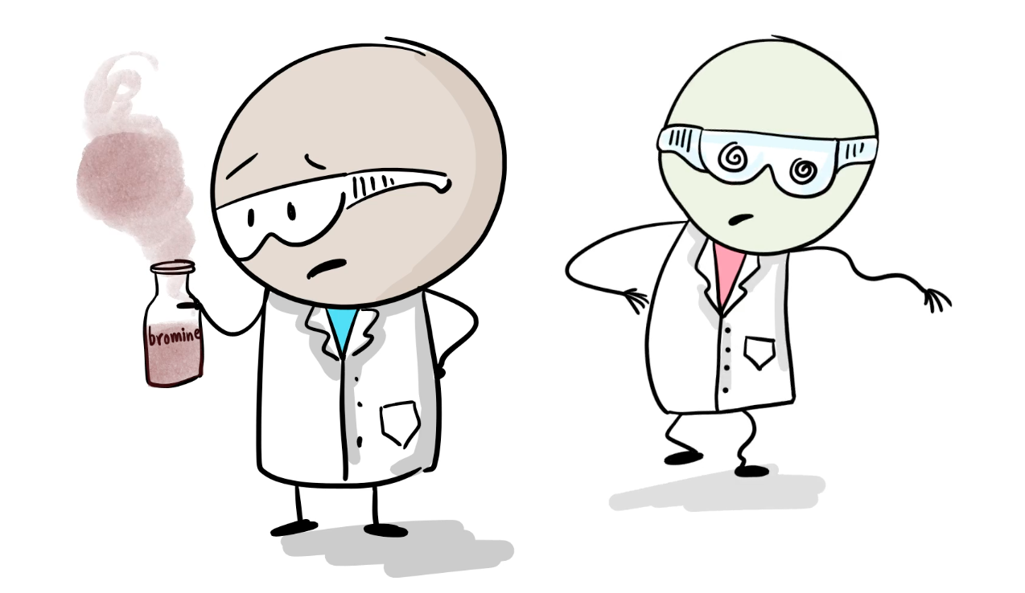
Fallacy 2: I’m Safe Because I’m Working with Small Quantities
At the University of Bristol in the UK, a graduate student was working on a procedure that was planned to involve 1 ml of H₂O₂ and 50 mL of acetone. Overuse of the oxidizer led to the formation of TATP, a known explosive. The graduate student appropriately alerted his PI to the problem, which led to a building evacuation. There was no loss other than an interruption of business, but a risk assessment that identified limits on the amount of peroxide to be used would have avoided this disruption. You can read more about this event at http://cenblog.org/the-safety-zone/2017/02/how-a-student-unintentionally-made-an-explosive-at-u-bristol/

Slide 23
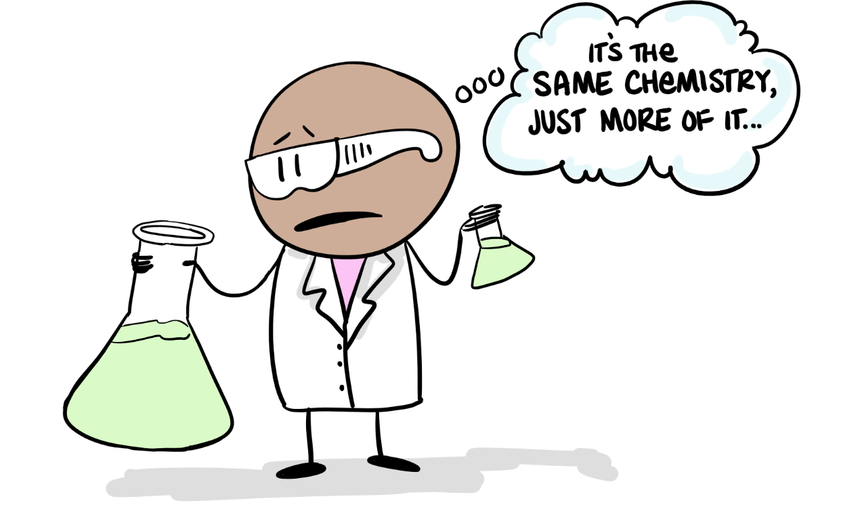
Fallacy 3: A Reaction is a Reaction
One of the reasons for the fatal fire at UCLA in 2008 was that the reaction being performed was scaled up by a factor of three without any change in the equipment used to perform the work. See the C&EN SafetyZone blog entry at https://cen.acs.org/articles/87/i31/Learning-UCLA.html for specific information about the impacts of this change.

Slide 24
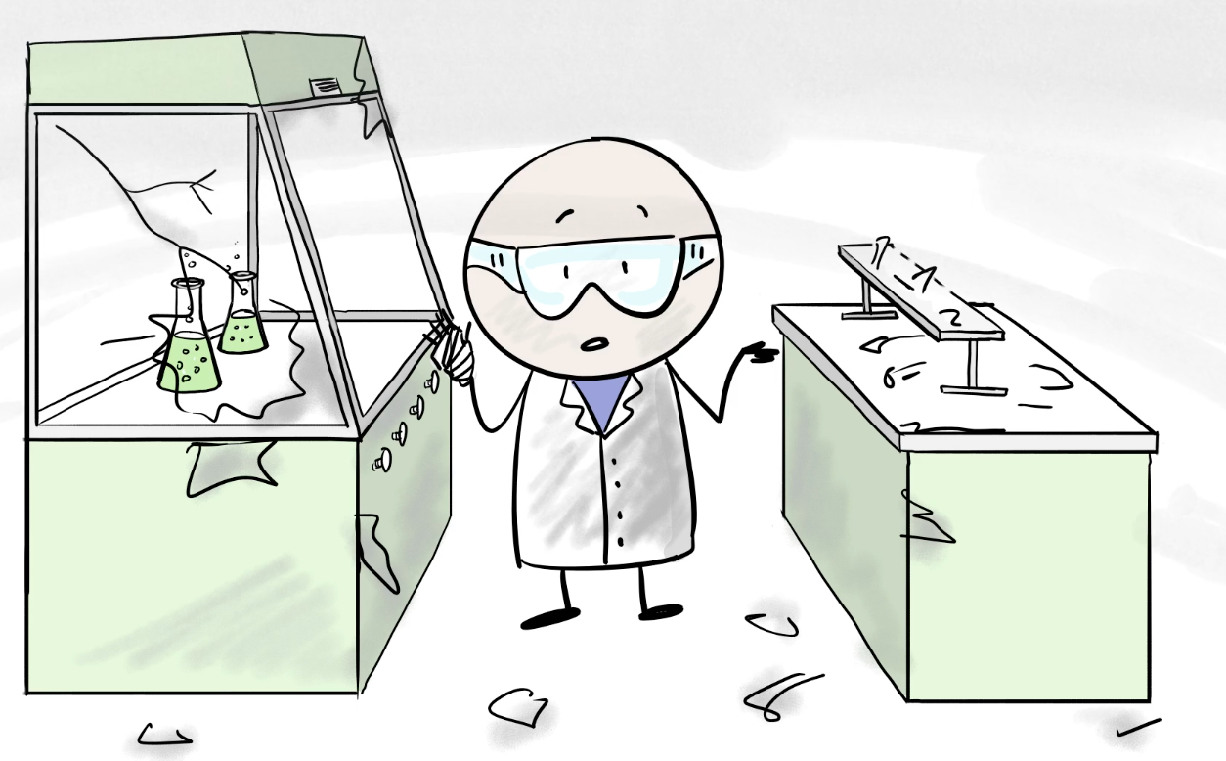
Fallacy 4: I Don’t Need Everything Every Time
An explosion at Texas Tech University in 2011 led to serious hand and eye injuries for a graduate student who had removed his safety glasses a few minutes before. See https://www.csb.gov/texas-tech-university-chemistry-lab-explosion/ for details.

Slide 25
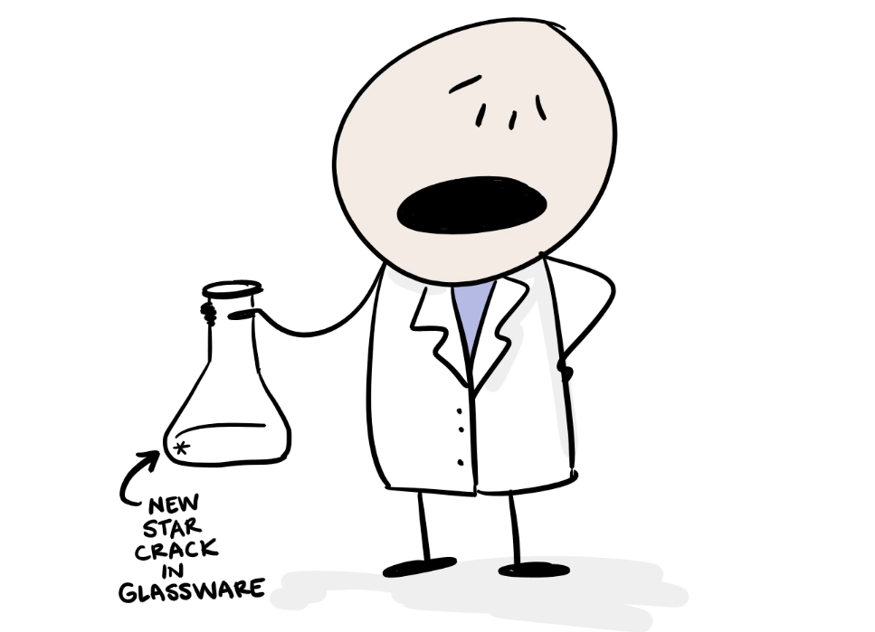
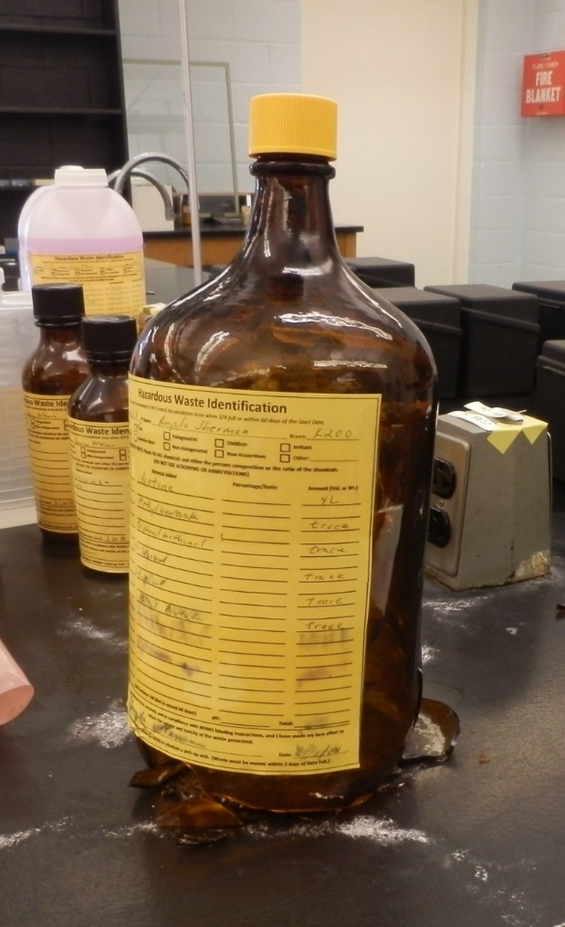
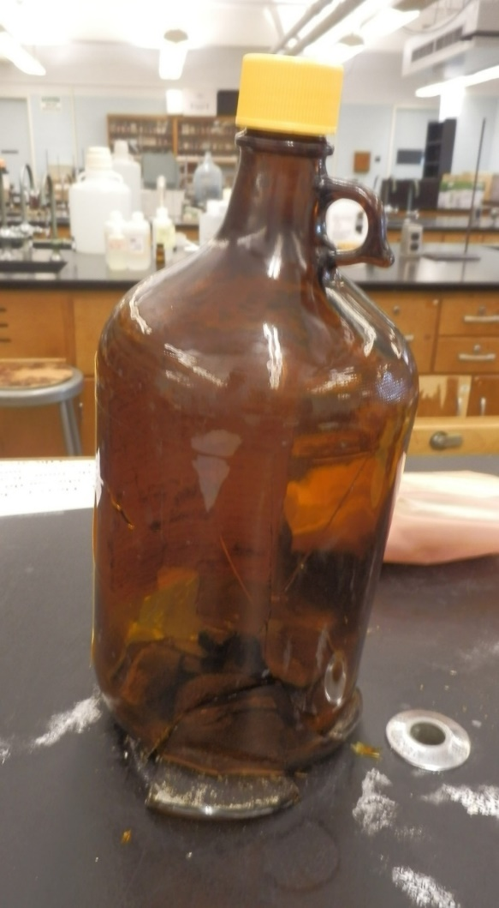
Fallacy 5: I Did This Safely Yesterday, So I Can Just Do It The Same Way Today
A checklist is a good way to remember the basics of safe practices, but it can include a number of hidden assumptions about the equipment being used. It is not unusual for chemical waste containers to fail due to stresses on their glassware or cap.

Slide 26
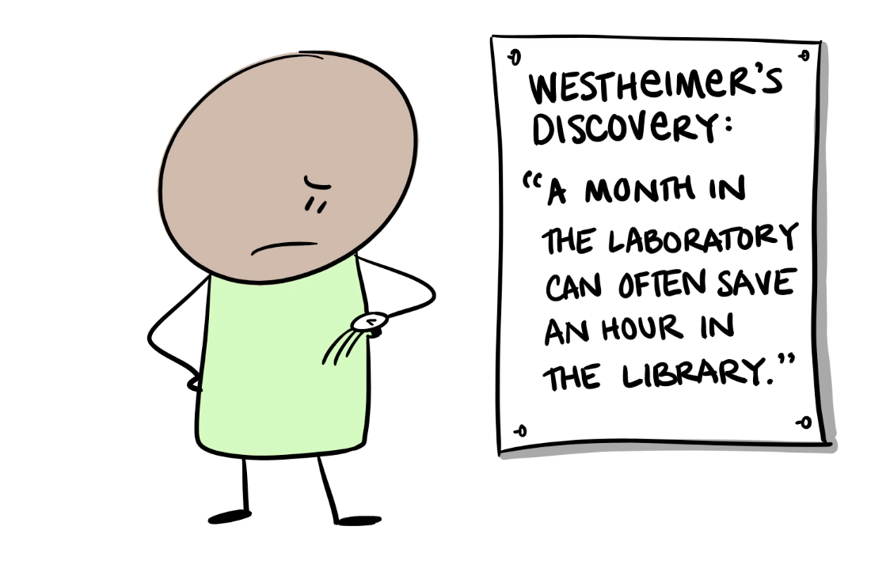
Fallacy 6: If I Don’t Get Started Now, I Won’t Get Finished on Time
Taking the time to plan your research work carefully, both in terms of defining what will happen when things go well as when things go wrong, can save both time and money.

Slide 27
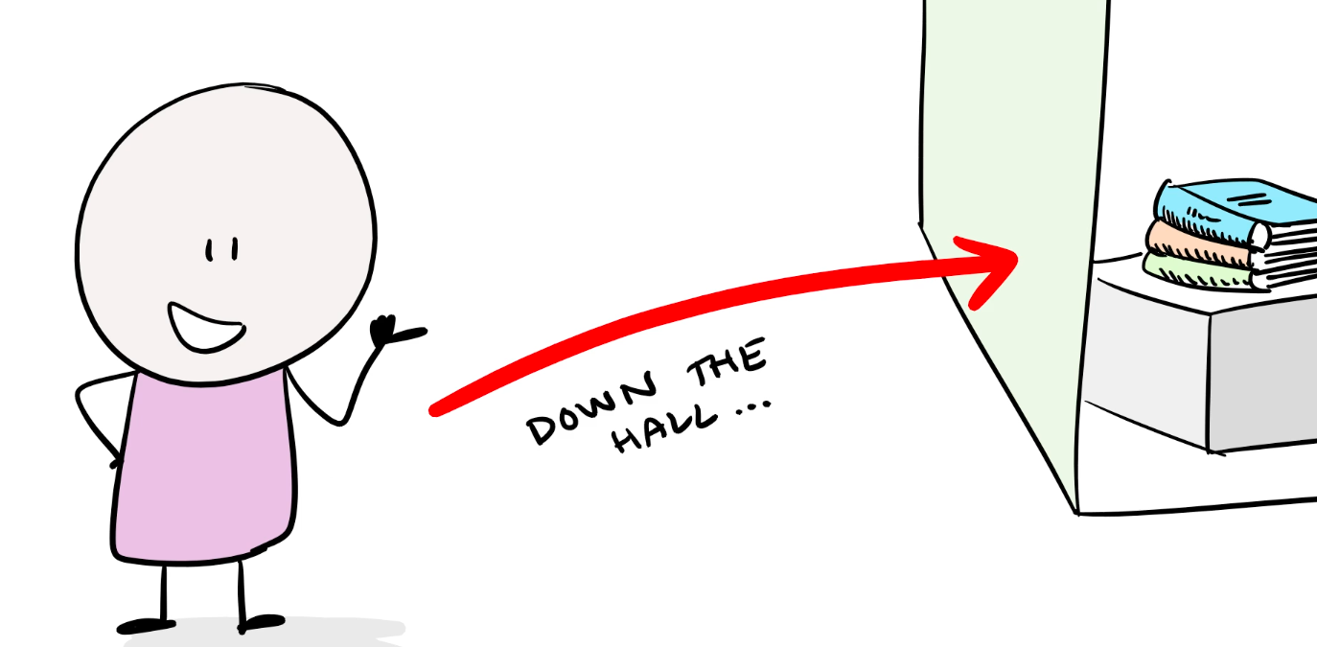
Fallacy 7: Someone Else Has Already Figured Out How to Do This Safely
In 2016 an undergraduate research student was injured when a glass scintillation vial exploded. The cause of the accident is believed to be an omission of a hydrochloric acid precipitation step while following a synthesis reaction taken from literature. This allowed the unintentional formation of a diazonium salt that exploded during collection. See more details at http://www.depts.ttu.edu/vpr/integrity/lessons-learned/march-2016.php

Slide 28
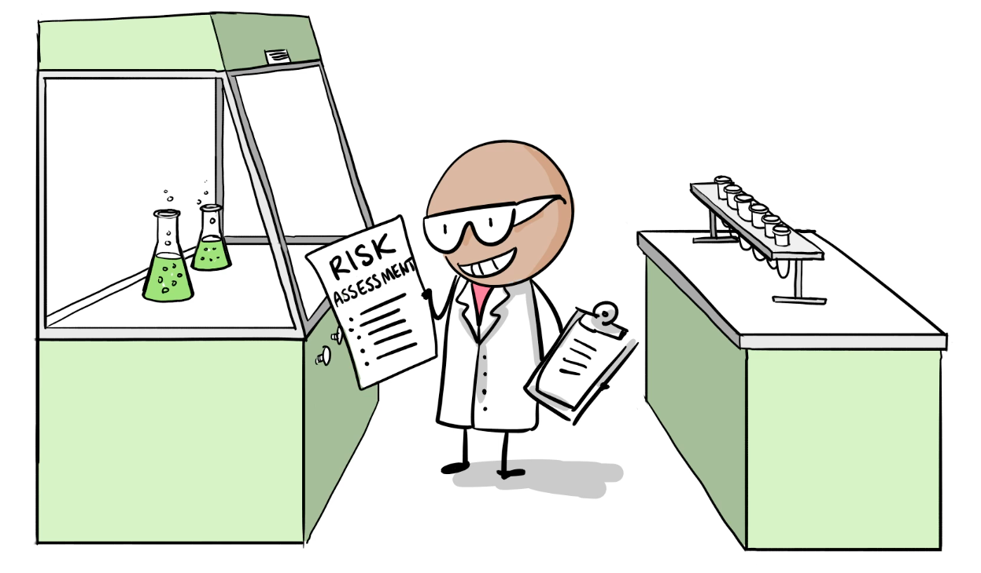
The Prepared Lab Worker
Lab Safety education has no final exam; that doesn’t mean that it doesn’t require ongoing attention over the course of your scientific career. You can use the tools described in this presentation to help you organize and share what you learn about lab safety as you do your science.

Slide 29
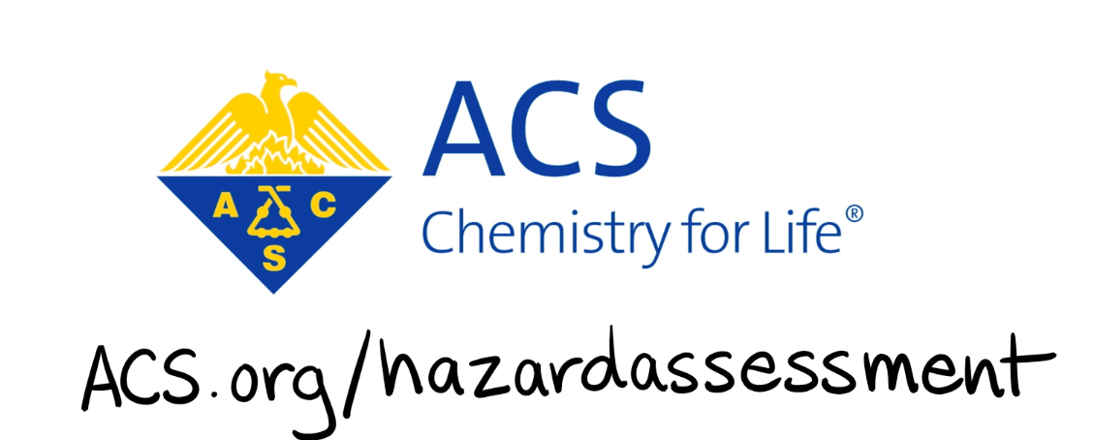
For More Information
Forms and ideas to help you organize risk assessments for your laboratory work are available at the ACS hazard assessment web site, http://www.acs.org/hazardassessment

Slide 30
Related References
American Chemical Society web site documents
Guidelines for Chemical Laboratory Safety in Secondary Schools
Guidelines for Chemical Laboratory Safety in Academic Institutions
Safety in Academic Chemistry Laboratories, 8th edition
http://www.acs.org/safety
Safety: Declare the Hidden Risks and Hazards of Your Research Anal. Chem. 2016, 88, 11261−11261
https://pubs.acs.org/doi/full/10.1021/acs.analchem.6b04513
C&EN Safety Zone http://cenblog.org/the-safety-zone/
US Chemical Safety Board report on Texas Tech Chemistry Lab Explosion
https://www.csb.gov/texas-tech-university-chemistry-lab-explosion/
Safety@TTU: Lessons Learned
http://www.depts.ttu.edu/vpr/integrity/lessons-learned/
Not VooDoo X Rookie Mistakes http://chem.chem.rochester.edu/~nvd/pages/rookie-mistakes.php?page=main

Slide 31
Credits and Permissions
This video was produced in 2018 by Blue Seat Studios, with the assistance of the ACS Division of Chemical Health and Safety and the University of Bristol. It is being shared under a non-commercial, by attribution Creative Commons license.

Slide 32
Sample Quiz Questions
Which of these are relevant to identifying a chemical hazard?
Fume hood face velocity
Fire Extinguisher Class
Thickness of a lab glove
The GHS pictogram
Which of these is most helpful in assessing the relative risks of using two chemicals?
The molecular weight of the chemicals
The concentration of the chemicals
The number of hydrogen atoms each chemical contains
The temperature the lab is kept at
Which RAMP step most involves review of relevant chemical safety information?
Recognize the Hazards
Assess the Risks
Manage Safety
Prepare for Emergencies

Slide 33
Sample Quiz Questions
Situational awareness refers to
Monitoring changes in a chemical process that indicate a developing risk
Being aware that your job will end in 3 months
Knowing when the deadline for the abstract for the next ACS national meeting is
Knowing when other people will be in the lab and avoiding those times so that you can work more efficiently
What level of scale up of a synthesis should trigger a complete review of the risk assessment for the procedure?
Ten times more material
Three times more material
Depends on the equipment involved and whether it is designed for the new quantities

