Slide 1
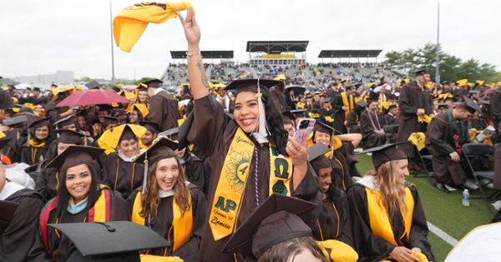
Meeting Reminders:
Thank you for participating in this Graduation and Commencement Information Session!
We will get started momentarily.
You will be muted, and your camera will be off for this session.
If you have a question, please place it in the Q&A. We will cover all questions not answered in the presentation at the end of each segment.

Slide 2
Commencement & Graduation Information Session Meeting Agenda
Graduation
Steps to apply to graduate
Internships, Clinical Practice and finals
University Honors explained
How do I get my diploma?
Commencement
Schedule Review and what to expect at Commencement
Participation Eligibility
Registration & Ticketing
Regalia
Accessibility Services
Important Dates to Remember

Slide 3
Graduation vs. Commencement
Graduation…
Commencement…
is the successful completion of a student’s major/minor/ concentration and the issuing of a diploma.
is the celebration of
your time and hard
work at Rowan
University.

Slide 4
5 Steps for Success
Step 1: Apply to Graduate
Step 2: Register to participate in Commencement and claim guest tickets
Step 3: Share the ceremony details and tickets with your guests
Step 4: Caps & Gowns
Step 5: Pay attention to communication

Slide 5
Step 1: Apply to Graduate
Graduation Dates & Deadlines
Term you expect to graduate: This means you must complete all degree/program requirements (including transfer credits, all grades, GPA minimums, special courses, internships/clinical practice, etc.) by the end of this term. | Deadline dates for student to apply to graduate: Students must apply online for graduation review via SSB, rowan.edu/selfservice. | Deadline dates for Academic Advisors to review any submitted graduation applications: | Dates when degrees will be awarded in system and posted on transcripts: | Date that will be posted on the transcript and official diploma: | Date official diploma will be mailed to you:
Fall 2025 | Aug. 11 - Oct. 3 | November 7, 2025 | January 2026 | December 30, 2025 | February 2026
Winter 2026 | Oct. 13 - Nov. 28 | December 19, 2025 | February 2026 | January 30, 2026 | March 2026
Spring 2026 | Jan. 2 - Feb. 27 | March 20, 2026 | June 2026 | May 31, 2026 | August 2026
Summer 2026 | April 1 - May 29 | June 19, 2026 | September 2026 | August 31, 2026 | October 2026

Slide 6
Step 1: Apply to Graduate
Students should contact their ADVISOR for each program and REVIEW their transcript and Degree Works report to ensure that ALL University Requirements surrounding the Major, Minor, and/or Concentration have been met.
Students must Apply to Graduate (Earn the Degree) online through Self-Service Banner. Select “Apply to Graduate” under the student tab. Applying to Graduate is NOT related to the Commencement Ceremony.
After the application is submitted, students will receive email confirmation to their Rowan Student email address. This email includes instructions for Commencement.
All Graduation information will be sent to students’ Rowan email addresses only. Please check often, through the receipt of your Diploma in the mail.
Students can verify the information on their application at any time. Select “View Pending Graduation Application” on Self-Service Banner.

Slide 7
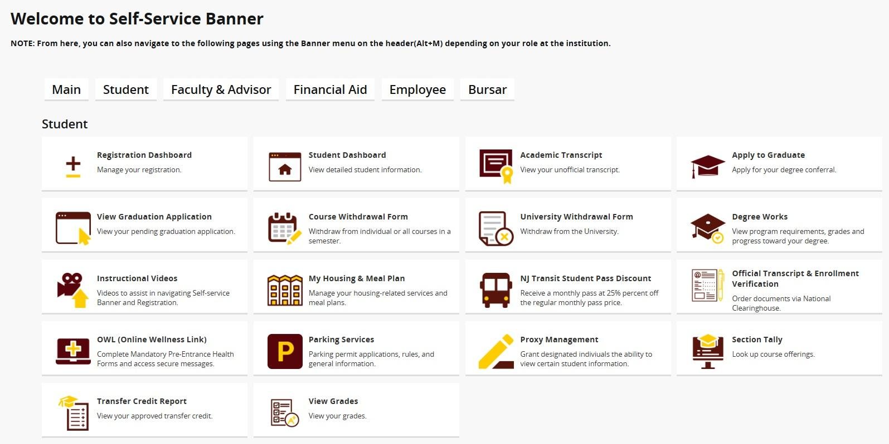
Did I Apply to Graduate?
You can view the Graduation Application and details that you submitted through SSB.
Review:
Name preference
Mailing address
Program

Slide 8
RU Completing an Internship/Clinical Practice/Final Project/Thesis/Dissertation?
If students receive an incomplete grade, the final graduation review cannot occur until the IN grade is replaced.
Important! IN grades must be replaced within the deadline of the term of the graduation application. If the IN grade is replaced after the deadline, the application will be denied, and the STUDENT will need to RE-APPLY. (no added charge)
Example – Student applied for May conferral and has an IN. If the grade is replaced by June 30th, and all other University requirements are met, the conferral date will remain May 30th. If the IN grade is replaced after June 30th, the conferral date will be August after a new application is submitted.

Slide 9

University Honors
3.450 – 3.649 Cum Laude
3.650 – 3.849 Magna Cum Laude
3.850 – 4.000 Summa Cum Laude
For Graduation, University Honors are based on students’ final cumulative GPA and will be printed on students’ Diploma and Transcript.
For Commencement, University Honors are based on the cumulative GPA earned at the end of the Winter term, and will be noted, with a symbol, in the Commencement Program.

Slide 10
Diplomas
The final review of Spring Graduation Applications will occur during the month of June (after the semester ends and all final grades are submitted). Summer applications will be reviewed/awarded in September.
Students will be notified by email when their degree is awarded or if there are issues regarding their application.
Diplomas will list MAJORS only. Minors, concentrations, specializations and CUGS will appear on your final transcript.
Diplomas are mailed directly from our Diploma vendor Paradigm and students will receive email notification when their diploma ships.

Slide 11
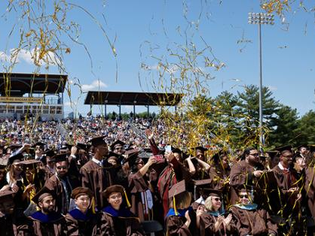
COMMENCEMENT 2026

Slide 12
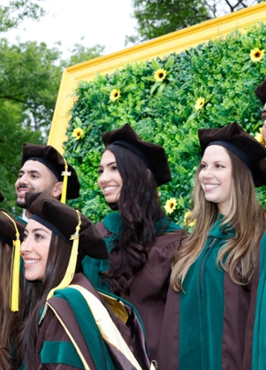
Commencement Week
The School of Graduate Studies Doctoral Recognition Ceremony & Reception
May 8, 2026 @ 3 p.m.
University Commencement Ceremony & Celebration
May 9, 2026 @ 10:00 am
College Commencement Ceremonies
May 11 – 15, 2026
Registration is required.

Slide 13
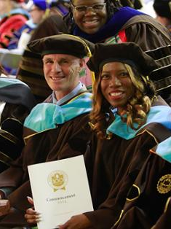
School of Graduate Studies Doctoral Recognition Ceremony & Reception
Esbjornson Gymnasium, Glassboro Friday, May 8, 2026 at 3 p.m.
Ed.D. and Ph.D. graduates come to the stage accompanied by their dissertation advisor to be hooded.
All are invited to a reception directly following the ceremony.
Doors open at 2 p.m.
Up to 4 guest tickets per registered graduate
All M.D. and D.O. graduates will be hooded at their college ceremony.

Slide 14

University Ceremony & Celebration
Wackar Stadium, Saturday, May 9, 2026 – 10 a.m.
The Celebration
Immediately following the ceremony
Complimentary light bites
Celebratory music
Photo opportunities
Beer & wine garden (for a fee, with ID)
The Ceremony
Approximately 1.5 hours
President Houshmand’s address
Ceremonial conferral of degrees
Cash Prizes!
Exciting surprises and more!
Details
Up to 6 guest tickets per registered graduate
Graduates and guests may arrive at 8:30 a.m. before the ceremony.
Seating is first come, first served.

Slide 15
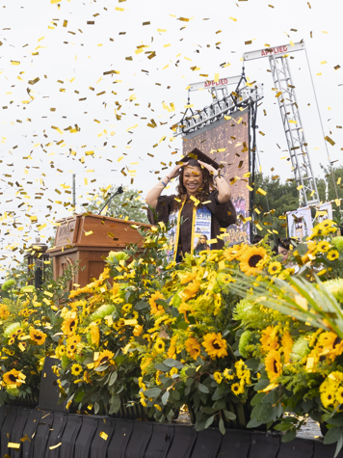
College Commencement Ceremonies
Richard Wackar Stadium and Esbjornson Gymansium, Glassboro, NJ
Monday, May 11 - Friday, May 15, 2026
Graduates cross the stage and have their have name read aloud.
Graduate name, college and degree (1) will appear on screens at the ceremony as well as on the live stream for those watching at home.
Gates open 45 minutes prior to the start of each ceremony.
Seating is first come, first served.

Slide 16
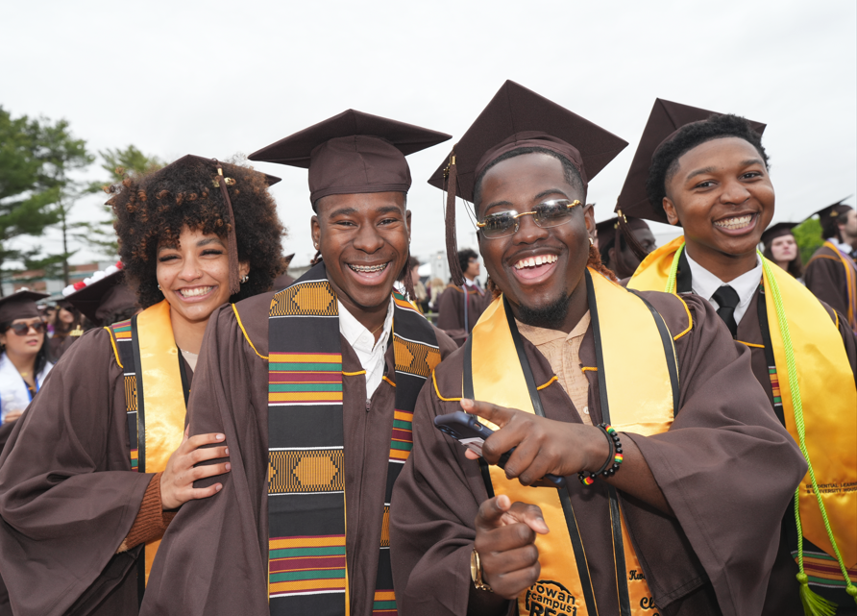
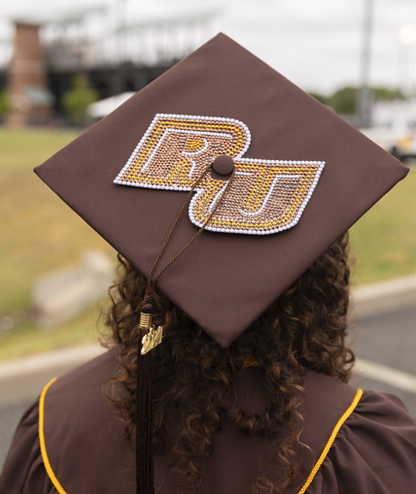
What to expect at the College Ceremony
The Ceremony
1.5 hour ceremony
The ceremony includes:
Dean’s Remarks
Special Guest Address
Presentation of Graduates, where graduates cross the stage, have their names read out loud, and appear on screens and on the live stream, as well as, collect their diploma cover and have their professional photo taken.
Music Rowan’s Commencement Band
Post Ceremony
Enjoy complimentary snacks, water and photo opportunities
Enjoy iconic locations, like the Prof Pride statue and the Bunce Hall stairs for a selfie.
Secure a reservation at a local restaurant to celebrate with your guests.

Slide 17
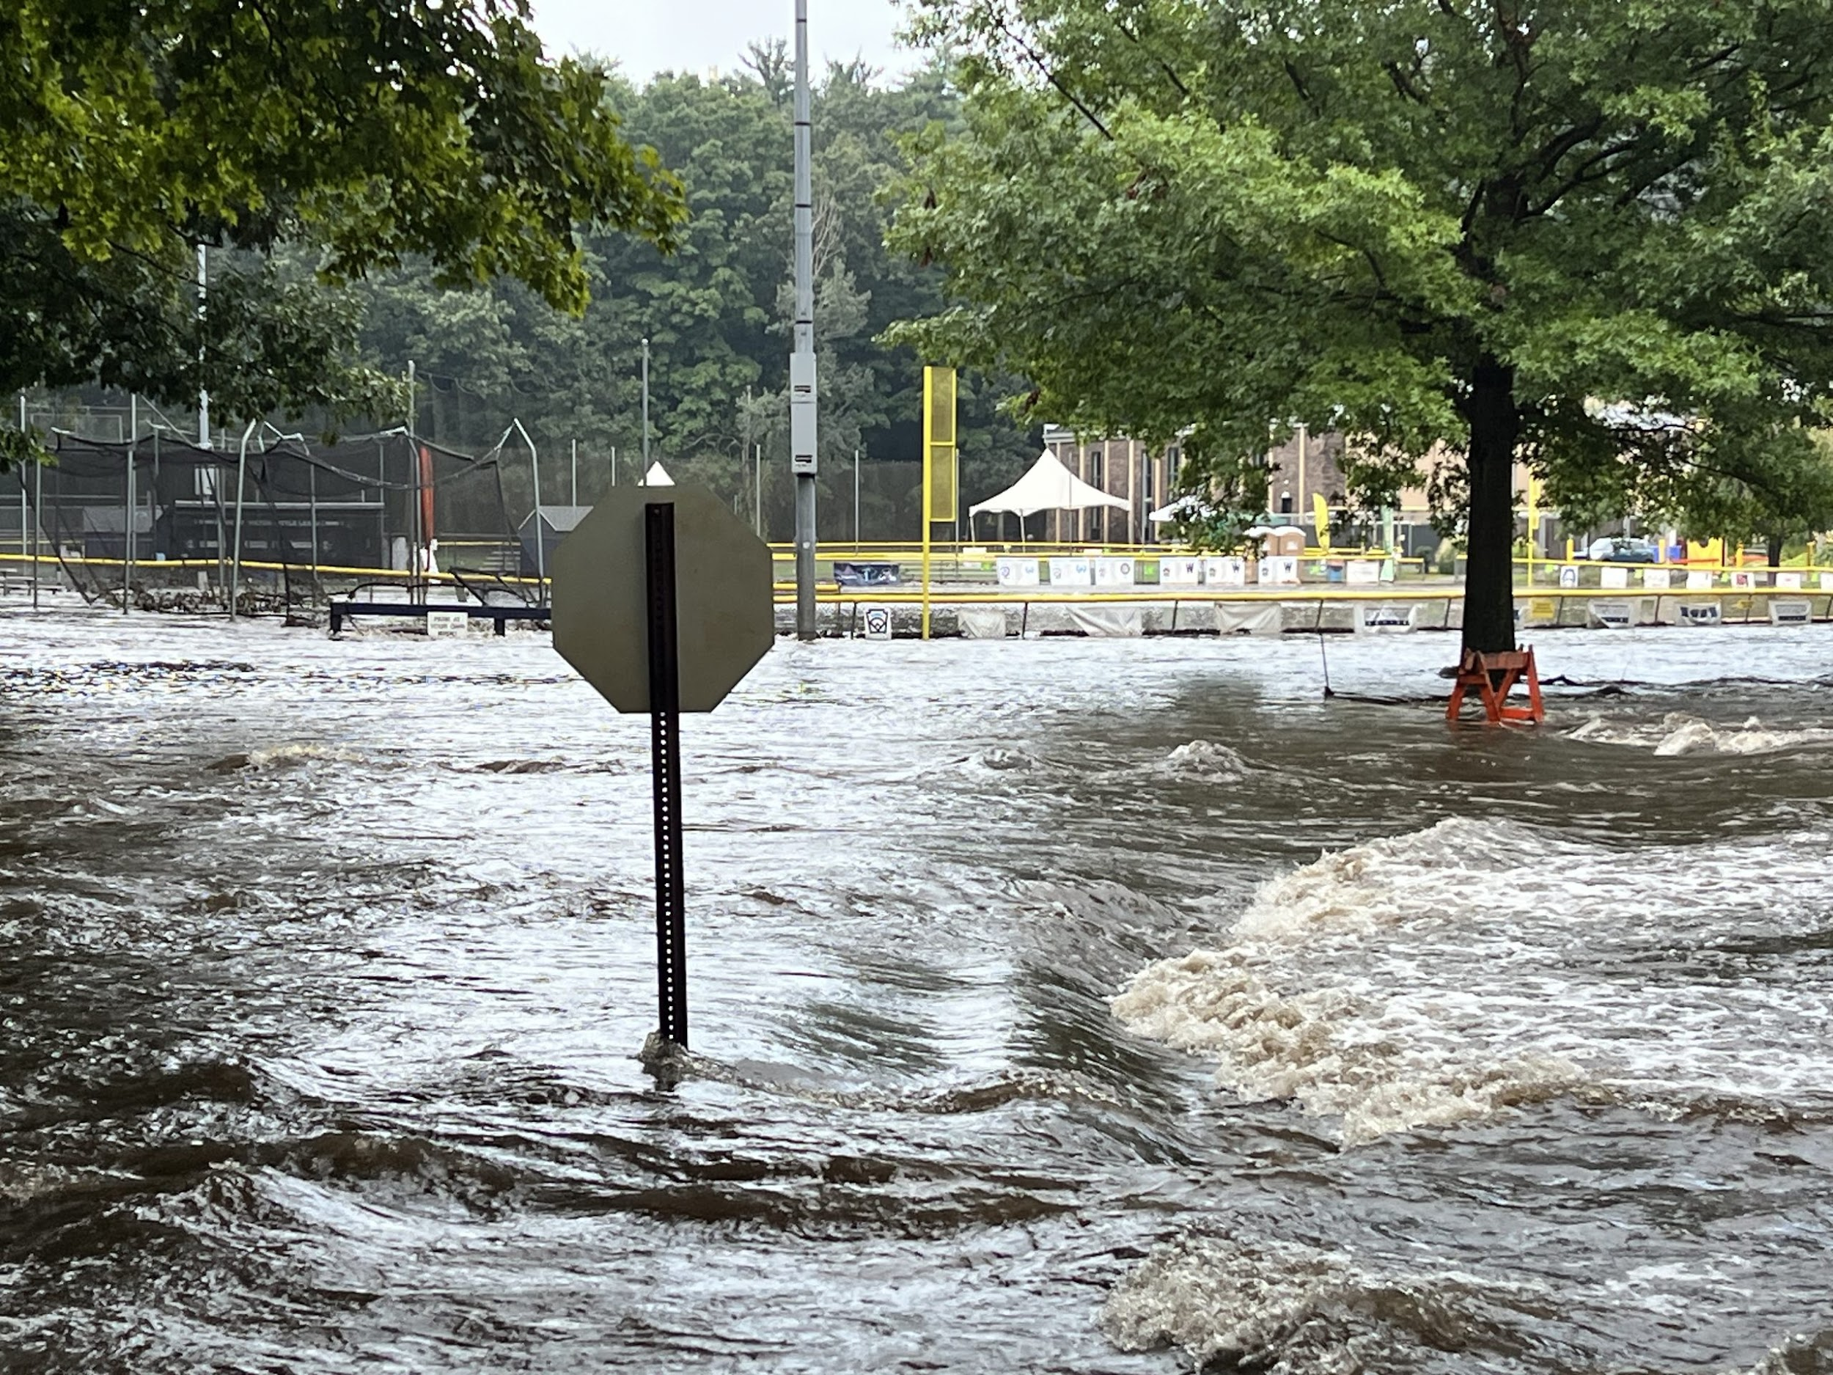

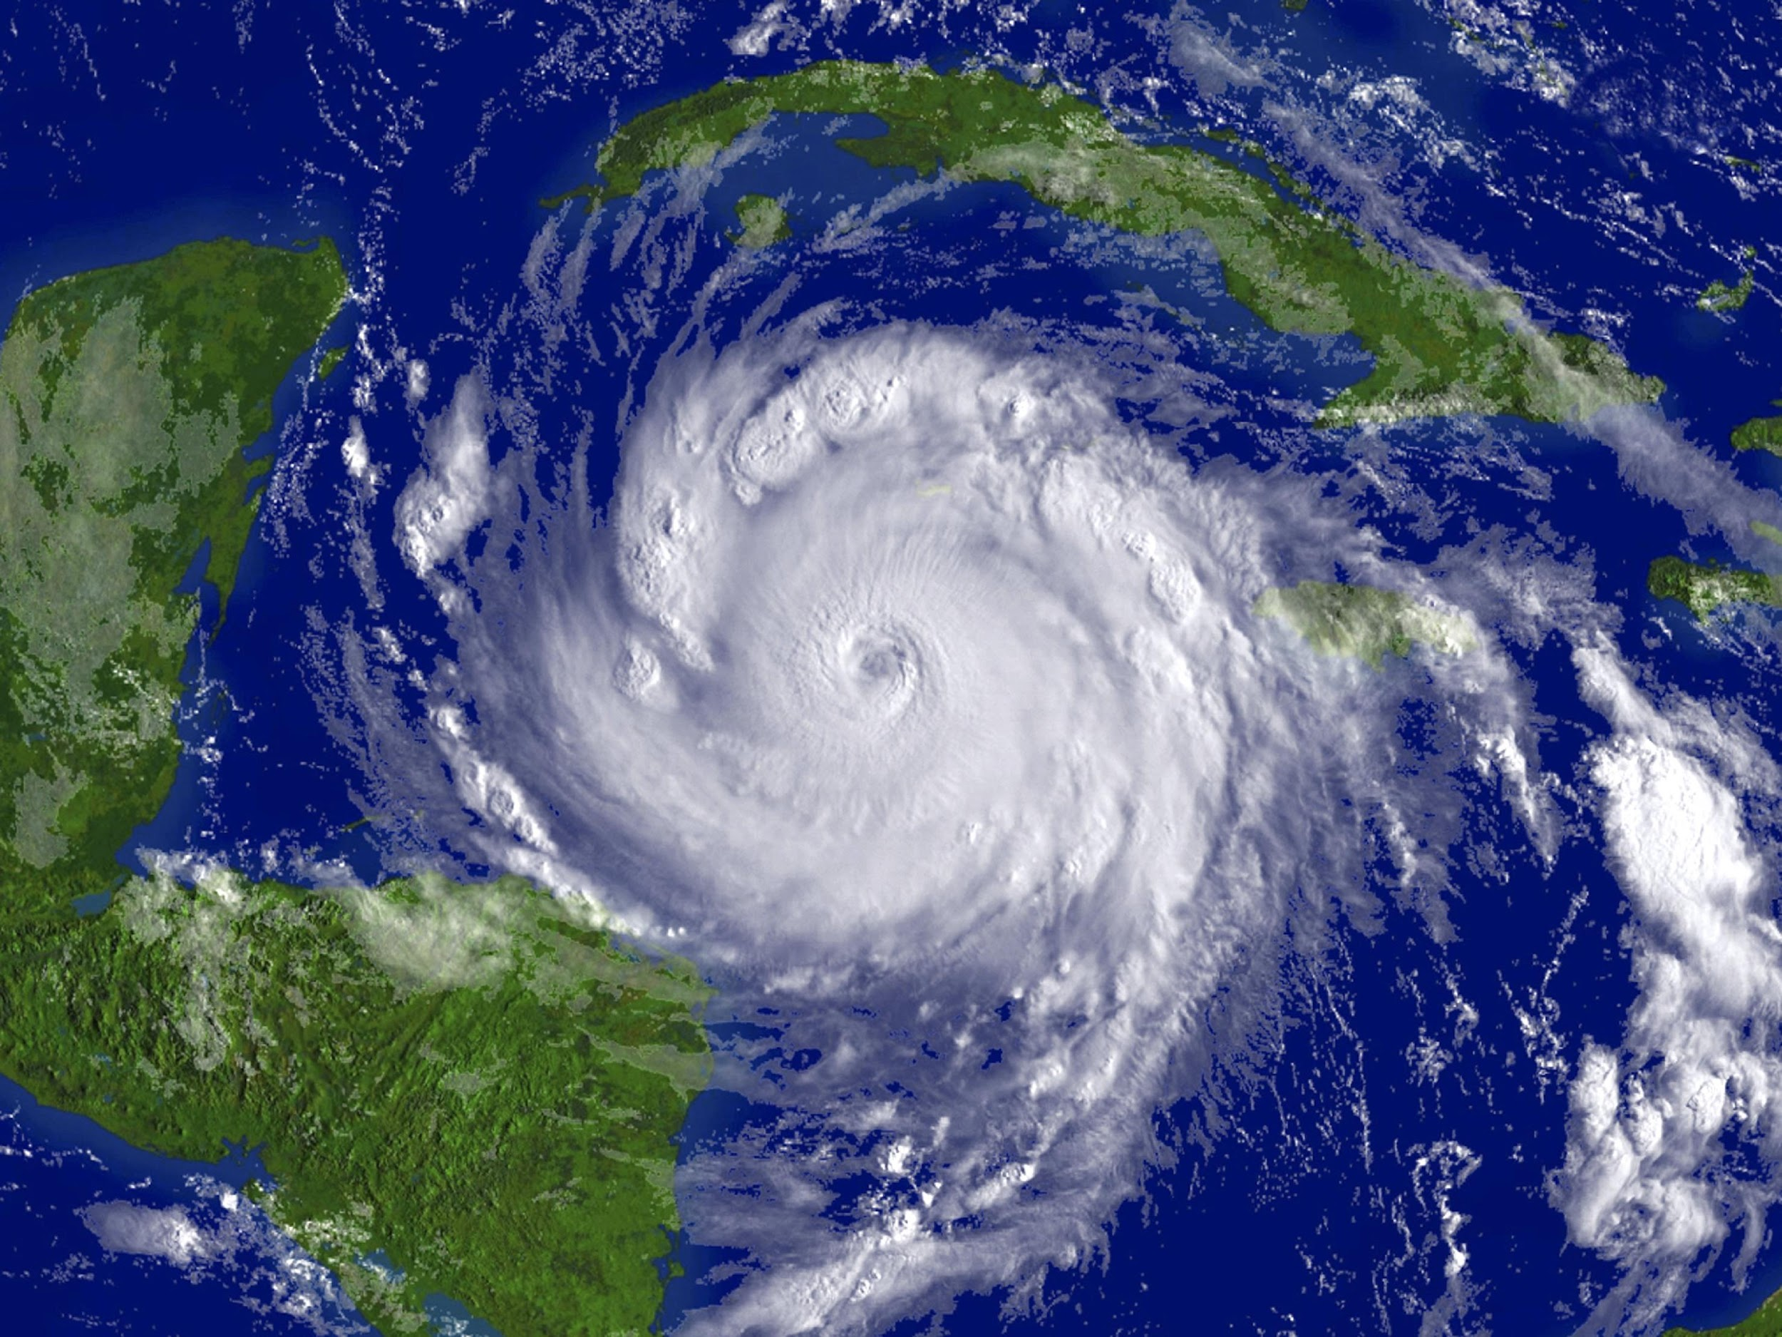
Extreme Weather
Extreme weather conditions, like high wind, thunder and lightning may impact the university and college ceremonies held in Richard Wackar Stadium.
The University Commencement Ceremony & Celebration extreme weather plan is to postpone to Sunday, May 10 at 2:00 p.m.
College ceremonies will relocate to Esbjornson Gymnasium at their regularly scheduled date and time.
www.rowan.edu/commencement

Slide 18
Commencement Participation Eligibility
Students who have been awarded their degree(s)
Students who apply to graduate prior to February 27, 2026
ADD (formerly CADP) students participating in the undergraduate portion of their program
Students with *remaining degree requirements may participate if they meet these requirements:
Undergraduate students within 20 credit hours of degree completion
Graduate students (Master’s level only) within 6 credit hours of degree completion
*Remaining degree requirements (undergraduate and graduate) to be completed in the Summer/Fall terms. Students completing degree requirements in Winter or Spring 2027 would attend Commencement in May of 2027.
DEADLINE REMINDER: *Students with remaining degree requirements must RSVP by February 27, 2026, to ensure inclusion of their name in the program book.

Slide 19

Commencement Program
Complete commencement registration no later than February 27 to ensure your name is listed in the Commencement Program!
Registration Deadline

Slide 20
Commencement Registration & Ticketing
Registration & Ticketing Process
Overview
Visit rowan.tassel.com
Log-in with Rowan credentials to the Tassel graduate homepage, where you will see all ceremonies you are eligible to participate in.
Complete registration for EACH ceremony you wish to participate in. Completing for one does not register you for all ceremonies.
VERIFY ALL INFORMATION!
Name, degree, college and phonetic spelling of name.
Share ceremony information with your guests!
Email tickets to guests or download and print
Deadline to register and claim guest tickets– April 1, 2026

Slide 21
Commencement Registration & Ticketing
Registration & Ticketing Process
Instructional Video
Commencement Registration Instructional Video

Slide 22
College Ceremony
Guest Ticket
Information
All ceremonies are ticketed. Each ceremony in Wackar Stadium receives:
All-Weather tickets (2 per graduate)
Stadium-Only tickets (4 per graduate)
Don’t delay! Tickets must be secured by April 1, 2026 at 12 p.m. After the deadline, additional tickets may become available on a first come, first served distribution.
If there are tickets remaining for a ceremony, registered graduates will receive an email notification on April 6, 2026 between 12pm and 1pm with information on how to secure additional tickets.
Digital and printed tickets will be accepted at gate entrances.
Only graduates and ticketed guests will be permitted inside of the venue
All ceremonies will be live streamed on the Rowan University YouTube channel. Links will be provided on the commencement website in the days prior to the ceremony.

Slide 23
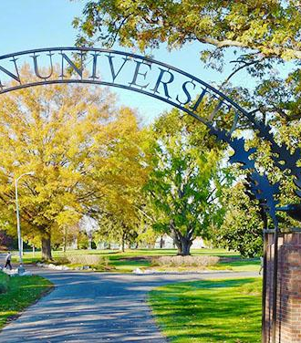
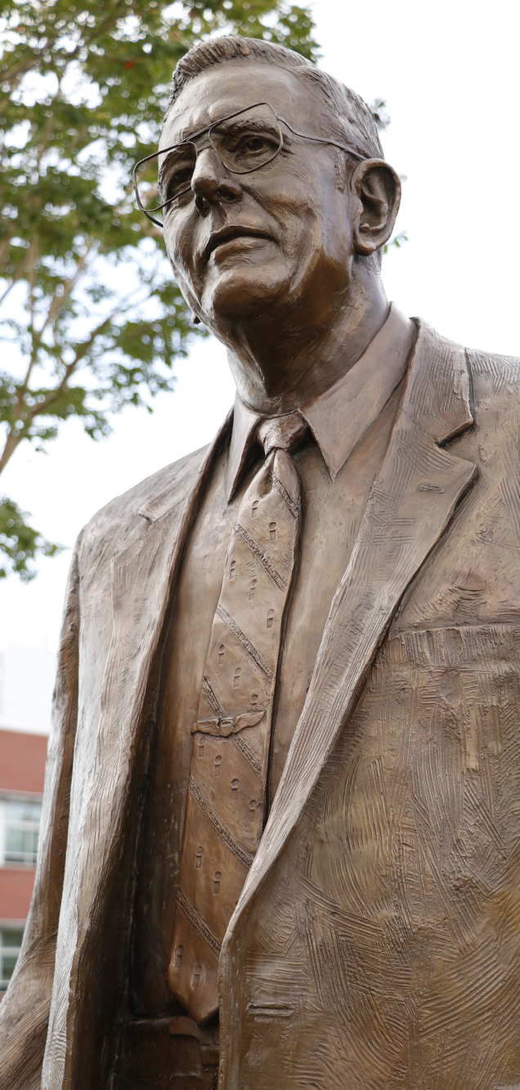
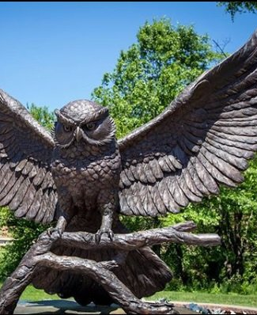
Photography
GradImages, our professional photographer, will capture moments in and around the ceremony and most importantly, as each graduate crosses the stage.
In addition to professional photography, stop at many of the campus locations, like the Prof Pride statue to capture a family photo or selfie.

Slide 24
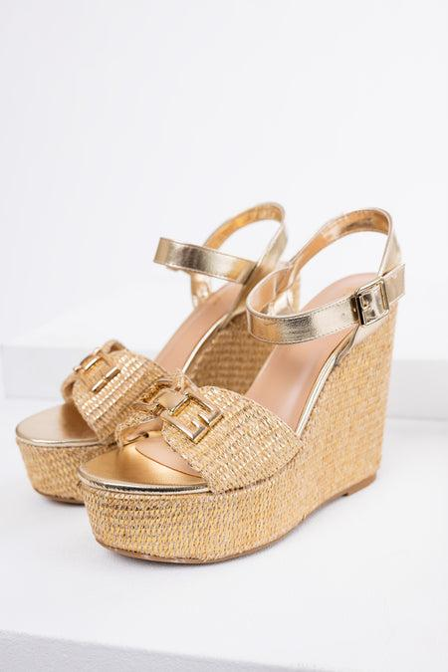

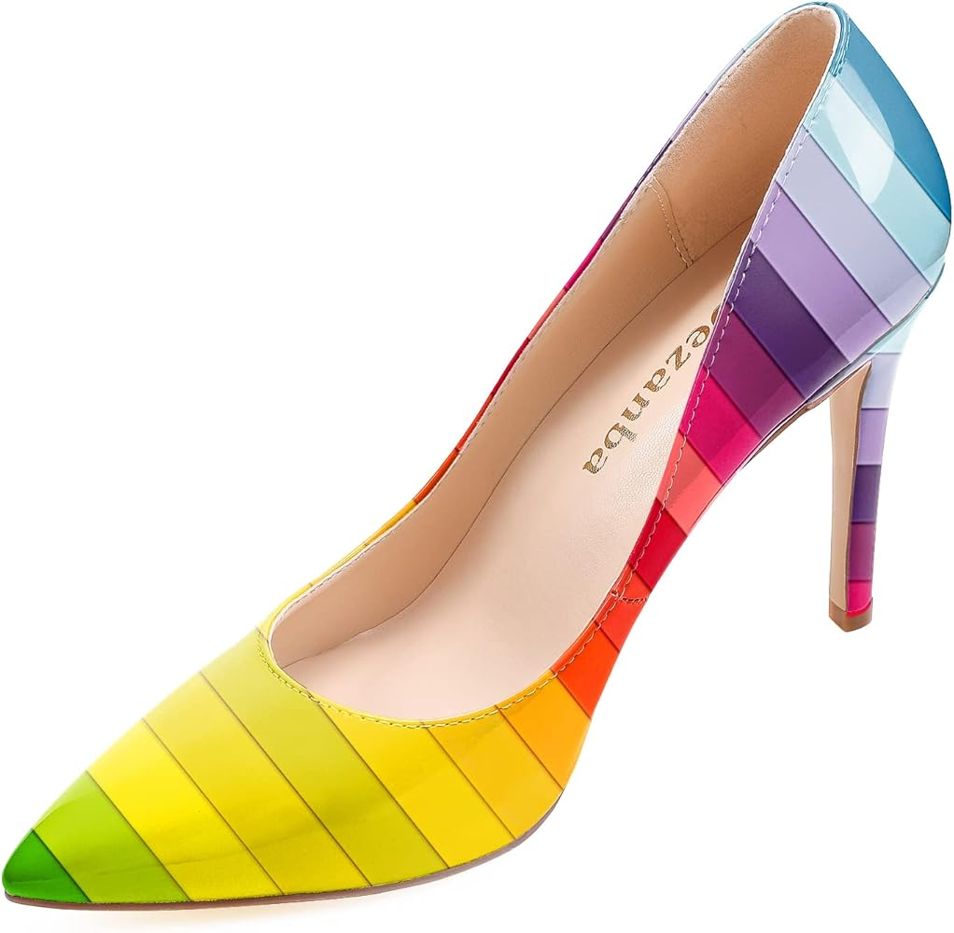
Safety & Security:
Footwear Policy
To safeguard the turf on the football field, sharp footwear, such as stiletto heels and shoes with pointed or spiked soles, is strictly prohibited. This type of footwear can cause significant damage to the turf and create unsafe conditions for others.
Approved Footwear Includes:
Flat-soled shoes (e.g., sneakers, loafers, wedged platforms or heels or sandals).
Comfortable formal shoes that do not have sharp or narrow points.
Reminders and Enforcement:
Event staff will monitor entry points to ensure compliance.
Non-compliant guests will be asked to change footwear or remain in designated areas, like bleacher seating.
Graduates will be required to comply with the approved footwear policy to cross the stage.
We appreciate your understanding and cooperation in helping us maintain a safe and welcoming environment for everyone. If you have any questions or need special accommodations, please contact the Office of University Events at commencement@rowan.edu.
X

Slide 25
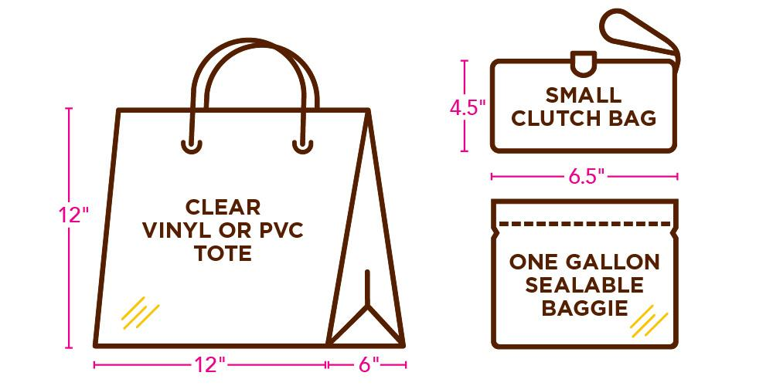
Safety & Security:
Clear Bag Policy
Clear bags are required. Only clear bags that does not exceed 12” x 6” x 12”, or one-gallon plastic freezer bags, will be allowed inside the venues.
In addition, small handheld clutch purses no larger than 4.5” x 6.5” will be permitted. All guests should be prepared to go through security bag checks prior to entry into the Commencement.
The following exceptions apply:
One clear bag made of plastic, vinyl, or PVC, not exceeding 12” x 6” x 12”, or a one-gallon clear plastic storage bag (e.g., Ziploc bag).
In addition to the clear bag, guests may carry a small clutch bag or purse, approximately hand-sized, with or without a handle or strap.
Medically necessary items may be allowed after proper inspection.

Slide 26
Safety & Security: Student & Safety Policies
For additional information on requirements and policies for academic attire, participation guidelines, prohibited items and more, please visit the
Student and Safety Policies page of the commencement website.

Slide 27
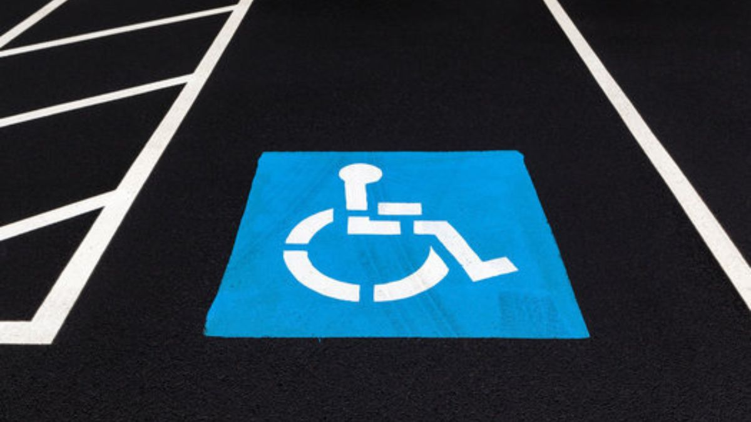
Accessibility Accommodations
Parking & Seating
Contact & Accommodation Information
Graduates and guests requiring an accessible parking pass must submit a request to parking@rowan.edu. Requests can be made from March 23 – April 24, 2026.
Permits are limited and issued first-come, first-served.
Golf carts will loop continuously through parking areas to bring guests directly to the accessible seating area.
The accessible seating area is for the ticketed guest needing accessible seating and one ticketed companion. No special ticketing is required.
If additional assistance is required, please contact the Academic Success Center at 856-256-4259 to request accommodations.

Slide 28
Rowan University Regalia
Rowan Brown & Gold Caps & Gowns
Available Exclusively Through Rowan Barnes & Noble
Purchase with the Glassboro Barnes & Noble:
In-person at Rowan Barnes & Noble beginning Monday, April 6, 2026
Sales will continue through the start of commencement.
Sizes are not guaranteed after April 24, 2026.
Online
More information available in late March.
Commencement Fair @ Rowan Barnes & Noble
Monday, April 6, 2026 - Thursday, April 9, 2026
Cap & gown vendor will be on-site to help with sizing and answer questions. There will also be class ring vendors at this event.
Custom doctoral gowns – Contact Valerie at 856-881-5954 or wojcik@rowan.edu to schedule a fitting. Orders must be placed by March 6, 2026.

Slide 29
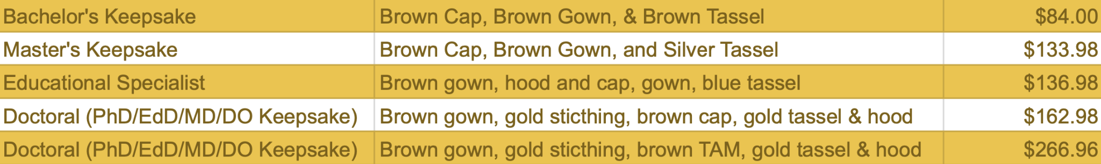
Rowan University Regalia
Caps & Gowns
Pricing
Undergraduate Academic Honor Cords available at Rowan Barnes & Noble for $19.98.

Slide 30

Important Dates to remember:
February 27: Last day to apply to graduate for Spring graduation
February 27 - Register by today to have name in printed program
April 1: Commencement registration and guest ticket access closes
April 1: Last day to make corrections to Commencement display details
April 6: Cap and Gown sales begin; In-person Commencement Fair at Barnes & Noble (April 6 – April 9)
April 6: First come, first served access to additional guest tickets (as available) will be announced via email between 12:00 p.m. – 1:00 p.m.
May 8: The School of Graduate Studies Hooding Recognition Ceremony & Reception
May 9: University Commencement Ceremony & Celebration at 10:00 a.m.
May 11 - 15: College Commencement Ceremonies

Slide 31
Keep Up To Date
Check your Rowan email
Always open and read emails from graduation@rowan.edu and commencement@rowan.edu as they contain important information.
Know the deadlines; don’t wait until the last day!
Check the commencement and graduation websites regularly for updates.
Follow Rowan on social media; look for Instagram stories and participate in Q & A’s.
Use #Rowan2026 to filter your posts onto the commencement website
Prepare for commencement
Review the final details in the “Know Before You Go” email sent 48 hours prior to commencement
Be sure to share details with your guests.

Slide 32
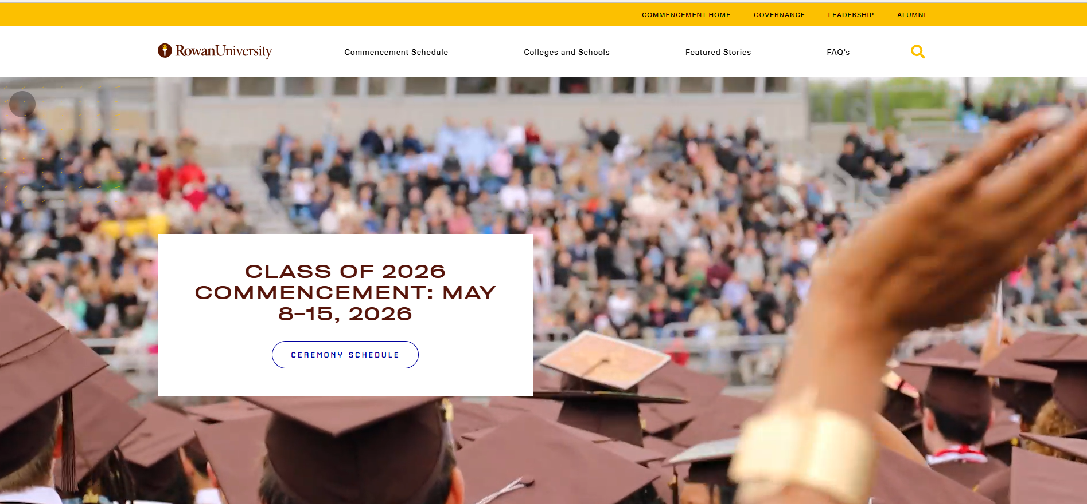
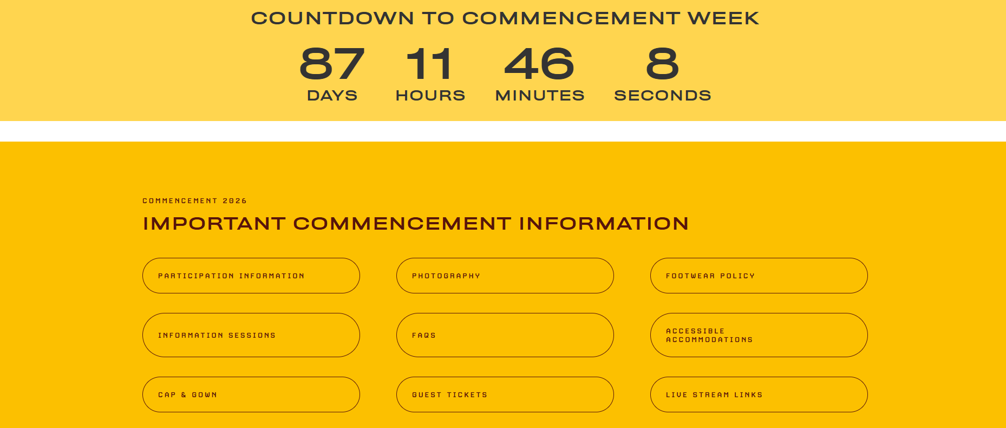
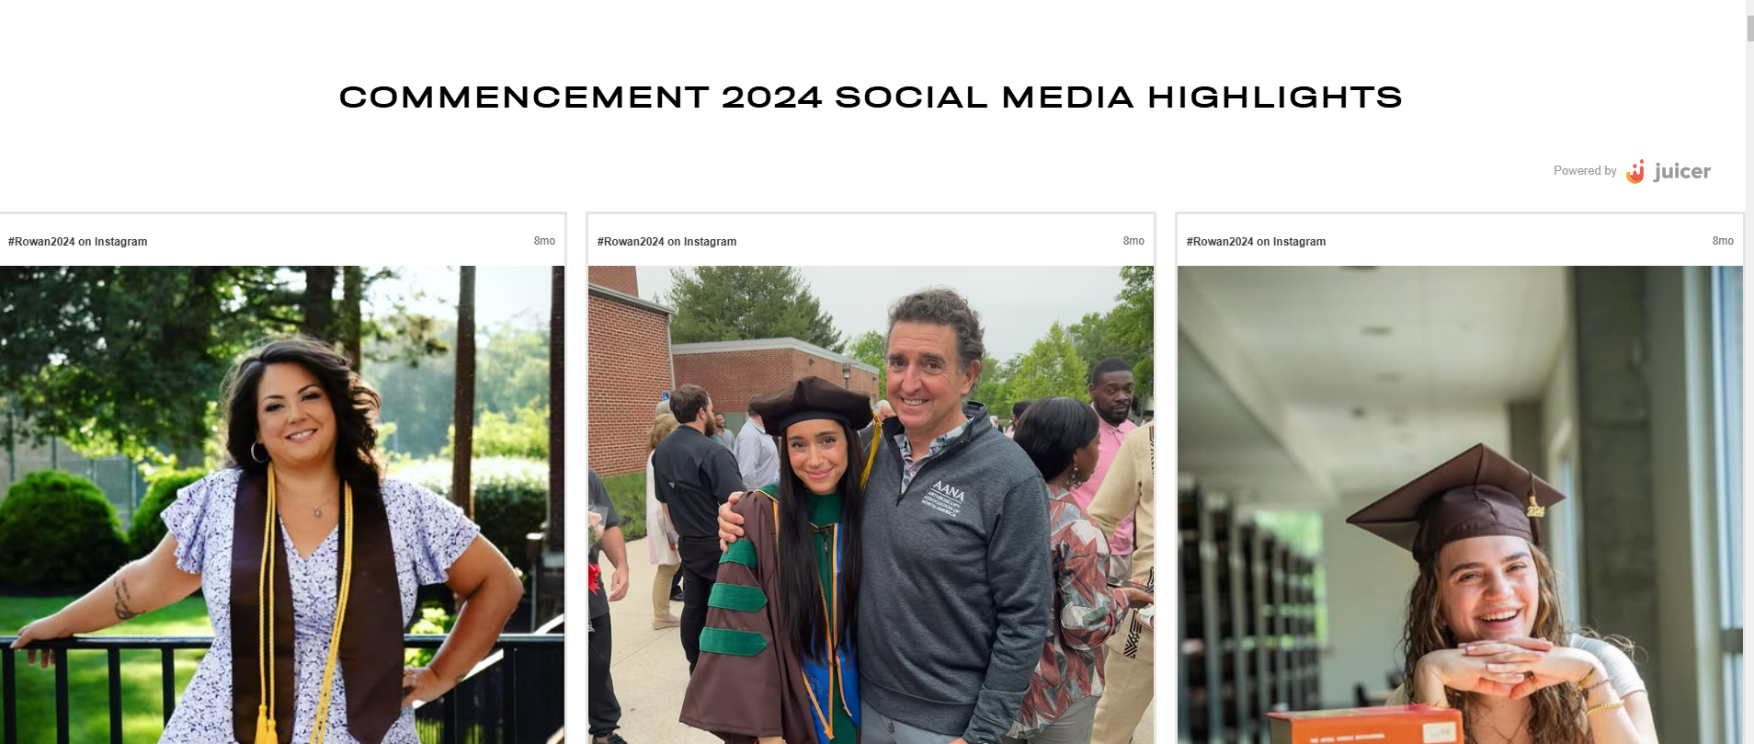
Commencement Website
rowan.edu/commencement
www.rowan.edu/commencement

Slide 33

Thank you! We look forward to celebrating with you in May!
#Rowan2026
Additional questions? Email us! Be sure to include your Banner ID!
Graduation – graduation@rowan.edu
Commencement – commencement@rowan.edu
www.rowan.edu/commencement

