Slide 1
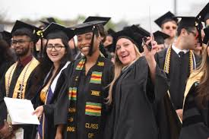
Meeting Reminders:
Thank you for participating in this Graduation and Commencement Information Session!
We will get started momentarily.
You will be muted and your camera will be off for this session.
If you have a question, please place it in the Q&A. We will cover all questions not answered in the presentation at the end of each segment.

Slide 2
Commencement & Graduation Guide 2022
Presented by
Office of University Events &
Office of the University Registrar

Slide 3
Graduation vs. Commencement
Graduation…
Commencement…
is the successful completion of a student’s major/minor/ concentration and the issuing of a diploma.
is the celebration of your time and hard work at Rowan University.

Slide 4
Only 5 Steps
Step 1: Apply to Graduate
Step 2: Register to Participate
Step 3: R.S.V.P. to Assigned
Ceremony/Claim Guest Tickets
Step 4: Caps & Gowns
Step 5: Pay attention to communication

Slide 5
Step 1: Apply to Graduate
Graduation Dates & Deadlines
Term you expect to graduate: This means you must complete all degree/program requirements (including transfer credits, all grades, GPA minimums, special courses, internships/clinical practice, etc.) by the end of this term. | Deadline dates for student to apply to graduate: Students must apply online for graduation review via SSB, rowan.edu/selfservice. | Deadline dates for Academic Advisors to review any submitted graduation applications: | Dates when degrees will be awarded in system and posted on transcripts: | Date that will be posted on the transcript and official diploma: | Date official diploma will be mailed to you:
Fall 2021 | Aug. 17 – Oct. 5 | Oct. 18 – Nov. 29 | January 2022 | December 30, 2021 | February 2022
Winter 2022 | Oct. 19 – Nov. 30 | Dec. 6 – Dec. 17 | February 2022 | January 30, 2022 | March 2022
Spring 2022 | Jan. 3 – Feb. 25 | Mar. 7 – Mar. 18 | June 2022 | May 30, 2022 | August 2022
Summer 2022 | April 4 – June 3 | June 13 - June 24 | September 2022 | August 30, 2022 | October 2022

Slide 6
Step 1: Apply to Graduate
Students should contact their ADVISOR for each program, and REVIEW their transcript and DegreeWorks report to ensure that ALL University Requirements surrounding the Major, Minor, and/or Concentration have been met.
Students must Apply to Graduate (Earn the Degree) online through Self-Service Banner. Select “Apply to Graduate” under the student tab. Applying to Graduate is NOT related to the Commencement Ceremony.
After the application is submitted, students will receive email confirmation to their Rowan Student email address. This email includes instructions for Commencement.
All Graduation information will be sent to students’ Rowan email addresses only. Please check often, through the receipt of your Diploma in the mail.
Students can verify the information on their application at any time. Select “View Pending Graduation Application” on Self-Service Banner.

Slide 7
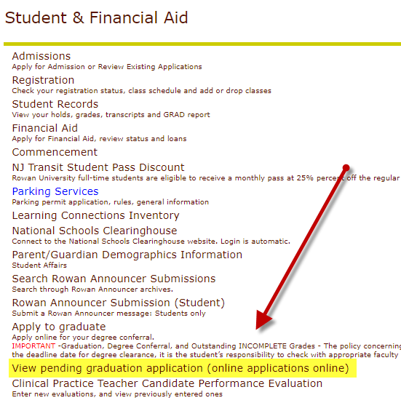
Did I Apply to Graduate?
You can view the Graduation Application and details that you submitted through SSB.
Review:
Name preference
Mailing address
Program

Slide 8
RU Completing an Internship/Clinical Practice/Final Project/Thesis/Dissertation?
If students’ receive an incomplete grade, the final graduation review cannot occur until the IN grade is replaced.
Important! IN grades must be replaced within the deadline of the term of the graduation application. If the IN grade is replaced after the deadline, the application will be denied and the STUDENT will need to RE-APPLY. (no added charge)
Example – Student applied for May conferral and has an IN. If the grade is replaced by June 30th, and all other University requirements are met, the conferral date will remain May 30th. If the IN grade is replaced after June 30th, the conferral date will be August after a new application is submitted.

Slide 9
University Honors
3.450 – 3.649 Cum Laude
3.650 – 3.849 Magna Cum Laude
3.850 – 4.000 Summa Cum Laude
For Graduation, University Honors are based on students’ final cumulative GPA and will be printed on students’ Diploma and Transcript.
For Commencement, University Honors are based on the cumulative GPA earned at the end of the Winter term, and will be noted, with a symbol, in the Commencement Program.

Slide 10
Diplomas
The final review of Spring Graduation Applications will occur during June (after the semester ends and all final grades are submitted). Summer applications will be reviewed/awarded in September.
Students will be notified by email when their degree is awarded or if there are issues regarding their application.
Diplomas will list MAJORS only. Minors, concentrations, specializations and CUGS will appear on your final transcript.
Diplomas are mailed directly from our Diploma vendor Paradigm and students will receive email notification when their diploma ships.

Slide 11
Commencement 2022

Slide 12
Commencement at a Glance
Commencement Week
RSVP is required for all ceremonies.
University Ceremony & Celebration
Wackar Stadium
May 7, 2022 @ 10:00 am
College Commencement Ceremonies
University Green at Bunce Hall
May 9 – 13, 2022

Slide 13
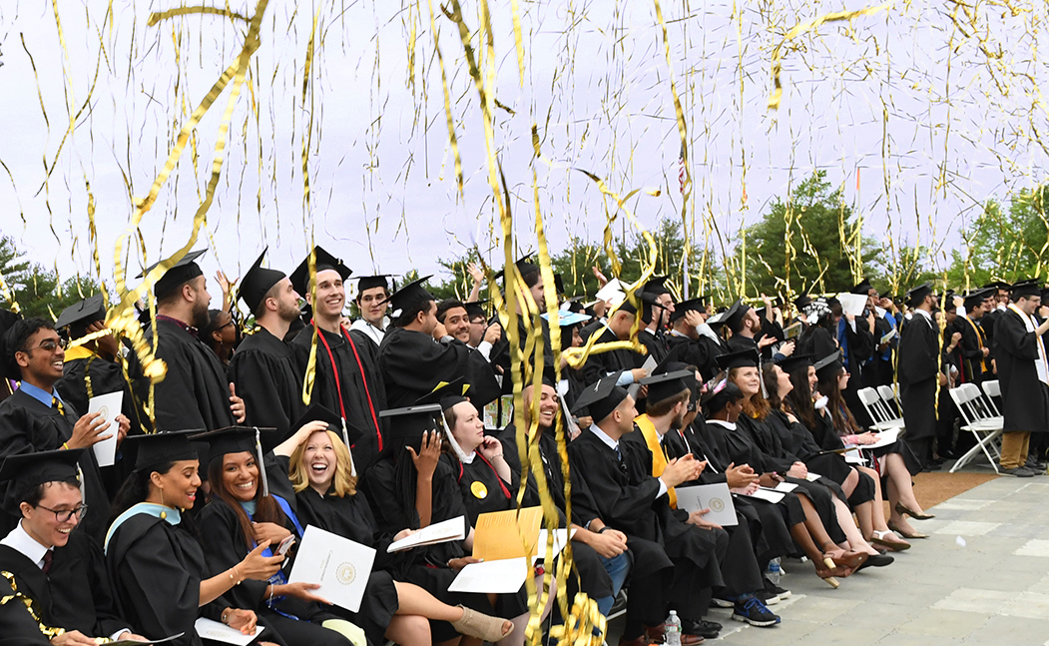
University Ceremony & Celebration
Saturday, May 7, 2022 - 10:00 a.m.
The Ceremony
Approximately 1 1/2 hours
Dr. Ali A. Houshmand’s address
Conferral of degrees
Messages from guest speakers
Exciting surprises
The Celebration
Immediately following the ceremony
Complimentary light bites
Celebratory music
Photo opportunities
Beer & wine garden (for a fee, ID required)
Registered graduates are eligible for 6 guest tickets
Graduates and guests may arrive 1 ½ hours prior to ceremony start time

Slide 14
College Commencement Ceremonies
Monday, May 9 – Friday, May 13, 2022
Under a tent on the University Green at Bunce Hall
Graduates cross stage, have name read aloud
NEW for 2022 - name will appear on screens in the tent, as well as on the live stream
Ticketed event; each registered graduate receives 8 guest tickets
Full schedule with ceremony times and ticket access - March 10
Graduates and guests should arrive 45 minutes prior to the start of their ceremony

Slide 15
College Commencement Ceremonies- What to expect
The Ceremony
1 1/2 hours long from processional to recessional, and includes
Processional
Dean’s remarks
Special Guest’s remarks
Presentation of Graduates
Names read out loud, and appear on all screens, as graduates cross the stage, collect diploma cover and have photos taken
Recessional of graduates and guests
Inspirational music from Rowan’s Pep Band
After your ceremony:
Enjoy a complimentary snack and water along Summit Lane
Stop at the resource tables on your way to your vehicle
Make your way across campus and enjoy the photo ops
Secure a reservation at a local restaurant to celebrate with your guests

Slide 16
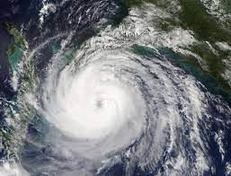
Extreme Weather Postponement
Only extreme weather conditions would cause postponement of ceremony (lightning, severe storm/winds, torrential downpours)
University Commencement postponement is the day after, Sunday, May 8, 2022 at 10 am.
College ceremonies postponed due to extreme weather conditions will be rescheduled to the following week, in the order of postponement, beginning Monday, May 16.
www.rowan.edu/commencement

Slide 17
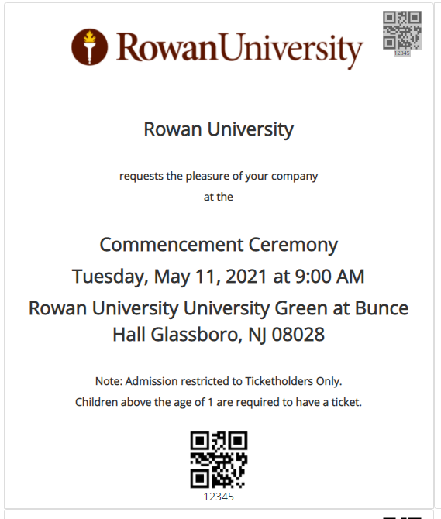
College Commencement Ceremonies - What to expect
Ticketed Event
Eight guest tickets per registered graduate
Don’t delay! Download and send guests their tickets starting March 10th
Digital and printed tickets accepted at entrance points around the University Green and Baseball Field
Only graduates and ticketed guests will be permitted on and around the University Green.
All in-person ceremonies will be streamed live over YouTube. Links will be provided on the commencement website in the days prior to the ceremony – rowan.edu/commencement
**As a reminder – there are no extra tickets**

Slide 18
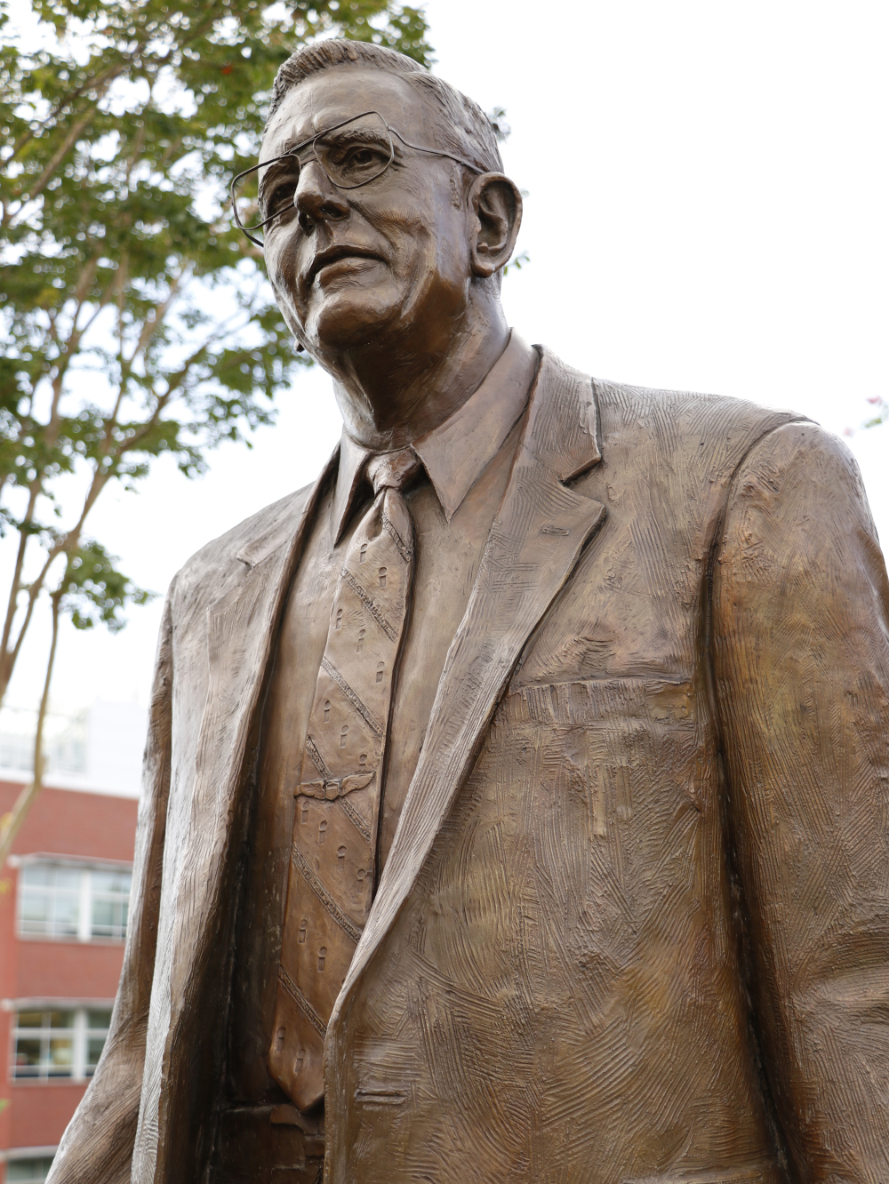
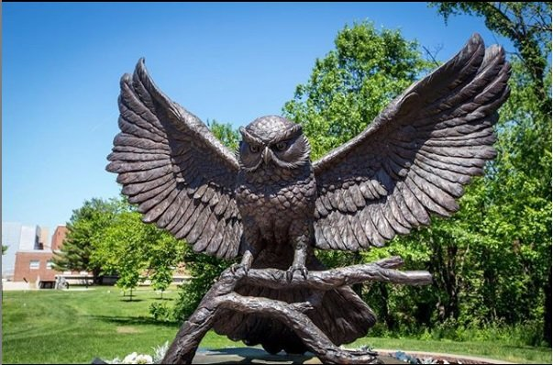
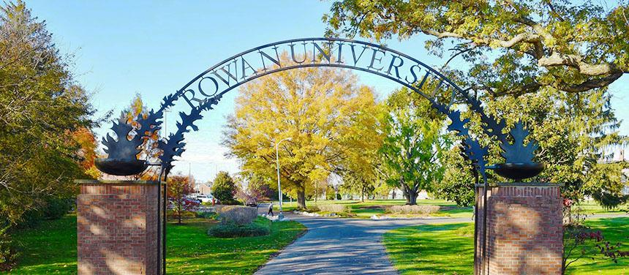
College Commencement Ceremonies - What to expect
Photography
Grad Images photographers will capture moments in the baseball field and as graduates cross stage at the University Green.
In addition to professional photography, there will be many opportunities to capture a popular family photo or selfie around campus.

Slide 19
College Commencement Ceremonies - What to expect
Rain or Shine
Commencement ceremonies will be held rain or shine.
In the case of extreme weather or circumstance, we will host postponed ceremonies the following week, May 16-20
Post Ceremony Celebration
At the conclusion of the ceremony, graduates and guests are invited to enjoy a snack and bottled water along Summit Lane, between Laurel and Oak Halls

Slide 20
Commencement Participation Criteria
To be eligible to Register/RSVP in Marching Order:
Students who have been awarded their degree(s)
Students who apply to graduate prior to February 25, 2022
CADP (formerly 4+1) students participating in the undergraduate portion of their program
Students with *remaining degree requirements may participate if they meet these requirements:
Undergraduate students within 20 credit hours of degree completion
Graduate students (Master’s level only) within 6 credit hours of degree completion
*Remaining degree requirements (undergraduate and graduate) to be completed in the Summer/Fall terms. Students completing degree requirements in Spring 2023 would attend Commencement in May of 2023.
DEADLINE: *Students with remaining degree requirements must RSVP by February 25, 2022 to ensure inclusion of their name in the program book.

Slide 21
Registration Process for Graduates
RSVP for In-Person Commencement
go.rowan.edu/commencementparticipation or Self Service Banner, Student tab, commencement attendance confirmation
Log in with Rowan credentials, enter Marching Order graduate homepage - Here you will see all ceremonies you are eligible to attend
Complete the registration form for all ceremonies listed
Answer all questions in the registration form
Access guest tickets and view ceremony details
On March 10, 2022, a full Commencement schedule with times will be posted and graduates will be able to sign back into Marching Order and collect their guest tickets and see their assigned ceremony times

Slide 22
Marching Order: Commencement Registration & Ticketing
How do I get there?
go.rowan.edu/commencementparticipation
Self Service Banner/Student Tab/Commencement Attendance Confirmation

Slide 23
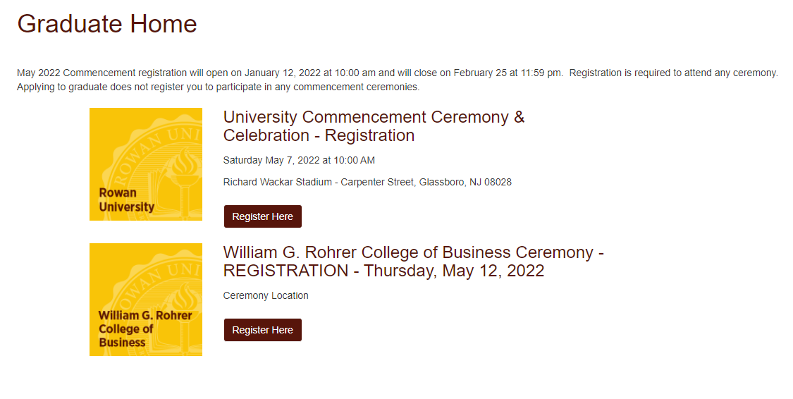
Marching Order - Registration
Registration Deadline – February 25, 2022

Slide 24
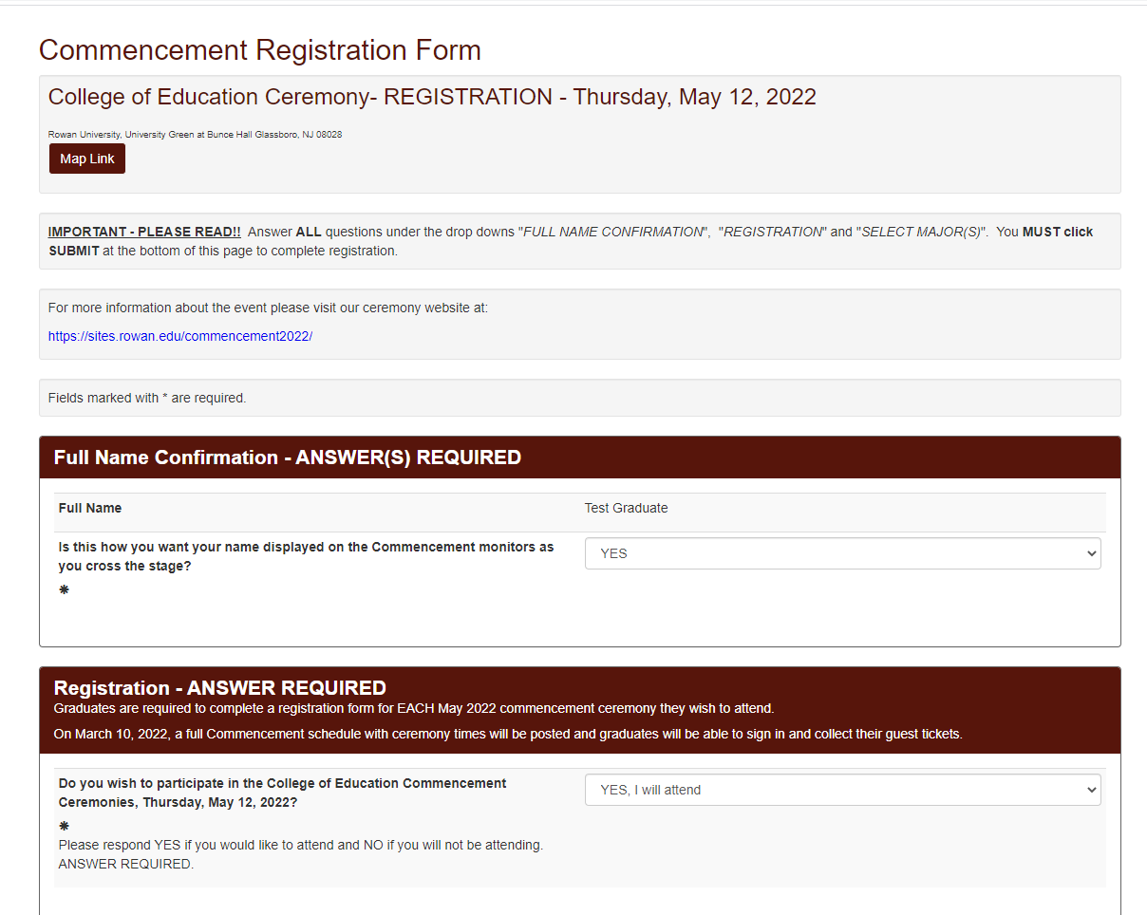
Marching Order - Registration
Registration Deadline – February 25, 2022
Full name confirmation
Check your name for display on the commencement monitors.

Slide 25
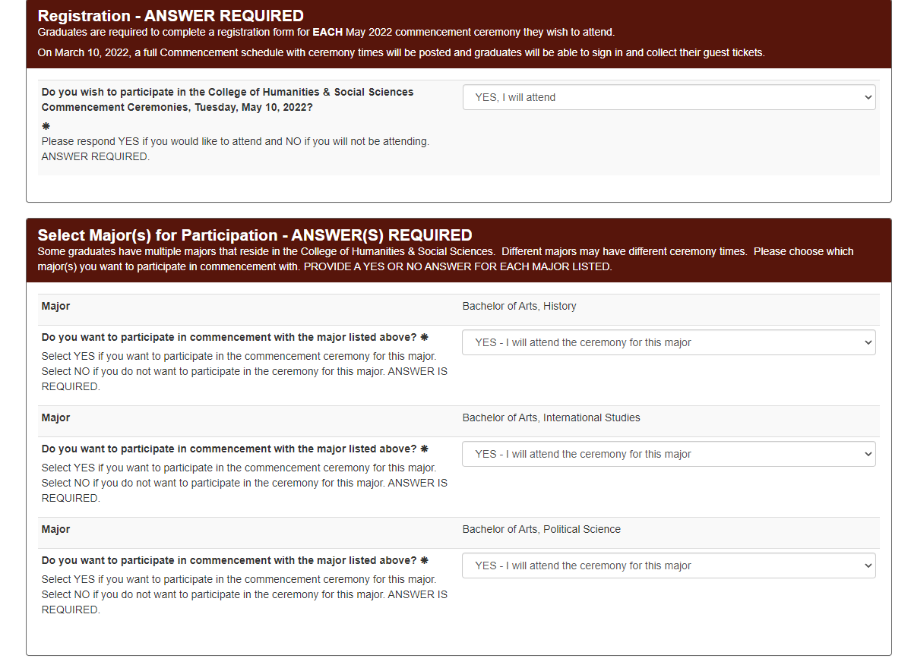
Marching Order - Registration
Registration Deadline – February 25, 2022
If a graduate has multiple majors that reside in the same school or college, they can choose to participate in commencement with one or all majors.
Once “YES, I will attend is selected, the Select Major options will appear.
This is important, as some majors may be split into different ceremonies.

Slide 26
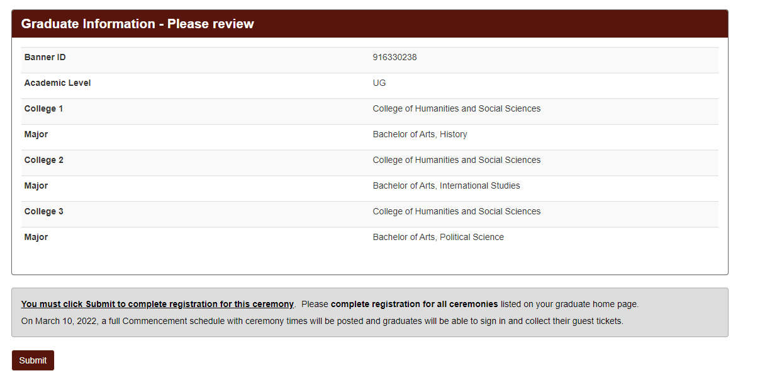
Marching Order - Registration
Registration Deadline – February 25, 2022
Review college and major information. You must click “Submit” to finish registration.

Slide 27
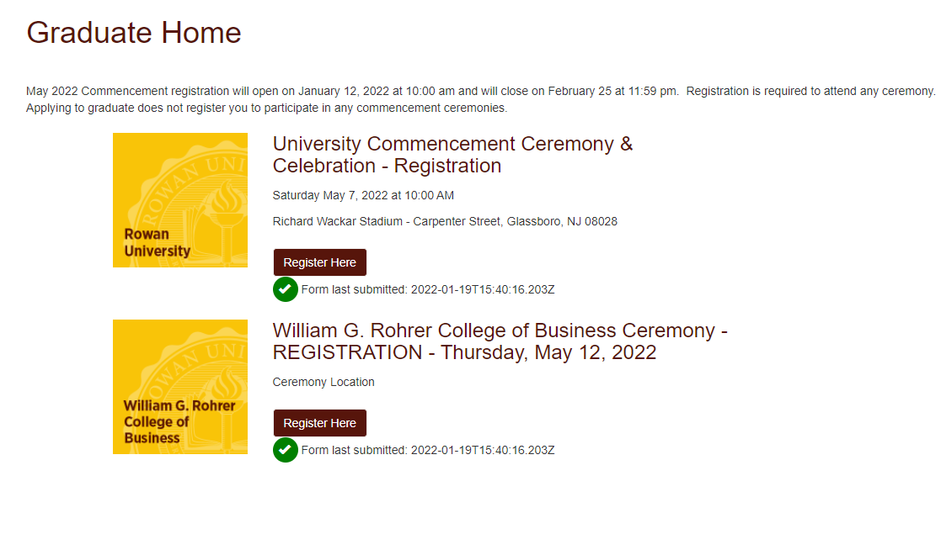
Marching Order - Registration Confirmation
How can I confirm that I registered for commencement?
Green check marks indicate your registration form was submitted
Log back into go.rowan.edu/commencement to verify registration

Slide 28
Caps & Gowns
Rowan University regalia is sold by the Glassboro Barnes & Noble
In-person at Rowan Barnes & Noble beginning April 4, 2022
Sizes not guaranteed after April 25, 2022
Sales will continue through May 12, 2022
Commencement Fair Rowan Barnes & Noble - April 4-8, 2022, 10am-5pm
Barnes and Noble will host a Commencement Fair April 4 - April 8, 2022, 10am-5pm. Cap & Gown Vendors will be on-site to help with sizing and answer questions. There will also be class ring vendors at this event.
Custom doctoral gowns – Contact Valerie at 856-881-5954 or wojcik@rowan.edu to schedule a fitting. Orders must be placed by March 12, 2021.
**All students attending this information session will be entered into a randomized drawing to win a free undergraduate/graduate Cap and Gown. The winner will be notified by email. Free regalia can be claimed in-person at Barnes and Noble, and is not eligible for mail order.**

Slide 29
Caps & Gowns – 2021 pricing
Bachelor’s | Cap, Gown and Tassel | $ 48.98
Master’s | Cap, Gown, Silver Tassel & Hood | $ 89.98
Educational Specialist | Cap, Gown, Blue Tassel & Hood | $ 96.98
Doctoral | Cap, Gown, Gold Tassel & Hood | $ 111.98
Academic Honor Cords available at Rowan Barnes & Noble for $16.98.

Slide 30
Accessible Accomodations
If you require accessible parking accommodations for the Commencement ceremonies, you MUST contact the parking office at parking@rowan.edu. Requests can be submitted starting April 1, with a deadline of May 1, 2022. Passes are assigned to qualified guests on a first-come, first-served basis. Golf cars will bring guests from accessible parking areas out to ceremony seating.
A handicap parking tag will not gain you access to the reserved parking lot. The specific parking pass will be required to gain access.
If you require additional assistance, please contact the Academic Success Center at 856-256-4259 to request accommodations.

Slide 31
Senior Class Gift
Pay it forward by giving back.
Each year, graduating students participate in the Senior Class Gift, a Rowan University tradition. This year, the Class of 2022 has a goal of 222 senior donors starting on Rowan University Day of Giving, March 9. All gifts of $5 or more to any allocation across campus will count toward the total goal.
Seniors giving $20.22 or more will receive a white and gold spirit cord to wear at commencement.*
Mark your calendars for March 9, and get ready to support your teammates, your favorite club, your major area of study, or whatever area on campus is most meaningful to you. And be sure to look for Senior Class-specific challenges on the day!
*Spirit cord pick up will be coordinated prior to graduation. Stay tuned!
Questions?
Contact Kaylee Collins, Director of Annual Giving
(856) 256-5415
collinske@rowan.edu

Slide 32
Important Dates to remember:
February 25: Last day to apply to graduate for Spring graduation
February 25: Commencement Registration closes
March 10: Ceremony dates/times assigned; students notified via email
March 10: Graduates can collect their guest tickets.
April 4: Cap and Gown sales begin; In-person Commencement Fair at Barnes & Noble
May 7: University Commencement Ceremony at 10:00 a.m.
May 9-13: In-person commencement ceremonies
The Grad Fair will be held April 4 - 8, 10am-5pm.
Barnes & Noble will sell regalia through May 12 but can not guarantee sizes after April 25.

Slide 33
Staying Informed
Check your Rowan email daily.
Always open and read emails from graduation@rowan.edu and commencement@rowan.edu as they contain important information.
Know your deadlines; don’t wait until the last day(s)!
Read the commencement and graduation websites; check back regularly for updates.
Follow Rowan social media; look for Instagram Stories and Q&A’s about commencement.
Watch for the social media Instagram story “What to Know Before You Go” to see an inside look at what the commencement ceremonies will look like.
#Rowan2022
Prepare for In-Person Commencement
Review the final details email sent 48 hours prior to your ceremony, share details with guests.

Slide 34
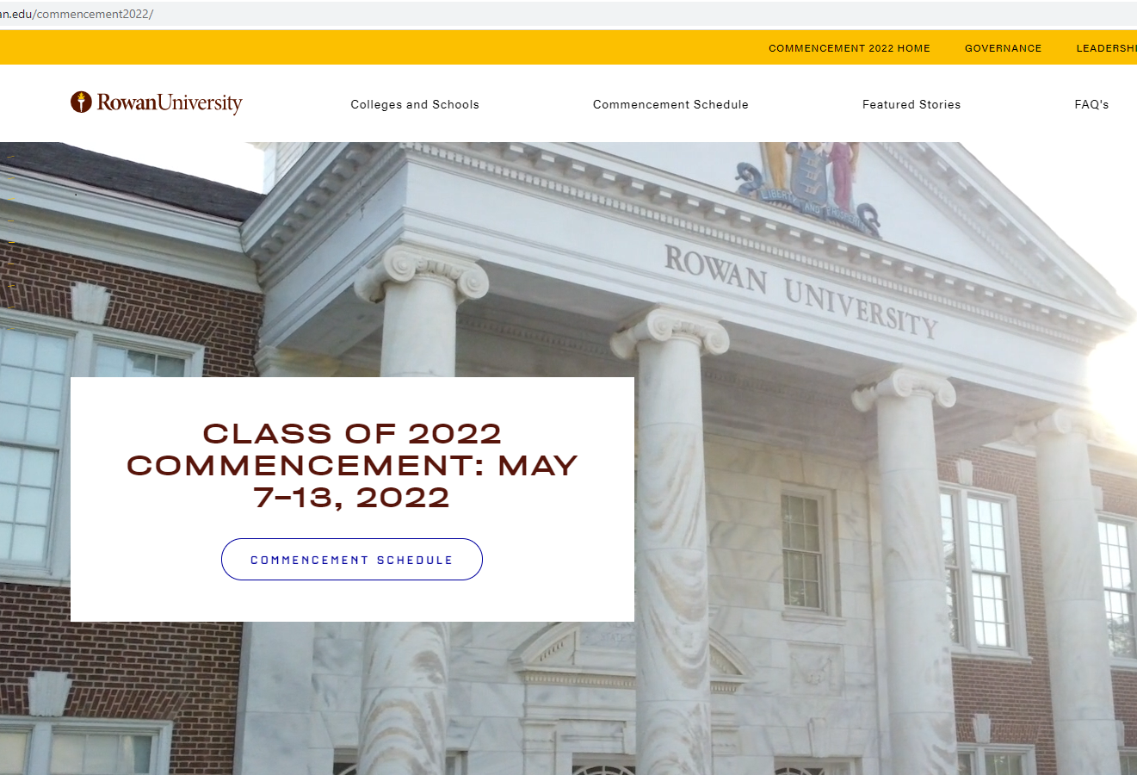
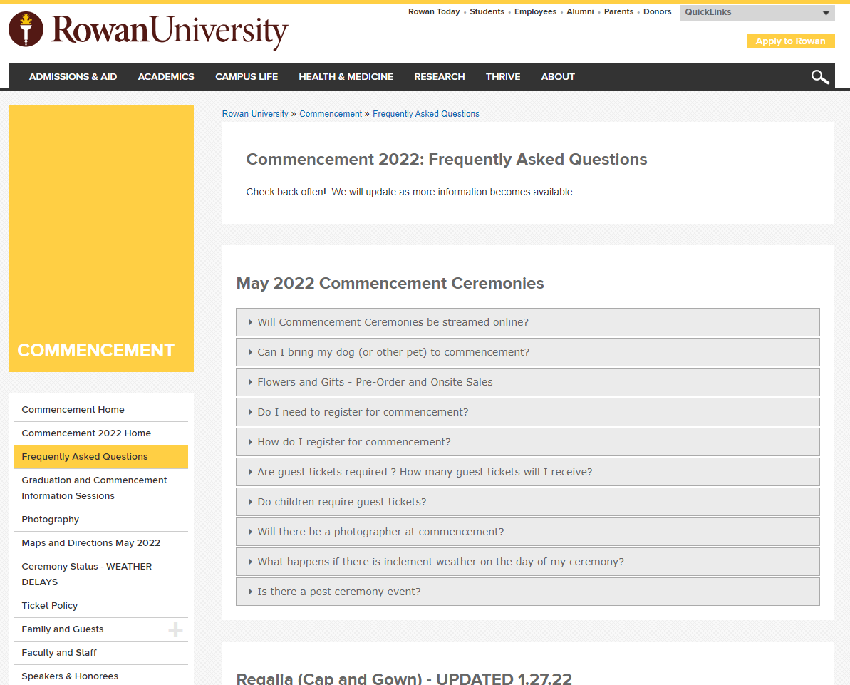
Commencement Website
rowan.edu/commencement
sites.rowan.edu/commencement/faq.html
Updated as more information becomes available

Slide 35
Thank you! We look forward to celebrating with you in May!
#Rowan2022
Additional questions? Email us! Be sure to include your Banner ID!
Graduation – graduation@rowan.edu
Commencement – commencement@rowan.edu

