Slide 1
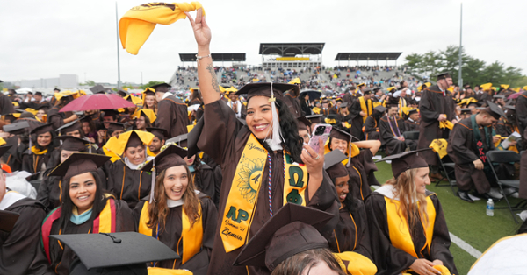
Meeting Reminders:
Thank you for participating in this Graduation and Commencement Information Session!
We will get started momentarily.
You will be muted, and your camera will be off for this session.
If you have a question, please place it in the Q&A. We will cover all questions not answered in the presentation at the end of each segment.

Slide 2
Commencement & Graduation Information Session Meeting Agenda
Graduation
Steps to apply to graduate
Internships, Clinical Practice and finals
University Honors explained
How do I get my diploma?
Commencement
Schedule Review and what to expect at Commencement
Participation Eligibility
Registration & Ticketing
Regalia
Accessibility Services
Important Dates to Remember

Slide 3
Graduation vs. Commencement
Graduation…
Commencement…
is the successful completion of a student’s major/minor/ concentration and the issuing of a diploma.
is the celebration of
your time and hard
work at Rowan
University.

Slide 4
5 Steps for Success
Step 1: Apply to Graduate
Step 2: Register to participate in Commencement and claim guest tickets
Step 3: Share the ceremony details and tickets with your guests
Step 4: Caps & Gowns
Step 5: Pay attention to communication

Slide 5
Step 1: Apply to Graduate
Graduation Dates & Deadlines
Term you expect to graduate: This means you must complete all degree/program requirements (including transfer credits, all grades, GPA minimums, special courses, internships/clinical practice, etc.) by the end of this term. | Deadline dates for student to apply to graduate: Students must apply online for graduation review via SSB, rowan.edu/selfservice. | Deadline dates for Academic Advisors to review any submitted graduation applications: | Dates when degrees will be awarded in system and posted on transcripts: | Date that will be posted on the transcript and official diploma: | Date official diploma will be mailed to you:
Fall 2024 | Aug. 12 - Oct. 4 | November 1, 2024 | January 2025 | Dec. 30, 2024 | February 2025
Winter 2025 | Oct. 15 - Nov. 29 | December 20, 2024 | February 2025 | January 30, 2025 | March 2025
Spring 2025 | Jan. 2 - Feb. 28 | March 21, 2025 | June 2025 | May 30, 2025 | August 2025
Summer 2025 | April 2 - May 30 | June 20, 2025 | September 2025 | August 30, 2025 | October 2025

Slide 6
Step 1: Apply to Graduate
Students should contact their ADVISOR for each program and REVIEW their transcript and Degree Works report to ensure that ALL University Requirements surrounding the Major, Minor, and/or Concentration have been met.
Students must Apply to Graduate (Earn the Degree) online through Self-Service Banner. Select “Apply to Graduate” under the student tab. Applying to Graduate is NOT related to the Commencement Ceremony.
After the application is submitted, students will receive email confirmation to their Rowan Student email address. This email includes instructions for Commencement.
All Graduation information will be sent to students’ Rowan email addresses only. Please check often, through the receipt of your Diploma in the mail.
Students can verify the information on their application at any time. Select “View Pending Graduation Application” on Self-Service Banner.

Slide 7
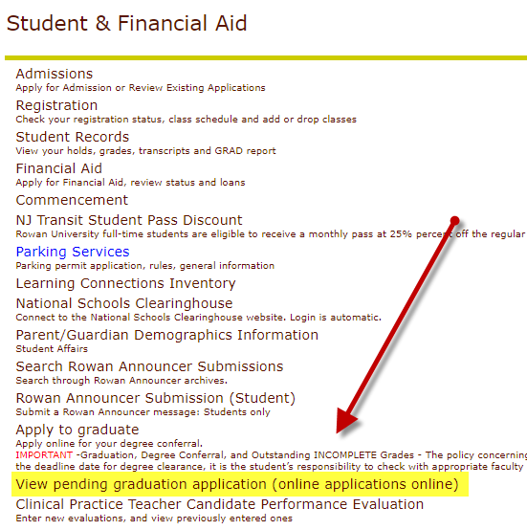
Did I Apply to Graduate?
You can view the Graduation Application and details that you submitted through SSB.
Review:
Name preference
Mailing address
Program

Slide 8
RU Completing an Internship/Clinical Practice/Final Project/Thesis/Dissertation?
If students receive an incomplete grade, the final graduation review cannot occur until the IN grade is replaced.
Important! IN grades must be replaced within the deadline of the term of the graduation application. If the IN grade is replaced after the deadline, the application will be denied, and the STUDENT will need to RE-APPLY. (no added charge)
Example – Student applied for May conferral and has an IN. If the grade is replaced by June 30th, and all other University requirements are met, the conferral date will remain May 30th. If the IN grade is replaced after June 30th, the conferral date will be August after a new application is submitted.

Slide 9
University Honors
3.450 – 3.649 Cum Laude
3.650 – 3.849 Magna Cum Laude
3.850 – 4.000 Summa Cum Laude
For Graduation, University Honors are based on students’ final cumulative GPA and will be printed on students’ Diploma and Transcript.
For Commencement, University Honors are based on the cumulative GPA earned at the end of the Winter term, and will be noted, with a symbol, in the Commencement Program.

Slide 10
Diplomas
The final review of Spring Graduation Applications will occur during the month of June (after the semester ends and all final grades are submitted). Summer applications will be reviewed/awarded in September.
Students will be notified by email when their degree is awarded or if there are issues regarding their application.
Diplomas will list MAJORS only. Minors, concentrations, specializations and CUGS will appear on your final transcript.
Diplomas are mailed directly from our Diploma vendor Paradigm and students will receive email notification when their diploma ships.

Slide 11
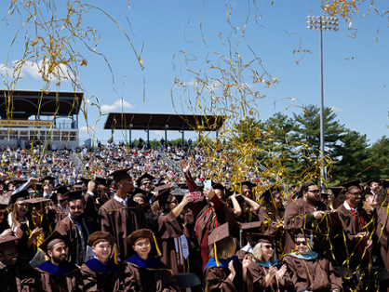
COMMENCEMENT 2025

Slide 12
Commencement Week
The School of Graduate Studies Hooding Recognition Ceremony & Reception
May 9, 2025 @ 3 p.m.
University Commencement Ceremony & Celebration
May 10, 2025 @ 10:00 am
College Commencement Ceremonies
May 12 – 15, 2025
Registration is required.

Slide 13
School of Graduate Studies Hooding Ceremony & Reception
Esbjornson Gymnasium Friday, May 9, 2025 3 p.m.
Ed.D., Ed.S., and Ph.D. graduates come to the stage accompanied by their dissertation advisor to be hooded.
All are invited to a reception directly following the ceremony.
Doors open at 2 p.m.
All M.D. and D.O. graduates will be hooded at their college ceremony.

Slide 14
University Ceremony & Celebration
Wackar Stadium, Saturday, May 10, 2025 – 10 a.m.
The Ceremony
Approximately 1.5 hours
President Houshmand’s address
Ceremonial conferral of degrees
Chris Gheysens, CEO of Wawa to deliver commencement address
Exciting surprises and more!
The Celebration
Immediately following the ceremony
Complimentary light bites
Celebratory music
Photo opportunities
Beer & wine garden (for a fee, with ID)
Details:
All graduates receive 6 guest tickets
Graduates and guests may arrive at 8:30 a.m. before the ceremony.
Seating is first come, first served.

Slide 15
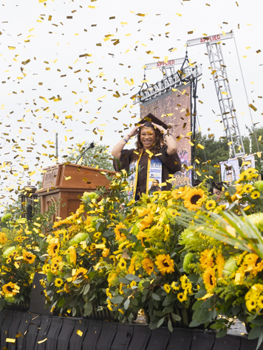
College Commencement Ceremonies
Richard Wackar Stadium, Glassboro, NJ Monday, May 12- Thursday, May 15, 2025
Graduates cross the stage and have their have name read aloud.
Graduate name, college and degree (1) will appear on screens at the ceremony as well as on the live stream for those watching at home.
Gates open 45 minutes prior to the start of each ceremony.
Seating is first come, first served.

Slide 16
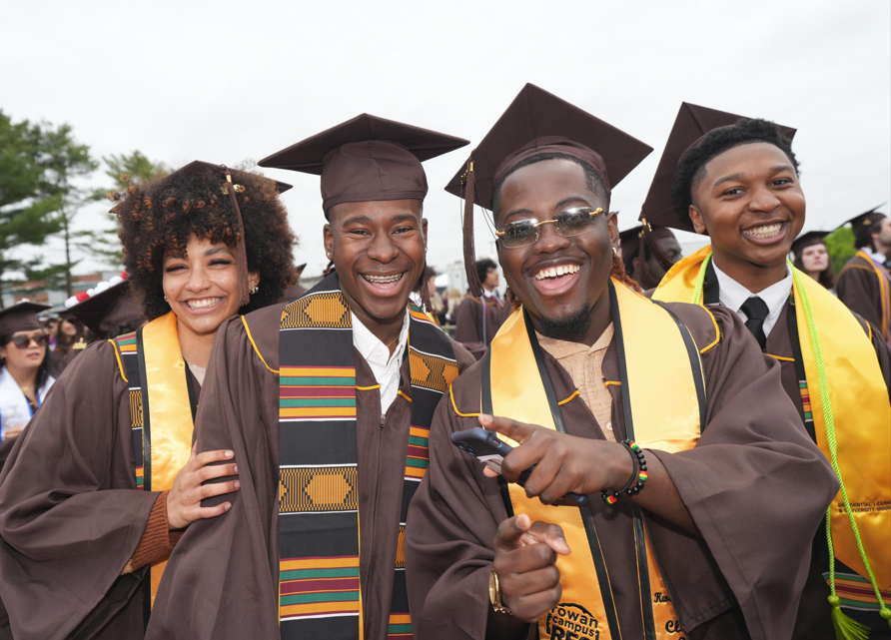
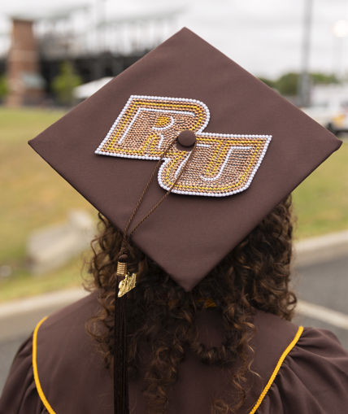
What to expect at the College Ceremony
The Ceremony
1.5-hour ceremony
The ceremony includes:
Dean’s Remarks
Special Guest Address
Presentation of Graduates, where graduates cross the stage, have their names read out loud, and appear on screens and on the live stream, as well as, collect their diploma cover and have their professional photo taken.
Inspirational music from Rowan’s Pep Band
Post Ceremony
Enjoy complimentary snacks, water and photo opportunities
Enjoy iconic locations, like the Prof Pride statue, for a selfie.
Secure a reservation at a local restaurant to celebrate with your guests.

Slide 17
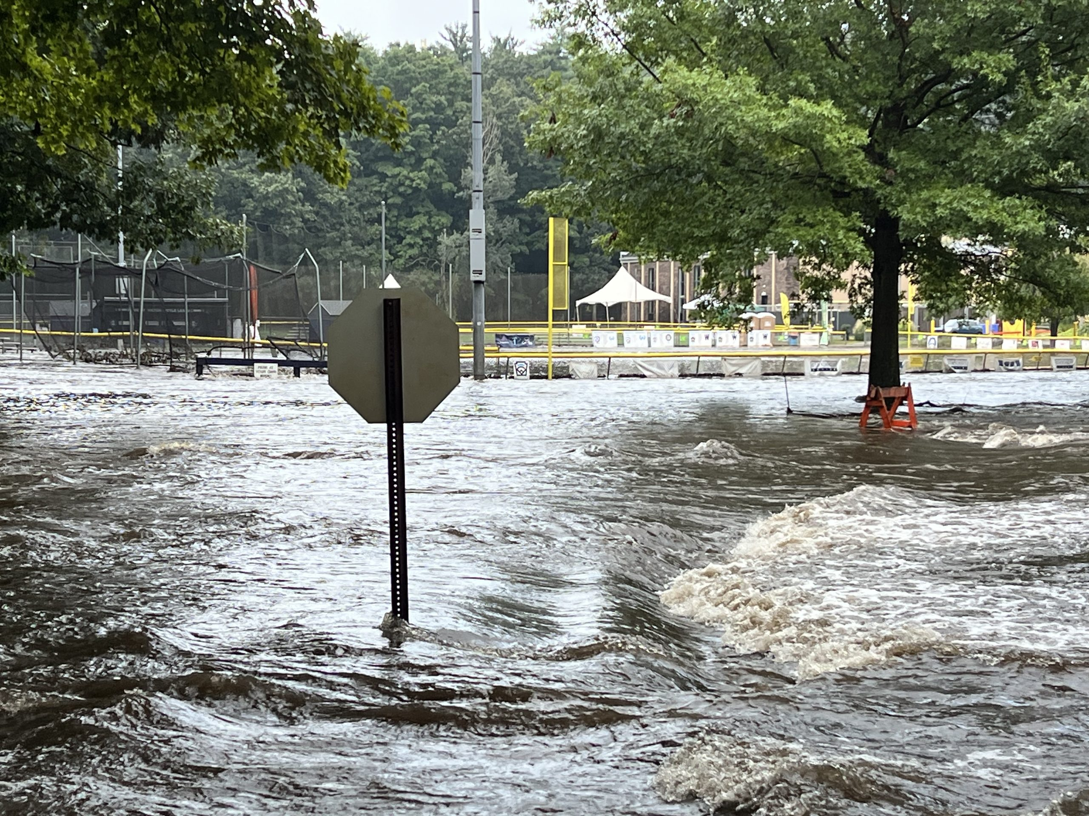
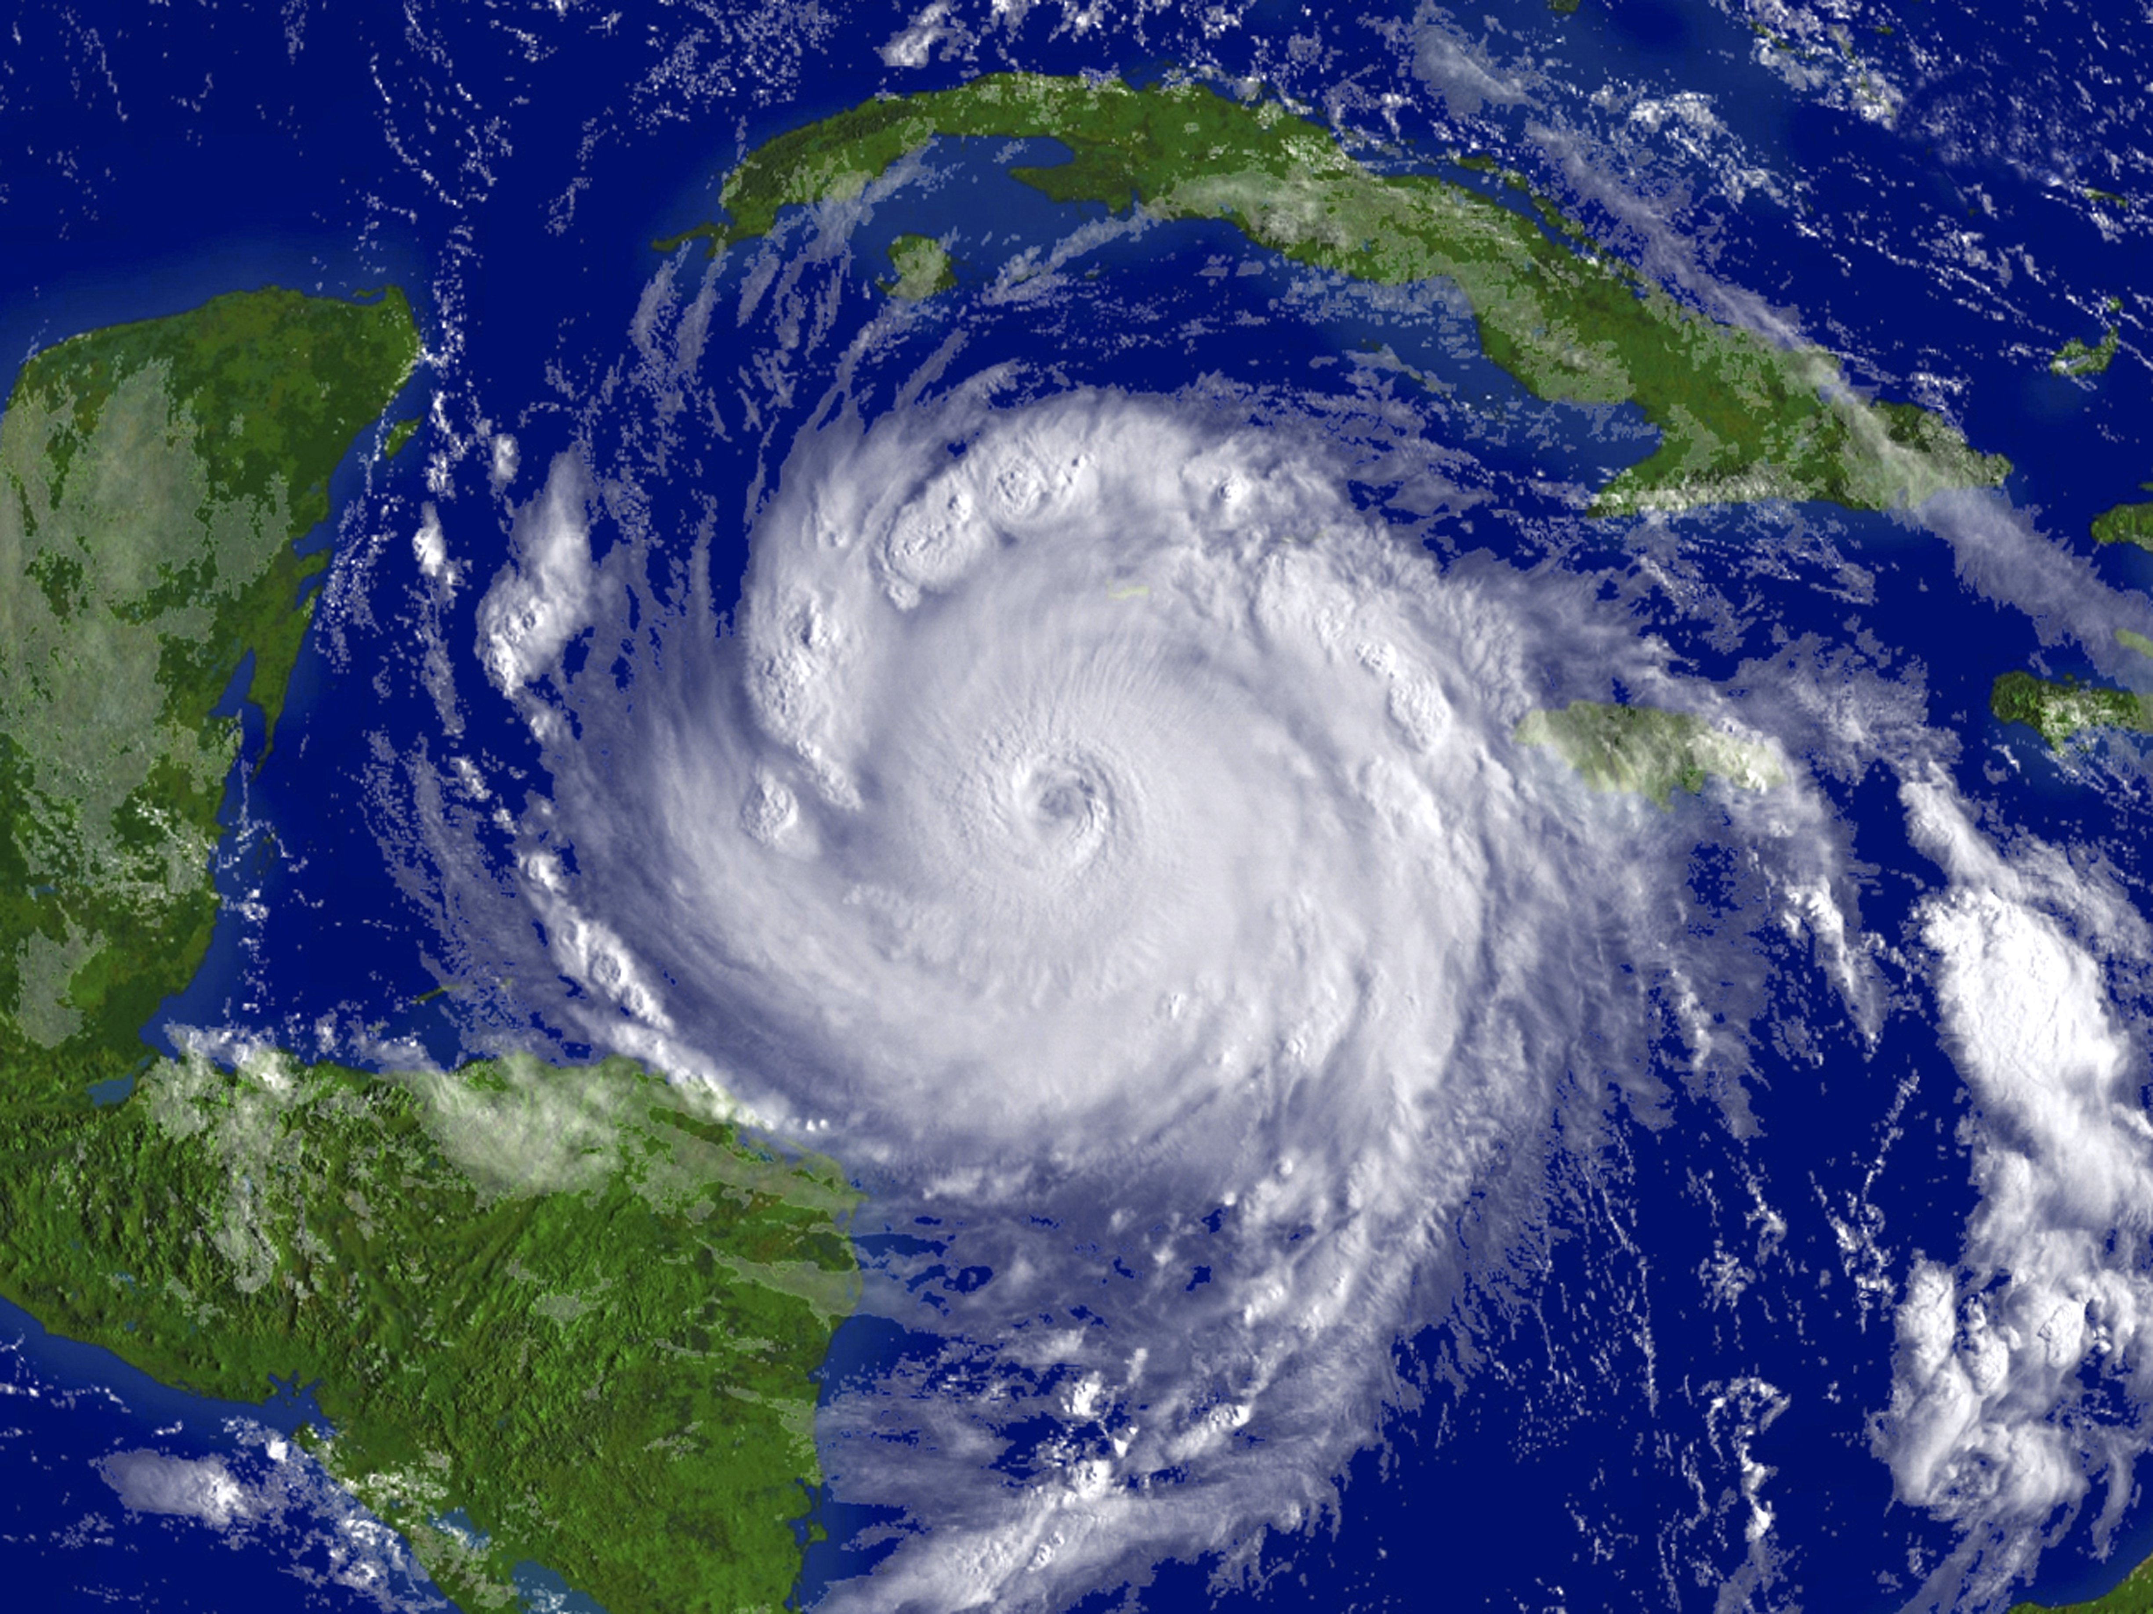
Extreme Weather
Extreme weather conditions, like high wind, thunder and lightning may impact the university and college ceremonies.
The University Commencement Ceremony and Celebration extreme weather plan is to postpone to Sunday, May 11 at 3:00 p.m.
College ceremonies will relocate to Esbjornson Gymnasium at their regularly scheduled date and time.
www.rowan.edu/commencement

Slide 18
Commencement Participation Eligibility
Students who have been awarded their degree(s)
Students who apply to graduate prior to February 28, 2025
CADP (formerly 4+1) students participating in the undergraduate portion of their program
Students with *remaining degree requirements may participate if they meet these requirements:
Undergraduate students within 20 credit hours of degree completion
Graduate students (Master’s level only) within 6 credit hours of degree completion
*Remaining degree requirements (undergraduate and graduate) to be completed in the Summer/Fall terms. Students completing degree requirements in Winter or Spring 2026 would attend Commencement in May of 2026.
DEADLINE REMINDER: *Students with remaining degree requirements must RSVP by February 28, 2025, to ensure inclusion of their name in the program book.

Slide 19
Commencement Program
Registration Deadline
Complete commencement registration no later than February 28 to ensure your name is listed in the Commencement Program!

Slide 20
Commencement Registration & Ticketing
Registration & Ticketing Process
Overview
Visit go.rowan.edu/commencementparticipation or Self-Service Banner, Student Tab, Commencement Attendance Confirmation.
Log-in with Rowan credentials to the Tassel graduate homepage, where you will see all ceremonies you are eligible to participate in.
Complete registration for EACH ceremony you wish to participate in. Completing for one does not register you for all ceremonies.
VERIFY ALL INFORMATION!
Name, degree, college and phonetic spelling of name.
Share ceremony information with your guests!
Email tickets to guests or download and print
Deadline to register and claim guest tickets– April 3, 2025

Slide 21
Commencement Registration & Ticketing
Tassel Registration & Ticketing System
How to access
go.rowan.edu/commencementparticipation
Self Service Banner/Student Tab/Commencement Attendance Confirmation
Deadline to register and claim guest tickets– April 3, 2025

Slide 22
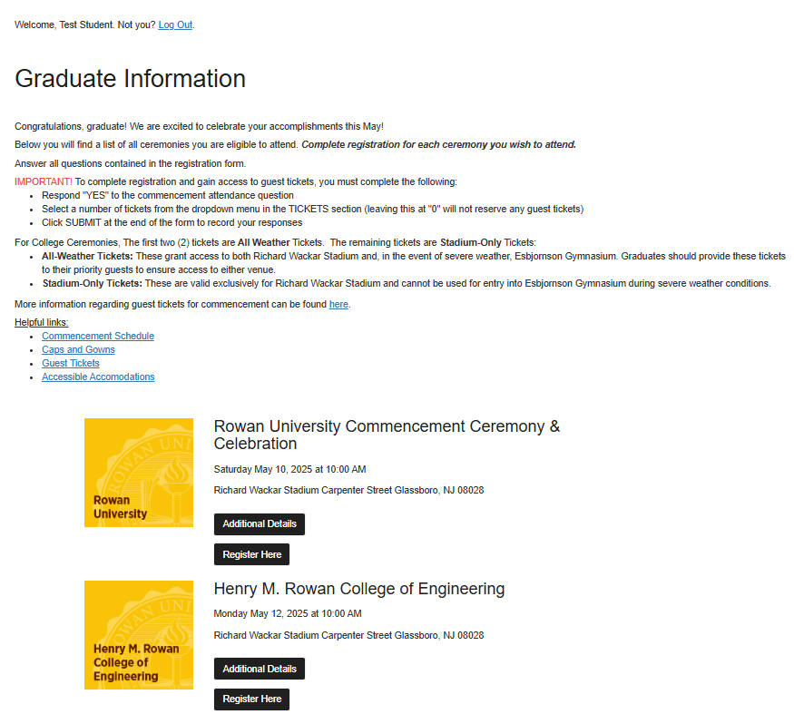
Commencement Registration & Ticketing
Graduate Home Page
Register, Access Guest Tickets & Review Additional Details
Click “Additional Details” to view important details for each ceremony.
Click “Register Here” to complete registration for each ceremony you want to attend.
Deadline to register and claim guest tickets– April 3, 2025

Slide 23
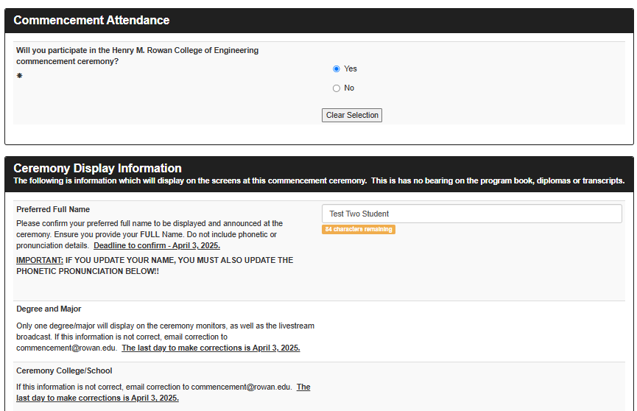
Commencement Registration & Ticketing
Registration Form
Attendance and Display Information
Commencement Attendance
Be sure to answer YES!
(If you do not select YES, you will not have access to guest tickets.)
Ceremony Display Information
Confirm information for display at ceremony - name, degree, major and college.
With corrections, email commencement@rowan.edu
Deadline to register and claim guest tickets– April 3, 2025

Slide 24
Commencement Registration & Ticketing
Registration Form
Pronunciation (College Ceremonies Only)
Enter the phonetic spelling of your name. Edit as necessary.(If you update your Preferred Name for ceremony display, you edit phonetics to match.)
Record your name.
Record your name for the ceremony name reader.
Deadline to register and claim guest tickets– April 3, 2025

Slide 25
Commencement Registration & Ticketing
Registration Form – Guest Tickets
Graduates receive guest tickets divided into two categories:
All-Weather Tickets: These grant access to both Richard Wackar Stadium and, in the event of severe weather, Esbjornson Gymnasium. Graduates should provide these tickets to their priority guests to ensure access to either venue.
Stadium-Only Tickets: These are valid exclusively for Richard Wackar Stadium and cannot be used for entry into Esbjornson Gymnasium during severe weather conditions.
Select the number of guest tickets from the dropdown (up to the maximum allowed per graduate, per ceremony). IF YOU LEAVE SET TO “0” – YOU WILL RECEIVE ZERO TICKETS!
Deadline to register and claim guest tickets– April 3, 2025

Slide 26
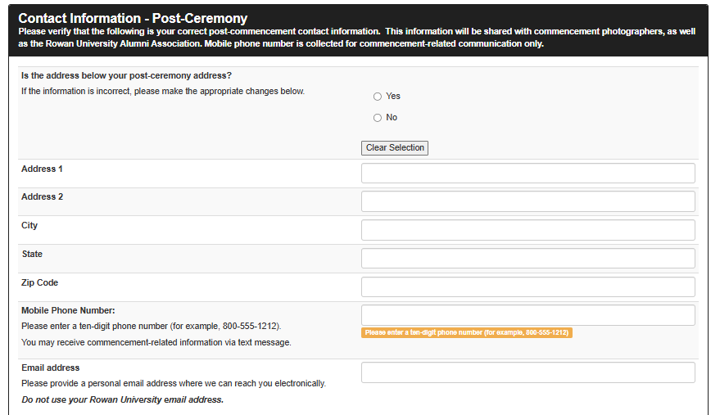
Commencement Registration & Ticketing
Registration Form
Contact Information – Post ceremony
Provide mailing and email addresses you will use after graduation. Information will be shared with commencement photographers and the Rowan Alumni Association.
Provide your cell phone number to receive important commencement updates.
Deadline to register and claim guest tickets– April 3, 2024

Slide 27
Commencement Registration & Ticketing
Registration Form
Share Ceremony Details & Submit Form
Enter the email address of anyone you want to send ceremony information.
Click enter after entering each email address.
Click summit to record your registration responses!
Deadline to register and claim guest tickets– April 3, 2025

Slide 28
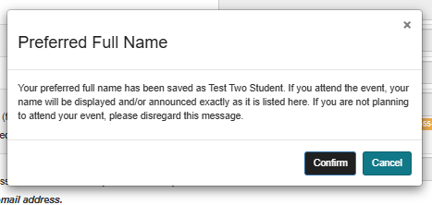
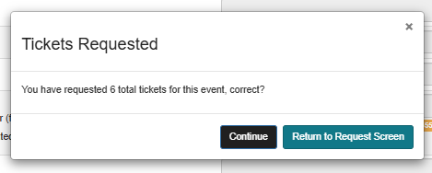
Commencement Registration & Ticketing
Registration Form
Verification Prompts
Click “Confirm” to verify your preferred full name is correct or click “Cancel” to go back to the form and make changes and submit again. You will need to confirm name to move on to guest ticket access.
Click “Continue” or click “Return to Request Screen” to go back to the form and update the number of tickets selected and submit again.
Deadline to register and claim guest tickets– April 3, 2025

Slide 29
Commencement Registration & Ticketing
Registration Form
Registration Confirmation
Click “Close” to go back to your graduate homepage and collect guest tickets.
Deadline to register and claim guest tickets– April 3, 2025

Slide 30
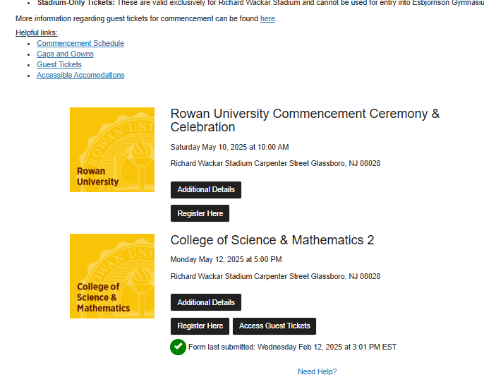
Commencement Registration & Ticketing
Graduate Home Page
Register, Access Guest Tickets & Review Additional Information
Deadline to register and claim guest tickets– April 3, 2025
Click “Register Here” to complete registration for any additional ceremonies you want to attend.
Click “Access Guest Tickets” to view, print and email your guest tickets.
Green check mark indicates your registration form was SUBMITTED - not whether you chose to attend. Click “Register Here” to review your responses.
Log back into go.rowan.edu/commencement anytime to review registration responses, access guest tickets and view important ceremony information.

Slide 31
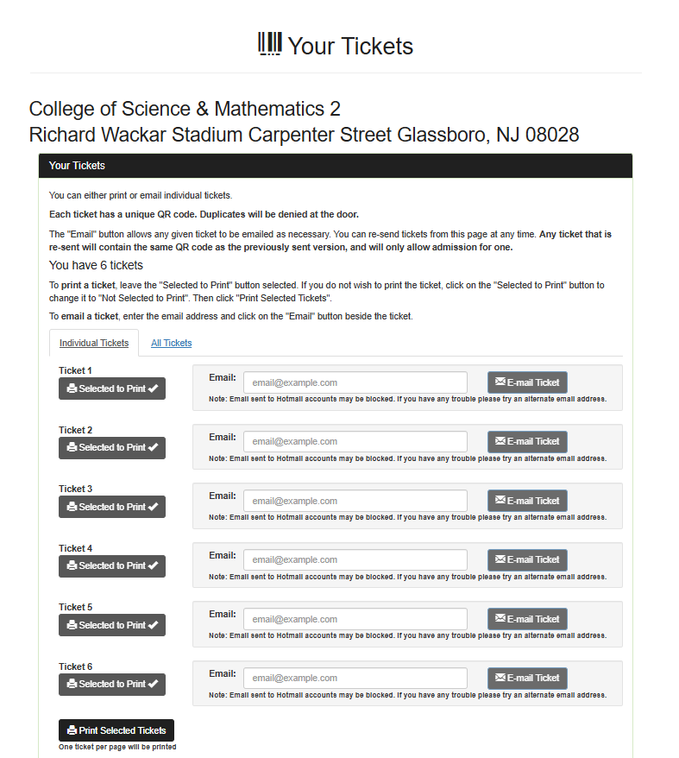
Commencement Registration & Ticketing
Access Guest Tickets
You can either print or email individual tickets.
Each ticket has a unique QR code and cannot be copied or duplicated.
IMPORTANT – All-Weather tickets (2) are at the top of the ticket list. The rest are Stadium-Only Tickets.

Slide 32
Guest Tickets
All ceremonies are ticketed. Each graduate receives All-Weather tickets (2 per graduate) and Stadium-Only tickets (4 per graduate)
Don’t delay! Tickets must be secured by April 3, 2025 at 12 p.m. After the deadline, additional tickets may become available on a first come, first served distribution.
If there are tickets remaining for a ceremony, registered graduates will receive an email notification on April 8, 2025 between 12pm and 1pm with information on how to secure additional tickets.
Digital and printed tickets will be accepted at gate entrances.
Only graduates and ticketed guests will be permitted inside of the venue
All ceremonies will be live streamed on the Rowan University YouTube channel. Links will be provided on the commencement website in the days prior to the ceremony.

Slide 33
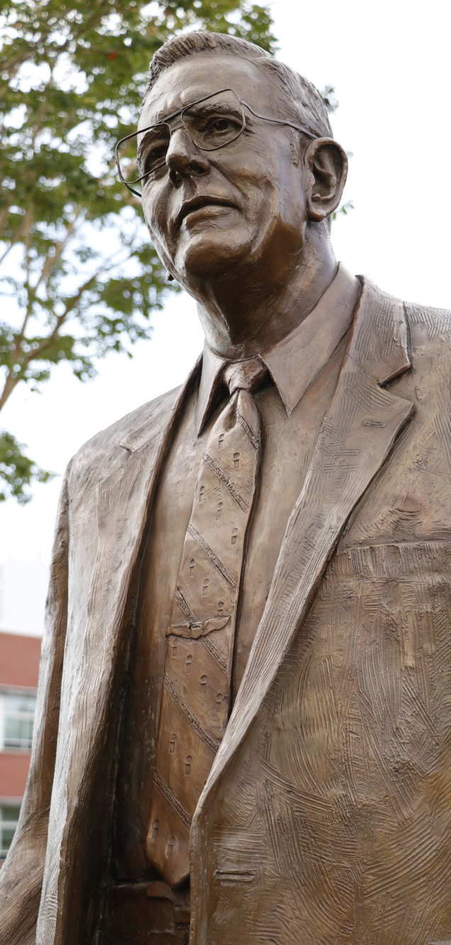
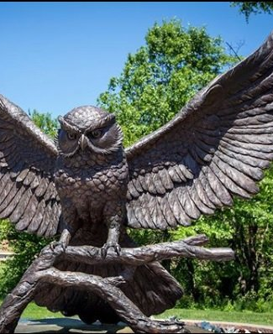
Photography
GradImages, our professional photographer, will capture moments in and around the ceremony and most importantly, as each graduate crosses the stage.
In addition to professional photography, stop at many of the campus locations, like the Prof Pride statue to capture a family photo or selfie.

Slide 34
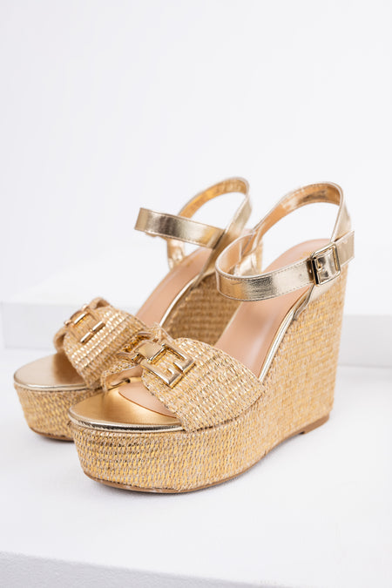
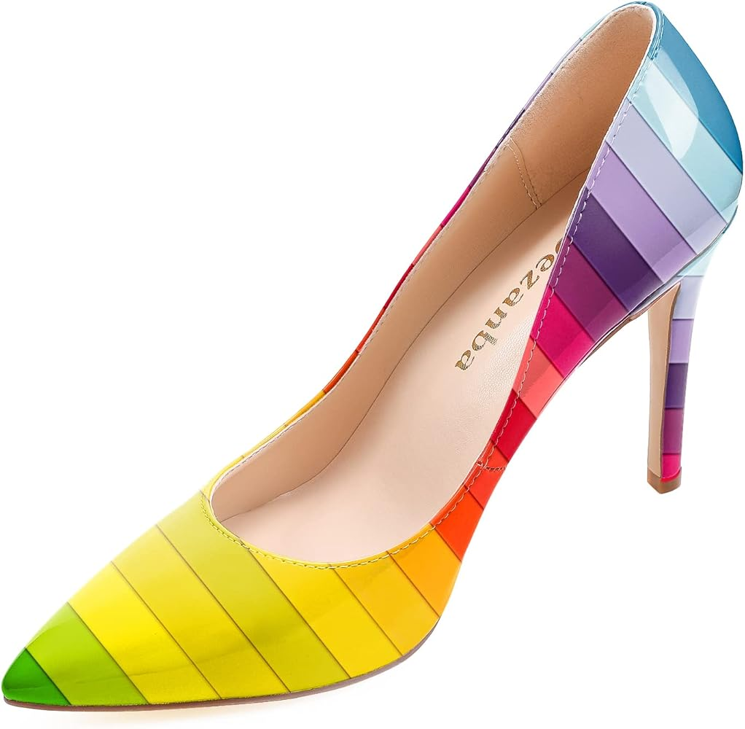
Safety & Security: Footwear Policy
To safeguard the turf on the football field, sharp footwear, such as stiletto heels and shoes with pointed or spiked soles, is strictly prohibited. This type of footwear can cause significant damage to the turf and create unsafe conditions for others.
Approved Footwear Includes:
Flat-soled shoes (e.g., sneakers, loafers, wedged platforms or heels or sandals).
Comfortable formal shoes that do not have sharp or narrow points.
Reminders and Enforcement:
Event staff will monitor entry points to ensure compliance.
Non-compliant guests will be asked to change footwear or remain in designated areas, like bleacher seating.
Graduates will be required to comply with the approved footwear policy to cross the stage.
We appreciate your understanding and cooperation in helping us maintain a safe and welcoming environment for everyone. If you have any questions or need special accommodations, please contact the Office of University Events at commencement@rowan.edu.
X

Slide 35
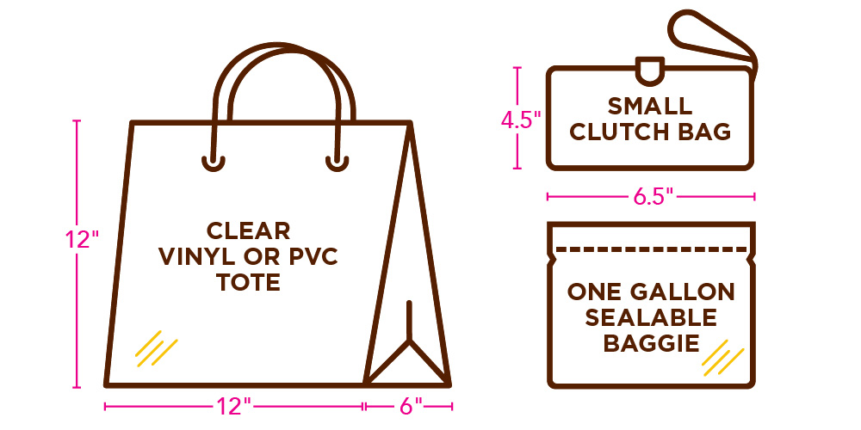
Safety & Security: Clear Bag Policy
Clear bags are required. Only clear bags that does not exceed 12” x 6” x 12”, or one-gallon plastic freezer bags, will be allowed inside the venues. In addition, small handheld clutch purses no larger than 4.5” x 6.5” will be permitted. All guests should be prepared to go through security bag checks prior to entry into the Commencement.
The following exceptions apply:
One clear bag made of plastic, vinyl, or PVC, not exceeding 12” x 6” x 12”, or a one-gallon clear plastic storage bag (e.g., Ziploc bag).
In addition to the clear bag, guests may carry a small clutch bag or purse, approximately hand-sized, with or without a handle or strap.
Medically necessary items may be allowed after proper inspection.

Slide 36
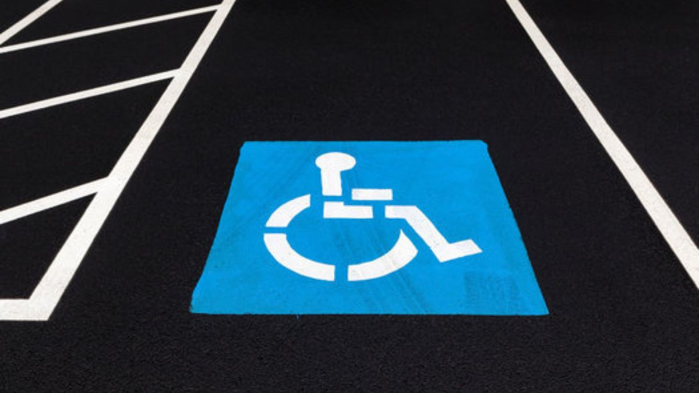
Accessibility Accommodations
Parking & Seating
Contact & Accommodation Information
Graduates and guests requiring an accessible parking pass must submit a request to parking@rowan.edu. Requests can be made from March 24 – April 25, 2025. Dedicated accessible parking for ceremonies in Wackar Stadium is in Lot C and for ceremonies in Esbjornson Gymnasium is Lot W.
Golf carts will loop continuously through parking areas to bring guests directly to the accessible seating area.
The accessible seating area is for the ticketed guest needing accessible seating and one ticketed companion. No special ticketing is required.
If additional assistance is required, please contact the Academic Success Center at 856-256-4259 to request accommodations.

Slide 37
Rowan University Regalia
Rowan Brown & Gold Caps & Gowns
Available Exclusively Through Rowan Barnes & Noble
Purchase Rowan University Caps & Gowns at Glassboro Barnes & Noble:
In-person at Rowan Barnes & Noble beginning March 31, 2025
Sales will continue through the start of commencement.
Sizes are not guaranteed after April 17, 2025.
Online
More information available in late March.
Commencement Fair @ Rowan Barnes & Noble
Monday, March 31, 2025 - Friday, April 3, 2025
Cap & gown vendor will be on-site to help with sizing and answer questions. There will also be class ring vendors at this event.
Custom doctoral gowns – Contact Valerie at 856-881-5954 or wojcik@rowan.edu to schedule a fitting. Orders must be placed by March 6, 2025.

Slide 38
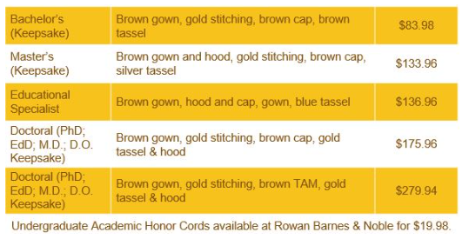
Rowan University Regalia
Caps & Gowns
Pricing
Undergraduate Academic Honor Cords available at Rowan Barnes & Noble for $19.98.

Slide 39
Important Dates to remember:
February 28: Last day to apply to graduate for Spring graduation
February 28 - Register by today to have name in printed program
March 31: Cap and Gown sales begin; In-person Commencement Fair at Barnes & Noble (March 31 – April 3)
April 3: Commencement registration and guest ticket access closes
April 3: Last day to make corrections to Commencement display details
April 8: First come, first served access to additional guest tickets (as available) will be announced via email between 12:00 p.m. – 1:00 p.m.
May 9: The School of Graduate Studies Hooding Recognition Ceremony & Reception
May 10: University Commencement Ceremony & Celebration at 10:00 a.m.
May 12 - 15: College Commencement Ceremonies

Slide 40
Keep Up To Date
Check your Rowan email
Always open and read emails from graduation@rowan.edu and commencement@rowan.edu as they contain important information.
Know the deadlines; don’t wait until the last day!
Check the commencement and graduation websites regularly for updates.
Follow Rowan on social media; look for Instagram stories and participate in Q & A’s.
Use #Rowan2025 to filter your posts onto the commencement website
Prepare for commencement
Review the final details in the “Know Before You Go” email sent 48 hours prior to commencement
Be sure to share details with your guests.

Slide 41
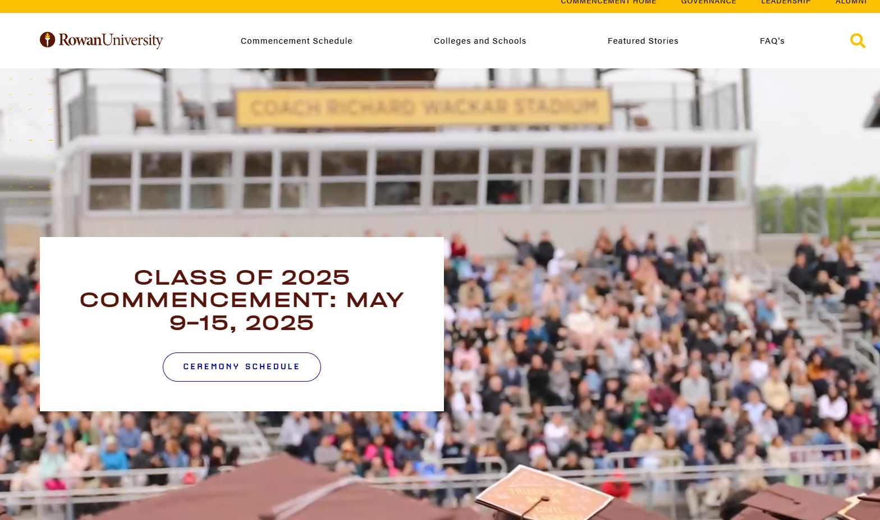
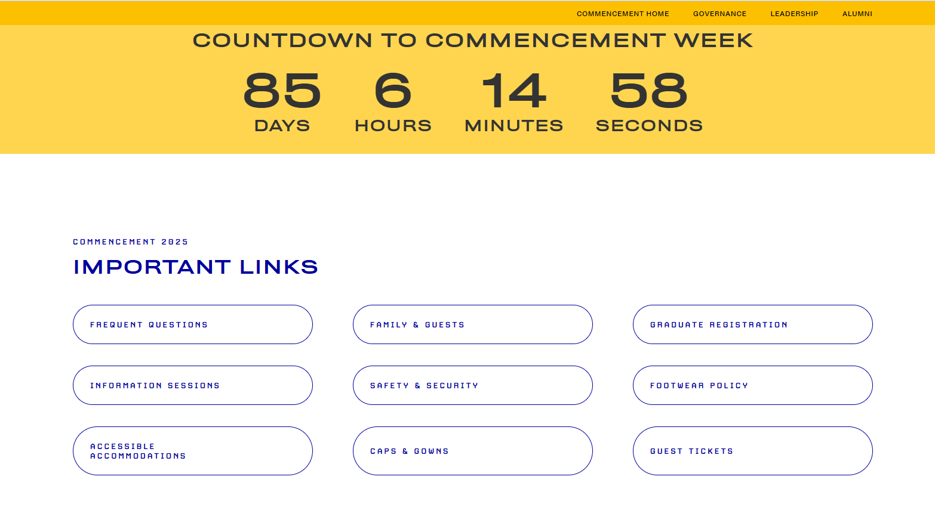
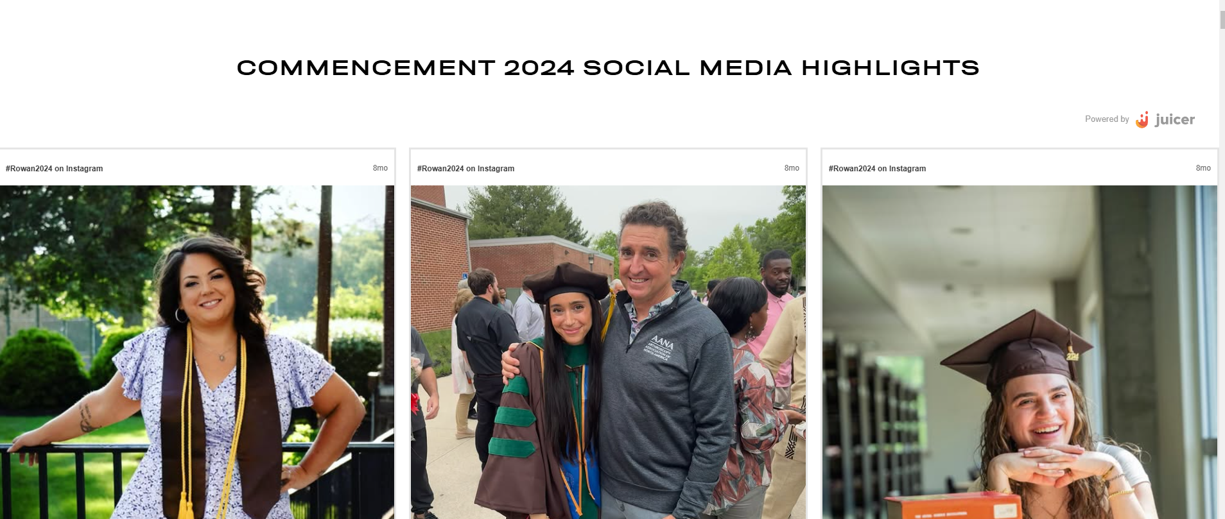
Commencement Website
rowan.edu/commencement
www.rowan.edu/commencement

Slide 42
Thank you! We look forward to celebrating with you in May!
#Rowan2025
Additional questions? Email us! Be sure to include your Banner ID!
Graduation – graduation@rowan.edu
Commencement – commencement@rowan.edu
www.rowan.edu/commencement

