Slide 1
Student Travel Process
April 27, 2023

Slide 2
Agenda
Day Travel
Day Travel Expense Form
Overnight Travel
Domestic Travel Request Form
International Travel Request Form
Travel Expense
Travel Expense Form
Proof of Payment Examples
Expense Report Tips
Payment Methods
Students Traveling with Employees
Payment Methods
Chat with Travel
Contact Information

Slide 3
Day Travel
Day travel does not require a pre-approved travel request — no encumbrance # needed

Slide 4
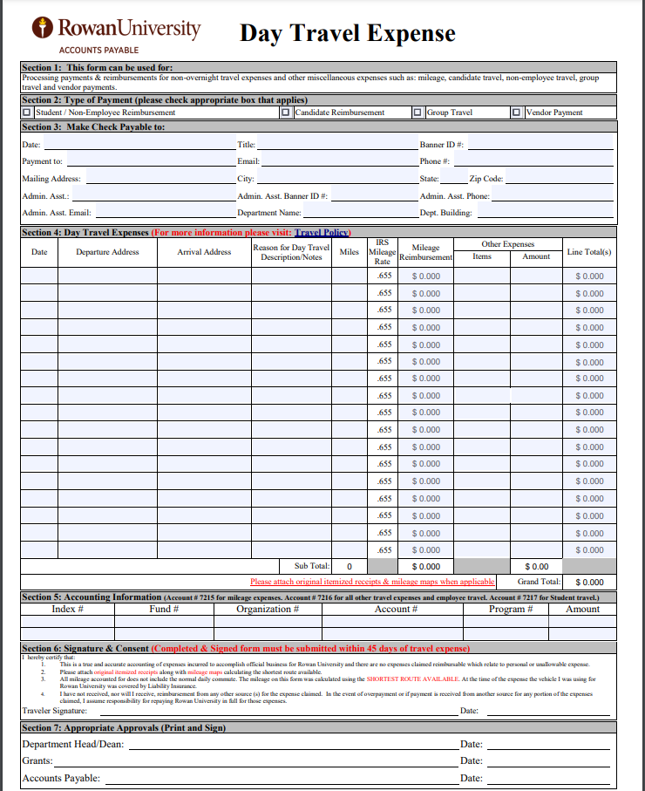
Day Travel Expense Form
Note: If you do not have a Banner ID, please go through the Vendor Portal to set up the individual to receive a payment from Accounts Payable.

Slide 5
Day Expense Form
To be submitted within 45 days after the monthly travel has occurred, if reimbursement is required
Approvals Needed
Department Head/Dean
Grants, if applicable
Accounts Payable

Slide 6
Accounts Payable
Mileage- include a copy of Google map showing the mileage calculation
Utilize the physical street address
ex. 2000 Clements Bridge Rd Deptford, NJ instead of Deptford, NJ
Mileage is reimbursed in lieu of fuel
Uber & Lyft - include the destination address (ex. to conference or event site)
Receipt/Order Confirmation showing what was purchased (ex. registration, parking, tolls) & the amount
Proof of payment = credit card statement or copy of the credit card that matches the last 4 digits shown on the receipt
Meals are not permitted with day travel, unless specified by the Grant funding the expense

Slide 7
Overnight Travel
All overnight travel requires a pre-approved travel request – encumbrance # needed

Slide 8
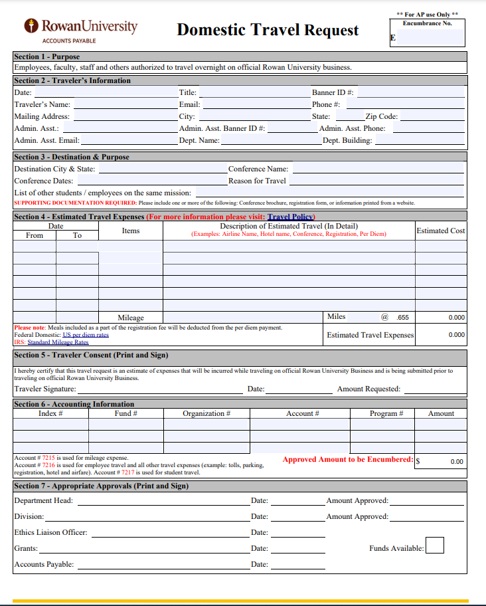
Domestic Travel Request Form

Slide 9
Domestic Travel Request
To be submitted & approved at least 4 weeks prior to the departure date
Approvals needed
Department Head
Division Head
Ethics Liaison Officer
Grants, if applicable
Accounts Payable
Include all travel expenses, but list expenses that will be charged to a Pcard or paid via PO as $0 so that those amounts are not included in the encumbrance

Slide 10
Ethics Liaison Officer
Location of travel
Release & Waiver needs to be attached
Appropriate signatures obtained
ELO signature & date

Slide 11
Grants, if applicable
Check grant budget for allowability and to make sure there are enough funds in the account to cover expenses (OK to approve if enough money in pooled accounts)
Do budget transfer if requested by department
Check to make sure there is documentation supporting the request
Check to make sure form has required signatures (Post award signatures include Post award specialist and either Lisa Ciliberto or Rita Piccioni)
Send signed form to A/P for processing

Slide 12
Accounts Payable
One request per student
Conference Brochure/Flyer/Website screenshot with the start & end date of the conference as well as the location of the travel
Hotel Name & Address Information
Copy of Per Diem screenshot obtained from U.S. Department of State Lodging and Food Per Diem Rates
Signed Rowan University Release and Waiver

Slide 13
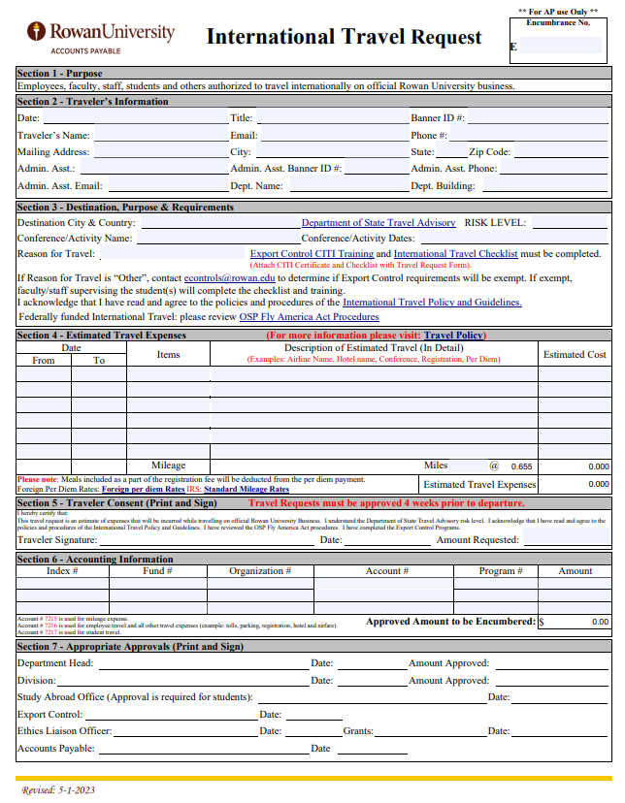
International Travel Request Form
Note: Section 3 of this form was recently updated. Please ensure you are utilizing the most up to date version from the Accounts Payable webpage.

Slide 14
International Travel Request
To be submitted & approved at least 4 weeks prior to the departure date
Approvals needed
Department Head
Division Head
Study Abroad Office (student travel only)
Export Control
Ethics Liaison Officer
Grants, if applicable
Accounts Payable
Include all travel expenses, but list expenses that will be charged to a Pcard or paid via PO as $0 so that those amounts are not included in the encumbrance

Slide 15
Study Abroad Office
Approval given:
Department of State Travel Advisory
Level 1: Exercise normal precautions - travel permitted
Level 2: Exercise increased caution - travel permitted
Level 3: Reconsider travel - travel unlikely, but MAY be permitted with further approval from Provost
Level 4: Do not travel - travel *not* permitted

Slide 16
Export Control
Complete Export Control requirements before submitting travel paperwork.
Section 3 - Destination, Purpose & Requirements
Reason for Travel (research, conference, teaching, other)
International Travel Checklist
CITI Program Export Controls Course
Attach travel checklist and CITI certificate to travel request
If Reason for Travel is “other” ( athletic conference, performing services abroad, study abroad, etc.), contact econtrols@rowan.edu to determine if Export Control training and checklist is required. *If determined exempt, faculty/staff supervising the students will complete the travel checklist and CITI training.

Slide 17
Ethics Liaison Officer
Location of travel
Release & Waiver needs to be attached
Appropriate signatures obtained
ELO signature & date

Slide 18
Grants, if applicable
Receive international request form from Research Compliance (Priscilla Lyons)
Check grant budget for allowability and to make sure there are enough funds in the account to cover expenses (OK to approve if enough money in pooled accounts)
Do budget transfer if requested by department
Check to make sure there is documentation supporting the request
Check to make sure form has required signatures (Sarah Piddington signs under Export Controls/Post Award Specialist signs under Grants)
Send signed form back to Priscilla Lyons for processing

Slide 19
Accounts Payable
One request per student
Conference Brochure/Flyer/Website screenshot with the start & end date of the conference as well as the location of the travel
Hotel Name & Address Information
Copy of Per Diem screenshot obtained from U.S. Department of State Lodging and Food Per Diem Rates
Signed Rowan University Release and Waiver

Slide 20
Travel Expense
If reimbursement is required

Slide 21
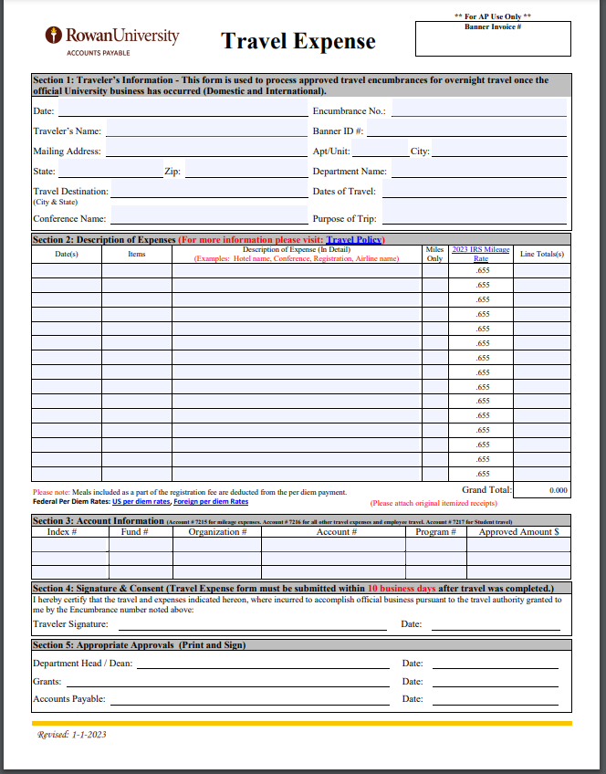
Travel Expense Form

Slide 22
Travel Expense
To be submitted 10 days after the travel has occurred
Approvals needed
Department Head/Dean
Grants, if applicable
Accounts Payable

Slide 23
Grants, if applicable
Check grant budget for allowability and to make sure there are enough funds in the account to cover expenses (OK to approve if enough money in pooled accounts)
Do budget transfer if requested by department
Check to make sure all supporting documentation/receipts are attached
Check to make sure proof of payment is included if applicable
Check to make sure form has required signatures (Post award signatures include Post award specialist and either Lisa Ciliberto or Rita Piccioni)
Send signed form to A/P for processing

Slide 24
Accounts Payable
Receipt/Order Confirmation showing what was purchased & the amount
Proof of payment = credit card statement or copy of the credit card that matches the last 4 digits shown on the receipt
Mileage- include a copy of Google map showing the mileage calculation
Utilize the physical street address
ex. 2000 Clements Bridge Rd Deptford, NJ instead of Deptford, NJ
Mileage is reimbursed in lieu of fuel
Uber & Lyft - include the destination address (ex. to hotel, conference or airport)
Hotel- include folio or receipt that shows the full breakdown of the charge as well as the dates
Airfare- include receipt that shows airfare class
travel insurance not reimbursable
Utilize U.S. Department of State Lodging and Food Per Diem Rates to calculate per diem & include printout
include conference agenda showing any meals provided

Slide 25
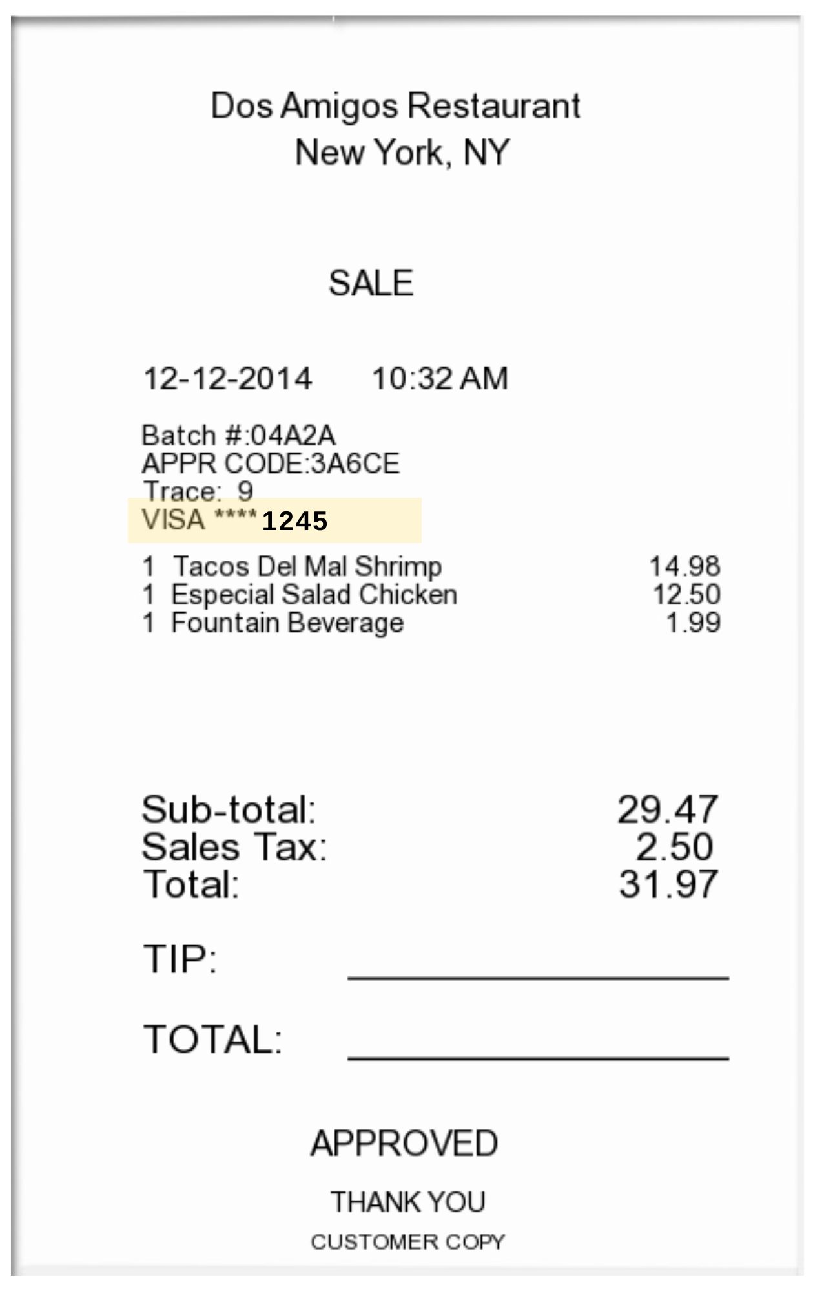
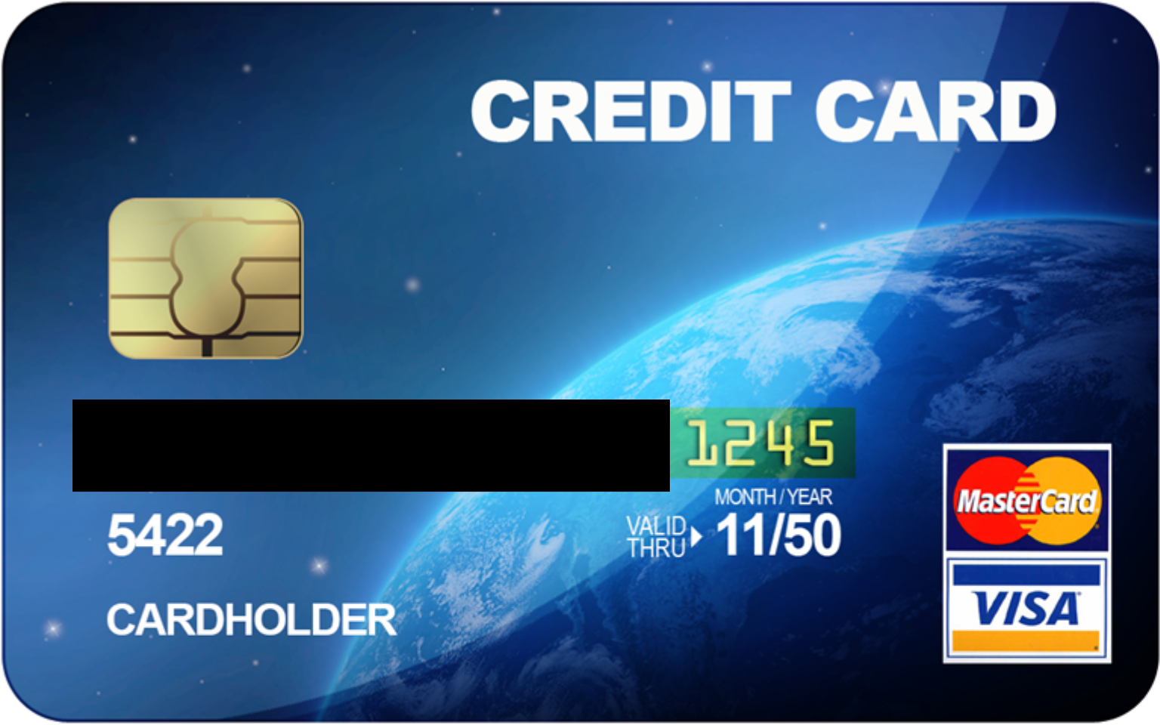
Proof of Payment Example
Itemized Receipt with CC Info Listed
Credit Card with matching 4 digits

Slide 26
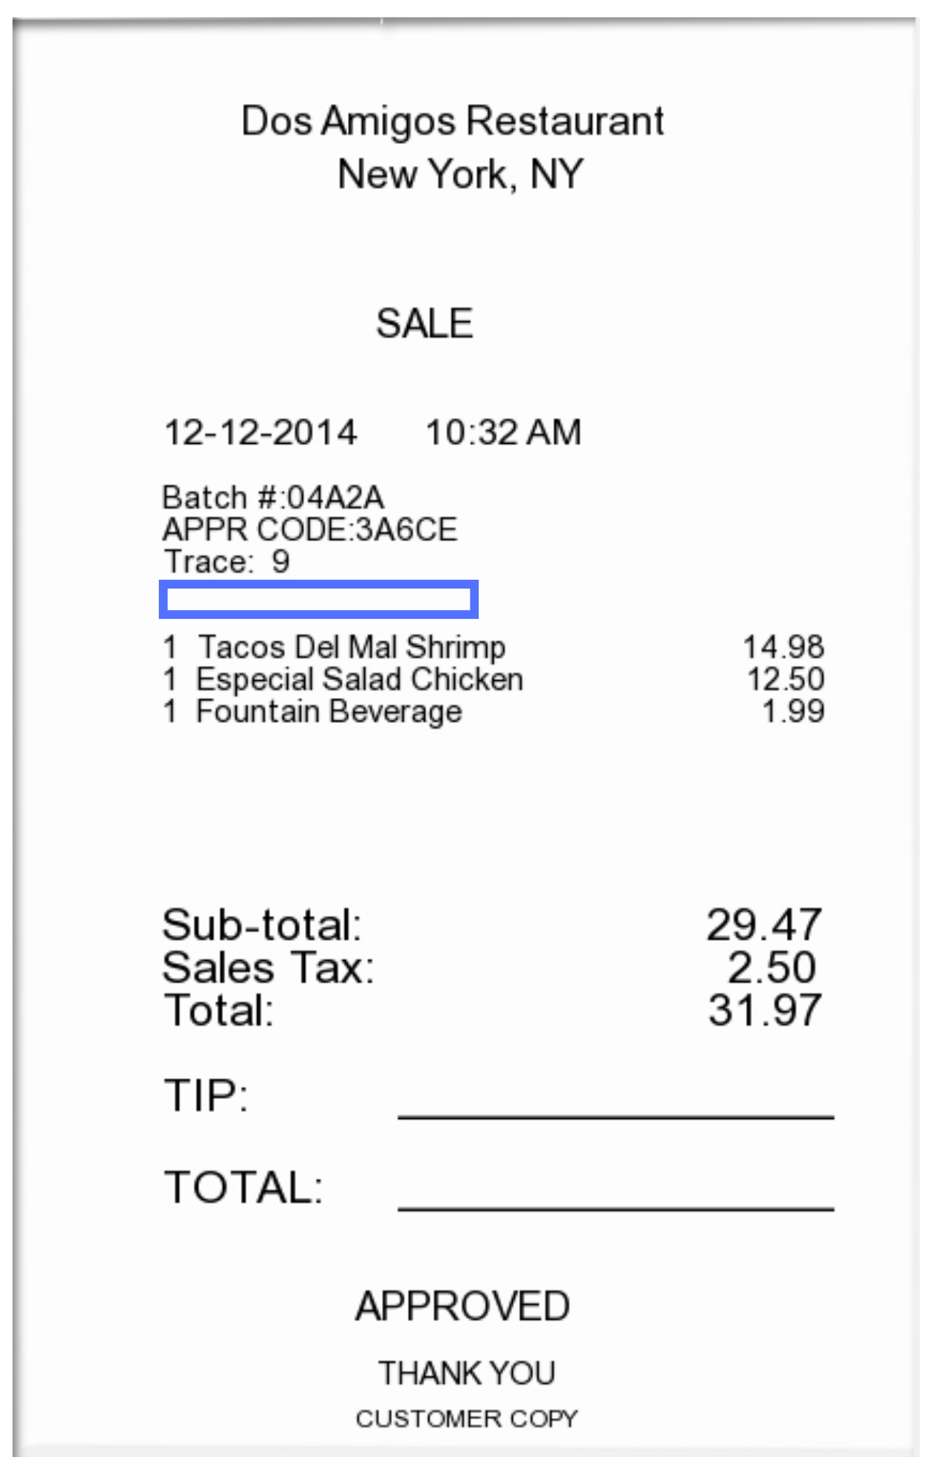
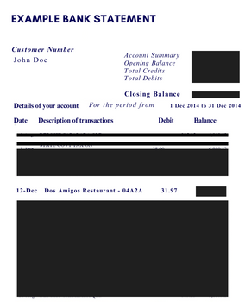
Proof of Payment Example
Itemized Receipt without CC Info Listed
Redacted bank statement showing the charge & the name of the individual being reimbursed

Slide 27
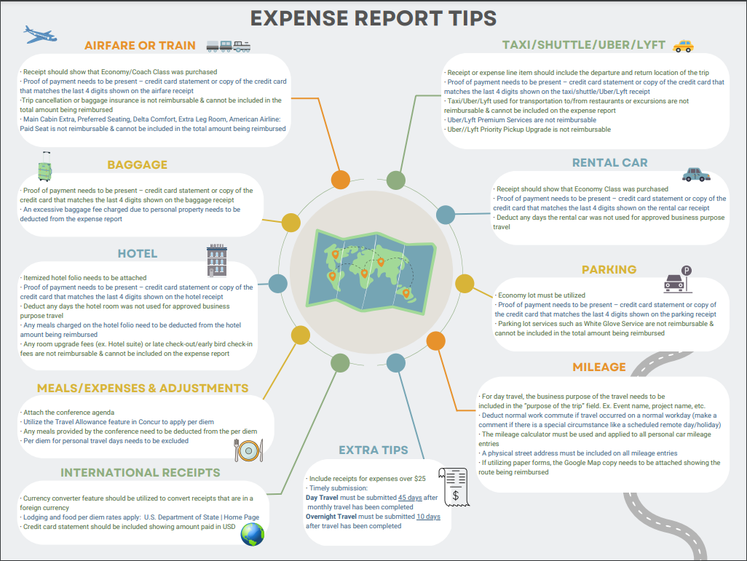
Expense Report Tips

Slide 28
When Students are Traveling with Employees
Employee should process their own travel request in Concur with all of their own estimated expenses
Student (s) should process their own travel request via paper travel form with all of their own estimated expenses
After the travel, if the employee paid out of pocket for any of the student’s expenses, they can include those items on their expense report in Concur
list the student’s encumbrance number
allocate those expenses to student travel account code - 7217

Slide 29
Payment Methods
Rowan’s Travel Agent, Direct Travel for airfare & lodging — with an approved encumbrance #
University Pcard — with approved encumbrance # email as backup
Personal Credit Card

Slide 30
Chat with Travel Sessions
These sessions provide Rowan faculty and staff the opportunity to pop in at their convenience to chat with the travel team in an open WebEx session. An AP travel team member is available once a week from 9:30am-1pm and 2pm-3:30pm to discuss any travel questions, comments, or concerns.
Visit AP’s News and Updates webpage to see upcoming dates listed in the Daily Mailers

Slide 31
Contact Information
For Accounts Payable Related Questions: Accounts Payable Webpage
For more information specifically related to Student Travel: Student Travel
Email AskTravel@rowan.edu
To learn more information about applying for and/or utilizing a Pcard: visit Procurement’s webpage- Purchasing Cards
Export Control
Study Abroad

Slide 32
Questions?

