Slide 1
New Employee Training Travel
Presented by
Accounts Payable (AP)
Notes:
1

Slide 2
What is Concur?
Logging into Concur
Concur Homepage
Accessing Concur training site
Concur Training Site
Training Videos
Training Guides
Accessing Profile
Requests
Expense Reports
Payment Methods
Accounts Payable Website
Travel Policy
Expense Report Tips
Chat with Travel
Contact Information
Overview of Training

Slide 3
What is Concur?
Concur Travel and Expense is Rowan's system of record in facilitating all your University travel needs. Concur integrates encumbrances, travel bookings, and expense reporting into a single system of record.
Through this technology, administrative functions are consolidated, thereby allowing you to seamlessly request travel, receive approval for travel, book travel, and submit travel-related expenses.

Slide 4
Logging into Concur
Visit go.rowan.edu/ConcurTravel
Enter your Rowan NetID.
Select Login and complete Duo two-factor authentication, if prompted.
or
visit the Accounts Payable Webpage and select the blue SAP Concur button and follow steps 2-3 to login.

Slide 5
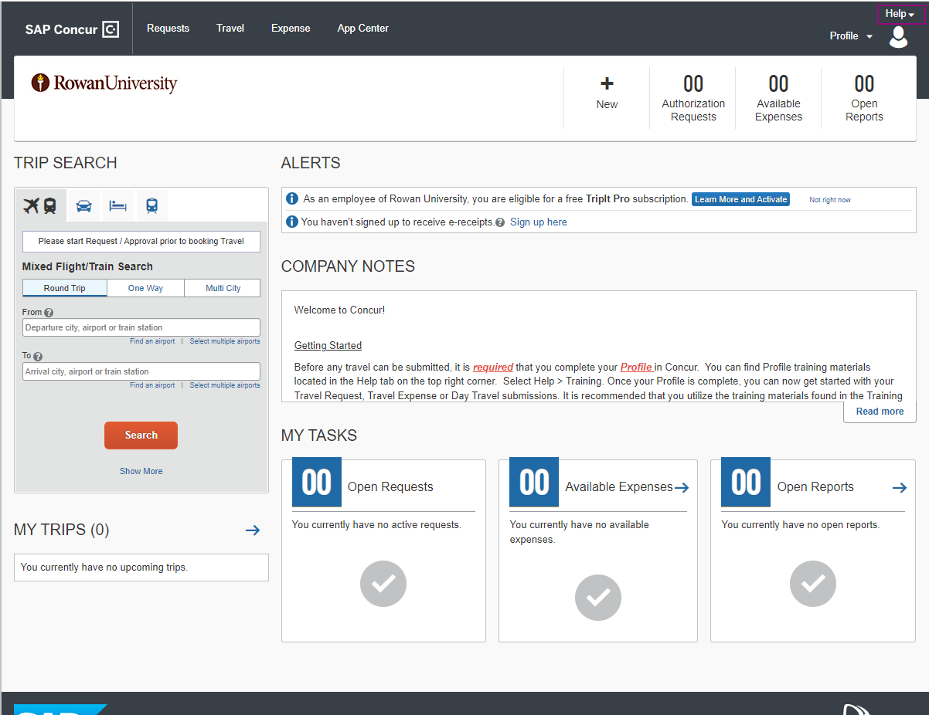
Rowan University Concur Homepage

Slide 6
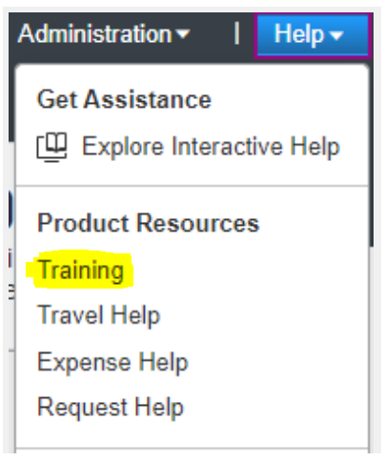
Assessing Training Videos & Guides
Select Help in the upper right corner
Select Training
Notes:
6

Slide 7
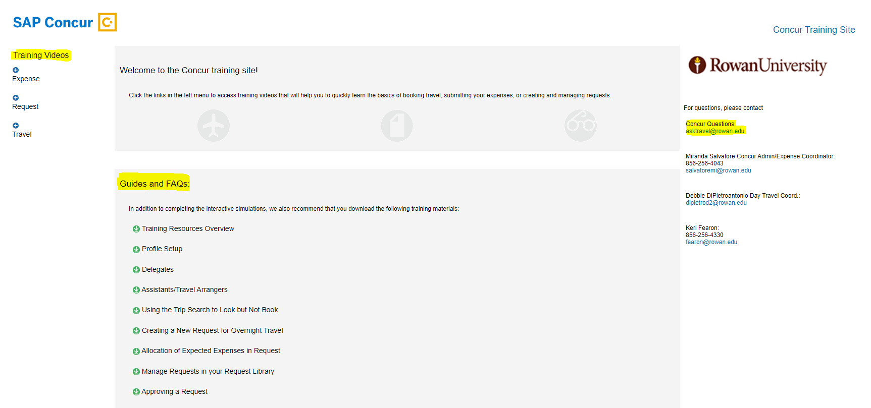
Concur Training Site

Slide 8
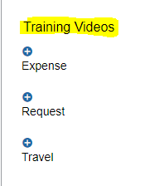
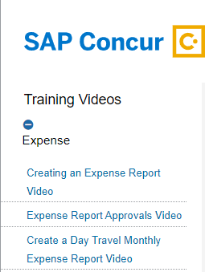
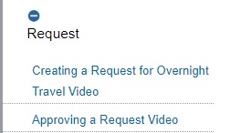
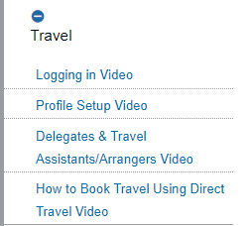
Training Videos

Slide 9
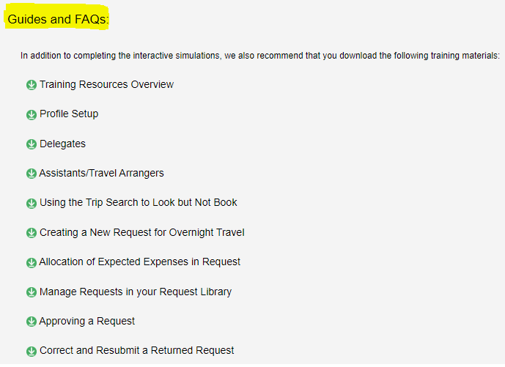
Guides and FAQs:
VIP
Additional guides provided

Slide 10
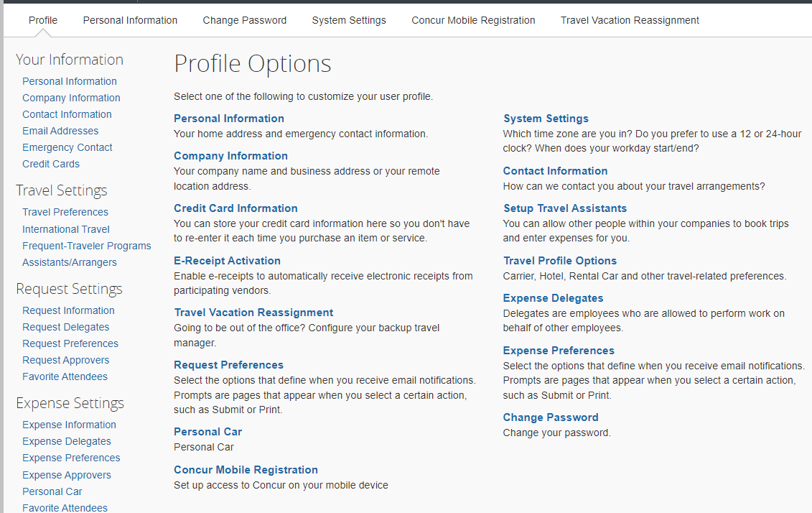
Accessing Profile
All users MUST complete the Personal Information Section and Request/Expense Approver Sections first as part of the profile setup process.

Slide 11
Requests
Requests are used to obtain pre approval for overnight travel only.
Rowan University employees are required to submit Requests in Concur for all overnight domestic and international travel.
NOTE: Per University policy Requests (Domestic / International) must be submitted and approved 4 weeks prior to departure.

Slide 12
Day Travel Expense Reports
Day Travel consists of attending official University business without the need to stay overnight. NOTE: meals are not reimbursable with day travel
A Request or Encumbrance Approval Number (E#) is not required for Day Travel.
Monthly Submission deadline for Day Travel is 45 days after the end of each month traveled.
Overnight Travel Expense Reports
Once overnight travel is complete, you must complete an Expense Report connected to the approved Request to ensure appropriate reimbursements occur.
Expense Reports must be submitted within 10 business days after overnight travel was completed.
Once the Expense Report has been submitted, the request must be closed by the traveler to ensure any remaining balance is released and returned to the assigned FOAPAL.
Visit Close Your Request for step-by-step instructions

Slide 13
Payment Methods for Booking Travel
Rowan’s Travel Agent, Direct Travel, for airfare & lodging — with an approved encumbrance #
University P-card— with approved encumbrance # email as backup
Utilize a personal credit card to later be reimbursed (least preferred method)

Slide 14
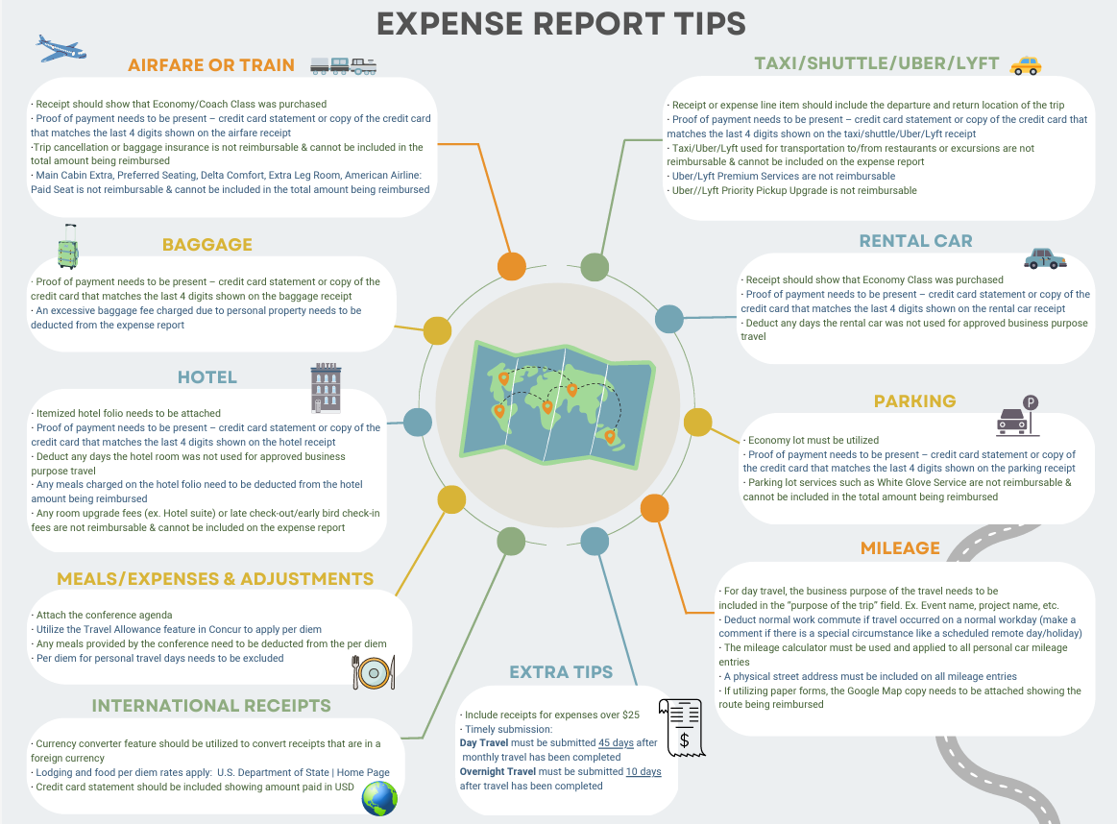
Accounts Payable Website
Travel Policy
Expense Report Tip Sheet

Slide 15
Chat with Travel
These sessions provide Rowan faculty and staff the opportunity to pop in at their convenience to chat with the travel team in an open WebEx session. An AP travel team member is available from 9:30am-1pm and 2pm-3:30pm to discuss any travel questions, comments, or concerns on specific days of every month.
Visit AP’s News and Updates Webpage to see upcoming dates listed in the Daily Mailers
NOTE: Department and/or 1:1 training is also available. Email asktravel@rowan.edu to set up an appointment.

Slide 16
asktravel@rowan.edu
Miranda Salvatore
Concur Travel & Expense Administrator
Prepayments/Overnight Expense -Processor
Deborah DiPietroantonio
Concur Travel & Expense Administrator
Requests/Day Travel Expense - Processor
Joselyn Peoples
Director of Accounts Payable

