Slide 1
New Employee Training Purchase to Pay
Presented by
Office of Contracting & Procurement (OCP)and Accounts Payable (AP)
Notes:
1

Slide 2
Overview of Training
Payment Methods
Requisition to Check Process
Vendor Information
Requisitions/Purchase Orders
Invoice Processing
University P-Card
Non-PO Payment Request
Payment Verification
Contact Us

Slide 3
Payment Methods for Purchasing Goods & Services
Requisition/Purchase Order (most preferred method)
University P-Card
Non-PO Payment Request (least preferred method & not permissible for services)
Wires (only applicable for foreign vendors who do not have U.S Bank Accounts)
Approved PO# is still required before payment can be processed

Slide 4
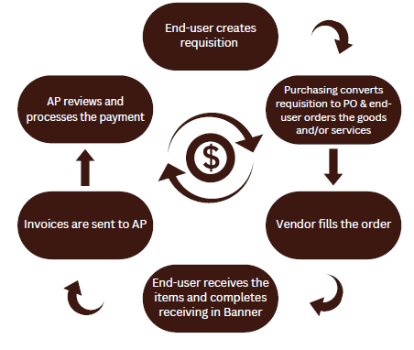
Requisition to Check Process

Slide 5
Vendor Information
Preferred Vendors
Some examples include:
Amazon (Online Marketplace)
Office Depot for all office supplies, including ink cartridges & toner
Barnes and Noble for all textbooks
Home Depot & Lowe’s
Setting up vendors to do business with Rowan - Vendor Portal
Vendor OnBoarding
If vendor is in Banner, but not currently active, contact OCP to find out why

Slide 6
Requisition to a Purchase Order
Must have an approved PO# prior to placing an order
Avoid Confirming Orders to be in compliance
When placing your requisition in Banner, provide the required documentation including any quotes, forms, & other procurement approvals to requisitions@rowan.edu, so the purchase order conversion can be completed timely
Submit a Change Order Request in the Change Order Portal to increase or decrease your purchase order
If your request has an associated contract, submit a contract for review through the Contract Portal
Independent Contractors
See Quick Reference Guide on Requisitions

Slide 7
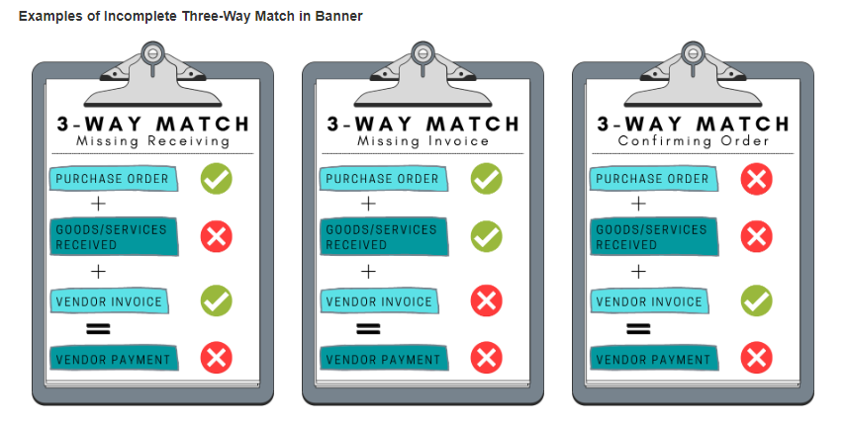
Invoice Processing
Vendor must send the invoice directly to AP to invoices@rowan.edu with approved PO# on it (due to audit compliance)
Department can be copied on the email
Proforma, statements, quotes & order confirmations are NOT acceptable
Invoices are paid on a Net 30 basis unless otherwise stated on the contract
Vendors receive payment on or within 30 days of the invoice date
Electronic receiving in Banner needs to be completed once the product has been physically delivered or the service has been provided
See Quick Reference Guide on Receiving

Slide 8
University P-Card
All purchases must be in compliance with the University Purchasing Card Policy
Can only be utilized for allowable purchases including
Entertainment, dining, receptions, with approved Entertainment Form and Gourmet Dining waiver, if applicable
Must adhere to Reception & Entertainment Policy
Emergency situations, with prior approval from the Office of Contracting and Procurement (OC&P)
Vendors who are compliant, but do not accept POs, checks or ACH payments, or issue invoices
Memberships, registration fees, and job posting fees
Travel accommodations, with limitations
Submit P-Card Account Application
Please note a required training must be completed prior to card being issued.
Visit Purchasing Credit Card Webpage to learn more

Slide 9
Non-PO Payment Request
Primarily used for reimbursement to faculty, staff members or students who incur minor out of pocket expenses
Must be in compliance with General Payment Policy & must abide by Non-PO Category List
Cannot bypass Office of Contracting & Procurement – this includes payment for the following:
Consultant payments
Speaker fees unless it is an Honorarium
Rental fees
Other services
NJ & FL sales tax is not reimbursable
Proof of payment must always be submitted
Visit Non-PO Payment Request Webpage to learn more about what should be included with requests & what is permissible

Slide 10
Payment Verification
Utilize Banner Screen FOIDOCH to review the status of a particular document (can search by a requisition #, a purchase order #, an invoice #, or a check #)
If invoice states “Receipt Required” = either electronic receiving was not done on a PO or there may be an issue with the receiving document (Y number)
If invoice states “Approved” = direct pay or invoice is approved, but payment has not been disbursed
If invoice states “Paid” = payment has been disbursed
There will be a corresponding check disbursement document (CHK #)
Utilize Banner Screen FAIVNDH to review all of the payments processed to a vendor
Can search by Banner ID to see if a Non-PO has been processed
For detailed step-by-step instructions on utilizing these screens, visit Invoice Payments

Slide 11
Alexis Jones
Director of Contracting & Procurement (OCP)
Full OCP Team
vendors@rowan.edu
Joselyn Peoples
Director of Accounts Payable (AP)
Full AP Team
invoices@rowan.edu
*Feel free to contact us to schedule 1:1 training on a particular topic*

