Slide 1
Fiscal Year-End Prep
FY 23 Year-End Training presented by the Division of Finance
April 26, 2023

Slide 2
Agenda
Budget
Procurement
Accounts Payable
Accounting Services
Contact Information
Questions

Slide 3
Finance Division
Accounting Services
Payroll
Accounts Payable (A/P)
Finance Division
Contracting & Procurement
Budget
Bursar

Slide 4
Budget

Slide 5
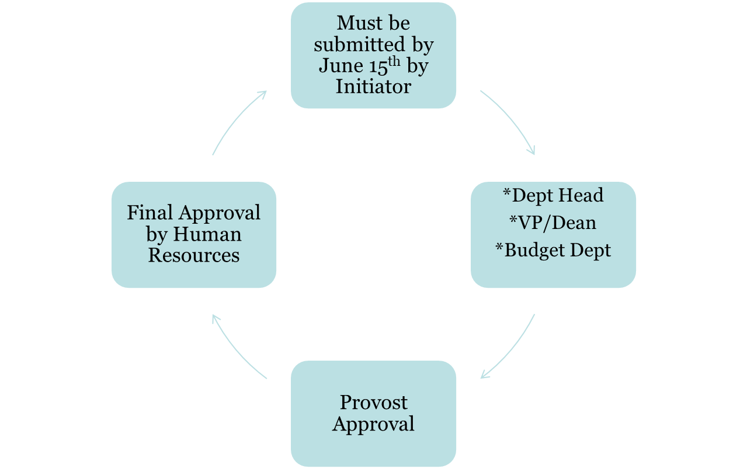
Life Cycle of a Salary Contract
*Fiscal Year End Budget Availability (Payroll 14)

Slide 6
Finalize FY 23 Operating Budgets (Non-Rollover)
Clean up account
Start the new fiscal year fresh
For closing purchase orders - refer to slide 16
For closing travel – refer to slides 26-27
Purchase Orders roll, but NOT the funds in operating accounts!

Slide 7
Finalize FY 23 Operating Budgets (Non-Rollover)
Ensure adequate budget availability for central charges (non encumbered expenses)
Purchasing Card (BOA)
Amazon
Telephone
Duplicating
Copier
Catering
Stationary
Office Depot
Bookstore
Gasoline
Housekeeping Supplies

Slide 8
FY 24 Operating vs Carry Forward Budgets
Operating Budgets = Non Rollover
Funds include: 10110, 10200, 10112, 11050, 10400, 30010, 30015, 30040, 30050, 30200
Budgets available starting July 1st
Carry Forward Budgets = Rollover
Start Up Funds: 11099
CHRI: 16800, 16801
Student Clubs: 30044
Budgets will be available after FY 23 closes and the reconciliation process is complete

Slide 9
FY 24 Operating Budgets vs Carry Forward Budgets
Carry Forward Budgets = Rollover
Special Program Budgets
Will follow annual process
Budget Form Submission exceptions
Start Up Funds: 11099
CHRI: 16800, 16801
Student Clubs: 30044
Budgets will be available after FY 23 closes and the reconciliation process is complete

Slide 10
Contact Information
Budget@rowan.edu

Slide 11
Procurement

Slide 12
New Vendor, Vendor Reactivation Requests, Contracts
Vendors
Requests submitted after June 15th may not be processed before the requisition cut off date. It is imperative that all requests are submitted by the deadline to ensure vendor accounts are established in time to process your requisition. Banner IDs will not be created in lieu of vendor compliance in order to process requisitions.
Vendors with an anticipated spend of $15,000 or more generally take more time to onboard. Please keep this in mind when submitting your requests.
You can request a New Vendor or Reactivation in our Vendor Portal.
Contracts
If your request has an associated contract and services will be provided in the closing fiscal year, please submit the contract accordingly and allow three weeks for processing.
You can submit a contract for review through the Contract Portal.

Slide 13
Requisitions
All new requisitions must be completed, including appropriate Departmental Queue Approvals (here’s a nice overview of this process), by the date provided in the Annual Memo. When placing your requisition in Banner, please ensure you provide the required documentation including any quotes, forms, and other procurement approvals to requisitions@rowan.edu, so the purchase order conversion can be completed timely.
Requisitions in Departmental Queues or incomplete requisitions will be deleted on June 30th regardless of funding to ensure a smooth fiscal year closeout.
How can I tell where my requisition is in the process? Or has my requisition been converted?
FOIDOCH will tell you the requisition Status:
Blank | = Incomplete
C | = Completed by end user
A | = Approved by Purchasing (you will also receive an email notification)

Slide 14
Requisitions (continued)
Each purchase will have at least two approvers: Departmental & Purchasing
To view the approval history for a document:
From the Banner 9 Welcome screen, search for page FOIAPPH and hit Enter
Enter the document number into the Document Code field
Click “Go” on right hand side
The Details section will display actions taken on the document to date
To view the pending approvals for a document:
From the Banner 9 Welcome screen, search for page FOAAINP and hit Enter
Enter the document number in the Document field
Click “Go” on right hand side
The Queue list will display queues and approvals still pending. Fully approved documents will not display on this page
NOTE: “NON_GRANTS REQ QUE” is the Purchasing queue.

Slide 15
Receiving
Receiving, as a process in Banner, is necessary for the Banner system to issue payment to the vendor. Receiving in Banner should be completed as soon as the goods or services have been received or completed - not before.
Goods and/or services must be physically and electronically received in Banner by the close of the fiscal period, June 30, to be charged to the closing year’s budget
Any open purchase orders at the end of the closing year will be charged against the new fiscal year’s budget if the item hasn’t been physically received.
How to ensure you have completed your receiving?
Start with FOIDOCH - has receiving been completed? Will additional receiving be needed for any items on the PO?
If so, FPARCVD - Receiving Goods is where you will complete the receiving.
More specific details on receiving can be found on the training website in the Banner Admin manual (page 50 et seq).

Slide 16
Existing Purchase Orders: Change Orders
Existing Purchase Orders: Change Orders
Change order requests to existing purchase orders will be treated like new requisitions and follow the same cutoff schedule.
NOTE: If the invoice amount is more than 10% of PO amount or greater than $100 you will need to request a change order
You can submit a request to increase or decrease your purchase order through our Change Order Request Form.
Please be ready to provide the following information:
Purchase Order #
Vendor
Buyer (listed on the bottom left corner of your purchase order)
Type (increase of decrease)
Amount (since last change order)
Change Request
New Total
Explanation for Change
Any documentation you can provide
If you have any PO specific questions, please reach out to the buyer listed on your PO.

Slide 17
Existing Purchase Orders: Closeouts
To release funds or to complete your purchase order, please submit a PO closeout request to have your PO closed by an Office of Contracting & Procurement team member.
You can request a purchase order closeout through our Closeout Request Form.
Please be ready to provide the following information:
Purchase Order #
Vendor
What is the remaining balance on the purchase order to be closed?
Comments
Notes:
Department will need to verify all invoices have been paid prior to requesting a closeout.
You will only be able to submit a request to close one PO at a time.
If your PO has multiple line items, they cannot be closed individually. Due to limitations in system functionality, the entire po will need to be closed.
Please check the PO status in FGIENCD in the Encumbrance Detail section to ensure your po is in "O" (open) status. If your status is "C" closed you will not need to fill out this form. Your PO has already been closed. *Pro Tip: Your Encumbrance Detail may have multiple pages, you will need to check each page to know if your PO is fully closed.
Systematic Closeouts: Systematic batch closing of POs with remaining balances of $10.00 and under is a process that will continue throughout Finance year-end close (mid-July). Once closed via batch process, POs cannot be re-opened or a change order processed.

Slide 18
Amazon
Orders submitted after the cutoff date of June 23rd will be rejected.
Forward all applicable approvals (Entertainment Form, IRT, furniture) to requisitions@rowan.edu to avoid processing delays.
Orders for departments with their own approval queues (Athletics, SOM, Engineering, and Grants) should be placed as early as possible to allow time for all Approver review.
For funds which are exempt from cutoff dates, Amazon orders may be processed with a requisition after this date. Choose “Pay by Invoice” as the payment method at checkout. Once approved, enter a requisition in Banner using ID 916307054. You will need to forward the order confirmation email to requisitions@rowan.edu as supporting documentation.

Slide 19
Purchasing Cards
Keeping in mind the date in which P-cards will be suspended is of June 23rd, make sure to complete any transactions that require credit card payments before the cut off.
When applicable, Entertainment Forms, Gourmet Dining Waivers, IRT approvals, and furniture approvals must be submitted to Nicole Johnson along with any override requests.
Finalizing Transactions
Transactions typically post to the account two business days after the purchase was made. During the month of June, you should routinely check your accounts in the Works system for any open transactions.
Transactions are not considered finalized until receipts have been uploaded, allocations have been completed, and transactions have been signed off.
Yes in the Uploaded Receipt column indicating you have successfully uploaded a receipt.
Three green check marks in the Comp/Val/Auth column indicates you have successfully allocated the transactions.
AH in the Sign Off column indicates you have successfully signed off.
All June P-Card transactions must be allocated in the BoA Works system by 4 p.m. on June 30. ***The standard nine-day grace period does not apply.

Slide 20
Contact Information
Alexis Jones jonesal@rowan.edu
Amazon: Stacie Mori mori@rowan.edu
Bank of America: Nicole Johnson johnsonn@rowan.edu
Closeouts: Jean Bubacz bubacz@rowan.edu
Change Orders: Christina Haley haley@rowan.edu
Contracts: Rebecca Hartman hartmanr@rowan.edu
Requisitions: Christina Haley haley@rowan.edu
Office Depot: Francine Dorch dorch@rowan.edu
Vendors: Erann Dutton duttone@rowan.edu

Slide 21
Accounts Payable

Slide 22
Invoices Paid Against a Purchase Order
Friday, July 7th— last day to submit any invoices to be processed for FY 23
Ensure all invoices have been sent to Accounts Payable via invoices@rowan.edu
Ensure you send the vendors you are working with their approved PO#(s) as soon as you obtain them & request that they send their invoices with the PO# on it to invoices@rowan.edu
Can request that the vendor copy end-user on the email
*Only services that have been rendered or items that have been physically received on or before June 30th will be recorded in FY 23*
To avoid processing delays:
Ensure you process electronic receiving in Banner as soon as you receive the product/service
If you know you will be invoiced a higher amount than you originally thought & requested on the requisition, submit a change order ASAP & ensure you process electronic receiving for the additional amount
NOTE: If the invoice amount is more than 10% of PO amount or greater than $100 you will need to request a change order
An invoice needs to be submitted - Proforma invoice or quote is NOT accepted
Start & end date of the service need to be provided if not listed on the invoice
For ex. Membership/subscription term
Ensure you are responding to AP requests in a timely manner
If receiving is required in order for the payment to be processed:
AP sends out reminder emails to process receiving – these emails will be sent out weekly & daily as we get closer to FYE
Automated daily emails are sent if receiving is incomplete

Slide 23
Non-PO Payment Requests
Friday, July 7th— last day to submit any Non-POs to be processed for FY 23
Email all requests directly to invoices@rowan.edu with “Non-PO” listed in the subject line – please do not send via inter-office mail.
To avoid processing delays:
Review the Non-PO Category List to ensure you are not submitting a Non-PO that is not reimbursable
Double check that all required documentation is attached to your Non-PO Payment Request Form & that all approvals have been obtained
For example, ensure proof of payment is attached (examples shown on slides 24-25) & all approval signatures have been obtained
For additional information on required documentation, visit our Non-PO Payment Request Webpage

Slide 24
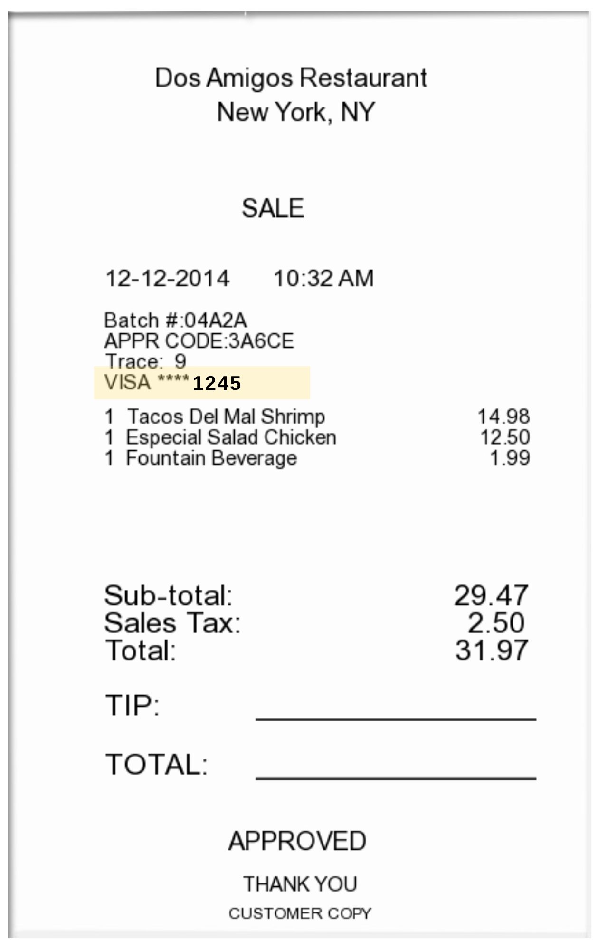
Proof of Payment Example
Itemized Receipt with CC Info Listed
Credit Card with matching 4 digits

Slide 25
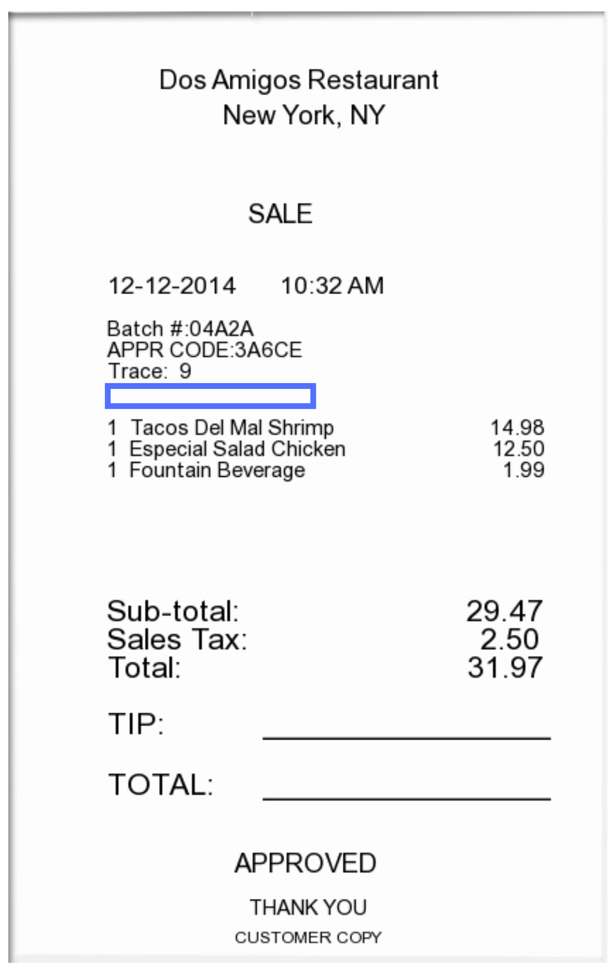
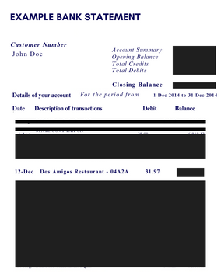
Proof of Payment Example
Redacted bank statement showing the charge & the name of the individual being reimbursed
Itemized Receipt without CC Info Listed

Slide 26
Employee Travel
Friday, July 7th— last day to submit any Concur expense reports to be processed for FY 23
NOTE: Keep in mind that you need to allow sufficient processing time for travel requests to be fully approved with encumbrance #s.
Review any open encumbrances — confirm expense reports have been submitted & fully approved
Once the report has been fully approved in Concur (sent for payment status), Close Out Your Request
If you closed out your request and notice the budget is still held up, there may be an error — email asktravel@rowan.edu
To avoid processing delays:
Cost Object Approvers (COA) in Concur — verify there is sufficient budget in the foapal lines before approving reports to avoid Non-Sufficient Fund (NSF) issues. If you need to move budget, have it moved prior to submitting the report.
Ensure all required documentation is attached – utilize Expense Report Tip Sheet and visit Employee Travel for more resources

Slide 27
Concur Travel Encumbrances - For Employees
FY 23 encumbrances do not roll over into FY 24 — this cannot be changed due to Banner systematically closing out the encumbrances for the fiscal year-end roll
Due to this, if your trip is still multiple months away & you will not be charging any of the expenses before June 30th, we recommend not submitting your Travel Request until after June 30th.
If submitting an FY 24 Travel Request in FY 23:
Before June 30th - include all predicted travel expenses on the request, but only include amounts for the expenses that will be charged in FY 23 and will be included in the encumbrance
After July 1st – submit another Travel Request as “extension of prior trip”
Include all travel expenses, but only include amounts for the expenses that will be charged in FY 24 and will be included in the encumbrance

Slide 28
Student Travel
Friday, July 7th— last day to submit any paper expense reports to be processed for FY 23
NOTE: Keep in mind that you need to allow sufficient processing time for travel requests to be fully approved with encumbrance #s.
Review any open encumbrances
Confirm expense reports have been submitted & fully approved – can verify payment status to the student via Banner screen FAIVNDH
Email asktravel@rowan.edu with the following info to close-out existing encumbrances:
Traveler Name
Encumbrance #
Destination
Reason for closing
To avoid processing delays:
Verify there is sufficient budget in the foapal lines before approving reports to avoid Non-Sufficient Fund (NSF) issues. If you need to move budget, have it moved prior to submitting the report.
Ensure all required documentation is attached to the travel form – utilize Expense Report Tip Sheet and visit Student Travel Webpage for more resources

Slide 29
Payment Verification
Utilize Banner Screen FOIDOCH to review the status of a particular document (can search by a requisition #, a purchase order #, an invoice #, or a check #)
If invoice states “Receipt Required” = either electronic receiving was not done on a PO or there may be an issue with the receiving document (Y number)
If invoice states “Approved” = direct pay or invoice is approved, but payment has not been disbursed
If invoice states “Paid” = payment has been disbursed
There will be a corresponding check disbursement document (CHK #)
Utilize Banner Screen FAIVNDH to review all of the payments processed to a vendor
Can search by Banner ID to see if a Non-PO has been processed
For detailed step-by-step instructions on utilizing these screens, visit Invoice Payments

Slide 30
Contact Information
AP Director - Joselyn Peoples ext. 4335 or email peoplesj@rowan.edu
AP Supervisor - Stacey Bucci ext. 4117 or email buccis@rowan.edu
Full AP Team Contact List
For Invoices or Non-PO Questions - email invoices@rowan.edu
Invoice Payments
Non-PO Payment Requests
For Travel Related Questions - email asktravel@rowan.edu
Travel

Slide 31
Accounting Services

Slide 32
Accounting Services (AS)…
Year End Topics
FinSecurity (Banner Access)
Set up Approval Queues (Banner Queues)
Banner Finance Fiscal Year End Process Update (Roll)
Fixed Assets/Equipment Inventory & recording Disposals
Journal Entries (including Departmental Charge Authorizations (DCAs))
Compile Annual Financial Statements for all entities (RU, RUF, SJTP, SGA, & RGI)
Work with external & internal auditors; ensuring audit compliance & reporting
Financial & Compliance Reporting (excluding external grant reporting)
Facilitating ad hoc, monthly, quarterly & annual reporting

Slide 33
FinSecurity
FinSecurity
AS in conjunction with Analytics, Systems & Applications (ASA) Security is responsible for providing access to the Banner Finance System.
Requests for Banner Finance Security should be made through self-service banner.
Instructions at AS website at: Banner Finance Security
Please allow adequate time for approvals and processing.
Fiscal Year End Reminder
Submit changes or access request as soon as possible with proper approvals via SSB.
Items emailed or SSB submissions without proper approval will not be addressed.
New FY24 funds must be established in banner before access is given.

Slide 34
Departmental Queue Approvals
Departmental Queue Approvals
AS sets up and maintains approval queues in the Banner Finance System
Approver instructions at AS website at: Banner Finance Approval Queues for Requisitions or
Requisition Approval instruction manual and
Requisition Approval instruction video
Queue approver changes should be communicated as soon as possible, please allow sufficient time for changes to be incorporated.
Queue approvers will be confirmed annually.
Fiscal Year End Reminder
Approvers to complete FY23 requisition review by cutoff date of June 22nd.
Approvers will be asked to clear all queue prior to the Banner Finance FYE Process update (system roll procedures), scheduled for mid-July (tentatively July 14th). See slide 13 for more information.
Finance will be reminding approvers of pending items prior to system roll. Items in queues may be deleted if not addressed.

Slide 35
Banner Finance FYE Process Update (Roll)
AS facilitates the Banner Finance Process Update (system roll)
Roll general ledger balances (balance sheet accounts beginning balances)
Roll Open POs so available in banner in new FY
All POs $10.00 and under will be systematically closed out.
All encumbrances (E#) will be systematically closed out.
Roll Grant & Capital Budgets (Inception to Date budgets)
All users are required to remain out of the system.
Fiscal Year End Reminder
Prep for roll by reviewing open POs throughout the year
Investigate open balances with services provided or goods received
Ensure receiving is done correctly on PO
Ensure vendor has submitted invoice to invoices@rowan.edu
Request close out of PO when no longer needed or with zero balance
Ensure all needed POs have a balance greater than $10.00. Change orders to increase balance should be submitted by June 22nd. Systematic close out to begin June 23rd and continue through July 14th.
Encumbrances (E#) should be closed out in concur.

Slide 36
Fixed Assets/Equipment
Fixed Asset Purchases
AS capitalizes equipment items that cost $5,000 or over including the shipping & handling, installation and parts needed to get the equipment to operational status for each item.
Requisitions must use account code 7645, equipment over $5K, and contain required document text (custodian information, intended usage, description, location and estimated useful life) on requisition.
Link to training tools on AS website at or:
Quick Reference Guide for Fixed Asset Purchases $5,000 and up and
Fixed Assets – Ordering Equipment over $5,000 instruction video
Fiscal Year End Reminder
Ensure requisition has proper account code and document text to prevent delays and denials.
AS is required to inventory items every two years. Please respond to inventory requests promptly to ensure all items are viewed in appropriate timeframe.
Items must be received on campus by June 30th in order to be applied against FY23.

Slide 37
Equipment Disposals
Fixed Asset Disposals
AS is responsible for the centralized accounting and reporting of University equipment assets meeting the capitalization threshold.
To ensure accurate financial reporting, disposal of equipment should be documented and communicated timely to AS.
Fiscal Year End Reminder
Ensure all equipment disposals have been communicated to AS, along with the fully completed disposal form.
Accurate financial statement presentation is dependent upon timely communication.

Slide 38
Journal Entry Examples
Journal Entry Requirements
DCAs are journal entries – Department Reimbursements**
Cash Receipts
Daily Transmittals – account for revenue
General Accounting Entries – e.g., depreciation, disposals, accruals & prepaid entries**, various monthly feeds, etc.
FOAPAL Reclassifications & Correcting Entries - e.g., correcting a program code
Must have supporting documentation
If Reclassification, correcting or general journal entry, must balance (Banner Doc Type JDCA, JE15 & JE16)
Must be submitted timely

Slide 39
DCAs (Departmental Charge Authorizations)
Currently two methods to submit DCAs, Electronic Workflow or legacy paper form .
Electronic DCA workflow has certain fund & account code exclusions, this activity should be submitted on legacy paper form. Also, legacy paper form should continue to be used for Barnes & Noble and Central Receiving/Stores.
Link to electronic DCA workflow process and help. (dca.rowan.edu) & link to Training material.
DCA email box for questions or legacy paper form submission is dca@rowan.edu.
Legacy paper forms may be submitted via interoffice mail to Bole Hall, Accounting Services, 1st floor.
Please only submit once, do not submit via email and hardcopy via interoffice mail.

Slide 40
DCAs (continued)
Reminders:
Account codes should match on each side of the transaction,
Exception of Bursar fund activity (2912) for Fellow Tuition/Fees/Stipends & Rowan Bucks
Only non-salary expense accounts (7xxx), can be used within the DCA workflow.
Paper DCA should be used for Revenue (5xxx) and Salary account (6020 or 6102).
No DCA should use 7400, reserve allocation.
Ensure budget availability & adequate documentation to support journal.
Electronic DCA workflow has validate button to check budget at point in time. FGIBAVL or FGIBDST should be verified before submitting paper form.
Copy of Banner expense should be included in supporting documentation, reference to Banner I# and/or PO# requested.
Approval routing can not be changed by AS on electronic DCA workflow.

Slide 41
DCAs (continued)
Fiscal Year End Reminder
Ensure routing department contact is correct.
Connect with other department to ensure proper contact (not department approver).
AS can not change routing of the electronic DCA workflow.
If routing is incorrect, DCA will need to be completely redone/resubmitted, which delays processing.
Ensure adequate documentation is attached to support the DCA.
Inadequate support will delay processing.
All journal entries need proper documentation to support transaction.
Operating Budgets cannot transfer to Special Programming accounts, including Rowan Global accounts.
Cutoff for all FY23 DCAs (paper and electronic) must be received in Accounting Services by end of day July 7th. These DCAS must contain appropriate sign off and documentation before sending to AS.
DCA cutoff is applicable for all funds and entities.

Slide 42
Accruals & Prepaid Entries
GAAP requires recognition of revenue when earned and expenses as incurred, an accrual/prepaid entry is an adjustment made to an account to ensure revenue & expenses are recorded in the same period.
Accounts Payable utilizes the Banner SDE field (Supplemental Data Engine) when processing invoices to identify appropriate timeframe for that expense.
To ensure accurate financial reporting, Accounting Services reviews the SDE data and prepares an adjusting journal entry to reflect as an accrual or a prepayment when appropriate.
Fiscal Year End Reminder
Complete Receiving in Banner timely, as goods are received and services performed.
Review POs to ensure all anticipated invoices are applied.
Ensure vendor provides invoices to invoices@rowan.edu in a timely manner and follow up on outstanding invoices.
POs will roll into FY24. After the system roll, invoices received for expenses incurred in FY23 will be accrued back to FY23 until mid-August.

Slide 43
Annual Audited Financial Statements….
Audit Process
Accounting Services is responsible for coordination of annual audit for all entities (RU, RUF, SJTP, SGA, & RGI)
Involves various Administrative Offices on Campus
Financial Aid, Grants, Bursar, Payroll, Human Resources
Involves ALL Departments, including Academic Departments
Fixed Asset/Equipment physical inventory
Adequate supporting of all journal entries, including DCAs
Provide supporting documentation to auditors for selections
Journal entries are selected to “test” the balance shown in the financial statements.
Fiscal Year End Reminder
AS may reach out for assistance on certain audit requests, including asset inventory. Please respond timely to requests or direct to appropriate department contact.

Slide 44
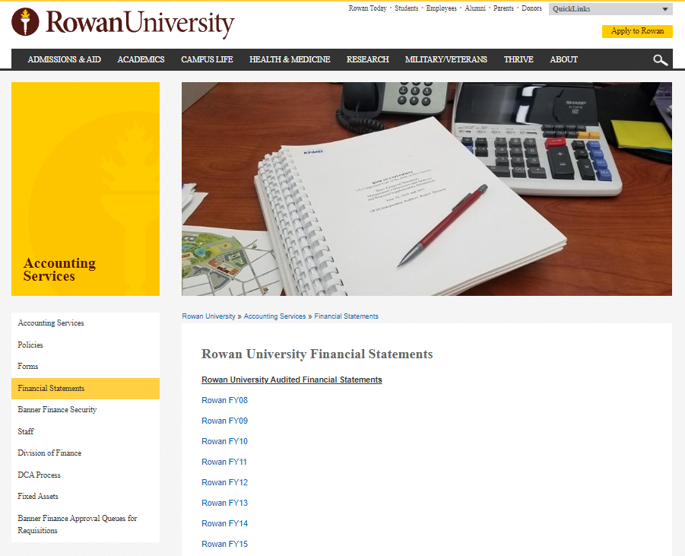
Financial Statements
Audited Financial Statements can be obtained from the Accounting Services website.

Slide 45
Examples of Financial Reporting
Annual Audited Financial Statements (main deliverable that drives Annual Memo deadlines- next slide)
Including A-133 Reporting
Annual Capital Grant Reporting to State
Annual statistical reporting
Annual IPEDS reporting
Quarterly: Financial Statement (USDA compliance requirement)
Monthly: SJTP, SOM prepares monthly reporting
Periodic: Actuals for Board Reporting multiple times per year for reporting entities
Bond Disclosure/Reporting
Event Disclosure under Rule 15c2-12
Annual Tax Compliance Certifications
Various Ad-hoc reporting

Slide 46
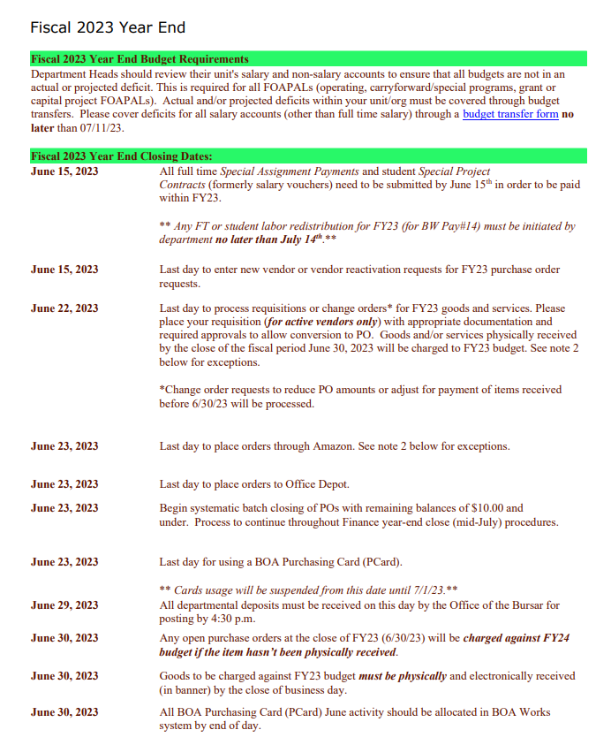
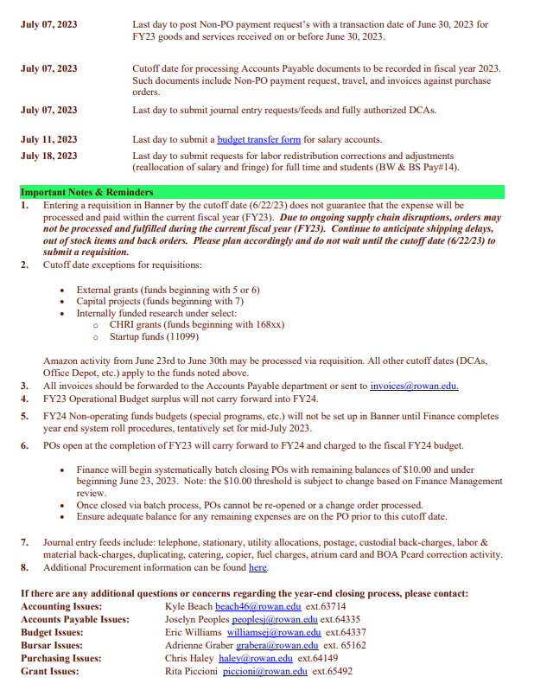
Reminder!

Slide 47
Contact Information
Accounting Services Department
Kyle Beach x53714 Beachk46@rowan.edu
Michael Bucciarelli x53385 Buccia77@rowan.edu
Diane Camaioni x53384 Camaioni@rowan.edu
Jason Dear x64914 Dearj@rowan.edu
Eileen DeFrank x64157 Defranke@rowan.edu
Angela DiMaggio x64112 Dimaggio@rowan.edu
Sharyn Giordano x 65498 Giordanosa@rowan.edu
Nikki LaBombard x64133 Labombard@rowan.edu
Mary Ann Nisula x64893 Nisula@rowan.edu
Michelle Prus x64144 Prus29@rowan.edu
Tiffany Reeve x65496 Reevet@rowan.edu
Ian Wrobel x64517 WrobelI0@rowan.edu

Slide 48
Questions?

