Slide 1
Finance New Hire Workshop
Presented by the Division of Finance
Wednesday, February 28, 2024

Slide 2
Agenda
Budget
Contracting & Procurement
Accounts Payable
Accounting Services
Payroll
Questions

Slide 3
Budget

Slide 4
Budget Overview
Self Service 9 Overview
Budget Transfers
New Fund/Org Setup Form
Annual Operating Budget Overview (Non - Rollovers)
Operating (Non -Rollover) vs. Carryforward (Rollover)
NSF - correspondence changes

Slide 5
Self Service Banner 9
Self Service Banner 9 Finance Dashboard instruction links that contain videos and knowledge based articles
https://irt.rowan.edu/service-catalog/support/training/resources/#finance
Budget Query & Budget Transfers

Slide 6
Budget Transfers
The more things change, the more things stay the same
Journal Entry type : BDZ1
Budget Period: 01
Debit / Credit Field : Always use + plus & - minus (DO NOT USE DEBIT & CREDIT)
Bank Code: Leave Blank (skip over it)
Even if you start a J document and don’t complete it, it will show up in system
Either Submit Journal or Delete Journal
If not, bad things happen (your user ID shows up on our Daily Report and an email will be sent) We will find you (read in Liam Neeson’s voice)

Slide 7
Request of New Fund and / or Org (Department)
Instructions and the New Fund/Org Setup Form can be found on our Budget Website
https://sites.rowan.edu/budget/_docs/new-fund-and-org-setup-form-12-7-2023.pdf

Slide 8
Finalize Operating Budgets (Non-Rollover)
Clean up Account
Start the new fiscal year fresh
For closing Purchase Orders - refer to Purchasing
For closing Travel - refer to AP Instructions
Purchase orders roll, but NOT the funds in operating accounts!

Slide 9
Operating Budget (Non - Rollover)
Ensure Adequate budget availability for central charges (non encumbered expenses)
Purchasing Card (BOA)
Amazon
Telephone
Duplicating
Copier
Catering
Stationary
Office Depot
Bookstore
Gasoline
Housekeeping Supplies

Slide 10
Operating vs Carry Forward Budgets
Operating Budgets = Non Rollover
Funds Include : 10110, 10200, 10112, 11050, 10400, 30010, 30015, 30040, 30050, 30200
Budgets available starting July 1st
Carry Forward Budgets = Rollover
Start Up Funds : 11099
CHRI : 16800, 16801
Student clubs: 30044
Budgets will be available after the current FY closes and the reconciliation process is complete

Slide 11
Operating vs Carry Forward Budgets
Carry Forward Budgets = Rollover
Special Program Budgets
Submit Annual Budget Form after July 1
Budget Form Submission exceptions
Start up Funds : 11099
CHRI : 16800, 16801
Student Clubs : 30044
Budgets will be available after the current fiscal year closes and the reconciliation process is complete

Slide 12
NSF (Non Sufficient Funds)
Changes to NSF communications
An automated email from (NO-REPLY@rowan.edu) titled “Insufficient Funds Notification: Documents Awaiting Approval_Burst” will be sent if you have any documents with non sufficient funds.
You still need to complete your due diligence
Budget Transfer
Check foapal string, Close PO’s, etc….
Notify budget@rowan.edu once funds are sufficient

Slide 13
Contact Information
Budget@rowan.edu

Slide 14
Contracting & Procurement

Slide 15
Procurement
The Office of Contracting & Procurement is dedicated to support the University's mission of education and research through fair and competitive procurement processes while fully complying with all applicable laws and internal policies and procedures.
Services
Advise units on procurement procedures
Vendor relationship management
Procurement process management
Contract review and completion
Requests for information, proposal, and quotation
Professional negotiation with suppliers
Development and management of strategic, university-wide contracts
Standards
Deliver the best overall value with a competitive bidding process
Implement best practices for cost containment
Ensure procurement compliance
Ensure fair and ethical relationships with suppliers
Maintain a diverse supplier base

Slide 16
Things to know before soliciting goods or services
The Office of Contracting & Procurement (OC&P) is bound by State laws and University policies that mandate how goods and services are procured.
Confirming Orders
Price Thresholds were developed by the State and adopted by our Board of Trustees.
Exceptions to Bidding:
There are 35 categories of exceptions that can be utilized by the campus community in lieu of quotes/bids; however, if your purchase exceeds the current bid threshold, exceptions can only be used with a Board of Trustees approval.
Additional Requirements or documentation may be applicable depending on the commodity and/or price of your purchase.
Contracting
Vendors are also subject to State regulations.
Please visit Vendors: Doing Business with Rowan for more information.

Slide 17
Confirming Orders
What is a Confirming Order?
A confirming order is defined as a purchase with a vendor (i.e., the goods and/or services were received thus becoming legally binding) prior to the conversion of a requisition to a purchase order and the requisite compliance checks that must accompany each such conversion. Such transactions are prohibited at the University.
Why are Confirming Orders prohibited?
There are several potential problems associated with confirming orders, such as violations of legal requirements, lost items, missed discounts, receipt of duplicate shipments, redundant payments, unidentified invoices, etc. Any person who is not authorized to approve a purchase or contract, or who does so in a manner that is in violation of state law may be held personally liable for the cost of such purchase or contract as provided in state law. Purchases or contracts violating state law shall be void and of no effect.

Slide 18
Price Thresholds
Assumption 1: An existing contract that obligates the University to purchase from a specific vendor does not exist; i.e, office supplies.
Assumption 2: An exception to price quotes or public bidding does not exist.
Assumption 3: The purchase is not subject to prevailing wage rates.
Bid splitting is the improper split of a purchase into multiple purchases in order to avoid triggering dollar thresholds that would require you to obtain additional documents. Bid splitting is in direct violation of University policies.
< $20,000 | One quote required.
$20,000 - $100,000 | Three quotes required or an exception applied.
> $100,000 | Public bid is required, unless an exception applies. Must also be accompanied by a BOT Resolution.

Slide 19
Preferred Vendors
Preferred vendors are those that have been awarded a contract by the Office of Contracting and Procurement for use by all departments and schools.
These vendors are fully onboarded and available for use. Please select a vendor or commodity below to review instructions on how to use.
Examples include, but are not limited to:
Amazon (Online Marketplace)
Barnes & Noble (Text Books)
Fisher Scientific (Scientific Supplies)
Home Depot (MRO & Janitorial Supplies)
Lowe’s (MRO & Walk-In)
ODP (Office Supplies)
VWR (Scientific Supplies)

Slide 20
Additional Procurement Requirements
Furniture: Facilities Approval
Grants: Uniform Guidance
Independent Contractors: Contracting & Determinations
Information Technology: ITAP
Reception & Entertainment: Gourmet Dining
Text Books: Barnes & Noble
Vehicles: Fleet Management

Slide 21
Contracting
When is a contract needed?
Any time you are bringing a vendor/service provider to campus to provide a service, or anytime a signature is required by a vendor/service provider that obligates the University.
Considerations:
Most purchase transactions require University issued purchase orders. A purchase order is a contract; however, if a contract becomes necessary, the vendor should use Rowan’s Service Agreement template.
University employees, including officers, faculty and staff, may not bind the University by signing contracts. The only authorized signatories are the University President and the Chief Financial Officer (CFO) or his designees.
Types of Procurement Templates:
Independent Contractor Service Agreement
Vendor Service Agreement
Addenda
To request a contract review and signature, submissions are only accepted electronically through the Contract Request Portal.

Slide 22
Vendor Onboarding
Following NJ State regulations, all vendors, including Independent Contractors, are required to provide and maintain all requested compliance.
Does the vendor 1) exist in Banner and 2) is the vendor terminated?
If the vendor does not exist in Banner, a New Vendor Request required.
If the vendor has an existing Banner ID, no action is needed from an onboarding perspective.
If the vendor has an existing Banner ID, but it is terminated, they are treated like new vendors. This is called a Reactivation Request.
New Vendor Request
In accordance with regulations imparted by the Internal Revenue Services, the State of New Jersey, and University policy, every individual, firm, or corporation selling goods or services to the University must complete, at a minimum, the Vendor Intake Form and submit a W9/W8 (for foreign vendors) to the requesting department for establishment in the Banner Finance System.
The requesting department must input the information collected on the Vendor Intake Form through the Vendor Request Portal. The OC&P will reach out directly to the service provider/vendor to collect required compliance documentation, perform TIN matches, and sign University terms and conditions if applicable. A Reactivation Request will be handled the same way to ensure the service provider/vendor is still capable of doing business with the University according to regulatory requirements.

Slide 23
State Compliance Requirements
When the University reaches certain monetary thresholds for a particular supplier, whether it be a one-time buy or through cumulative campus spending, certain compliance documentation is required.
The Office of Contracting & Procurement will reach out to the vendor directly to obtain this documentation.
Note: Purchases subject to Prevailing Wage have lower BRC and EEO thresholds found here.
All Purchases | W9/W8 for foreign entities, Signed RU Terms & Conditions, ACH Credit Transfer
$15,000 | New Jersey Business Registration Certificate (BRC)
$17,500 | EO333 / CH 51 Compliance Application (for purchases exceeding $17,499.00 formally EO117)
$25,000 | System for Award Management (SAM) - Debarment Check
$100,000 | Certificate of Employee Information Report / Federal Letter of Affirmative Action Plan Approval (AA302 Form)

Slide 24
Payment Methods for Purchasing Goods & Services
Requisition/Purchase Order (most preferred method)
University P-Card
Non-PO Payment Request (least preferred method & not permissible for vendor payments)
Wires (only applicable for foreign vendors who do not have U.S Bank Accounts)
Approved PO# is still required before payment can be processed
Payment Guidelines can be found here.

Slide 25
Requisitions to Purchase Orders
Create your request for purchase order (requisition) in Banner. It will move through various approval queues until it reaches the assigned Buyer.
Forward the supporting documentation, i.e., quotes, fully executed contracts, and any additional procurement approvals to requisitions@rowan.edu in order to complete the purchase order conversion timely.
Once you physically receive the items or services, you must also perform receiving in Banner (sans standing orders)
If you need to adjust your purchase order, submit a change request in the Change Order Portal i.e., increases or decreases.
Once your purchase is received and paid in full, submit a request to complete or close your purchase order in the Closeout Portal.
Banner Trainings can be found here.

Slide 26
University P-Card
All purchases must be in compliance with the University Purchasing Card Policy
Can only be utilized for allowable purchases including
Entertainment, dining, receptions, with approved Entertainment Form and Gourmet Dining waiver, if applicable. Must adhere to Reception & Entertainment Policy
Emergency situations, with prior approval from the Office of Contracting and Procurement (OC&P)
Vendors who are compliant, but do not accept POs, checks or ACH payments, or issue invoices
Memberships, registration fees, and job posting fees
Travel accommodations, with limitations
If you do not have a P-Card and wish to obtain one, you can find applications and other helpful information here. Please note a required training must be completed prior to card being issued.

Slide 27
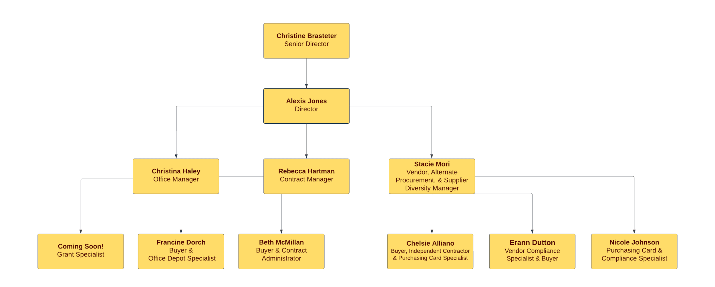
Meet the Team
Chelsie Alliano, 856-256-5175
Christine Brasteter, 856-256-5173
Francine Dorch, 856-256-4172
Erann Dutton, 856-256-4196
Christina Haley, 856-256-4149
Rebecca Hartman, 856-256-4165
Nicole Johnson, 856-256-5174
Alexis Jones, 856-256-5171
Beth McMillan, 856-256-5172
Stacie Mori, 856-256-4504

Slide 28
Resources
Webpage
Workflows & Trainings
Frequently Used Forms

Slide 29
Accounts Payable

Slide 30
Processes that fall in AP
Invoice Processing (paid against a purchase order)
Non-PO Payment Requests (reimbursements)
Wire Transfers (only applicable for foreign vendors who do not have U.S Bank Accounts)
Other payment related functions:
Setting up vendors for ACH/direct deposit payments
Voids and Payment Reissues
Travel for Employees, Students & Non-Employees (including candidates)
Gift Cards through Clincard
1099 Reporting

Slide 31
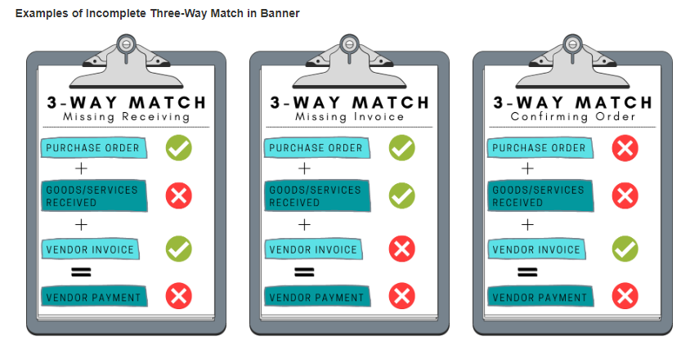
Invoice Processing
Vendor must send the invoice directly to AP to invoices@rowan.edu with approved PO# on it (due to audit compliance)
Department can be copied on the email
Proforma, statements, quotes & order confirmations are NOT acceptable
Invoices are paid on a Net 30 basis unless otherwise stated on the contract
Vendors receive payment on or within 30 days of the invoice date
Electronic receiving in Banner needs to be completed once the product has been physically delivered or the service has been provided
See Quick Reference Guide on Receiving

Slide 32
Non-PO Payment Request
Primarily used for reimbursement to faculty, staff members or students who incur minor out of pocket expenses
Must be in compliance with General Payment Policy & must abide by Non-PO Category List
Cannot bypass Office of Contracting & Procurement – this includes payment for the following:
Consultant payments
Speaker fees unless it is an Honorarium
Rental fees
Other services
Non-PO Payment Request Form should be sent with supporting documentation (including proof of payment) to invoices@rowan.edu
Visit Non-PO Payment Request Webpage to learn more about what should be included with requests & what is permissible

Slide 33
Payment Verification
Utilize Banner Screen FOIDOCH to review the status of a particular document (can search by a requisition #, a purchase order #, an invoice #, or a check #)
If invoice states “Receipt Required” = either electronic receiving was not done on a PO or there may be an issue with the receiving document (Y number)
If invoice states “Approved” = direct pay or invoice is approved, but payment has not been disbursed
If invoice states “Paid” = payment has been disbursed
There will be a corresponding check disbursement document (CHK #)
Utilize Banner Screen FAIVNDH to review all of the payments processed to a vendor
Can search by Banner ID to see if a Non-PO has been processed
For detailed step-by-step instructions on utilizing these screens, visit Invoice Payments

Slide 34
Wire Transfers
Only applicable for foreign vendors who do not have U.S Bank Accounts
Wire Transfer Request Form should be sent to invoices@rowan.edu for processing
A PO# is required for all wire transfer payments.
Please note that before a wire transfer is processed, Accounts Payable must first complete a phone call confirmation of the information. Once the information is confirmed via phone call, the wire transfer is processed.
Use a currency converter report when submitting paperwork for foreign payments. It is recommended to use Oanda.com for currency conversion.

Slide 35
Other Payment Related Functions
Setting up ACH/Direct Deposit Payments for Vendors
Current vendors who are being paid via check can fill out the ACH Credit Transfer Setup Form and send to directdeposit@rowan.edu
NOTE: New vendors are automatically sent this form when they are being set up through the Office of Contracting & Procurement (OCP). If they fill it out, OCP forwards to AP.
ACH/Direct Deposit information is not entered into Banner until an AP Team Member is able to verify the information via phone call with the vendor.
Once information is confirmed, a pre-note goes out to ensure the bank account is valid and all future payments are then processed as direct deposit.
Voids and Payment Reissues – necessary if a check was sent to the wrong address/lost & payment needs to be reissued via direct deposit or check
Send Void Check Request Form to invoices@rowan.edu for processing

Slide 36
Traveling on Behalf of Rowan?
Concur Travel and Expense is Rowan's system of record in facilitating all your University travel needs. Concur integrates encumbrances, travel bookings, and expense reporting into a single system of record.
Through this technology, administrative functions are consolidated, thereby allowing you to seamlessly request travel, receive approval for travel, book travel, and submit travel-related expenses.

Slide 37
Logging into Concur
Visit go.rowan.edu/ConcurTravel
Enter your Rowan NetID.
Select Login and complete Duo two-factor authentication, if prompted.
or
visit the Accounts Payable Webpage and select the blue SAP Concur button and follow steps 2-3 to login.

Slide 38
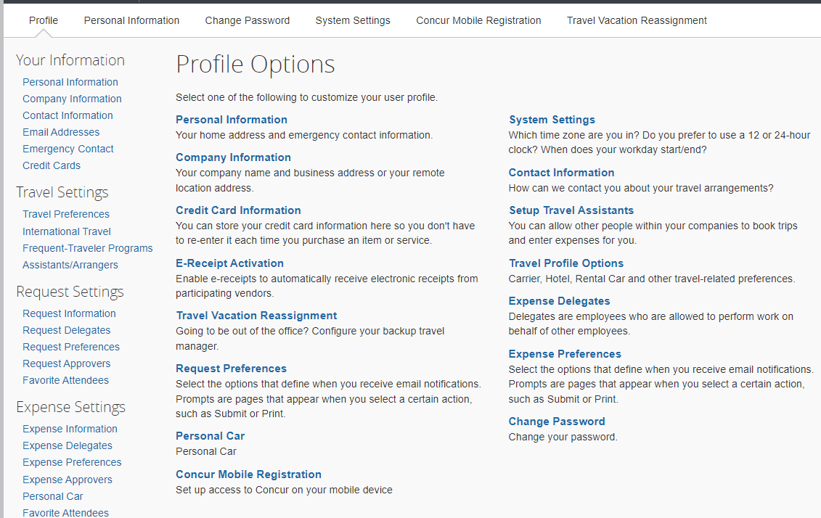
Accessing Profile
All users MUST complete the Personal Information Section and Request/Expense Approver Sections first as part of the profile setup process.

Slide 39
Requests
Requests are used to obtain pre approval for overnight travel only.
Rowan University employees are required to submit Requests in Concur for all overnight domestic and international travel.
NOTE: Per the University’s Travel Policy, Requests (Domestic / International) must be submitted and approved 4 weeks prior to departure.

Slide 40
Day Travel Expense Reports
Day Travel consists of attending official University business without the need to stay overnight. NOTE: meals are not reimbursable with day travel
A Request or Encumbrance Approval Number (E#) is not required for Day Travel.
Monthly Submission deadline for Day Travel is 45 days after the end of each month traveled.
Overnight Travel Expense Reports
Once overnight travel is complete, you must complete an Expense Report connected to the approved Request to ensure appropriate reimbursements occur.
Expense Reports must be submitted within 10 business days after overnight travel was completed.
Once the Expense Report has been submitted, the request must be closed by the traveler to ensure any remaining balance is released and returned to the assigned FOAPAL.
Visit Close Your Request for step-by-step instructions

Slide 41
Payment Methods for Booking Travel
Rowan’s Travel Agent, Direct Travel, for airfare & lodging — with an approved encumbrance #
University P-card— with approved encumbrance # email as backup
Utilize a personal credit card to later be reimbursed (least preferred method)

Slide 42
Chat with Travel
These sessions provide Rowan faculty and staff the opportunity to pop in at their convenience to chat with the travel team in an open WebEx session. An AP travel team member is available from 9:30am-1pm and 2pm-3:30pm to discuss any travel questions, comments, or concerns on specific days of every month.
Visit AP’s News and Updates Webpage to see upcoming dates listed in the Daily Mailers
NOTE: Department and/or 1:1 training is also available. Email asktravel@rowan.edu to set up an appointment.

Slide 43
Training Resources for Travel
Concur: Training Resources
Concur Approval Flow
Expense Report Tip Sheet
Travel on Behalf of Rowan
Concur Training Videos

Slide 44
Gift Cards through Clincard
All gift cards must be in compliance with the University’s Gift Card Policy
Gift card purchases must go through Clincard – for research participants & all other purposes
Gift Card Request Form needs to be sent to giftcards@rowan.edu for any requests
Unless specified by the Grant, account code 7000 (supplies) should be utilized
New request form is needed for an increase in gift cards or funds

Slide 45
Contact Information
AP Director - Joselyn Peoples ext. 4335 or email peoplesj@rowan.edu
AP Supervisor - Stacey Bucci ext. 4117 or email buccis@rowan.edu
Full AP Team Contact List
For Invoices, Non-POs, Wire Transfers, Voids & Reissue Questions - email invoices@rowan.edu
Invoice Payments
Non-PO Payment Requests
AP Forms - Wire Transfer, Voids & Reissue, Entertainment Form, Sales Tax Exempt Letters, etc.
For Travel Related Questions - email asktravel@rowan.edu
Travel
Travel Policy
For Gift Card Related Questions - email giftcards@rowan.edu
Gift Cards
Gift Card Policy
For Direct Deposit Questions - email directdeposit@rowan.edu

Slide 46
Accounting Services

Slide 47
Accounting Services
What We Do
Post non-student A/R, cash receipts
Post transfers and corrections to Banner (and other journal entries)
Facilitate FY end process and reporting
Work with external and internal auditors, maintain audit compliance.
Compile information for Rowan and other entity’s Financial Statements and Tax reporting.
Oversee Inventory process and Capital Projects
Help with any questions

Slide 48
Accounting Services
What We Don’t Do
Determine office’s/dept.’s budgets (Budget)
Pay:
–Vendors/Invoices (A/P)
–Student refunds (Bursar)
–You (Payroll)
Requisitions / Purchase Orders (Purchasing)
Maintain awarded Grant budgets (GCA/OSP)

Slide 49
Accounting Services (AS)…
Today’s Topics:
Banner Finance Security Access (FinSecurity)
Set up Approval Queues (Banner Approval Queues)
Fixed Asset Equipment Inventory & recording Disposals
Departmental Charge Authorizations (DCAs)
Fiscal Year End & Banner Finance Fiscal Year End Update (Roll)
Compile Annual Financial Statements for all entities (RU, RUF, SJTP, SGA, & RGI)
Work with external & internal auditors; ensuring audit compliance & reporting
Financial & Compliance Reporting (excluding external grant reporting)
Facilitating ad hoc, monthly, quarterly & annual reporting

Slide 50
Banner FinSecurity
AS in conjunction with Analytics, Systems & Applications (ASA) Security is responsible for providing access to the Banner Finance module.
FOAPAL (Fund, Organization, Account, Program) Access
Requests for Banner Finance Security should be made through self-service banner.
Complete information should be provided in request as well as proper authorization
Initial grant fund access established via Cayuse
Instructions at AS website at: Banner Finance Security
Change in Access or New Access
○ Please allow adequate time for approvals and processing.

Slide 51
Banner Approval Queues
Types: Requisitions**, Cash Receipts, Non PO Payments
Requisition Approver Training Material
Approval Instruction Manual
Approval Instruction Video
Banner Screens to review
FOAUAPP - User Approval
Banner Screens to verify
FOIAPPH - Document Approval History (already approved)
FOAAINP - Document Approval (awaiting approval)
Requisition Queue Approver (new & changes): reqapprovalqueue@rowan.edu
Please allow adequate time for approvals and processing.

Slide 52
Fixed Asset Equipment & Inventory
What is classified as Fixed Asset Equipment
The term fixed asset equipment refers to those assets defined in Rowan University’s policy as:
Fixed or movable, tangible property
Cost of $5,000 or greater per item or component unit or
Bulk orders costing less than $5,000 each, but with a PO totaling $50,000 and over
An estimated useful life greater than one year
University owned
purchased with University funds
acquired under sponsored agreements/grants
on loan in connection with sponsored agreements/grants
Equipment meeting above requirements must be purchased using banner expense account code 7645, equipment over $5,000. All other equipment should be recorded to 7015, equipment under $5,000.
Additional training material for equipment available via quick reference guide and video.

Slide 53
Fixed Asset Equipment & Inventory
Examples of University Equipment
Furniture & Office Equipment Furniture
Computers & Telephone Equipment
Custodial & Grounds Equipment
Engineering, Scientific & Medical Equipment
Vehicles
Buses, electric cars, trucks, automobiles
Recreational & Athletic Equipment
Musical Equipment & Artwork
Radio & Communication Equipment

Slide 54
Fixed Asset Equipment & Inventory
Inventory: Reason & Timing
Periodic physical inventory or verification is required per compliance guidelines.
Supports the asset value on the financial statements.
Equipment inventory will be performed annually.
not all assets will be inventoried every year
Finance will notify the custodians prior to inventory being performed.
Equipment assets should be tagged (Finance Division Tag - yellow tag with QR code).
Every asset should be assigned to a University custodian, location (including building and room number).
AS utilizes ServiceNow for tracking and maintaining asset details.
Assist in identifying disposals - disposal form required for all disposals. See disposal policy.

Slide 55
DCAs
What is a DCA
DCAs are Departmental Charge Authorization (DCA) forms, used to transfer funds internally between departments. These request forms (online or paper) are used for reimbursement. A DCA is a journal entry, subject to audit procedures, and requiring adequate support and approvals for the transaction.
The transfer should be from the same account code between the foapals. So for instance, funds from one FOAPAL using 7000 (supplies) account code should be transferred to another Department’s FOAPAL using 7000 (supplies) account code. The account code used should be where the expense was incurred (where payment was recorded).
Currently two methods for processing:
Online workflow (go.rowan.edu/dca)
Paper form (via email to dca@rowan.edu)

Slide 56
DCAs - online workflow
IRT assisted in the development of an online workflow for the DCA process. The workflow mirrors the legacy paper form, but incorporates foapal validation and budget checking features.
Application allows for the DCA support to be attached and submitted to initiating approver, then routed to other department representative and approver. Once all departmental steps have been completed, form & support routes to AS for review, approval and posting to banner.
The workflow processes support to Onbase for document storage and updates the banner journal entry reference for the transaction.
Further information can be found on the the DCA Home Page or direct access to application via dca.rowan.edu.
Additional links to the training manual, knowledge article and frequently asked questions can be found from the DCA Help page.
At this time, the online application should be used for Rowan University, non-grant fund, non-salary expense/bursar account 2912 DCA activity only. A listing of non-salary expense account code descriptions can be found on the Accounting Services website.

Slide 57
DCAs - online workflow (dca.rowan.edu)
From the DCA application can use hamburger icon to access DCA Home Page & Help.

Slide 58
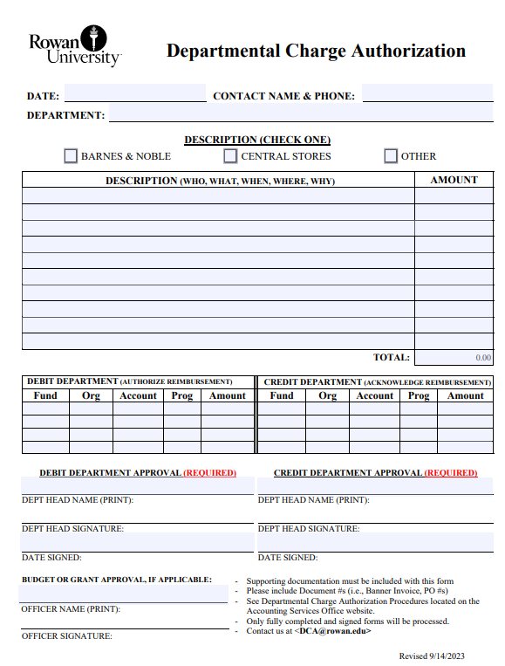
DCAs - paper form
When to use legacy paper DCA form (other)
For fund codes excluded from the online DCA form:
All external Grants (Funds 50000-69999)
Undergraduate Student Government Association (Fund 90000)
Separate DCA form for SGA
South Jersey Tech Park (Fund 99000)
Foundation Funds
Rowan Global, Inc. (Fund 99100)
Rowan Educational Attractions, Inc. (Fund 99200)
For salary transfer activity, limited to:
6020, salary adjustment
6026, course buyout
6102, fringe benefits
For revenue transfer activity
5xxx account codes
For Barnes & Noble and Central Stores activity (separate processes)

Slide 59
DCAs - paper form
Where Can I Locate Legacy Paper DCA forms?
Legacy paper form DCAs can be located on the Accounting Services website at:
Departmental Charge Authorization DCA Form (University)
Departmental Charge Authorization DCA Form (Includes SGA)
Above links are to fillable pdf forms
Select “other” category at top of form
Should only be used for excluded areas and activity
Where Do I Submit My Paper DCA Requests?
Fully completed, supported and approved paper DCAs should be submitted to DCA@rowan.edu.
All charges and credits against an external grant (funds beginning with a 5 or 6) must be reviewed by OSP team prior to submission to Accounting Services.

Slide 60
FYE & Banner Finance FYE Update (Roll)
Fiscal Year End (FYE)
June 30th
Refresher Training
Cutoff Announcer
Banner Finance FYE Update (Roll)
Roll Timing - mid-July
Roll Prep - addressing incomplete documents (budget transfers, receiving, etc.)
Budget of Grants & Capital Funds
Open Purchase Orders

Slide 61
Commonly Used Banner Admin Screens
FAIVNDH - Vendor Detail History
FGIBAVL - Budget Availability Status
FGIBDST - Organization Budget Status
FGITRND - Transaction Detail
FOIDOCH - Document History
FGIDOCR - Document Retrieval Inquiry
FPAREQN - Create a Requisition
FGIENCD - Detailed Encumbrance Activity
FGIOENC - Open Encumbrance List
FPARCVD - Receive against a standing order or regular purchase order

Slide 62
Entities & Reporting
Entities
Rowan University
Rowan University Foundation
South Jersey Technology Park at Rowan University (SJTP)
Student Government Association (SGA)
Rowan Global Inc. (RGI)
Rowan Educational Attractions (REA)
Types of Reporting
Annual Financial Statements
Tax Reporting (990 & 990T)
Various Compliance & Adhoc Reporting
State Capital Grant Reporting; Escheat Process; IPEDS Reporting & other surveys

Slide 63
Contacts & Resource Information
Associate Controller-Mary Ann Nisula x64893 - Nisula@rowan.edu
Accounting Services Full Team Contact Information
For General Accounting Services questions - AccountingServices@rowan.edu
Link to Accounting Services Website
Link to Financial Statements
For FinSecurity information
Link to Instructions - Banner Finance Security
For Requisition Approval Queues information
Link to Instructions - Requisition Approval Queue
Link to video - User Approval Instruction Video
For Fixed Asset Equipment information
Link to policy - Fixed Assets
Link to policy - Disposal of Fixed Assets
Link to disposal form - Equipment Disposal Form
For DCA information & questions - DCA@rowan.edu
Link to DCA Process
Link to DCA instruction manual

Slide 64
Payroll

Slide 65
Required Docs for Payroll
Setting up Your Federal Tax Profile
Please NOTE: If you are a full-time new hire and your forms were submitted through Page Up, your information is already in the system and you do not need to utilize these W4 instructions unless you need to make changes.
If you are a student and have received instructions to complete your W4 forms you will need to take care of BOTH your federal and state forms. You will receive frequent email reminders until both requirements are satisfied!
Federal W4 (two options):
Employee Dashboard>>Taxes>>W-4 Employee’s Withholding Allowance Certificate>>Update … Complete the fields and be sure to click Certify Changes to save. If you are not making any changes to the default settings you still need to click the Update option and then click Certify Changes in order for the system to recognize that you are accepting them.
-OR-
Employee can complete page one of the manual form (https://www.irs.gov/pub/irs-pdf/fw4.pdf) and email it to payrollservices@rowan.edu

Slide 66
Required Docs for Payroll (cont’d)
Setting up Your State Tax Profile
NJ State W4 is not yet available for electronic completion/upload.
Employee must complete the manual form (again, unless you are a full-time employee and it was submitted via Page Up)…
https://www.state.nj.us/treasury/taxation/pdf/current/njw4.pdf
Reciprocal Agreement Between NJ and PA
If you live in PA and would like to file a PA return rather than NJ, please complete the Employee’s
Certificate of Nonresidence in New Jersey (Form NJ-165)
https://www.nj.gov/treasury/taxation/pdf/current/nj165.pdf
If you live in any state other than PA you will need to complete the NJ W4.
All manual forms must be sent to payrollservices@rowan.edu

Slide 67
Required Docs for Payroll (cont’d)
Setting up Your Direct Deposit Profile
Direct Deposit is mandatory in the State of NJ.
You can have up to 3 bank accounts set up for you biweekly Payroll paycheck deposit.
There are two options for setting up your banking information for direct deposit of your biweekly paychecks:
Electronic Option via Direct Deposit Portal in Self Service Banner:
Employee Dashboard>>Direct Deposit Information (you will need to be logged in).
Complete Proposed Pay Distribution section and click Save Changes.
Manual Option via Email:
Once you have an active assignment, if you have any issues accessing the online portal, please contact the Payroll Department by emailing payrollservices@rowan.edu and requesting our manual Direct Deposit Authorization form. We will send you a blank copy to complete and return.

Slide 68
Web Time Entry
Electronic Timesheets are Legal and Binding Documents!
Once you have approved the timesheet, YOU are responsible for accuracy!
Get written permission to submit on another employee’s behalf if necessary.
Access in Self Service Banner via Employee Tab (Employee Dashboard>>Enter Time)
Department Timekeeper (DTK) – FIRST point of contact (liaison with Payroll Dept)
Access typically requires Superuser rights
Must handle all WTE for absent or unavailable staff (including Sabbaticals, LOA’s, etc).
WTE Approver
Every timesheet must have an established WTE Approver and only ONE can be assigned.
You will not be able to access your timesheet until your approval route is established.
Timesheet Status: In Progress, Pending, Approved, Completed, Error

Slide 69
Web Time Entry (cont’d)
How Clock Deadlines Affect Your WTE Access
Deadlines are STRICTLY as follows on the Monday after the pay period ends:
Submissions 10:00 AM
Approvals 11:00 AM
Correction Forms 4:30 PM – if late your correction risks not being included in current pay
Does Payroll Extend the Deadlines?
We try very hard to accommodate all staff but we can’t always extend the clock due to our own deadlines.
Consider the above cutoff times to be FINAL
Can DTK enter time for staff?
DTK is responsible for tracking and ensuring all WTE timesheets are submitted/approved
Must submit time for anyone unavailable to submit on their own due to LOA, Sabbatical, etc.
Can DTK approve timesheets?
NO for Regular Staff … Exceptions can be made with written permission from Approver when unavoidable.
Yes for Student employees if DTK is the assigned approver

Slide 70
WTE Proxies
Approver & Proxy Guidelines:
If you will be unable to handle your timesheet submission, approvals or other WTE obligations you must establish a proxy
Notify Payroll (payrollservices@rowan.edu) if your Proxy will be approving timesheets
Your proxy’s access will need to mirror yours and so must be either the same employee class or above (see below).
Deans are the approvers for the College that reports to them. The Dean must have an agreement with their Chairs in order to designate them as departmental approvers since they are not considered “management” level employee classes.

Slide 71
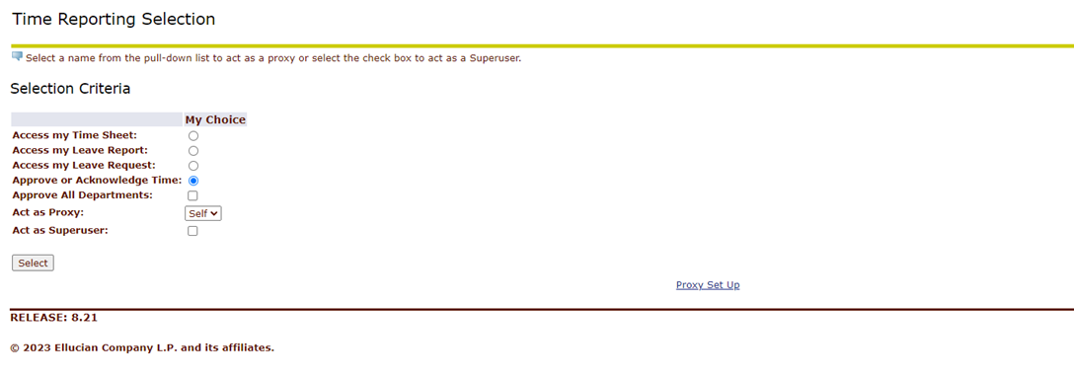
WTE Proxies (Cont’d)
Setting Up a Proxy - Employee Dashboard>>Enter Time>>Proxy Set Up

Slide 72
WTE for End User (Employee)
TIMESHEET CATEGORIES:
Access timesheets via Employee Dashboard>>Enter Time>>Access my Time Sheet and click Select
Full Time Hourly Entry: All hours must be entered and must add up to your contract agreement. If you have a 70 hour contract, your hours must add up to 70 and be made up of Regular, Holiday, Sick, Vacation, Admin, Comp Used, etc. Any Comp Time or Overtime being EARNED does not count toward your contract hours.
Faculty and Exception Time Only: Regular hours worked are not entered. Only leave time should be included. Exceptions include FMLA and Sabbatical hours. If all hours for the pay period are regular hours you should just open and submit with 0 hours entered.
Grad Assist/Fellows: Just open and submit with 0 hours entered biweekly. These contracts are compensated by stipend and the timesheet is necessary for approval purposes so that no contracts are paid out when a student is no longer actively working.
Part Time and Student Hourly Assignments: Biweekly submissions are due with all hours reported as worked. If a full two-week pay period passes with zero hours worked the student’s hourly timesheet should be either left unopened OR opened with 1 UNIT on the line labeled PT No Hours Worked entered. The single unit entered on any day of the pay covers both weeks.
Novatime: Utilize timeclock on site. Training provided by department

Slide 73
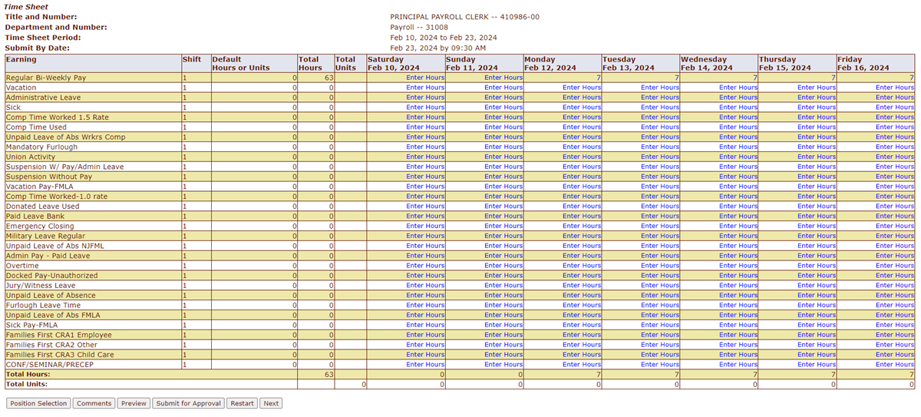
WTE for End User (Employee)
TIMESHEET TYPES:
NON-Exempt (HOURLY): You MUST enter hours In and Out!

Slide 74
WTE for End User (Employee)
TIMESHEET TYPES:
SALARY: You enter Exception Time ONLY
If you worked your regular hours and have NO leave time to submit,
your WTE timesheet fields will be blank as shown:

Slide 75
Leave Time
Accrual Date
Based on employee classification
January: C1, C2, C3, C4, A2, F2, F7, F8
July: A1 (Managers)
September: F1, F3, F6, F9 (includes all 10-month faculty)
SOM Management (including Faculty Mgmt) and Executives are front-loaded and accrue annually in July
SOM Non-Management (including Faculty) accrue monthly
Leave Balances
Viewable in your Employee Dashboard in SSB in the top right hand side of the screen.
Balances include leave calculated as of the prior finalized pay period. For example, your leave balances will NOT include anything that is on your current timesheet which has not yet been submitted and processed.
Note: Employee must be in a PAID status to receive Holiday pay (see your Supervisor for details)

Slide 76
Leave Time (Cont’d)
Comp Time
Earning Comp and Overtime requires mandatory pre-approvals à
Employee Dashboard>>Submit Electronic Forms>>Comp Time Request
Employee Dashboard>>Submit Electronic Forms>>Overtime Request
The comp and overtime request forms must be approved AND your actual worked comp or overtime hours MUST be entered on your timesheet.
Carry Over
Sick – Indefinite
Vacation – One Year
Admin or Personal – Not subject to carry over and does not apply to all e-classes
Comp – Not subject to accrual and does not apply to all e-classes
Resignation/Retirement Planning:
Contact HR first
Email payrollservices@rowan.edu for precise leave balances including any lost time (unearned time you will lose based on your projected term date

Slide 77
Payroll Calendars
Each pay period encompasses two weeks with the timesheets being due on the final day of the pay period. BW (Glassboro/CMSRU/Camden) and SOM approvals are due Monday morning and BS (Glassboro/CMSRU/Camden students) approvals are due Tuesday morning.
We process BW and SOM payrolls during the first week following timesheet submission which usually allows us to grant BS timesheets an extra couple of days for approvals but this cannot be guaranteed. The BS pay is processed during week 2 after timesheet submission.
Payroll calendars are available on our website in fiscal year and calendar year formats. We also have the holiday calendar for the current calendar year and calendars for the Adjunct/Overload pay dates.

Slide 78
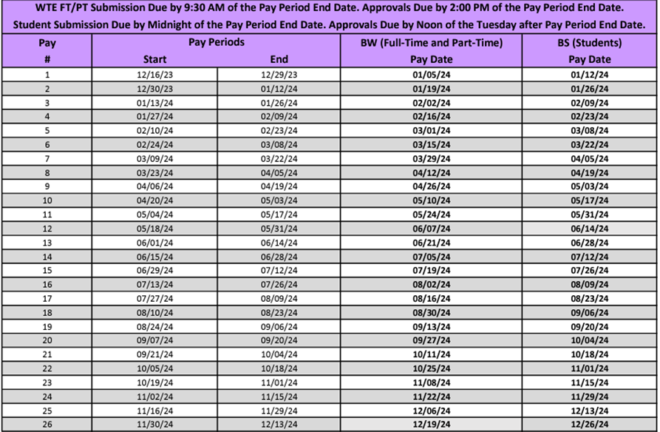
Payroll Calendars (Cont’d)
2024 Payroll Calendar for BW/BS

Slide 79
Important Related Information
Automatic Email Reminders
If your timesheet is not submitted you will begin to receive automatic email alerts on the Thursday prior to timesheet submission due date. These reminders will continue periodically until you submit your timesheet.
FYI - Your approver and DTK will also receive these reminders that you have not submitted your timesheet!
Time & Attendance Correction Forms
If hours are missed for any pay period they cannot be included in the current timesheet or added to the next.
Missed hours MUST be submitted on a correction form accessed via
Employee Dashboard>>Submit Electronic Forms>>Time & Attendance Correction.
Once it is approved Payroll will automatically receive a copy in our Forms mailbox.
The missed hours will be added to the next payroll that is being processed. Manual paychecks are NOT an option so please take the time to ensure your timesheets are correct or your pay may be delayed until the next check date.

Slide 80
Informative Links & References
WTE Training Manual: https://sites.rowan.edu/payroll/_docs/wte/wte_handout.pdf
DTK Guidelines: https://sites.rowan.edu/payroll/_docs/wte/WTE_Guidelines_for_Departmental_Timekeeper.pdf
Approvers & Proxies: https://confluence.rowan.edu/display/POLICY/Payroll+WTE+Approvers+and+Proxies
Employee WTE/Leave Guidelines: https://sites.rowan.edu/payroll/_docs/wte/WTE_Shortcut_Guidelines.pdf
Errors vs Warnings: https://sites.rowan.edu/payroll/_docs/wte/errors_vs_warnings.pdf
Comp & Overtime Quick Reference: https://sites.rowan.edu/payroll/_docs/wte/comp_overtime_quick_reference.pdf
WTE FAQ’s: https://sites.rowan.edu/payroll/_docs/wte_faq_2.pdf
Payroll FAQ’s: https://sites.rowan.edu/payroll/payroll_faq.html
Explaining the Form W4: https://sites.rowan.edu/payroll/_docs/2020_w4_info.pdf
Miscellaneous Leave Time Policy (HR): https://confluence.rowan.edu/display/POLICY/Miscellaneous+Leave+Time
Novatime Training Manual: https://sites.rowan.edu/payroll/_docs/novatime_manual_vers_2.pdf
Novatime Supervisor Training Video: https://rowan.mediaspace.kaltura.com/media/NOVAtime+Time+and+Attendance+Supervisor+Training/1_1t3g7ech

Slide 81
Contact Information
Payroll Office- Bole Hall
Monday – Friday
8:30 am – 4:30 pm
856-256-4166
payrollservices@rowan.edu
Payroll Department Webpage

Slide 82
Questions?

