Slide 1
Fiscal Year-End Update for Electronic Non-POs – FY 26
Presented by Accounts Payable
Wednesday, June 3rd

Slide 2
Agenda
Incomplete Documents
Backdating Transactions
  When to Backdate a Transaction
  Example of Backdating a Transaction
After July 9th at noon
Reminders
  Proof of Payment Examples
Checking the Status of a Non-PO
Contact Information
Questions

Slide 3
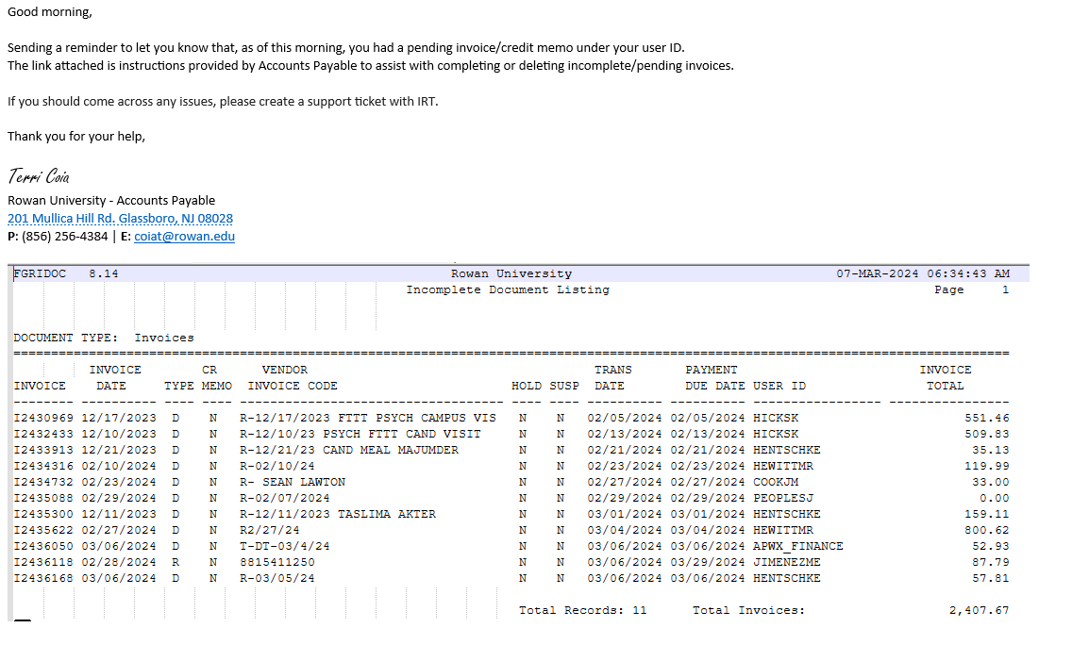
Incomplete Documents
Please ensure you are completing or deleting your incomplete documents ASAP.
Any incomplete documents that remain in Banner on Thursday, July 23rd will be deleted from Banner in order for the fiscal year-end roll to be completed.
Example of the email received
from Accounts Payable when
you have an incomplete
document:

Slide 4
Backdating Transactions
From July 1st-July 9th at noon --- You can process FY 26 Electronic Non-POs by backdating the transaction date to 06/28/26.
  Please note all electronic Non-POs must be processed and fully approved by your budget approver to be reviewed by Accounts Payable no later than Thursday, July 9th at noon.
  Please note the transaction date can only be changed during this timeframe.

Slide 5
When to Backdate a Transaction?
Only items that were physically received or meals consumed on or before June 30th should be backdated. If it is not truly something that should be backdated, AP will be disapproving and the transaction date will have to be modified to current date.
  If you do not have FY 27 budget available in Banner, please delete and wait to process the Non-PO. Contact budget@rowan.edu with any budget related questions.
Memberships/Subscriptions spanning two fiscal years: FY 26-FY 27 or purely for FY 27
  For ex. Spanning from June 1, 2026 – June 1, 2027 or July 1, 2026 – July 1, 2027
  Must be processed and paid by June 30th
    NOTE: If it is not processed & paid by June 30th, have to wait until July 27th to process & utilize SDE Dates (start & end date)

Slide 6
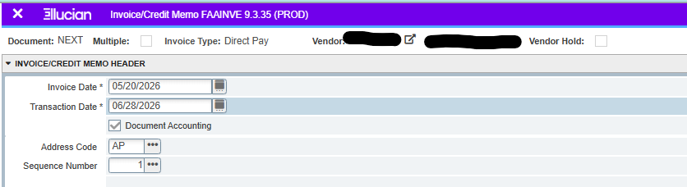
Example of Backdating a Transaction

Slide 7
After July 22nd at noon
After the deadline, no electronic Non-POs can be processed until Monday, July 27th due to the fiscal year-end roll process.
  Filling out the SDE field (start and end date of purchase) accurately will allow Accounting Services to capture and analyze the expense for reporting in the proper fiscal year.

Slide 8
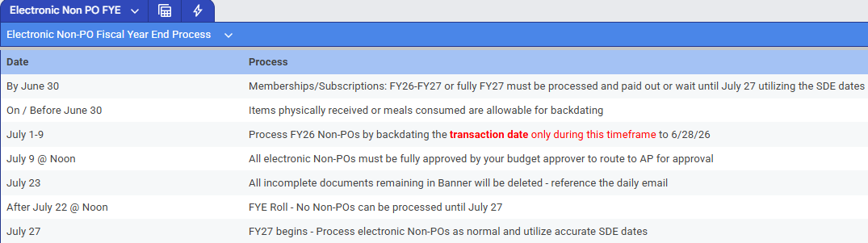
Electronic Non-PO FYE Quick Reference Guide

Slide 9
Reminders
To avoid processing delays:
  Review the Non-PO Category List to ensure you are not submitting a Non-PO that is not reimbursable
  Double check that all required documentation is attached on OnBase to your direct pays
    For example, ensure proof of payment is attached (examples shown on slides 9-10)
    For additional information on required documentation, visit our Non-PO Payment Request Webpage
  Ensure the SDE fields (start and end dates) are accurately filled out

Slide 10
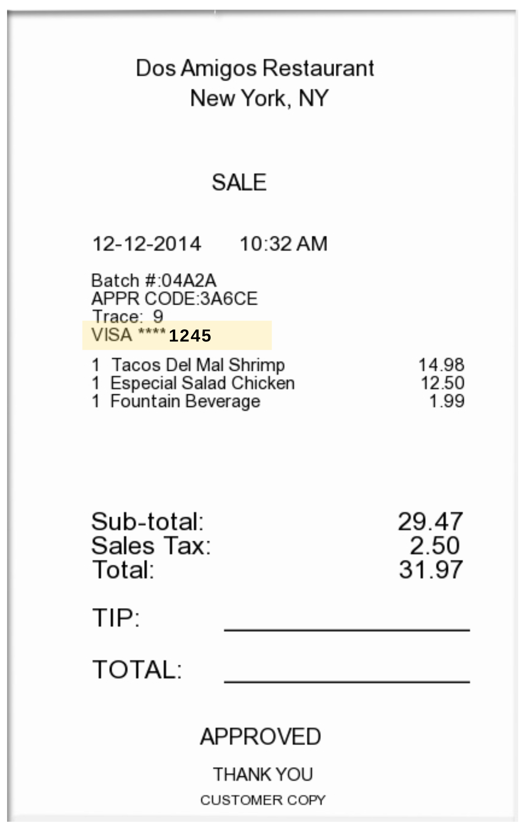
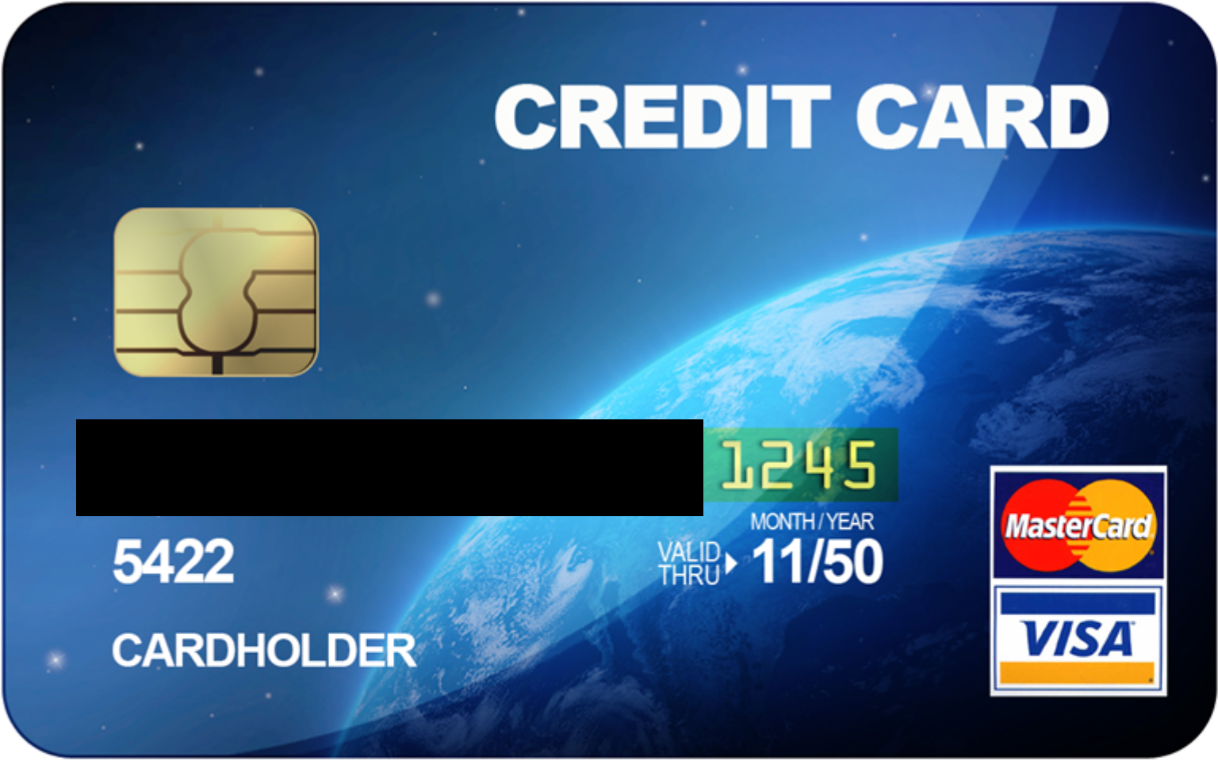
Proof of Payment Example
Itemized Receipt with CC Info Listed
Credit Card with matching 4 digits

Slide 11
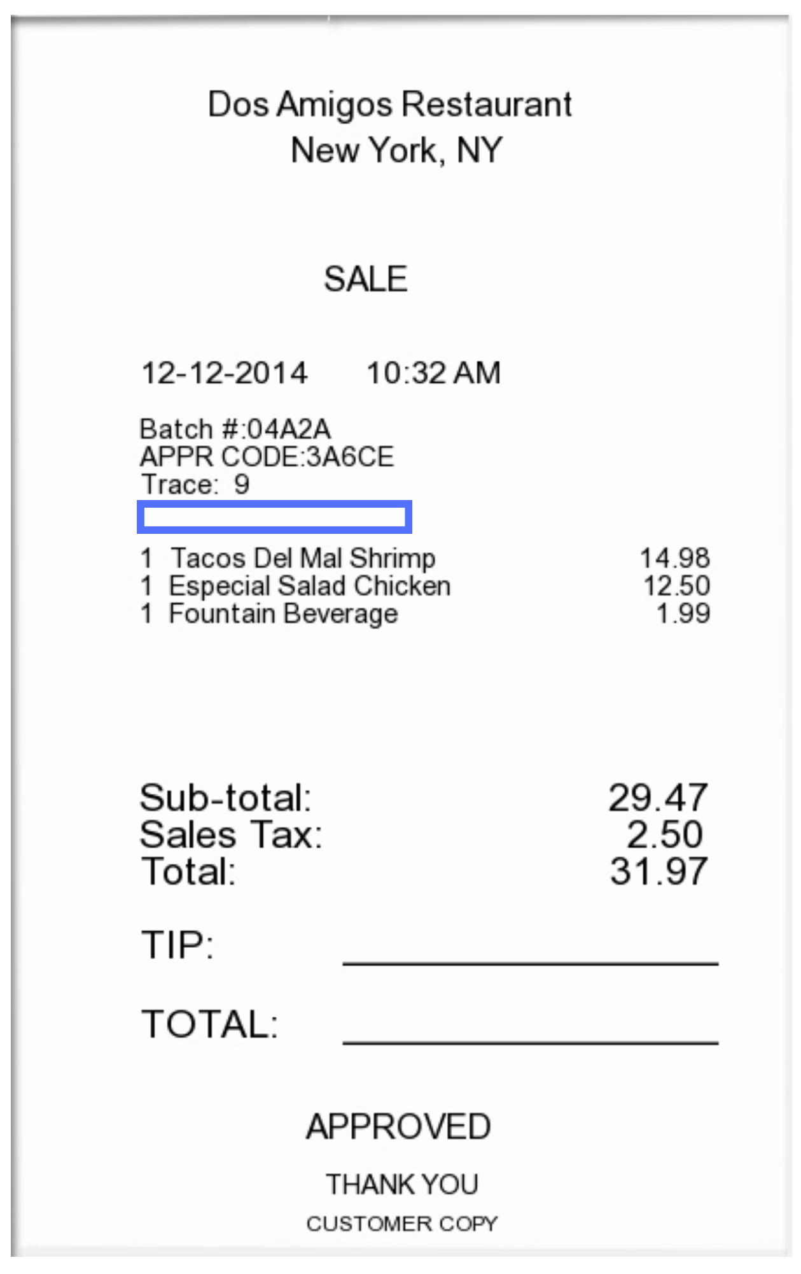
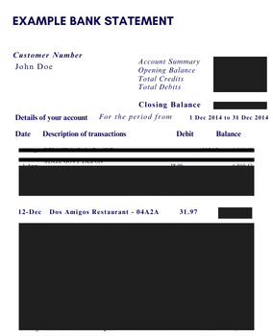
Proof of Payment Example
Itemized Receipt without CC Info Listed
Redacted bank statement showing the charge & the name of the individual being reimbursed

Slide 12
Checking the Status of a Non-PO
Utilize Banner Screen FOAAINP (Document Approval) to see which approvers still need to approve the direct pay
Utilize Banner Screen FOIDOCH (Document History) to review the status of a particular document - can search by I#
  If direct pay states “Complete” = submitted by end user, but not fully approved
  If direct pay states “Approved” = invoice is approved, but payment has not been disbursed
  If direct pay states “Paid” = payment has been disbursed
    There will be a corresponding check disbursement document (CHK # or ACH!)
Utilize Banner Screen FAIVNDH (Vendor Detail History) to review all of the payments processed to an individual
  Can search by Banner ID to see if a Non-PO has been processed
For detailed step-by-step instructions on utilizing these screens, visit Invoice Payments

Slide 13
Contact Information
AP Director - Joselyn Peoples ext. 4335 or email peoplesj@rowan.edu
AP Supervisor - Stacey Bucci ext. 4117 or email buccis@rowan.edu
Full AP Team Contact List
For Non-PO Questions - email invoices@rowan.edu
  Electronic Non-PO Processing Webpage Non-PO Payment Requests

Slide 14
Questions?

