Slide 1
Fiscal Year-End Prep
FY 26 Year-End Training presented by the Division of Finance
Wednesday, April 29, 2026

Slide 2
Agenda
Budget
Procurement
Accounts Payable
Accounting Services
Grants
Questions

Slide 3
Finance Division
Accounting Services
Payroll
Accounts Payable (A/P)
Finance Division
Contracting & Procurement
Budget
Bursar

Slide 4
Budget

Slide 5
Submitting an electronic Special Assignment Payment for FY26
Initiator should submit all Special Assignment Payments and Student Special Project Contracts via the electronic form by June 17th.
All ASA electronic request forms can be found here:
https://irt.rowan.edu/service-catalog/software/development/
Anything submitted after this date will not be expensed to FY26.

Slide 6
Finalize FY 26 Operating Budgets (Non-Rollover)
Clean up accounts
  Start the new fiscal year fresh
For closing purchase orders - refer to slide 15
For closing travel – refer to slide 26
Open Purchase Orders roll, but NOT the funds in operating accounts!
  Purchase order balances will be deducted from FY27 Operating budgets if they are not closed.

Slide 7
Finalize FY 26 Operating Budgets (Non-Rollover)
Ensure adequate budget availability for central charges (non encumbered expenses)
Purchasing Card (BOA)
Telephone
Duplicating
Copier
Catering
Stationery
Bookstore
Gasoline
Housekeeping Supplies

Slide 8
FY 27 Operating vs Carry Forward Budgets
Operating Budgets = Non Rollover
  Funds include: 10110, 10200, 10112, 10400, 10600, 10610, 10650, 30010, 30015, 30040, 30050, 30200
    Budgets available starting July 1st
Carry Forward Budgets = Rollover
  Start Up Funds: 11099
  CHRI: 16800, 16801
  SOM Special Programs: 18000-18999
  Student Clubs: 30044
    Budgets will be available after FY 26 closes and the reconciliation process is complete

Slide 9
FY 27 Operating Budgets vs Carry Forward Budgets
Carry Forward Budgets = Rollover
  Special Program Budgets
    Will follow annual process
  Budget Form Submission exceptions
    Start Up Funds: 11099
    CHRI: 16800, 16801
    Student Clubs: 30044
      Budgets will be available after FY 26 closes and the reconciliation process is complete

Slide 10
Contact Information
Budget@rowan.edu

Slide 11
Procurement

Slide 12


New Vendor, Vendor Reactivation Requests, Contracts
Vendors
Requests submitted after June 12th may not be processed before the requisition cut off date. It is imperative that all requests are submitted by the deadline to ensure vendor accounts are established in time to process your requisition. Vendor IDs will not be created in lieu of vendor compliance in order to process requisitions.
Vendors with an anticipated spend of $15,000 or more generally take more time to onboard. Please keep this in mind when submitting your requests.
Contracts
If your request has an associated contract and services will be provided in the closing fiscal year, please submit the contract accordingly and allow three weeks for processing.
You can request a New Vendor, Vendor Reactivation, and a Contract Request in ProConnect.

Slide 13

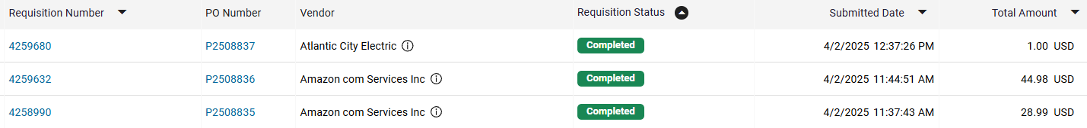
Requisitions
Training Materials for ProConnect Requisitions
ProConnect:
Shopper Guide
Requestor Guide
Approver Guide
New requisitions, including all required Departmental Queue Approvals and documentation (quotes, forms, etc.), must be completed by the Annual Memo deadline to ensure timely purchase order conversion.
How can I tell where my requisition is in the process? Or has my requisition been converted?
Go to Orders>My Orders>My Requisitions
Use the Filter Tool to organize your view

Slide 14
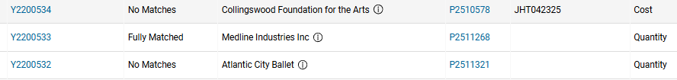
Receiving
How to create receipts in ProConnect?
Receiving an Order or Service
Receiving is required for Non-Catalog & Punchout orders
Complete receiving only after goods or services are delivered or completed.
To charge the closing year's budget, goods/services must be physically and electronically received by June 30.
Open purchase orders not physically received by year-end will be charged to the new fiscal year's budget.
Ensure receiving is complete:
Go to Orders > My Orders > My Receipts
Use the Filter Tool to organize.
Check the Matching tab. Payment requires the invoice to be in 'matched' status. If 'unmatched,' review for a potential change order.

Slide 15
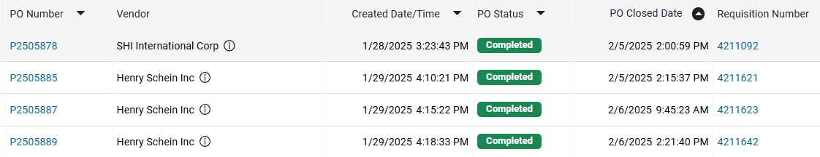
Existing Purchase Orders: Closeouts
All invoices must be paid prior to closing PO.
If your PO has multiple line items, they cannot be closed individually. Due to limitations in system functionality, the entire PO will need to be closed.
How to close a po in ProConnect?
Closeout
How can I tell if my purchase order is closed?
Go to Orders>My Orders>My Purchase Orders
Use the Filter Tool to organize your view

Slide 16
Existing Purchase Orders: Change Orders
Change order requests to existing purchase orders will be treated like new requisitions and follow the same cutoff schedule.
Note: If the invoice amount is more than 10% of PO amount or greater than $100 a change order is required. In ProConnect, an individual line item cannot exceed 20%. If shipping is not present on the PO, but included on the invoice, AP can add any amount up to $100. Otherwise, you will need a change order.
If you have any PO specific questions, please reach out to the buyer listed on your PO.
How to create a change order in ProConnect?
Change Orders

Slide 17


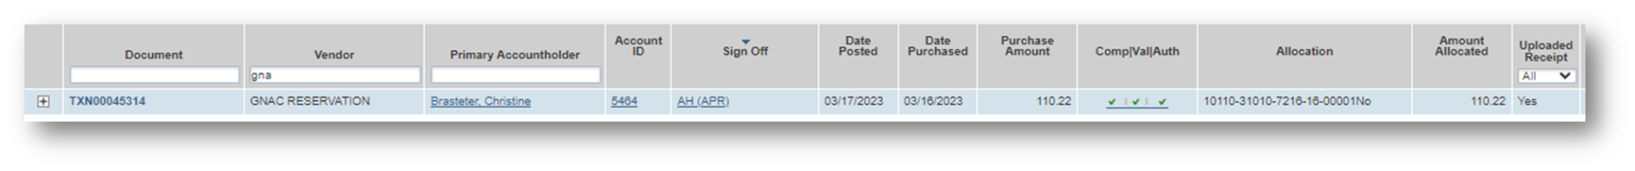
Purchasing Cards
The cutoff date for FY26 purchases is June 30th. Purchases for FY27 should not be made until July 1st.
When applicable, Entertainment Forms, Gourmet Dining Waivers, IRT approvals, furniture approvals, etc., must be submitted to the Accountholder’s designated P-Card representative along with any override requests.
All June P-Card transactions must be allocated in the BoA Works system by 4 p.m. on July 10th.
Finalizing Transactions
Transactions typically post to the account two business days after the purchase was made. During the month of June, you should routinely check your accounts in the Works system for any open transactions. Transactions are not considered finalized until receipts have been uploaded, allocations have been completed, and transactions have been signed off. Yes in the Uploaded Receipt column indicating you have successfully uploaded a receipt. Three green check marks in the Comp/Val/Auth column indicates you have successfully allocated the transactions. AH in the Sign Off column indicates you have successfully signed off.

Slide 18
Contact Information
Alexis Jones jonesal@rowan.edu
Amazon: amazon@rowan.edu
Bank of America: pcard@rowan.edu
Contracts: contracts@rowan.edu
ProConnect: ProConnectsupport@rowan.edu, or Beth McMillan mcmillanb@rowan.edu
Vendors: vendors@rowan.edu

Slide 19
Accounts Payable

Slide 20
Invoices Processed in ProConnect
Monday, July 7th— last day to submit any invoices to be processed for FY 26
  Ensure all invoices have been sent to Accounts Payable via invoices@rowan.edu
  Ensure you send the vendors you are working with their approved PO#(s) as soon as you obtain them & request that they send their invoices with the PO# on it to invoices@rowan.edu
    Can request that the vendor copy end-user on the email
To avoid processing delays:
  Approve any standing order invoices (awaiting invoice owner approval)
  Complete receiving for any regular order invoices if items have been received on or before June 30th
    If items have not been received, make a comment on the invoice in ProConnect.
  Verify that PI approval is also completed when applicable (necessary for all 5 or 6 funds)
  Review any invoices in Match Exception – do not only approve without further action as these require change orders
    Ensure change orders are in complete status prior to approving the invoice
      Change order is needed if the line item has been exceeded by more than 20%
      Change order is needed if shipping was not requested on the PO and is on the invoice for more than $100
  An invoice needs to be submitted - Proforma invoice or quote is NOT accepted
  Start & end date of the service need to be provided if not listed on the invoice
    For ex. Membership/subscription term
  Ensure you are responding to AP requests in a timely manner
For additional instructions on invoices in ProConnect, please visit Invoice Payments - ProConnect or see ProConnect End User Invoice Guide .

Slide 21
Important Note Pertaining to ALL Invoices
*Only services that have been rendered or items that have been physically received on or before June 30th will be recorded in FY 26*
Any invoices processed in ProConnect that remain in the system awaiting receiving or approval as of June 30th EOB will require confirmation of delivery/service date prior to the invoice being exported into Banner.

Slide 22
Non-PO Payment Requests
Tuesday, July 7th— last day to submit any Non-POs to be processed for FY 26
  Email all requests directly to invoices@rowan.edu with “Non-PO” listed in the subject line – please do not send via inter-office mail.
  Note: we will be hosting a separate training specifically on Electronic Non-POs during FYE on Wednesday, June 3rd.
To avoid processing delays:
  Review the Non-PO Category List to ensure you are not submitting a Non-PO that is not reimbursable
  Double check that all required documentation is attached to your Non-PO Payment Request Form & that all approvals have been obtained
    For example, ensure proof of payment is attached (examples shown on slides 28-29) & all approval signatures have been obtained
    For additional information on required documentation, visit our Non-PO Payment Request Webpage

Slide 23
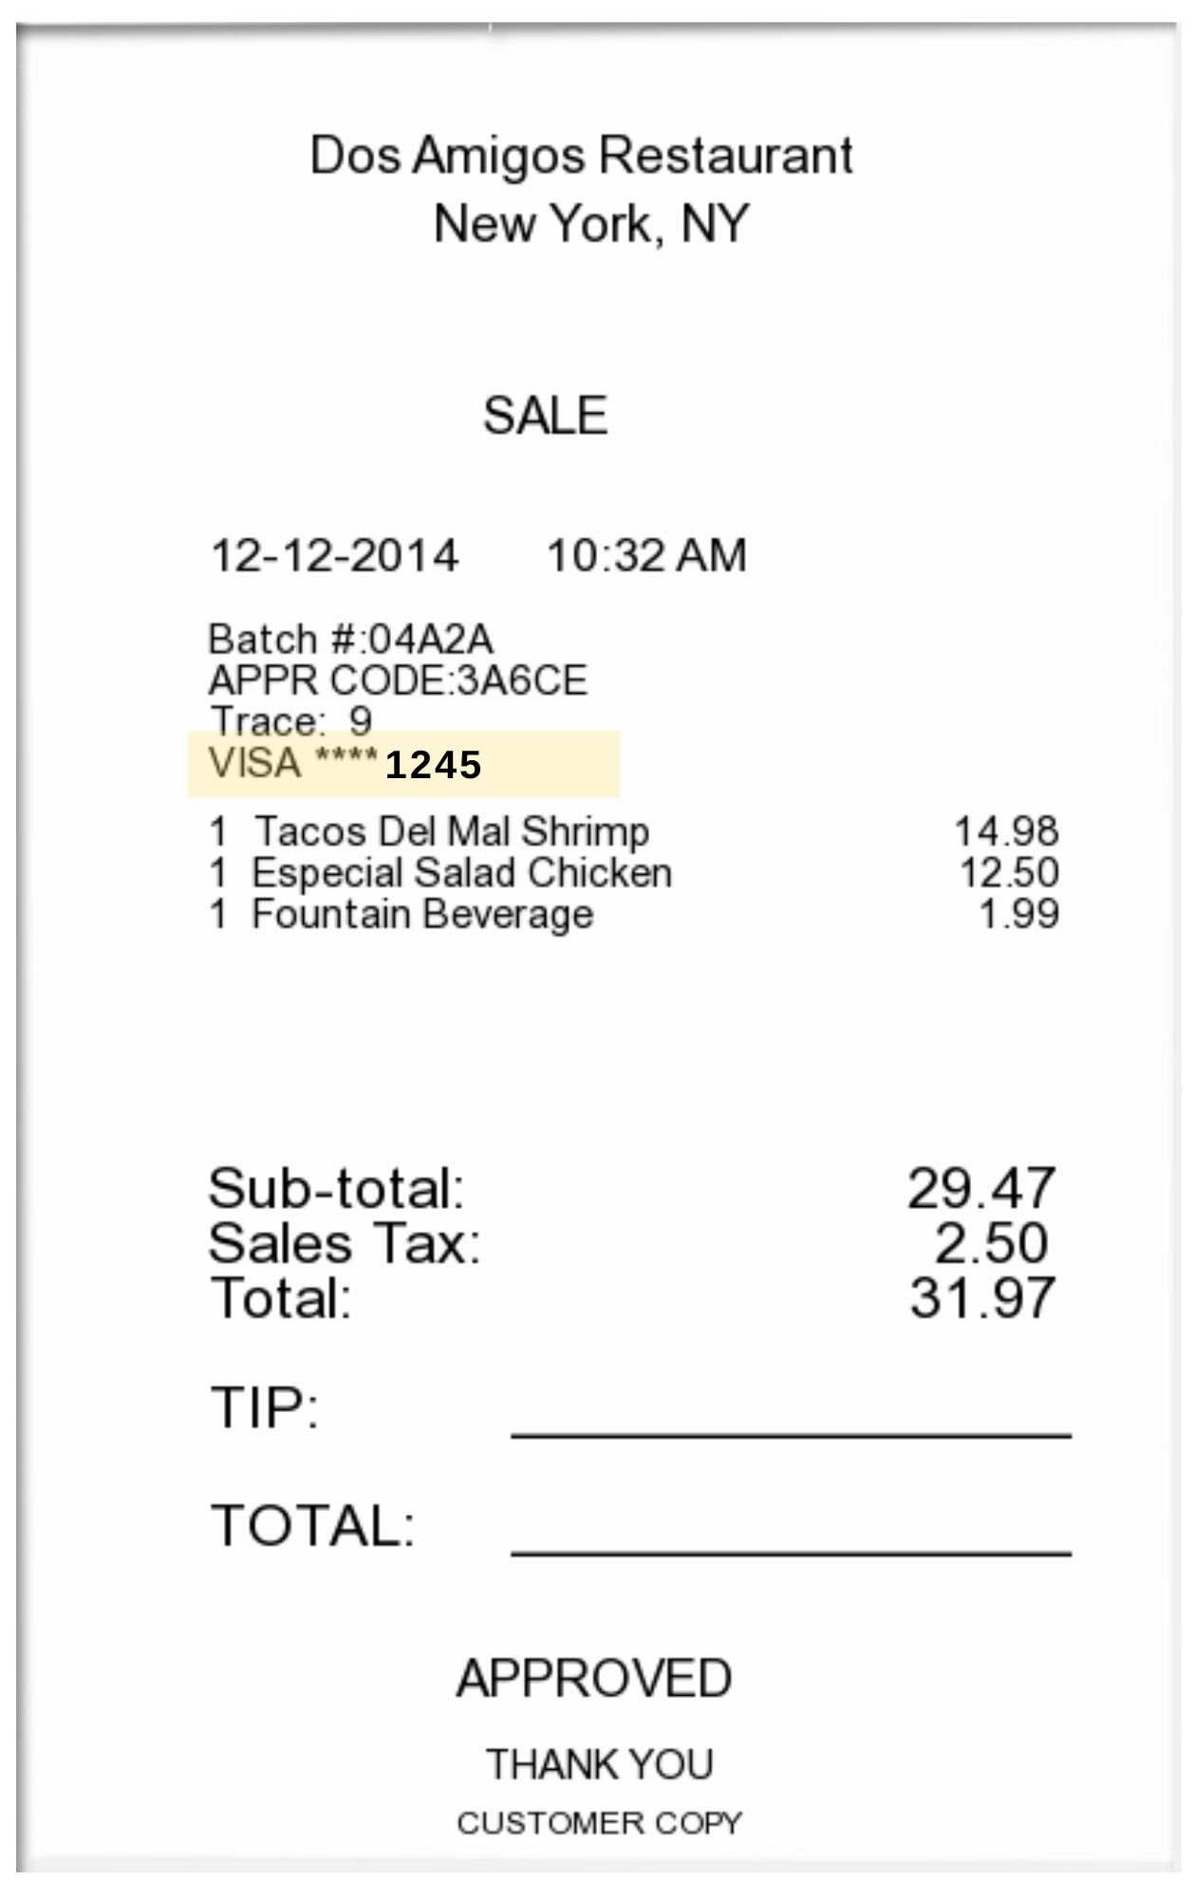

Proof of Payment Example
Itemized Receipt with CC Info Listed
Credit Card with matching 4 digits

Slide 24
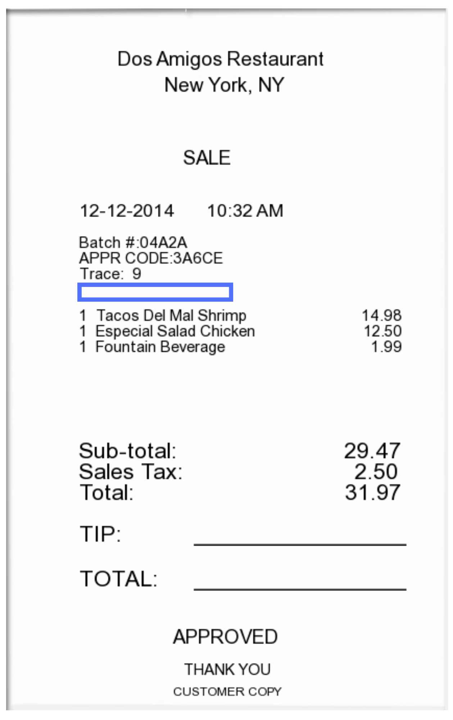
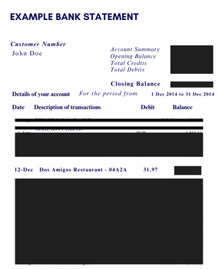
Proof of Payment Example
Itemized Receipt without CC Info Listed
Redacted bank statement showing the charge & the name of the individual being reimbursed

Slide 25
Memberships/Subscriptions
Memberships/Subscriptions spanning two fiscal years: FY 26-FY 27 or purely for FY 27
  For ex. Spanning from June 1, 2026 – June 1, 2027 or July 1, 2026 – July 1, 2027
  Must be processed and paid by June 30th
    NOTE: It must be processed & paid by June 30th in order to be reflected in FY26 & utilize SDE Dates (start & end date)

Slide 26
Employee Travel - Overnight & Day
Friday, June 26th— last day to submit any Concur expense reports to be processed for FY 26
  NOTE: Keep in mind that you need to allow sufficient processing time for travel requests to be fully approved with encumbrance #s.
  If deadline is missed, Accounting Services will capture and analyze the expense for reporting in the proper fiscal year.
Review any open encumbrances — confirm expense reports have been submitted & fully approved
  Once the report has been fully approved in Concur (sent for payment status), Close Out Your Request
  If you closed out your request and notice the budget is still held up, there may be an error — email asktravel@rowan.edu
To avoid processing delays:
  Cost Object Approvers (COA) in Concur — verify there is sufficient budget in the foapal lines before approving reports to avoid Non-Sufficient Fund (NSF) issues. If you need to move budget, have it moved prior to submitting the report.
  Ensure all required documentation is attached – utilize Expense Report Tip Sheet and visit Employee Travel for more resources

Slide 27
Concur Travel Encumbrances - For Employees
FY 26 encumbrances do not roll over into FY 27 — this cannot be changed due to Banner systematically closing out the encumbrances for the fiscal year-end roll
  Due to this, if your trip is still multiple months away & you will not be charging any of the expenses before June 30th, we recommend not submitting your Travel Request until after June 30th.
If submitting an FY 27 Travel Request in FY 26:
  Before June 30th - include all predicted travel expenses on the request, but only include amounts for the expenses that will be charged in FY 26 and will be included in the encumbrance
  After July 1st – submit another Travel Request as “extension of prior trip”
    Include all travel expenses, but only include amounts for the expenses that will be charged in FY 27 and will be included in the encumbrance
  NOTE: Only airfare and registration can be submitted as a prepayment for reimbursement.

Slide 28
Student Travel - Overnight & Day
Tuesday, July 7th— last day to submit any paper expense reports to be processed for FY 26
  NOTE: Keep in mind that you need to allow sufficient processing time for travel requests to be fully approved with encumbrance #s.
Review any open encumbrances
  Confirm expense reports have been submitted & fully approved – can verify payment status to the student via Banner screen FAIVNDH
  Email asktravel@rowan.edu with the following info to close-out existing encumbrances:
    Traveler Name
    Encumbrance #
    Destination
    Reason for closing
To avoid processing delays:
  Verify there is sufficient budget in the foapal lines before approving reports to avoid Non-Sufficient Fund (NSF) issues. If you need to move budget, have it moved prior to submitting the report.
  Ensure all required documentation is attached to the travel form – utilize Expense Report Tip Sheet and visit Student Travel Webpage for more resources

Slide 29
Payment Verification
Payment info is available for Z#s in ProConnect, but there might be a delay in the information transferring over. For most up to date information, check Banner.
Utilize Banner Screen FOIDOCH to review the status of a particular document (can search by a requisition #, a purchase order #, an invoice #, or a check #)
  If invoice states “Receipt Required” = either electronic receiving was not done on a PO or there may be an issue with the receiving document (Y number)
  If invoice states “Approved” = direct pay or invoice is approved, but payment has not been disbursed
  If invoice states “Paid” = payment has been disbursed
    There will be a corresponding check disbursement document (CHK #)
Utilize Banner Screen FAIVNDH to review all of the payments processed to a vendor
  Can search by Banner ID to see if a Non-PO has been processed
For detailed step-by-step instructions on utilizing these screens, visit Invoice Payments

Slide 30
Contact Information
AP Director - Joselyn Peoples ext. 4335 or email peoplesj@rowan.edu
AP Supervisor - Stacey Bucci ext. 4117 or email buccis@rowan.edu
Full AP Team Contact List
For Invoices or Non-PO Questions - email invoices@rowan.edu
  Invoice Payments - ProConnect
  Non-PO Payment Requests
For Travel Related Questions - email asktravel@rowan.edu
  Travel
For Gift Card Related Questions, email giftcards@rowan.edu
  Gift Cards

Slide 31
Accounting Services

Slide 32

Accounting Services (AS)…
Year End Topics
  FinSecurity (Banner Finance Access)
  Banner Finance Fiscal Year End Process Update (Roll)
  Fixed Assets/Equipment Inventory & recording Disposals
  Journal Entries (including Departmental Charge Authorizations (DCAs))
  Compile Annual Financial Statements for all entities (RU, RUF, SJTP, & REA)
    Work with external & internal auditors; ensuring audit compliance & reporting
  Financial & Compliance Reporting (excluding external grant reporting)
    Facilitating ad hoc, monthly, quarterly & annual reporting

Slide 33
FinSecurity
FinSecurity
  AS in conjunction with Analytics, Systems & Applications (ASA) Security is responsible for providing access to the Banner Finance System.
  Requests for Banner Finance Security should be made through Rowan Support Portal
  Instructions on AS website at: Banner Finance Security
  Please allow adequate time for approvals and processing.
Fiscal Year End Reminder
  Submit changes or access request as soon as possible with proper approvals via the Rowan Support Portal.
  FY26 fund access cutoff is June 1, 2026.
  Access can not be established via email requests.
  New FY27 funds must be established in Banner before access is given.

Slide 34
Banner Finance FYE Process Update (Roll)
AS facilitates the Banner Finance Process Update (system roll)
  Roll general ledger balances (balance sheet accounts beginning balances)
  Roll Open ProConnect POs so available in Banner in new FY
    All encumbrances (E#) will be systematically closed out.
  Roll Grant & Capital Budgets (Inception to Date budgets)
  All users are required to remain out of the system.
Fiscal Year End Reminder
  Prep for roll by reviewing open POs throughout the year
    Investigate open balances with services provided or goods received
      Ensure receiving is done correctly on PO in ProConnect
      Ensure vendor has submitted invoice to invoices@rowan.edu
      Ensure all invoices in ProConnect have been properly approved.
      Request close out of PO when no longer needed or with zero balance
  Encumbrances (E#) should be closed out in concur.

Slide 35
Fixed Assets/Equipment
AS capitalizes equipment that meets the policy threshold.
  Beginning FY26, the threshold was $10,000 for non-external grant funds. External grant funds (beginning with a 5xxxx or 6xxxx) continue to capitalize costs above $5,000.
    This includes the shipping and handling, installation, and parts needed to make the equipment operational for each item.
  Equipment requisitions must continue to use account code 7645, equipment over threshold, and contain required information within ProConnect’s internal notes section (custodian information, intended usage, description, location, and estimated useful life).
AS is required to inventory non-grant purchased items every three years in order to comply with federal, state and University guidelines. OSP is required to inventory grant purchased items every two years in line with OMB and University guidelines. Departments are encouraged to maintain up-to-date equipment records in order to assist in the physical inventory process.

Slide 36
Fixed Assets/Equipment
Link to equipment related policies on the AS website at:
  Fixed Assets
  Disposal of Fixed Assets
Fiscal Year End Reminder
  Ensure requisition has proper account code and required internal notes to prevent delays and denials.
  Please respond to inventory requests promptly to ensure all items are viewed in appropriate timeframe.
  Items must be received on campus by June 30th in order to be applied against FY26. If an item is not received by June 30th it will be applied to FY27 budget.

Slide 37
Equipment Disposals
Fixed Asset Disposals
  To ensure accurate financial reporting, disposal of equipment should be documented and communicated timely to AS.
  Disposals include transfers to outside agencies (state, other institutions of higher education, not for profit organizations).
Link to equipment disposal/adjustment form:
  Equipment Disposal/Adjustment Form
Fiscal Year End Reminder
  Departments are responsible to ensure all equipment disposals have the fully completed disposal form submitted to AS. Disposals will not be processed without the fully completed/approved disposal form.

Slide 38
Journal Entry Examples
Journal Entry Requirements
DCAs are journal entries – Department Reimbursements**
Cash Receipts
Daily Transmittals – account for revenue
General Accounting Entries – e.g., depreciation, disposals, accruals & prepaid entries**, various monthly feeds, etc.
FOAPAL Reclassifications & Correcting Entries - e.g., correcting a program code
Must have supporting documentation
If Reclassification, correcting or general journal entry, must balance (Banner Doc Type JDCA, JE15 & JE16)
Must be submitted timely

Slide 39
DCAs (Departmental Charge Authorizations)
Currently two methods to submit DCAs, Electronic Workflow or legacy paper form .
  Electronic DCA workflow has certain fund & account code exclusions, this activity should be submitted on legacy paper form. Also, legacy paper form should continue to be used for Barnes & Noble and Central Receiving/Stores.
    Link to electronic DCA workflow process and help. (dca.rowan.edu) & link to Training material.
    DCA email box for questions or legacy paper form submission is dca@rowan.edu.
      Reminder, please only submit DCA forms once and only as fully executed documents.

Slide 40
DCAs (continued)
Reminders:
  Account codes should match on each side of the transaction,
    Only non-salary expense accounts (7xxx), can be used within the DCA workflow.
    Exception: Bursar Fund-Account (10000-2912) for Tuition/Fees/Stipends, RowanBucks, etc.
    Legacy paper DCAs should be used for external grants & component unit activity.
    No DCA should use 7400, reserve allocation.
  Ensure budget availability & adequate documentation to support journal.
    Electronic DCA workflow has validate button to check budget at point in time. FGIBAVL should be verified before submitting paper form.
    Copy of Banner expense should be included in supporting documentation, reference to Banner I# and/or PO# requested.
  Approval routing can not be changed by AS on electronic DCA workflow.

Slide 41
DCAs (continued)
Fiscal Year End Reminder
  Ensure routing department contact is correct.
    Connect with other department to ensure proper contact (not department approver).
    AS can not change routing of the electronic DCA workflow.
    If routing is incorrect, DCA will need to be completely redone/resubmitted, which delays processing.
  Ensure adequate documentation is attached to support the DCA.
    Inadequate support will delay processing.
    All journal entries need proper documentation to support transaction.
  Operating Budgets cannot transfer to Special Programming accounts, including Rowan Global accounts unless a direct expense reimbursement.
Cutoff for all FY26 DCAs (paper and electronic) must be received in Accounting Services by end of day July 10th. These DCAS must contain appropriate sign off and documentation before sending to AS.
  External Grants (funds beginning with 5 or 6) have a DCA cutoff extension of July 24th at noon.

Slide 42
Foundation at Year End – 3 Steps
Look at each account code
  5302 – Foundation Revenue (applies to carryforward funds)
  7415 – Transfer from Foundation (applies to operating & carryforward funds)
  9001 – Discuss with OSP (applies to specific external grant funds)
Verify the activity
  Review the budget and YTD Activity column’s transaction details
  In other words, does each transaction make sense to you? Does anything sound unfamiliar?
  Contact Information:
    rennie@rowan.edu for transfer support questions
    dearj@rowan.edu for pending transfers or accounting issues/questions
Act on the information
  Be cognizant of donor intent before using Foundation funds
  Operating fund balances do not roll into next fiscal year. Use funds ASAP before 6/30
  Special program/carryforward fund balances will either roll or can be made available in next fiscal year after a budget set-up request

Slide 43
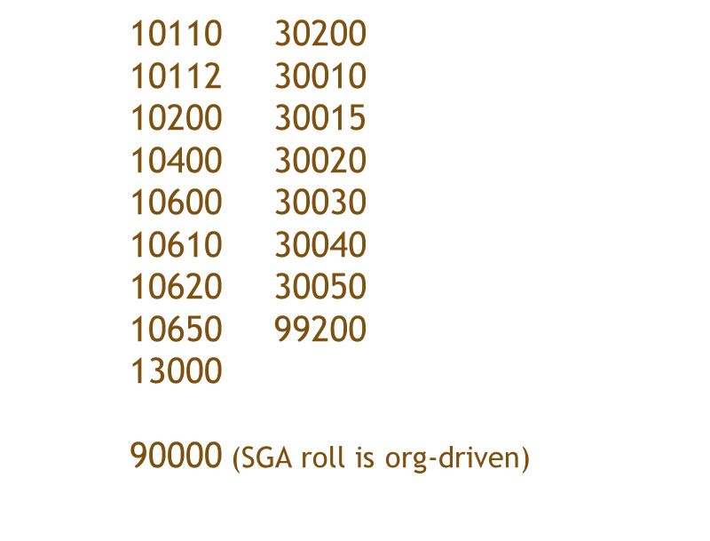
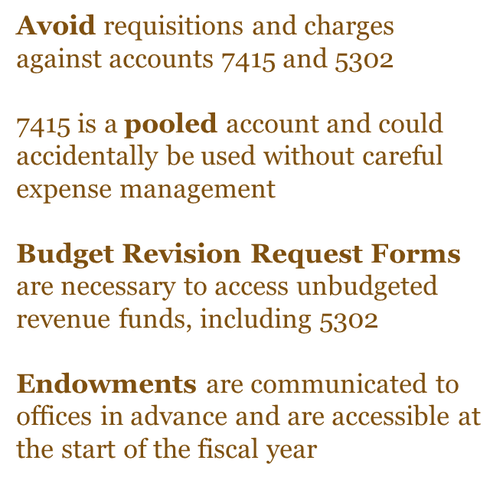
Foundation Reminders

Slide 44
Accruals & Prepaid Entries
GAAP requires recognition of revenue when earned and expenses as incurred, an accrual/prepaid entry is an adjustment made to an account to ensure revenue & expenses are recorded in the same period.
  Accounts Payable assists when processing invoices in identifying appropriate timeframe for that expense.
  To ensure accurate financial reporting, Accounting Services reviews data and prepares an adjusting journal entry to reflect as an accrual or a prepayment when appropriate.
Fiscal Year End Reminder
  Complete Receiving timely, as goods are received and services performed. Do not complete receiving before goods are received or services performed.
  Review POs to ensure all anticipated invoices are applied and close out POs when no longer needed.
  Ensure vendor provides invoices to invoices@rowan.edu in a timely manner and follow up on outstanding invoices.
  ProConnect POs will roll into FY27. After the system roll, invoices received for expenses incurred in FY26 will be accrued back to FY26 until mid-August.

Slide 45
Annual Audited Financial Statements….
Audit Process
Accounting Services is responsible for coordination of annual audit for all entities (RU, RUF, SJTP, & REA)
  Involves various Administrative Offices on Campus
    Financial Aid, Grants, Bursar, Payroll, Human Resources
  Involves ALL Departments, including Academic Departments
    Fixed Asset/Equipment physical inventory
    Adequate supporting of all journal entries, including DCAs
  Provide supporting documentation to auditors for selections
    Journal entries are selected to “test” the balance shown in the financial statements.
Fiscal Year End Reminder
  AS may reach out for assistance on certain audit requests, including asset inventory. Please respond timely to requests or direct to appropriate department contact.

Slide 46
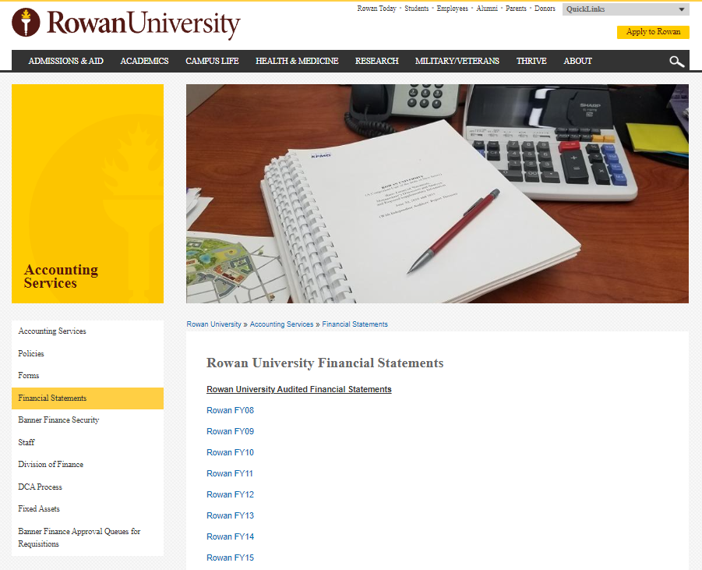
Financial Statements
Audited Financial Statements can be obtained from the Accounting Services website.

Slide 47

Examples of Financial Reporting
Annual Audited Financial Statements (main deliverable that drives Annual Memo deadlines- next slide)
  Including A-133 Reporting
Annual Capital Grant Reporting to State
Annual statistical reporting
Annual IPEDS reporting
Monthly: SJTP, SOM prepares monthly reporting
Periodic: Actuals for Board Reporting multiple times per year for reporting entities
Bond Disclosure/Reporting
  Event Disclosure under Rule 15c2-12
  Annual Tax Compliance Certifications
Various Ad-hoc reporting

Slide 48
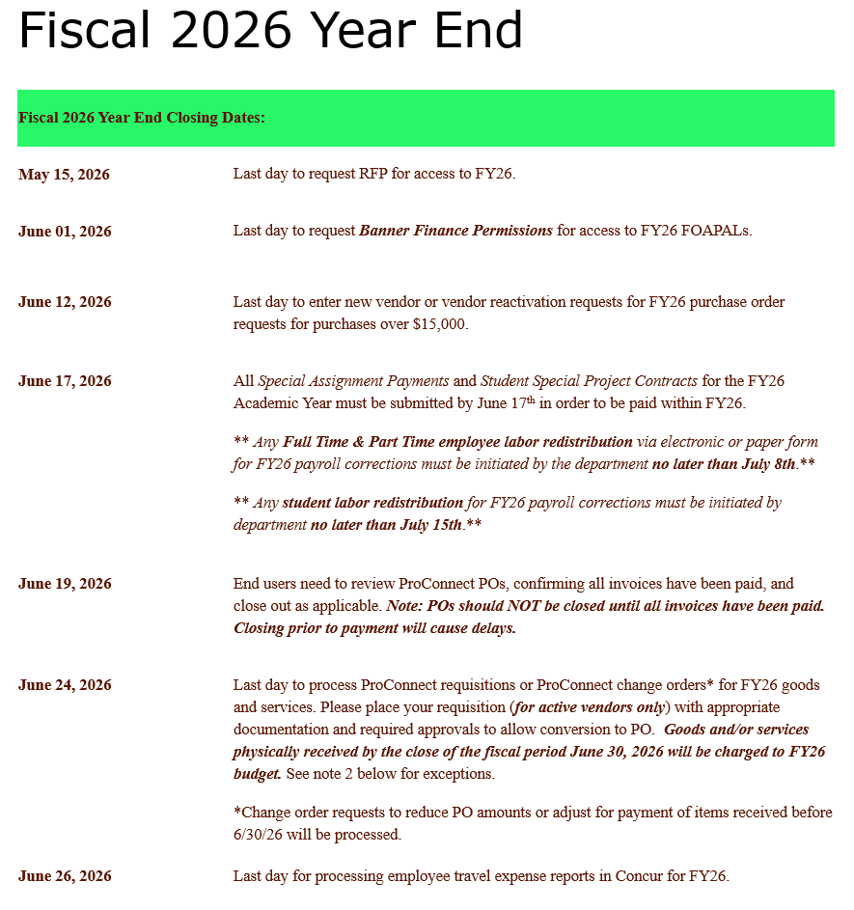
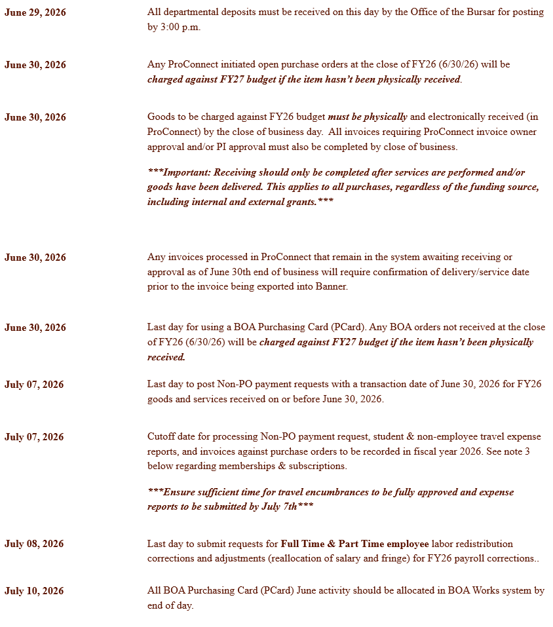
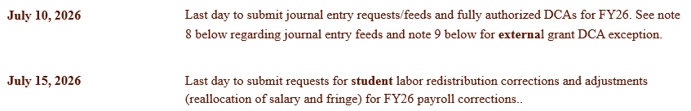
Reminder!

Slide 49
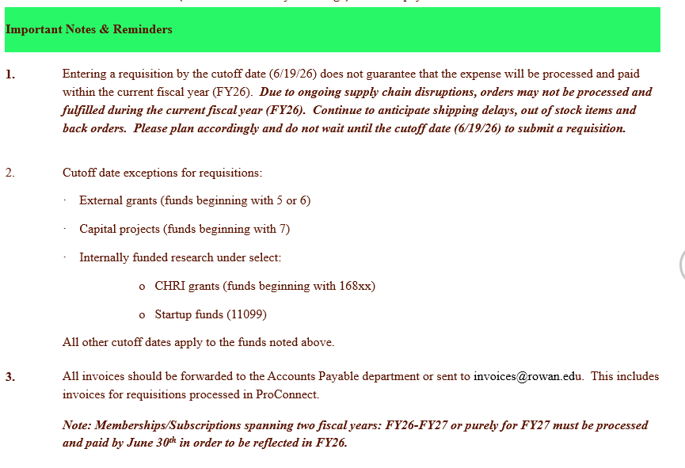
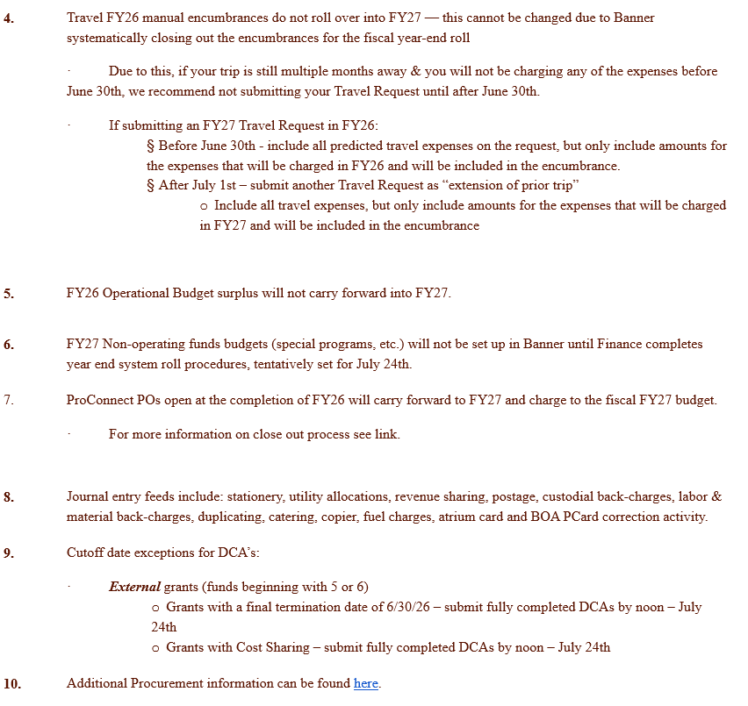
Reminder!

Slide 50
Contacts & Resource Information
Accounting Services Full Team Contact Information
For General Accounting Services questions - AccountingServices@rowan.edu
  Link to Accounting Services Website
  Link to Financial Statements
For FinSecurity information
  Link to Instructions - Banner Finance Security
For Fixed Asset Equipment information
  Link to policy - Fixed Assets
  Link to policy - Disposal of Fixed Assets
  Link to disposal form - Equipment Disposal Form
For DCA information & questions - DCA@rowan.edu
  Link to DCA Process
  Link to DCA instruction manual

Slide 51
Grants

Slide 52
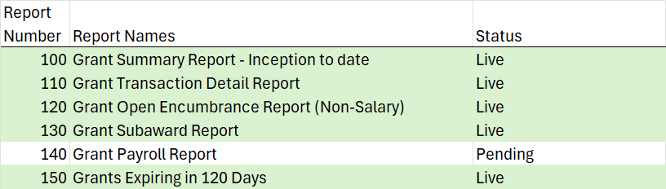
Grant Related Reminders
Budgets
Grant Budgets are carry-forward budgets and do not always operate on the same fiscal year as operating budgets.
  Cognos reports found in Grants > Department User Reports

Slide 53
New Grants Management Cognos Reports
To request Cognos report access, email postaward@rowan.edu
Include details such as the PI(s) or Orgs you manage.
You will be added to a RIMS group managed by the Post Award Team.

Slide 54
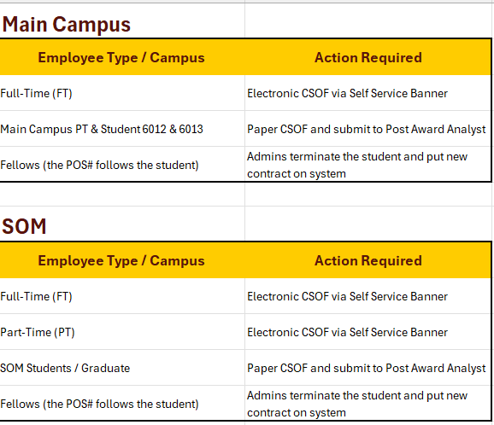
Grant Related Reminders
Process when changing the funding source for future payroll for FY27
Salary Redistribution Final Cut Off Dates
Full Time & Part Time employee labor redistribution for FY26 must be initiated by the department no later than July 8th.
Student labor redistribution for FY26 must be initiated by department no later than July 15th.
SAP/Student/Summer Cut off Dates
Special Assignment Payments and Student Special Project Contracts for FY26 must be submitted NLT June 17th:
Summer Non Teaching requests (July 1 through August 31) should be submitted for payment in July and August.

Slide 55
Grant Related Reminders
Procurement
  Receiving - If you have physically received the goods or services, you must receive in ProConnect by 6/30
  Approvals - Promptly approve invoices awaiting PI approval or invoice owner approval in ProConnect for payment
  Standing orders (Subawards, etc.) - Open POs will carry forward to FY27
  Amazon - Now via ProConnect

Slide 56
Grant Related Reminders, continued
Accounting Services
  DCAs - still a paper process for grants:
    DCA Form on Accounting Services' webpage
  DCAs will not be processed without proper supporting documentation.
    DCA (fully approved) deadline July 10
    Exception: Deadline for FY26 DCA’s is noon on July 24th for grants that end 6/30/2026 or have Department Cost Sharing.
    Cost Transfers (form) - per federal regulations must be submitted within 90 days of occurrence. Salary Transfers cannot cross fiscal years.
  Asset Inventory - is required every 2 years per federal regulations. Please respond timely to requests or direct to appropriate department contact.
    If Asset is no longer in use, please let us know!

Slide 57
Post Award Staff Assignments
Staffing Assignments found on OSP Website under Staff Members tab:
https://docs.google.com/spreadsheets/d/1or3VnFbLiXj5zQeTO5wPxfzw84_33jOD5xEUNhog0hI/edit

Slide 58
Any Questions?

