Slide 1
Gift Card Form
Step-by-Step review of the Gift Card Request Form
Last Revised 06/05/2023

Slide 2
Table of Contents
Introduction 3
Fillable PDF Form 5
Gift Card Request Form 7
Do’s & Don'ts 32
Resources 33
Contact Information 34

Slide 3
Gift Card Request Form Introduction
This PowerPoint is a step-by-step guide on how to complete the Gift Card Request Form. This document will review how to utilize the fillable PDF form, complete each section, calculate quantities and fees, comply with IRS requirements, and provides additional resources.

Slide 4
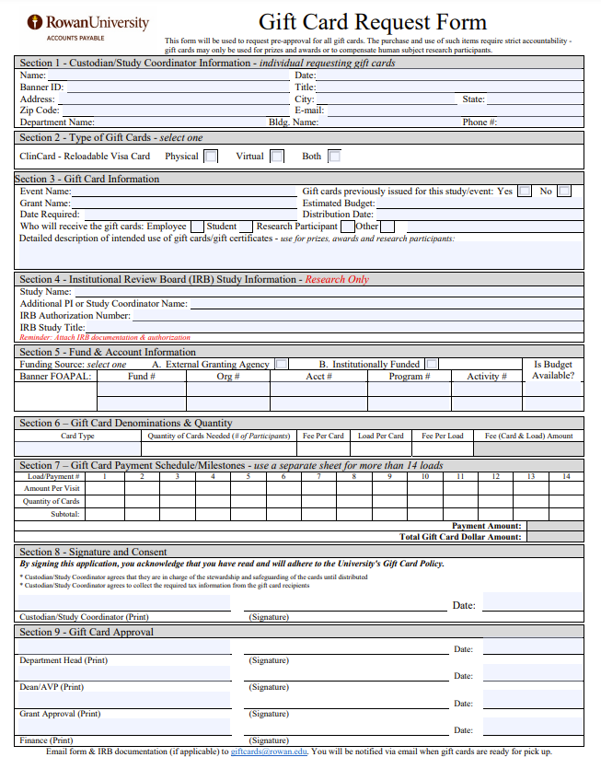
Gift Card Request Form Definition
Gift Card Request Form
This form will be used to request pre-approval for all gift cards in accordance with the Gift Card Policy.
The purchase and use of such items requires strict accountability – gift cards may only be used for prizes and awards or to compensate human subject research participants.

Slide 5
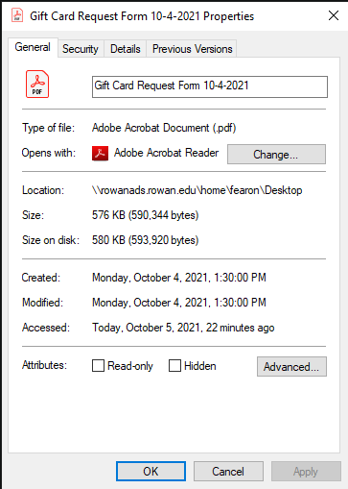
Gift Card Request Form Fillable PDF Form
The Gift Card Request Form is a fillable PDF form that works best with Adobe Acrobat Reader. Complete the following steps to verify your default settings:
Right click any PDF document on your desktop
Click Properties
Review Opens With:
Verify Adobe is listed
If Adobe Acrobat Reader is not listed as the default continue to the next slide for instructions on how to set Adobe Acrobat Reader as your default.

Slide 6
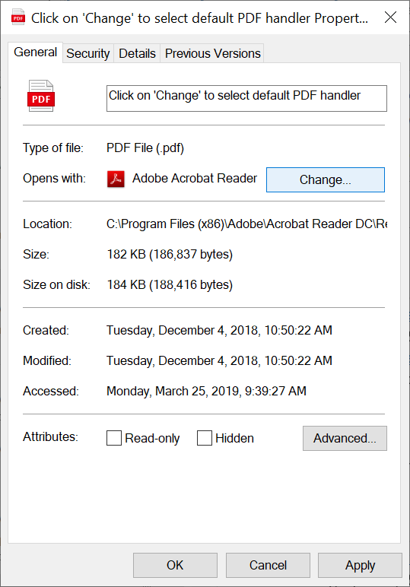
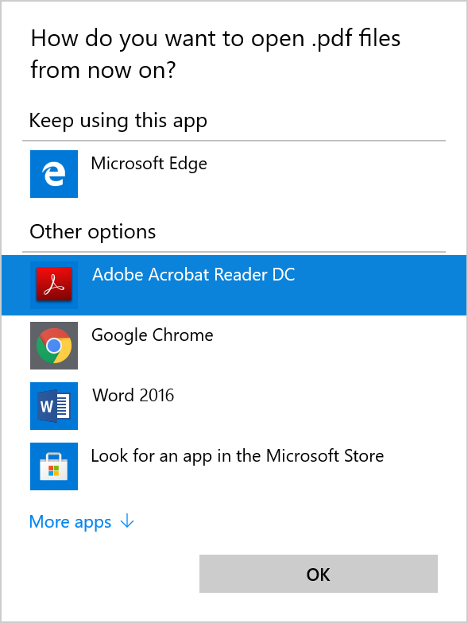
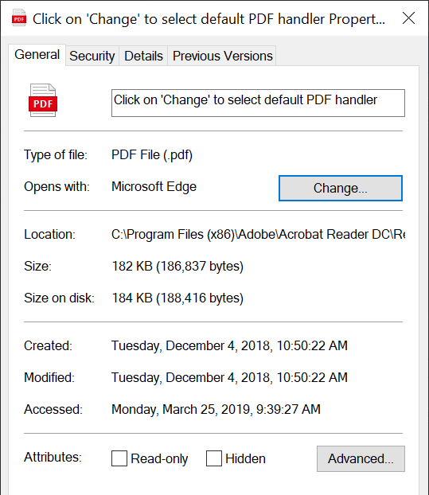
Gift Card Request Form Fillable PDF Form
Click Change
Select Adobe Acrobat Reader DC
Click OK
Select Apply

Slide 7
Gift Card Request Form Section 1 – Custodian/Study Coordinator Information - individual requesting gift cards
Who should complete this form?
This form should be completed by the individual (Custodian/Study Coordinator) requesting the gift cards. Complete all fields to ensure the administrator can identify the correct individual in Banner and contact them with questions or clarifications.
Custodian/Study Coordinator is responsible for disbursing, collecting, reconciling and submitting the gift card supporting documentation to Accounts Payable, giftcards@rowan.edu.
Also, this person will be the individual set up in the ClinCard system to distribute and load the ClinCards.

Slide 8
Gift Card Request Form Section 2 – Method for Purchasing Gift Cards - select one
Which type of gift cards will you be requesting?
Choose between ClinCard or one of the approved contracted vendors.
ClinCard (Re-loadable Visa Card)
Physical Card
Virtual Card
Both

Slide 9
Gift Card Request Form Section 3 – Study/Event Information
Why are gift cards needed?
Fill out one of the following fields:
Event Name
Grant Name
Were gift cards previously issued for this study? Select Yes or No
Estimated budget: Enter the amount for the entire event/study/program, including all fees.
Section 3 continued on next page

Slide 10
Gift Card Request Form Section 3 – Study/Event Information
Dates: Enter the date you require to pick up the gift cards, as well as, the date you intend to distribute the gift cards.
Who will receive cards: Select the group you will be distributing the gift cards to employees, students, etc.
Detailed description: Tell us a little bit about your event/study/program. This will assist Finance in determining the type of gift card that would be most appropriate.

Slide 11
Gift Card Request Form Section 4 – Institutional Review Board (IRB) Study Information - Research Only
IRB Offices mission is to support the University's research enterprise by ensuring the protection of individuals who participate in research; ensuring compliance with federal and state laws and regulations; fostering the ethical conduct of human subjects research; and providing education and other services to the University's researchers regarding regulatory requirements and best practices.
Who completes this section?
IRB Research Studies only. All other requests can skip this section.
Study Name: This information will be used to identify the study in ClinCard
Section 4 continued on next page

Slide 12
Gift Card Request Form Section 4 – Institutional Review Board (IRB) Study Information - Research Only
Additional PI or Study Coordinator Name: If your study has two or more individuals that will be responsible for distributing and loading ClinCards, provide their name in this section. This will ensure them access to the study in the ClinCard system.
IRB Authorization Number: Must be included for the request to be approved.
IRB Study Title: Provide the IRB study title if different than the study name.
Include IRB documentation & authorization when sending your Gift Card Request Form to giftcards@rowan.edu.

Slide 13
Gift Card Request Form Section 5 – Fund & Account Information
What is the funding source and what account will you be using?
Funding Source: Select either grant or institutionally funded.
Banner FOAPAL: Provide the FOAPAL(s) to charge the expense for the gift card request.
Unless the gift cards are funded by a grant specifying which account code to utilize, please utilize account code 7000 (supplies).
Verify budget is available for the gift card request. Select Yes or No

Slide 14
Gift Card Request Form Section 6 – Number of Gift Cards and Loads
Which type of card did you select from above in Section 2?
When selecting a gift card method in Section 2 from above, the Card Type in Section 6 will auto populate.
For Example:
When selecting Both under ClinCard – Reloadable Visa Card in Section 2, you will be directed to use the calculation form, which will only be available on page four of the gift card request form when selecting this option.
More information regarding the Calculation Form is provided on slide 27
Section 6 continued on next page

Slide 15
Gift Card Request Form Section 6 – Number of Gift Cards and Loads
What are your ClinCard fees for this request?
The physical card & virtual card fees will auto populate based on the selection from Section 2.
Physical Card fees:
Virtual Card fees:
Section 6 continued on next page
Auto populates
Auto populates
Auto populates
Auto populates

Slide 16
Gift Card Request Form Section 6 – Number of Gift Cards and Loads
How many cards do you need for this request?
ClinCard Request:
Quantity of Cards Needed: Enter the number of participants for your research study.
Fee Per Card: Card fees are listed on the Accounts Payable website and only Rowan employees will be able to view these fees.
Section 6 continued on next page

Slide 17
Gift Card Request Form Section 6 – Number of Gift Cards and Loads
How many times will you load an individual ClinCard with a payment?
Load Per Card: Clincard “Load” definition - Each time a payment is submitted onto the card.
ClinCard is the only reloadable card and this field will only be accessible when selecting ClinCard
Study coordinators will be creating the load/payment schedule based on the study’s requirements.
Each time the participant completes a phase (day, visit, survey) of the schedule, the study coordinator will load payment onto the ClinCard for each participant.
There will be a fee on each load for each participant.
For example: A 20 participant study, requiring attendance on 4 different days: enter 4 under Load Per Card
Fee Per Load:
ClinCard: “Fee Per Load” field will auto populate load fee.
See example on next page

Slide 18
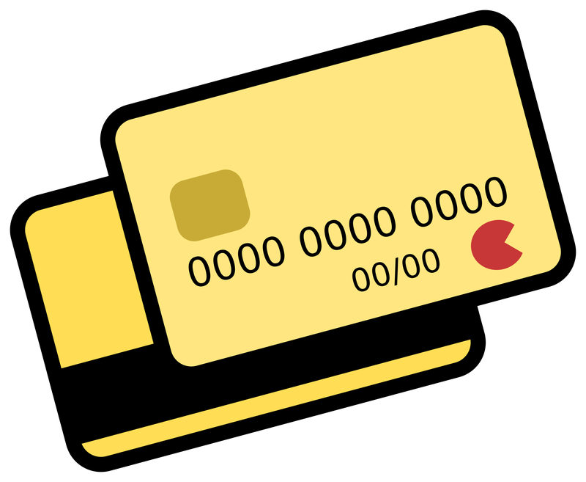
Gift Card Request Form Section 6 – Number of Gift Cards and Loads
Auto populates
Auto populates
20
4
Formula:
(20 Participants x Fee per card*)
+
(Load per card x Fee Per Load* x 20 Participants)
=
Total Fee Amount
ClinCard formula calculation example:
4 different visits
*See website for fees

Slide 19
Gift Card Request Form Section 7 – Gift Card Amount(s) & Payment Schedule/Milestones
What is a Milestone?
Schedule/Milestone: Payment schedule will be defined as milestones in the ClinCard system.
Note: After you select Card Type from Section 2 the formulas will appear in Section 7. Section 7 will only be available for ClinCards.
Before
After
Section 7 continued on next page

Slide 20
Gift Card Request Form Section 7 – Gift Card Amount(s) & Payment Schedule/Milestones
Load/Payment # (1, 2, 3, 4, etc.): The number of phases (day, visit, survey) the recipient will be participating during the study.
If your study requires more than 14 loads, use a separate sheet of paper to log those additional visits. Reminder: the calculations will not account for those additional loads.
Note: This section is only available when selecting ClinCard in Section 2
Section 7 continued on next page

Slide 21
Gift Card Request Form Section 7 – Gift Card Amount(s) & Payment Schedule/Milestones
Amount Per Visit: Enter the payment amount for each visit. For example: 20 participants will receive:
Day 1: $10.00
Day 2: $20.00
Day 3: $25.00
Day 4: $10.00
Quantity of Cards: Fill in the quantity of cards being distributed during each visit. In this example we will use 20 participants.
Section 7 continued on next page

Slide 22
Gift Card Request Form Section 7 – Gift Card Amount(s) & Payment Schedule/Milestones
Total Gift Card Dollar Amount: Sections 6 & 7 were created to auto calculate the total budget amount for our users. By filling out these fields as previously shown, the gift card fees will be combined with the participant payments to give you the Total Gift Card Dollar Amount.
*See website for fees

Slide 23
Gift Card Request Form Section 8 – Signature and Consent
By signing this application the custodian/study coordinator/PI acknowledges that they have read the policy, and are responsible for safeguarding, disbursing, tracking the distribution of the cards, and submitting the appropriate forms.

Slide 24
Gift Card Request Form Section 9 – Gift Card Approval
All approvals are required. Each approver is certifying that they are in agreement with the request, knowledgeable and compliant with university policies and regulations.
Ensure all signatures have been captured before sending form to giftcards@rowan.edu.

Slide 25
Gift Card Request Form Finance Distribution & Tracking
Do I need to complete the Finance Distribution & Tracking section as the custodian/study coordinator?
No, this section will be filled out by the finance department once you come to pick up the gift cards.

Slide 26
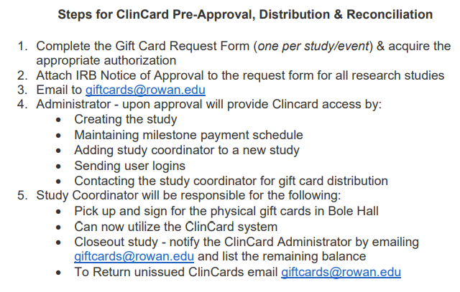
Gift Card Request Form Gift Card Procedures
What are the gift card procedures?
The third page of the Gift Card Request Form is a quick overview of the gift card procedures for ClinCard.
More gift card information can be found on the Accounts Payable website: https://sites.rowan.edu/accountspayable/gift_cards/index.html

Slide 27
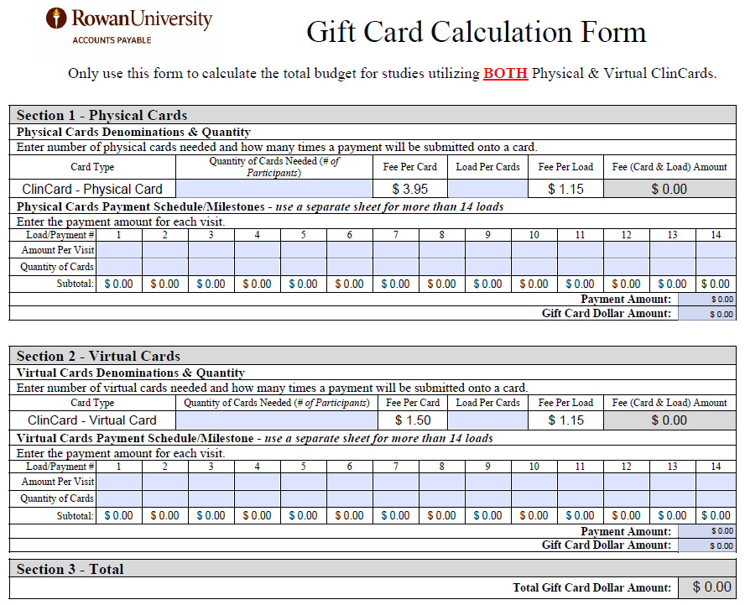
Gift Card Request Form Gift Card Calculation Form
What is the purpose of the Gift Card Calculation Form?
The Gift Card Calculation Form will allow you to calculate ClinCard fees and total dollar amounts when requesting BOTH physical & virtual cards.
This form will only be visible when selecting Both in Section 2 of the gift card request form.
Continued on next page

Slide 28
Gift Card Request Form Gift Card Calculation Form
How do I use Gift Card Calculation Form?
This form is comparable to Gift Card Request Form Sections 6 & 7. This form will allow you to calculate fees and totals for both physical and virtual cards then combine the amounts for a final total.
Section 1 – Physical Cards
Continued on next page

Slide 29
Gift Card Request Form Gift Card Calculation Form
Section 2 – Virtual Cards
Section 3 – Total
This section will calculate the total budget amount for the request.
See example on next page

Slide 30
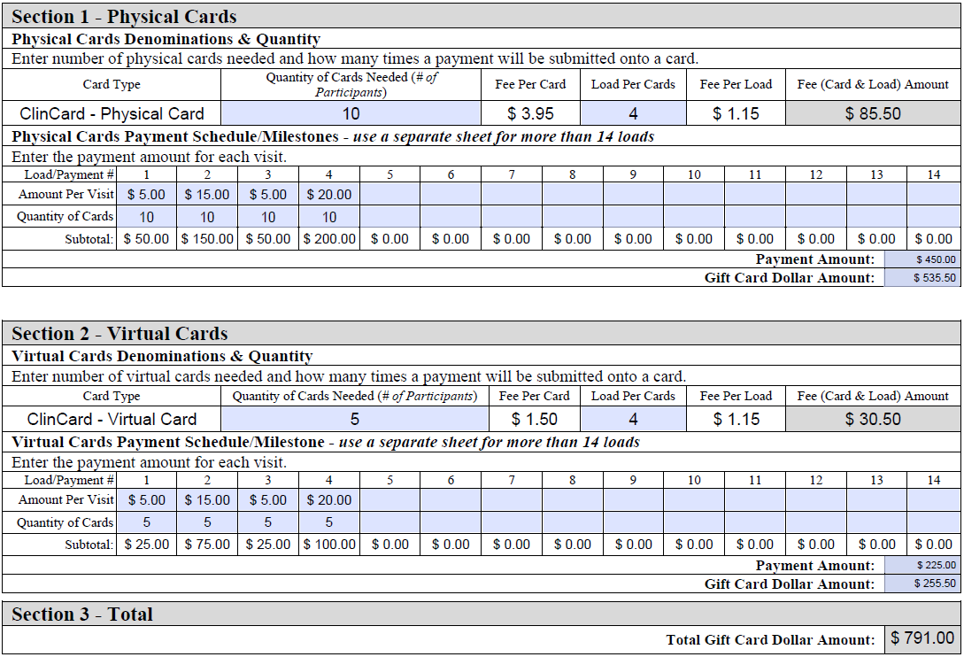
Gift Card Request Form Gift Card Calculation Form
Example of completed Calculation Form:
Physical Cards
Cards needed: 10
Load Per Card: 4
Fees: (auto populated)
*See website for fees
Virtual Cards
Cards needed: 5
Load per card: 4
Fees: (auto populated)
*See website for fees
There are 15 participants (Quantity of Cards) and this study requires them to complete 4 different portions (Load Per Card) of a study: i.e. surveys, doctor visits, other appointments, etc.

Slide 31
Gift Card Payment Acknowledgment Custodian responsibilities
What tax information is the custodian responsible for reminding the recipient?
The custodian is responsible for communicating the following to the recipient :
Non- Employees: understand that if they receive $600.00 or more in a calendar year, they may be subject to 1099 reporting. If the total dollar amount a non-employee receives is less than $600.00, it is the responsibility of the individual to report these earnings.
Employees & Student workers: understand the value of the gift card will be added to their W-2 through Payroll regardless of the dollar amount for tax reporting purposes.
Reminder: The value of gift cards given to non-employees is taxable and reportable income on IRS form 1099 if the value of gift cards plus any other non-W2 compensation received by an individual from the University as a whole aggregates to an amount of $600.00 or more per calendar year.

Slide 32
Gift Card Do’s and Don’ts
Do
Only email forms accepted
Email form to giftcards@rowan.edu
Email request 4 weeks in advance
Complete the entire form(s)
Attach IRB documentation if applicable
Acquire all approvals
Don’t
Do not send forms interoffice
Do not hand deliver forms
Do not send incomplete forms
Do not buy out of pocket

Slide 33
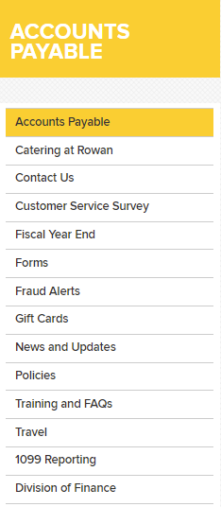
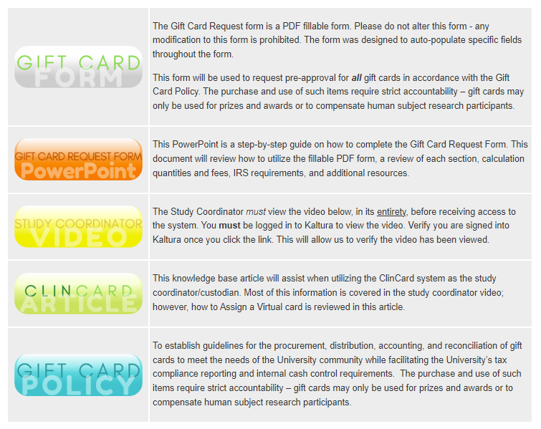
Gift Card Request Resources
All gift card resources can be found on the Accounts Payable website under Gift Cards
FAQs
Form
Knowledge Base Article
Policy
Procedures
Study Coordinator Video

Slide 34
Gift Card Request Contact information
All gift card related requests and questions should be directed to the dedicated inbox, giftcards@rowan.edu.

