Slide 1
A Primer for Promotion
2017-2018
Barbara Bole Williams
Chair, University Senate Promotion Committee
williamsb@rowan.edu
(Adapted from presentation of Barbara Bole Williams, Jess Everett and Scott Morschauser)

Slide 2
Promotion MOA
Read It! Be sure it’s dated 10.19.17!
Senate website under “Promotion” on the left side menu OR
Provost’s website under “AFT local agreements and titled Promotion Agreement 2017-2019 - Updated October 19, 2017
OR
https://sites.rowan.edu/academic-affairs/aftlocalagreements.html
  Under Faculty Downloads
  Be sure it is the updated version (10.19.17)
  Date on lower right handed corner of coversheet

Slide 3

Disclaimer
This presentation represents the an interpretation of the MOA
Other interpretations may be made by various committees, chairs, and administrators
skydancingblog.com/2010/09/

Slide 4
Tenure & Promotion
If you are going up for tenure, your tenure packet will also be used for promotion to associate professor
  You do NOT need to go through the separate promotion process
  See MOA, Rationale, Promotion, Page 3
T&R
Prom.

Slide 5

Promotion - proficiency in
Teaching Effectiveness
Scholarly and Creative Activity
Contribution to University Community
Contribution to Wider & Professional Community
Defined in
  MOA, Appendix A
  Department / College
  Promotion document

Slide 6

Your application
Describe your experiences as a teacher, scholar, & professional
Make compelling argument for what you do
Clearly show how you met benchmarks

Slide 7
Folder Contents [MOA 5.2]
See Appendix D
FORM 2 - Relative Weights of Areas of Evaluation for Promotion
FORM 3 - College/Department/Office Promotion Committee Recommendation Form
(no FORM 4)
FORM 5 - Application for Faculty Promotion
FORM 6 - Checklist with page #s & initialed by dept. promotion chair
FORM 7 - External Reviewer Conflicts of Interest (info only,
not for inclusion in packet)
FORM 8 – Signature Sheet for Evaluative Criteria
FORM 9 - Courses Taught and Adjusted Load Worksheet
Form 10 – Personnel Resume
Form 11 – Department Recommendation Form (fully signed)
Be sure it is 10.19.17 version of MOA
IMPORTANT:
Use online versions of forms when completing.

Slide 8
Folder Contents (Cont.)
(Corresponds to Form 6 Faculty Promotion Checklist)
Curriculum Vitae
Executive Summary (examples in Appendix C)
Job Description
  If original posting unavailable, work out with dept. promotion committee chair--Clearly state source of description
Approved Department Promotion Criteria Document
  From last promotion or year of hire
  Also included in this section:
    Weight and interpretation of criteria
    Evaluative procedures
    Role of Department Chairperson
    Definition of Terminal Degree
Notes:
Checklist typos. Two 8’s. Committee instead of College

Slide 9
Folder Contents (Cont.)
Teaching/Professional Performance
  Self-Appraisal, Student Evaluations, Peer Evaluations, Plans for Future Growth
Scholarly/Creative or Professional Development
  Self-Appraisal, External Review & Response (Full Professor only), Plans for Future Growth
Service to University
  Self-Appraisal, Plans for Future Growth
Service to Wider Professional Community
  Self-Appraisal, Plans for Future Growth
Department/Committee Evaluation, Numerical Vote and Minority Report (if necessary)
  ENSURE ALL SIGNATURES ARE PRESENT
Supplemental Folder (if needed)

Slide 10
Curriculum Vitae
Clearly describe accomplishments [MOA 4.2]
  Authorship
    List authors / principle investigators in order of article/proposal
  Dates
  Journal articles, chapters or books
    What was your role? (Especially if you are not 1st or 2nd author)
    How good is the Journal or Publisher? (Various indexes)
    Why is it a good article, chapter or book? (e.g., # of citations)
  Conference articles
    In the proceedings?
    Acceptance based on abstract or paper?
  Grants
    Include: Principle Investigators, Title, Funding Agency, $ amount, Years & Status
      Status – Pending, Declined, Funded

Slide 11

Executive Summary (see Appendix c for examples)
2-5 pages summarizing highlights of your accomplishments during review period
  Make it easy for evaluators to “count” your accomplishments
Consistent with Curriculum Vitae & rest of document
Notes:
http://www.infotales.com/wp-content/uploads/2013/09/Facebook-Fan-Counter-fliike.png

Slide 12
Relative Weights
Specify relative importance of:
  Teaching Effectiveness
  Scholarship and Creative Activity
  Contribution to University Community
  Contribution to Wider &
  Professional Community
Explicitly identified in portfolio [MOA 1.4]
Signed letter from Chair AND Dean specifies your weights [MOA 1.75 & FORM 2]. Changes in release time result in new weights, recorded in another letter. If your weights changed during the period of evaluation, time-weight them. [MOA 2.522]

Slide 13

Self-Appraisals
Demonstrate honest and deep appraisal
Notes:
http://www.halogensoftware.com/uploads/blog/self-appraisal-examples-to-use-as-guidance-or-inspiration/_thumb/848x450/self-appraisal-examples-to-use-as-guidance-or-inspiration.png

Slide 14

Plans for Future Growth
Be as specific as you can be
Provide timelines
Notes:
http://events2011.groupedr.eu/media/cache/136_resized_600_600_90_4f74324714087_goingforgrowth.jpg

Slide 15
2017-2018 Schedule
(See MOA Faculty Promotion Calendar )
Before Oct 15 – Inform Department Chair/Head of intent to apply
Oct 15 - Intent to Apply form
Nov 1 - Department Committees
Nov 1 - External Evaluator Names
  Department & Dean (approve w/in 2 weeks)
Dec 1 - College Committees
Jan 15 - External Evaluator Assessments
Jan 15 - Submit Application to Department (Committee) Chair
Feb 1 - Department Committee Concludes Work
March 1 - College Committee Concludes Work
April 1 – Senate Committee & Deans Conclude Work
May 1 - Provost Concludes Work
June 1 - President Concludes Work
June - Trustees Acts on Recommendations

Slide 16
Applicant
Write letter to Department chair
Sign intention to apply form
(Office of Provost)
Complete promotion application (Form 5)
Ensure documents get to proper person / office
Candidates for full professor ONLY [MOA 5.24 & 5.34]
  Identify ≥3 external evaluators
    No conflicts of interest [FORM 7]
    Dept. promotion comm. sends ≥3 names to Dean (with CV for each)
    Sample letter (on provost promotion website)

Slide 17
Application Copies
Original signed paper copy & pdf to DPC [MOA 5.26]
  Plus one paper copy of supplemental material
Ditto to CPC [MOA 5.344]
  With dept. report and Candidate response
College promotion chair provides pdf & supplemental to Dean [MOA 5.4232]
    With College report and Candidate response
College promotion chair sends original signed paper copy to USPC [MOA 5.4235]
ANY unfavorable votes (Department or College)
  College promotion chair sends electronic copy to USPC Chair [MOA 5.4234]
    Candidate may wish to provide supplemental as well
Candidate: make sure this happens!
DPC = Department Promotion Chair
CPC = College Promotion Chair
USPC = University Senate Promotion Committee

Slide 18
Department Responsibilities (5.3)
Department Purpose Statement
Promotion Document defining Standards
  All 4 areas
Schedule for evaluation
Review standards and procedures periodically
  Approved by College Deans and Provost
Your evaluation is based on the approved promotion
document in effect when you were last promoted (or hired if you are not yet promoted) [MOA 1.5]

Slide 19

Department Responsibilities (Cont.)
Faculty evaluation
  Plans, standards, criteria, procedures, schedules
New faculty orientation (5.314)
In-House Costs
Optional Development Plans (1.6 Preamble and 5.315)
Notes:
http://abacus.bates.edu/bcsg/images/committee.jpg

Slide 20

Department Promotion Committee (DPC)
Meet with candidate to review portfolio
Write Recommendation Report
  Includes vote
  Must give to Candidate
  ≥24 hours before due to respond
DPC FAVORABLE
  DPC informs applicant and
  forwards materials to
  CPC
Candidate must respond to DPC report,
report & response are incorporated into application

Slide 21
Department Promotion Committee (Cont.)
DPC UNFAVORABLE
  DPC report explains unfavorable vote, including how candidate does not meet the criteria
  At request of candidate, meeting scheduled to discuss
  Applicant can withdraw application or ask to have materials forwarded to CPC
    Candidate is responsible for forwarding the documents
ANY Unfavorable Vote at DPC
  USPC reviews promotion process
Split votes requires inclusion of a minority report
Once DPC Report is signed, your application cannot be changed
  Except addition of reports and candidate responses

Slide 22
Tips for Departments
Guide Candidate in early years
Provide thorough, honest, direct reviews to Candidate (T&R and Promotion)
Give Candidate things to think about, reflect upon, and grow from (things candidate can write about)
Suggest improvements & give constructive criticism
Provide relative weights
Provide constructive peer observations,
  Relate to department criteria
  Do not merely summarize the class

Slide 23
Sample Criteria for Peer Observation
Good organization of subject matter
Appropriate pacing
Adherence to departmental
syllabi & policies
Effective communication
Knowledge and enthusiasm for
subject matter & teaching
Positive attitudes toward students
Fairness in examinations and grading
Flexibility in approaches to teaching
Appropriate student learning outcomes

Slide 24
College Promotion Committee (CPC)
USPC runs elections for most colleges
Role of CPC
  Review DPC recommendation & evaluate application
  Meet with candidate to review portfolio
  Write Recommendation Report
    Includes vote
    Must give to Candidate
    ≥24 hours before due to respond
  Forward recommendation & application
    Electronic + supplemental to College Dean
    Original signed Paper copy to University Senate
Candidate must respond to CPC report, report & response are go into application

Slide 25
College Promotion Committee (Cont.)
Split votes require inclusion of a minority report
CPC UNFAVORABLE
  Candidate can withdraw from process by informing College Dean and USPC Chair
  CPC report “must describe actions candidate can take to improve future portfolios” [MOA 5.4231]
ANY Unfavorable Vote at CPC
  USPC reviews promotion process
    Chair informs USPC Chair and sends application pdf

Slide 26

College Dean
Review DPC & CPC recommendations, rationales and Applicant portfolio
Meet with applicant
Write recommendation report and deliver to candidate, DPC & CPC chairs
  If Negative, applicant may
    Withdraw from further consideration, or
    Appeal negative recommendation by advancing application to Provost
  Positive
  recommendation
    Automatic advance
    to Provost

Slide 27
University Senate Promotion Committee (USPC)
Members from each College
Chair elected by Senate
Conduct and supervise election of College Committees
Receive, retain and review all applicants who received 1 or more negative vote at department or college level
  Determine if procedures followed by DPC & CPC
    Certify process to provost (or certify violation)
    Forward original signed paper copies to Provost

Slide 28
Administration
Provost & President “largely procedural”, but can (and do) conduct substantive reviews
Provost reviews portfolios & makes recommendations to President
  Copy of recommendation provided to candidate
    If not recommended, candidate may
      Withdraw
      Request materials forwarded to President
President considers Provost recommendation & informs candidate of his/her decision
  Candidates or Chairs of any promotion committee can request meeting [MOA 6.3]

Slide 29
Board of Trustees
Recommendations
considered by BOT
at June meeting
Promotion takes
effect following
September

Slide 30
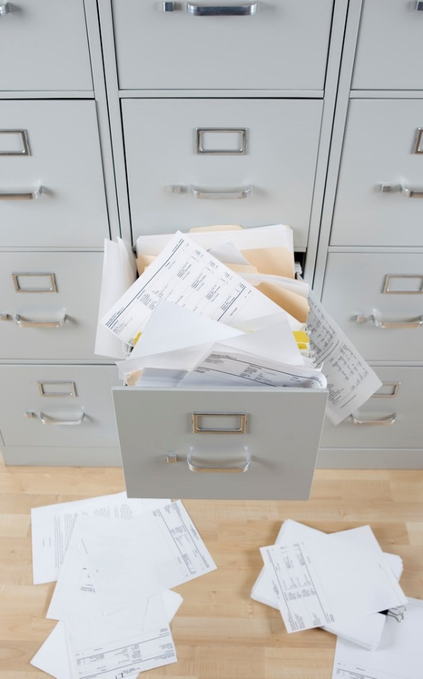
Frequent Concerns
Sloppiness, lack of organization,
missing page numbers
  Show pride in work
Poor candidate reflection
Poor candidate response to student
evaluations and peer observations
  Provide thorough self-reflection &
  explanations
  Provide all student comments. Respond!
Missing signatures and/or dates

Slide 31
DOUBLE CHECK FOLDER
MOA checklist
  Initialed by DPC Chair
Consecutive page numbers
Student evals signed and dated by DPC Chair
Peer observations signed and dated by Observer and Candidate
Department Evaluation signed and dated by all DPC members and Candidate
  Numerical vote must be recorded
College Evaluation signed and dated by all DPC members and Candidate
  Numerical vote must be recorded

Slide 32
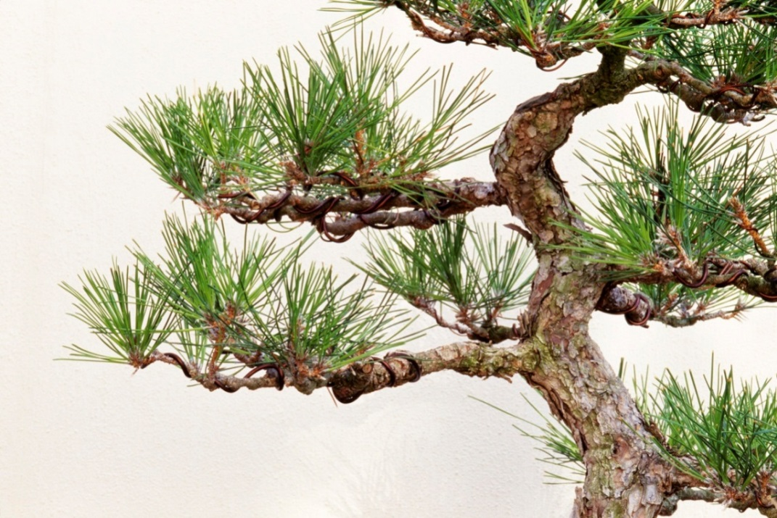
Tips for Candidates
Print Double-Sided
Check and double-check
file organization
Check spelling and
grammar (proof-reader?)
If inserting pages at the last minute, use letters with numbers (14, 14A, 15, etc.)
Use tabs to divide sections of folder
Do not double count [MOA 2.53]
  Single work should not be counted in more than one category

Slide 33
Tips for Candidates (cont.)
Carefully read MOA and checklist
Know your department guidelines
Make a strong case
  Prove you are deserving of financial commitment from university
  Show pride in work
  Thorough self-reflection, explanation, and documentation of work and growth in all 4 areas
Do not leave anything open for questioning by multiple reviewers outside your Department
  Respond to any and all issues raised in review letters from most recent previous review cycle

Slide 34
Tips for Candidates (cont.)
Include all student evaluations & peer observations
  Only current are required. Rest can go in Supplemental
Show the questions on student evaluation form
  E.g., Blank survey form
Explain the scoring of the student evaluations
  Range (0-4 ? 1-5?)
  Value (5=poor? 5=excellent?)
Include Table or Figure summarizing ALL student evaluations
  By class classes & semester

Slide 35
Example Figure of Student evaluations
5
4
3
2
1
*
*
*
*
*
*
*
*
*
*
*
*
*
*
*
*
*
*
*
*
*
Student Eval on Question 12
* Class 1
* Class 2
* Class 3
* Class 4
* Class 5
F12 S13 F13 S14 F14 S15 F15
Semester
Question 12: How do you rate this instructor?

Slide 36

Tips for Candidates (cont.)
Put supporting material in Supplemental File
  Table of Contents
  Tabs
  Page numbers
Include any student or peer
evaluations not in the
Promotion folder
in Supplemental File

Slide 37
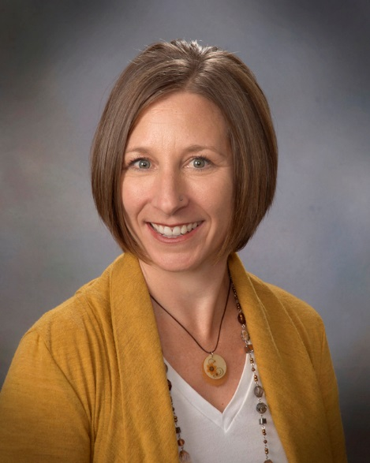
Where to go for help
Department Promotion Committee members
Faculty Center
Director: Bonnie Angelone
angelone@rowan.edu
3rd Floor James Hall
  Mentoring
  Sample documents
  Organization
  Teaching tips

Slide 38
Where to go for help (cont.)
Senate website
  Faculty Promotion MOA &tips available for download
  www.rowan.edu/president/senate/ (then click “Promotion” on left)
Check website for Promotion tips and documents
  Provost website - http://www.rowan.edu/provost/aft/
Chair of USPC:
  Barbara Bole Williams (williamsb@rowan.edu)

