Slide 1

Effective Performance Reviews
A major factor in employee success and engagement

Slide 2

DISCUSSION TOPICS
Common Review Perspectives
Keys to Success
General Recommendations
System Overview & Tips
New Hire Guidance
Process and Timelines
Questions and Support

Slide 3

Common Perspectives on Performance Reviews
When you think of writing and delivering performance reviews, what comes to mind?
When you think of receiving a performance review from your manager, what do you think of?
What do you think comes to mind for most employees?

Slide 4

Common Negative Supervisor Perspectives on Performance Reviews
Delivering bad news is difficult; employees may get defensive
My direct reports don’t take constructive criticism and professional development suggestions well
I don’t see the value gained through the process.
I struggle to come up with specific, measurable goals.

Slide 5
Common Positive Supervisor Perspectives on Performance Reviews
Builds rapport with my team members (discussing career aspirations, progress, where they can improve, etc.)
Develops my skills as a Supervisor (writing, coaching, having challenging conversations, etc.) and the skills of my direct reports (writing, goal setting, evaluating their own performance, etc.)
Helps my team stay on target with individual and departmental goals
Can be used as a tool to manage and document performance improvement and performance issues;
  Documentation is critical when an employee’s performance is subpar

Slide 6
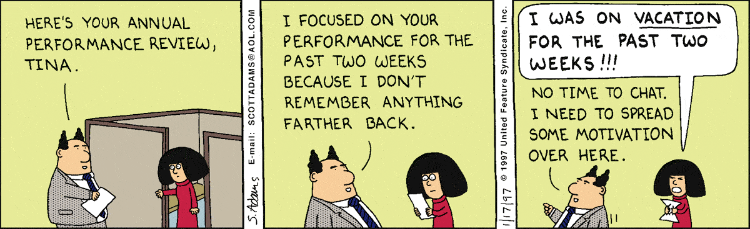
Common Negative Employee Perspectives on Performance Reviews
It’s a meaningless exercise that Managers just want to get through.
There’s always one negative focus area and then little about anything else.
It’s rarely a two-way discussion.
The basis for measurement is vague.
My manager has a minimal understanding of my work.

Slide 7

Common Positive Employee Perspectives on Performance Reviews
Receiving feedback is a growth opportunity that will improve my overall performance
It’s scheduled time to discuss my career plan, professional development options, and other concerns
The process will sharpen my skills (evaluating my performance, writing, performance discussions, etc.)
The process ensures that I am on target with goals and daily responsibilities

Slide 8

Reviewer Keys to Success
Demonstrate respect and confidentiality
Encourage conversation at the review meeting
Track performance year-round (positive and negative)
Frequent one-on-one feedback meetings to discuss goal progress and overall performance is critical to prevent annual review surprises.
Ratings and narrative regarding subpar performance must be specific; if not, the behavior is unlikely to change!
Avoid recency bias! The review must be an annual review.
  Example: Great performance for 11 months of review period, 1 mistake in the last few weeks before review is written by supervisor = subpar review and vice-versa – not fair, but often happens!

Slide 9
Avoid the Halo/Horns Effect
Definition: a type of cognitive bias where a person’s impression of another can substantially influence one’s thoughts and feelings about that person.
Best way to avoid: Strong documentation; take notes on all aspects of performance throughout the year – it helps ensure a more well-rounded review for the employee.
Without notes, managers can tend to base their evaluations around one event or a recent memory of events.
What have you found to be the most important keys to ensuring successful performance reviews?

Slide 10
Review Completion
Ensure your comments are constructive, specific and focused on performance
Vague | Specific
You frequently miss tasks and project deadlines. | The ABC report that was due on October 15th was received on November 8th. The XYZ project was due on December 31st and was turned in on January 22nd.
You seem to make a lot of errors. | During August, you made five errors on the monthly report, three errors on the customer service letter, and routed four calls incorrectly.
You are never at your desk. | I went by your office four different times yesterday and you weren’t there.

Slide 11

Review Completion
Another example:
Instead of:
“You have good communication skills.”
Consider:
“Your verbal and written communication is clear, accurate and thorough. The monthly reports you submitted were complete, easy to understand and required little to no modification. You can further enhance your presentation skills by taking a training course on Effective Presentations.”

Slide 12

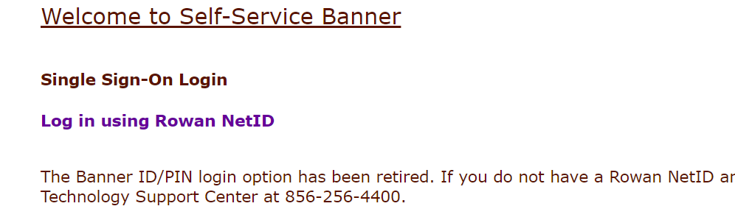
Completing the Managerial Performance Review
System Access:
Self-Service Banner (SSB) –
Log Into SSB > Click On Employee Tab > Employee Dashboard > Manager Employee Menu In Bottom Right Corner > You Will See The Managerial Review Form Link > Click On This Link To Access The System.

Slide 13
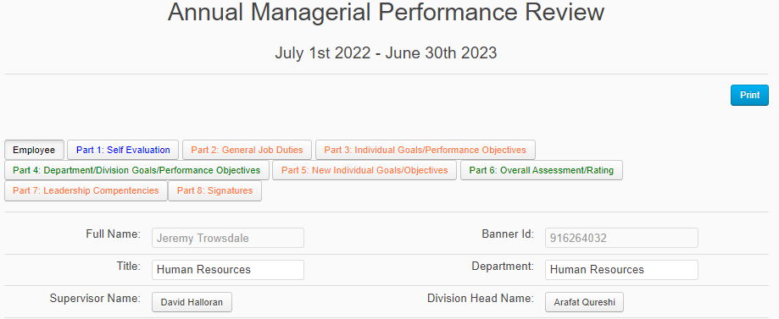

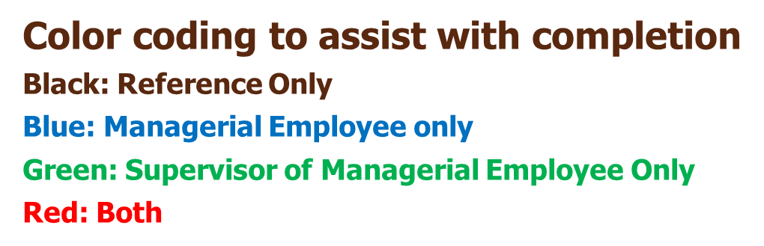
The Employee Tab

Slide 14
Completing the Managerial Performance Review
Part 1: Self Evaluation
Blue indicates to be completed by Mgr. employee only

Slide 15
The Importance of the Self-Evaluation
Your Manager may not have all the facts
  They may not be maintaining a list of your accomplishments throughout the year
  Even worse, they may only be remembering the one project you were unsuccessful with this year
  Ultimately, the person with the most knowledge of what you do at work is you.
You and your manager might not be on the same page
  Your self-evaluation may cause your manager to see your performance in a different light
  By recommending goals for the upcoming year, you can drive your area in the way you see best
Allows you the opportunity to recommend the professional development plan that makes sense for your role

Slide 16
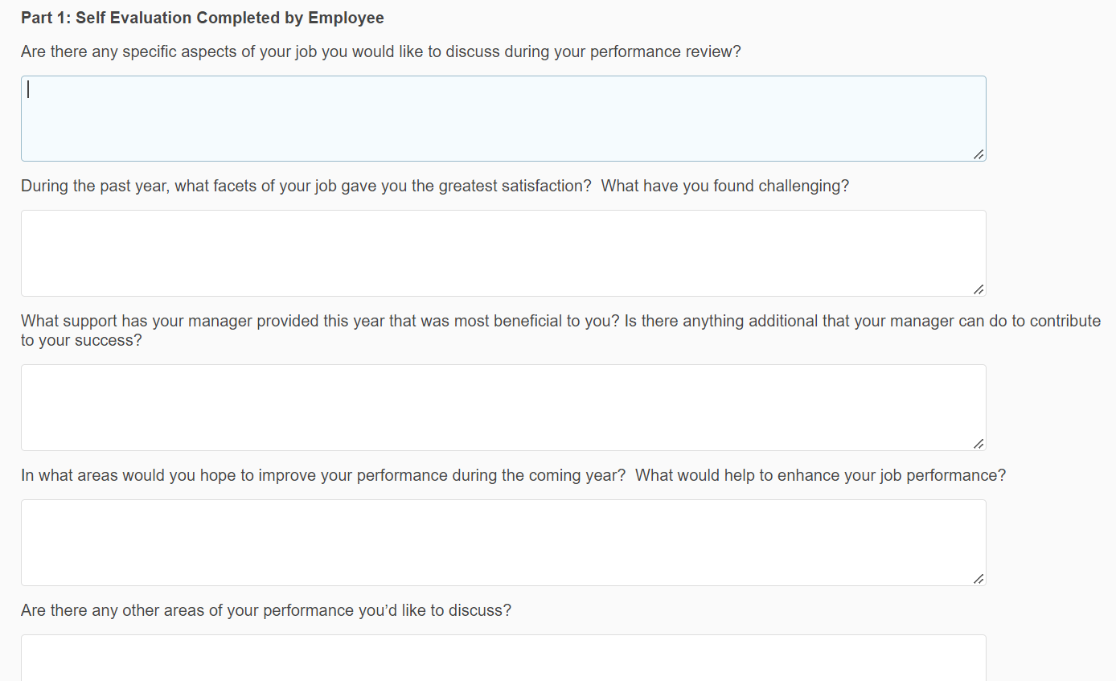
The Self-Evaluation

Slide 17
Completing the Managerial Performance Review
Part 2: General Job Duties
Red indicates the Supervisor of the Mgr. employee will complete ratings and comments and the Managerial employee will edit any Duties/Responsibilities if necessary
Note: If the Managerial employee didn’t receive a review in 2022, they will have to fill in the Duties/Responsibilities

Slide 18
Performance Review Sections
  General Job Duties (Part 2) – 4 to 5 major areas for which the employee has responsibility
    Mgr. employee does not provide self-narrative; Rating and comments completed by Supervisor of Mgr. employee
    Comprised of what the employee does, oversees, or both (brief description)
    Note: If employee received Mgr. Rev. in 2022, the verbiage from that review will already be there (it is moved over)
  Supervisor can edit the responsibilities if needed; new hires and transfers will need their duties/responsibilities data entered

Slide 19
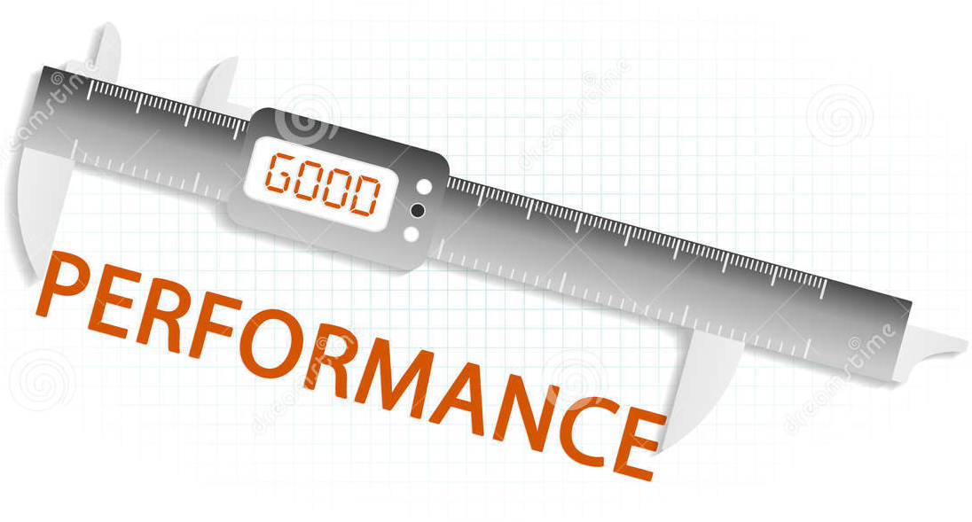
General Job Duty – Example
Administration & Training for performance management
Expectation (Description of the job duty)
  - Oversee the ePAR process and monitor compliance of ePAR forms
  - Advise supervisors regarding performance issues and the applicable documentation.
  - Ensure training programs are held on a regular basis.
  - Develop and maintain regular performance management workshops for managerial employees.
  - Track compliance of managerial forms.

Slide 20
The Ratings System
Outstanding Achievement: Employee performance is consistently excellent and exceeds expectations. Demonstrates very high level of performance in all areas of responsibility. Viewed as a role model in position. Demonstrates high levels of effort, effectiveness, and judgment.
Full Achievement: Performance consistently meets the appropriate level of expectations. Consistent, ongoing accomplishment of goals and ongoing work responsibilities; successful in terms of expected work output, quantity/quality and contribution to unit success.
Partial Achievement: Performance did not consistently meet expectations or at times was below expectations. Inconsistent job performance related to goal achievement, quality, quantity of work and/or the individual is not yet technically proficient or does not show sustained and continuing progress toward achieving proficiency, ongoing work results, or goals.
Unacceptable Achievement: Performance did not meet most objectives and/or did not demonstrate results at the expected level. Termination for cause is likely unless performance materially improves promptly.
The Ratings System descriptions can be seen on the Employee tab in every performance review.

Slide 21
Completing the Managerial Performance Review
Part 3: Individual Goals/Performance Objectives
Red indicates both the Mgr. employee and their supervisor will be completing part of the section

Slide 22
Individual Goals/Performance Objectives
Employees who received a Managerial Review last year: The goals that were set in last year’s performance review carry over to the new review. Provide input on your performance as it relates to these goals. If a goal was changed during the year, edit accordingly.
Employees who did not receive a Managerial Review last year: The employee will either fill in the goals given by their supervisor since their hire date, transfer date, etc. or leave the section blank if they are a recent New Hire or have not received goals.
Supervisors: Either select N/A in the Ratings dropdown menu or rate the goals accordingly. Add Comments to substantiate the rating.

Slide 23
Completing the Managerial Performance Review
PART 4: DEPARTMENT/DIVISION GOALS/PERFORMANCE OBJECTIVES
GREEN INDICATES THE SUPERVISOR OF THE MGR. EMPLOYEE WILL BE COMPLETING THE SECTION

Slide 24
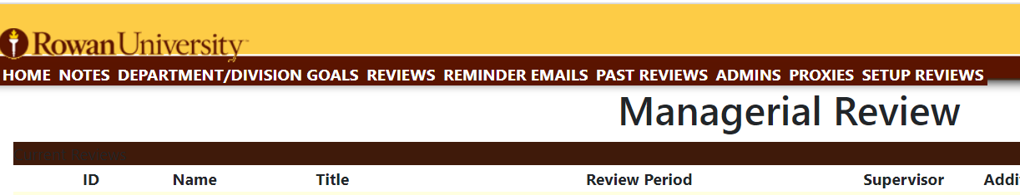
Department/Division Goals/Performance Objectives
Supervisor completes before Mgr. employee writes their individual goals – ensures individual goals are aligned with Department/Division goals
  Click “Department/Division Goals” on Home screen and add each goal one by one; on Part 4 of each employee’s review, select each department/division goal on the dropdown box and the description will flood in automatically.
Beginning June 1, Mgr. employee can begin Self-Evaluation, Supervisor can begin Department/Division Goals; once Department/Division goals done, Mgr. employee can complete their individual goals and finalize their self-eval.

Slide 25
Completing the Managerial Performance Review
Part 5: New Individual Goals/Objectives
(Red indicates the Mgr. employee and possibly their supervisor will be completing part of the section)

Slide 26

Goal Setting Guidelines
Goal setting in partnership is an effective strategy. The Review system is designed accordingly.
Potential Issues with Manager completing solely:
  The employee feels left out of the process
  Limited buy-in from the employee
  Resentment towards the manager may develop
Potential Issues with Employee completing solely:
  Misalignment with overall organizational/departmental goals
  Goals may be focused on existing strengths of employee rather than challenging the employee to grow in other areas that are outside his/her comfort zone

Slide 27

Goal Setting Guidelines
Goal setting in partnership should ensure the goals:
  Align with University/Department objectives
  Offer a fair amount of challenge
  Create buy-in from both parties
  Are more project than task list oriented
Things to consider when writing goals:
  What steps the employee will take … by when?
  What steps the supervisor will take … by when?
  Criteria for assessing success
  Process to track and review plan

Slide 28
Completing the Managerial Performance Review
Part 6: Overall Assessment/Rating
Green indicates the supervisor of the Mgr. employee will be completing the section

Slide 29
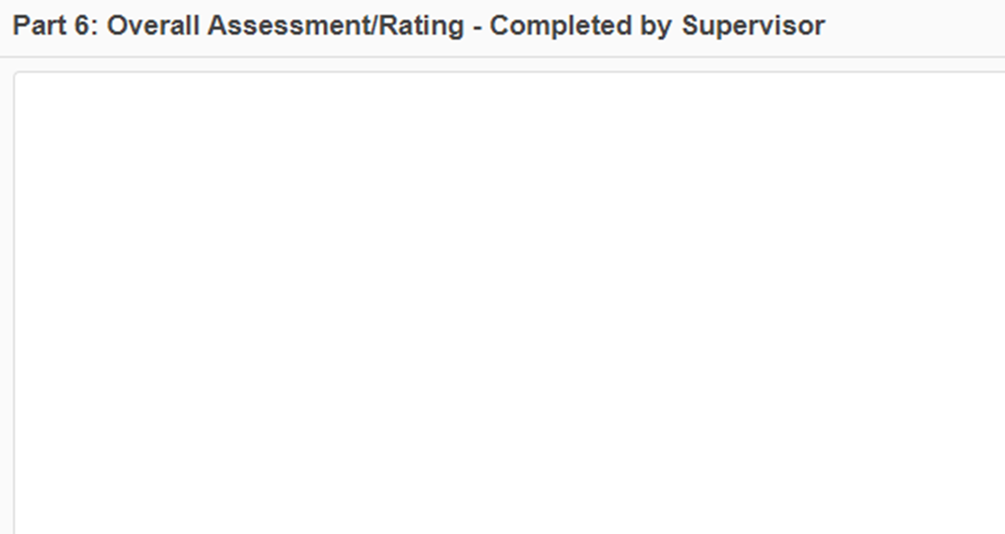
Overall Assessment/Rating
Supervisor provides an overall performance summary (narrative) and an overall rating for the employee – it should be brief
The Managerial employee doesn’t complete any part of this section.

Slide 30
Completing the Managerial Performance Review
Part 7: Leadership Competencies
(Red indicates the Mgr. employee and possibly their supervisor will be completing part of the section)

Slide 31
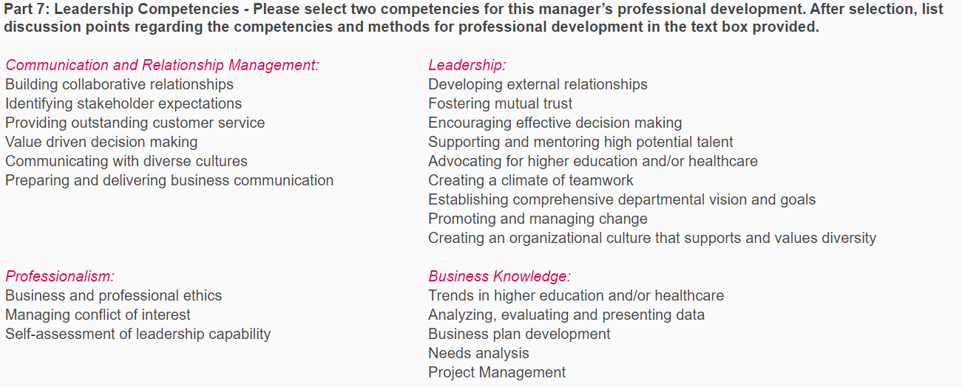
Leadership Competencies
Completed by Managerial employee as a draft, supervisor to edit.
What type of professional development would add value to the employee’s role at Rowan?
Examples: certifications, new job tasks, new projects, training classes, other education, etc.

Slide 32
Completing the Managerial Performance Review
Part 8: Signatures
Red indicates both the Mgr. employee and their supervisor will be completing the section

Slide 33
Signatures
Signatures Order:
  Supervisor
  Employee (system will allow employee to sign first also)
  Division Head (if applicable)
The Employee signature only acknowledges receipt of the review, not necessarily agreement. The employee should use the Comments section to document concerns.
  Ensure all electronic signatures have been completed. The review won’t go into Final Status until that is done.
  To add the electronic signature, click “Electronically Sign”.

Slide 34
Understanding Review Status
Initial: Only the Managerial employee can view and edit the review information; the Manager and Division Head will not be able to view most of the information
Supervisor Review: Only the Manager can edit the review; the Employee can’t view the comments or ratings being added to the review by the Manager
Review Meeting: Both the Employee and Manager have completed their sections of the review and it is now able to be viewed by all three parties involved; signatures can be completed
Awaiting Division Head Signature: Review is complete and signed by the Employee and their Manager; the Division Head signature is the last task to finalize the review
Final: The review is complete, and all necessary signatures have been obtained

Slide 35


System Guidance
The Save button saves your completed work; it does not allow for saving to a computer drive.
You can save reviews to a drive if you need to, but only in pdf format. The process:
  Click the Print button, click Change, select Save as PDF, click Save, and select the drive and folder.
Spellcheck: Words underlined in red are misspelled; there isn’t a spellcheck button to click to check the whole document

Slide 36
System Guidance
Upon completion of all their sections, the Employee should click “Send to Supervisor” to notify the supervisor they can begin their sections.
Click “Return to Employee for Editing if Needed” to have the employee make changes.
Click “Ready for Review” to finalize and move to your in-person meeting
If you receive a message that you need to fix your errors, check to ensure you have filled out every comment field and selected a rating or N/A.
  Boxes that are incomplete will have a red outline if they are the reason for the error.
You will receive automated E-mails when a Status changes or the Employee “Sends to Supervisor” because they are done their portion of the performance review.
  The Subject Line will summarize the E-mail purpose (see below).

Slide 37

New Hire Guidance
Forego ratings for 2023 New Hires hired this calendar year (provide feedback only)
New Hire Goal Sheet for New Hire Managerial employees – available on the HR website (Training > Manager’s Toolkit)
  Outside of system, easy option to provide goals to a New Hire that starts mid-cycle
Benefits of completion for New Hires:
  Provides an opportunity for the new Managerial Employee and their Supervisor to agree upon and document goals (if not previously done)
  The New Employee receives a progress update.
  Facilitates next year’s review
    Carry-over of information put in this year to next year’s review

Slide 38
Process and Timelines
Review based on performance between July 1, 2022 and June 30, 2023
June 1 – June 30 – Department/Division goals are completed; Managerial employees complete self-evaluations and submit their portion of the evaluation process by June 30th.
July 1 – August 11 – Supervisors finish evaluations, review evaluations with division heads and hold meetings with direct reports
August 31 – Last day to finalize all signatures for the reviews

Slide 39
Process and Timelines
Summary of Review Sections:
  Part 1 – Self Evaluation – Managerial Employee
  Part 2 – General Job Duties – Supervisor, unless employee is a New Hire or edits are needed
  Part 3 – Individual Goals/Performance Objectives – Both
  Part 4 – Department/Division Goals/Performance Objectives – Supervisor
  Part 5 – New Individual Goals/Objectives – Managerial employee, unless supervisor would like to edit
  Part 6 – Overall Assessment/Rating – Supervisor
  Part 7 – Leadership Competencies – Managerial employee unless supervisor would like to edit
  Part 8 – Signatures – Both

Slide 40
Questions/Support
Call or E-mail:
  Jeremy Trowsdale – System/Technical questions, verbiage or ratings
  Example: If an employee’s review is missing from the system or a reporting relationship needs to be corrected
  Utilize the Managers Toolkit on the HR website under Training
    This Power Point, timelines, resources, and articles (best practices for coaching, feedback, etc.)

