Slide 1
Student Employment
Office of Human Resources

Slide 2
Agenda
Contacts
Types of Student Employment
Student Employment Rules
EPAFs
Federal Work Study Overview with Kira Aguilar
Q&A

Slide 3
Contacts
Student Work Study, EPAFs: Edyta Paluch
Paluch@rowan.edu | Ext. 53129
Federal Work Study: Kira Aguilar
Aguilar@rowan.edu | Ext. 64277
I-9 HQ & I-9s: Payton Hynson & Sonia Bodden
hynsonp9@rowan.edu | Ext. 65237
bodden@rowan.edu | Ext. 53366

Slide 4
Types of student employment

Slide 5
Federal Work Study (FWS)
Available to students who have been awarded work-study as a part of their Financial Aid package.
Student is awarded money and can look for employment on campus and use those funds to be paid.

Slide 6
Institutional Work Study (IWS)
Available to all students regardless of if they are eligible for financial aid.
Students may work both FWS and IWS but are encouraged to use their FWS funds first.
IWS funds are allocated to departments as a part of their annual budgets.
Students can apply for employment in the departments and be paid as long as the department has funds available.

Slide 7
Part-Time Hourly
Departments can hire students in a part-time temporary status using a budget or grant surplus.

Slide 8
Student Employment Rules

Slide 9
General Rules
Students may not work more than 20 hours per week while classes are in session and may work up to 25 hours per week during breaks.
Note: Students with a full-time stipend contract working 20 hours a week (i.e. Fellows or Residence Directors) may not work any additional assignments.
Students must be in good academic standing.
Students may not work until the I-9 is completed in I-9 HQ and the EPAF has been entered and processed.
Notes:
Students may work no more than 20 hours per week while classes are in session and are capped at 25 hours a week during Summer and Winter breaks. Summer hours begin at the end of the academic year and end August 31st. Departments must adhere to the 25-hour cap to ensure that students remain below the threshold for state benefits eligibility. This keeps Rowan University in compliance with federal and state rules and regulations as well as union rules regarding memberships.

Slide 10
Documentation
Do not send any copies of student documentation to Human Resources.
A paper copy of the State W-4 or Certificate of PA Residency must be filled out and sent to Payroll Services.
The Federal W-4 and Direct Deposit will be filled out by the student via Self-Service Banner once the EPAF has been processed and the job is in the system.
The student will receive an automated email instructing them to log into Banner to update these forms.

Slide 11
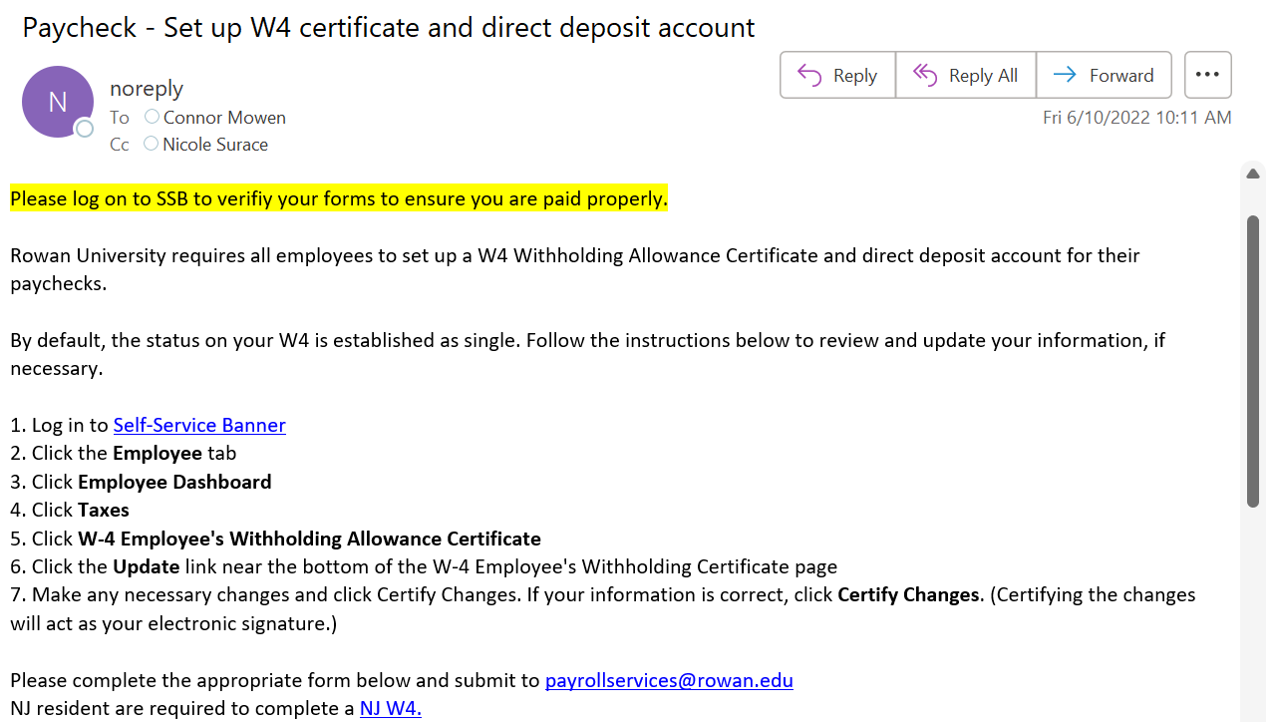
Sample Email

Slide 12
I-9s
An I-9 must be completed in I-9 HQ prior to a student beginning employment. All student employees must have a valid I-9 on file.
The I-9 must be completed prior to the EPAF being submitted.
If you’re not sure if a student has a valid I-9 on file, please reach out to Human Resources to verify.
You must view original documents (not scans/copies) when completing the I-9. It is against federal regulation to accept scans or copies of documents.

Slide 13
Compensation
Jobs are classified into four levels and seven steps per level. The more complex the job, the higher the level.
Student workers typically earn step increases after they have worked one academic year and return to work to the same department the following year.
Step increases are processed via the Student Changing Assignment EPAF.
Departments that wish to pay students a different hourly wage than listed must submit a job description and pay rate justification in the comments of the EPAF.

Slide 14
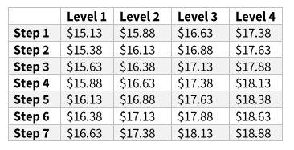
Pay Scale as of January 1, 2024

Slide 15
EPAFs

Slide 16
Types of EPAFs
New Student Assignment: To be used for a student that has never worked for the University before.
Changing Student Assignment: To be used for students that have previously worked for the University.
Terminate Assignment: To be used to end a student assignment.

Slide 17
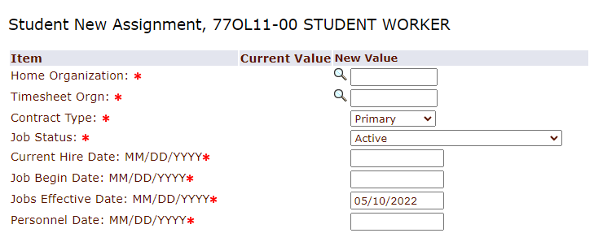
EPAF Dates for New Student Assignments
The Current Hire Date, Job Begin Date, and Jobs Effective date should all match and should all be the start of the pay period.
The Personnel Date should match the original hire date on the I-9 and should reflect the date that the new hire actually began working.
Notes:
The effective date will be the beginning of the pay period that the new hire will begin working in.
The personnel date is the date that the new hire actually began working.
Note: The personnel date must match the hire date listed on the I-9!

Slide 18
I-9 Indicator/Date on New Student Assignment EPAF
The I-9 Indicator should be marked as ‘Received’.
The I-9 Date should reflect the date that Section 2 of the I-9 was completed.
Note: the EPAF should not be submitted until Section 1 and Section 2 of the I-9 are complete.

Slide 19
EPAF Dates for Changing Student Assignments
The Jobs Effective date should be the start of the pay period. The Job Begin date should be carried over from the Current Value field.
The Personnel Date is not a required field and should be left blank unless the student needs a timesheet for a prior pay period.

Slide 20
EPAF Dates for Terminating Student Assignment
The Jobs Effective date and the Job End Date must match. The date entered cannot be prior to the Last Paid Date.

Slide 21
Federal Work Study Overview
Notes:
What do students think about the financial aid office?
Who has completed a FAFSA?
What do you know about financial aid?
What is the most confusing part of financial aid for you?
What do you think student’s need to know about for financial aid?

Slide 22
What is FWS?
FWS is a federally-funded program that allows eligible students to earn funds and gain real-life work experience through working on-campus or for an approved off-campus community service program.
Notes:
Federal Work-Study is a federally funded program that allows eligible students to earn a bi-weekly paycheck to assist with the cost of school while gaining real-life work experience. Many positions are located on campus, while others are in partnership with off-campus non-profit organizations and community service.

Slide 23
Federal Work Study
100% of wages are paid to eligible students by the Financial Aid Office
Department is only require to pay for their NJ Paid Leave (NJPL) earnings
One hour of sick time accrued for every 30 hours worked.
Student must complete a FAFSA and have financial need
Money is paid to students as a bi-weekly paycheck.
Students receive the money as they work and earn it.

Slide 24
Student Onboarding
• Must complete the I-9 form before starting work.
Must not start working before having an active timesheet in Self-Service Banner.
Student workers may work in only ONE FWS position at a time.
Student workers must be paid for ALL hours worked. Volunteering is not permitted.
Notes:
Before you can start working you need to make sure you have an active timesheet in Self-Service Banner. There is a hiring process that your supervisor will guide you through prior to your first day of work. If you are unsure, please check with your supervisor to confirm.
You are only permitted for have one FWS position at a time, but you are able to have a second job on campus, as long as it is being paid through non-FWS funds. There are limits to the number of hours you can work between your positions which we will discuss shortly.
Keep in mind- volunteering for FWS is not permitted, you must be paid for all hours worked.

Slide 25
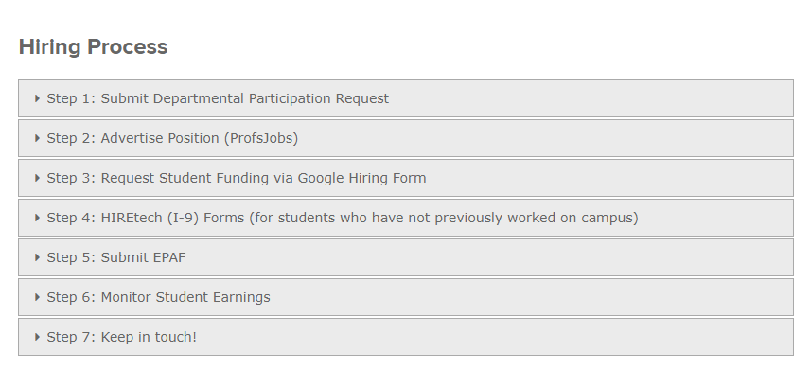
How to Participate in FWS
FWS Supervisor Information

Slide 26
Questions?

