Slide 1
Project Payments
Office of Human Resources
Updated February 2023

Slide 2
Overview of Project Payment Forms
Special Assignment Payments (Salary Vouchers)
Student Special Projects
Student Summer Contracts
Summer Non-Teaching

Slide 3
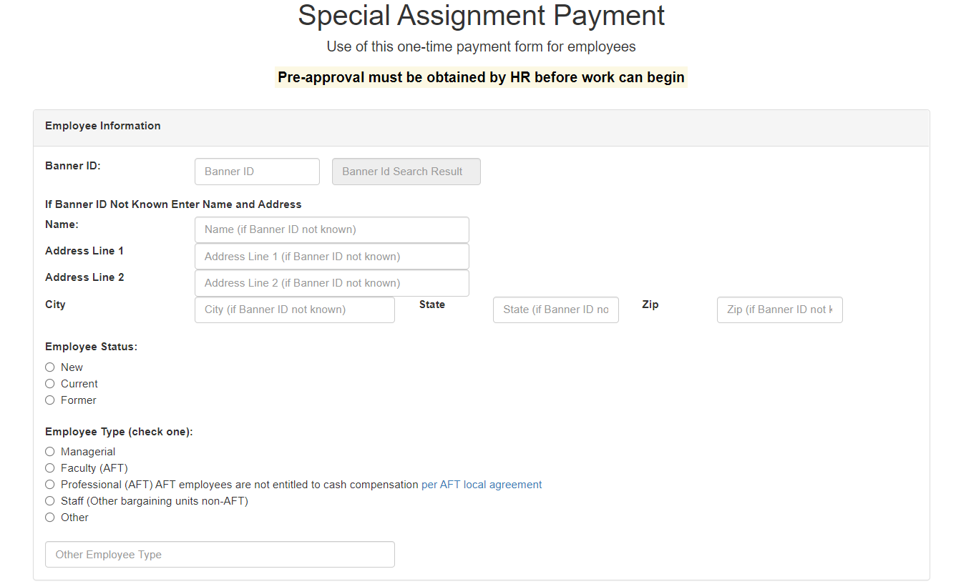
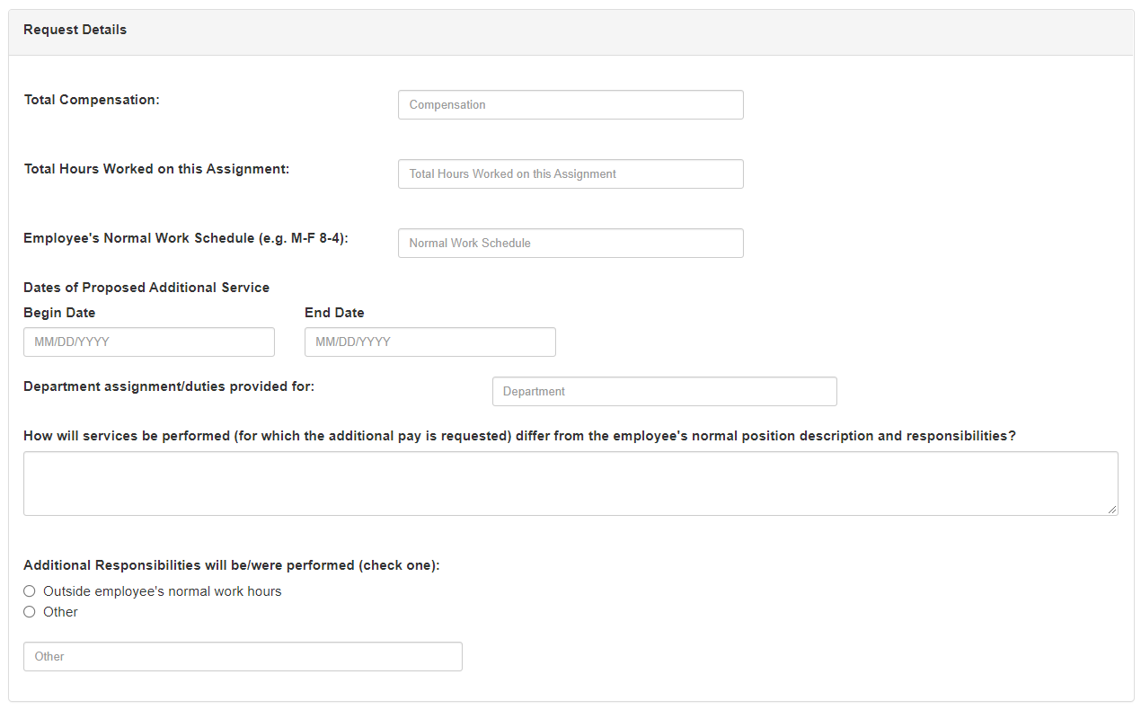
Special Assignment Payments (Salary Vouchers)
Must seek pre-approval prior to project beginning.
Separate forms for Main Campus/CMSRU and SOM.
One-time payment paid out at the end of the agreed-upon project.
Will be paid on or after the pay period that includes the end date on the contract, NOT before.
Must include a description of the project or have supporting documentation attached.
Form can be used September 1st through June 30th.

Slide 4
Pre-Approval Process for Special Assignment Payments
All departments must seek pre-approval from several approvers prior to an employee beginning a Special Assignment Payment.
The SAP form must be submitted up to 90 days but no later than one week before the start date of the project.
Any forms that are submitted after the project begin date must include an explanation from the department as to why the form was not submitted on time and the pre-approval process was not followed.

Slide 5
Pre-Approval Process for Special Assignment Payments (Cont’d)
Departments will designate Office & Division Approvers along with a “certifier” to approve payment and attest to satisfactory work completion.
Note: The certifier must be someone other than the employee being paid and must be in a supervisory position overseeing the project.

Slide 6
Pre-Approval Process for Special Assignment Payments (Cont’d)
The following approvers will grant pre-approval or deny the form:
Supervisor/Director of Program
Dean
Admins if required
Human Resources Pre-Approver
Budget/OSP (depending on the funding source for the project)
Division

Slide 7
Pre-Approval Process for Special Assignment Payments (Cont’d)
Once the project receives pre-approval from the aforementioned parties, the submitter will receive an email notifying them that the project has been approved and the employee may begin working on the project.

Slide 8
Pre-Approval Process for Special Assignment Payments (Cont’d)
On the project’s end date, the certifier (selected during the pre-approval phase) will receive an email instructing them to open up the form again and certify that the work has been completed.
Once the certifier verifies that the work has been completed, the form will then be processed for payment.
Note: the certifier cannot verify that the work has been completed until on or after the project end date noted on the electronic form.

Slide 9
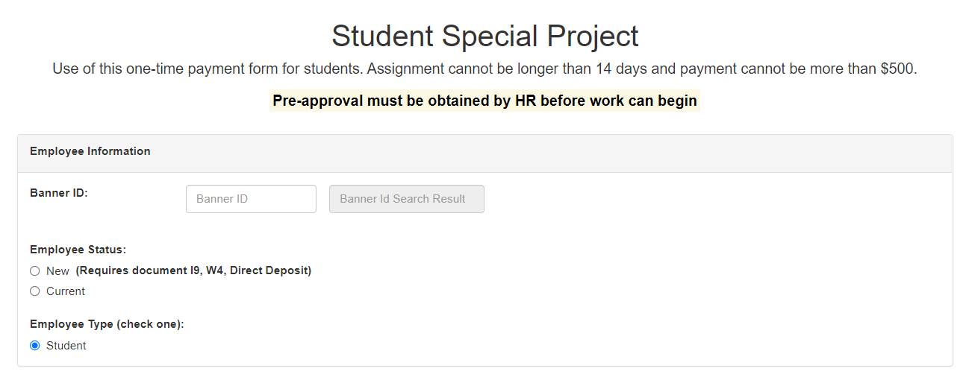
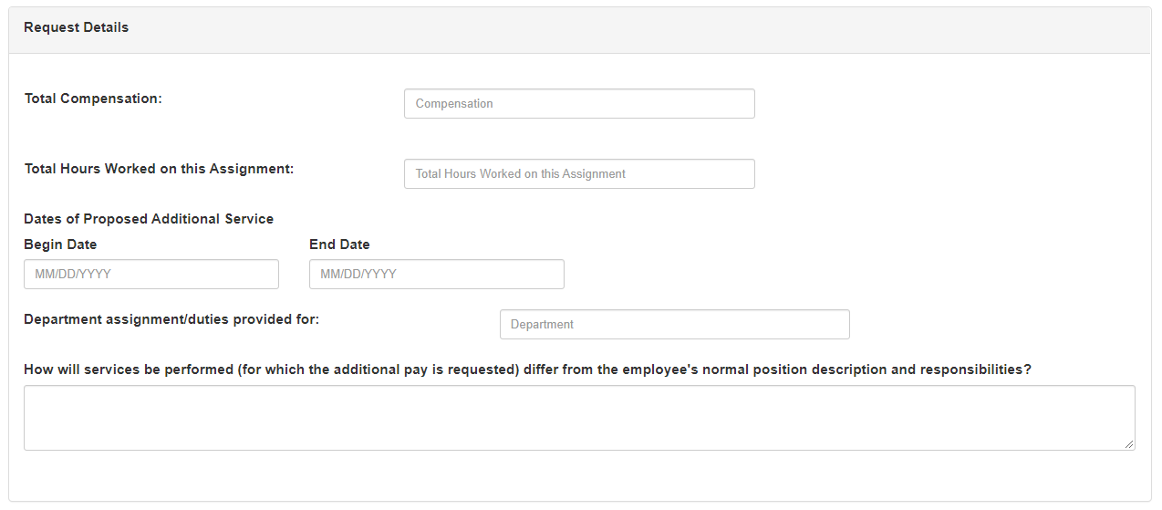
Student Special Projects
Must seek pre-approval prior to project beginning.
Separate forms for Main Campus/CMSRU and SOM.
To be used for any student project that is less than 2 weeks in length and is to be paid $500 or less.
Can be used year-round.
Will be paid out once the project is complete, NOT before.

Slide 10
Pre-Approval Process for Student Special Projects
Departments must seek pre-approval prior to a student beginning a Student Special Project.
Departments will need to follow the same process as the Special Assignment Payments; however, the form may only be submitted up to 30 days in advance.

Slide 11
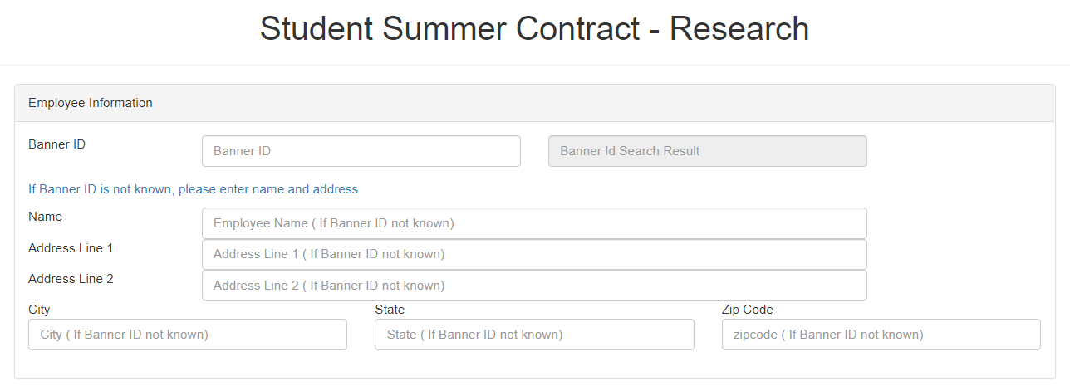
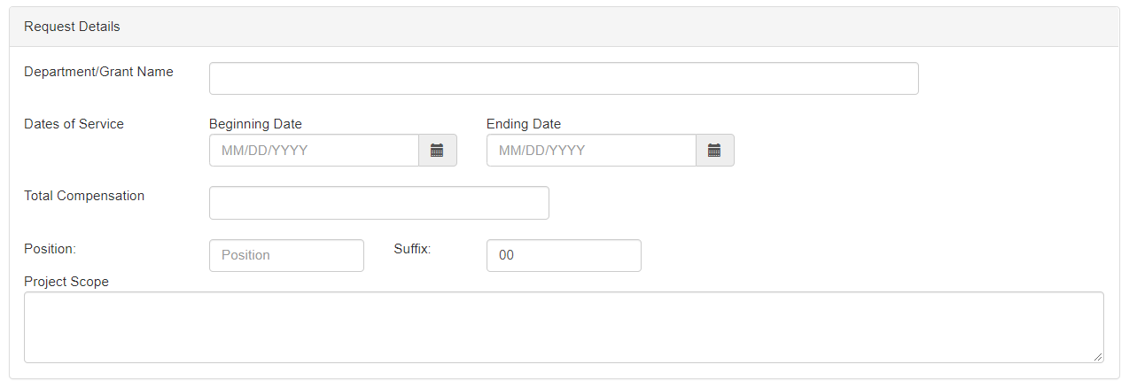
Student Summer Contracts
Separate forms for Main Campus/CMSRU and SOM.
To be used from the end of Spring semester through August 31st.
Paid biweekly according to regular student pay schedule.
Used to pay students who are working on summer research only.
Description of the work must be included or have supporting documentation attached.

Slide 12
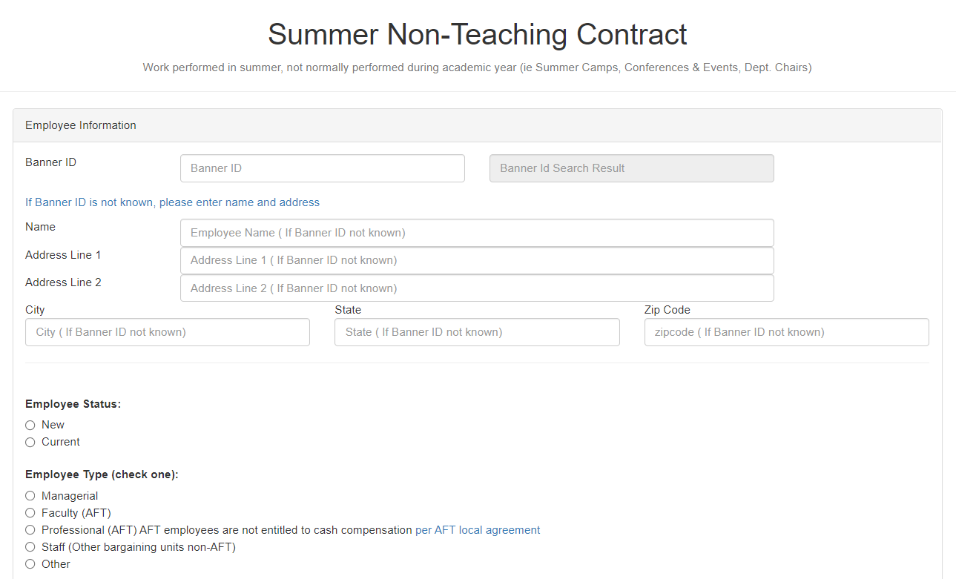
Summer Non-Teaching Contracts
Main Campus/CMSRU Only.
To be used for non-teaching work during the summer months only.
For Faculty, summer months are July 1st through August 31st
For everyone else, summer begins at the conclusion of Spring semester.
Paid bi-weekly.

Slide 13
30% Rule for Faculty Members
The 30% rule states that faculty members cannot make more than 30% of their annual salary in project payments.
Any summer work done by 10-month facultydoes not count towards the 30% rule.
Any summer work done by 12-month faculty does count towards the 30% rule.
Any questions regarding the 30% rule can be directed to the Provost’s Office at provostoffice3@rowan.edu.

Slide 14
I-9s and Project Payments
Anyone being paid by the university in any capacity (including project payments) must complete an I-9 before beginning their project if they do not have one on file already.
Note: If you have questions regarding if an individual has an I-9 on file, please reach out to Human Resources to verify.
If a new I-9 is to be completed, the Original Hire Date on the I-9 should match the start date of the project that is listed on the project payment form.

Slide 15
Questions?

