Slide 1
Electronic Performance Assessment Review: Step by Step
Amanda Tomczak
Human Resources
Rowan University

Slide 2
Course Objectives
After completing this workshop, you will be able to:
Explain the supervisors role as an ePAR Rater
Complete the electronic Performance Assessment Review Form
Summarize the guidelines to facilitating meaningful performance assessment discussions
Recognize common challenges in the review process
Construct effective goals (collaboratively with employees)

Slide 3
Agenda
Performance Management Guidelines
Setting Expectations
ePAR Process
Initial ePAR
Interim ePAR
Final ePAR
Facilitating the ePAR Meeting
Prepping
Scheduling
Conducting
Review

Slide 4
Performance Management Guidelines

Slide 5
What is Performance Management?
The ongoing process of goal-setting, communication, observation, and evaluation to support, retain, and develop exceptional employees for organizational success
Communicate
Observe
Evaluate
Set Goals

Slide 6
What is the Point of Performance ASSESSMENT?
Set clear expectations between supervisors and employees
Hold employees accountable for their job responsibilities
Curb or redirect non-productive activities

Slide 7
Common Mistakes of Raters
Tendency to avoid conflict with difficult employees
Use ePAR as a threat or punishment
Base the evaluation on hearsay and not on first hand knowledge & documentation
Not involving employees in the process
Poor preparation

Slide 8
The ePAR Process

Slide 9
The ePAR Cycle
Cycle: Oct 1 – Sept 30
Setting Expectations
Initial ePAR
What is the job?
What standards should
be met?
Due: Oct 31
Final ePAR
How well was it done
during the entire year?
Due: Sept 30
Interim ePAR
How well was it done
during the first six
months?
Due: April 29
Explain and Assign
Ratings, Feedback, Development Plan
Ratings, Feedback, Development Plan

Slide 10
Accessing the ePAR
The ePAR is located on the State of NJ’s My NJ Portal website
https://my.state.nj.us/openam/UI/Login
All employees must create an account to access the website
HR will provide necessary information to all new employees for registration via email

Slide 11
Participants in the ePAR Process
Ratee: The employee being rated
Rater: The immediate Supervisor who receives and/or assigns the work
Reviewer: Rater’s supervisor or manager who is checking for consistency
1
2
3
Notes:
Sign & Date

Slide 12
New Employee?
Initial ePAR
Complete immediately; Discuss expectations, role, responsibilities
Interim ePAR
Complete after the employee has been in the role for 6 months
Employees have a 4 month probationary period - within that time frame, no evaluation can be done (other than the evaluations that are part of the probationary period)

Slide 13
How does the process change with a new hire?
Initial ePAR “Job Expectations”
Complete immediately; Not all employees are hired within the cycle schedule
Interim ePAR
Complete after 6 months; ePAR may have to be skipped due to hire date
Employees have a 4 month probationary period - within that time frame, no evaluation can be done (other than the evaluations that are part of the probationary period)
Final ePAR
Due September; may have to be closed out due to hire date; Reason can be entered by Supervisor as “Final cannot be completed due to hire date”

Slide 14
ePAR Schedule: Unique FOR NEW HIRES
JANUARY * FEBRUARY * MARCH * APRIL
Complete Initial ePAR (job expectations) immediately
Skip the Interim in April as employees are ineligible
4 month probationary period - within that time frame, no evaluation can be done
Complete Final ePAR
MAY
Complete Initial ePAR; Interim N/A
Compete Final ePAR
JUNE * JULY * AUGUST * SEPTEMBER
Complete Initial ePAR
Close Out Final ePAR due to hire date; Reason can be entered by Supervisor as “Final cannot be completed due to hire date”
SEPTEMBER
Delay Initial ePAR until October in order to get on schedule
Complete Interim
Complete Final
OCTOBER * NOVEMBER * DECEMBER
Follow cycle
Initial ePAR
Final ePAR
Initial ePAR
Final ePAR
Initial ePAR
Initial ePAR NOTE
Interim ePAR
Final ePAR
Initial ePAR
Interim ePAR
Final ePAR

Slide 15
The Initial ePAR
Job Expectations

Slide 16
Initial ePAR: Setting Job Expectations
During the Initial ePAR:
Outline Major Goals for Unit (department)
Establish Major Ratee Goals
Determine Major Job Responsibilities
Set Specific, Measurable Essential Criteria
Review Performance Factors and discuss their application
to the Ratee’s role

Slide 17
Job Expectations Section
Major Goals of the Unit/Work Group (Department)
Goals of the Ratee and their role within the department
Job Responsibilities & Essential Criteria

Slide 18
Major Goals of Unit/Work Group
Listing of the Department’s goals
Work Unit or Group’s overall purpose as it relates to/supports the overall mission of the University
Should be the SAME for all employees in department

Slide 19
Major Goals of the Ratee
Identifies the individual goals of the ratee that support the department’s goals/purpose
Why is the Ratee’s job important to Rowan and the department?
How does the Ratee’s job make a contribution to the department’s accomplishment of goals?

Slide 20
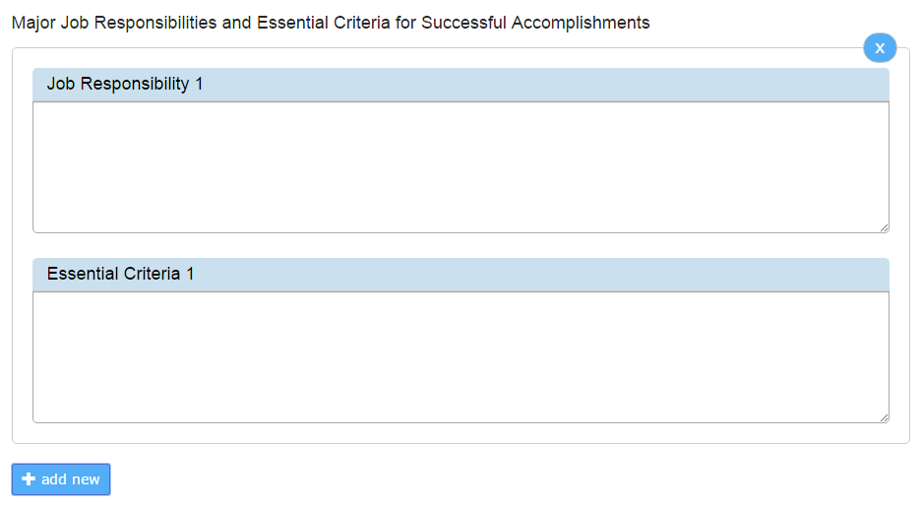
Major Job Responsibilities & Essential Criteria
Job Responsibilities
Essential Criteria
Approximately 6-10 broad duties which must be accomplished to achieve the dept.’s and individual’s goals
Critical to the job, done often & comprise a large portion of the role
Accurately reflect the Actual Work over which the employee has control (responsibility, authority, resources to act)
Provide specifics and detail as to how the responsibilities should be completed
Statements of what should be done to complete a responsibility successfully
At least one Criteria is required for each responsibility

Slide 21
Example- Facilities Supervisor
Job Responsibility
Essential Criteria
Ensure all bathrooms in assigned building are cleaned thoroughly
by staff
Train new employees on appropriate cleaning procedures
Inspect all bathrooms each evening: floors, sinks, toilets, walls, replace supplies. Provide feedback to staff.
Follow up with customers on a monthly basis to make sure your team is meeting their needs

Slide 22
Example- Non-Supervisory Clerical Position
Job Responsibility
Typing all departmental documents
Essential Criteria
Type all documents that are received within 24 hours of receipt
Review each document to ensure spelling & grammar checked, prior to submission to requestor

Slide 23
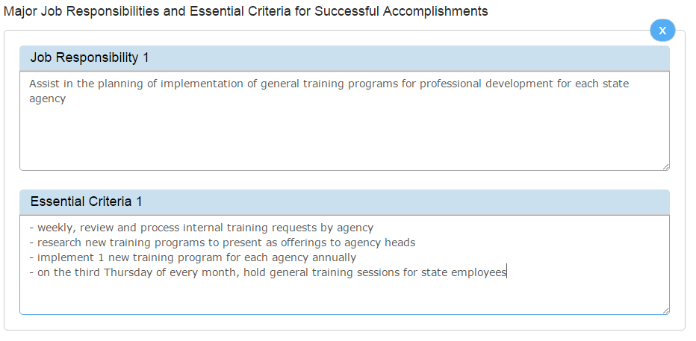
Example – Job Responsibility & Essential Criteria

Slide 24
Facilitating the ePAR Meeting

Slide 25
Scheduling the Meeting
Notice to employee
Location
Remind employee to review the ePAR before the meeting

Slide 26
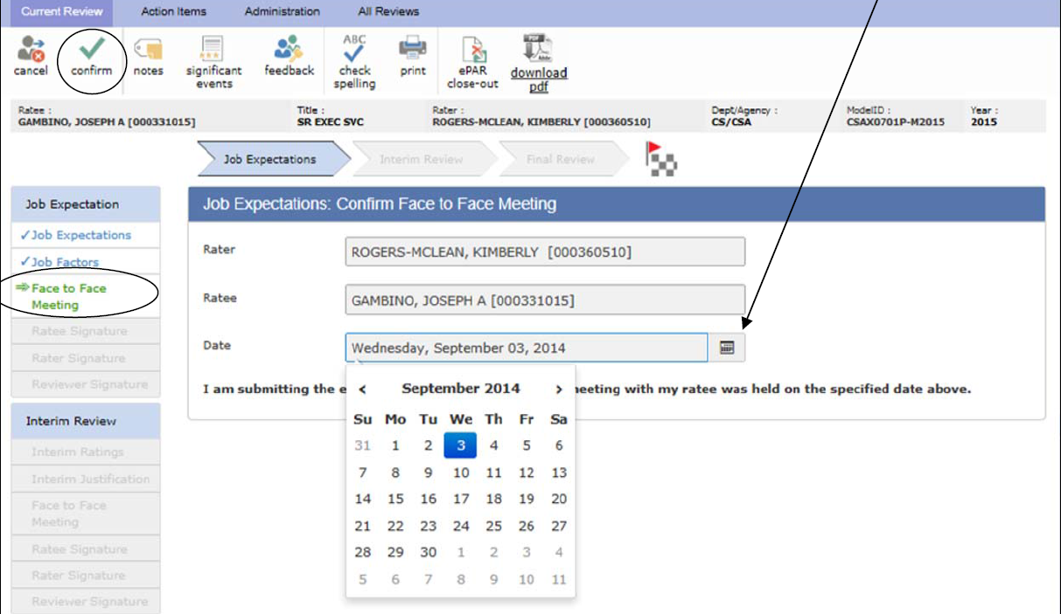
Face- to- Face Meeting
Ratees and Raters are required to meet to discuss the ePAR
Raters should set up a meeting at a mutually convenient time
Ratees can and should review the ePAR before the meeting and come prepared with questions/comments
Raters will make any necessary edits to the ePAR after the meeting
Raters will confirm the meeting in the ePAR system
Confirming the Meeting

Slide 27
Conducting the Initial ePAR Meeting
Review the goals, job responsibilities, and essential criteria in detail
Solicit input from the Ratee
Review the job factors and elements the employee will be rated on in future ePARs

Slide 28
Conducting the Interim and Final Meetings
Review rating system
Depending on meeting, review goals and ratings already recorded
Let employee talk
Be aware of all three parts of the messages you send:
Words
Tone
Body Language
Stay focused on performance and away from value judgments
Notes:
Value judgments- John seems to know every loophole in the system, and uses them all the time to get around his job.

Slide 29
Signatures & Ratee Comments
After the Initial ePAR meeting is held:
The rater will confirm the face-to-face meeting in the system
Once the meeting is confirmed, the ePAR will automatically be sent to
the Ratee to sign
The Ratee signs the ePAR
Ratee checks either “agree” or “disagree”
Ratee leaves any desired comments
ePAR is then forwarded to the Rater who reviews and signs
ePAR is then forwarded to the Reviewer to review and sign

Slide 30
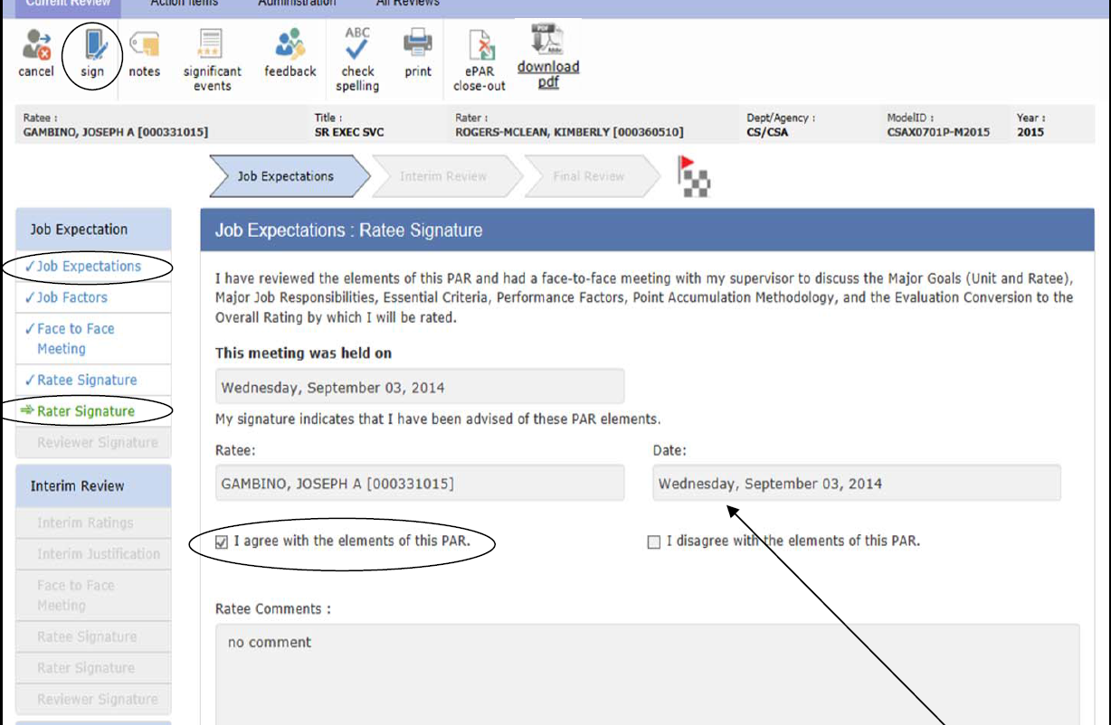
Signatures & Ratee Comments

Slide 31
Initial ePAR Workflow Process
1
Rater sets goals, job responsibilities, and essential criteria
2
Ratee reviews the goals, job responsibilities, and essential criteria set by the Rater
3
Rater schedules face-to-face meeting with the Ratee to discuss the ePAR
Rater hits "submit" which shares the ePAR with the Ratee
4
Rater and Ratee hold face-to-face meeting
5
Rater makes any edits to ePAR discussed in the meeting (if necessary)
Rater confirms the face-to-face meeting in the ePAR system
6
Ratee reviews, comments, and signs ePAR
7
Rater reviews, comments, and signs ePAR
8
Reviewer reviews, comments, and signs ePAR
When the Reviewer signs, the ePAR is then automatically sent to HR

Slide 32
Please Note!
The ePAR is not considered complete until the Reviewer has signed
The Rater is responsible for monitoring the progress of the ePAR and ensuring it is submitted on time
If an employee transfers to another department, you must close out their current ePAR.
If you hire an employee from another department, regardless of the time of year, you need to create an Initial ePAR.

Slide 33
Interim & Final ePAR: 6 Month and Full Year Review
During the Interim and Final ePAR:
Determine evaluation points and rating justification;
Recognize and document positive contributions and areas
needing improvement
Determine job performance gaps and action plan to close gaps
Mutually develop action plan for development and improvement
Mutually establish specific deadlines for improvement
Interim Rating covers the 1st 6 months
Final Rating covers the entire year

Slide 34
Interim Ratings – Job Factors
Performance Factors
Based on achievement of job responsibilities & goals
Job Achievement Factors
Job Related Factors
Align University-identified core skills/competencies with performance
Provide a uniform guide for evaluating performance across employees participating in the ePAR
Predefined by Rowan
Rated on a 3 point scale

Slide 35
ePAR Rating Factors
PAR Section | Competency Factors for Non-Supervisory Employee | Competency Factors for Supervisor
Job Achievement Factors (Results of doing the job) | Goal Achievement Quality of Work Quantity of Work Timeliness | Goal Achievement Quality of Work Quantity of Work Timeliness
Job Related Factors (How EE did job) | Communication Conscientiousness* Customer Service Flexibility Interpersonal Skills Job Knowledge Managing/Valuing Diversity Problem Solving Safety* Teamwork* | Communication Customer Service Flexibility Interpersonal Skills Job Knowledge Managing Resources* Managing/Valuing Diversity Problem Solving Project Management* Team Building*
These factors are directly related to the outputs of the job: Major Goals, Job Responsibilities,
and Essential Criteria.

Slide 36
ePAR Ratings
1 = Unsatisfactory
Failed to achieve most essential criteria.
2 = Successful
Met or occasionally exceeded essential criteria.
3 = Exceptional
Significantly exceeded essential criteria consistently in a
sustained job performance
Notes:
Mention that it is in whole numbers only

Slide 37
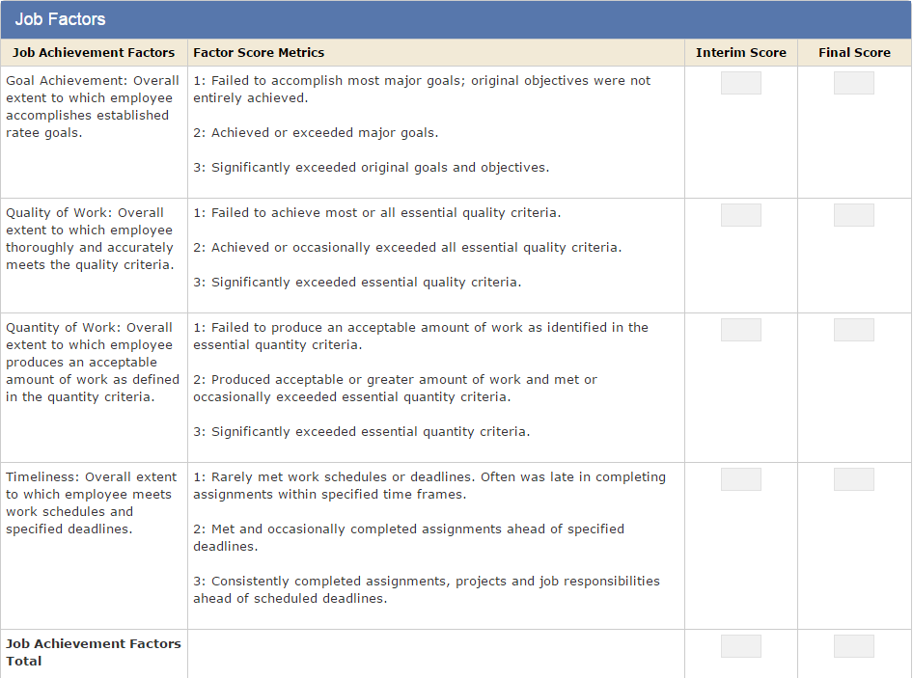
Job Performance Factors – Job Achievement

Slide 38
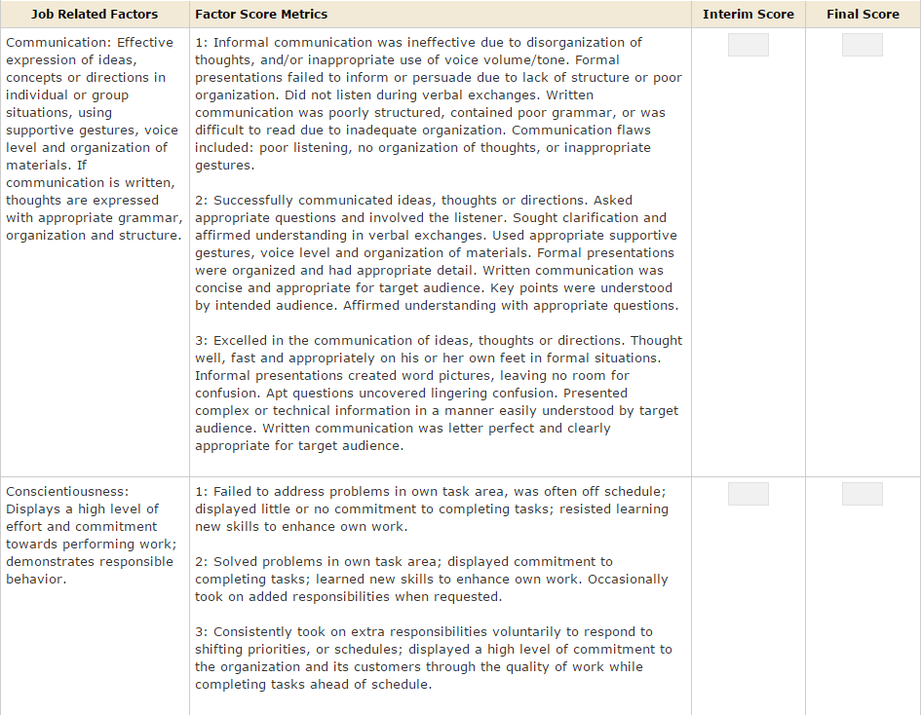
Job Performance Factors – Job Related

Slide 39
Job Performance Factors: Rating
Job Achievement
Job Related
Review Initial ePAR
Rate factors against Ratee’s Goals, Job Responsibilities, and Essential Criteria
Determine numerical rating for each factor
Review Initial ePAR
Rate factors against Ratee’s Overall Performance
Determine numerical rating for each factor

Slide 40
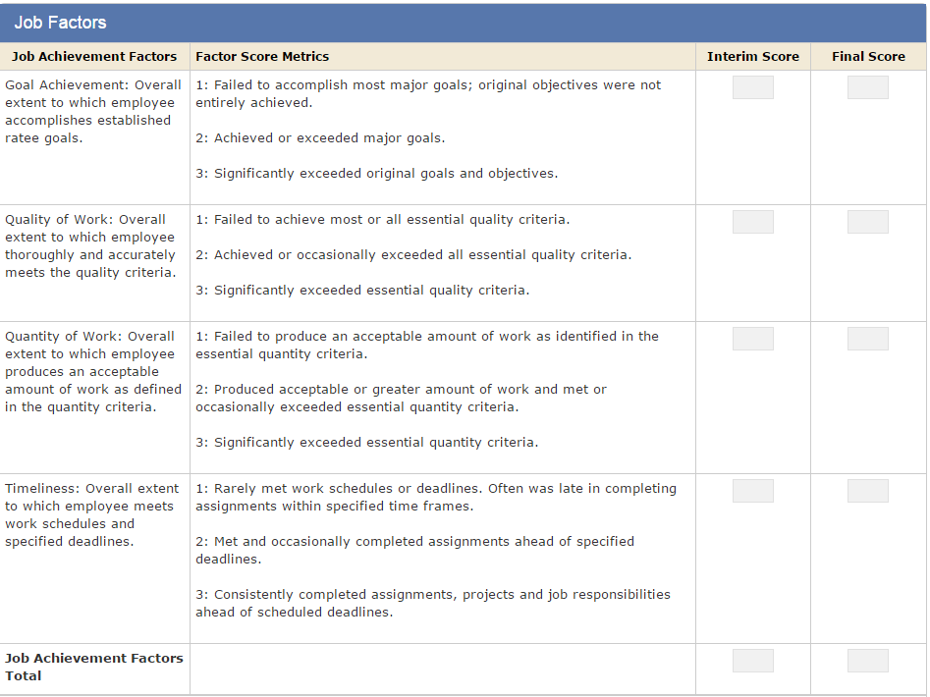
Example – Job Achievement Factors
2
3
2
2
9

Slide 41
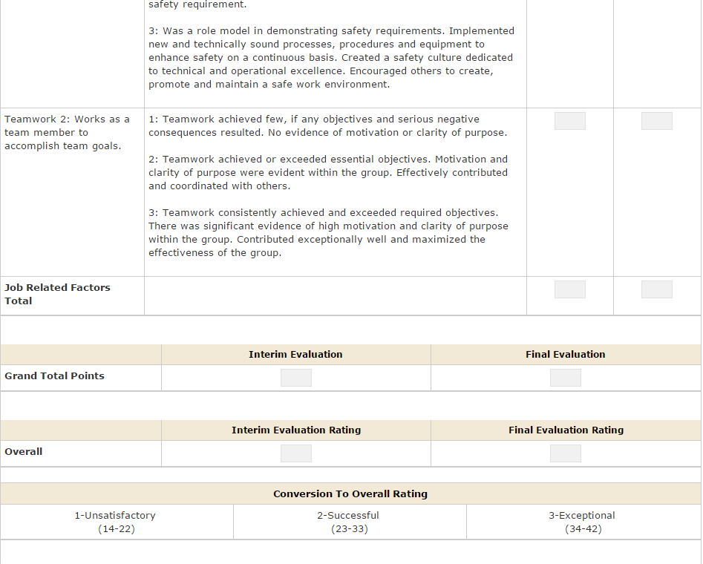
Example – Job Related Factors
2
21
2
30

Slide 42
Computation and Conversion to Overall Rating

Slide 43
Unsatisfactory Rating
If an employee earns an Unsatisfactory rating for the Interim or Final rating period, then the supervisor must complete a Performance Improvement Plan (PIP) for that employee.
HR can assist the supervisor in creating the PIP document. Contact Jeremy Trowsdale, Director of Employee Training and Development, trowsdale@rowan.edu
Guidelines for creating a PIP can be found at:
https://sites.rowan.edu/hr/_docs/training/guidelines_for_performance.pdf

Slide 44
Justification and Development Plan
Justification for Interim Evaluation
Interim Development Plan
Specific Area(s) Identified for Development
Specific Action to be Taken by Ratee

Slide 45
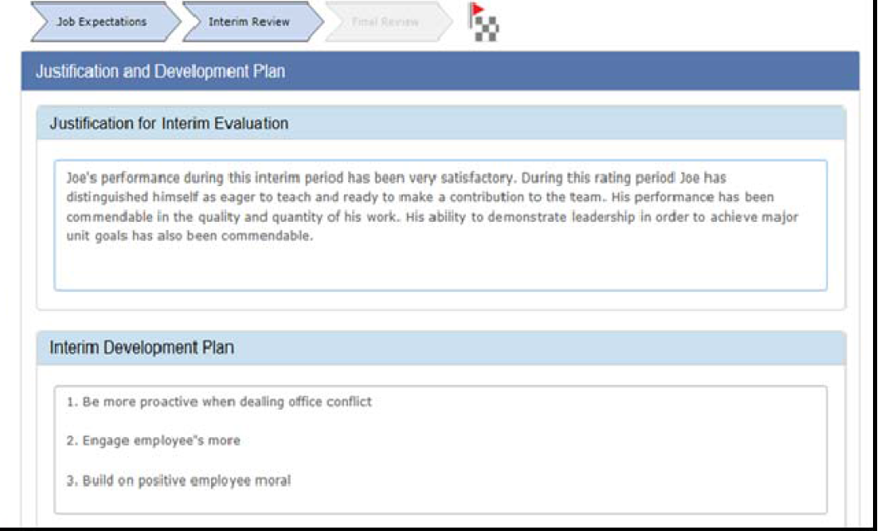
Justification and Development Plan

Slide 46
Justification for Evaluation
Recognize and document positive contributions as well as areas needing improvement.
Provide validation of the rating by citing specific examples
Provide justification for overall rating

Slide 47
Justification: Guidelines
DO:
Give reasons, both positive and negative, that substantiate the rating
Review the “Fact Sheet of Significant Events” and all documentation to prepare the justification
DON’T:
Include issues unrelated to job performance
Simply repeat the rating – “Bob’s performance is exemplary.”

Slide 48
Development Plan: Specific Area(s) Identified for Development
This should be completed regardless of the rating assigned to the Ratee
What areas, skills, or competencies should the Ratee improve or strengthen, and how should they get assistance to make these improvements?
Identify skills and competencies targeted for improvement
Focus on improvement in order of importance
Work together to develop a plan of action

Slide 49
Development Plan: Specific Action to be Taken by Ratee
Sample Actions include:
Take on special projects or assignments (within job scope)
Attend training courses offered by Rowan
Attend free webinars on relevant topics
Research and read relevant articles/materials/videos
Shadow a peer; or Mentor with a supervisor
Attend seminars and workshops outside of the University
Enroll in local and national professional organizations (if applicable)

Slide 50
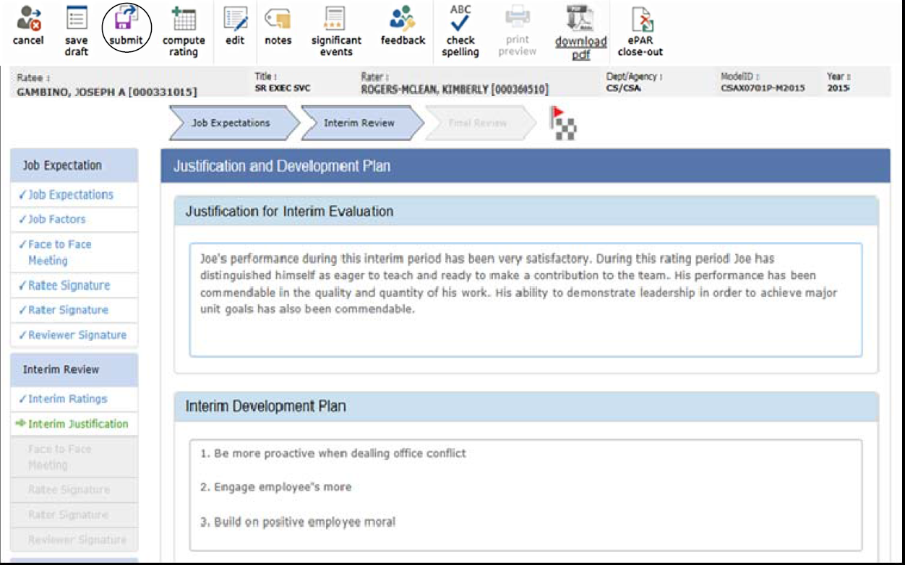
Example – Justification and Development Plan

Slide 51
Interim and Final Signatures and Comments
During the Interim and Final ePAR meetings, after the discussion of all sections is held:
The rater will confirm the face-to-face meeting in the system
Once the meeting is confirmed, the ePAR will automatically be sent to the Ratee to sign
The Ratee signs the ePAR
Ratee checks either “agree” or “disagree”
Ratee leaves any desired comments
ePAR is then forwarded to the Rater who reviews and signs
ePAR is then forwarded to the Reviewer to review and sign

Slide 52
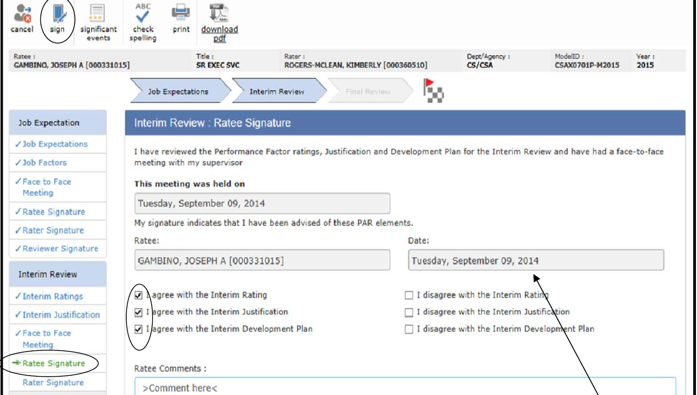
Example – Signatures & Comments

Slide 53
Interim ePAR Workflow Process
1
Rater enters the ratings, Justification for Interim Evaluation, and the Interim Development Plan
2
Ratee reviews the ratings, Justification for Interim Evaluation, and the Interim Development Plan set by the Rater
3
Rater schedules face-to-face meeting with the Ratee to discuss the Interim ePAR
Rater hits "submit" which shares the ePAR with the Ratee
4
Rater and Ratee hold face-to-face meeting
5
Rater makes any edits to ePAR discussed in the meeting (if necessary)
Rater confirms the face-to-face meeting in the ePAR system
6
Ratee reviews, comments, and signs ePAR
7
Rater reviews, comments, and signs ePAR
8
Reviewer reviews, comments, and signs ePAR
When the Reviewer signs, the ePAR is then automatically sent to HR

Slide 54
Final ePAR Workflow Process
1
Rater enters the ratings, Justification for Final Evaluation, and the Final Development Plan
2
Ratee reviews the ratings, Justification for Final Evaluation, and the Final Development Plan set by the Rater
3
Rater schedules face-to-face meeting with the Ratee to discuss the Final ePAR
4
Rater and Ratee hold face-to-face meeting
5
Rater makes any edits to ePAR discussed in the meeting (if necessary)
Rater confirms the face-to-face meeting in the ePAR system
6
Ratee reviews, comments, and signs ePAR
7
Rater reviews, comments, and signs ePAR
8
Reviewer reviews, comments, and signs ePAR
When the Reviewer signs, the ePAR is then automatically sent to HR
Rater hits "submit" which shares the ePAR with the Ratee

Slide 55
Additional Items to Note

Slide 56
Supervisor Accountability
NJ Administrative code:
“A supervisor who fails to timely complete the final ratings of his or her subordinates, or who is responsible for another employee’s failure to timely complete a final PAR rating, shall receive a rating of Unsatisfactory and maybe subject to discipline” for all classified employees

Slide 57
Remember!
Nothing written/shared in the ePAR should come as a surprise to the employee
The ePAR should be a summary of feedback from throughout the year

Slide 58
Significant Performance Events
Used to capture any noteworthy event documented that occurs
throughout the rating cycle
Both positive and negative events
Events should be as they occur
Events that represent Ratee performance above or below the successful
level throughout the year should be recorded
Ratees can request events to be added to the form
They should be added at the Rater’s discretion

Slide 59
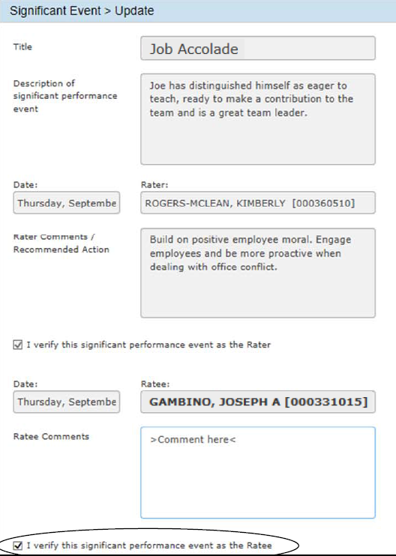
Example –Significant Events

Slide 60
State Resources
PAR Overview Manual: http://www.nj.gov/csc/about/publications/pdf/May_2004_PAR_Handbook.pdf
ePAR System Manual:
http://www.nj.gov/csc/employees/programs/performance/PDF/ePAR%20User%20Guide.pdf
State Civil Service Commission: http://www.nj.gov/csc/
State Civil Service Commission – Performance Assessment:
http://www.nj.gov/csc/employees/programs/performance/
ePAR Policy:
http://www.nj.gov/csc/employees/programs/performance/par_policy.html
New Jersey Administrative Code:
http://www.state.nj.us/csc/about/about/regulations/title4a.html

Slide 61
Rowan Resources
Rowan HR page:
http://www.rowan.edu/hr/
Rowan ePAR Resources
https://sites.rowan.edu/hr/ePar/index.html
Union contract
ePAR Contacts:
Amanda Tomczak x53366

Slide 62
PROCESS IN Review
ePAR Process
Initial ePAR
Interim ePAR
Final ePAR
Facilitating the ePAR Meeting
Prepping
Scheduling
Conducting
Review

