Slide 1
Got Debt?
Using the Snowball Method to Eliminate Debt
Notes:
Today 78% of Americans live paycheck to paycheck. And 44% could not afford a $400 unexpected bill. These statistics are pre-COVID,.
Winning with money is 80% behavior and 20% knowledge. Your wealth is dependent on you not owing others. Your ability to weather unexpected unemployment, or choosing to have one parent stay home with children, or your ability to live where you want or get the job you want, all can be negatively impacted by your bill-paying behaviors and decisions.
I am going to show you how you can organize your monthly payments to eliminate debt without feeling deprived each month. Seeing your progress quickly will motivate you to continue.
Let’s jump in!

Slide 2
Credit Utilization is 30% of Your Score
Source: https://www.myfico.com/credit-education/whats-in-your-credit-score

Slide 3
What Makes Up this Category?
Amounts Owed on ALL Accounts
Amounts Owed on Different Types of Debt: Credit Cards and Installment Loans
How Many Accounts Have Balances
Credit Utilization on Credit Cards (Are you maxed out?)
Utilization = Balance ÷ credit limit
How Much on Your Installment Loans is Still Owed
HINT: Utilization greater than 30% negatively impacts credit
Notes:
Why does this matter?
It’s all about risk and predictability of future repayment
As your balances increase so does the probability of difficulty meeting monthly payments on time.
A larger number of accounts with amounts owed can indicate higher risk of over-extension.
Paying down installment loans is a good sign that you're able and willing to manage and repay debt.
Most importantly on a personal level, How much stress do you experience each month because of your credit debt?
Imagine a proven method of alleviating that stress while improving your credit score? Would you try it?

Slide 4
What is a Snowball?
If you have a bit of extra money to apply, that is your snowball ($50)
Pay the Snowball ($50) + your monthly minimum payment to your smallest balance until that is paid-in-full
Then you take the snowball + the monthly minimum and apply that to the next bill, and so on and so on.
The snowball gets larger as it rolls to each debt.
Notes:
So What exactly is a snowball?
It’s a way of organizing your monthly payments so that the priority goes to the smallest balance first.
Let’s say you have $50 extra dollars you can squeeze out of your monthly budget and use to start paying down your debt. That $50 is your initial snowball.
You take that $50 + the minimum payment amount of your smallest bill (let’s say it’s $27) and instead of paying $27 each month, you pay $77 until that specific card is paid in full. Here’s where the magic happens….
NEXT, you take that $77 dollars and you apply it, PLUS the minimum of the next card (let’s say it’s $35. So instead of paying $35, you now pay $35 + $77, $112 to that card until it’s paid off.
The snowball keeps growing larger and larger and debt is getting paid off quickly with the same amount you were spending each month.
Now obviously, I have to remind you that this will work only if you don’t turn around and spend up your credit cards again. Step away from the credit cards!

Slide 5
SNOWBALL Spreadsheet
Enter data in the WHITE fields
Hints available if you hover over cells
Use Sort Order to compare the Avalanche Method
Refer to your monthly statements for interest rates
Available on our financial literacy page – just ask Susan to find it for you!

Slide 6
Two Methods of Attack
SNOWBALL:
Pay all debts on-time
Minimum payment due
Focus extra payments on smallest balance
Work from smallest balance to largest
AVALACHE:
Pay all debts on-time
Minimum payment due
Focus extra payments on highest interest rate
Working highest to lowest interest rate

Slide 7
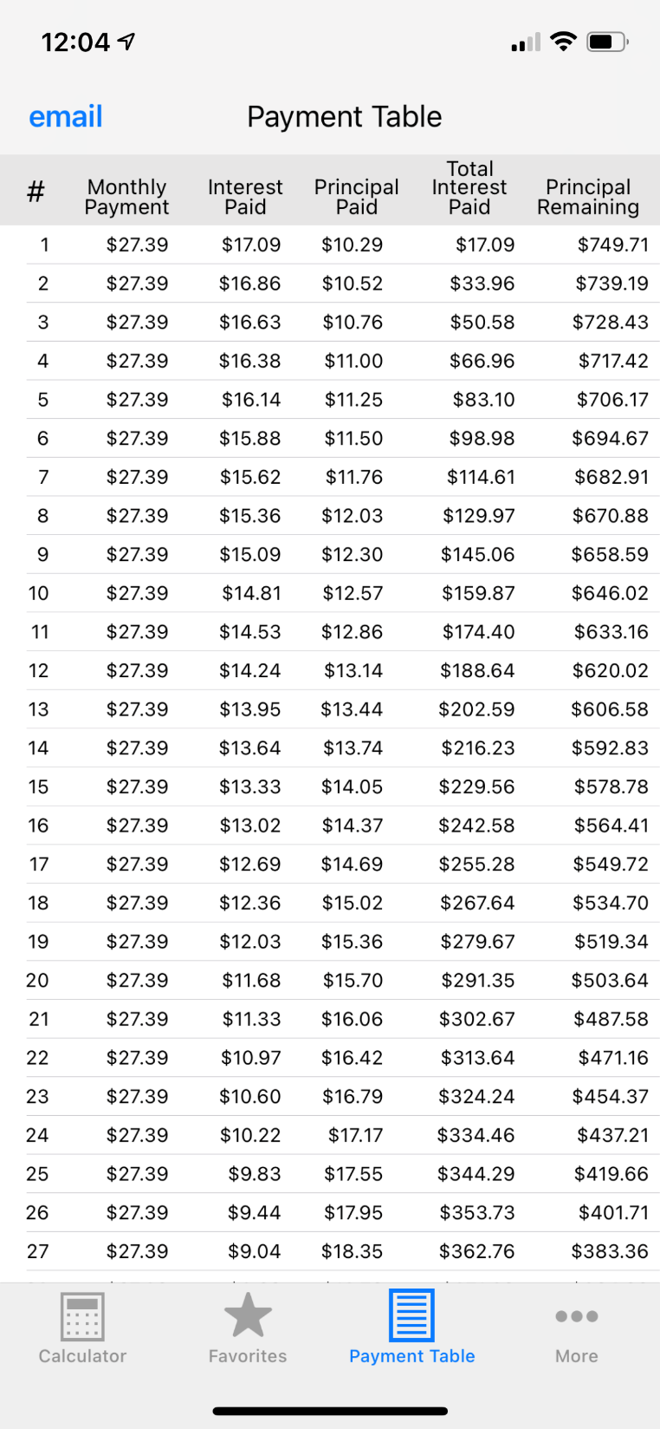
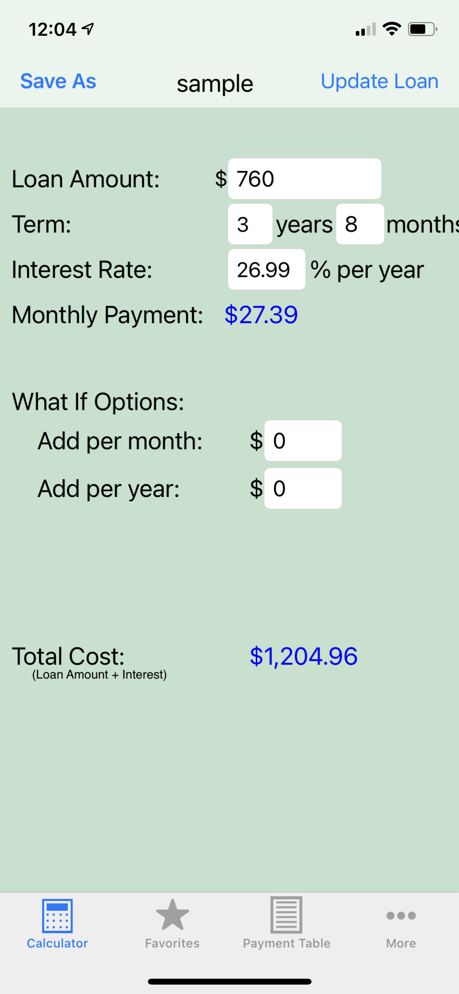
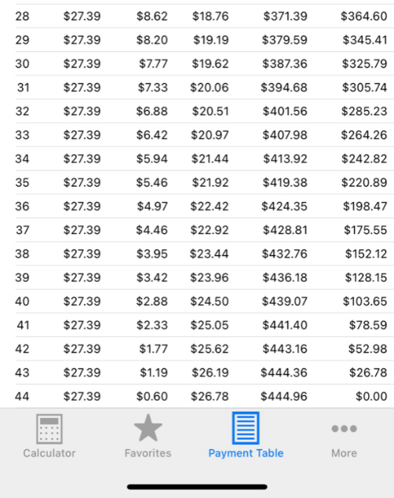
There’s an App for that… and it’s FREE
Making a minimum payment of $27 will take 44 months to pay in full and will cost $445 in interest
LOAN…What if available in the App Store

Slide 8
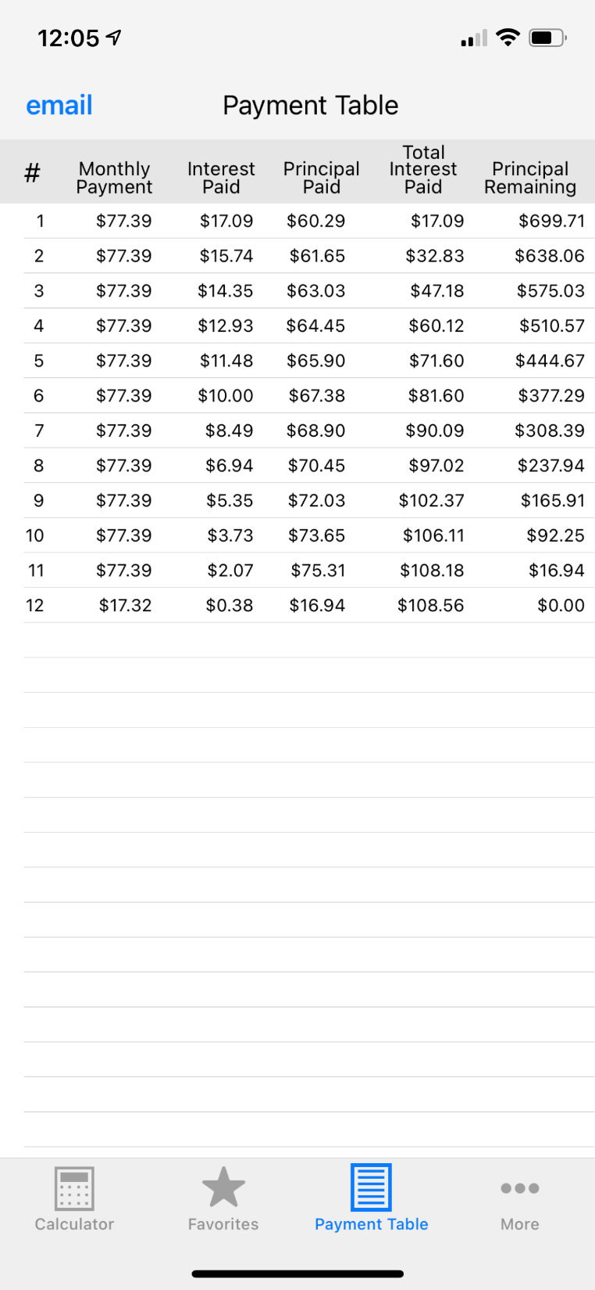
Now Let’s Throw a Snowball at it!
Now, see how effective that $50 snowball is!!
Paying $77 each month
Cuts off 32 payments and saves $336 in interest! (76% savings!)
HINT: You can save each loan/credit card to build a list of “favorites.”
LOAN…What if available in the App Store

Slide 9
TIPS for Success
Add bill due dates and amounts to your phone’s calendar
Add your payday to your calendar
PAY the bills that are due within the next pay period on Payday, don’t wait for the due date
Call each of your creditors and ask for an interest rate reduction
EXCLUDE 0% interest from snowball, instead ÷ by #months and make those payments
Consider using your tax refund to help pay down (see calculator)
Keep an emergency savings account (avoid using credit card)
Do not close your accounts (this hurts your credit score)

Slide 10
Thank You!
Heidi Kovalick
Director, Office of Financial Aid
Rowan.edu/financialaid

