Slide 1
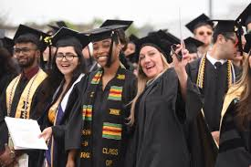
Meeting Reminders:
Thank you for participating in this Graduation and Commencement Information Session!
We will get started momentarily.
You will be muted and your camera will be off for this session.
If you have a question, please place it in the Q&A. We will cover all questions not answered in the presentation at the end of each segment.

Slide 2
Commencement & Graduation Guide 2024
Presented by
Office of University Events &
Office of the University Registrar

Slide 3
Graduation vs. Commencement
Graduation…
Commencement…
is the successful completion of a student’s major/minor/ concentration and the issuing of a diploma.
is the celebration of
your time and hard
work at Rowan
University.

Slide 4
5 Steps for Success
Step 1: Apply to Graduate
Step 2: Register to participate in Commencement and claim guest tickets
Step 3: Share the ceremony details and tickets with your guests
Step 4: Caps & Gowns
Step 5: Pay attention to communication

Slide 5
Step 1: Apply to Graduate
Graduation Dates & Deadlines
Term you expect to graduate: This means you must complete all degree/program requirements (including transfer credits, all grades, GPA minimums, special courses, internships/clinical practice, etc.) by the end of this term. | Deadline dates for student to apply to graduate: Students must apply online for graduation review via SSB, rowan.edu/selfservice. | Deadline dates for Academic Advisors to review any submitted graduation applications: | Dates when degrees will be awarded in system and posted on transcripts: | Date that will be posted on the transcript and official diploma: | Date official diploma will be mailed to you:
Fall 2023 | Aug. 14 – Oct. 6 | October 28, 2023 | January 2024 | Dec. 30, 2023 | February 2024
Winter 2024 | Oct. 16 – Nov. 30 | December 21, 2023 | February 2024 | January 30, 2024 | March 2024
Spring 2024 | Jan. 2 – Feb. 28 | March 20, 2024 | June 2024 | May 30, 2024 | August 2024
Summer 2024 | April 2-May 31 | June 21, 2024 | September 2024 | August 30, 2024 | October 2024

Slide 6
Step 1: Apply to Graduate
Students should contact their ADVISOR for each program, and REVIEW their transcript and DegreeWorks report to ensure that ALL University Requirements surrounding the Major, Minor, and/or Concentration have been met.
Students must Apply to Graduate (Earn the Degree) online through Self-Service Banner. Select “Apply to Graduate” under the student tab. Applying to Graduate is NOT related to the Commencement Ceremony.
After the application is submitted, students will receive email confirmation to their Rowan Student email address. This email includes instructions for Commencement.
All Graduation information will be sent to students’ Rowan email addresses only. Please check often, through the receipt of your Diploma in the mail.
Students can verify the information on their application at any time. Select “View Pending Graduation Application” on Self-Service Banner.

Slide 7
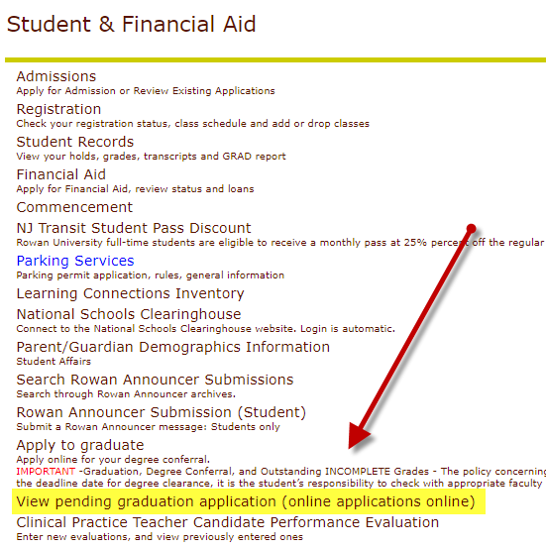
Did I Apply to Graduate?
You can view the Graduation Application and details that you submitted through SSB.
Review:
Name preference
Mailing address
Program

Slide 8
RU Completing an Internship/Clinical Practice/Final Project/Thesis/Dissertation?
If students’ receive an incomplete grade, the final graduation review cannot occur until the IN grade is replaced.
Important! IN grades must be replaced within the deadline of the term of the graduation application. If the IN grade is replaced after the deadline, the application will be denied and the STUDENT will need to RE-APPLY. (no added charge)
Example – Student applied for May conferral and has an IN. If the grade is replaced by June 30th, and all other University requirements are met, the conferral date will remain May 30th. If the IN grade is replaced after June 30th, the conferral date will be August after a new application is submitted.

Slide 9
University Honors
3.450 – 3.649 Cum Laude
3.650 – 3.849 Magna Cum Laude
3.850 – 4.000 Summa Cum Laude
For Graduation, University Honors are based on students’ final cumulative GPA and will be printed on students’ Diploma and Transcript.
For Commencement, University Honors are based on the cumulative GPA earned at the end of the Winter term, and will be noted, with a symbol, in the Commencement Program.

Slide 10
Diplomas
The final review of Spring Graduation Applications will occur during the month of June (after the semester ends and all final grades are submitted). Summer applications will be reviewed/awarded in September.
Students will be notified by email when their degree is awarded or if there are issues regarding their application.
Diplomas will list MAJORS only. Minors, concentrations, specializations and CUGS will appear on your final transcript.
Diplomas are mailed directly from our Diploma vendor Paradigm and students will receive email notification when their diploma ships.

Slide 11
Commencement 2024

Slide 12
Commencement at a Glance
The School of Graduate Studies Hooding Recognition Ceremony & Reception
May 3, 2024 @ 2:00 pm
University Commencement Ceremony & Celebration
Richard Wackar Stadium
May 4, 2024 @ 10:00 am
College Commencement Ceremonies
University Green at Bunce Hall
May 6 – 9, 2024
Registration is required.

Slide 13
School of Graduate Studies Hooding Recognition Ceremony & Reception
Esbjornson Gymnasium, Friday, May 3, 2024 – 2:00 p.m.
Ed.D., Ed.S., and Ph.D. graduates come to the stage accompanied by their dissertation advisor or selected faculty member to be hooded.
Following the ceremony, graduates and guests are invited to a reception.
Doors open 1 hour prior to the start of each ceremony.
All M.D. and D.O. graduates will be hooded at their college ceremony.

Slide 14
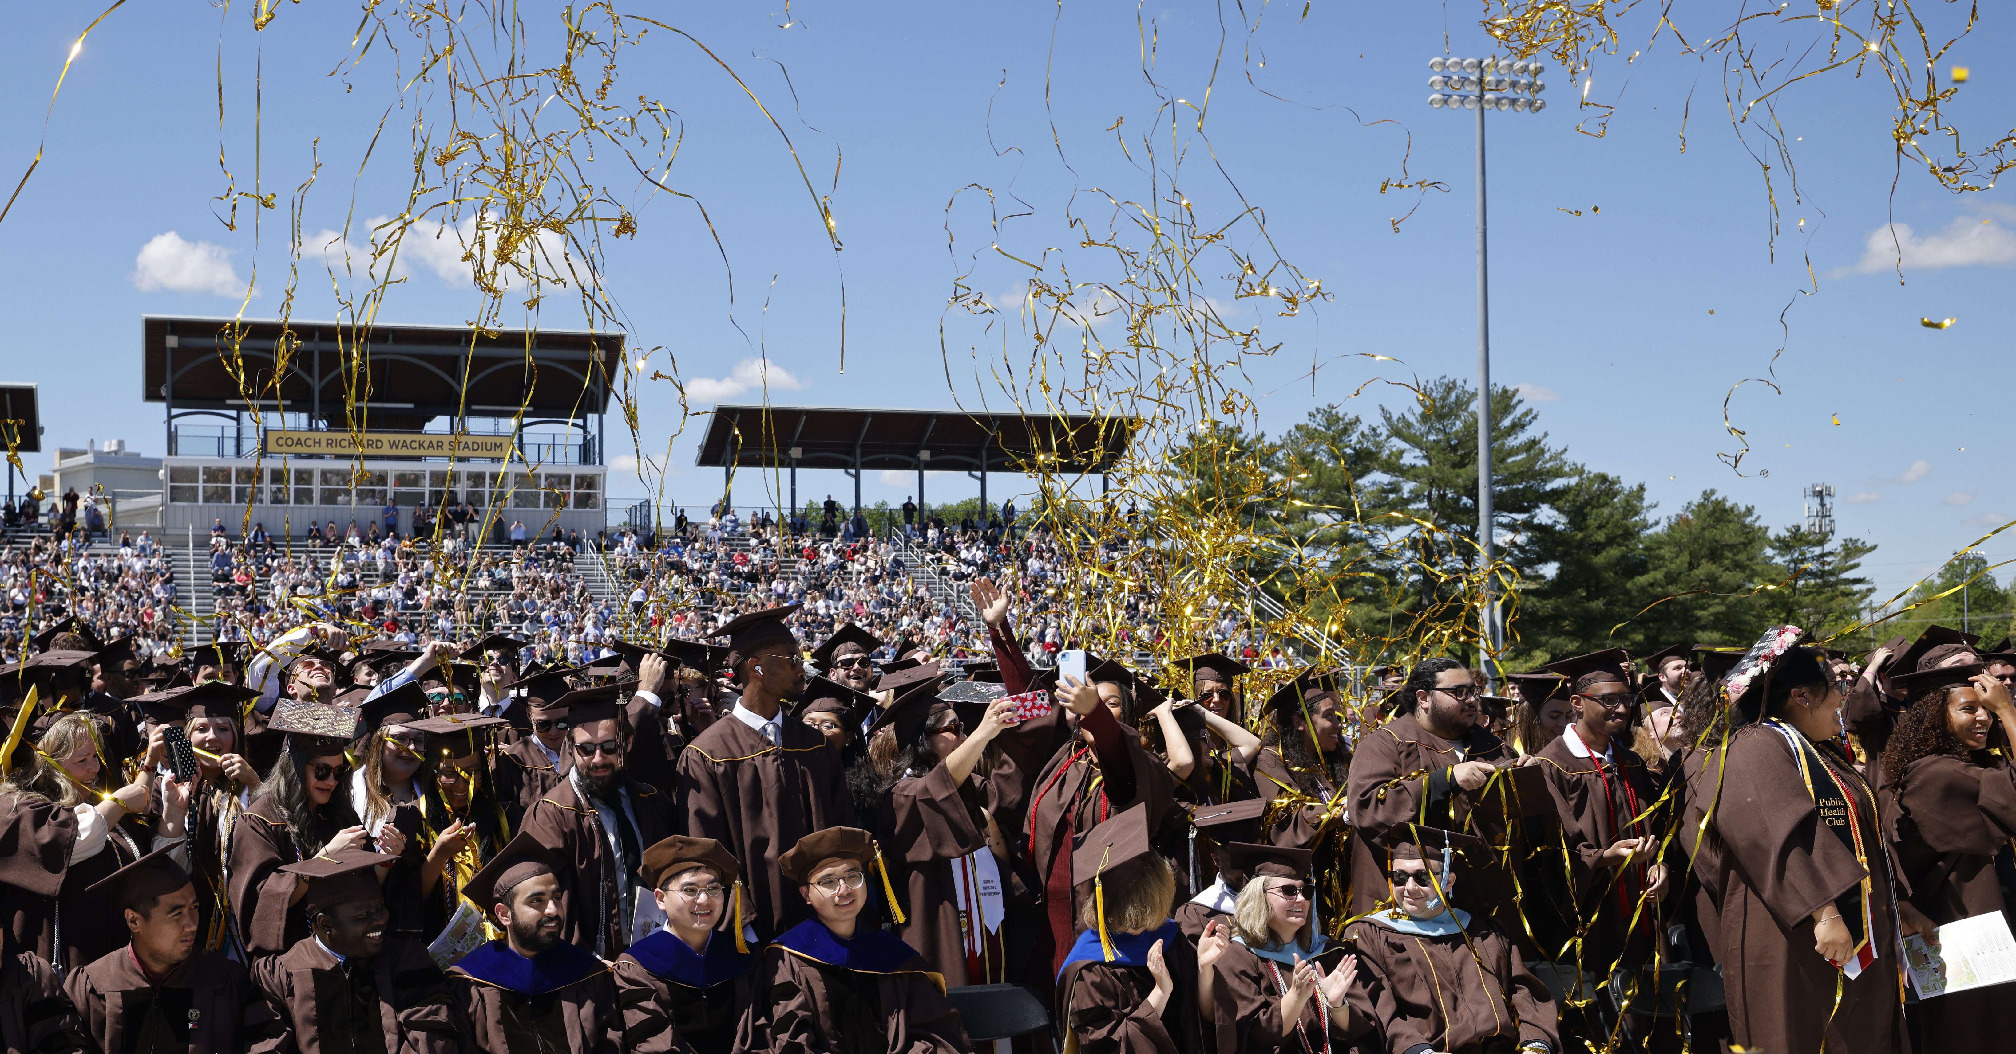
University Ceremony & Celebration
Wackar Stadium, Saturday, May 4, 2024 - 10:00 a.m.
The Ceremony
Approximately 1.5 hours
President Houshmand’s address
Ceremonial conferral of degrees
Addresses from honorary degree recipient and others
Exciting surprises and more!
The Celebration
Immediately following the ceremony
Complimentary light bites
Celebratory music
Photo opportunities
Beer & wine garden (for a fee, with ID)
Details:
All graduates receives 6 guest tickets
Graduates and guests may arrive 1 1/2 hours prior to ceremony start time. Seating is first come, first served.

Slide 15
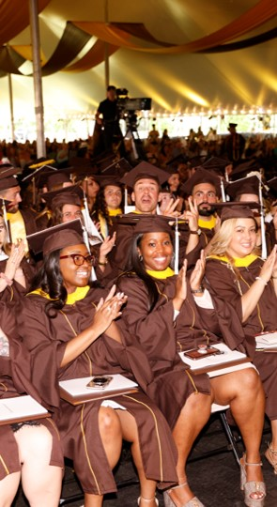
College Commencement Ceremonies
University Green at Bunce Hall, under the tent
Monday, May 6 through Thursday, May 9, 2024.
Graduates cross stage and have their have name read aloud.
Graduate name, college and degree (1) will appear on screens in the tent, as well as, on the live stream for those watching at home.
Gates open 45 minutes prior to the start of each ceremony. Seating is first come, first served.

Slide 16
What to expect at the College Ceremony
The Ceremony
1 1/2 hours long from processional to recessional.
The ceremony includes:
Dean’s Remarks
Special Guest Address
Presentation of Graduates, where graduates cross the stage, have their names read out loud, and appear on screens in the tent and on the live stream, as well as, collect their diploma cover and have their professional photo taken.
Inspirational music from Rowan’s Pep Band
Post Ceremony
Enjoy a complimentary snack and water along Summit Lane.
Make your way across campus and enjoy iconic locations, like the Prof Pride statue, for a selfie.
Secure a reservation at a local restaurant to celebrate with your guests.

Slide 17
What to expect at the College Ceremony Tickets
All ceremonies are ticketed events.
Don’t delay! Tickets must be secured by April 5, 2024, at 12:00 p.m. After the deadline, additional guest tickets for each ceremony may become available on a first come, first served distribution.
If there are tickets remaining for a ceremony, registered graduates will receive an email notification on April 10, 2024 between 12pm and 1pm with information on how to secure additional tickets.
Greeters at the three entrance gates around the University Green will scan guest tickets beginning 45 minutes before each ceremony.
Digital and printed tickets will be accepted at gate entrances.
Only graduates and ticketed guests will be permitted on and around the University Green.
All ceremonies will be streamed live over YouTube. Links will be provided on the commencement website in the days prior to the ceremony.

Slide 18
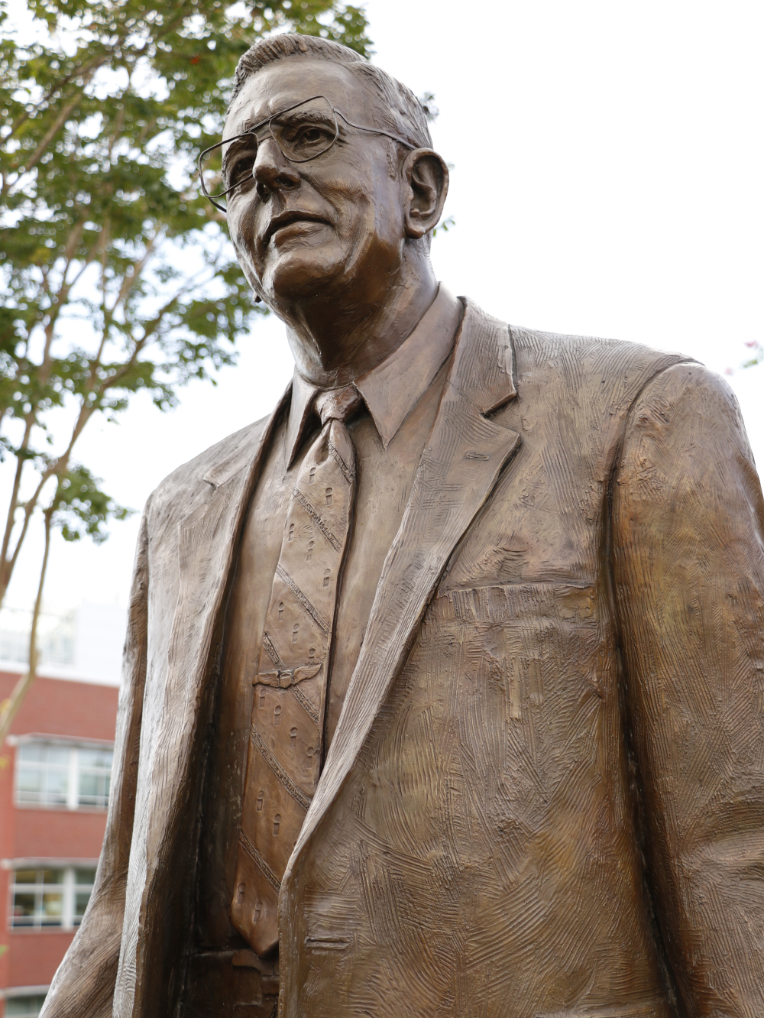
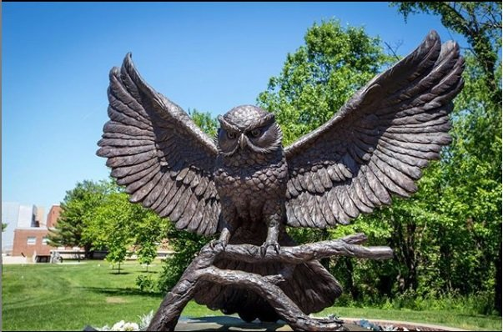
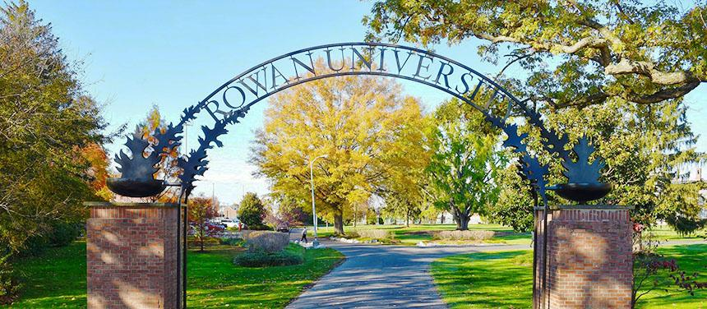
What to expect at the College Ceremony
Photography
GradImages, our professional photographer, will capture moments in the baseball field and as graduates cross the stage.
In addition to professional photography, stop at many of the campus locations, like the Prof Pride statue to capture a family photo or selfie.

Slide 19
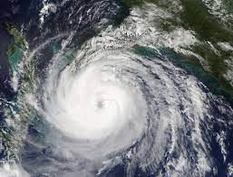
Extreme Weather
Extreme weather conditions, like high wind, thunder and lightning may impact the university and college ceremonies.
The University Commencement Ceremony and Celebration extreme weather plan is to postpone to Sunday, May 5 at 3:00 p.m.
College ceremonies will relocate to Esbjornson Gymnasium at their regularly scheduled date and time.
www.rowan.edu/commencement

Slide 20
Commencement Participation Eligibility
Eligible Commencement Participants:
Students who have been awarded their degree(s)
Students who apply to graduate prior to February 28, 2024
CADP (formerly 4+1) students participating in the undergraduate portion of their program
Students with *remaining degree requirements may participate if they meet these requirements:
Undergraduate students within 20 credit hours of degree completion
Graduate students (Master’s level only) within 6 credit hours of degree completion
*Remaining degree requirements (undergraduate and graduate) to be completed in the Summer/Fall terms. Students completing degree requirements in Winter or Spring 2025 would attend Commencement in May of 2025.
DEADLINE REMINDER: *Students with remaining degree requirements must RSVP by February 28, 2024, to ensure inclusion of their name in the program book.

Slide 21
Commencement Registration & Ticketing
Registration & Ticketing Process
Overview
Visit go.rowan.edu/commencementparticipation or Self-Service Banner, Student Tab, Commencement Attendance Confirmation.
Log-in with Rowan credentials to the Marching Order graduate homepage, where you will see all ceremonies you are eligible to participate in.
Complete registration for EACH ceremony you wish to participate in. Completing for one does not register you for all ceremonies.
VERIFY ALL INFORMATION!
Name, degree, college and phonetic spelling of name.
Share ceremony information with your guests!
Email tickets to guests or download and print
Deadline to register and claim guest tickets– April 5, 2024

Slide 22
Commencement Registration & Ticketing
Marching Order Registration & Ticketing System
How to access
go.rowan.edu/commencementparticipation
Self Service Banner/Student Tab/Commencement Attendance Confirmation
Deadline to register and claim guest tickets– April 5, 2024

Slide 23
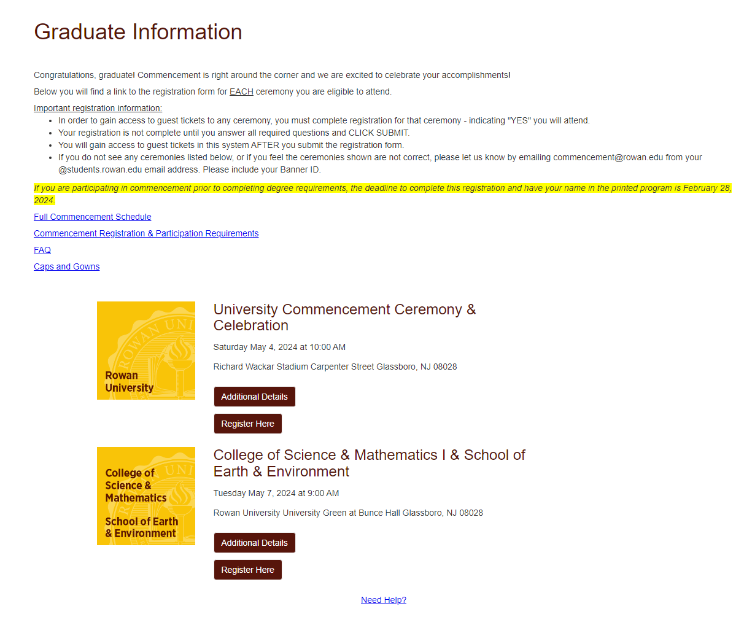
Commencement Registration & Ticketing
Graduate Home Page
Register, Access Guest Tickets & Review Additional Details
Click “Additional Details” to view important details for each ceremony.
Click “Register Here” to complete registration for each ceremony you want to attend.
Deadline to register and claim guest tickets– April 5, 2024

Slide 24
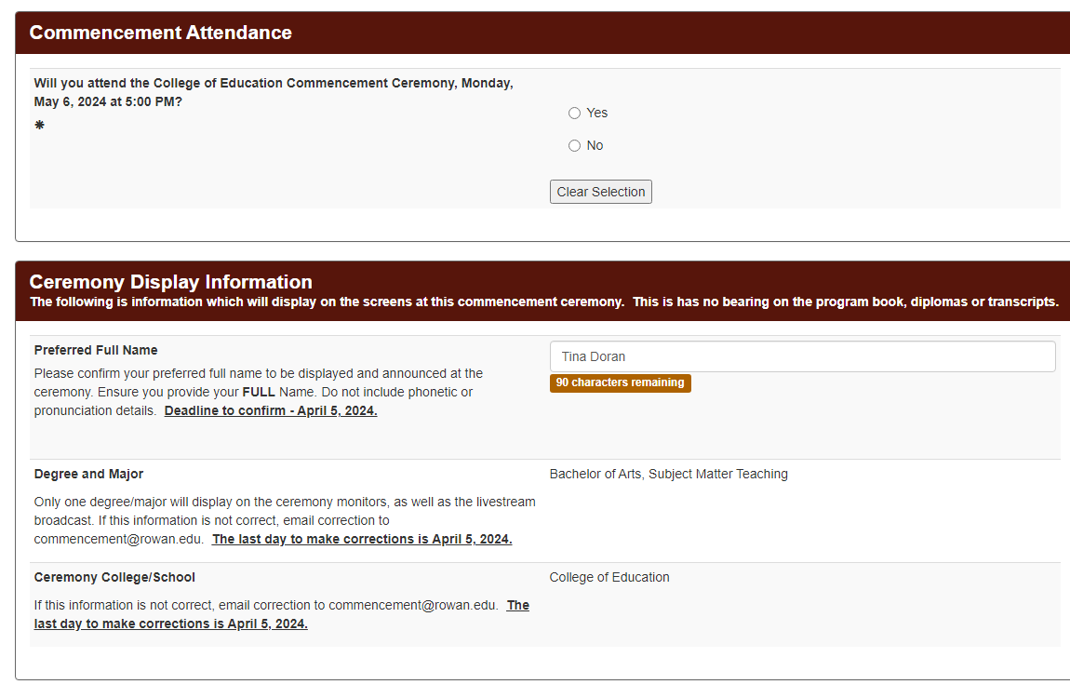
Commencement Registration & Ticketing
Registration Form
Attendance and Display Information
Commencement Attendance
Be sure to answer YES!
(If you do not select YES, you will not have access to guest tickets.)
Ceremony Display Information
Confirm information for display at ceremony - name, degree, major and college.
With corrections, email commencement@rowan.edu
Deadline to register and claim guest tickets– April 5, 2024

Slide 25
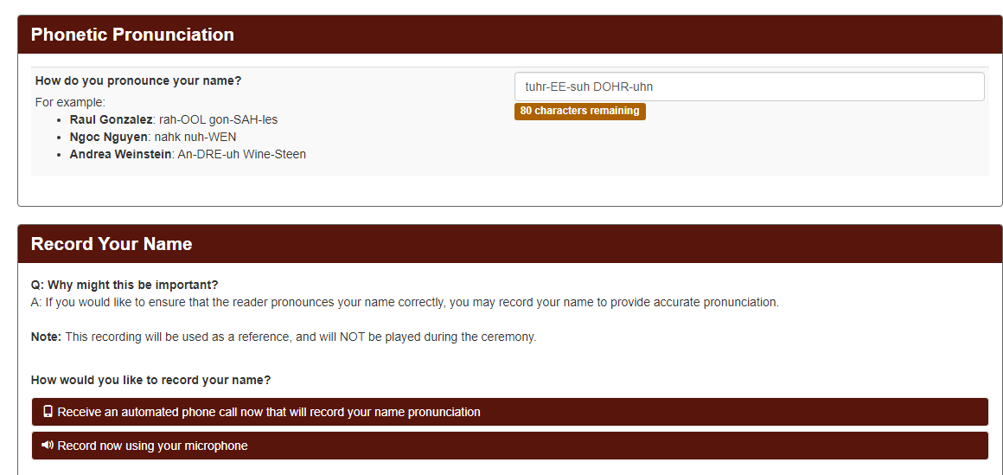
Commencement Registration & Ticketing
Registration Form
Pronunciation (College Ceremonies Only)
Enter the phonetic spelling of your name.
Edit as necessary.(If you update your Preferred Name for ceremony display, you edit phonetics to match.)
Record your name.
Follow instructions provided to make a voice recording of your name for the ceremony name reader.
Deadline to register and claim guest tickets– April 5, 2024

Slide 26
Commencement Registration & Ticketing
Registration Form
Guest Tickets
Use the dropdown to choose the number of guest tickets you want to claim.
(Limited to the maximum number of tickets per graduate, per ceremony.)
Deadline to register and claim guest tickets– April 5, 2024

Slide 27
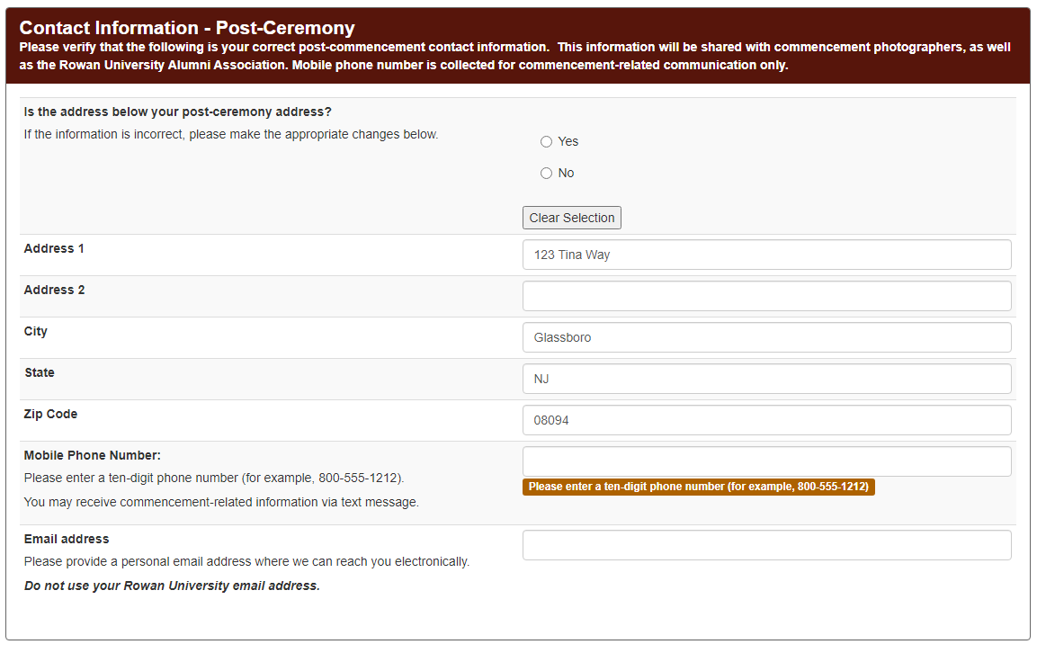
Commencement Registration & Ticketing
Registration Form
Contact Information – Post ceremony
Provide mailing and email addresses you will use after graduation. Information will be shared with commencement photographers and the Rowan Alumni Association.
Provide your cell phone number to receive important commencement updates.
Deadline to register and claim guest tickets– April 5, 2024

Slide 28
Commencement Registration & Ticketing
Registration Form
Share Ceremony Details & Submit Form
Click summit to record your registration responses!
Enter the email address of anyone you want to send ceremony information.
Click enter after entering each email address.
IMPORTANT! CLICK SUBMIT TO RECORD YOUR COMMENCEMENT REGISTRATION!
Deadline to register and claim guest tickets– April 5, 2024

Slide 29
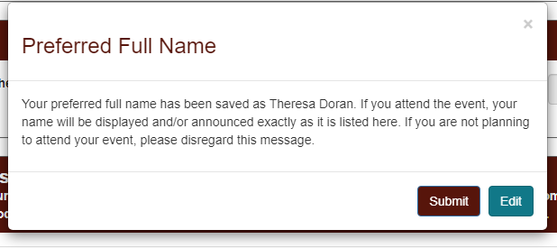
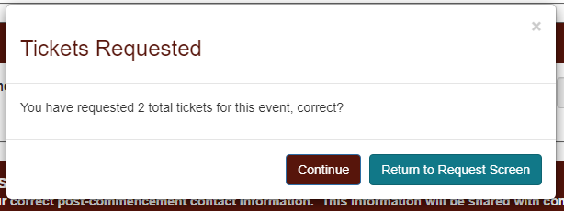
Commencement Registration & Ticketing
Registration Form
Verification Prompts
Click “Submit” to verify your preferred full name is correct or click “Edit” to go back to the form and make changes.
Click “Continue” to access your guest tickets or click “Return to Request Screen” to go back to the form and update the number of tickets selected.
Deadline to register and claim guest tickets– April 5, 2024

Slide 30
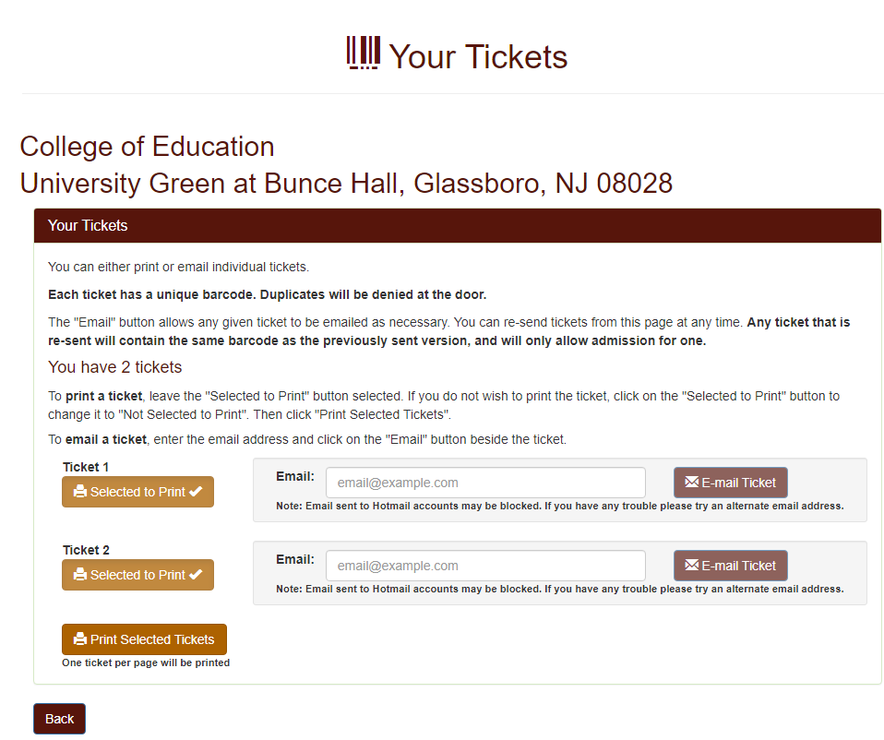
Commencement Registration & Ticketing
Registration Form
Registration Confirmation & Guest Ticket Access
Deadline to register and claim guest tickets– April 5, 2024
Click “Get your tickets” to access your guest tickets.
Guest tickets can either be emailed directly to yourself, your guests, or printed.
Digital and printed tickets will be accepted at the gate entrances.
All ceremonies are ticketed events and only guests with tickets will be permitted.
Graduates are required to register and select and share guest tickets by April 5, 2024.
After the deadline, undeclared tickets may be offered on a first come, first served distribution of tickets. If there are tickets remaining for a ceremony, graduates will receive an email notification on April 10, 2024 between 12pm and 1pm with information on how to secure additional tickets. Please note, the capacity at the University Green is greater than Esbjornson Gymnasium, so some tickets may only be valid for the University Green.
Click “Back” to return to the Graduate Home Page.

Slide 31
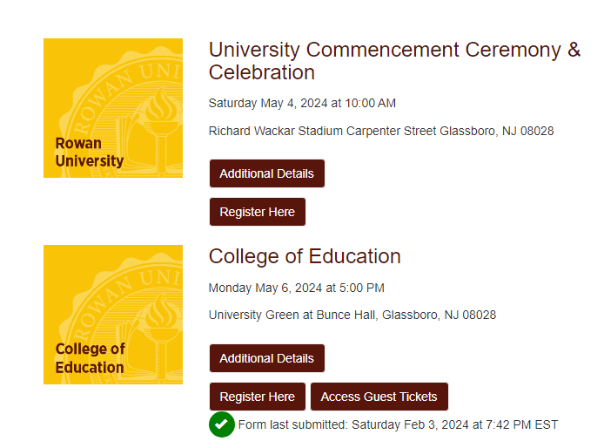
Commencement Registration & Ticketing
Graduate Home Page
Register, Access Guest Tickets & Review Additional Information
Deadline to register and claim guest tickets– April 5, 2024
Click “Register Here” to complete registration for any additional ceremonies you want to attend.
Click “Access Guest Tickets” to view, print and email your tickets for the ceremony
Green check mark indicates your registration form was SUBMITTED - not whether you chose to attend. Click “Register Here” to review your responses.
Log back into go.rowan.edu/commencement anytime to review registration responses, access guest tickets and view important ceremony information.

Slide 32
Rowan University Regalia
Caps & Gowns
Available Exclusively Through Rowan Barnes & Noble
Purchase Rowan University Caps & Gowns at Glassboro Barnes & Noble:
In-person at Rowan Barnes & Noble beginning March 18, 2024
Sales will continue through the start of commencement.
Sizes are not guaranteed after April 18, 2024.
Online
An online website will be available to purchase regalia from March 18 – April 7, 2024. The link will be provided on the commencement website by March 18, 2024.
Commencement Fair @ Rowan Barnes & Noble
March 18, 2024 - March 22, 2024
Cap & gown vendor will be on-site to help with sizing and answer questions. There will also be class ring vendors at this event.
Custom doctoral gowns – Contact Valerie at 856-881-5954 or wojcik@rowan.edu to schedule a fitting. Orders must be placed by March 8, 2024.

Slide 33
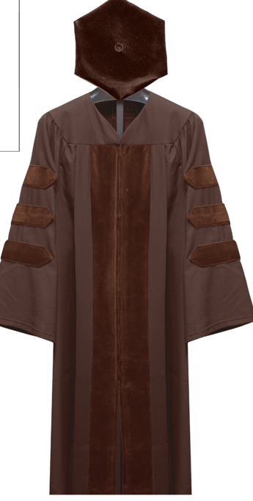
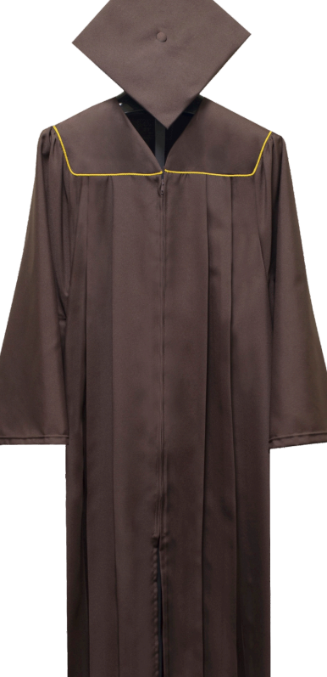
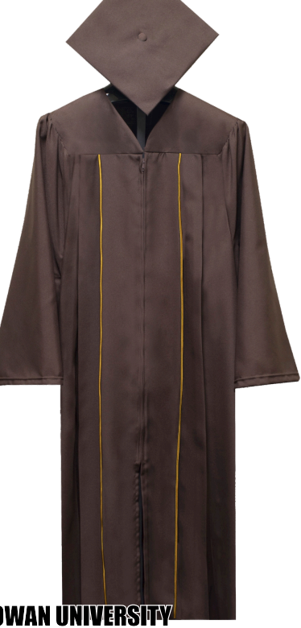
Bachelors
Masters
Rowan University Regalia
Caps & Gowns
Available Exclusively Through Rowan Barnes & Noble
Keepsake Ed.D. & Ph.D.

Slide 34
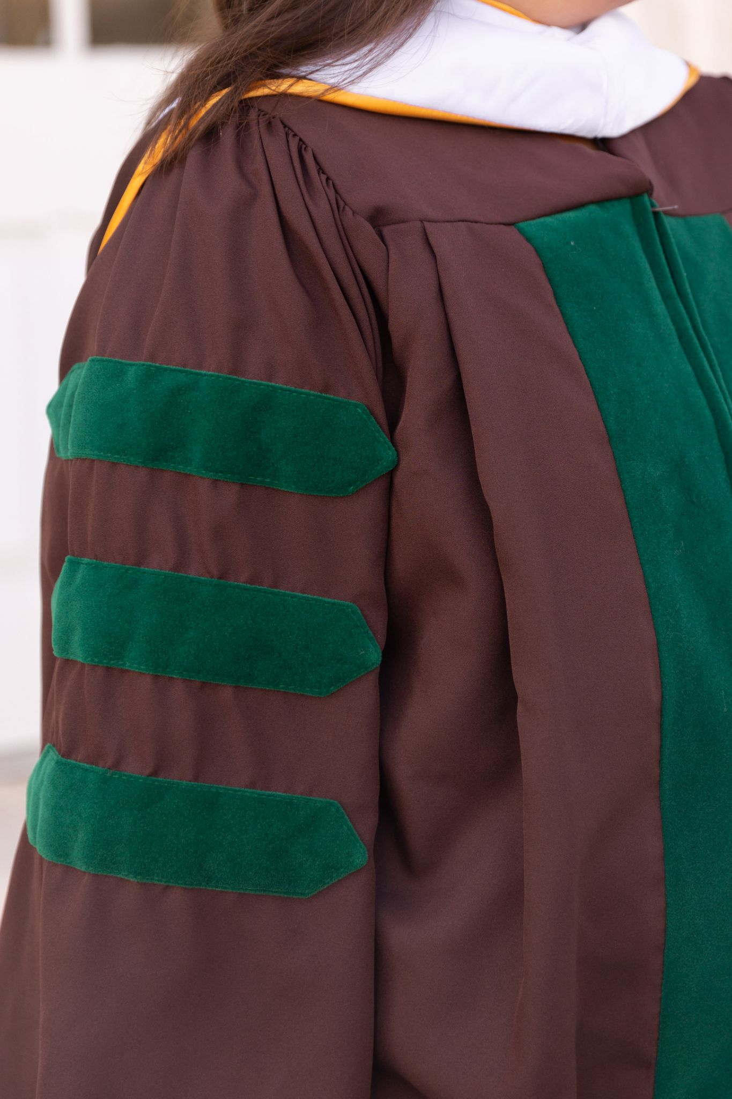
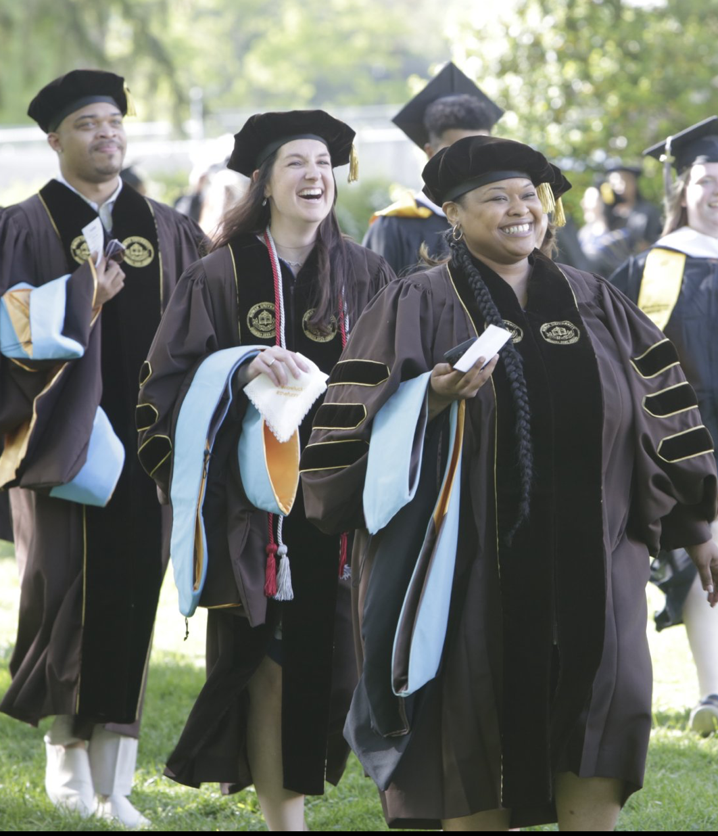
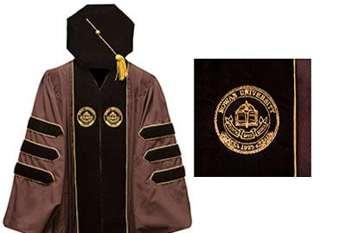
Rowan University Regalia
Caps & Gowns
Available Exclusively Through Rowan Barnes & Noble
Board of Trustees
MD & DO Keepsake
Custom Doctoral

Slide 35
Rowan University Regalia
Caps & Gowns
Pricing
Bachelor’s (Keepsake) | Brown gown, gold stitching, brown cap, brown & tassel | $81.98
Master’s (Keepsake) | Brown gown and hood, gold stitching, brown cap, silver tassel | $128.98
Educational Specialist | Brown gown, hood and cap, Gown, Blue Tassel | $132.96
Doctoral (PhD & EdD; Keepsake) | Brown gown, TAM, gold tassel & hood | $228.98
Doctoral (MD & DO; Keepsake) | Brown gown, TAM, gold tassel & hood | $239.98
Undergraduate Academic Honor Cords available at Rowan Barnes & Noble for $18.98.

Slide 36
Accessibility Accommodations
Parking & Seating
Contact & Accommodation Information
Graduates and guests requiring an accessible parking pass must submit a request to parking@rowan.edu. Requests can be made from March 25 – April 19, 2024. Dedicated parking lots for accessible parking with permit for the University Commencement Ceremony is Lot C and all ceremonies on the University Green is Lot P.
Golf carts will continuously loop through these parking areas to bring guests directly to the accessible seating area.
Accessible seating is for the ticketed guest needing accessible seating and one ticketed companion. No special ticketing is required.
If additional assistance is required, please contact the Academic Success Center at 856-256-4259 to request accommodations.
Requesting an accessible parking pass Graduates and guests requiring accessible parking must submit a request for a permit to parking@rowan.edu. Requests can be made from March 25 – April 19, 2024. For the University Commencement Ceremony, parking Lot C is dedicated for accessible parking and Lot P has been dedicated for all ceremonies on the University Green. These parking lots are permit only. Space in each lot is limited. Passes will be sent out the week of April 22, 2024.

Slide 37
Senior Class Gift
Pay It Forward By Giving Back
Each year, graduating students participate in the Senior Class Gift, a Rowan University tradition. This year, the Class of 2024 has a goal of 224 graduating donors. Any students graduating in 2024 are welcome to participate!
If you make a gift of $20.24 or more between now and May, you’ll receive a white and gold spirit cord to wear at commencement!
Kick off the Senior Class Gift Campaign by making your gift on Day of Giving, Thursday, February 22! There will be a Senior Class Gift Challenge, and all gifts of $5 or more to any allocation across campus will count toward the total donor goal for Senior Class Gift. Visit dayofgiving.rowan.edu starting the week of Feb 12 to make an early gift.
Visit the Chamberlain Student Center on Day of Giving (2/22) between 10 a.m. - 2 p.m. to celebrate the impact of philanthropy (and earn a t-shirt!).
*Additional spirit cord pick-up dates and locations will be updated on the Senior Class Gift site. Stay tuned!
Questions?
Contact Kaylee Collins, Director of Annual Giving
(856) 256-5415
collinske@rowan.edu

Slide 38
Important Dates to remember:
February 28: Last day to apply to graduate for Spring graduation
February 28 - Register by today to have name in printed program
March 18: Cap and Gown sales begin; In-person Commencement Fair at Barnes & Noble (March 18 - 22)
April 5: Commencement registration and guest ticket access closes
April 5: Last day to make corrections to Commencement display details
April 10: First come, first served access to additional guest tickets (as available) will be announced via email between 12:00 p.m. – 1:00 p.m.
May 4: University Commencement Ceremony & Celebration at 10:00 a.m.
May 6 - 9: College Commencement Ceremonies

Slide 39
Keep Up To Date
Check your Rowan email
Always open and read emails from graduation@rowan.edu and commencement@rowan.edu as they contain important information.
Know the deadlines; don’t wait until the last day!
Check the commencement and graduation websites regularly for updates.
Follow Rowan on social media; look for Instagram stories and participate in Q & A’s.
Use #Rowan2024 to filter your posts onto the commencement website
Prepare for commencement
Review the final details in the “Know Before You Go” email sent 48 hours prior to commencement
Be sure to share details with your guests.

Slide 40
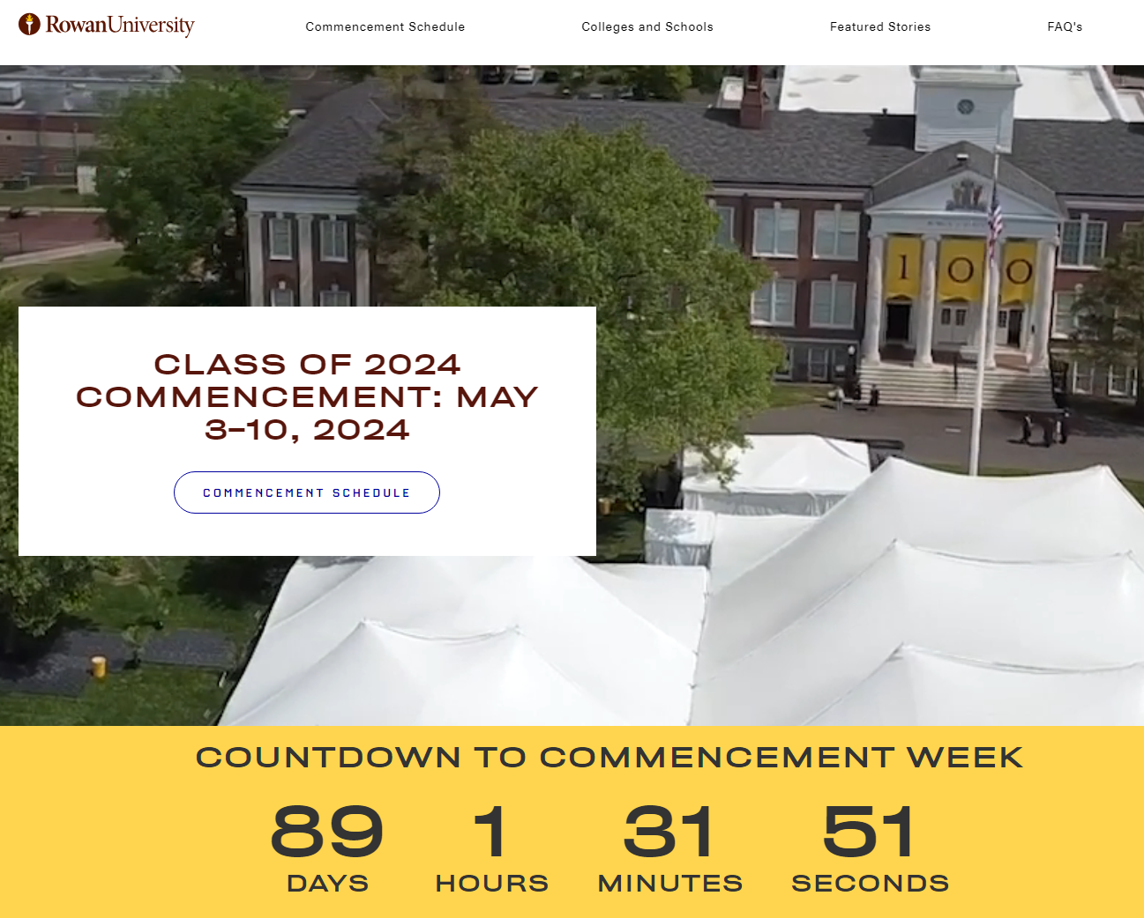
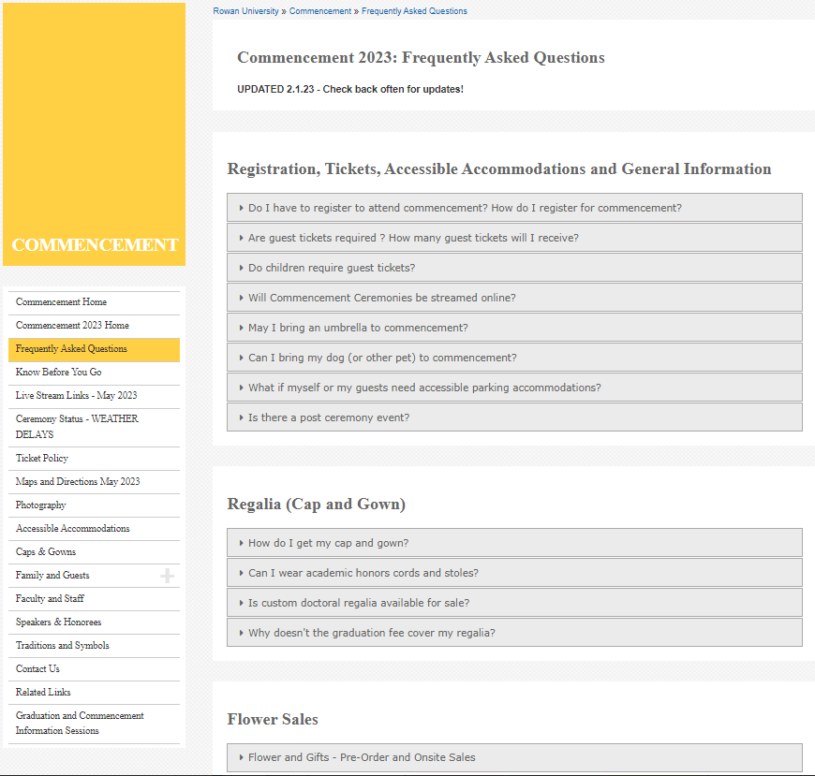
Commencement Website
rowan.edu/commencement
sites.rowan.edu/commencement/faq.html
www.rowan.edu/commencement

Slide 41
Thank you! We look forward to celebrating with you in May!
#Rowan2024
Additional questions? Email us! Be sure to include your Banner ID!
Graduation – graduation@rowan.edu
Commencement – commencement@rowan.edu
www.rowan.edu/commencement

